Slide 1
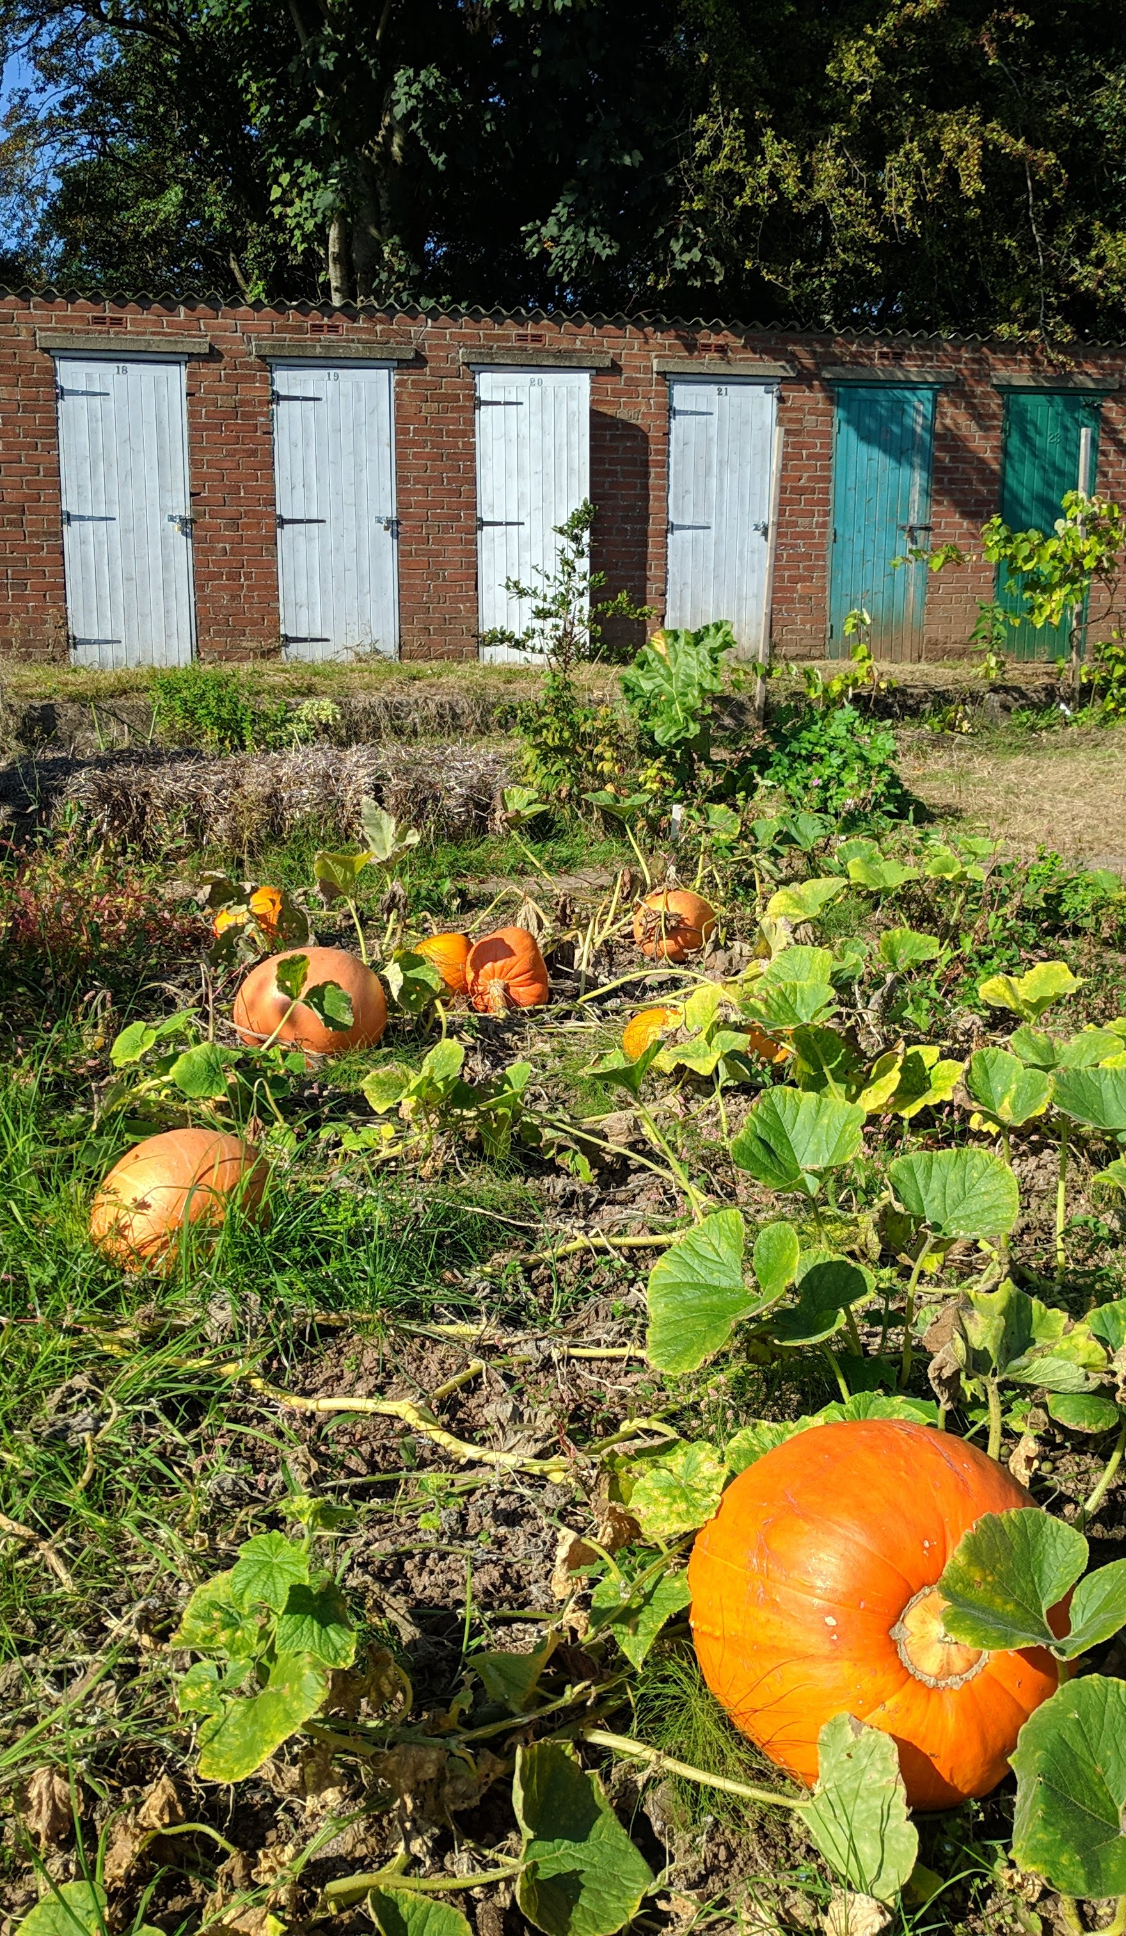
Commoning Through the Lifecourse: The Mundane Politics of Retirement and Life Beyond the Wage
Owain Hanmer
Cardiff University/Prifysgol Caerdydd
Deep Commons Conference

Slide 2
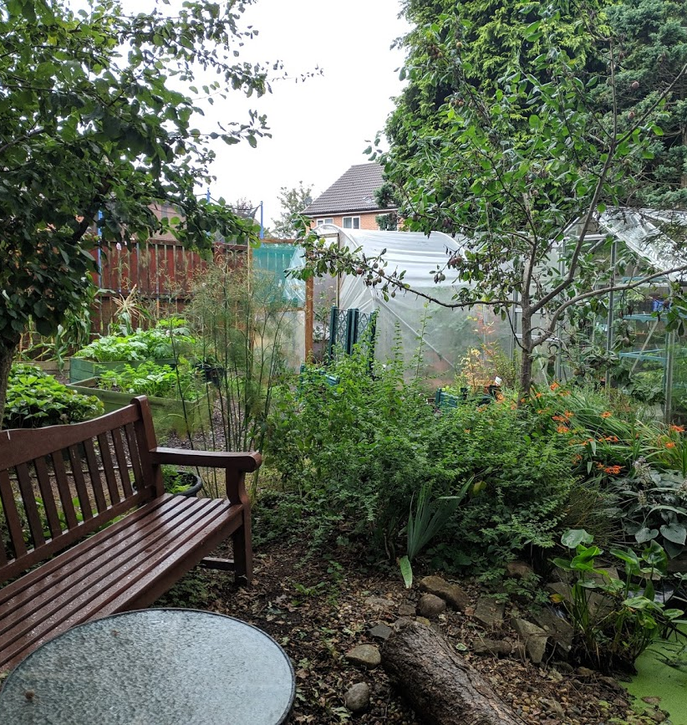
Context
Commons no longer a historical phenomena
Ongoing process
Political-economic alternatives
But mundane forms of commoning overlooked
Research in urban gardens in Cardiff (Wales)

Slide 3

From the commons to commoning
More than a resource
But contested politics
EXOGENOUS
ENDOGENOUS
2 key challenges:
De Angelis (2017)
The shift to “commoning”

Slide 4
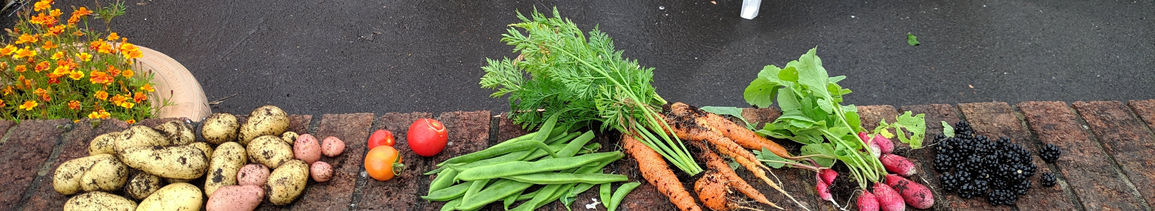
Everyday Life
The antagonisms of everyday life (Gonzalez 2019)
Capitalism imposes a singular value on a rich array of functionings (Cleaver 2017)
Alternative everyday values within commoning
Self-valorisation
The contradictory politics of urban gardens (McClintock 2014) as ideal spaces for exploration
Despite, beyond, or in service of capitalism?

Slide 5
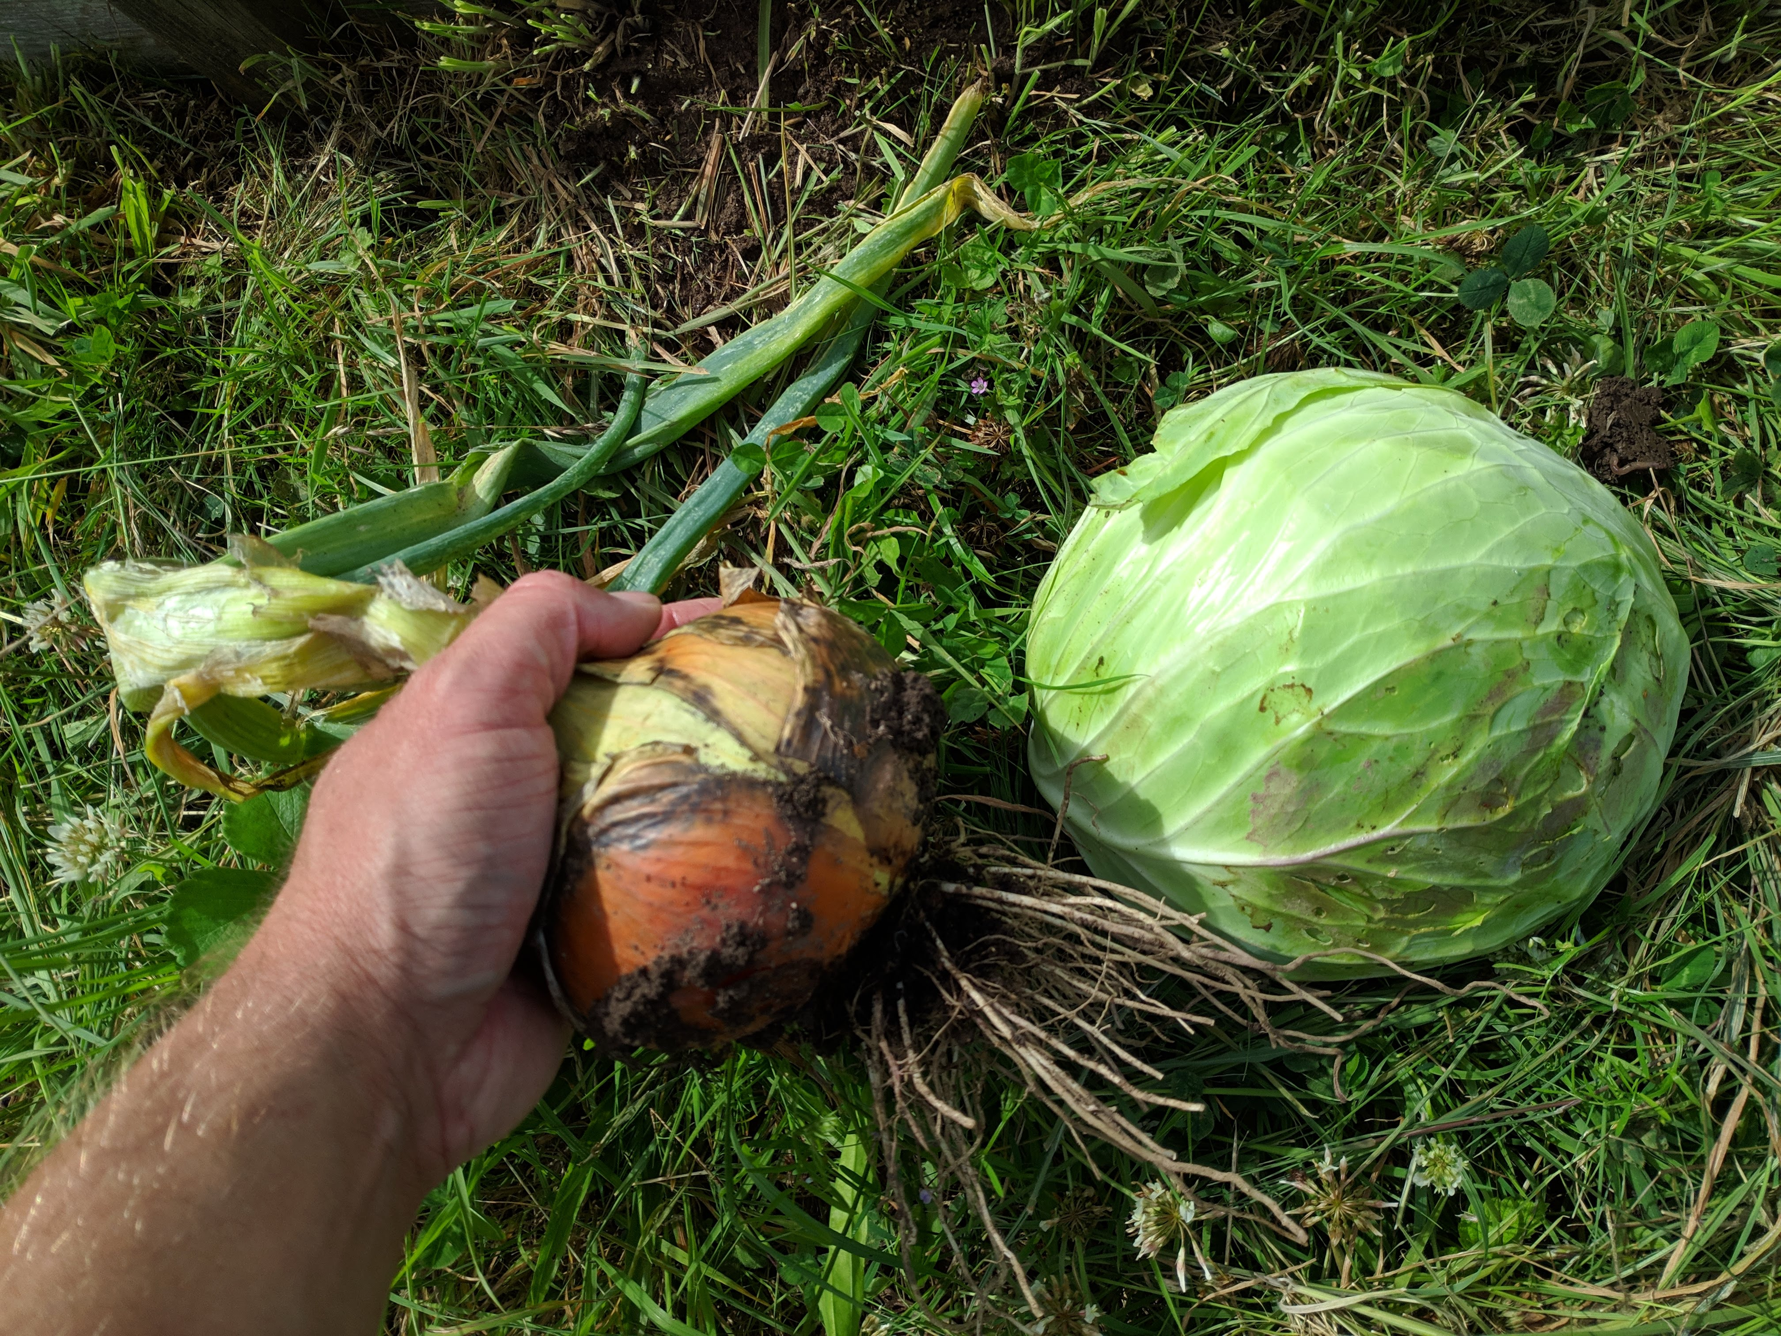
Methods
Ethnographic fieldwork
2019
3 urban garden sites
Community gardens / allotment
Retirement

Slide 6
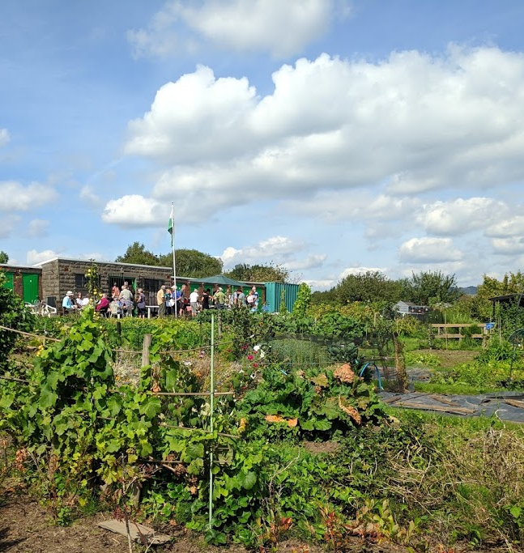
Social Alienation
Alienation from each other
Retirement as a social disruption
“It was a shock how quickly I felt isolated, 6 months or a year…So, I started looking around for things to do, and when you start looking you find things.”

Slide 7
Social Alienation
Alienation from each other
Changing position within capitalism (social reproduction)
“as you get older, you get different perspectives on your life. Obviously, your kids are grown up, so you're not forever running around after them you know. But that part of your life is gone so you need to fill it with something…so you branch out, and then the community becomes your life, it really does.”

Slide 8
Social Alienation
Alienation from each other
Changing position within capitalism (production)
“To come up here after a week’s work was a wonderful release…It was like a therapy at times to get out of the steel plant and in the fresh air and enjoy…” but now it was more about “the social aspect of it all”

Slide 9
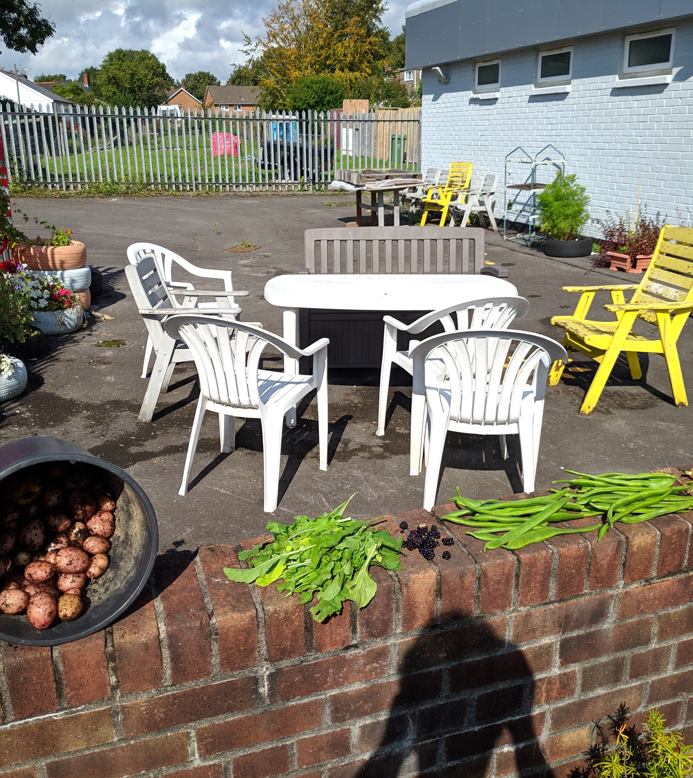
Spatial Alienation
Alienation from the spaces around us
Specific spaces for social/collective experience:
“It is that being part of a group, not being isolated, being involved in something is what I get from it. Because I’ve got my own garden if all I wanted to do was get my hands dirty.”
“I think if I had the garden the same size as my allotment, I think it would mostly be lawn. It's the camaraderie of the people in the allotments.”

Slide 10
Spatial Alienation
Alienation from the spaces around us
Contrasts with the “outside”:
“Allotments are good socially. They're quite good if people want to talk to you. In the modern world nobody bloody talks to you anyway, would you say that? You know you say ‘morning’ and they look at you as though it’s some strange word they've never heard of before.”
“Up here you don’t get that animosity that you hear about everywhere, but you have a good joke”.

Slide 11
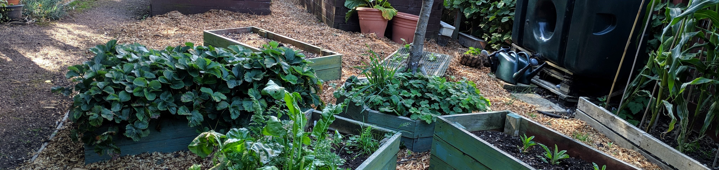
Creative Alienation
Alienation from what we create
Interconnection of means/ends: tangible and concrete
“I find it very soothing to the despair that I can feel about what we’ve done to our environment and how difficult it is to shift from a destructive interaction as a species, but then I put my hands in the dirt and do something constructive, do something for the earth in a very direct but small way.”
“With so much electronic stuff and you don't have a product and I like to have a product, and so this gives me a product whether it's a bag of beans or some sweet corn or pumpkin. I've done something and it’s tangible.”

Slide 12
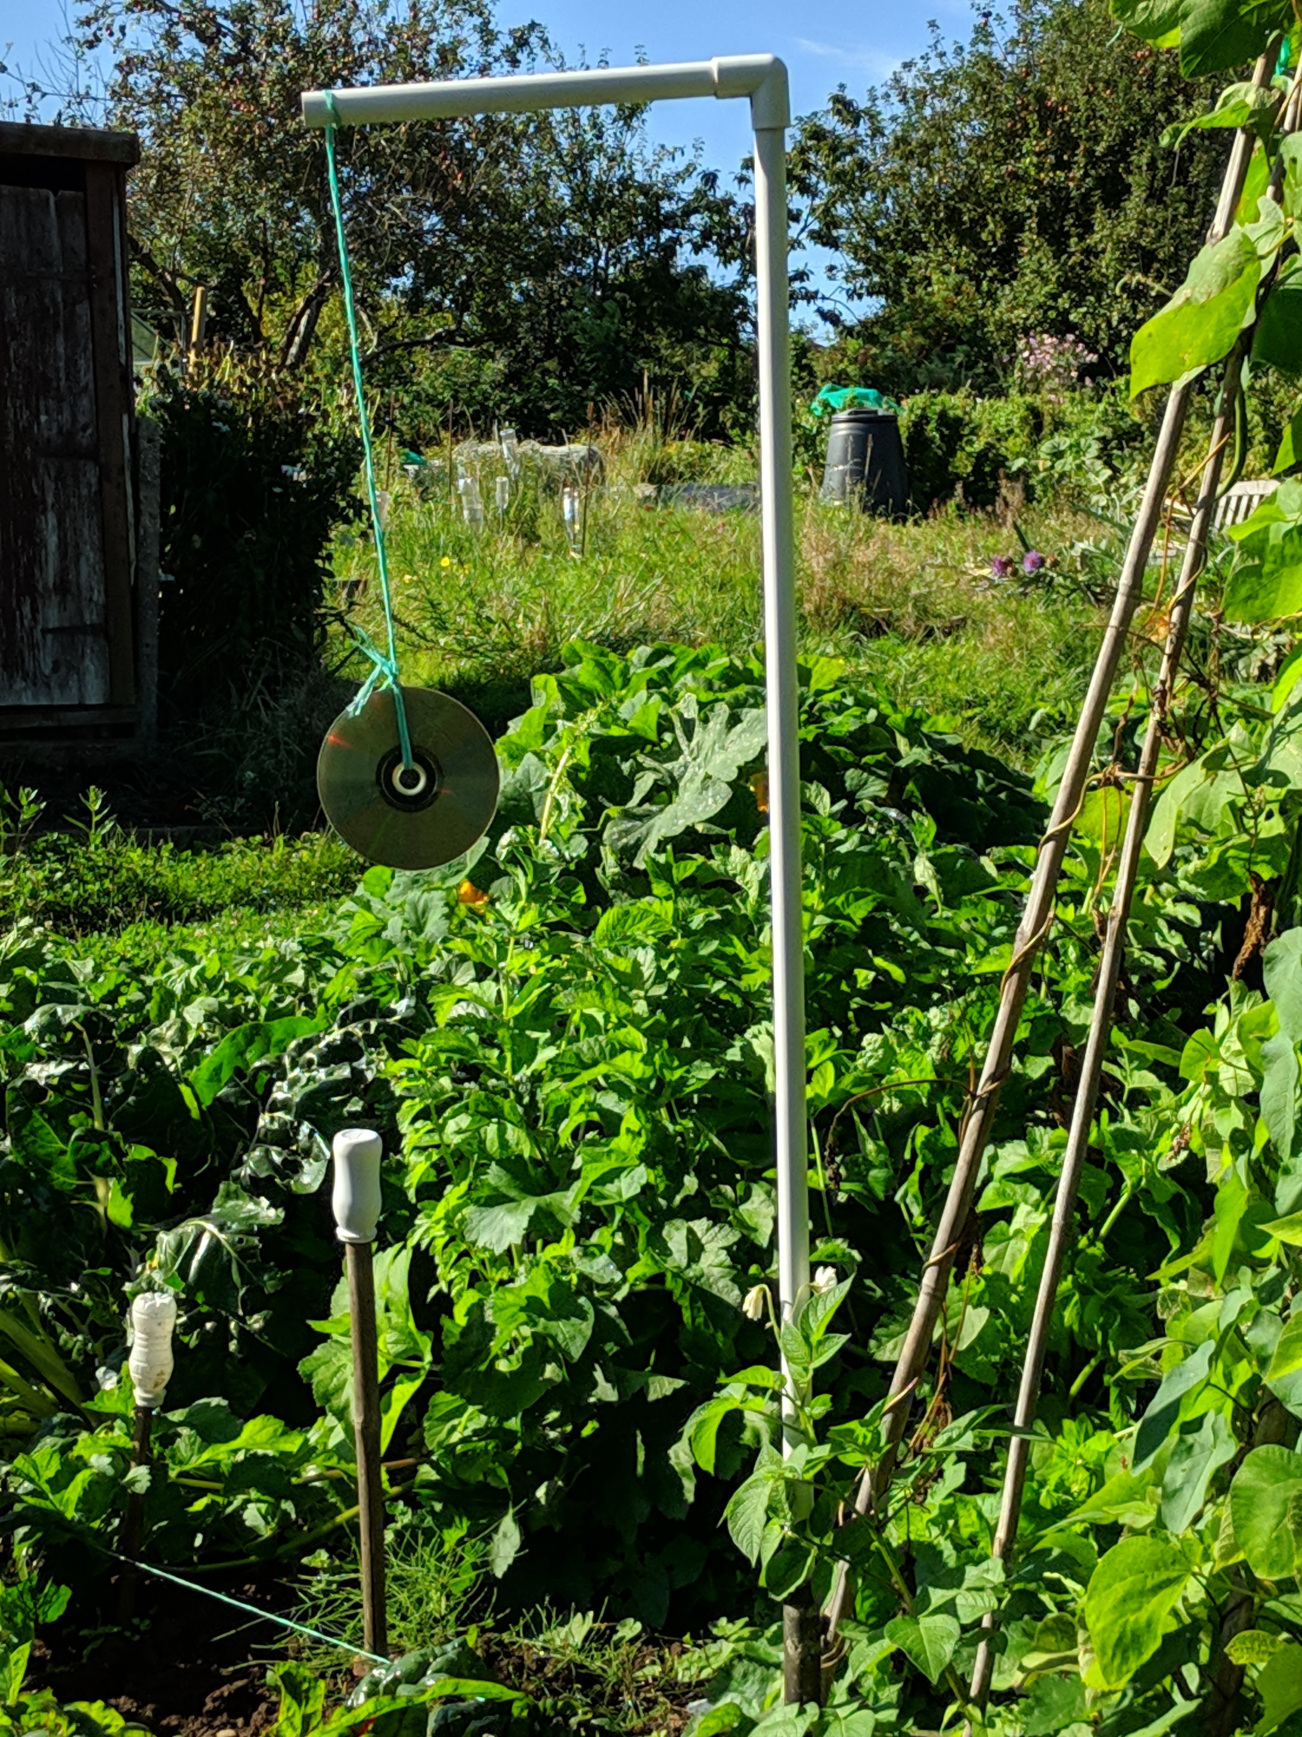
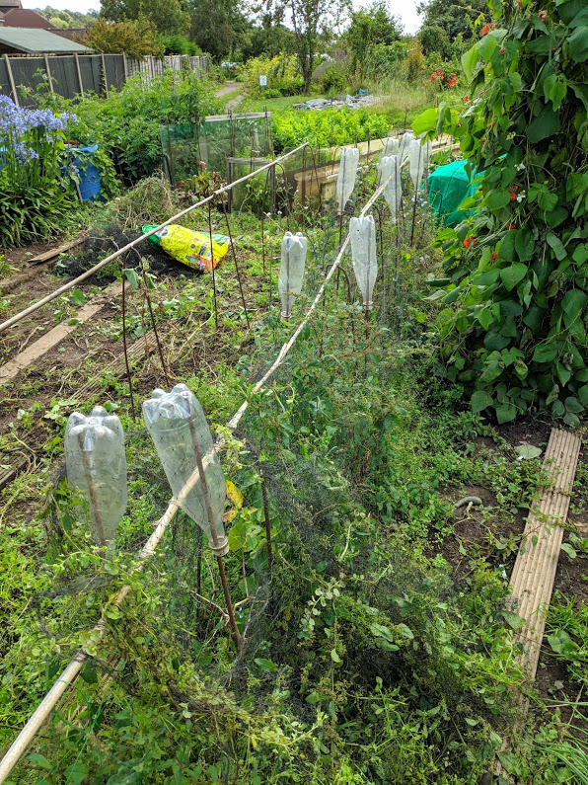
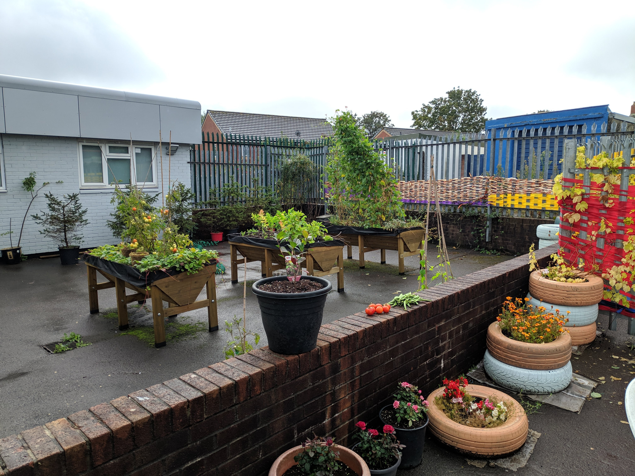
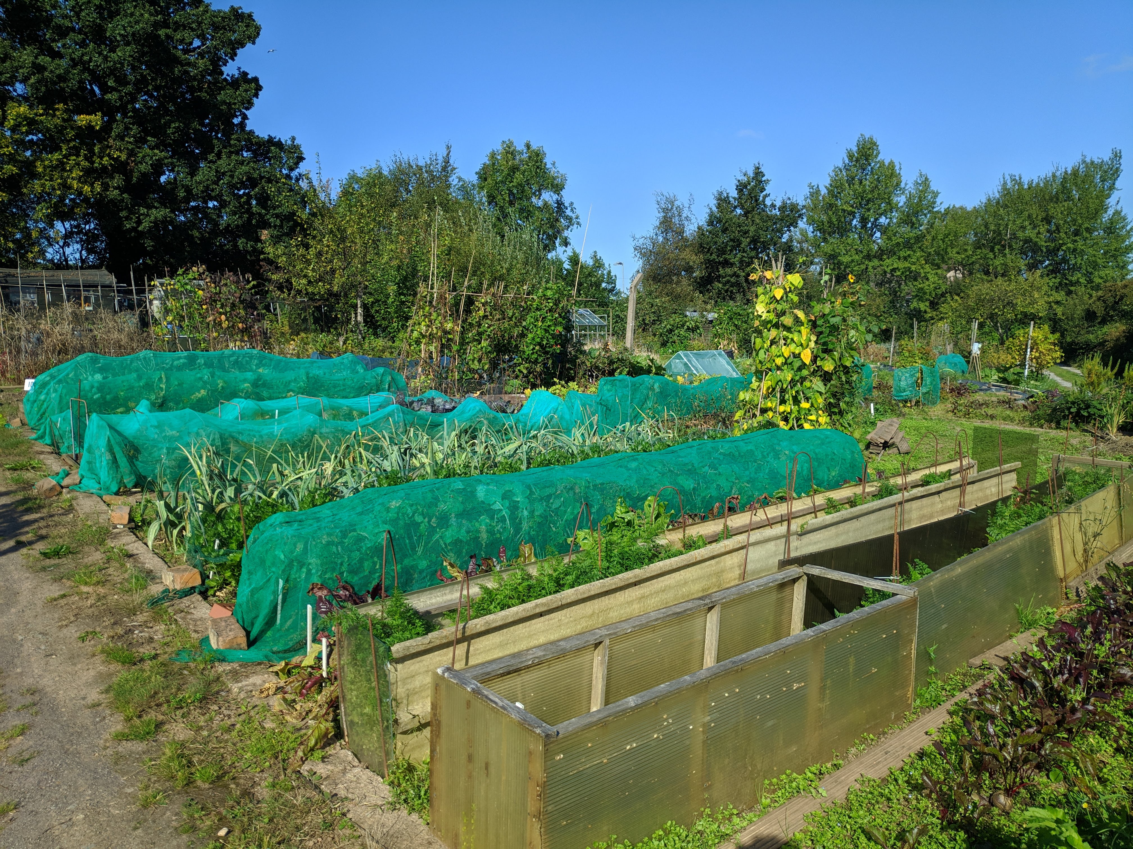
Creative Alienation
Alienation from what we create
The worker “contemplates himself in a world that he has created” (Marx 2011 [1932], p.55)
“it is just an interaction. There is a feedback from the space you’re working with”
Creative re-use of scrap materials

Slide 13
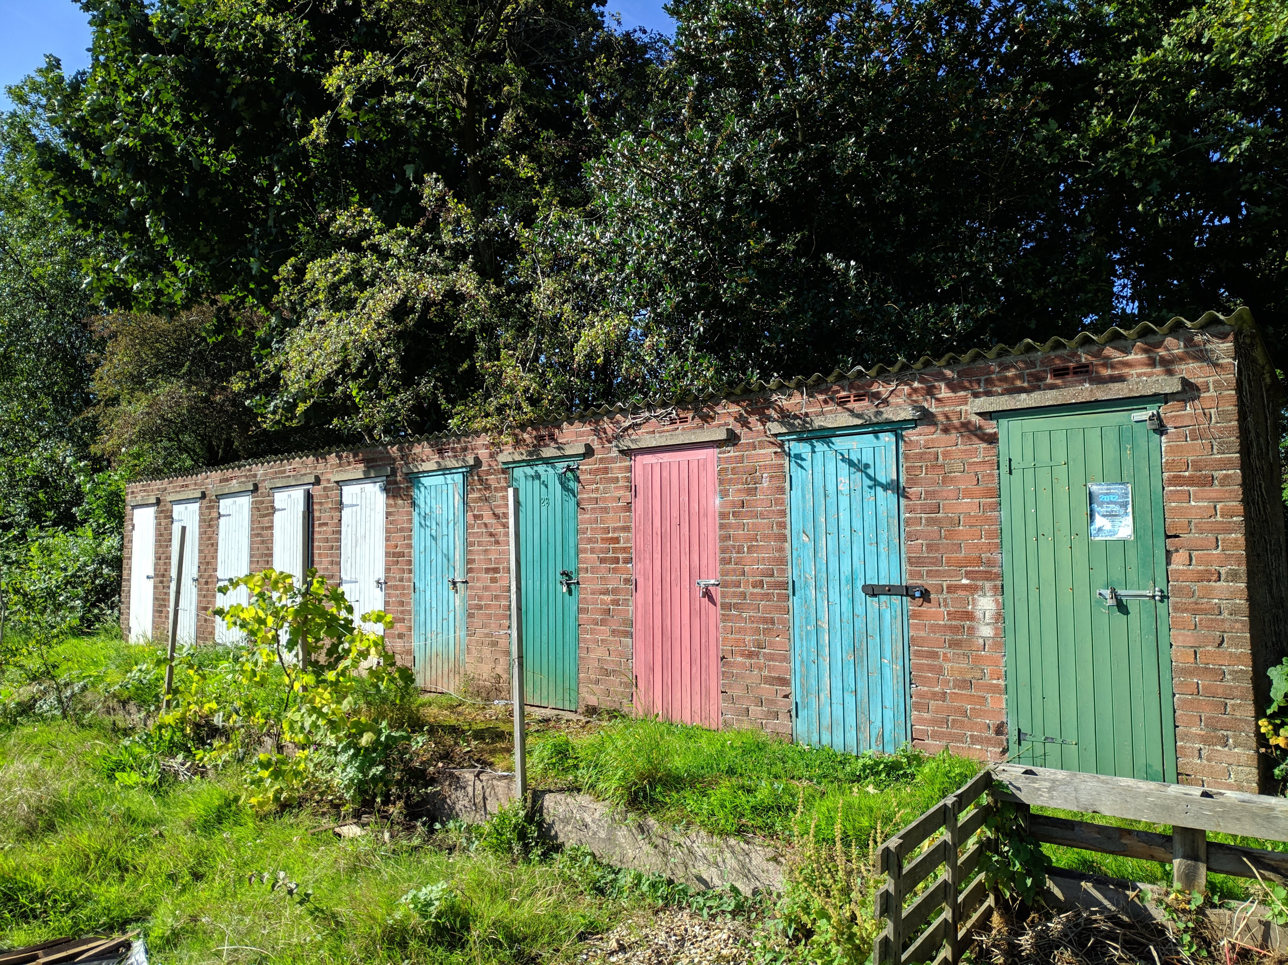
Conclusions
Social / spatial / creative alienation inter-relate
Commoning and the lifecourse
Valorising the ordinary dynamics of commoning (not simply as being in service of capitalist reproduction)

Slide 14
References
Cleaver, H. 2017. Rupturing the Dialectic: The Struggle against Work, Money, and Financialization. Oakland, California: AK Press.
Cumbers, A. 2015. Constructing a global commons in, against and beyond the state. Space and Polity 19(1), pp. 62–75.
De Angelis, M. 2017. Omnia Sunt Communia: On the Commons and the Transformation to Postcapitalism. London: Zed Books.
Gonzalez, E. 2019. The Construction of a Conceptual Prison. In: Barbagallo, C., Beuret, N., and Harvie, D. eds. Commoning with George Caffentzis and Silvia Federici. London: Pluto Press, pp. 247–251.
Helfrich, S. 2012. Common goods don’t simply exist – they are created. In: Bollier, D. and Helfrich, S. eds. The Wealth of the Commons: A World Beyond Market and State. Amherst, MA: Levellers Press, pp. 61–67.
McClintock, N. 2014. Radical, reformist, and garden-variety neoliberal: coming to terms with urban agriculture’s contradictions. Local Environment 19(2), pp. 147–171.

Slide 15
Diolch
Owain Hanmer
hanmerOJ@cardiff.ac.uk

