Slide 1
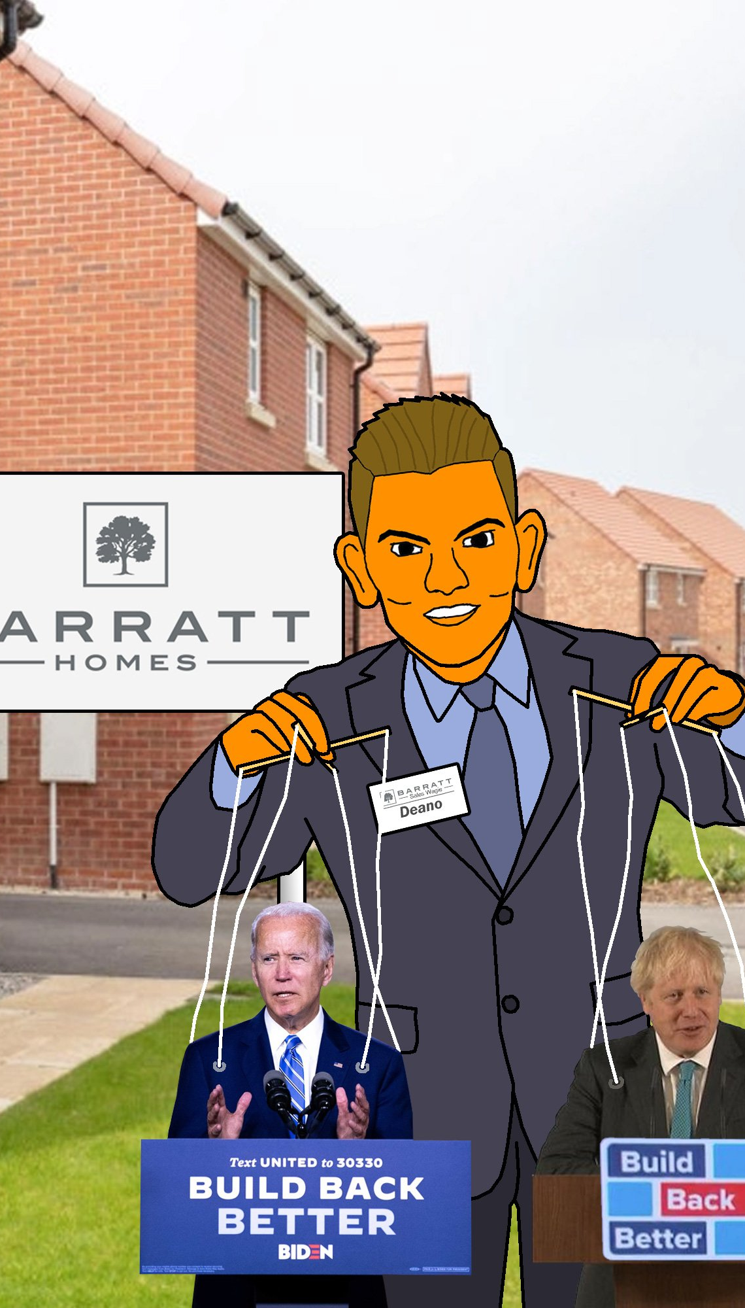
The Petty Bourgeoisie in the Current Crisis: A Kingmaker Class?
Dan Evans, Cardiff University Evansd70@cardiff.ac.uk
Owain Hanmer, Cardiff University HanmerOJ@cardiff.ac.uk

Slide 2
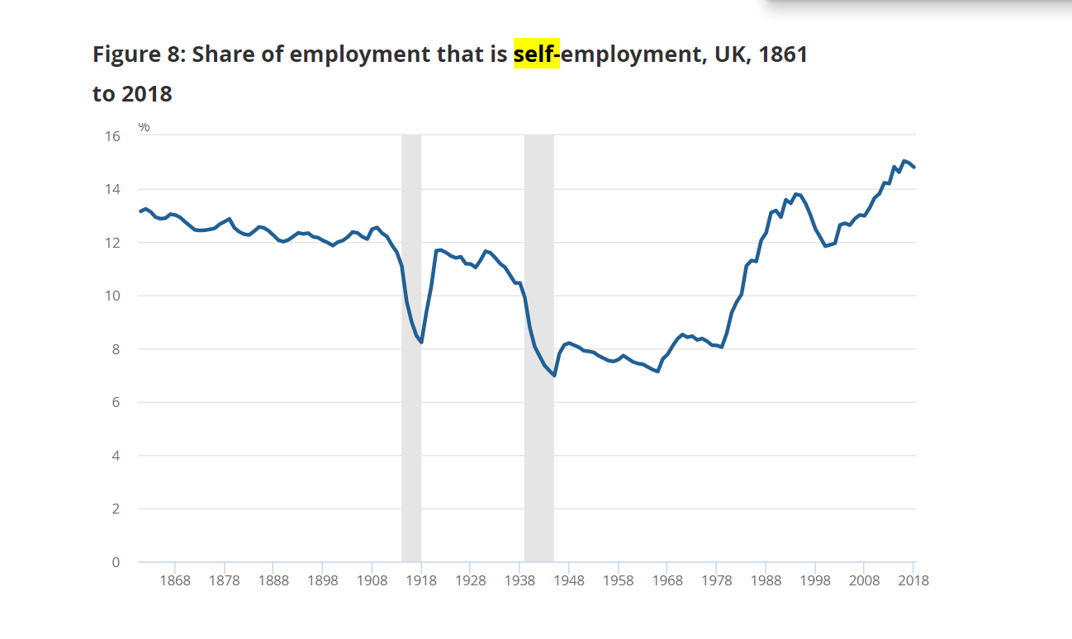
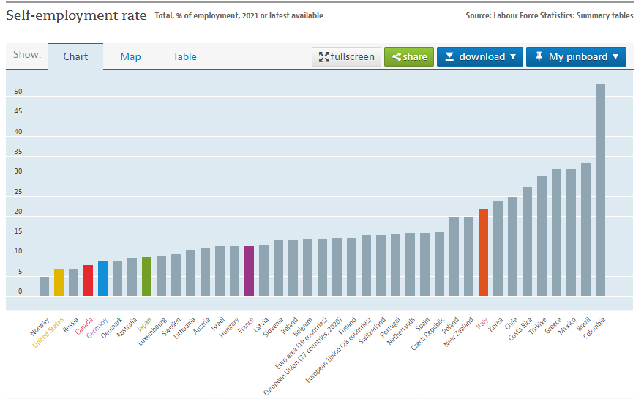
The growth of the petty bourgeoisie & its re- emergence as a political actor
Far from disappearing as Marx predicted, small capital (solo-self-employment) has grown exponentially under neoliberalism.
Over 15% of the British workforce in 2017/1, peaking at over 5 million workers in 2019.
Mike Davis notes the growth of the informal or grey economy across the world and the rise of small entrepreneurialism.
Small capital not naturally ‘resilient’ but consciously grown since Thatcherism.
Small capital is a ‘shock absorber’ for the capitalist system.
Increasingly precarious and impoverished, with over half of the self-employed in poverty (TUC, 2019).
Self-employed particularly impacted by COVID.
Permeable class boundaries as people change class.

Slide 3
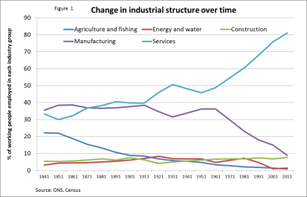
DEINDUSTRIALIZATION & THE TRANSITION TO SERVICES
The ‘deindustrial revolution’ between the 60s and the present day.
Huge increase in management and supervisory roles.
Huge increase in professional jobs.
‘Services’ now account for 85% of the British economy, more than any other G7 country.
By 2003, only one third of the British workforce did a manual job.
A huge increase in ‘Bullshit jobs’- Graeber (2013).
Capitalism has grown more complex, moving from national industries and companies with a simple division of labour to sprawling transnational corporations. You need more people to service capital- lawyers, accountants, HR, advertising.
The public sector has also grown (teachers, social workers, nurses, doctors), as has the carceral state (police officers, prison officers, probation workers, etc).
Are all these people working class?

Slide 4
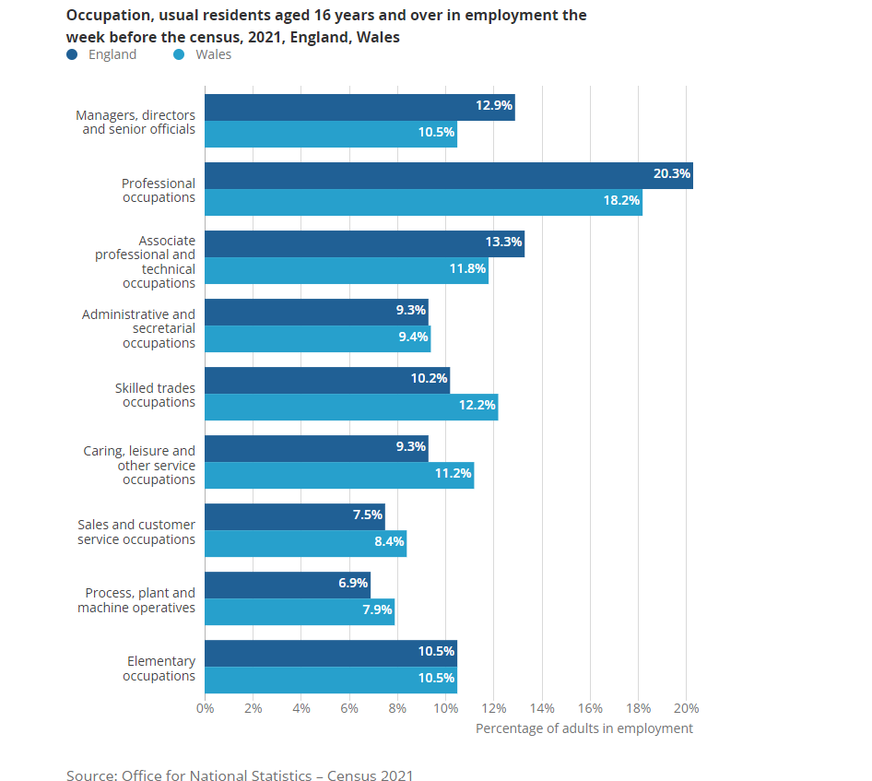
The Occupational Structure then and now

Slide 5
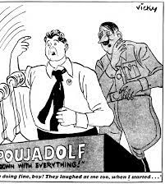
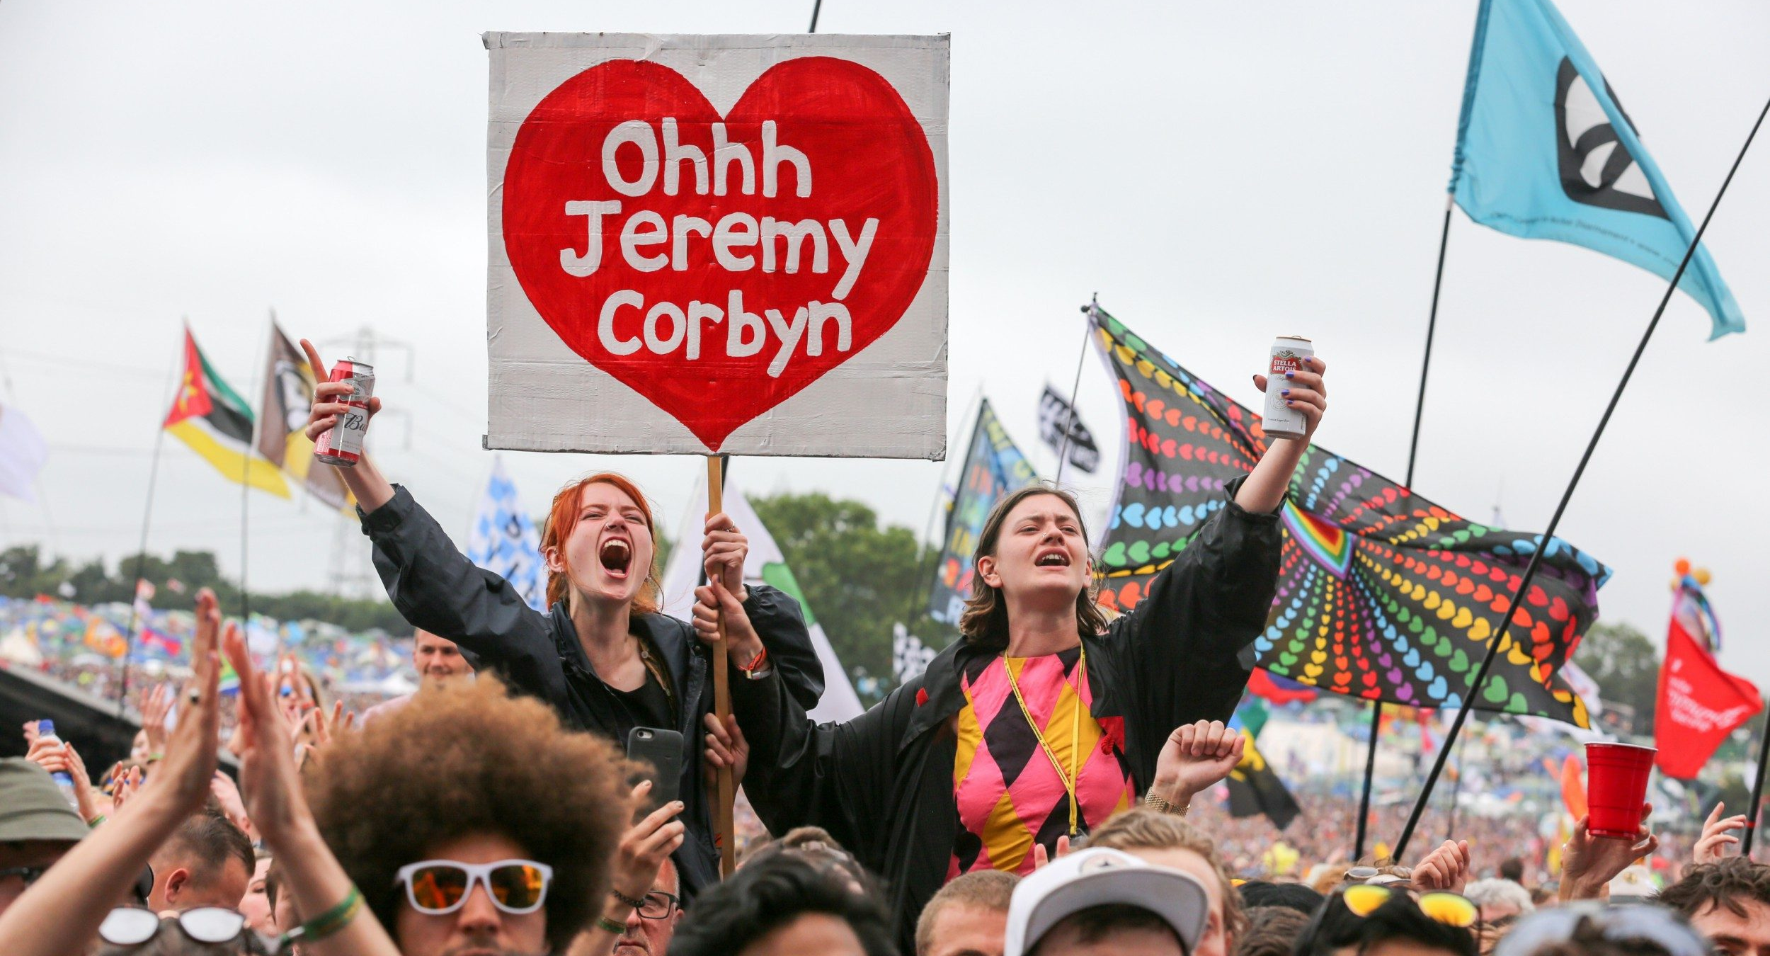
Guess who’s back? The re- emergence of the petty bourgeoisie as a political actor
The ‘old’ petty bourgeoisie are drawn to right wing politics across the globe (Lubbers et al, 2002; Ignazi, 2003; Rydgen, 2012; Evans & Mellon, 2016; Cooper, 2022), both parliamentary and extra-parliamentary, although routinely lumped in with ‘skilled working class’.
“Through the fascist agency, capitalism sets in motion the masses of the crazed petty bourgeoisie and the bands of declassed and demoralized lumpenproletariat – all the countless human beings whom finance capital itself has brought to desperation and frenzy”- Trotsky
Emergence of the petty bourgeoisie a reliable indicator of a pre-revolutionary moment- Trotsky
Meanwhile, ‘progressive’ or ‘left-populist’ movements across the world favoured by downwardly mobile graduates based in urban centres (Ramiro, 2014; Tugal, 2015; Bale et al, 2018; Santana & Rama, 2018; Farrer & Zingher, 2022, etc etc….)
Piketty (2018, 2021) ‘merchant right vs brahmin left’ and class dealignment.
The need for a Marxist engagement with the intermediate classes (e.g., Carter, Carchedi, Poulantzas, Ehrenreich, EO Wright, etc)
Better classed as a ‘new petty bourgeoisie’ (Poulantzas, 1974)?
Both fractions now clearly significant political actors.
Goes beyond ‘formal politics’ (i.e., voting) and the boundaries of the petty bourgeoisie itself. Consider the ways in which the traditional condition and ideology of the petty bourgeoisie (isolation/rugged individualism/uncollectivized anger) is now hegemonic?

Slide 6
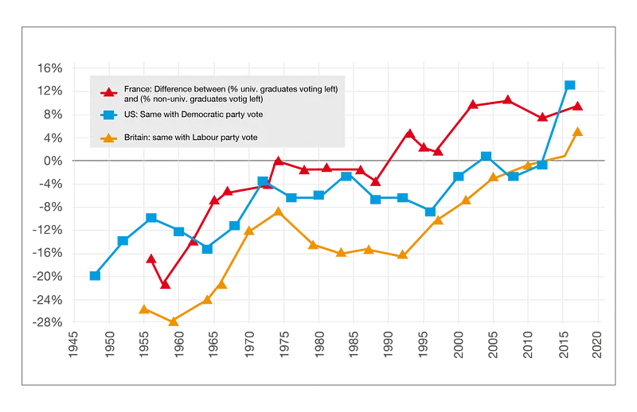
Evans & Mellon (2020)
Piketty (2021)

Slide 7
The small-holding peasants form an enormous mass whose members live in similar conditions but without entering into manifold relations with each other. Their mode of production isolates them from one another instead of bringing them into mutual intercourse.
(Marx 1852 - The Eighteenth Brumaire of Louis Bonaparte)

Slide 8
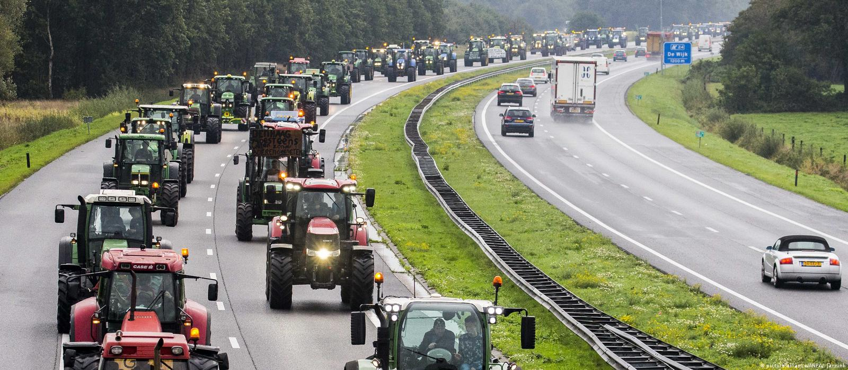
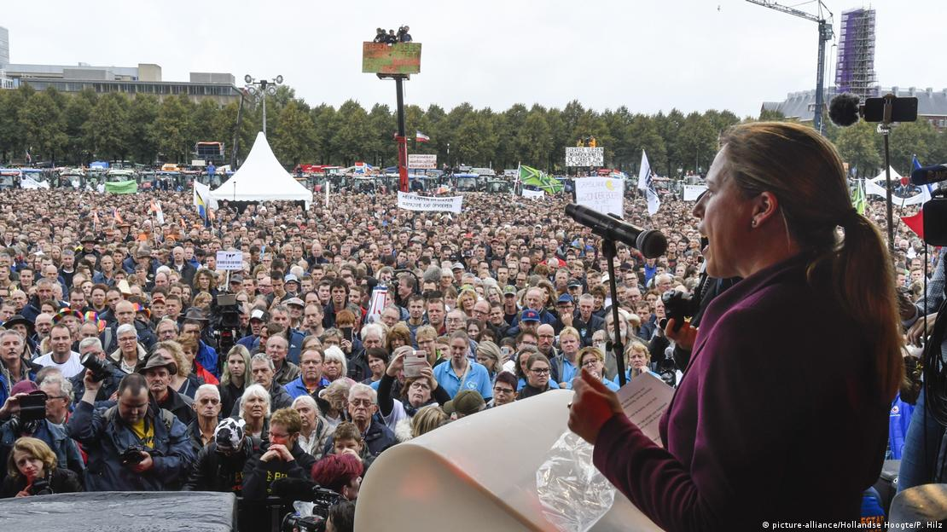
October 2019
Image: https://www.dw.com/en/netherlands-farmers-stage-tractor-protest-cause-huge-jams/a-50665750
October 2019
DUTCH FARMERS PROTESTS
Image: https://www.dw.com/en/netherlands-farmers-stage-tractor-protest-cause-huge-jams/a-50665750

Slide 9
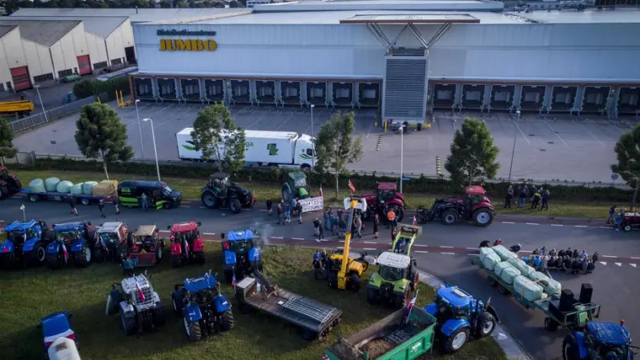
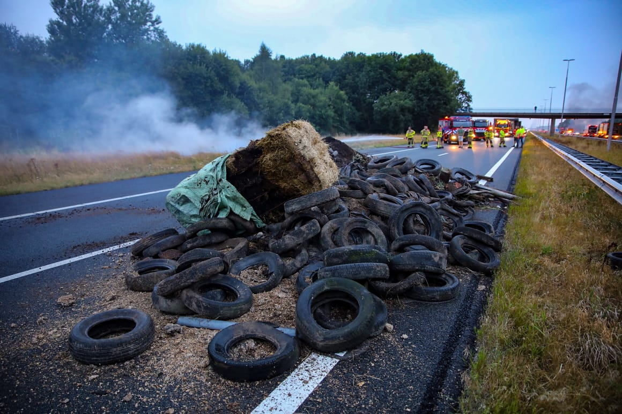
Summer 2022
Image: https://cde.news/dutch-farmers-protest-by-blocking-supermarket-distribution-centres/
Image: https://www.politico.eu/article/dutch-farmer-protest-manure-roadblock-agriculture-what-to-know/

Slide 10
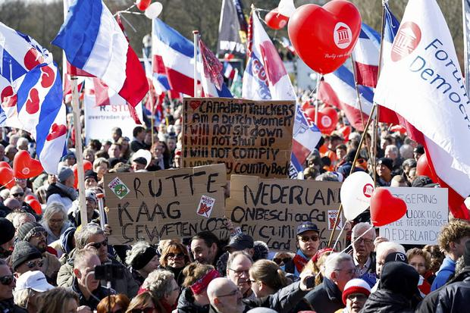
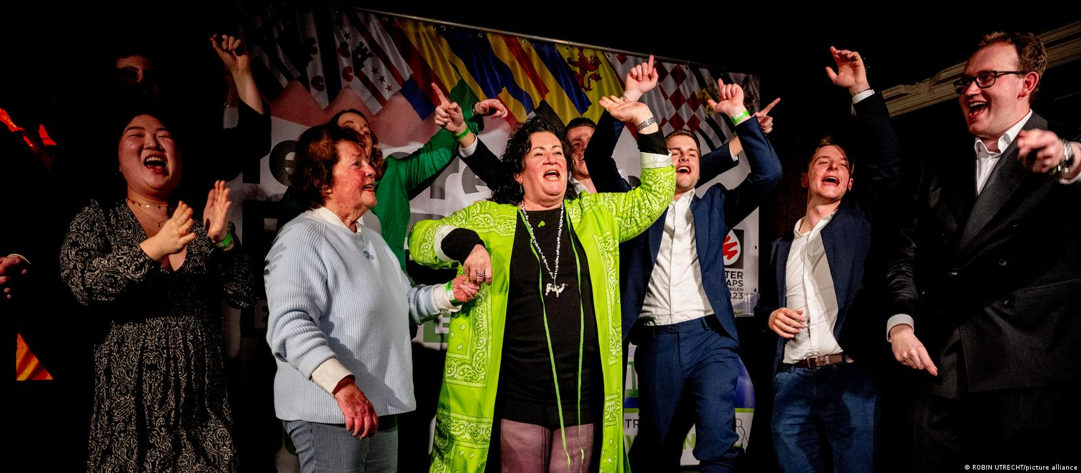
Summer 2022
March 2023
Image: https://www.independent.ie/business/farming/news/farming-news/dutch-farmers-protest-over-government-policies-ahead-of-key-elections-42382354.html
Boer-Burger Beweging (BBB) “Farmer-Citizen Movement”
20% of votes, 15/75 seats
Image: https://www.dw.com/en/dutch-farmers-party-wins-big-in-provincial-elections/a-65009995

Slide 11
Differentiated farming communities (van der Ploeg 2020)
70% of farmers agree with the statement that farmers were better off 20 years ago than they are today
85% think that the countryside is suffering a socio-political crisis
But split between:
Large “entrepreneurial” farmers (see the crisis as issue of “others”, evade responsibility)
Small peasant-like farmers (against neoliberal industrialised model)*
55% claimed that export orientation is not sustainable
46% that industrialised model damages the landscape
64.5% agreed that ‘we are working, above all, for the benefit of banks, food industry and big retailers’
*(only 16% of the farmers considered the emergence of mega-farms as a positive development – Socialist Party survey of 841 farmers)

Slide 12
Right wing populism
“Above all it is regressively populist in as far as it used the many in order to obtain privilege for the few. It mobilized all farmers to protest against policies meant to redress the environmental effects of contemporary farming, but the solutions it sought (and won) only served the interests of the few in the entrepreneurial pole, allowing them more opportunities for future expansion.” (van der Ploeg 2020)
Controlled by mega farms and corporations – but small farmers and workers as foot soliders
Need a left-wing movement rooted in principles of food sovereignty and agroecology (van der Ploeg 2020)

Slide 13
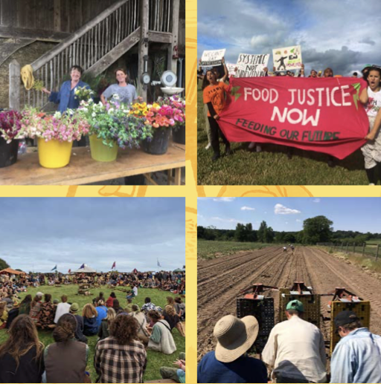
LANDWORKERS ALLIANCE, UK
a union of farmers, growers, foresters and land-based workers.

Slide 14
Activist farmers and the New Petty Bourgeoisie
2300 members, popular amongst ‘new’ activist farmers (from cities)
Purposeful and fulfilling work; agroecology and climate crisis; community building.
New entrants survey:
Average age 37
77% had degree level or above, but only 21% had agricultural qualifications
61% no previous connection to farming whatsoever
Average turnover of £23,500 (about 26,500 euro)
54% turnover less than £10,000

Slide 15
Limitations of activist ‘New PB’ farmers
Working alongside state (receiving funding/grants, organising with/within local municipalities etc)
Doesn’t come into direct conflict with big capital
Localism – sells products close to home, directly to consumers or small businesses (restaurants etc)
Socially and culturally distant from traditional farming communities

Slide 16
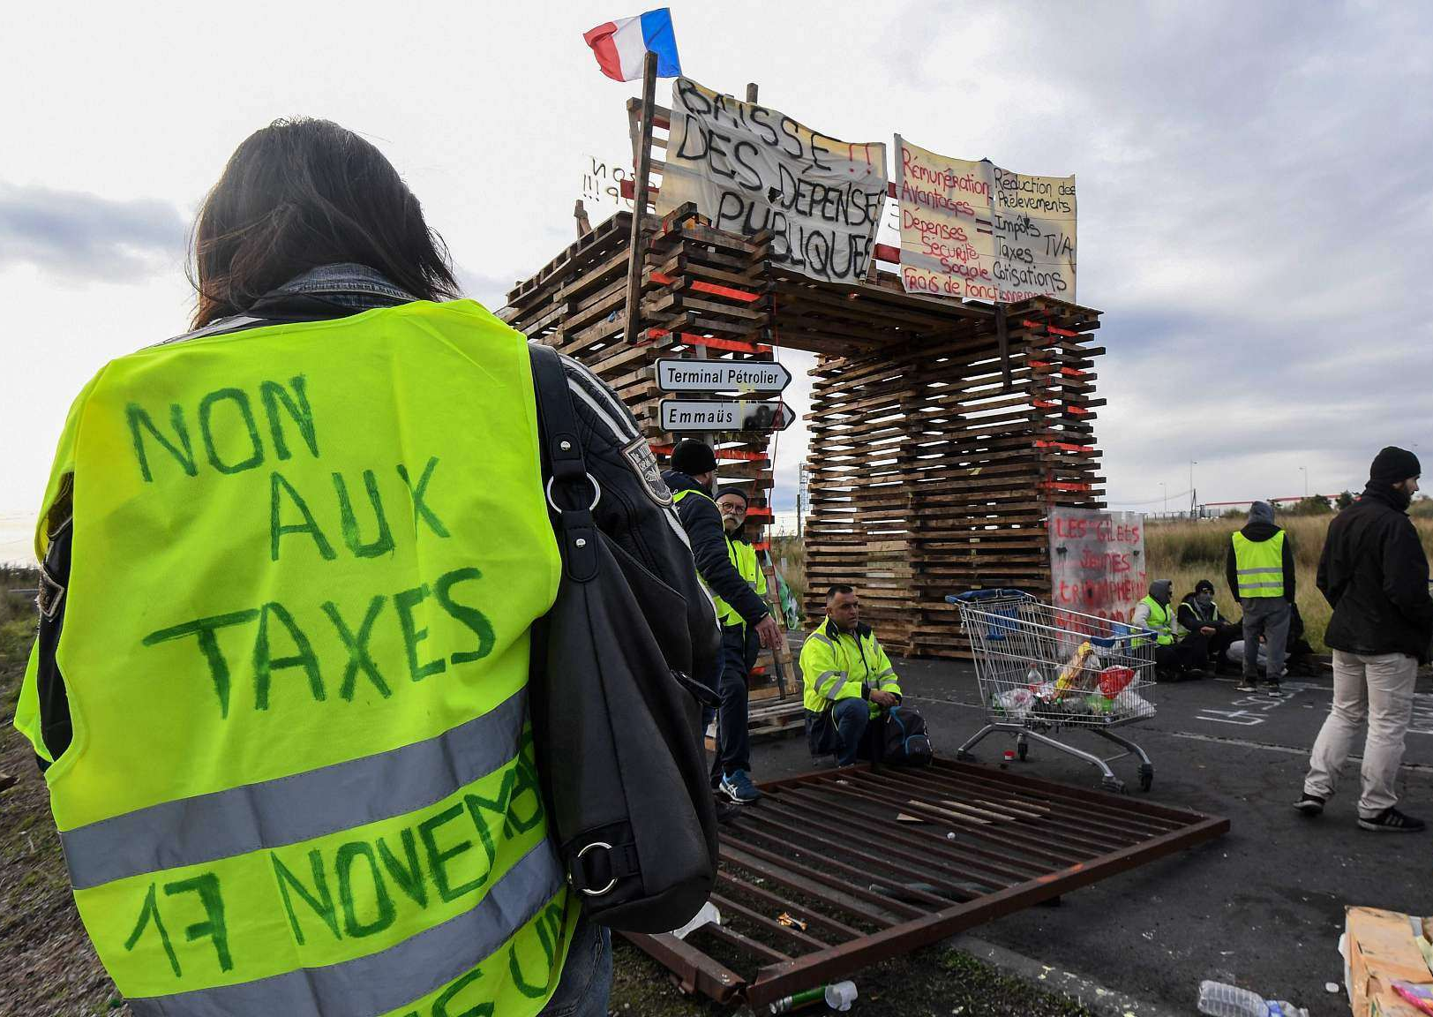
What is to be done?
Capitalist crisis in rural spaces – vacuum exploited by right populism
Traditional approach has been to dismiss petty bourgeoisie as innately fascistic.
The class structure- and people’s politics- is chaotic. It resembles the period immediately before the industrial revolution.
Both Lenin and Trotsky are clear that the only option is a class alliance between the proletariat and the petty bourgeoisie.
Obvious points of potential division over autonomy and the role of the state- taxes, housing, environmentalism, migration.
Yet France suggests the possibility of a powerful coalition, with unions and yellow vests coming together, and unions learning from the GJ movement (Kouvelakis, 2019).
‘The gilet-jaunisation’ of the unions- Haynes, 2023, Hutteau, 2023) and a class alliance.
Benefits of the insurgent, anti- state, anti-bureaucratic politics of the pb.

Slide 17
References
Bosma, A., & Peeren, E. (2022). #Proudofthefarmer: Authenticity, populism and rural masculinity in the 2019 Dutch farmers' protests. In P. Pospěch, E. M. Fuglestad, & E. Figueiredo (Eds.), Politics and Policies of Rural Authenticity (pp. 113-128). (Perspectives on Rural Policy and Planning)
Chivers, Charlotte-Anne, Hafferty, Caitlin, Reed, Matt and Raseta, Sofia (2022) Exploring the socio-economic dynamics and innovation capacities of rural food and farming microbusinesses. Technical Report. National Innovation Centre for Rural Enterprise
Jan Douwe van der Ploeg (2020) Farmers’ upheaval, climate crisis and populism, The Journal of Peasant Studies, 47:3, 589-605
Landworkers Alliance (2020) New Entrants survey
Landworkers Alliance (2022) Annual Report October 2021-September 2022
Landworkers Alliance (2022) The Attraction of Agroecology

