Slide 1
URBAN GARDENS, COMMONING, AND THE SEEDS OF POST- CAPITALISM
Owain Hanmer
hanmerOJ@cardiff.ac.uk

Slide 2
THE CONTESTED POLITICS OF URBAN GARDENS
Division between
Urban gardens as social and political alternative (food justice/sovereignty, right to the city, solidarity economy, diverse community economy etc)
Urban gardens as sites of neoliberalisation
Neoliberal governance – austerity localism, scaled-back state
Neoliberal subjectification – individualism, self-help, self-improvement etc

Slide 3
RECLAIMING THE AGENCY OF URBAN GARDENERS
Binary & contradictions – situating post-capitalist potential is challenging
Intellectual emphasis on documenting the manipulative mechanisms of capitalism (Cleaver 1992)
Critical scholars regularly do the work for capitalism in the process (Graeber…)
Increasing efforts to reclaim the everyday and quiet politics of urban gardening
Commoning as a useful framework

Slide 4
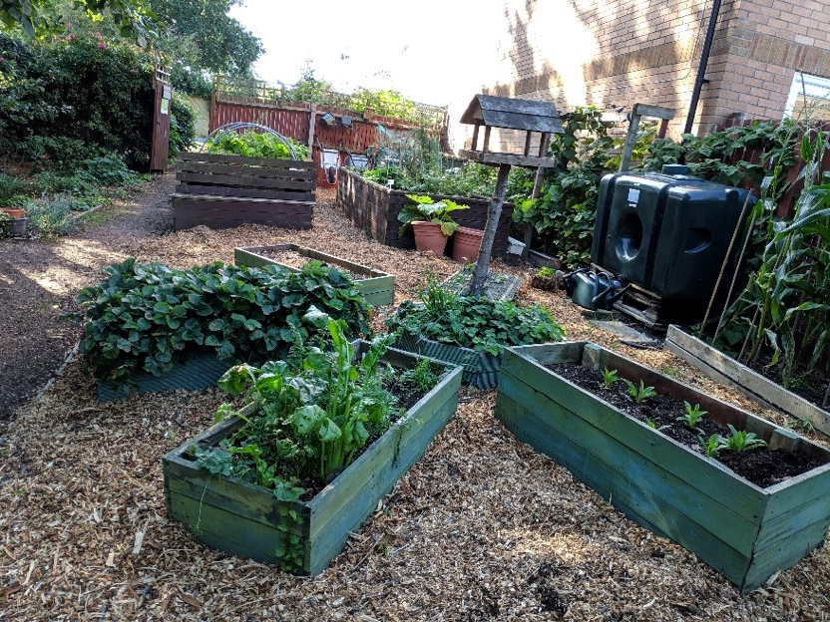
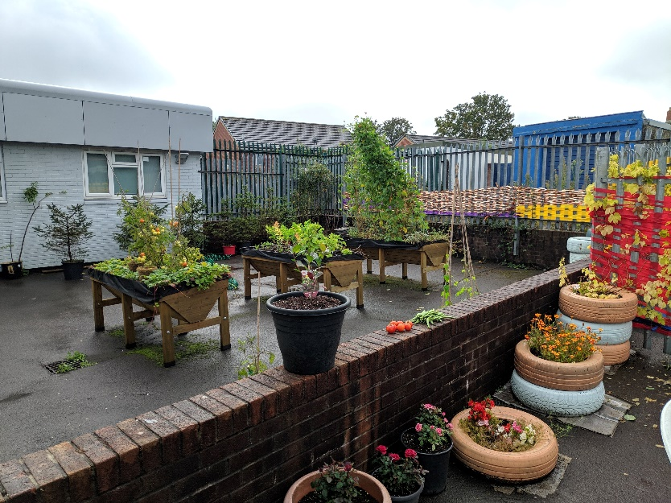
THE FOUNDATIONAL VALUE PRACTICES
But everyday value practices exist despite (& beyond) capitalist logics?
Social Alienation – alienation from each other
Spatial Alienation – alienation from our spatial environment
Creative Alienation – alienation from what we create

Slide 5
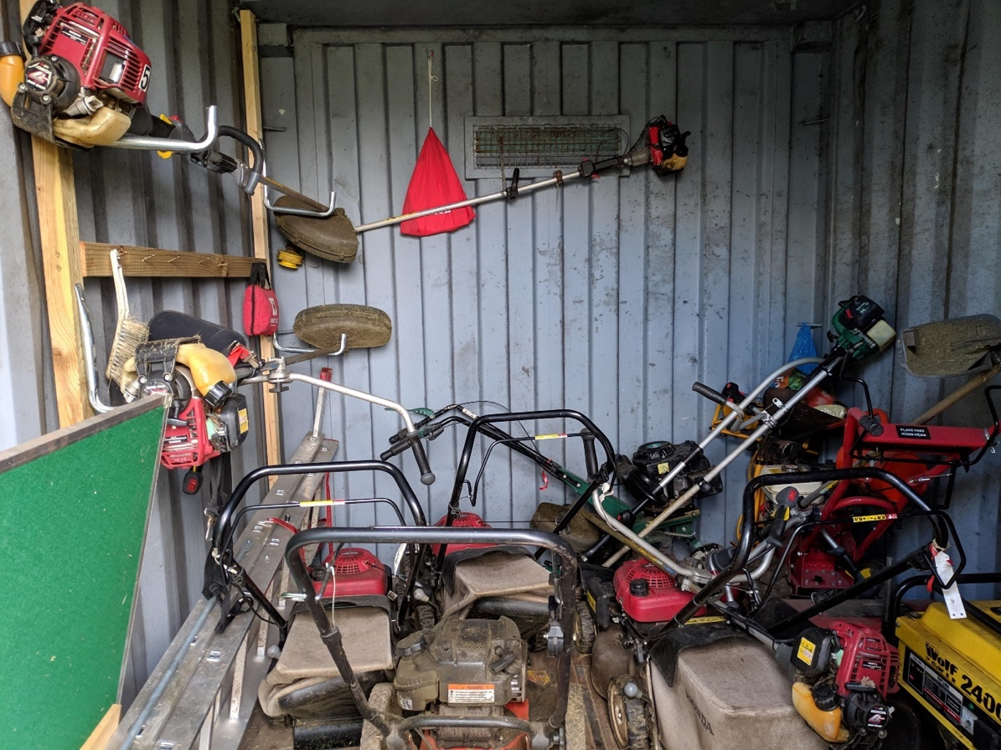
THE EVERYDAY SOCIAL RELATIONS
Based on mutual aid and co-operation
Communal work, helping one another (when sick/on holiday), sharing tools and resources
Part of the mundane and everyday, as well as celebrations and events
Requires processes of complementarity (Bookchin 2005) – pooling diversity of skills and interests to meet individual and collective needs

Slide 6
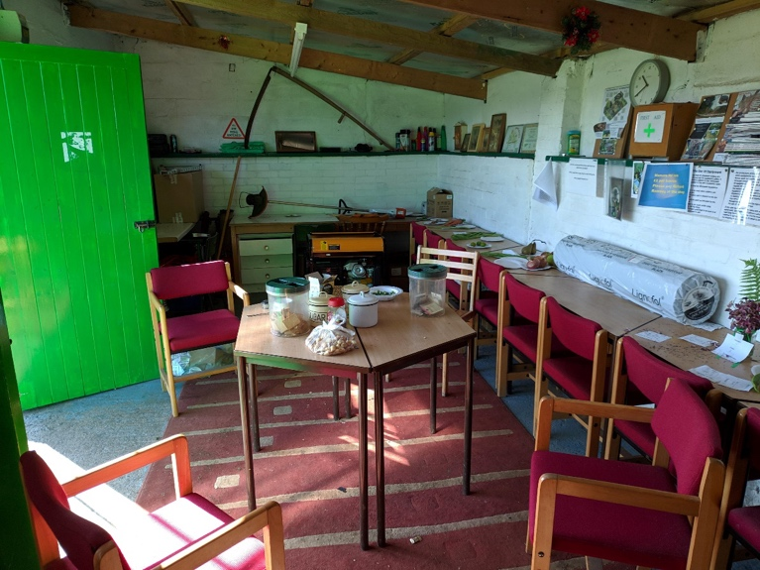
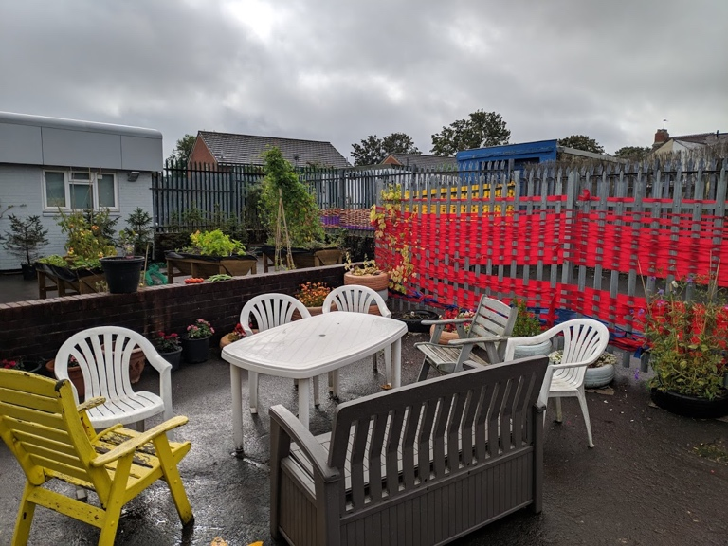
THE EXPERIMENTATION IN COLLECTIVE SELF-MANAGEMENT
Desire for self-management – beyond the alienating/hierarchical state/market of governance
Internal challenges – breaking habits of delegation (De Angelis 2017), neoliberal subjectification
External challenges – landowners wanting control
Vernacular everyday governance emerges despite this

Slide 7
CONCLUSION
The interaction of these three spheres is the seed of post-capitalism in urban gardens?
Everyday mundane practices – destabilises the authority and centrality of capitalism in everyday life
Cleaver, H. 1992. The inversion of class perspective in Marxian theory: From valorisation to self-valorisation. In: Holloway, J., Bonefeld, W., and Psychopedis, K. eds. Open Marxism, Volume 2; Theory and Practice. London: Pluto, pp. 106–145.
De Angelis, M. 2017. Omnia Sunt Communia: On the Commons and the Transformation to Postcapitalism. London: Zed Books.
Gibson-Graham, J.K. 2006. A Postcapitalist Politics. University of Minnesota Press.
Graeber, D. 2001. Toward an Anthropological Theory of Value: The False Coin of Our Own Dreams. New York: Palgrave Macmillan US.
Graeber, D. 2004. Fragments of an Anarchist Anthropology. Prickly Paradigm Press.
Tsing, A.L. 2017. The Mushroom at the End of the World: On the Possibility of Life in Capitalist Ruins. New Jersey: Princeton University Press.

