Slide 1
Air Quality and Inequalities in the UK:
- What do we know?
- What do we need to know?
Distributive, procedural and policy justices
Public Policy Exchange webinar: Air Pollution in the UK
Presented by
Dr Jo Barnes, Professor of Clean Air,
Air Quality Management Resource Centre,
University of the West of England (UWE) Bristol, UK
17 October 2023

Slide 2
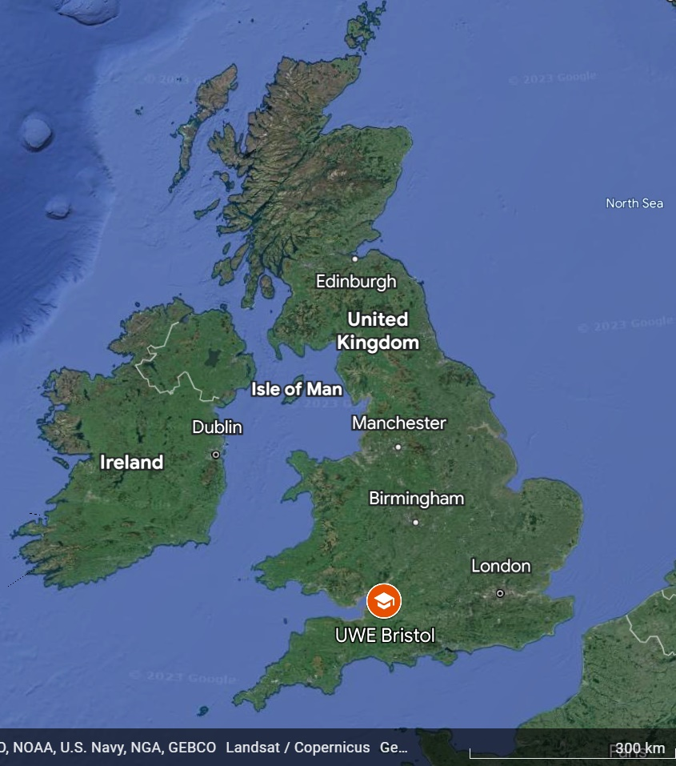
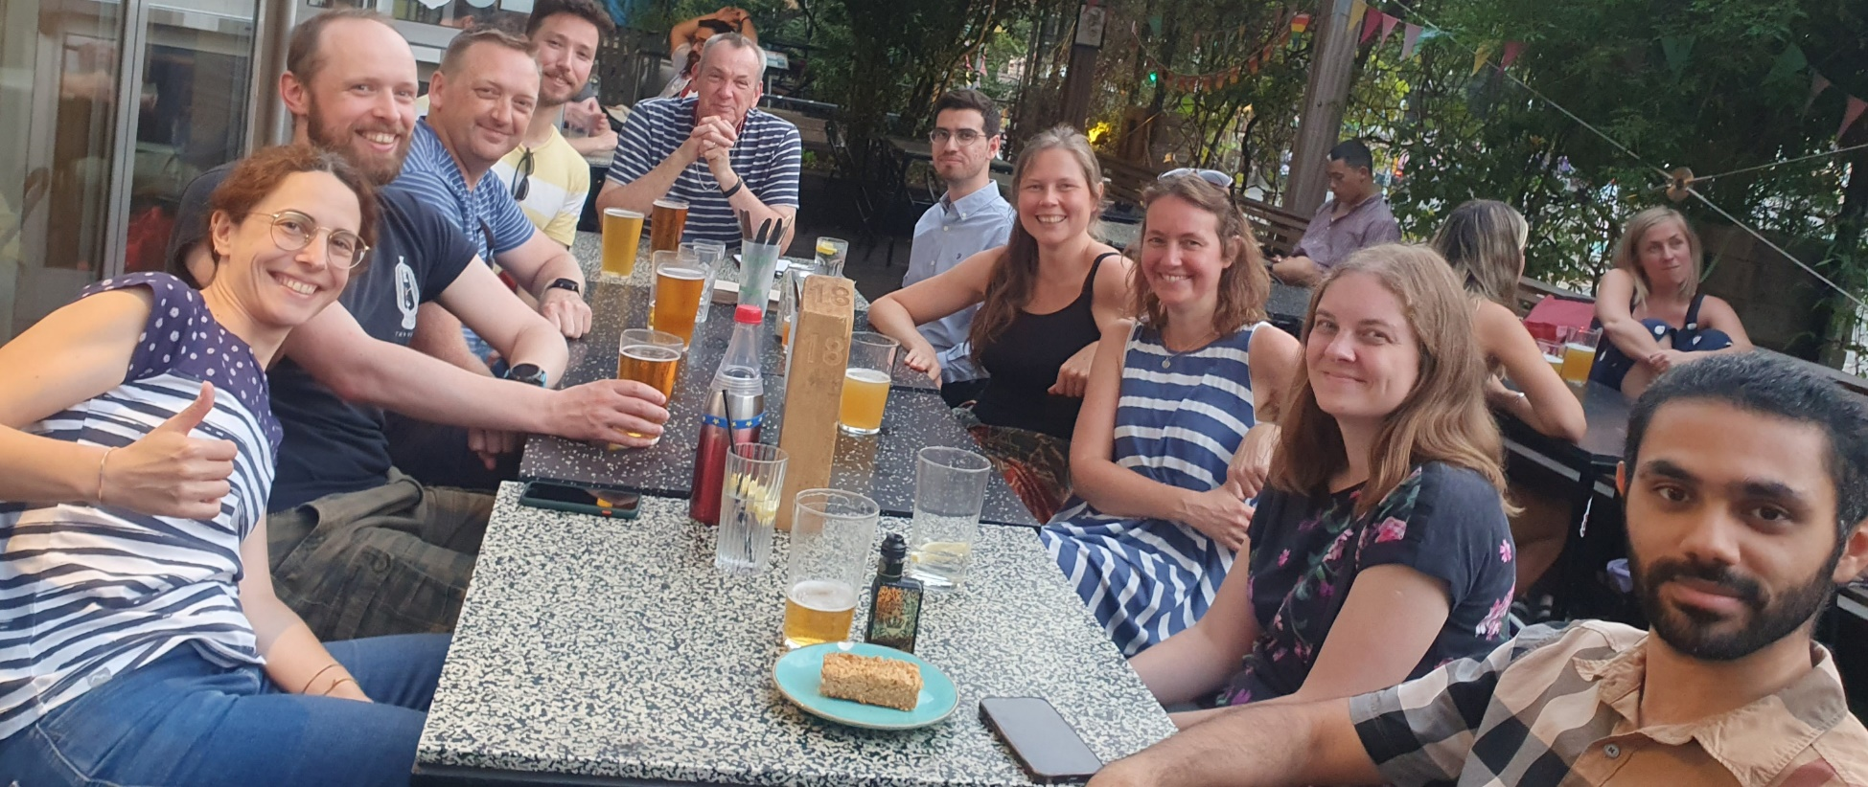
Air Quality Management Resource Centre, UWE Bristol
Established 1997
Research group in SW UK
“AQ science, policy and people nexus”
Supporting local and national government

Slide 3
Introduction – EJ definitions used
Distributive justice
Inequitable distribution AQ among different groups
Procedural justice
Inequitable access to environmental decision-making
Policy justice
Inequitable outcomes of environmental policy decisions
Environmental Justice definitions (from Stephens and Church (2017))
Notes:
To fully get to grips with understanding air quality inequalities in the UK we need to consider distributive, procedural and policy environmental justices. That is, how vulnerable groups are unequally affected by air pollution, but also what are the systemic processes that perpetuate those inequalities in terms of decision making and policy implementation.
Environmental Justice definitions (from Stephens and Church (2017)).
Distributive justice is concerned with how environmental ‘goods’ (e.g., air quality) and environmental ‘bads’ (e.g., pollution and risk) are distributed among different groups and the fairness or equity of this distribution.
Procedural justice is concerned with the fairness or equity of access to environmental decision-making processes and to rights and recourse in environmental law.
Policy justice is concerned with the principles and outcomes of environmental policy decisions and how these have impacts on different social groups.

Slide 4
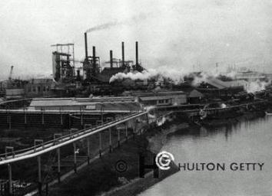
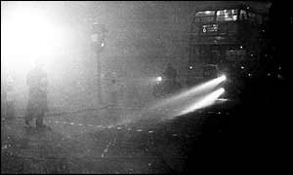
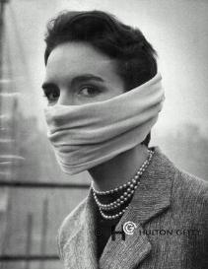
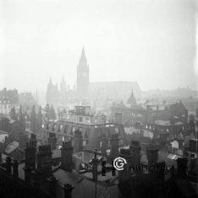
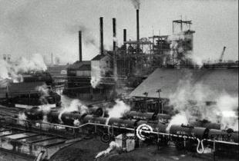
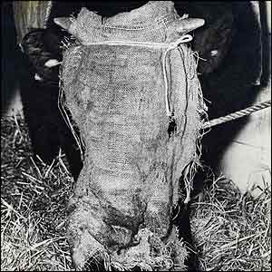
Historical UK sulphurous smogs – e.g. Great London Smog 1952
Notes:
Over the first half of the 20th century, UK air pollution was primarily from industry and domestic solid fuel burning. Sulphurous smogs especially under still conditions were seen as an inevitable consequence of economic growth. Those that could afford to live upwind of pollution sources moved to the west, leaving the poorer, more polluted areas downwind in the east of cities. This phenomenon can still be seen in the richer west and poorer east districts in many UK cities. As the century wore on and our understanding of the health effects increased, tolerance of high levels of pollution reduced. Following the Great London Smog in 1952, which reportedly killed ~12,000 individuals, new legislation (the UK Clean Air Act 1956) was brought in to help control industrial and domestic emissions in urban areas. Unfortunately, although the visible pollution largely disappeared, we did not adequately predict the impact that the growth in other sources, e.g. road traffic, would have on air quality.

Slide 5
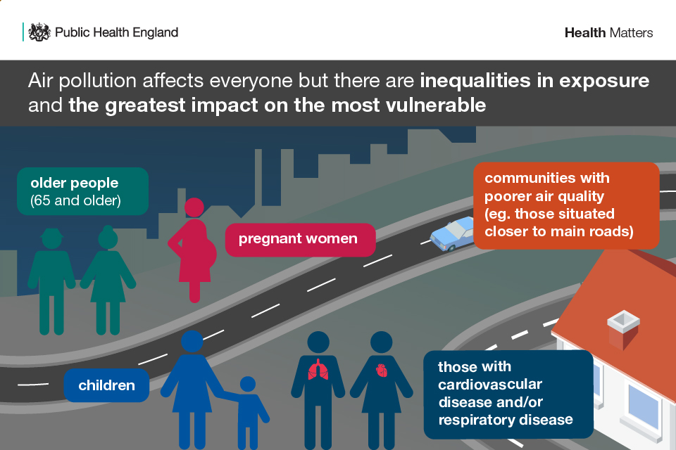
https://www.gov.uk/government/publications/health-matters-air-pollution/health-matters-air-pollution
Notes:
It is now recognised that there are differences in susceptibility to air pollution experienced throughout the life course and for those with pre-existing health conditions. Young children, pregnant women and older people are considered most vulnerable groups.
Communities living in areas with higher levels of pollution are also more affected.

Slide 6
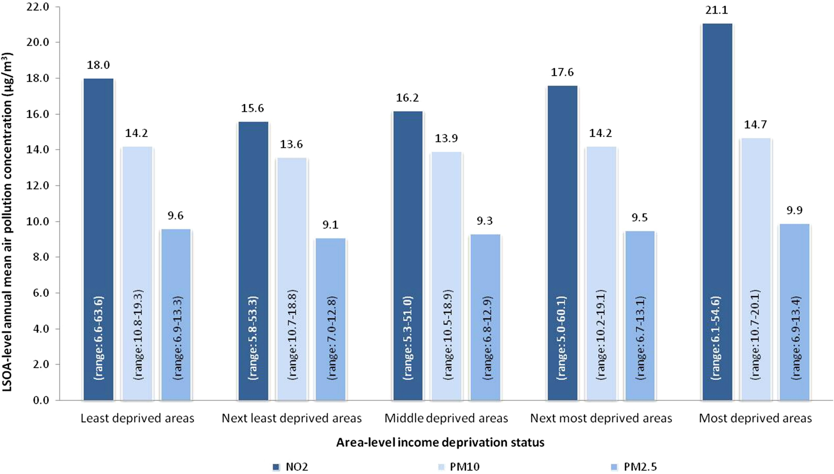
Air pollution exposure and deprivation
Brunt, H., Barnes, J., Jones, S., Longhurst, J., Scally, G. and Hayes, E. T. (2017) Air pollution, deprivation and health: Understanding relationships to add value to local air quality management policy and practice in Wales, UK. Journal of Public Health, 39 (3). pp. 485-497. ISSN 1741-3842 Available from: http://eprints.uwe.ac.uk/30133
Notes:
PhD research from 2017 using areal-based analysis in Wales showed a U-shaped or J-shaped relationship between annual mean concentrations of NO2 and deprivation with those in the most deprived quintile exposed to the highest concentrations, on average more than one third higher than communities in the second least deprived quintile. A similar, although less pronounced relationship was observed for PM10 and PM2.5. It is interesting to note that those in the least deprived quintile do not have the lowest concentrations of NO2, PM10 or PM2.5 perhaps indicating an active choice to live in urban areas, however these communities are more likely to have the means to be able to reduce residential exposure by having houses set back from the road or by living in high-rise apartments.

Slide 7
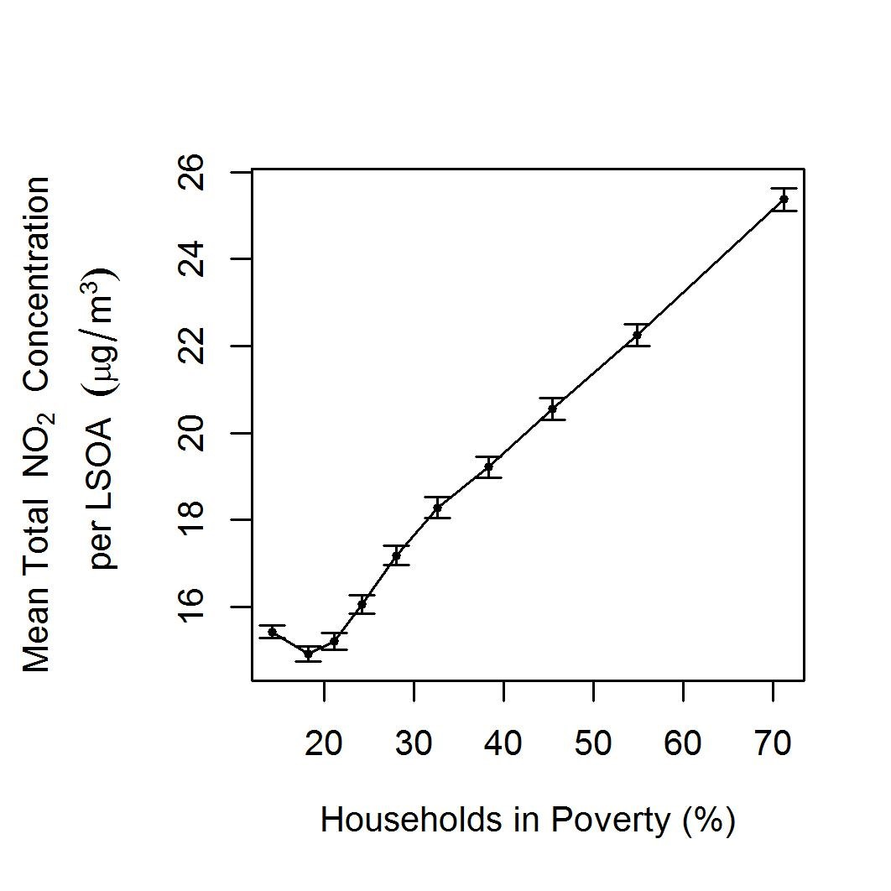
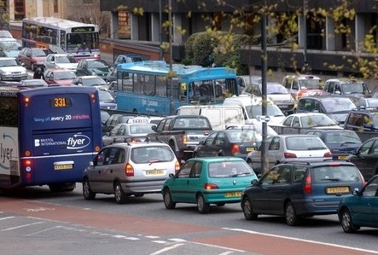
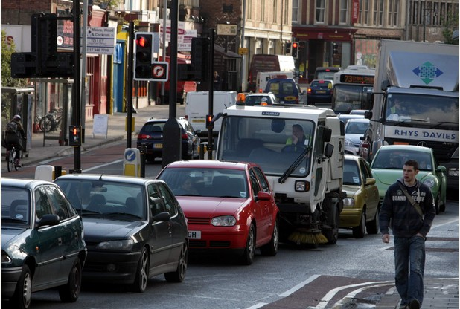
NO₂ concentrations against poverty
Barnes, J. , Chatterton, T. and Longhurst, J. (2019) Emissions vs exposure: Increasing injustice from road traffic-related air pollution in the United Kingdom. Transportation Research Part D: Transport and Environment, 73. pp. 56-66. ISSN 1361-9209 Available from: https://uwe-repository.worktribe.com/output/1491851
Notes:
In other areal-based research across England and Wales, using a different metric for poverty based on the Breadline Britain Index, areas with higher air pollution (particularly road traffic pollution) tend to have higher prevalence of households with lower socio-economic status. These two studies help to demonstrate the social inequality or inequity of exposure to air pollution.

Slide 8
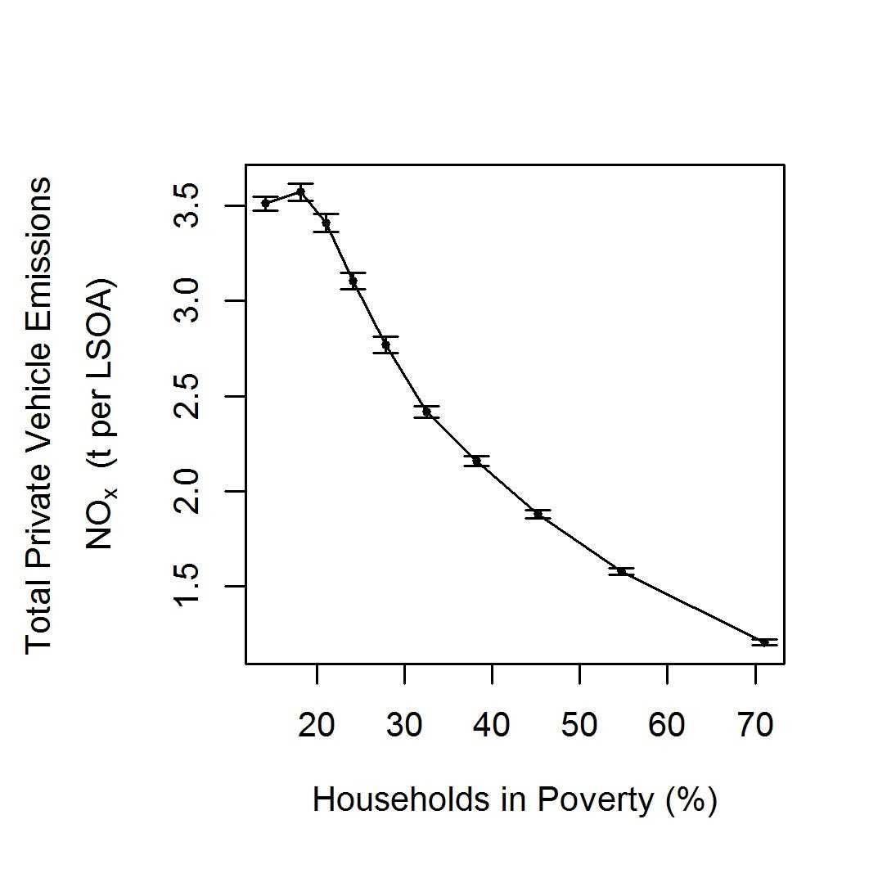
NO₂ concentrations vs NOx emissions against poverty
Barnes, J. , Chatterton, T. and Longhurst, J. (2019) Emissions vs exposure: Increasing injustice from road traffic-related air pollution in the United Kingdom. Transportation Research Part D: Transport and Environment, 73. pp. 56-66. ISSN 1361-9209 Available from: https://uwe-repository.worktribe.com/output/1491851
Notes:
In the same study, we also looked at the average total vehicle emissions per household on the same areal basis, as shown in the graph on the right. Here you can see that areas with the highest proportion of households in poverty produce the lowest private vehicle NOx emissions per household, whereas those in the least poor areas produce the most. Contrasting this with the graph we have just seen on the left which relates to exposure, we can clearly see that there is a distributive environmental justice issue between who is producing road traffic pollution and who is suffering the consequences.

Slide 9
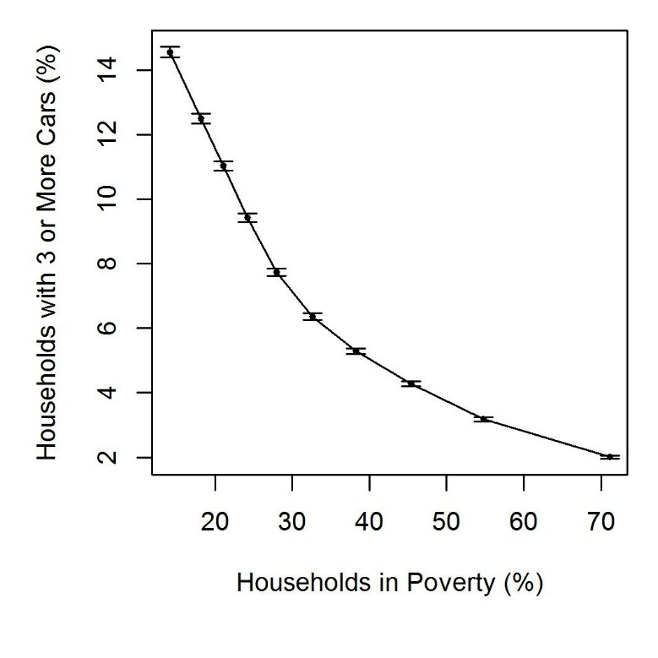
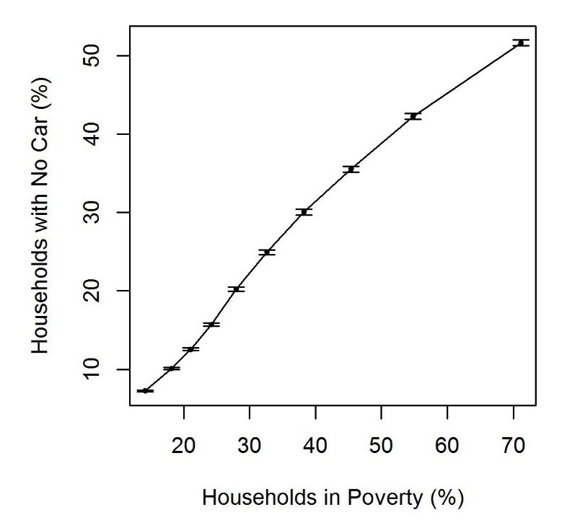
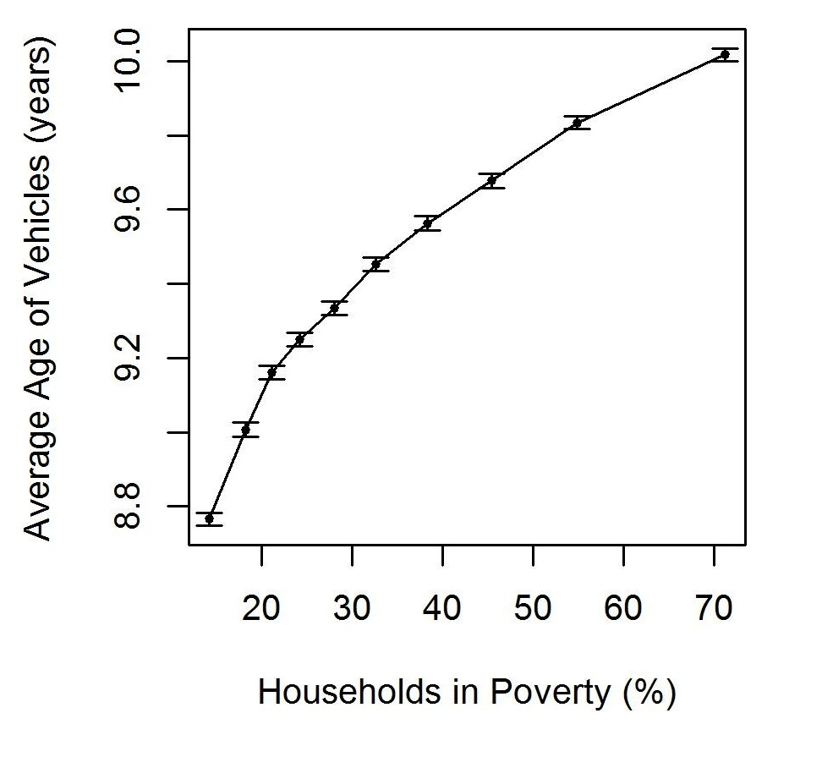
Vehicle ownership
Poorer households less likely to own a car
And vehicles only ~1.2 years older
Barnes, J. , Chatterton, T. and Longhurst, J. (2019) Emissions vs exposure: Increasing injustice from road traffic-related air pollution in the United Kingdom. Transportation Research Part D: Transport and Environment, 73. pp. 56-66. ISSN 1361-9209 Available from: https://uwe-repository.worktribe.com/output/1491851
Notes:
We can unpick this further to explore why there is this difference between average total household vehicle emissions by looking at the age of vehicles owned in these households, distance driven, and fuel types of vehicles. Our analysis showed that areas with a higher proportion of households in poverty are less likely to have access to a car and were less likely to be multiple-car households. However, for those that do have private vehicles, the average age of those owned by poorer households was only just over a year older than those in the least poor areas. This may be due to more affluent multi-car households having older second-hand cars for their non-primary vehicles.

Slide 10
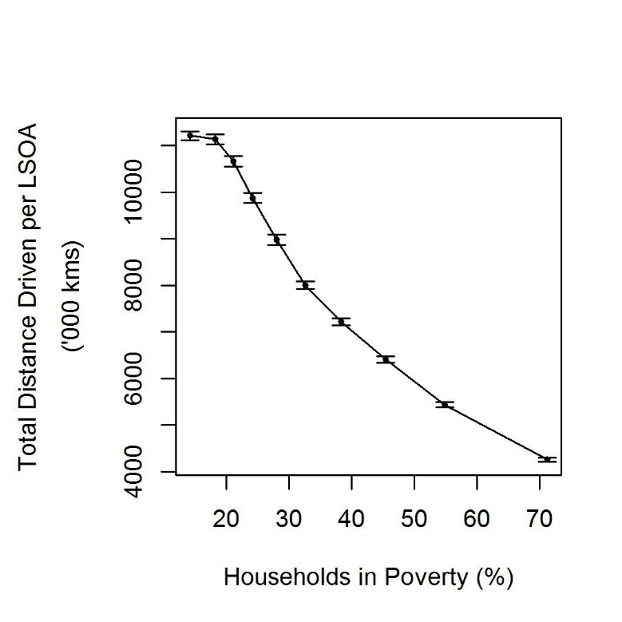
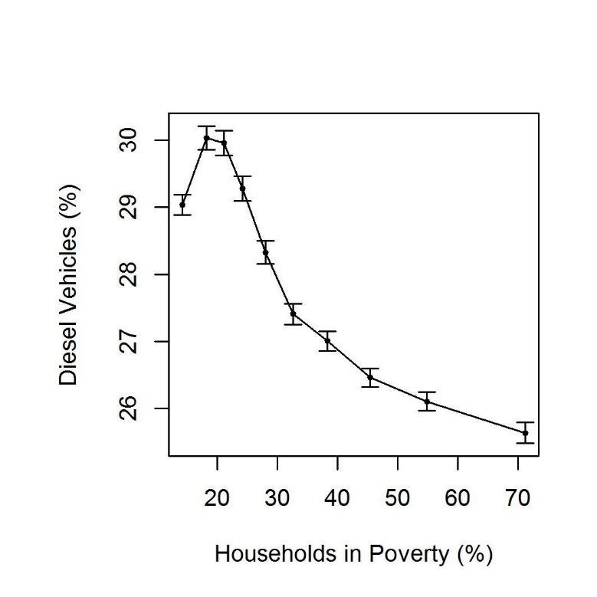
Vehicle ownership
More affluent households drive further
And more likely to drive diesels
Barnes, J. , Chatterton, T. and Longhurst, J. (2019) Emissions vs exposure: Increasing injustice from road traffic-related air pollution in the United Kingdom. Transportation Research Part D: Transport and Environment, 73. pp. 56-66. ISSN 1361-9209 Available from: https://uwe-repository.worktribe.com/output/1491851
Notes:
More affluent households are also much more likely to drive more/longer distances. These households are also more likely to drive diesel vehicles with associated higher NOx emission factors.

Slide 11
Air pollution, deprivation and health
 |  | Air pollution status (PM₁₀)
 |  | Low | Moderate | High
All-cause mortality | Least deprived | - | RR = 1.02 (0.96 to 1.08) | RR = 1.06 (0.91-1.24)
 | Most deprived | RR = 1.56 (1.46 to 1.66) | RR = 1.58 (1.50 to 1.66) | RR = 1.65 (1.50 to 1.80)
Respiratory disease mortality | Least deprived | - | RR = 1.19 (1.02 to 1.39) | RR = 1.35 (0.86 to 1.95)
 | Most deprived | RR = 2.05 (1.73 to 2.41) | RR = 2.21 (1.92 to 2.53) | RR = 2.38 (1.89 to 2.95)
Air pollution + deprivation = greater health impacts
Higher all-cause and respiratory disease mortality
Especially in ‘most deprived’ areas
Bold = Statistically signiﬁcant result.
Bold underlined = Statistically signiﬁcant result; RR increased as area-level air pollution status worsened.
Brunt, H., Barnes, J., Jones, S., Longhurst, J., Scally, G. and Hayes, E. T. (2017) Air pollution, deprivation and health: Understanding relationships to add value to local air quality management policy and practice in Wales, UK. Journal of Public Health, 39 (3). pp. 485-497. ISSN 1741-3842 Available from: http://eprints.uwe.ac.uk/30133
Notes:
Returning to the PhD research in Wales, analysis of the health effects associated with air pollution and deprivation found that the combined health effects of exposure to PM10 and deprivation are greater than the sum of their respective parts. Risk Ratios for all-cause mortality and respiratory disease mortality were statistically higher in the most deprived areas, but were significantly higher in deprived areas with higher concentrations of PM10 compared to those in least deprived areas. The distributive injustice previously identified therefore has real health outcomes for the most vulnerable in society.

Slide 12
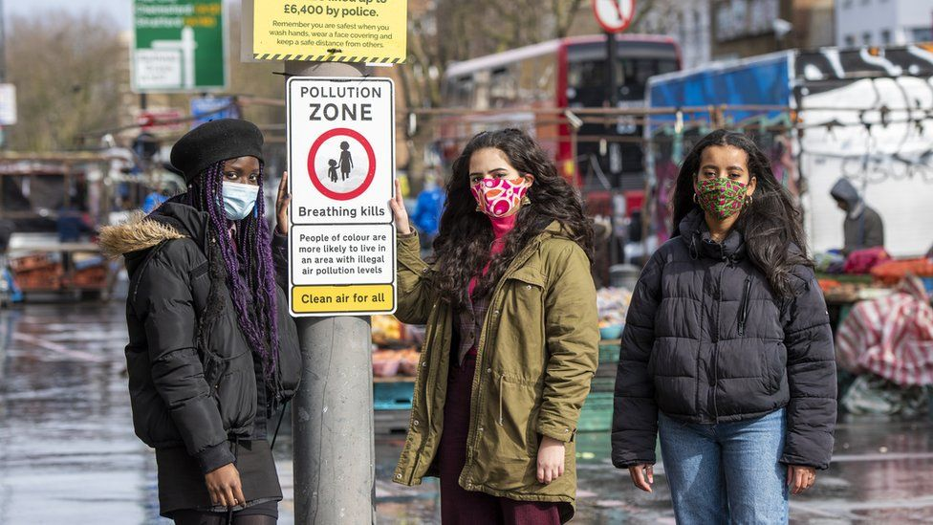
Air pollution and ethnicity
Neighbourhoods in England >20% non-White:
  higher mean PM₁₀ (4.2 μg/m³) and NO₂ (13.5 μg/m³)
  after adjustment for deprivation and demographics
    (Fecht et al., 2015)
In UK, poorer self-reported health in ethnic groups and non-UK-born individuals with increasing concentrations of NO₂, SO₂, PM₁₀, and PM_{2.5} cf. British-white and UK-born individuals
    (Abed Al Ahad et al., 2023)
In London:
  NO₂ 16-27% higher where ethnic minorities live
    (Environmental Defense Fund, 2021)
  31-35% black and mixed/multiple ethnicities have higher AP
  cf. 4-5% for white ethnic groups
    (Greater London Authority, 2021)
EDF
Notes:
Other studies in England have also associated ethnicity with higher levels of air pollution, even after accounting for deprivation.
Neighbourhoods in England with >20% non-White residents had statistically significantly higher mean PM₁₀ (4.2 μg/m³) and NO₂ (13.5 μg/m³) concentrations than neighbourhoods with ≤20% non-White, even after adjustment for deprivation and other demographic factors. (D. Fecht et al., 2015). Whilst Indian, Pakistani/Bangladeshi, Black/African/Caribbean and other ethnic groups and non-UK-born individuals reported poorer health with increasing concentrations of NO₂, SO₂, PM10, and PM2.5 pollutants in comparison to the British-white and UK-born individuals (Abed Al Ahad et al., 2023).
In 2019 in London, average annual concentrations of NO2 were on average between 16% and 27% higher in areas where people of ethnic minority background were most likely to live compared to areas where people of white background were most likely to live. (Environmental Defense Fund, 2021)
Between 31% and 35% of areas with the highest proportion of black and mixed/multiple ethnicities were in areas with higher levels of air pollution, reducing to 15% to 18% for Asian ethnic groups, and just 4% to 5% for white ethnic groups. (Greater London Authority, 2021)

Slide 13
Intersectionalities – social & environmental
Low SES
Ethnicity
Ill-health
Age
Air quality
Noise pollution
Access to green/blue space
Urban Heat Index
Barnes, J. , De Vito, L. , Blanes Guàrdia, Núria, Fons Esteve, J. , van Kamp, I. , Marín Puig, A. , Hayes, E. T.and Michalec, A. (2019) Qualitative assessment of links between exposure to noise and air pollution and socioeconomic status. Technical Report. University of the West of England. Available from: https://uwe-repository.worktribe.com/output/869590
Notes:
To use the language of Kimberlé Crenshaw, there are intersections of social inequalities, e.g. between deprivation, ethnicity, age and health status. There is also evidence of intersectionality between environmental factors (such as air and noise pollution) with deprivation. However there is little understanding of the intersectionalities between different social factors or between different environmental factors, let alone the intersectionalities between combined multiple social and environmental factors. Clearer understanding of where these overlaps occur, particularly with the addition of health outcomes data, could help policy makers to target resources and prioritise action.

Slide 14
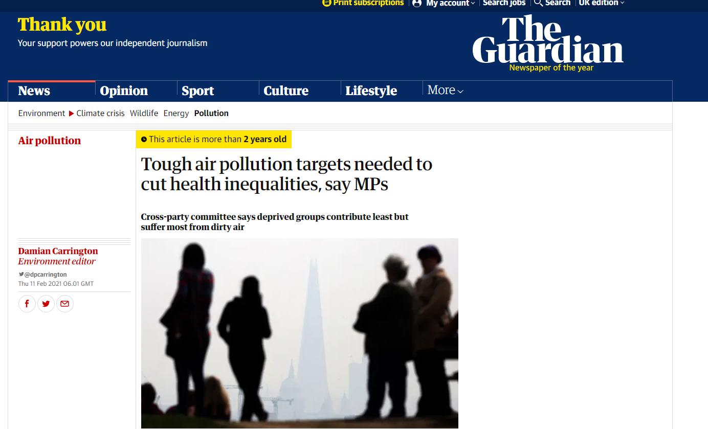
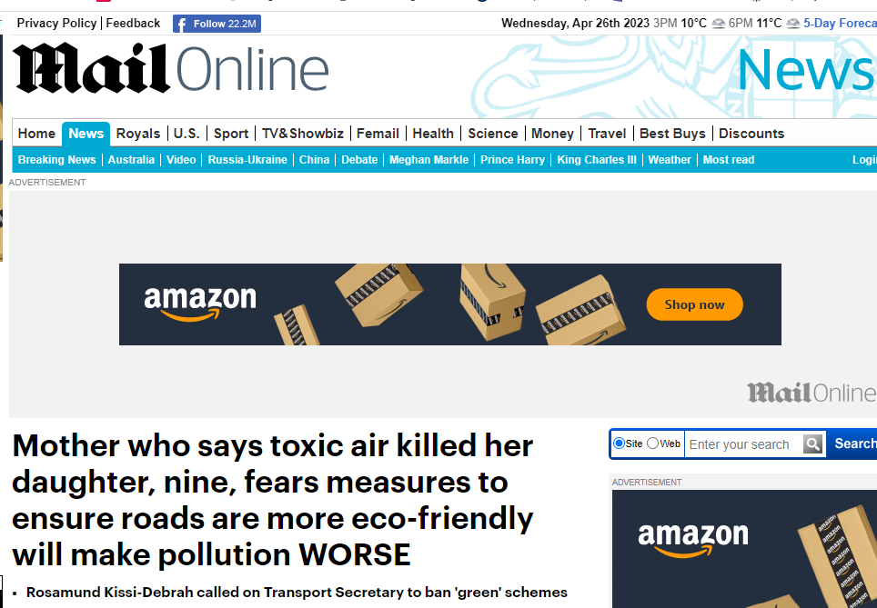


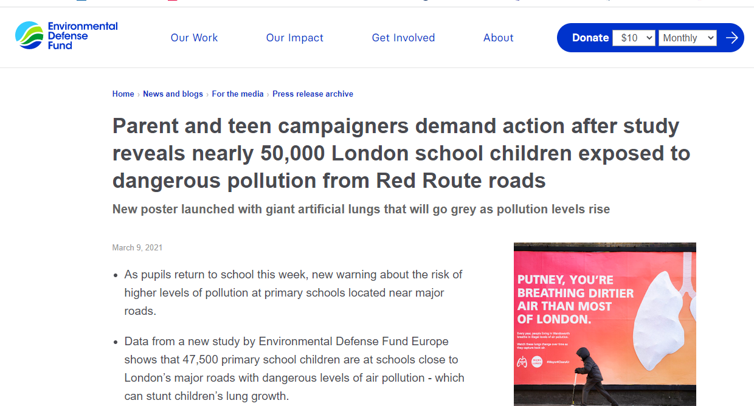
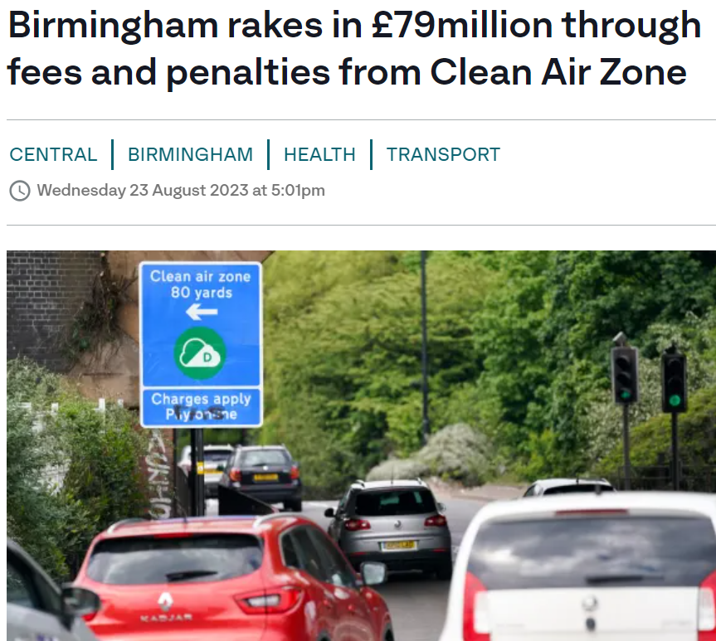
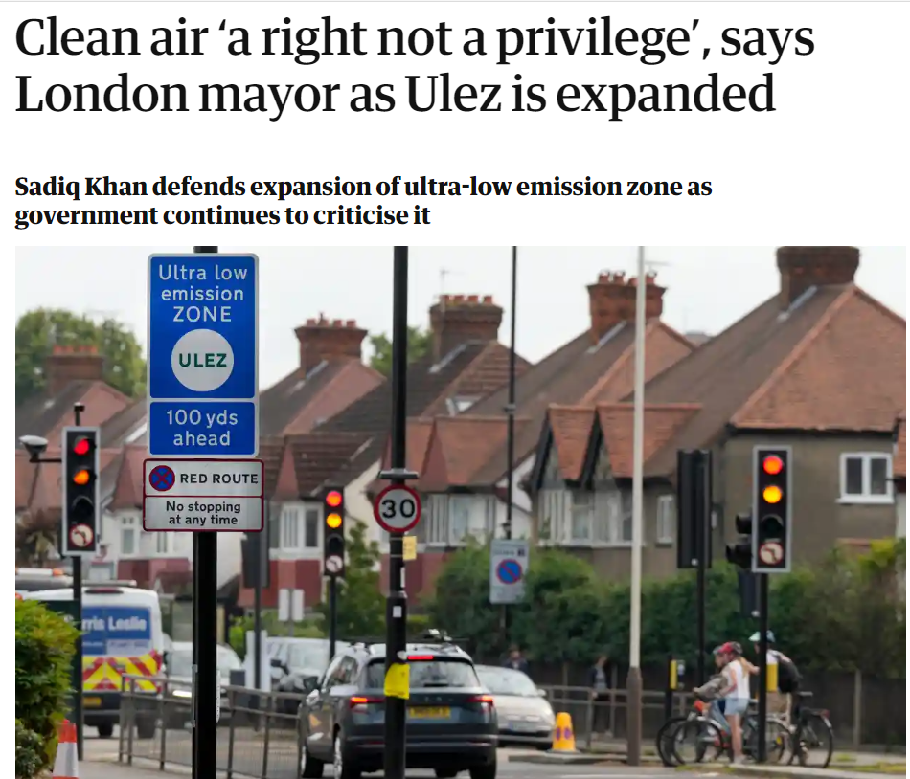
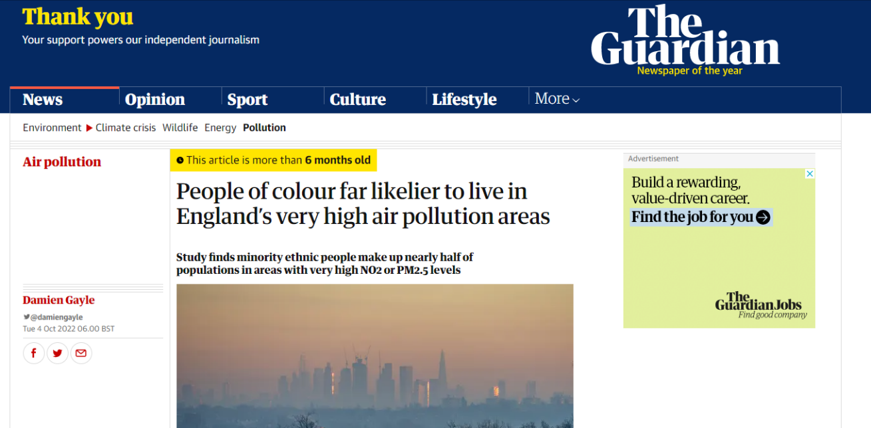
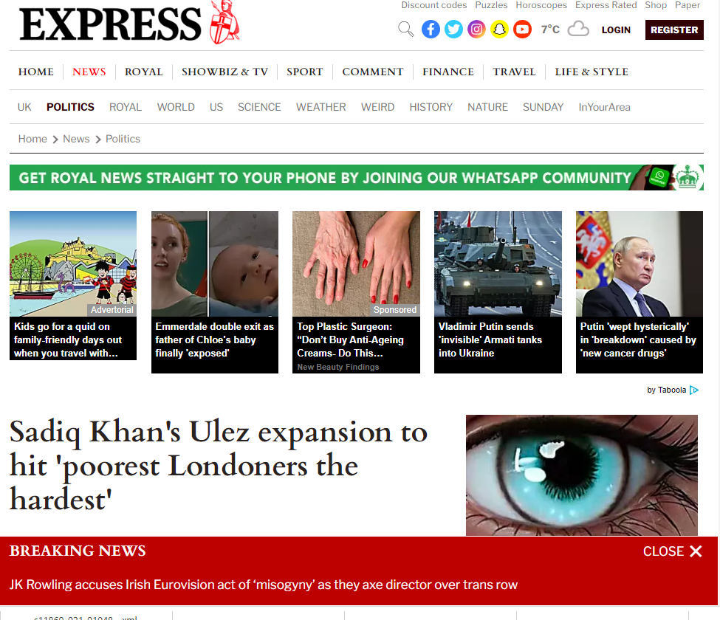
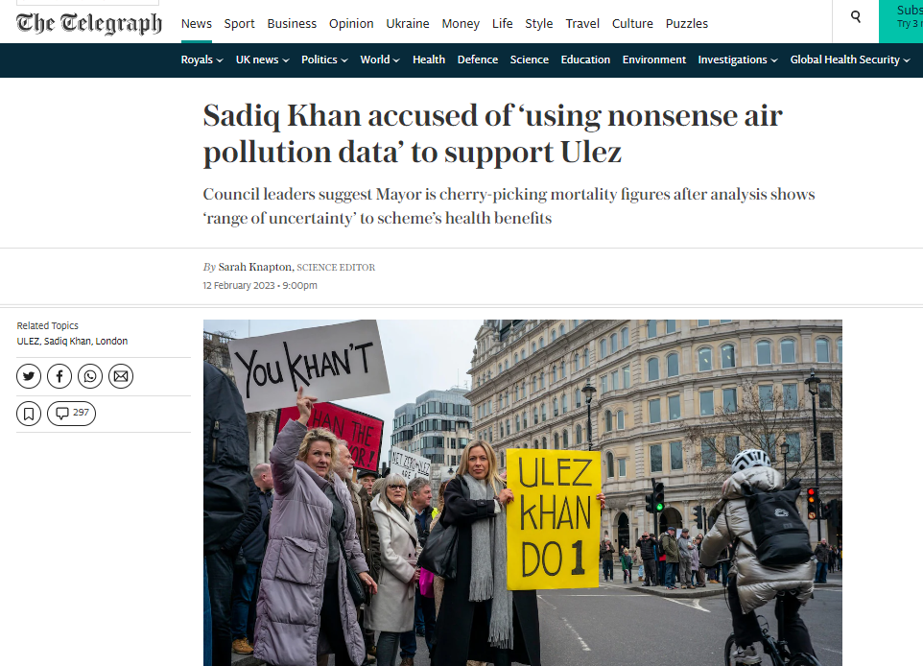
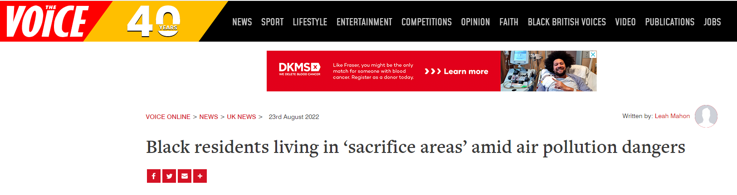
(Gary Fuller)
Notes:
Air quality is very much in the news in the UK these days and has become a contentious subject particularly around the issue of inequalities, as politicians work to address these sources such as road traffic.

Slide 15
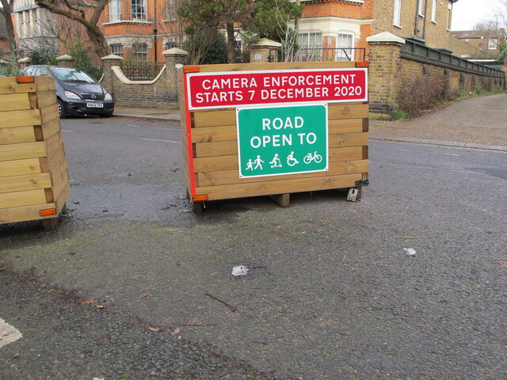
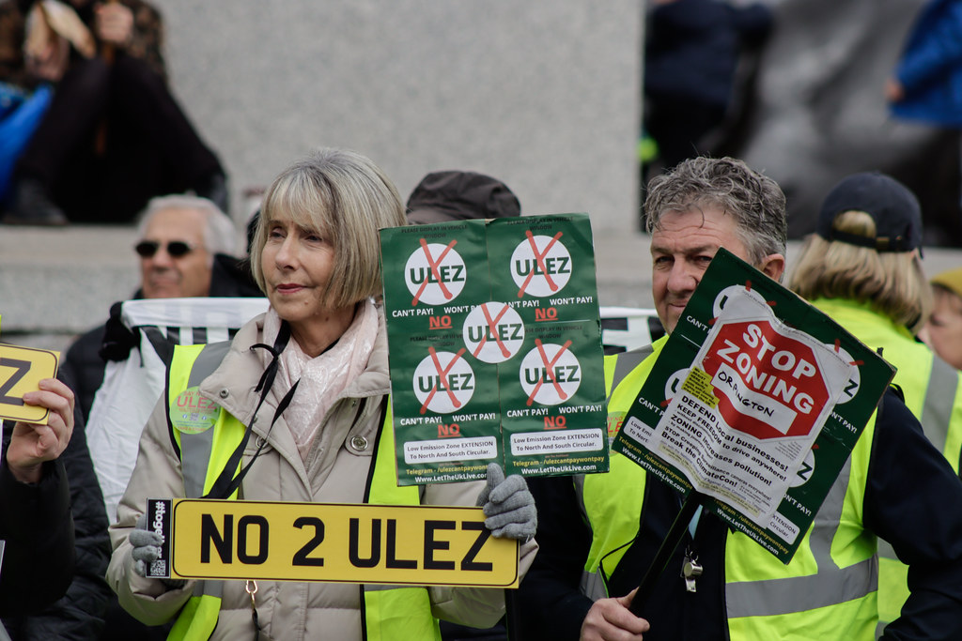
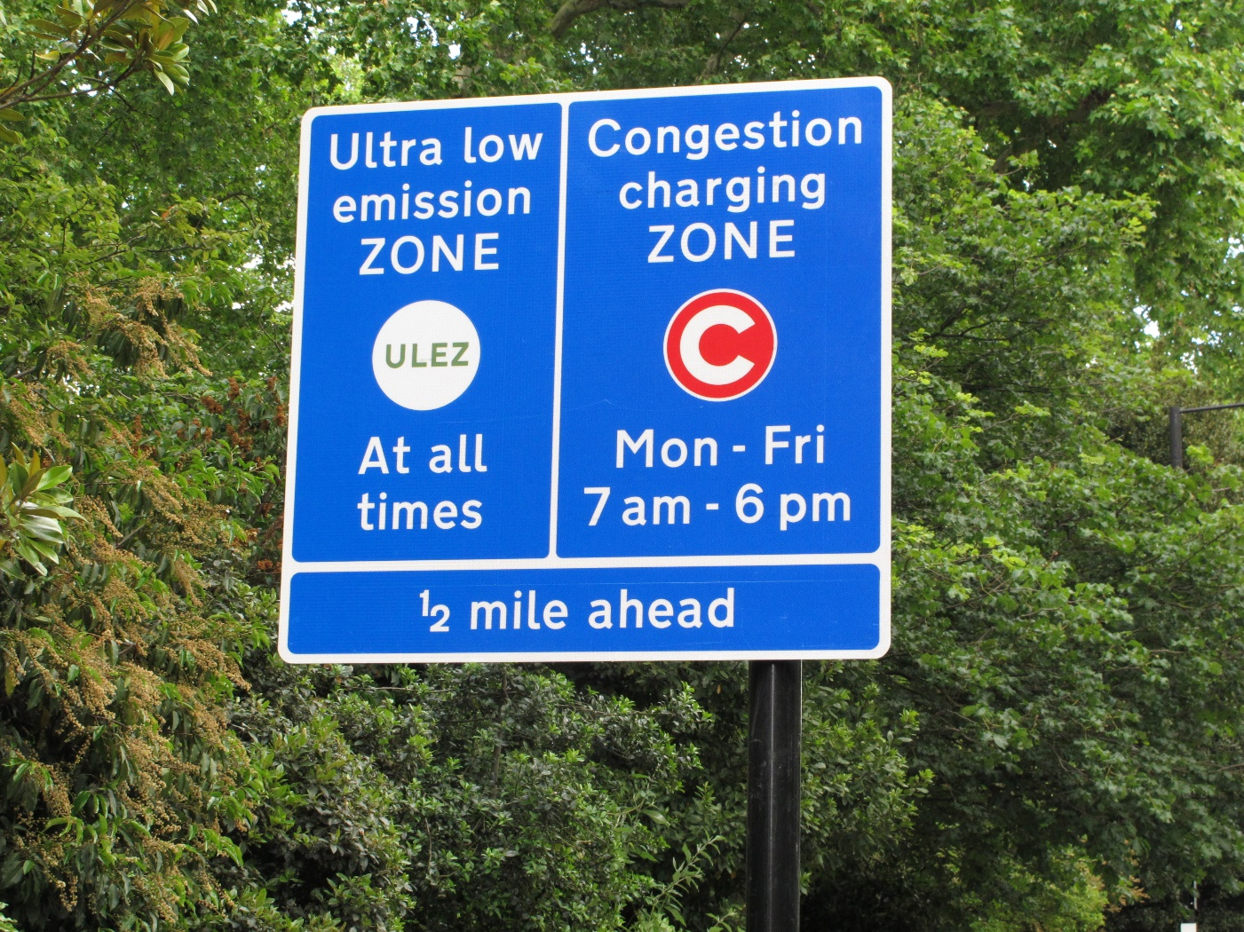
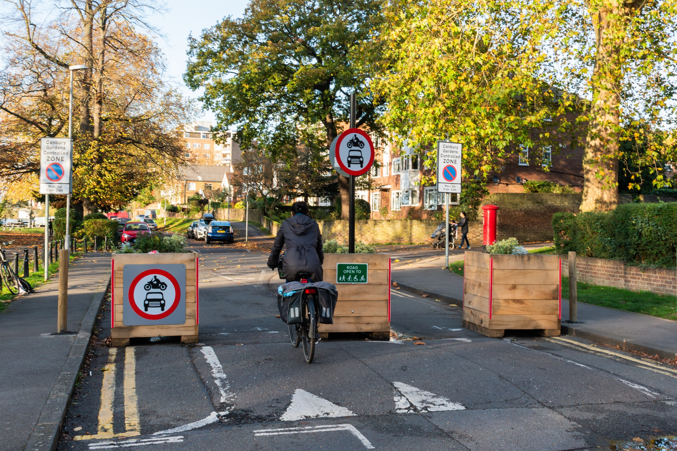
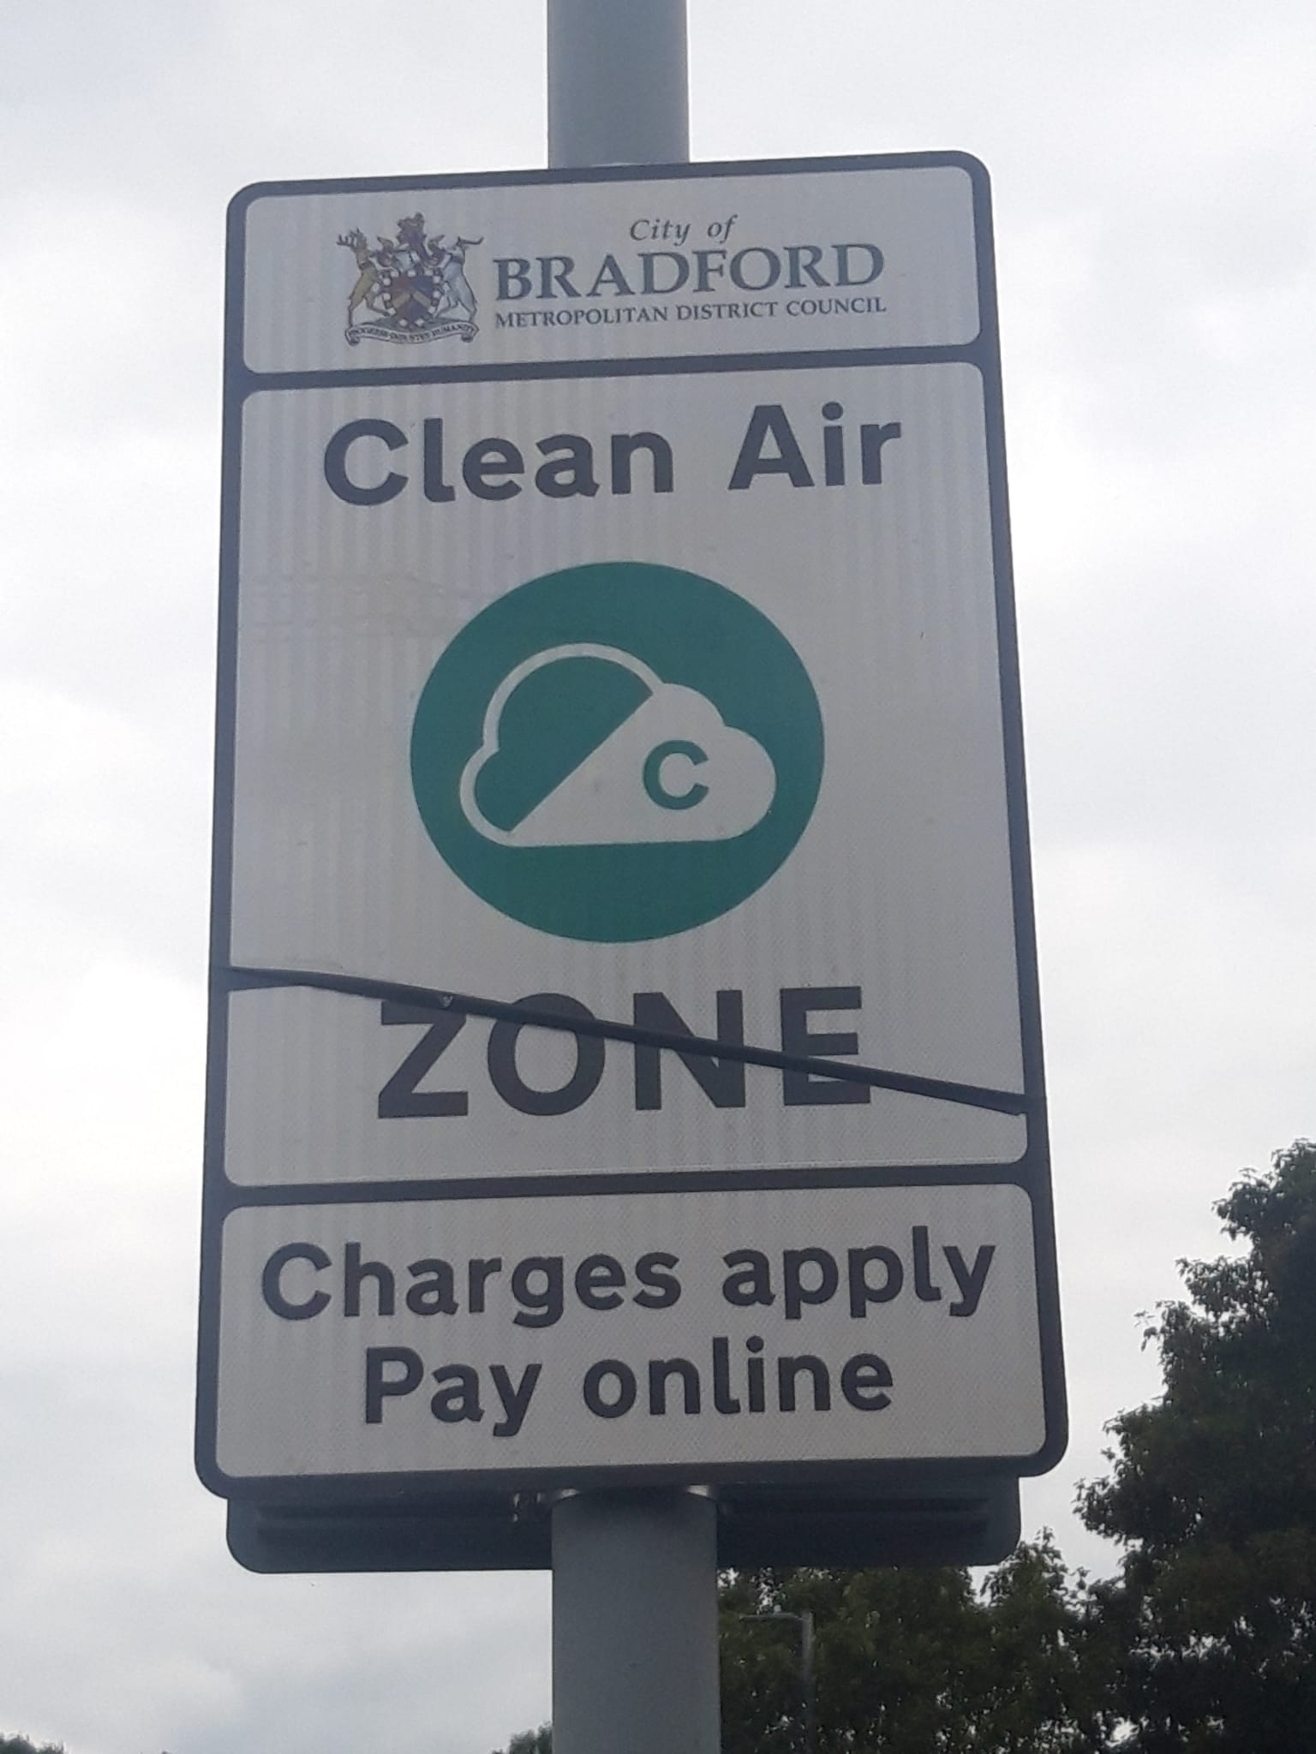
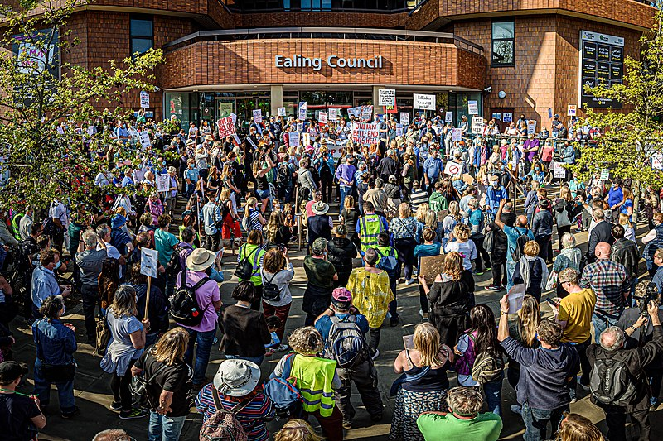
Notes:
However, public concern about restrictions on vehicle ownership and use, and the cost of replacing older vehicles, has become politicised with the expansion of the London Ultra Low Emission Zone, the development of Clean Air Zones in cities outside of London, and the introduction on Low Traffic Neighbourhoods in residential areas which were brought in during the Covid lockdowns to facilitate walking and cycling but with little public consultation, highlighting procedural and potentially policy justice issues.

Slide 16
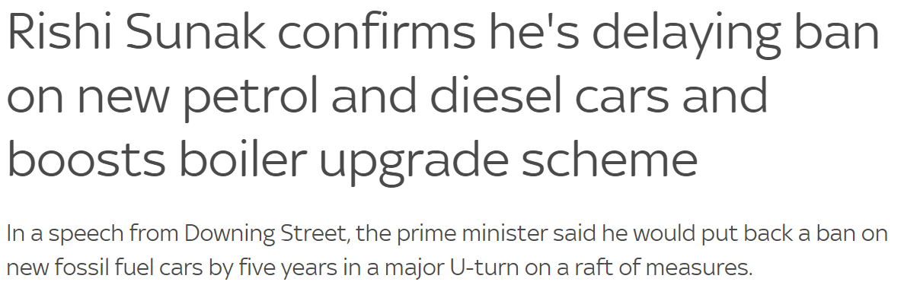
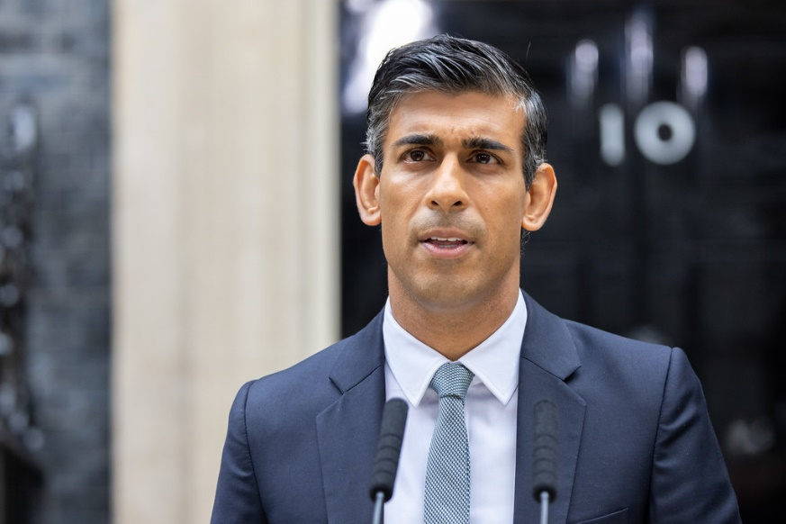
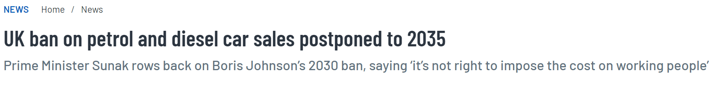
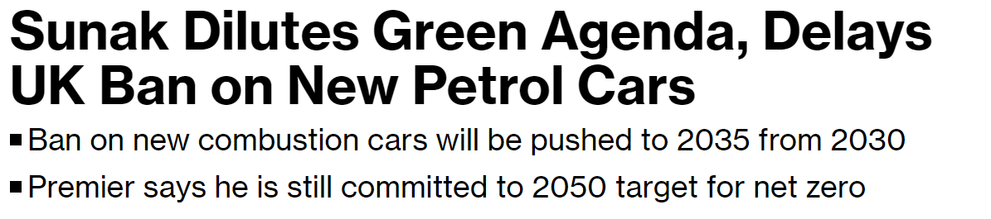
https://live.staticflickr.com/65535/52453487910_614eb21345_b.jpg
Notes:
Recently the government have announced a delay to policy intended to meet net zero targets for CO2 and improve air quality, citing the financial cost that a 2030 ban on the sale of petrol and diesel vehicles would have on poorest households.

Slide 17
Limitation of Choice
Employment
Work from home/travel times / Certain roles more exposed
Housing
Location / Ability to modify (e.g. rental)
Fuel-poverty
Home heating fuel and timing / Poor ventilation to reduce heat loss
Travel
Transport options / Vehicle upgrades
Schools
Choice of school location and travel
Access to green space
Limited respite from pollution
Notes:
Inequalities do exist in people’s ability to respond to air quality policies. Through a series of themed workshops led by the Environment Agency with advice from academics including myself, we engaged with communities and community representatives to better understand their lived experiences which determine their exposure to air pollution but also to their (in)ability to adjust their behaviours to reduce that exposure. Lack of choice over where people live, work and go to school, how and when they travel and how and whether they heat or ventilate their homes can all restrict their ability to avoid air pollution.

Slide 18
Local Authority avenues to address Air Quality Disparities
Community participation
Involve residents in AQ decision-making process
Planning
Protect vulnerable groups and reduce hotspots
Transport planning
Housing departments
Improve rentals / advise landlords/tenants
Open / Green space
Accessible public open and natural spaces
Pollution control and environmental protection
Careful siting of polluting industries
Sustainable transport for all
Notes:
The outcome from the lived experience workshops has subsequently fed into the 2022 update to local air quality policy guidance which now includes a chapter on Air Quality Disparities. This provides advice for local authorities on how to reduce inequalities in exposure to air pollution, including understanding communities’ experiences and needs, using planning and transport planning policies and working across sectors.

Slide 19

So, what do we need to know?
Sub-areal analysis of AQ inequalities
Other sources, pollutants and locations
Trends – temporal and spatial
Contributing factors
Policy analysis – systemic drivers
Effective engagement strategies
Notes:
Although not a comprehensive overview, the studies presented here have illustrated some of our current understanding of air quality inequalities in the UK. However, there are still significant gaps in our knowledge.
Whilst evidence to date has focused on areal analysis, there is a need to explore whether exposure disparities occur more locally, i.e. whether the effect is real or an artefact of the analysis.
We have also tended to focus on road traffic sources and pollutants (NO2 and PM), but there may also be other sources and pollutants that are causing distributive justice issues that need investigating, including in indoor environments.
We also need to update evidence using the latest national census data to determine whether exposure disparities are changing over time and if there are regional or local variations in these trends.
If sub-areal inequalities are found to exist we will need to explore what are the factors that lead to these inequalities and to any trends in inequalities. Are there systemic drivers and can changes to government policy help to reduce them?
As we develop a fuller understanding of the issues then we need to consider how to effectively engage politicians and the public to communicate that understanding to facilitate strategies to address them that will ensure longer-term procedural and policy justice.
The Air Quality Expert Group, which informs Defra, the national government department tasked with improving air quality, is about to undertake an exploration of UK air quality inequalities which I will co-lead. It is hoped that the resulting report will have resonance for other departments too, in reducing health disparities, in the “just transition” to net zero and in “levelling up” regional economies.

Slide 20


Slide 21
UWE Postgraduate programmes
Environmental Health - MSc/Postgraduate Diploma - UWE Bristol: Courses
Environmental Consultancy - MSc - UWE Bristol: Courses
Environmental Management - MSc - UWE Bristol: Courses
Sustainable Development in Practice - MSc - UWE Bristol: Courses

Slide 22
Thanks for your attention
– Any questions? jo.barnes@uwe.ac.uk linkedin.com/in/jo-barnes-561299a/

