Slide 1





















Constructions of young children’s participative rights across Initial Teacher Education in Wales
Presenting: Dr Jennie Clement and Dr Jacky Tyrie
Dr Sarah Chicken, Dr Jane Waters-Davies,
Dr Alison Murphy and Professor Jane Williams

Slide 2


Today
Our wider project
Young children’s participative rights (YCPR) across Initial Teacher Education (ITE) in Wales
Moving forward & Creating networks

Slide 3

About this Research
UK Research Association – Economic and Social Research Council (ESRC) funded 3-year project.
Across four UK universities with a focus on young children’s participation rights in the lower primary setting.
Goal - to uncover ways to integrate participatory rights into everyday teaching and learning activities … to create classroom environments where children's voices are not only valued but actively integrated into the teaching and learning processes.
How - explore and examine pedagogic practices that embed participatory rights while consistently attending to young children's voices and agency.
Partnerships, collaboration and network building are essential!

Slide 4

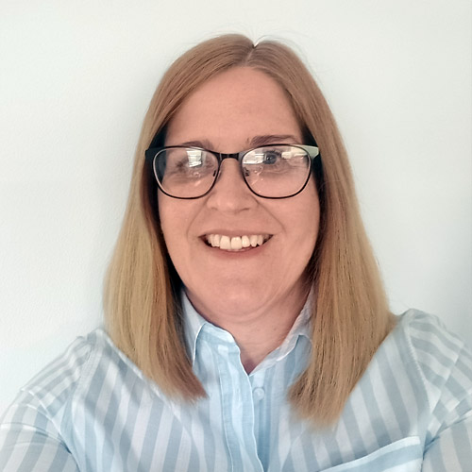

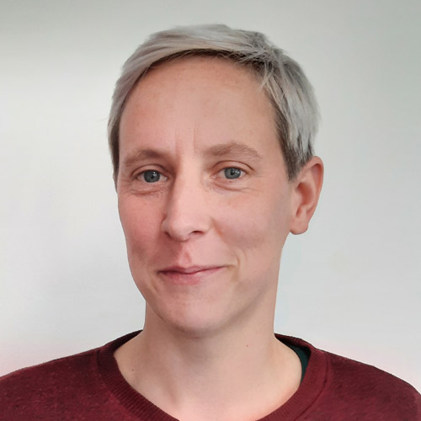

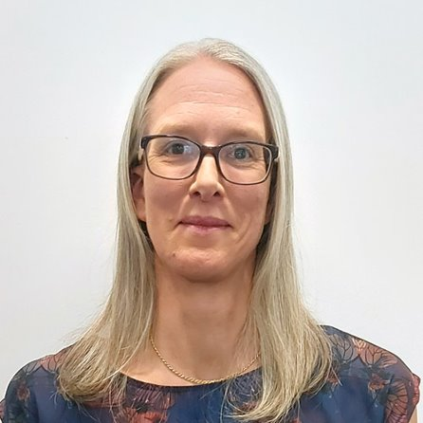



Meet The Team
Dr Sarah Chicken
Principal Investigator
Associate Professor in Childhood and Education at University of the West of England.
WP2 LEAD
Dr Alison Murphy
Co-Investigator, Lecturer in the Athrofa: Institute of Education, University of Wales Trinity Saint David.
WP1 LEAD
Debi Keyte-Hartland
Pedagogista – artist consultant, working across WP 2 and 3
Dr Jacky Tyrie
Co-Investigator, Senior Lecturer at Swansea University.
WP4 LEAD
Dr Jennie Clement Co-Investigator, Senior Lecturer ITE at Cardiff Metropolitan University.
Louisa Roberts
Research Associate, University of the West of England
Dr Jane Waters-Davies
Co-Investigator, Associate Professor in Early Education at University of Wales Trinity Saint David.
WP3 LEAD
Professor Jane Williams
Co-Investigator, Professor of Law at Swansea University.
Georgia Fee
Research Assistant, University of the West of England.

Slide 5
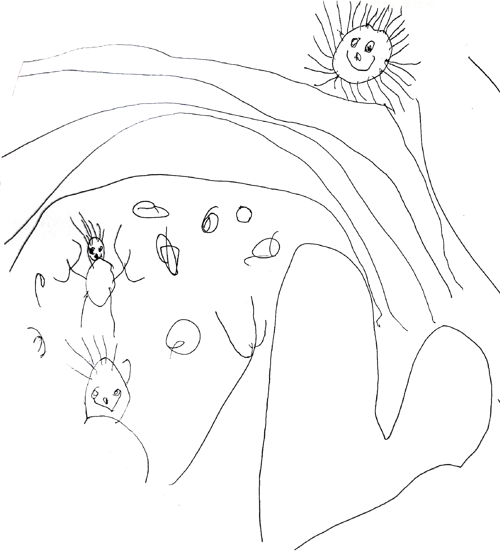
Project Background – why?
There is a gap between policy ambition and policy enactment in relation to young children’s participatory rights in schools.
Children’s participative rights are set out in Article 12 (and also included in Articles 13-17) of the UNCRC which requires governments to assure children the right to express their views freely in all matters related to and affecting the children.
There has been little research around embedding in practice children’s participative rights within ECEC settings.
Our context: Welsh Government has a strong commitment to children’s participative rights (UNCRC, Rights of Children and Young Persons (Wales) Measure (2011)).

Slide 6
Research Questions
The project aims and objectives translate into five research questions.
How does the distinct Welsh policy context position teachers in relation to young children’s participative rights in primary schools in Wales?
To what extent do programmes of professional learning, including Initial Teacher Education (ITE), support the WG vision/rhetoric for pedagogic practice that embeds young children's participative rights?
How are young children's participative rights in Welsh primary schools understood and experienced by young children themselves?
How do primary teachers in Wales conceptualise and support young children’s participative rights and what are perceived enablers and barriers to practice?
How can findings from this work be drawn together to understand the process by which pedagogies can be transformed in order to embed participative rights?
Today we shall be focusing on data related to Research Question 2

Slide 7
Project Elements – work packages
WP 1: Scoping out the landscape (RQs 1 & 2)
WP 2: Using Reggio-inspired pedagogy to explore participative rights
(RQs 3, 4 and 5)
WP 3: Embedding Participative Rights in Practice (RQ’s 2, 4 and 5)
WP 4: Impact and dissemination

Slide 8
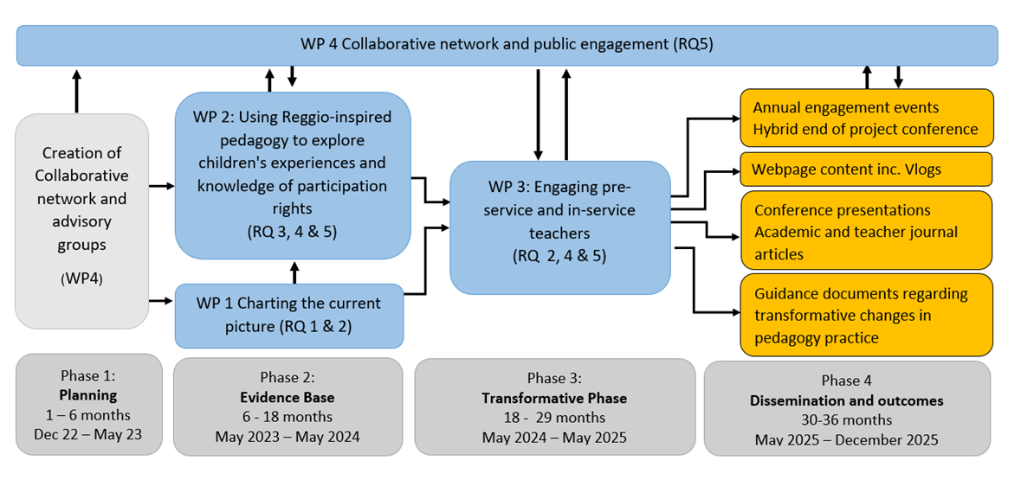

Slide 9
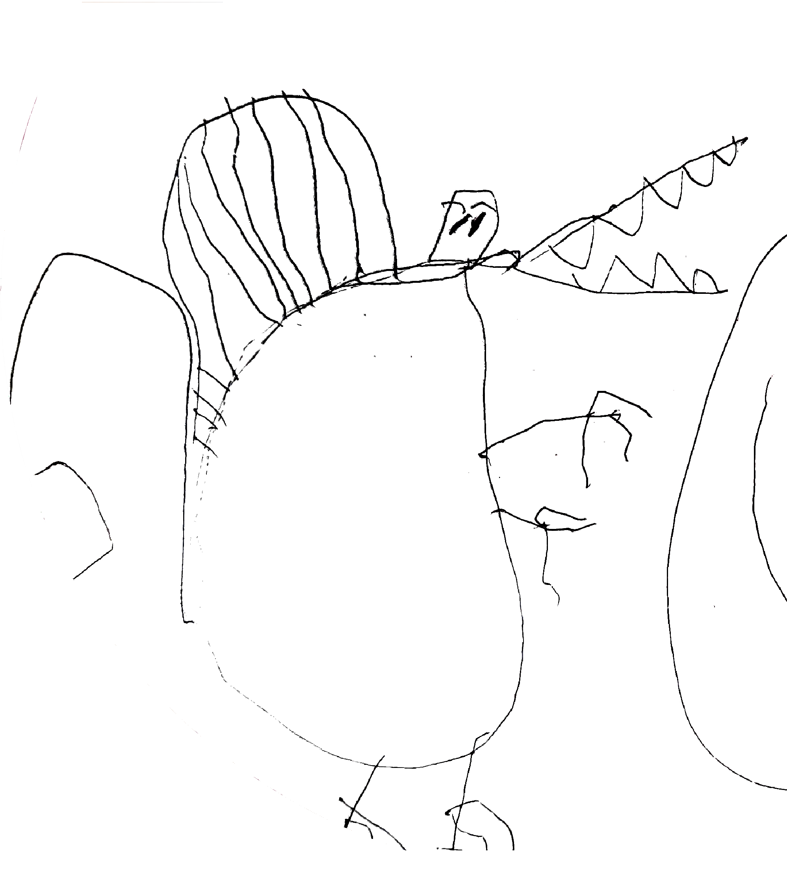
WP1 : Scoping out the landscape (RQs 1 & 2)
A critical policy analysis of Welsh legislation and educational policy documents relevant to children's participative rights in school.
Audit of professional learning opportunities related to children's participative rights.
  Initial Teacher Educator (ITE) questionnaire will gather data about where children’s participative rights sit in their programme and how pedagogic practices that reflect these rights develop.
Notes:
How does the distinct Welsh policy context position teachers in relation to young children’s participative rights in primary schools in Wales?
To what extent do programmes of professional learning, including Initial Teacher Education (ITE), support the WG vision/rhetoric for pedagogic practice that embeds young children's participative rights?
a survey administered to the seven HEI-School partnerships that provide ITE in Wales, and;​ accredited and non-accredited routes available from HEIs, local Authorities (LA), regional consortia (RC), private providers and non-governmental organisations (NGOs)​.

Slide 10
WP2: Using Reggio-inspired pedagogy to explore participative rights (RQs 3,4 &5)
Seven settings across Wales (2 staff in each):
  6 sessions of professional learning, facilitated by artist-researcher to develop teacher understanding of a Reggio Emilian
  Four collaborative workshops to facilitate the creation of RE inspired project with children in their classroom
Data Gathering
  project artefacts
  Teachers interviews before and after (reflective journals)
  Focus group of small group of children at each school
Notes:
One settings in each of the 7 Higher Education partnerships
Six sessions of professional learning, facilitated by artist-researcher to develop teacher understanding of a Reggio Emilian (RE) participatory approach
Four collaborative workshops to facilitate the creation of RE inspired project with children in their classroom
Each class project will create artefacts that reflect children’s experience and knowledge of their participation
Teachers interviewed before and after process, reflective journals
Focus group of six children at each school to reflect on their perceptions of the process

Slide 11
WP3: Embedding in Practice
(RQ’s 2,4 and 5)
Engaging teacher educators and student teachers in co-production of pedagogic practices that embed young children’s participative rights
Located in one ITE partnership – Yr Athrofa Professional Learning Partnership that provides UG and PG primary ITE programmes.
Taking outcomes from WP2 to explore the professional learning journey of ITE students and teacher educators regarding developing pedagogic practices that embed young children’s participation rights.
  6 semi-structured focus groups with teacher education and students (new participants).
  Teachers from WP2, alongside pedagogista will return to host 3 discursive workshops with 30 ITE students and 10 teacher educators Workshops will unpack findings from the focus groups.
  Outcomes: Participant reflective and reflexive diaries with targeted provocations alongside researcher fieldnotes.

Slide 12
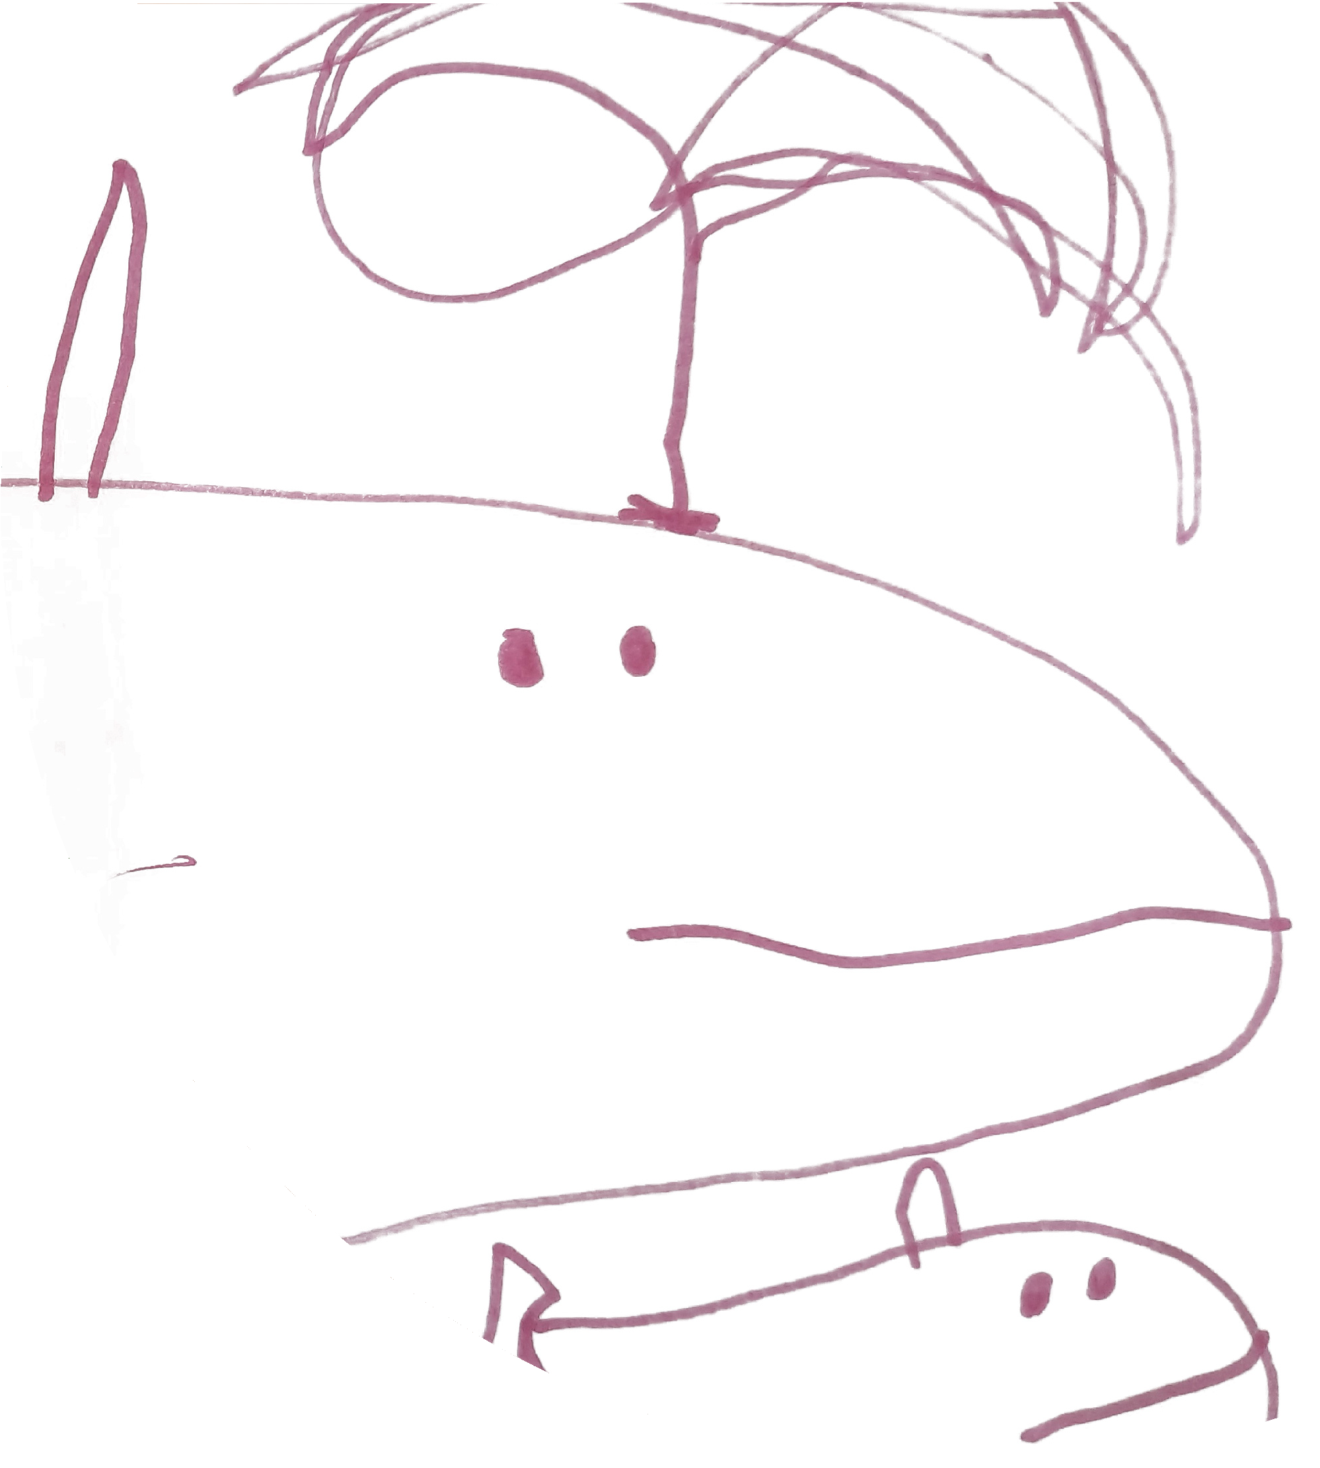
WP4: Impact and dissemination
Four elements involved:​
  Advisory Groups – Child advisory group and a professionals advisory group (e.g., academics, policy makers, ITE providers). These groups will advise the direction of the project and methodology.
  Collaborative Network – formed of any interested individuals who will interact through the website and regular online sessions​.
  Public Engagement – conferences and publications​.
  Resources – at a minimum of every 3 months during the project the RT will produce and disseminate a vlog – will explore methodological considerations and will invite others to engage and respond.
Notes:
Four elements involved:​
Advisory Groups – Child advisory group (made up of interested children from WP2) and a professionals AG (e.g., academics, policy makers, ITE providers). These groups will advise the direction of the project and methodology and meet online twice per year. ​
Collaborative Network – formed of any interested individuals who will interact through the website and regular online sessions​.
Public Engagement – conferences and publications​.
Resources – at a minimum of every 3 months during the project the RT will produce and disseminate a vlog – will explore methodological considerations and will invite others to engage and respond.

Slide 13

WP1: Research Question Two
RQ: To what extent do programmes of professional learning, including Initial Teacher Education (ITE), support the WG vision/rhetoric for pedagogic practice that embeds young children's participative rights?
Notes:
Ok, so back to Work Package one – and research question two.
To what extent do programmes of professional learning, including initial teacher education support the WG vision, rhetoric for pedagogic practice that embeds young children’s participative rights?
And thinking about why we are asking this question – it is because initial teacher education can be seen as ONE OF THE BRIDGES between WG rhetoric/vision and the practice in the classroom.
So we want to initially consider – are there bridges being built? What kinds of bridges are they?

Slide 14
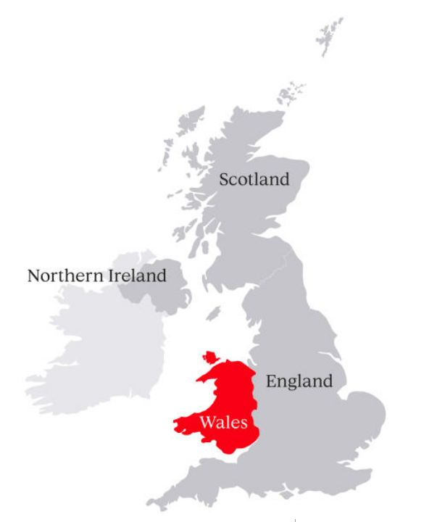
ITE in Wales
Bangor University
University of Wales Trinity Saint David
Cardiff Metropolitan University
Aberystwyth University
Swansea University
University of South Wales
The Open University
Notes:
To give a little context about Initial teacher education first …. We have devolved powers in Wales to provide education – the curriculum, assessment - it is only applicable within Wales.
There are 7 universities that provide Initial Teacher education – but each of these institutions form a partnership to provide initial teacher education with partnership / local schools, the local education authority and regional consortia – which are our school improvement advisors. The programmes, that we will look at today, have been co-designed (to varying degrees) with all partners.
So these seven institutions, alongside their partners, provide initial teacher education across Wales.

Slide 15
ITE in Wales
Bangor University (PG / UG)
University of Wales Trinity Saint David (PG / UG)
Cardiff Metropolitan University (PG / UG)
Aberystwyth University (PG)
Swansea University (PG)
University of South Wales (PG / UG)
The Open University (PG)
Notes:
Each of the university partnerships offer their own programmes and these can be either postgraduate certificates of education – which last one year (and students must have an undergraduate degree to be able to study) or an undergraduate programme that is a 3 year Bachalor of arts that also gives students Qualified teacher status at the end of their study.
SoITE partnerships offer a 3 year undergraduate programme or a post graduate one year programme or they offer both.
So across Wales students have a choice of 7 post graduate programmes and 4 undergraduate programmes.

Slide 16
Methods & Analysis
Methods: A survey administered to the seven HEIs that provide ITE in Wales
Analysis: Deductive content analysis (Elo & Kyngas, 2008) 3 models of Human Rights Education (Values and Awareness, Accountability model and Transformation) (Tibbetts, 2017)
Notes:
So, to find out how ITE programmes across Wales are supporting the WG rhetoric we administered a survey to the 7 HEIs.
And we adopted a deductive content analysis, using features of Tibbetts, 3 models of HRE to code the data. More of this in a little bit.

Slide 17
The survey . . .
Programme title:
Number of current students:
Aims/learning objectives related to YCPR programme validation documents:
Modules within which YCPR are covered:
Support:
Notes:
Within the survey we asked respondants for the ….
Programme title:
Number of current students:
Aims/learning objectives related to YCPR programme validation documents:
Modules within which YCPR are covered: (aims, learning objectives, content, hours dedicated, pedagogic practices that support YCPR, assessments, practice/school-based assessments).
Support:

Slide 18
HEI Survey Responses
7 separate programme responses across 7 HEIs
    3 postgraduate courses (PGCE)
    4 undergraduate courses (BA)
21 modules across 7 programmes
Programmes noted between 21-316 students each (2022-2023) reflecting 1301 student teachers.

Slide 19
Aims and Learning objectives across programmes
Aims/learning objectives across the 7 programme validation documents that relate to YCPR:
6 programmes: No specific aims or learning objectives
I programme: Aims included - “recognising the needs
and rights of all pupils”
Notes:
Respondents were asked to provide any aims or learning objectives in programme validation documents relating to children’s participative rights. Of eight responses, one respondent highlighted ‘recognising the needs and rights of all pupils’ from their programme validation documents.

Slide 20
Aims and Learning objectives across modules
Aims/learning objectives across 21 modules that relate to YCPR:
15 modules: No specific aims or learning objectives
6 modules: ‘develop skills of listening to learners and valuing pupil voice’
‘the use of learner voice’
‘appreciate and accommodate the role of the learner’s voice in the
development of effective learning and teaching’
‘consider the voice of the teacher and the learner in relation to
co-shaping school experiences and curricular experiences’
Notes:
0f the 21 modules put forward by the respondents as including YCPRs ¾ of them didn’t have any specific aims or objectives the 6 modules that did contain aims and objectives stated
The development of skills – listening to learners and valuing pupil voice …
Use of pupil voice
…..
We also realise that not all modular content covered as part of the module is contained within the stated aims and objectives so we also asked respondents to give details of content that wasn’t directly stated.

Slide 21
Content covered across modules
“understand the key principles of the United Nations Convention on the Rights of the Child”
“explore learning theories and learner rights in the context of Four Purposes of Curriculum for Wales”
“gain an understanding of current legislation, including ... children’s rights”
“global curriculum models/ approaches such as Reggio Emilia where the voices of young children are considered”
“design a research project that ensures that the voices of young children are respected and listened to in their research”
Notes:
and all 21 modules contained additional information that looked at aspects of young children’s participatory rights.
There was a mixture of content – understanding principles, legislation, models, practices….
However, it is important to remember that this content is something that is NOT required – it is not stated in the stated aims and objectives, but is additional content.

Slide 22
Analysis: Deductive content analysis (Elo & Kyngas, 2008)
3 models of Human Rights Education (Tibbett 2002, 2017)
“HRE is ultimately about action for building human rights cultures in our own communities” Tibbett, 2002, p.4
Values and Awareness – affirm existing HR discourse / provide knowledge of HR
*Learner is not encouraged nor empowered to take action to reduce HR violations
Accountability – Linked to professional role / intended to influence knowledge, attitude and actions so that they would promote HR standards in their professional role.
Transformation – transformative learning which can bring about profound change in the individual learner / personal transformation which results in taking action to eliminate HR violations

Slide 23
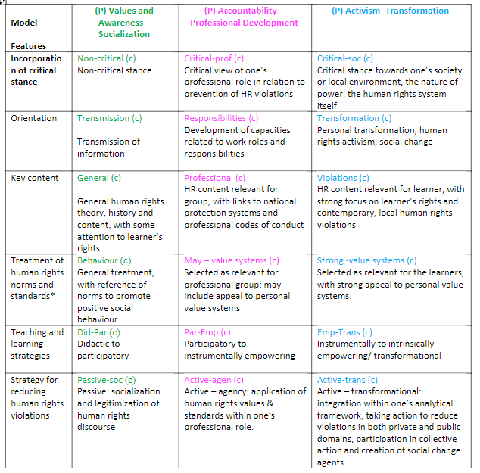
Initial findings: Mapping content across the key features
Explicit module aims and learning outcomes sit within the Accountability Model
Features:
Developing capacities related to work roles and responsibilities
Links to professional codes of conduct / professional standards
‘develop skills of listening to learners and valuing pupil voice’
‘appreciate and accommodate the role of the learner’s voice’
‘consider the voice of the teacher and the learner in relation to co-shaping school experiences and curricular experiences’

Slide 24
Initial findings: Mapping content across the key features
Additonal module content sit across the Values and Awareness and Accountability Models
Features:
Transmission of information
Human rights content – attention to learner’s rights
understand the key principles of the UNCRC
Explore learner rights
Gain understanding of children’s rights legislation
Features:
Developing capacities related to work roles and responsibilities
Links to professional codes of conduct / professional standards
design a research project that ensures that the voices of young children are respected and listened to in their research

Slide 25
ITE – Bridging the gap?
Provision is not consistent across ITE in Wales
Minority of modules contain explicit aims / learning objectives related to YCPR
Content sits across the Values and Awareness and Accountability models

Slide 26
Bridging the Gap: What next for RQ2?
Participants were asked whether and how they would like support in developing this area of practice.
More information on children’s participative rights
Guidance and resources to supplement delivery, curriculum design and implementation
Specific professional learning regarding children’s participatory rights
Guest lectures / resources (to make relevant and currant)
Support related to students developing their critical discourse and reflection skills in the area of learners’ rights
Research champions and mentors within ITE partnerships
Development of assessment criteria that better reflects theory relating to children’s participative rights
Creative solutions to balancing content provision across intensive ITE courses

Slide 27
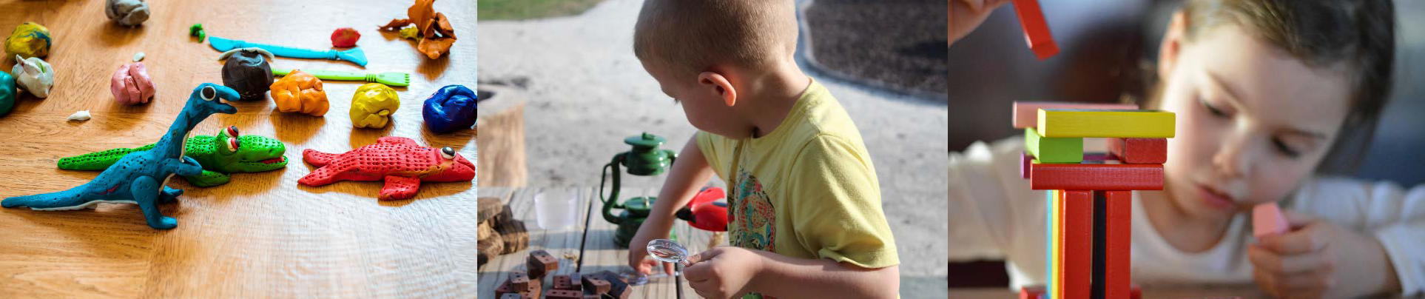
Key opportunities the project brings
Collaborative knowledge building with and between practitioners​
Collaborative working with academics, policy makers and third sector. ​
Improved empirical evidence base for practice – within the 5-7 year age range. ​
Better understanding of policy enactment - the barriers and enablers of this.​
Developing and sustaining networks. ​
The potential to transform teacher pedagogies

Slide 28
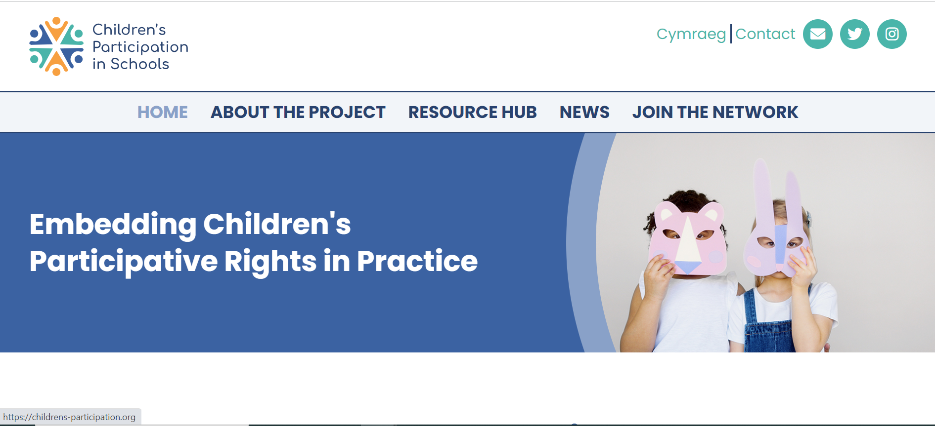



Website and Social Media
  Follow us on Social Media!
@ChildPart
@child.participation
child.participation@uwe.ac.uk
Website you can find out more about all parts of the project.
Resources Centre for all things related to children’s participation in schools
In addition to the resources, the project also has blogs, vlogs, and podcasts about our research.
Latest news and events in the field such as upcoming training sessions, conferences and webinars.
Become a Network Member - receive a monthly newsletter and invitation to our events
Visit our website on: https://childrens-participation.org/

Slide 29
Thank you!
Dr Jennie Clement
Dr Jacky Tyrie on behalf of the Children's Participation in Schools' team
child.participation@uwe.ac.uk
@child.participation
@ChildPart

Slide 30
References
Elo, S. & Kyngas, H. (2008) The qualitative content analysis process (62), pp.107-115
McDowall, J., 2016. Are we listening?: The need to facilitate participation in decision-making by children and young people in out-of-home care. Developing Practice: The Child, Youth and Family Work Journal, (44), pp.77-93.
Rights of Children and Young Persons (Wales) Measure 2011 (nawm 2)
Tibbitts, F. L. (2017) "Revisiting ‘Emerging Models of Human Rights Education’," International Journal of Human Rights
Education, 1(1)
UNICEF, UK., 1989. The United Nations Convention on the Rights of the Child. https://downloads.unicef.org.uk/wp-content/uploads/2010/05/UNCRC_PRESS200910web.pdf?_ga=2.78590034.795419542.1582474737-1972578648.1582474737

