Slide 1
Household water insecurity in a changing climate: The interplay between distance to water, income, caste and gender in rural Rajasthan, India
Mark Everard^{a*}, Thanti Octaviantiª, Kwok Chunª, Nicola Floyd^{b}, Om Prakash Sharma^{c}, Chad Staddonª, Todd Lewisª, Jasmine Blackfordª, Deidre Toherª
ªUniversity of the West of England (UWE), Bristol, UK
^{b}WaterHarvest, Winchester, UK
^{c}WaterHarvest – India Liaison Office, Udaipur, India
Thanti.Octavianti@uwe.ac.uk @thanti_octa
RGS Conference, 31 August 2023

Slide 2
Rajasthan
75% rural
Arid region with 91% rainfall in the monsoon season (July to Sept)
Groundwater as a vital resource
Traditional water structures to harvest episodic rainfall

Slide 3
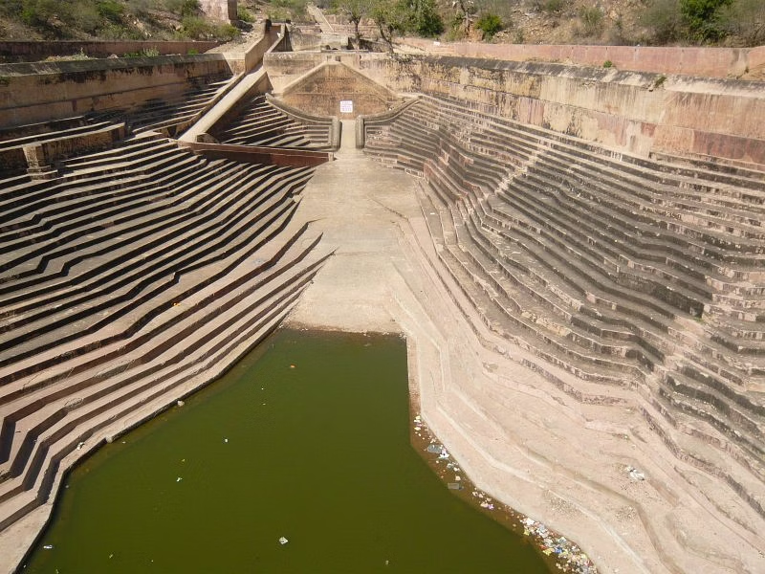
Bavadi

Slide 4
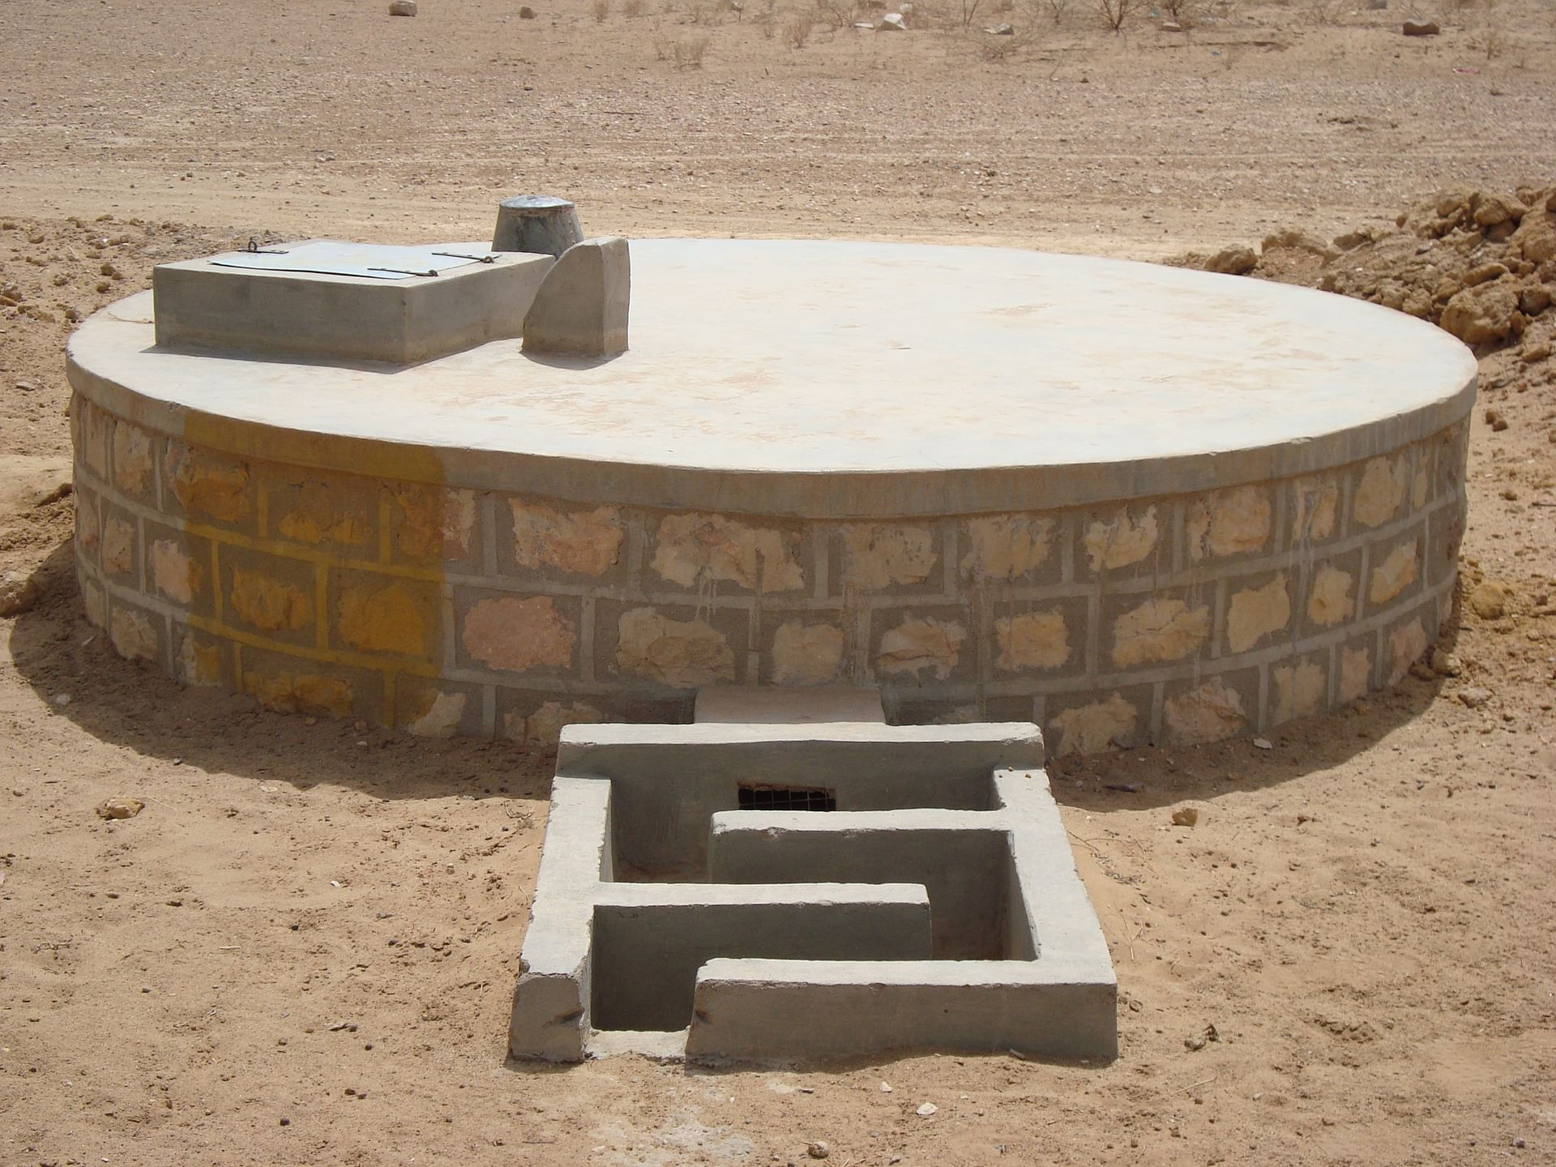
Taanka

Slide 5
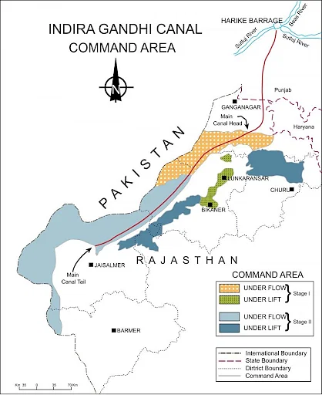
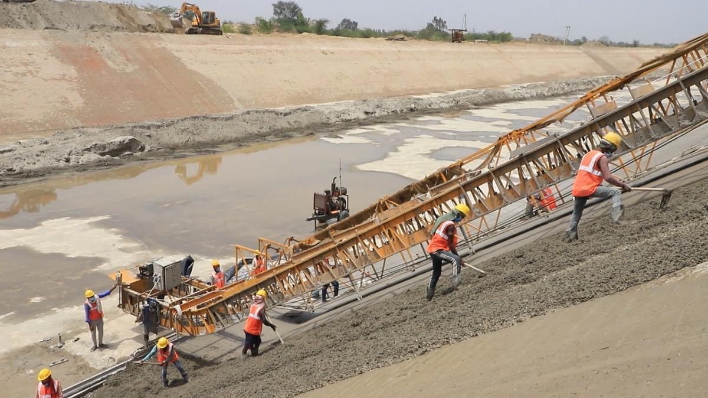
The progressive abandonment and loss of traditional solutions and the indigenous knowledge
“More from further” approach

Slide 6
Arid environment
Climate change
Traditional water structures
“Dying wisdom”
New water practices
Changes (e.g. agriculture, soc-econ)
This study investigates how household water insecurity linked to social structures and physical or economic access to water resources

Slide 7
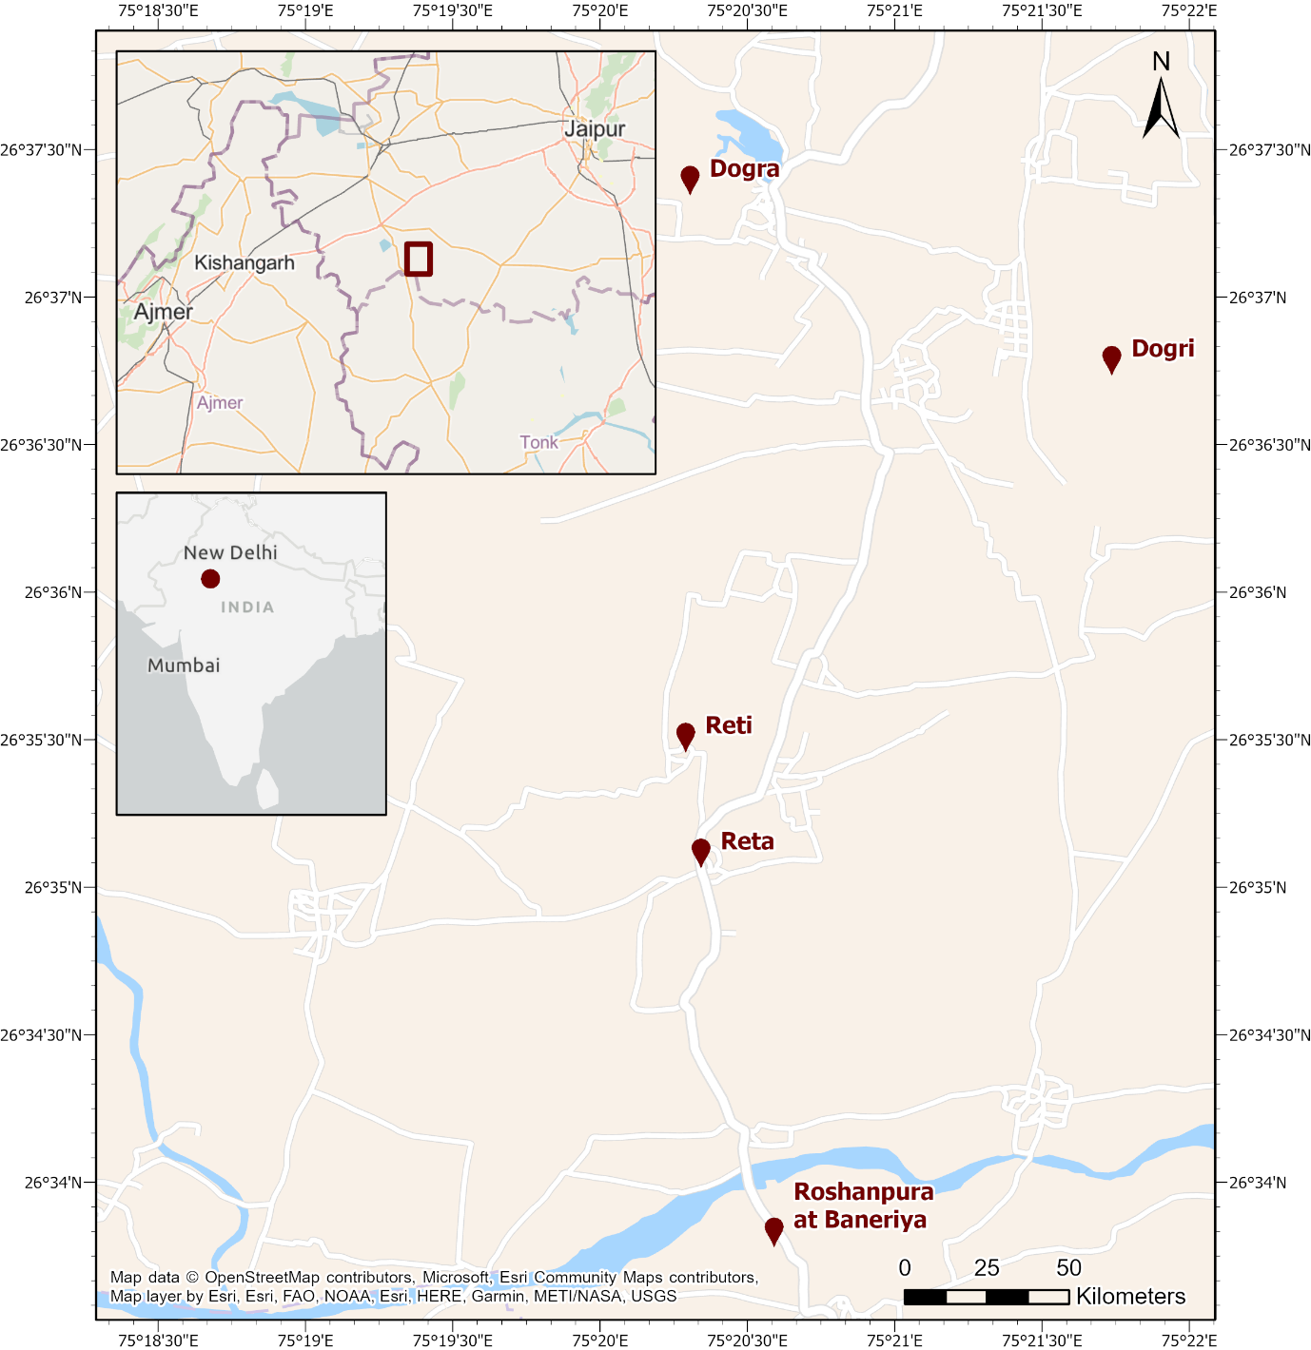
Method
A survey of 565 families in 5 villages (November 2019 - January 2020)
Designed and coordinated by the Rajasthan-based NGO Water Harvest; conducted by local NGO partner Prayas Kendra Sansthan Harsoli
Survey questions: socio-economic conditions & HWISE (Household Water InSecurity Experience)
Location of the study site in the Salt Lake region of Rajasthan state

Slide 8
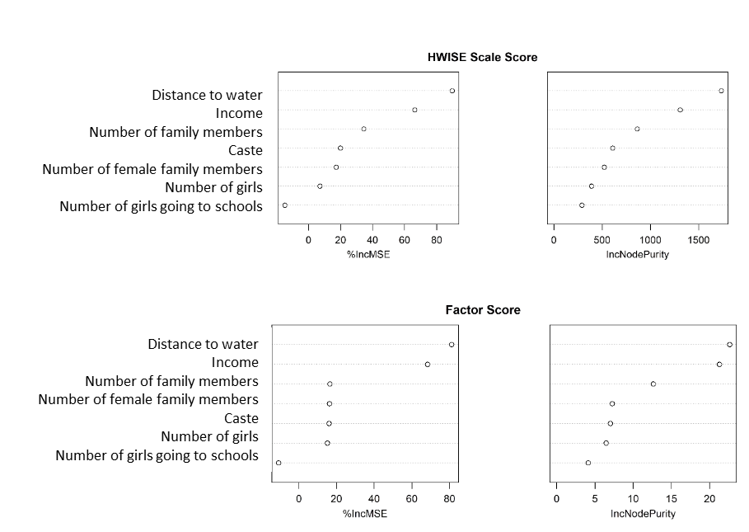
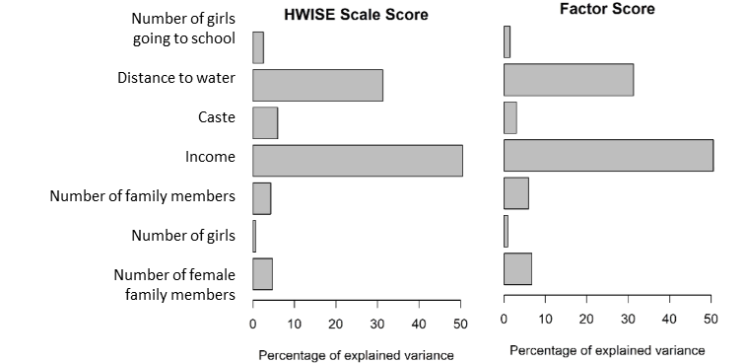
Results
Of all possible factors, which one does drive water security the most?
Relative importance and random forest to explain the driving variables for water security
Relative importance
Random forest

Slide 9
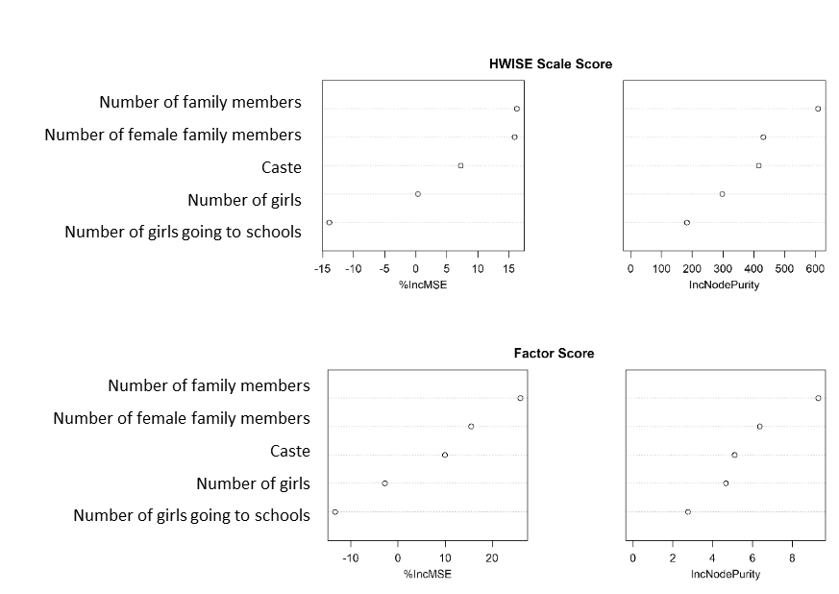
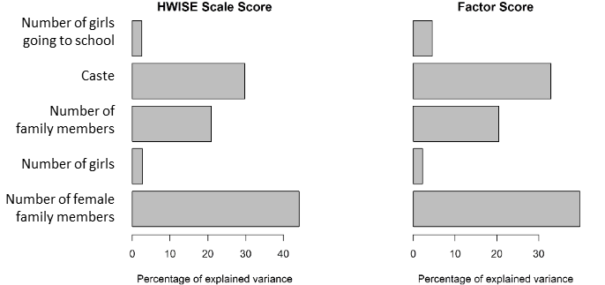
If we remove distance and income…
Relative importance
Random forest
Top four factors (in order of importance):
Household income; Distance to water
Gender (number of female family members)
Caste

Slide 10
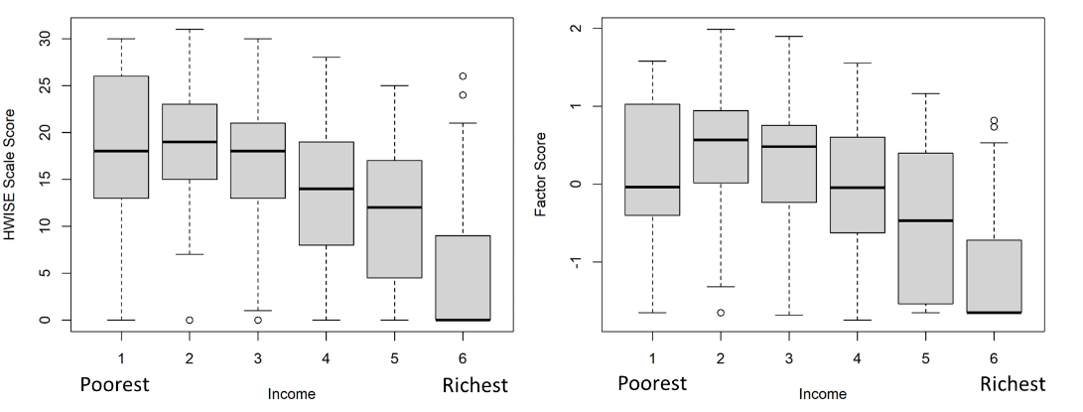
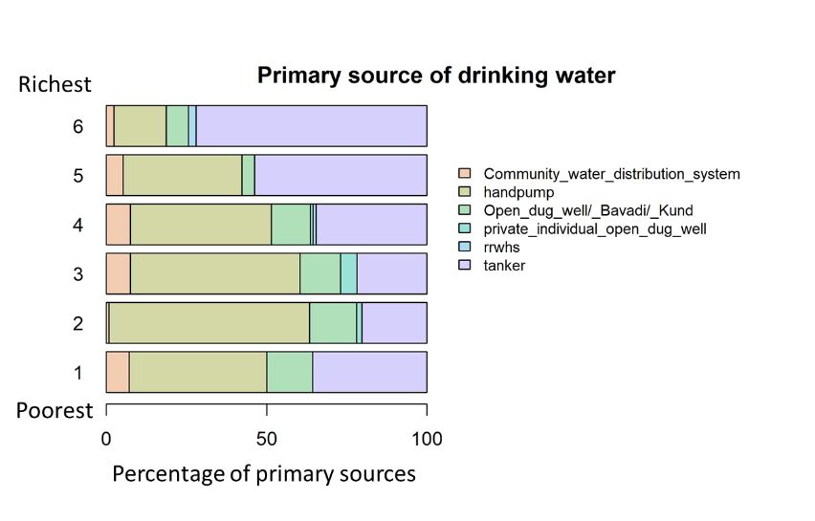
a. Household income
The higher the income, the more water secure a household is

Slide 11
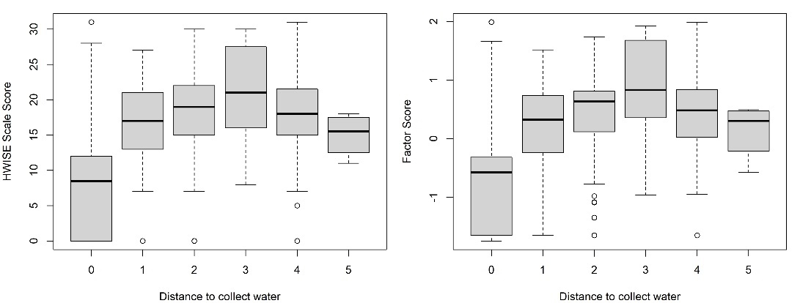
b. Distance to water
The further the distance to water sources, the higher the water insecurity score
Distance to water source and HWISE score
0 = less than 200 m, 1 = 201- 499 m, 2 = 500 – 999 m, 3 = 1 -2 km, 4 = 2.1 – 3 km, 5 = over 3 km

Slide 12
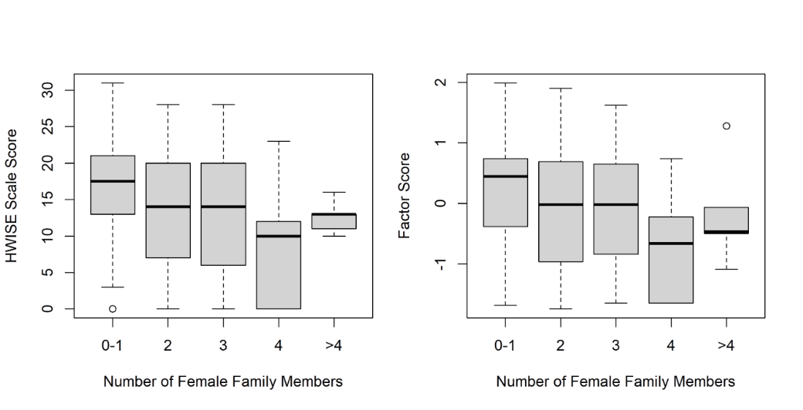
c. Gender
More female members correlates with greater water security

Slide 13
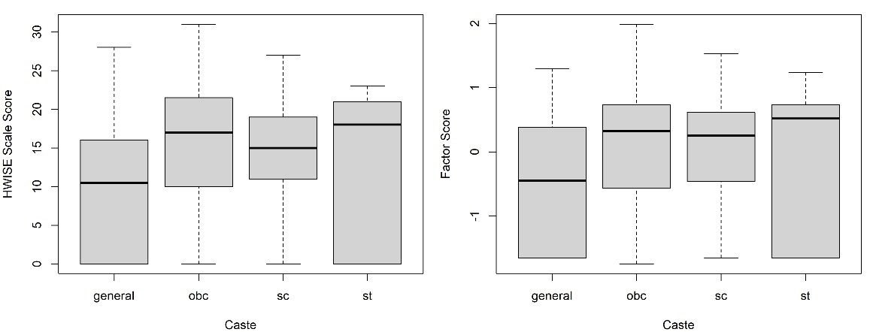
d. Caste
Those in lower caste categories
experience higher water insecurity

Slide 14
Climate change
Past:
An average rise of about 0.5ºC for the month of June and a decrease of annual rainfall of 50 mm in the western drylands of Rajasthan between 1973 and 2008 (Singh and Kumar, 2015)¹
Projection:
A temperature increase of 1% (around 0.42ºC), increasing evapotranspiration demand by 11.7 mm on an annual basis → more drought spells (Goyal and Gaur, 2022)²
Changes in WSDI (Warm Spell Duration Indicator) for period 2011 – 2040 (Sharma et al., 2018)³
¹ Singh and Kuma, 2015, Geoenvironmental Disasters, volume 2, Article number: 7
² Goyal and Gaur, 2022), Hydro-Meteorological Extremes and Disasters (pp. 265-278). Singapore: Springer Nature Singapore.
³ Sharma et al., 2018, Global and Planetary Change, volume 161, p.82-96

Slide 15
Take-away messages
Evidence of the interplay between physical access to water, household economy status and socio-cultural structures
Geography matters!
Implications: providing more water points/decentralisation, reviving traditional water structures, empowering communities
How do water challenges relate to, and/or are shaped by, the socio-political ecology of climate pressures?
Hotter and drier Rajasthan
Decreasing water availability → potentially reduce access to water
Struggling agricultural sector → potentially affect household income
Further implications for caste and gender
Is reviving to traditional water management sufficient? Combining indigenous knowledge and modern science

Slide 17
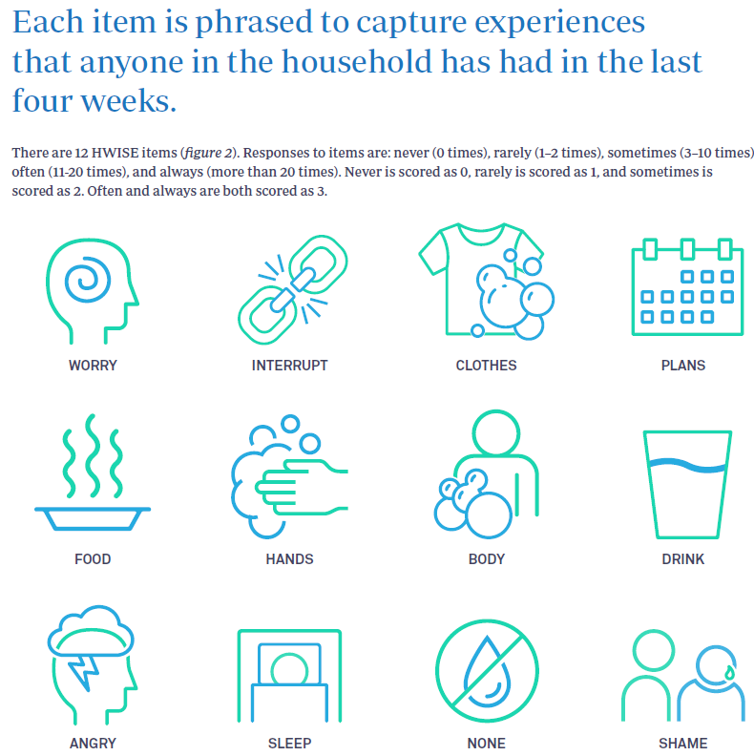
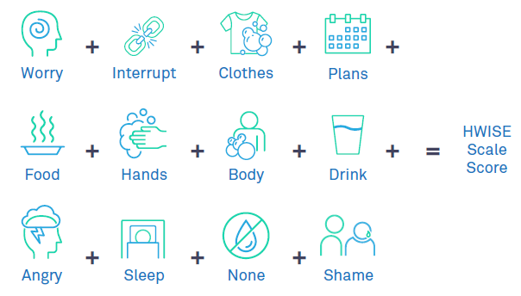

Slide 19
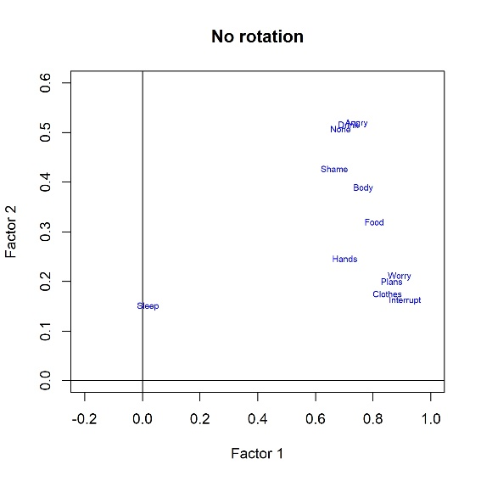
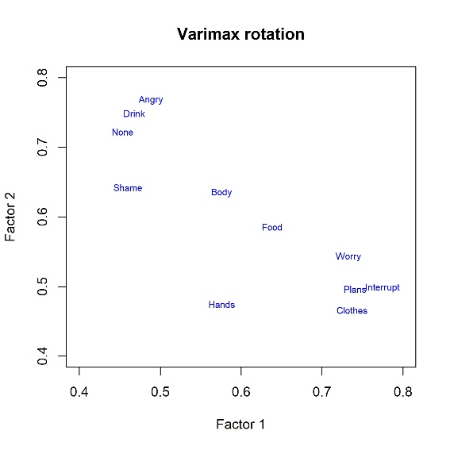
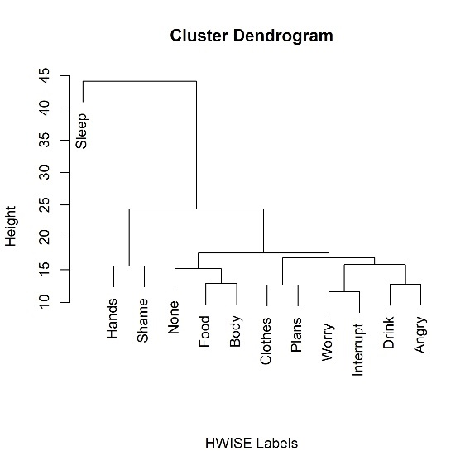
2. Relationship between the HWISE items
Hierarchical cluster analysis to determine how items in the scale related with each other

