Slide 1
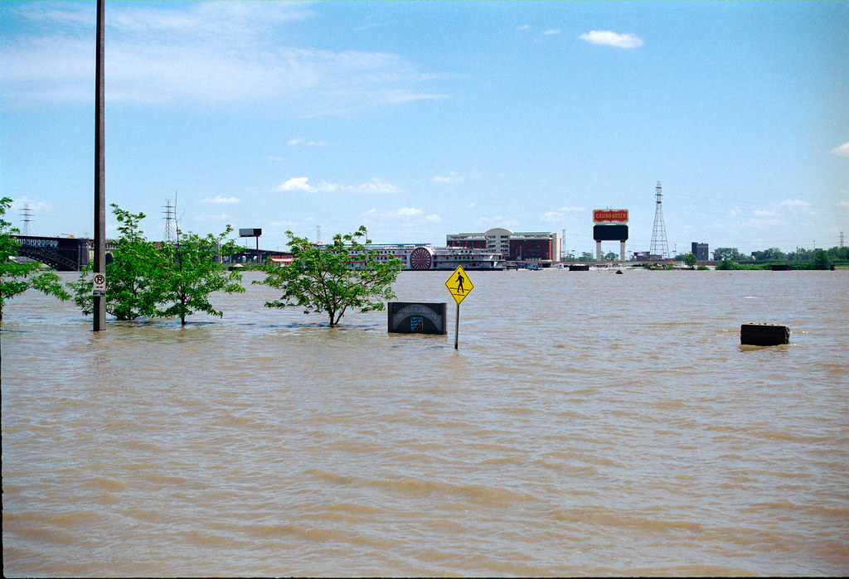

Techno-politics of using AI to manage flood risks in Jakarta
T. Octavianti ^{1*}, M. R. Utama ², P. F. Alam ³, R. A. Adhi ⁴, and D Wulandari ⁵
1 University of the West of England, UK, ² Monash University, Indonesia, ³ Telkom University, Indonesia,
⁴ WSP, Indonesia, ⁵Manchester University, UK
Thanti.Octavianti@uwe.ac.uk @thanti_octa
RGS Conference “Artificial intelligences and transformations to more sustainable urban futures”,
31 August 2023

Slide 2
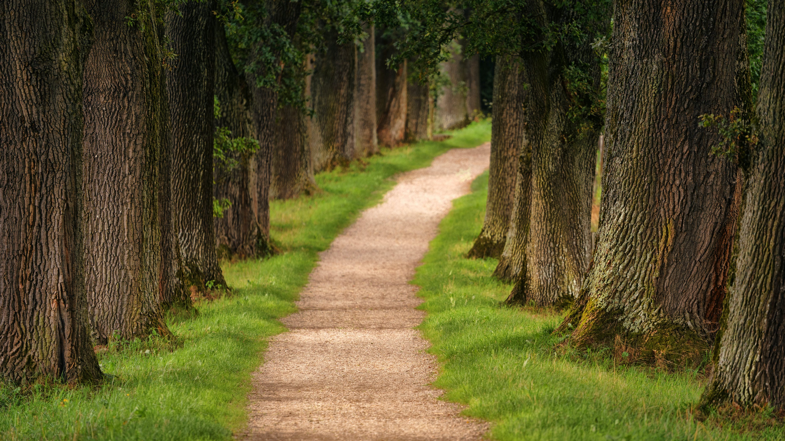
Overview
Introduction
Technopolitics
Networks of technology
Networks of discourse
Networks of actors
Conclusion

Slide 3
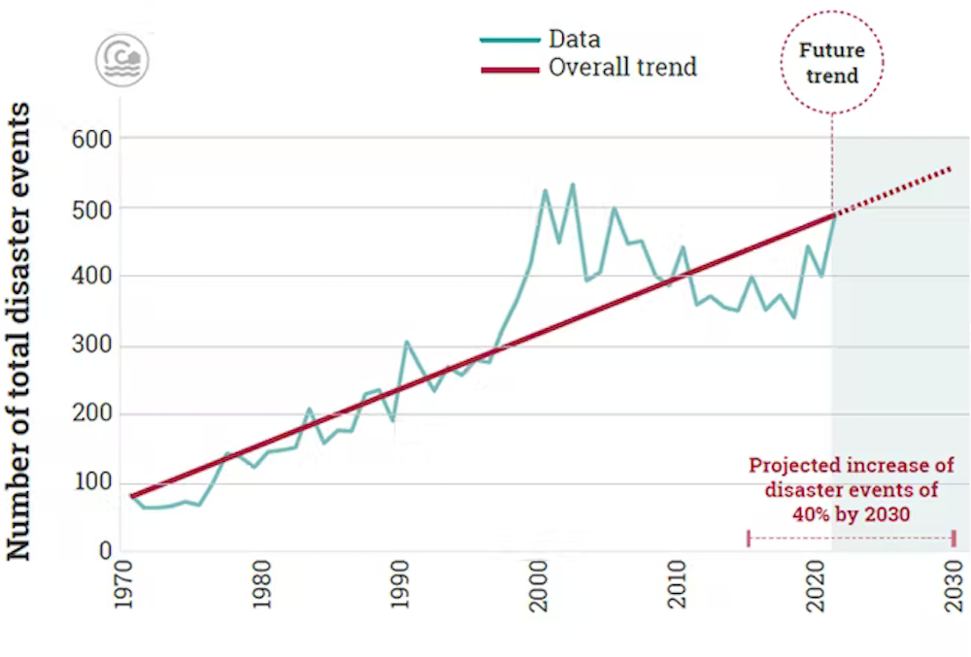
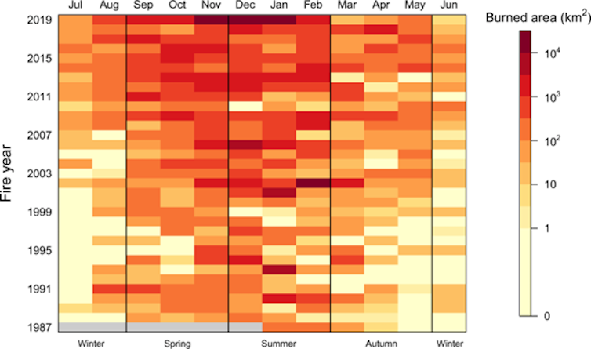
Introduction
Increasing frequency and severity of disasters
Number of disaster events from 1970 to 2020 and projected increase, 2021-2030.
Source: Global Assessment Report on Disaster Risk Reduction 2022/UNDRR, CC BY-NC
The area burnt each year by bushfires in Australia has been increasing.
Canadell et al 2021/Nature Communications, CC BY
Notes:
https://theconversation.com/climate-fuelled-disasters-warning-people-is-good-but-stopping-the-disaster-is-best-here-are-4-possible-ways-to-do-it-194916

Slide 4
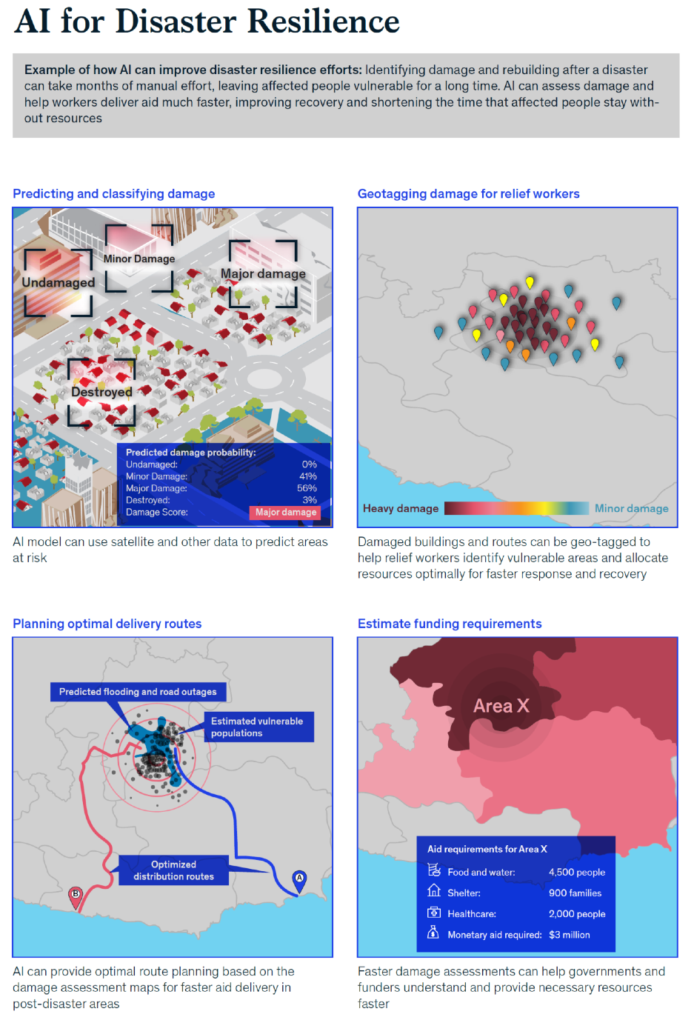
Notes:
https://www.weforum.org/agenda/2020/01/natural-disasters-resilience-relief-artificial-intelligence-ai-mckinsey/

Slide 5
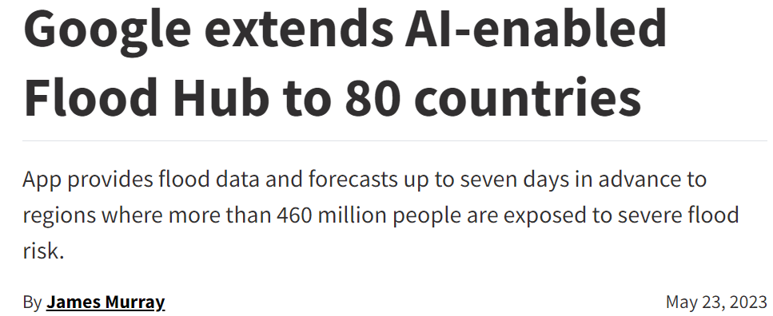
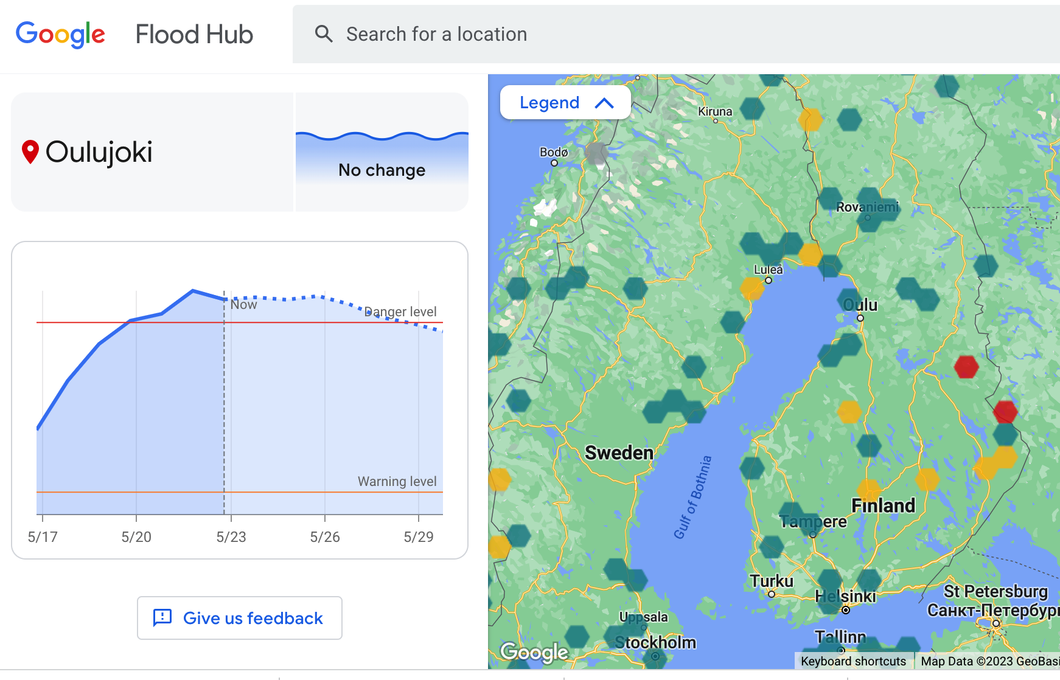
Source
Source
Notes:
https://www.greenbiz.com/article/google-extends-ai-enabled-flood-hub-80-countries
https://sites.research.google/floodforecasting/
https://www.newscientist.com/article/2387547-google-ai-predicts-floods-four-days-early-in-south-america-and-africa/
https://ai.googleblog.com/2020/09/the-technology-behind-our-recent.html

Slide 6
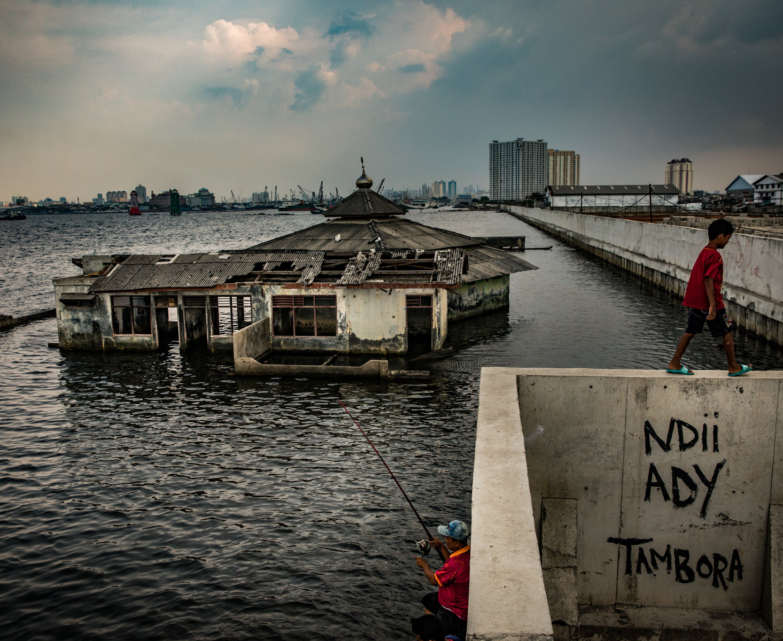
Jakarta
NYTimes, 2017,Link
Naturally vulnerable to flooding
Land subsidence, avg 15 cm/year
Sea level rise, avg 6 mm/year
Annual flooding, 2007 flood killed 79 people
Annual flood damage due to flooding USD 186 million
Flooding area is predicted to increase by 110.5 km2 by 2050

Slide 7
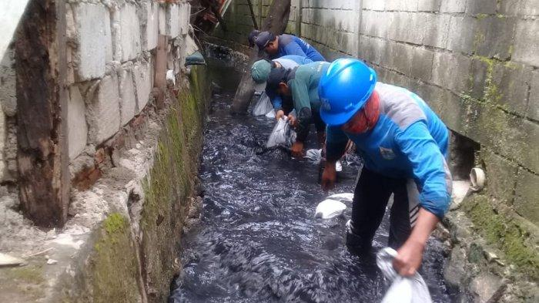
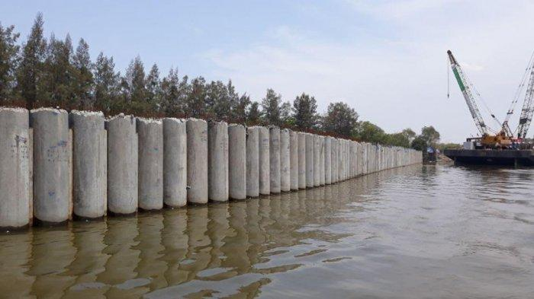
Types of flooding
Pluvial (rainfall) flooding : drainage system
Coastal flooding: seawall

Slide 8
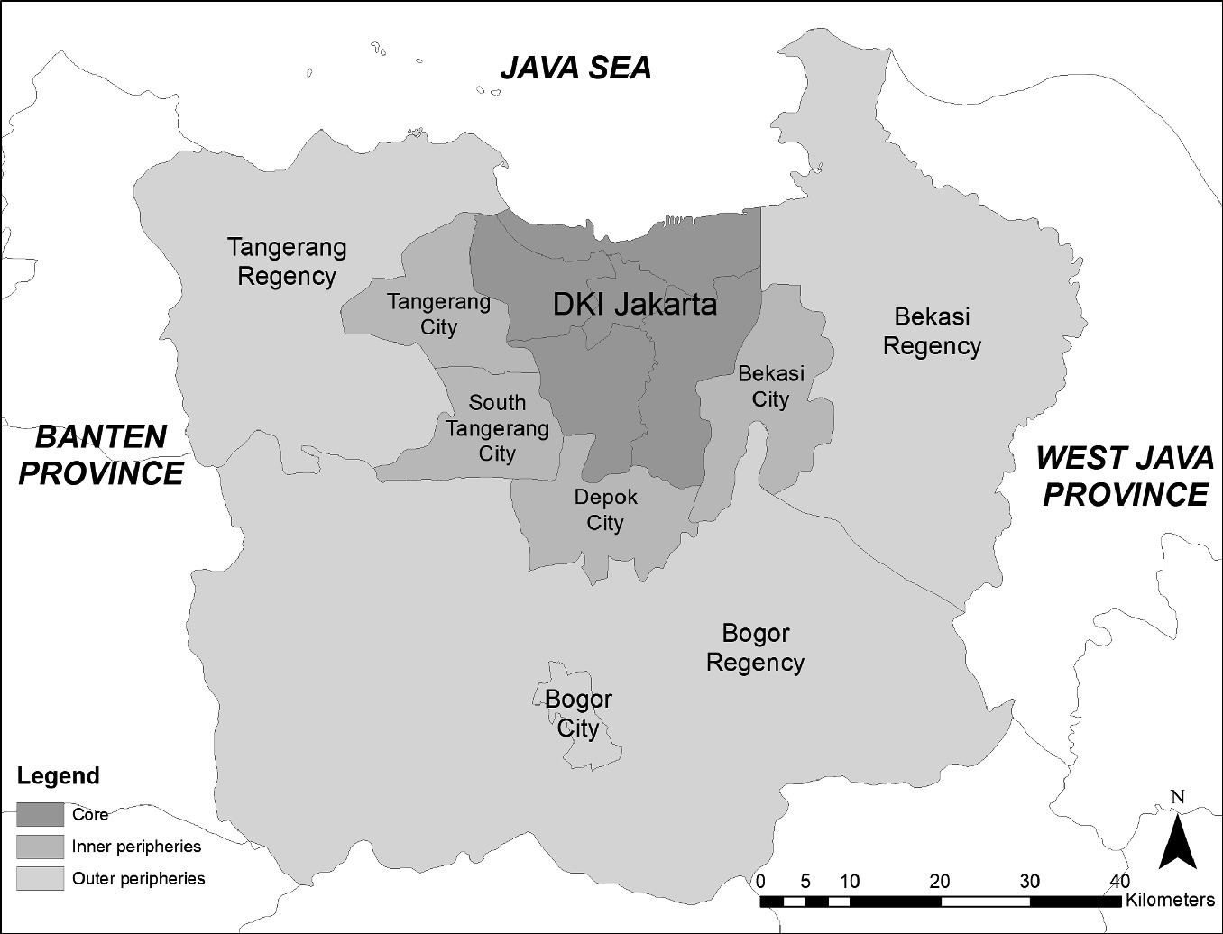
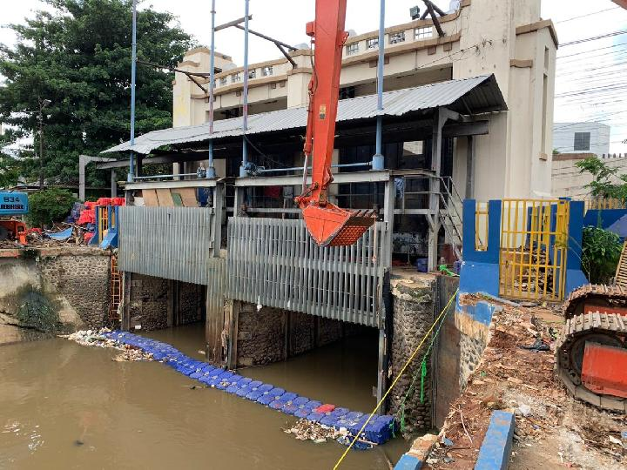
Fluvial (river) flooding: controlling flood gates and pumps
Manggarai flood gate
Rukmana and Ramadhani, 2021. Source

Slide 9
How has the new technology (intelligent flood prediction system) shaped, and are shaped by, political interventions? And what are the potential consequences?
Research question & method
Data collection
12 key informant interviews in late 2020 (early adoption of the system)
Fieldwork – visiting the central flood gate (Manggarai) and Water Agency’s Command Center

Slide 10
Technopolitics
Networks of technology
Essentially, the entanglement of technology with politics
Edwards and Hecht (2010)¹ define technopolitics as “hybrids of technical systems and political practices that produce new forms of power and agency”
Technopolitics
Networks of actors
Networks of discourse
Adopted from Gagliardone (2018)²
1 Edwards, PN; Hect, G. (2010). History and the Technopolitics of Identity: The Case of Apartheid South Africa. Journal of Southern African Studies, vol. 36, no. 3, p. 619-639.
2 Gagliardone, I. (2018). The Technopolitics of Communication Technologies in Africa. The Palgrave Handbook of Media and Communication Research in Africa, 263-277.

Slide 11
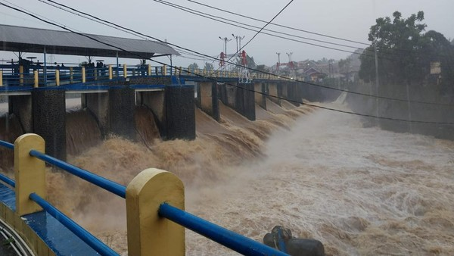
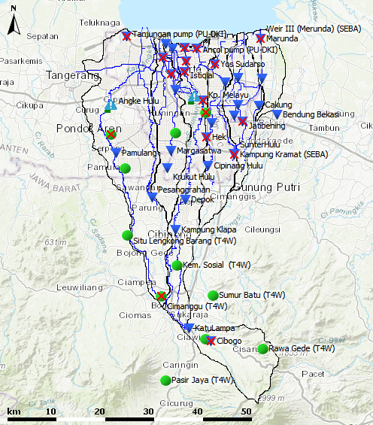
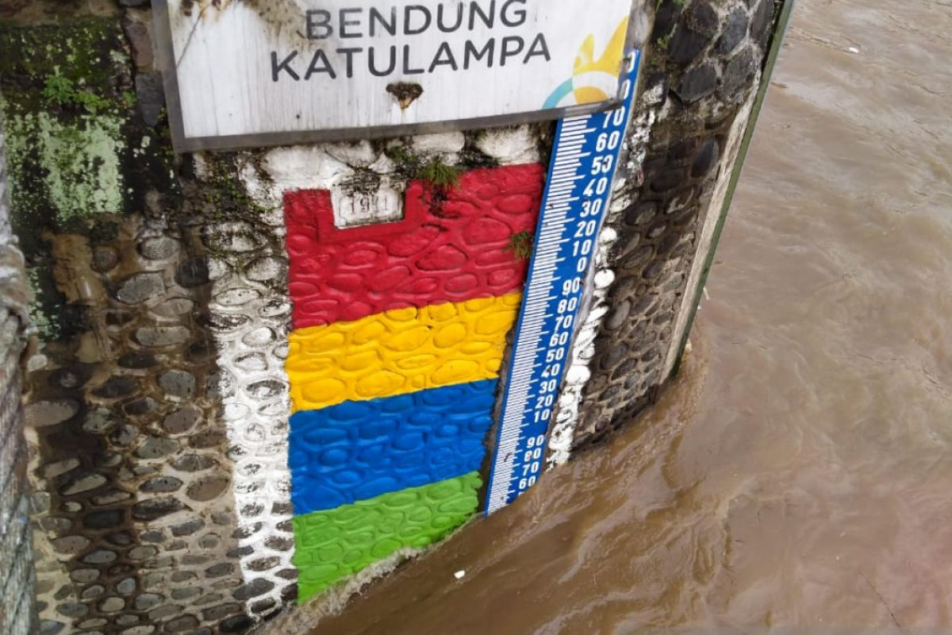
Networks of technology

Slide 12
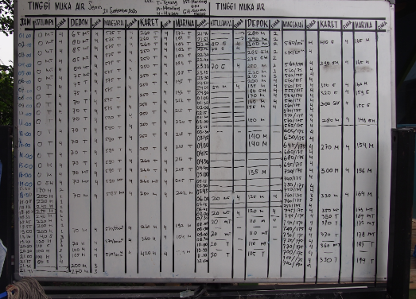
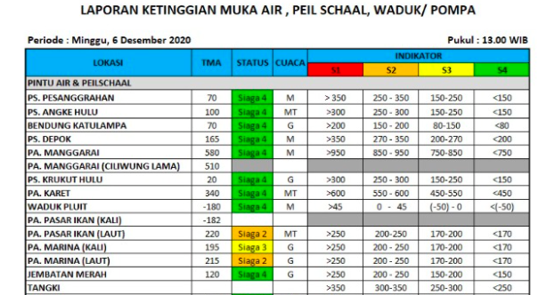

Slide 13
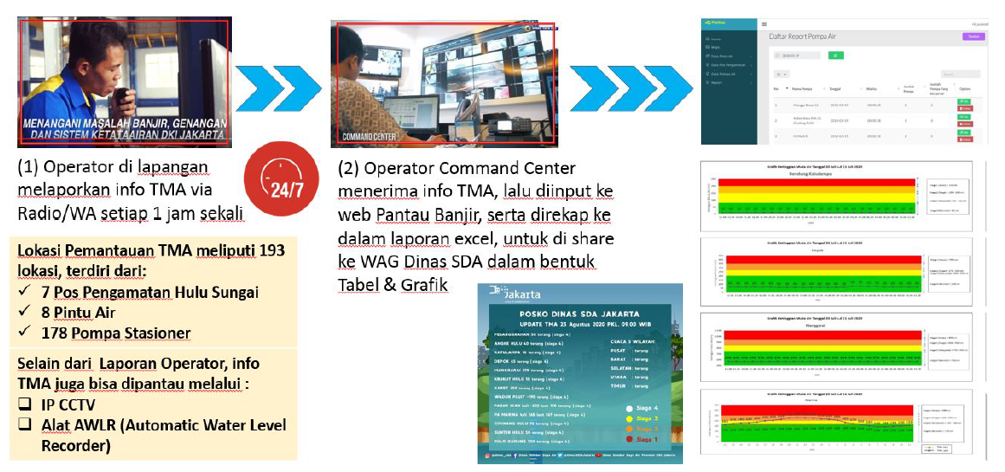
Water level monitoring (DSDA, 2020)
Operators in the flood gates recorded water level via radio/WhatsApp every hour
Operators in the Command Centre entered the water level information to Pantau Banjir web and sent an excel file to stakeholders’ WhatsApp Group
Monitoring at 193 points:
7 upstream posts
8 flood gates
178 pump houses
Secondary monitoring via:
CCTV
Sensors (Automatic water level recorder)
Notes:
TMA = tinggi muka air

Slide 14
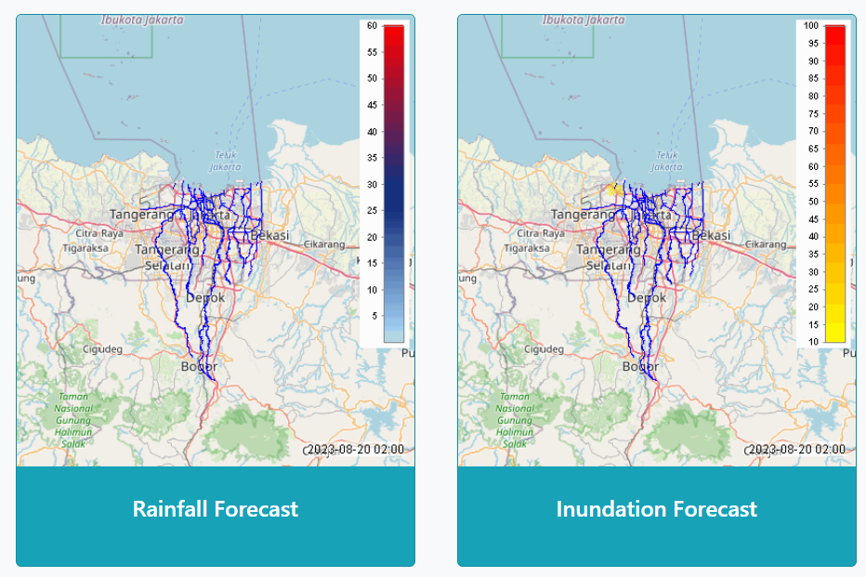
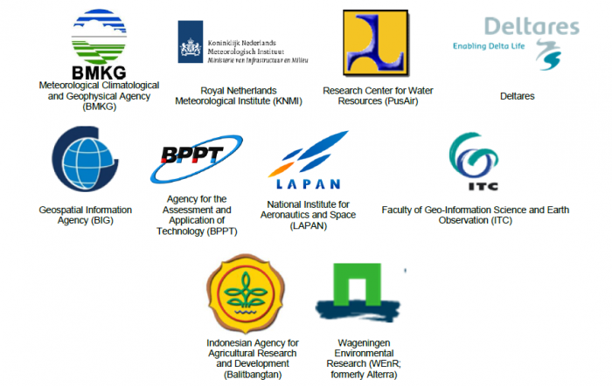
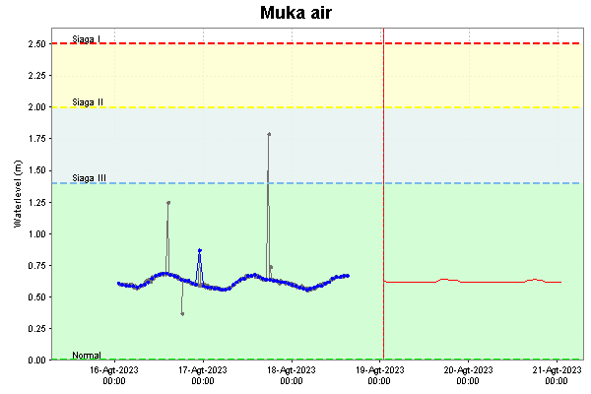
JFEWS
Jakarta Flood Early Warning System
Notes:
https://buletin-jfews.pusair-pu.go.id/

Slide 15
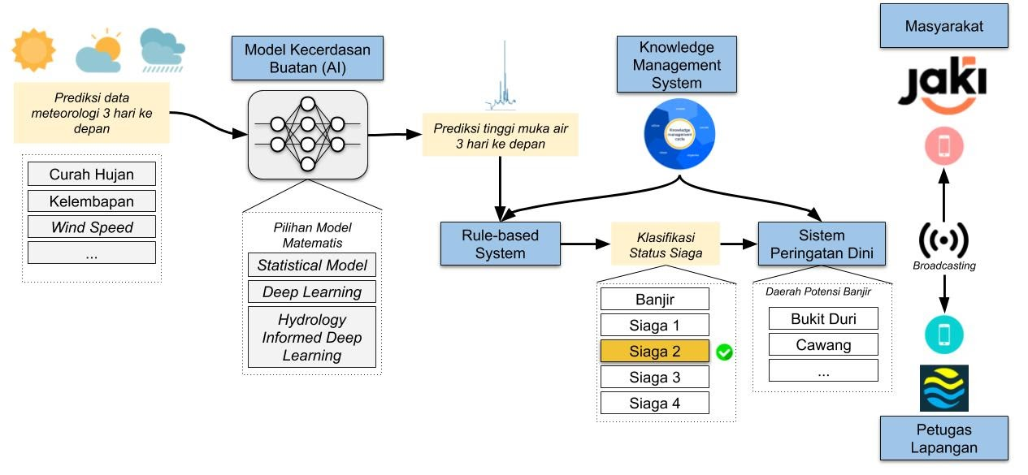
AI-enhanced flood prediction

Slide 16
Networks of actors
Unsuprisingly, complicated networks of actors
Stakeholders are involved in different phases of disaster
Fragmented data collection (not shared)
Social media data – not yet been used
Agency-level; actors-level
  Governor
  New political actors – experts
  Workers (technopolitics from ‘below’ – tacit knowledge)
  The public?

Slide 17


Data contribution
(local, national level):
Meteorological agency
Housing agency
etc
Subcontractors
Hardware
Software/ AI algorithms
etc
Water Agency
IT agency
Jakarta Smart City
NGOs; startups
PetaJakarta
etc
Disaster Agency

Slide 18
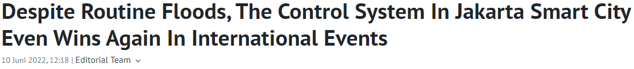
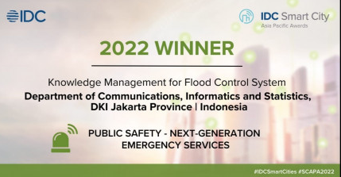
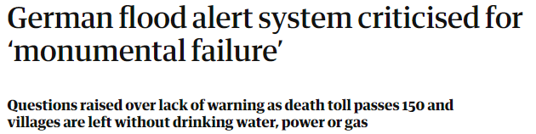

Networks of discourse
Hype
Hope
Hesitation
Practically none from the public
Workers – trust given to the sensors
Trust – controlling flood gate (Recommendation vs Action)
Fairness
Accountability
Worth the hype?
Link
Pride, futuristic Jakarta
Role model for other cities
Global city (no longer a capital)
Driven by ‘storyline’ form the government
More accurate prediction
More time for evacuation
Reducing flood risks?
Link

Slide 19
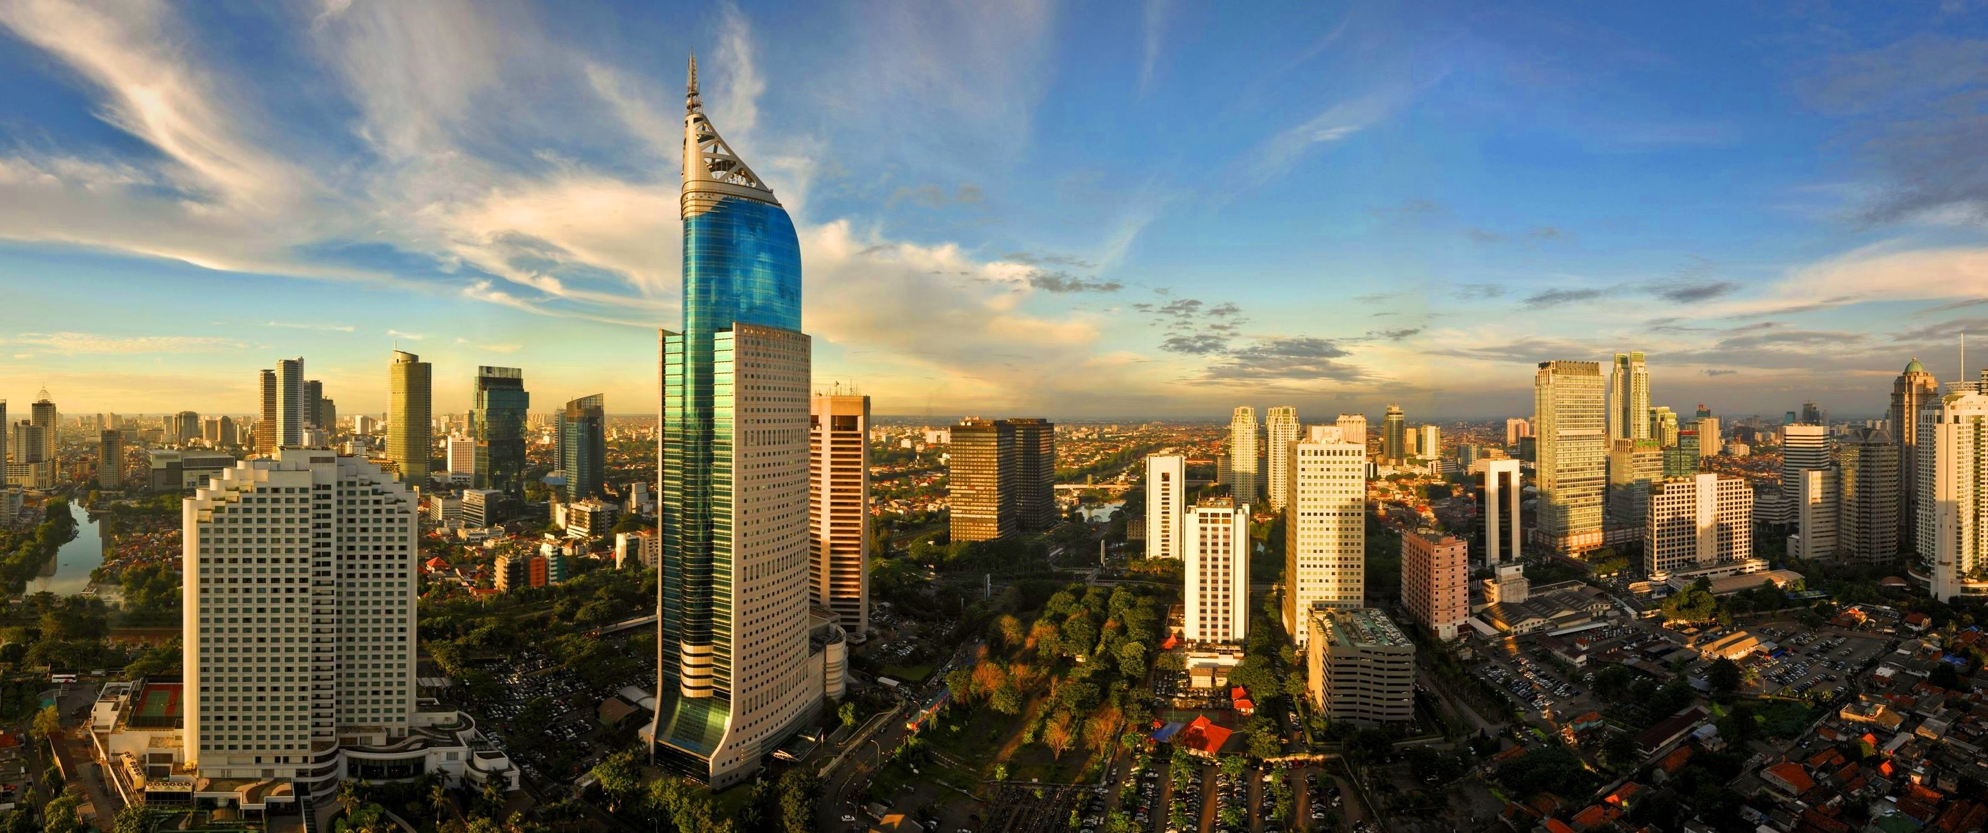
Conclusion
Technological innovation & political intervention
The new system was driven by political motivation, in addition to disaster pressure
Worth the hype? It is still in early adoption/in the training stage (maturity)
Not necessarily reducing flood risks, reducing flood impacts
Fragmented → integrated; Manual → (semi) autonomous system
Actors-level relationship (redefining power and knowledge)
Hype – hope – hesitation
Responsible and ethical use of AI – when something goes wrong?

