Slide 1
Exploring relationships between GBGI exposure and health and social outcomes in Bristol, UK
Presented by
Harry West, Issy Bray, Danielle Sinnett
Royal Geographical Society Annual International Conference
London, September 2023
Sept 2023

Slide 2
Background
Mental health, particularly for urban populations, is a growing public health concern.
Understanding how people relate to and feel a sense of belonging in the urban environment is an important research agenda.
There is mounting evidence about the importance of green (e.g. parks, trees) and blue (e.g. rivers, lakes) infrastructure for the health and wellbeing of urban residents.
There is also emerging evidence about the benefits of certain ‘grey’ features (e.g. historic buildings, active travel routes).

Slide 3
Our Project
Our Reclaim project “The role of GBGI in levelling up across Bristol” seeks to explore relationships between Green-Blue-Grey Infrastructure (GBGI) and a range of health and social outcomes in neighbourhoods across Bristol.

Slide 4
Bristol Quality of Life Survey
The Quality of Life (QoL) survey provides an annual snapshot of the quality of life across Bristol.
This is administered by Bristol City Council.
The survey has run since 2001
Our project will only explore data from 2011-2022.
Approx. 3000-5000 responses per year.
The survey includes up to 190 indicators of QoL and wellbeing of residents.
Data for this project is being supplied by BCC at the postcode level with demographic characteristics aggregated to preserve anonymity of respondents.

Slide 5
Methodology - Analysis
Using GIS and statistical analyses we explore associations with GBGI features to self-reported life satisfaction and wellbeing from the Bristol Quality of Life Survey.
We compare both the relationship between GBGI exposure and self-reported life satisfaction and wellbeing
  Exposure datasets were spatially analysed based on the postcode of survey respondents.
  Exposure and life satisfaction and wellbeing analysed using regression models (both for individual GBGI features and multiple regressions).
We also compare satisfaction and frequency of use of GBGI with life satisfaction and wellbeing.
  Comparison between satisfaction/frequency categories and life satisfaction and wellbeing undertaken using Kruskall-Wallis tests.
  Comparison between satisfaction/frequency categories and GBGI exposure.
Comparative analysis also undertaken for demographic groups and life satisfaction and wellbeing.

Slide 6
GBGI Exposures
Green | Blue | Grey
Urban tree coverage | Waterbody access (including accessibility consideration) | Bus stop access
Normalised Difference Vegetation Index (NDVI) |  | Density of historic/listed buildings
Greenspace access (including accessibility consideration) |  | Cycle network access
Woodland access (including accessibility consideration) |  | Building/area ratio
Conservation area access |  | Social infrastructure access
Outdoor sport facility access |  | Leisure centre access
Private garden access (and size consideration) |  | Road access and characteristics
 |  | Rail network access
Exposure analysed either by calculating network distance from postcode centroid or based on areal measure based on a 10min walking service area analysis.

Slide 7
Life Satisfaction and Wellbeing Measures
We compare GBGI with two measures from the Bristol Quality of Life Survey from 2011-2022.
Measure 1: Self-reported life satisfaction (recorded on a 10-point likert scale)
Measure 2: Short Warwick Edinburgh Mental Wellbeing Scale
  Composite measure of responses to the following statements:
    “I’ve been feeling optimistic about the future”
    “I’ve been feeling useful”
    “I’ve been feeling relaxed”
    “I’ve been dealing with problems well”
    “I’ve been thinking clearly”
    “I’ve been feeling close to other people”
    “I’ve been able to make up my own mind about things”

Slide 8
Results – GBGI Exposure Relationships
Linear regression models performed to explore relationships between GBGI exposure and self-reported life satisfaction and the Short Warwick Edinburgh Mental Wellbeing Scale.
No significant results have been found between exposure to GBGI and life satisfaction and wellbeing (R2 values at or close to 0).
No significant results for either individual GBGI exposure regression models or multiple regression models comprising of multiple GBGI exposures.

Slide 9
Results – GBGI Satisfaction/Frequency of Use
However comparative analysis between satisfaction with and frequency of use of GBGI undertaken using a Kruskall-Wallis test does show statistically significant results (i.e. life satisfaction and wellbeing median values are sig. different between groups).
Example results:
Greenspace Satisfaction (KW Z Score for LS)
Very Satisfied | 36.05
Fairly Satisfied | -0.03
Neither | -20.25
Fairly Dissatisfied | -21.57
Very Dissatisfied | -19.22
Does Not Apply | -7
NoData | 1.29
Neighbourhood Satisfaction (KW Z Score for LS)
Very Satisfied | 57.14
Fairly Satisfied | -7.63
Neither | -29.06
Fairly Dissatisfied | -33.98
Very Dissatisfied | -28.83
Does Not Apply | -2
NoData | -0.34
Neighbourhood Noise (KW Z Score for LS)
Serious Problem | -30.64
Problem but not Serious | -17.56
Not a problem | 33.96
Does Not Apply | 1.53
Street Litter (KW Z Score for LS)
Serious Problem | -20.43
Problem but not Serious | 3.9
Not a problem | 18.19
Does Not Apply | 0.21
Greenspace Frequency of Use (KW Score for LS)
Multiple times a week | 14.11
Once a week | 5.9
Multiple times a month | 4.77
Once a month | -9.55
Less than once a month | -10.68
Less than once a year | -13.14
NoData | -1.38
Air Quality (KW Z Score for LS)
Serious Problem | -14.25
Problem but not Serious | 1.28
Not a problem | 14
Does Not Apply | -2.23

Slide 10
Results – GBGI Exposure and Satisfaction/Use
Comparative analysis between satisfaction with and frequency of use of GBGI and GBGI exposure also reveals significant results:
Example results:
Greenspace Frequency of Use (KW Z Score for GS Exposure)
Multiple times a week | -12.35
Once a week | -2.53
Multiple times a month | 3.44
Once a month | 4.11
Less than once a month | 8.18
Less than once a year | 4.28
NoData | -0.25
Bus Satisfaction (KW Z Score for Bus Stop Exposure)
Very Satisfied | -9.41
Fairly Satisfied | -3.85
Neither | 3.78
Fairly Dissatisfied | 3.4
Very Dissatisfied | 2.19
Does Not Apply | 5.78
NoData | 0.25
Greenspace Satisfaction (KW Z Score for GS Exposure)
Very Satisfied | -3.67
Fairly Satisfied | 1.57
Neither | 3
Fairly Dissatisfied | -0.93
Very Dissatisfied | -0.09
Does Not Apply | 2.91
NoData | -1.82
Leisure Facility Satisfaction (KW Z Score for LF Exposure)
Very Satisfied | -7.18
Fairly Satisfied | -11.87
Neither | -1.01
Fairly Dissatisfied | 4.04
Very Dissatisfied | 13.07
Does Not Apply | 0.85
NoData | 7.58

Slide 11
Results - Demographics
Comparative analysis of demographic groups and life satisfaction and wellbeing also reveal statistically significant differences.
Example results:
Age Groups (KW Z Score for LS)
18-24 | -7.75
25-34 | 0.59
35-44 | -7.37
45-54 | -12.76
55-64 | -1.98
65-74 | 17.2
74-84 | 10.55
85+ | 2.6
NoData | -1.12
Unemployment (KW Z Score for LS)
No | 10.87
NoData | -3.04
Yes | -19.46
Retired (KW Score for LS)
No | -16.42
NoData | -7.33
Yes | 22.82
Long Term Sickness (KW Score for LS)
No | 24.81
NoData | 2.54
Yes | -45.77
Disability (KW Z Score for LS)
No | 48.99
NoData | -1.19
Prefer Not To Say | -19.09
Yes | -45.24

Slide 12
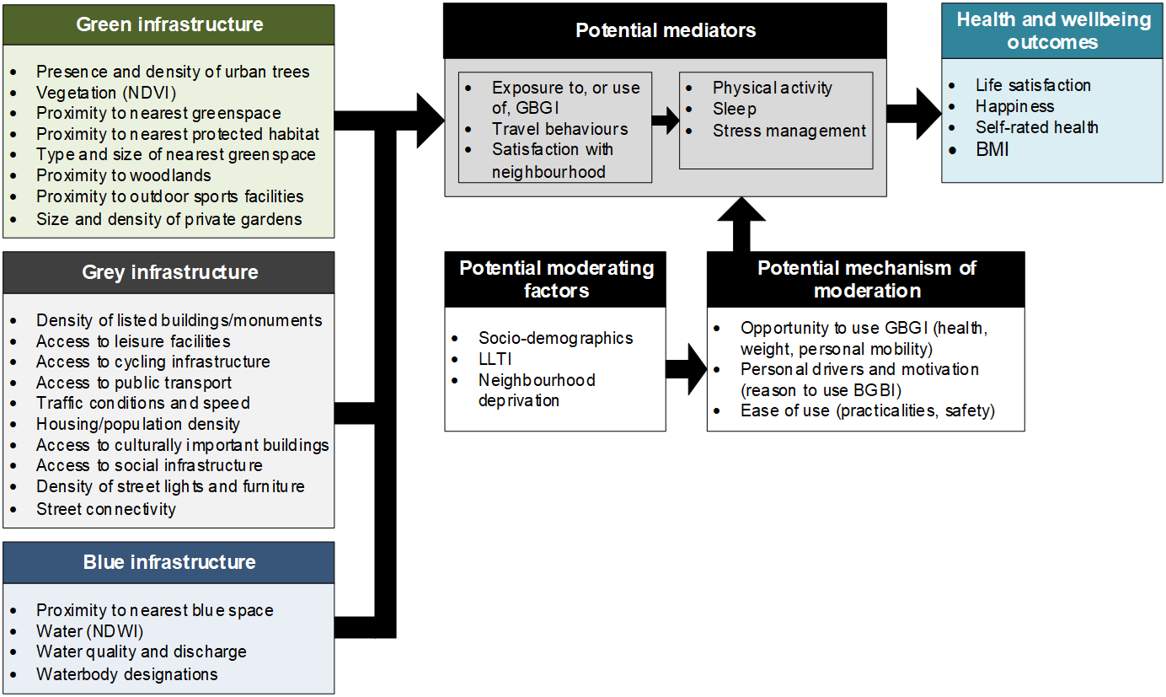
A Working Model for GBGI and LS and Wellbeing
Exposure/objective GBGI variables
(multiple data sources)
Subjective GBGI and demographic variables
(Bristol QoL Survey)
H&W Outcomes
(Bristol QoL Survey)

Slide 13
Conclusions
In this project we aimed to explore the relationship between GBGI and self-reported life satisfaction and wellbeing over a long time period at high-resolution in Bristol.
Multiple GBGI factors were explored, including detailed mapping of GBGI exposure and reported satisfaction with and frequency of use of GBGI.
No significant relationships have been found between GBGI exposure and self-reported life satisfaction and wellbeing.
However significant differences found relating to satisfaction and frequency of use (and between demographic groups).
Satisfaction and frequency of use is somewhat linked to GBGI exposure.
Suggests enhancing GBGI exposure in itself will likely not directly lead to improvements in LS and wellbeing.
However improving the quality of and peoples experience of GBGI and their local environment (as well as exposure) is potentially important in enhancing LS and wellbeing.

