Slide 1
Co-creating anti-racist datasets in AI workflows utilising films as data
Amanda Egbe, UWE Bristol

Slide 2
This Presentation will consider:
The potential of developing anti-racists datasets through using moving image archives.
This consideration is framed within the context of artistic practice
An exploration of archival material through an intersectional lens, that considers situated context

Slide 3
Introduction
Lessons from Archives: Strategies for Collecting Sociocultural Data in Machine Learning (Eun Seo Jo and Timnit Gebru’s , 2020)
Eun Seo Jo and Timnit Gebru’s exploration of archival practice as a site for interventions in AI, is a starting point to consider how work already done, strategies already considered may be applied in the field of machine learning.
Death 24x a Second (Laura Mulvey, 2006)
Mulvey’s Delayed Cinema approach, was a provocation to consider, the visual language of cinema within a critical frame.
Tom Tom the Piper’s Son (Ken Jacobs, 1969)
Artistic interventions with archival material have elicited insights into moving mage practice.

Slide 4
Archives are not neutral
Eun Seo Jo and Timnit Gebru may be optimistic in their assumptions about the archive but are right to consider some of the approaches to data collection by way of the archive, where issues of “consent, power consent, power, inclusivity, transparency, and ethics & privacy” have been explored.
My work will augment that with more critical approaches that inform film and archival practice. Archives are not neutral but rather shaped by the biases, assumptions, and perspectives of their creators and users.

Slide 5
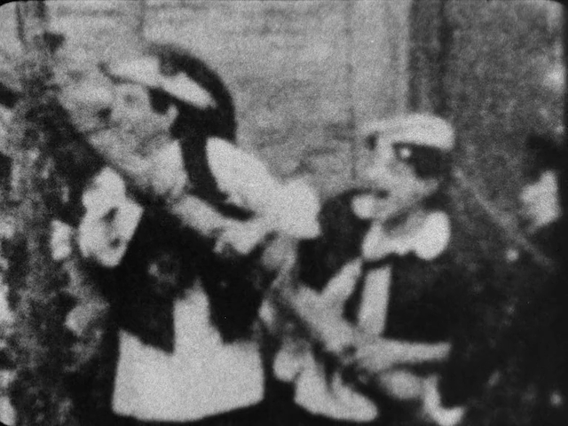
Artistic Practices
Structural film practices with found footage and archival film can create new meanings and narratives that challenge conventional representations of history and identity.
Situated Context
Yuval-Davis’ approach to intersectionality, considers situatedness (Yuval-Davis, 2011). Drawing on this approach, allows a consideration of the role and gaze of the viewer, the data collector, the programmer.
Co-creation
In bringing together these situated knowledges that can challenge biased representations, providing alternative perspectives.

Slide 6
Datasets
These datasets present, a collective knowledge, a situated context, which invites a constant reappraisal, a questioning of the viewer, tagger, the ethics of the collection and a reflection of the gaze, in answer to the question raised by Eun Seo Jo and Timnit Gebru.

Slide 7
Thank You
Amanda Egbe, amanda.egbe@uwe.ac.uk

