Slide 1
UWE BRISTOL A conversation to shape the future of the health and social care workforce for the South West of England
28 February 2023
Notes:
Mentimeter will be used during this interactive session this evening. You will be given guidance to enable you to access the questions that will be posed at key points in the next hour, that will also form the basis for a fairly quick conversation on tables.

Slide 2
IMMEDIATE CHALLENGE
Workforce Crisis
Our NHS is facing a workforce crisis, with over 130,000 vacancies in England.
The most recent data showed over 46,000 vacant nursing posts – a record high. This is despite the fact that the Government is on target to meet its 2019 manifesto of 50,000 more nurses by March 2024.
The demand for nurses is increasing more quickly than supply.
The emergence of new models of health and social care requires new roles, skills and ways of working.
Notes:
To frame discussion – recognise immediate collective challenge. Note working with University Alliance and others to directly engage Government on these challenges.

Slide 3
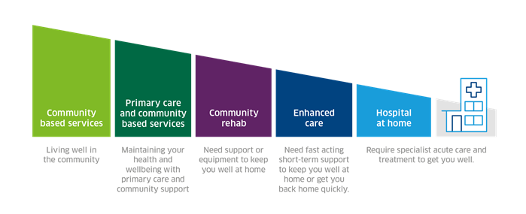
LOOKING AHEAD
Changing needs and opportunities
Creating the patient journey through:
Collaborative education models.
Contemporary placement models.
Innovative approaches to workforce. mapping.
Innovation and research.
How we use AI / Robotics / Diagnostics to help shape the above.
Notes:
As we look ahead, we see current changes accelerating and we see new challenges and opportunities on the horizon.
We want to explore with you your views on these changing needs, to help us shape work together to shape our collective vision and as a University, how we fulfil our important role in the health and social care ecosystem. We will do this through the use of Mentimeter, which will act as a prompt

Slide 4
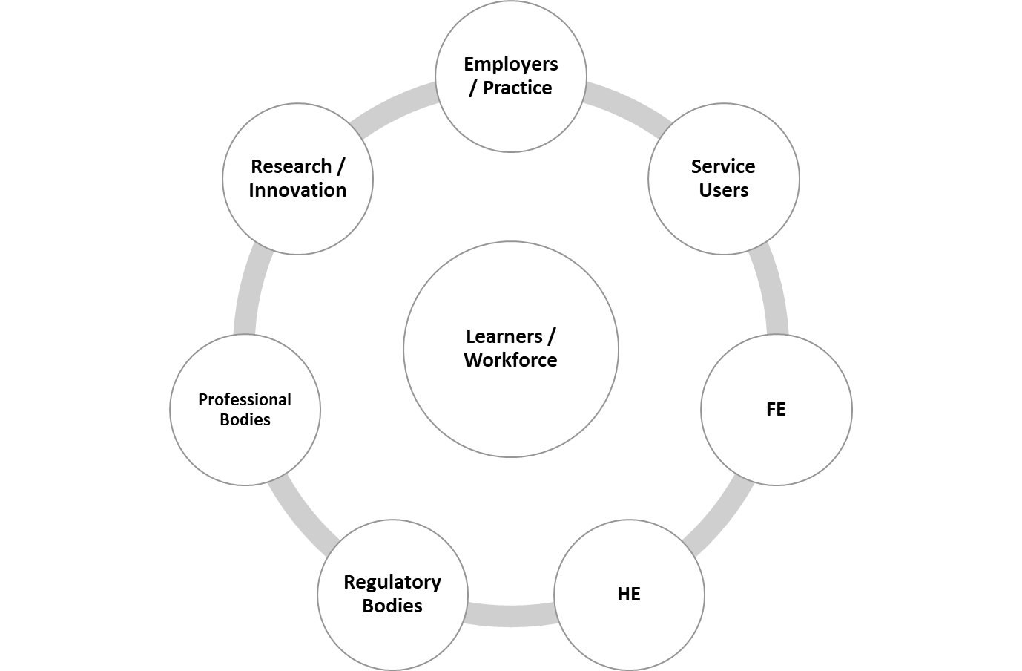
WORKING TOGETHER
A Multi-System Approach for Health and Social Care
Notes:
As we look ahead, we see current changes accelerating and we see new challenges and opportunities on the horizon.
We want to explore with you your views on these changing needs, to help us shape work together to shape our collective vision and as a University, how we fulfil our important role in the health and social care ecosystem. We will do this through the use of Mentimeter, which will act as a prompt

Slide 5
CREATING A STRONG ECOSYSTEM
Integrated Care Systems
Higher Education Institutions
NHS England
Health Education England
Further Education Institutions
Developing new models of recruitment
Students
Staff
Researchers
PPI
Mentorship & Coaching
Clinical Academic Model
Technicians
Promoting hybrid roles
Exploring future roles in
Diagnostics
Rehabilitation
AI / Digital / Genomics
Clinical Engineering
Notes:
As we look ahead, we see current changes accelerating and we see new challenges and opportunities on the horizon.
We want to explore with you your views on these changing needs, to help us shape work together to shape our collective vision and as a University, how we fulfil our important role in the health and social care ecosystem. We will do this through the use of Mentimeter, which will act as a prompt

Slide 6
LOOKING AHEAD
Changing needs and opportunities
Exploring our collective challenge and opportunity
Mentimeter questions (#1-2) – www.menti.com
Code: 2413 5898
Notes:
2 questions posed via MentiMeter and after each question has been completed (i.e. via participant interaction), then a 5 min discussion is undertaken per question on tables with a member of VCE / marketing present to capture key information / points.
Questions:
#1 - What emerging skills will our future health and social care workforce require?
#2 - What new health & social care roles will need to emerge in the next five years?
Purpose of this discussion – understanding our challenge to inform what we need to do as a whole system to achieve our best for our stakeholders.

Slide 7
NEW MODELS OF WORKFORCE DELIVERY
Changing approaches to workforce provision across the South West of England
Greater social mobility and access to education
Use of contemporary simulation environments and the true value of simulated learning
Regulatory changes – greater inclusion of simulation and clinical skills within an academic environment (i.e. increase in simulated practice hours mapped against programmes)
Change in organisational workforce design (i.e. impact of NHS People Plan)
The Topol Review – AI, Robotics, Digital literacy, Genomics, Digital Medicine – Evolution of new roles (i.e. Bioinformaticians)
Changing student expectations / greater co-creation opportunities
Graduate skills that are transferable and meet the needs of the NHS People Plan and Integrated Care Systems
Skills development of staff within the organisation – currency and competency
Impact of Covid-19 on learners and the need for holistic care for our students and tomorrow’s health and social care workforce.
Notes:
2 questions posed via MentiMeter and after each question has been completed (i.e. via participant interaction), then a 5 min discussion is undertaken per question on tables with a member of VCE / marketing present to capture key information / points.
Questions:
#1 - What emerging skills will our future health and social care workforce require?
#2 - What new health & social care roles will need to emerge in the next five years?
Purpose of this discussion – understanding our challenge to inform what we need to do as a whole system to achieve our best for our stakeholders.

Slide 8
UWE BRISTOL
HEALTH AND SOCIAL CARE
Building on our success and ecosystem
Notes:
Thank you for your insights so far which are hugely helpful to our collective thinking to address the task at hand. I want to share with you a bit more about how we have been working to address these challenges and our current plans for the future, again we will be looking to draw on your expertise as we know we are part of a much wider ecosystem that has to work collectively.
This slide, for those who aren’t already aware, sets out some of the ways we are already working to take an integrated approach to our provision as part of the wider ecosystem.

Slide 9
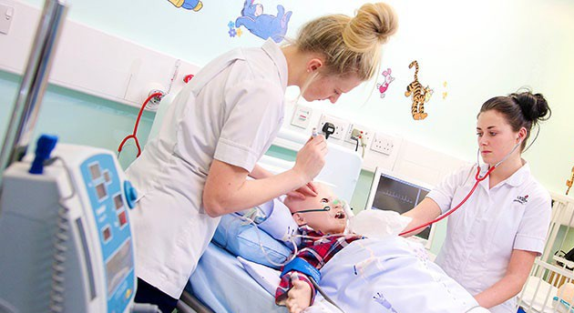
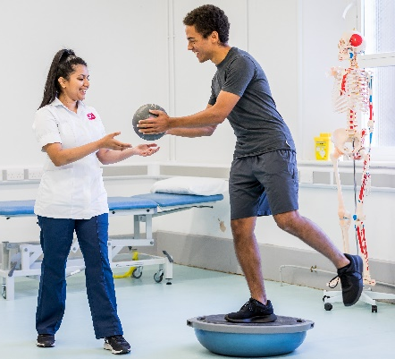
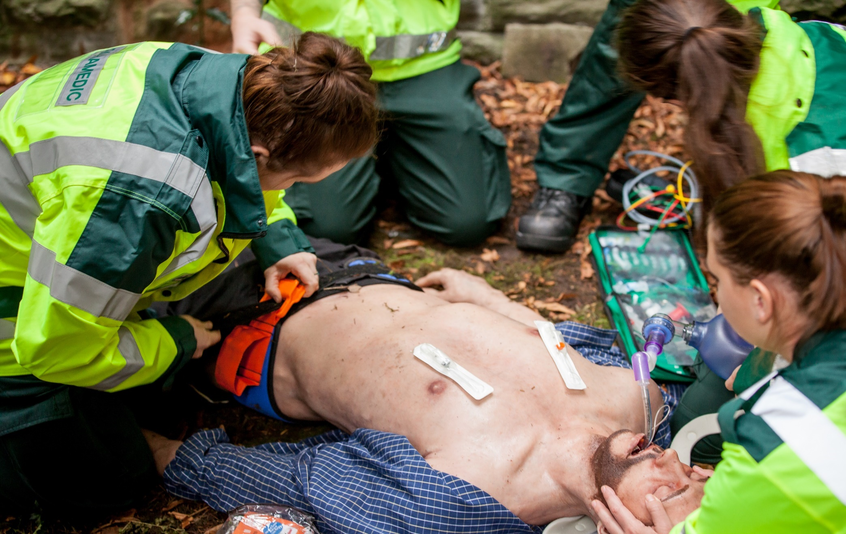
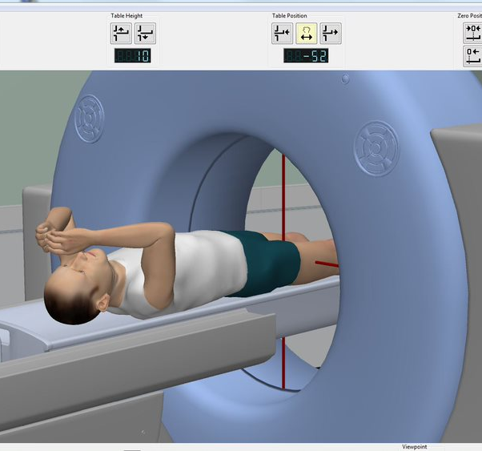
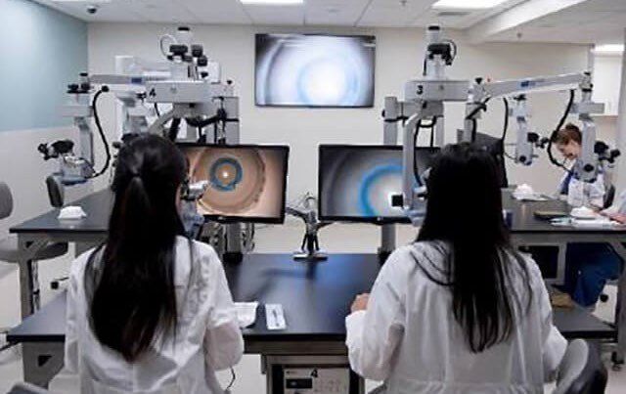
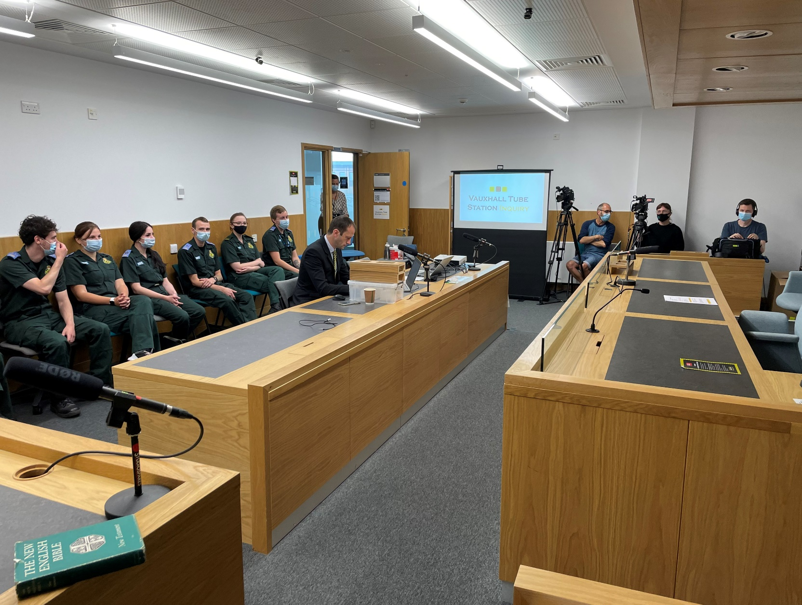
UWE BRISTOL
HEALTH AND SOCIAL CARE
Building on our success and ecosystem
Why UWE Bristol?
Notes:
This slide helps bring this to life and in particular that integrated approach.

Slide 10
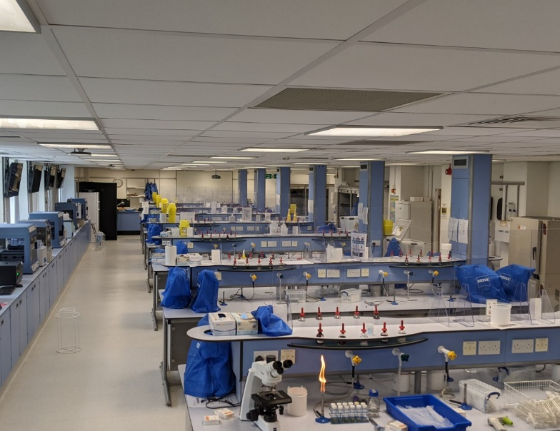
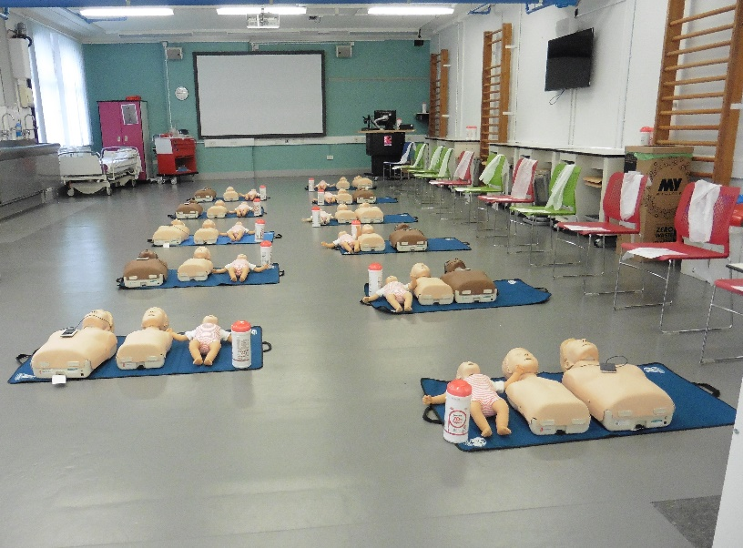
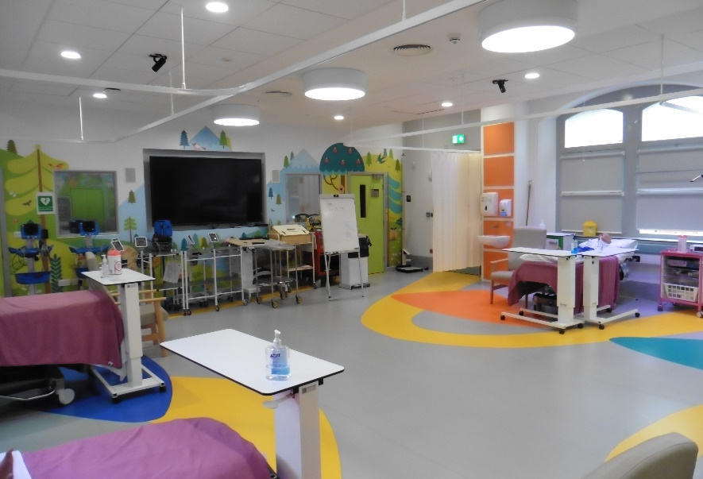
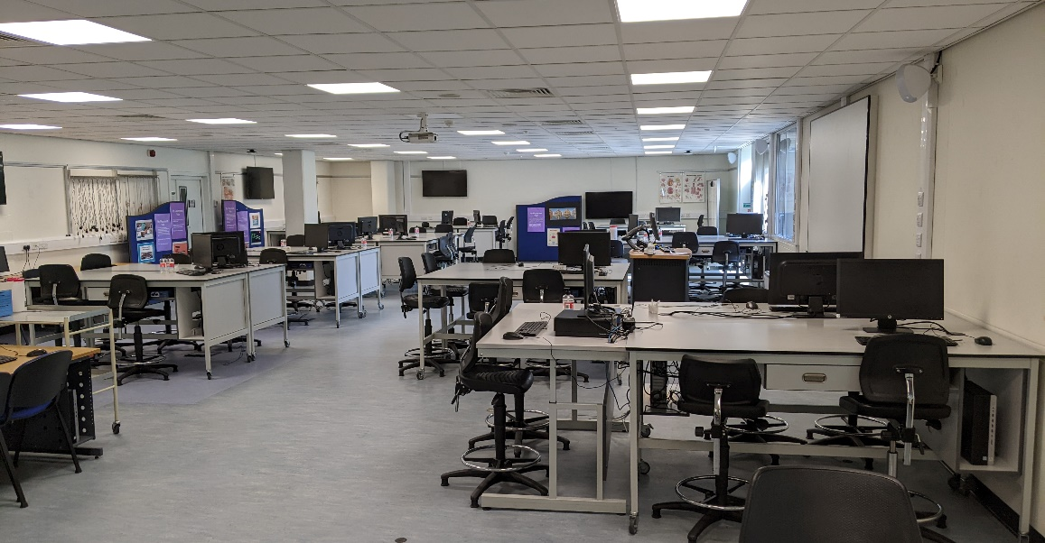
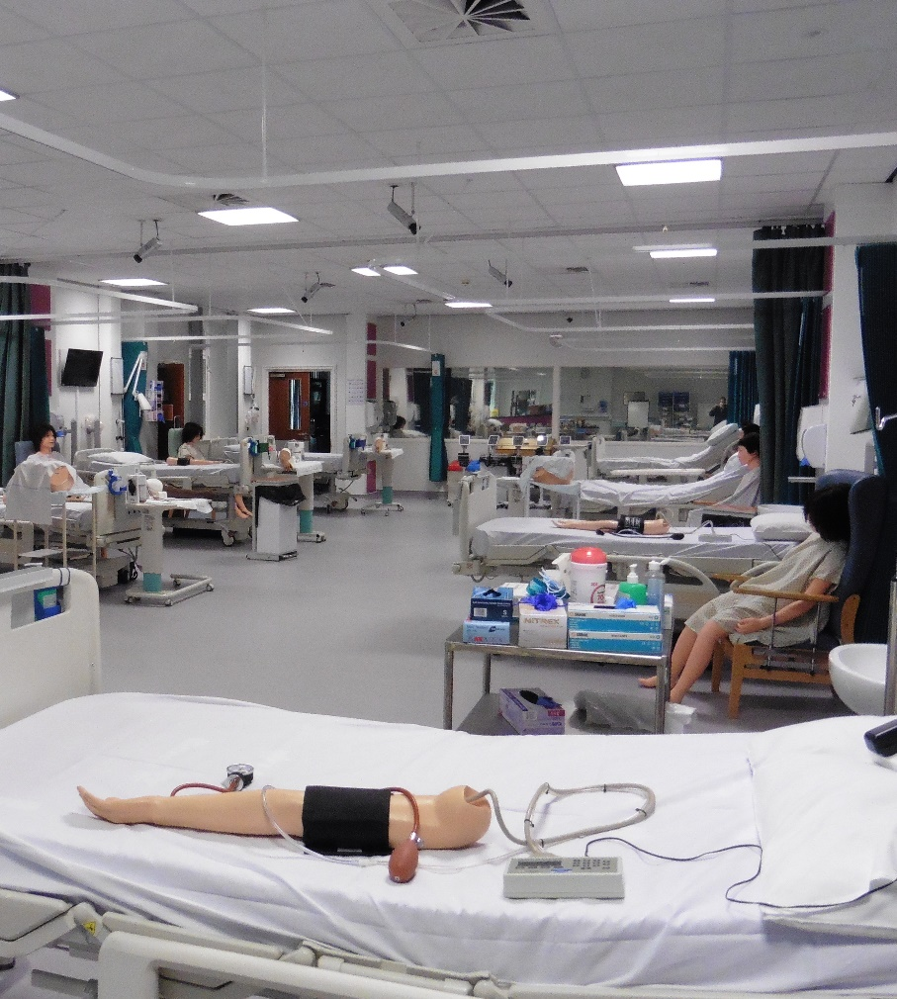
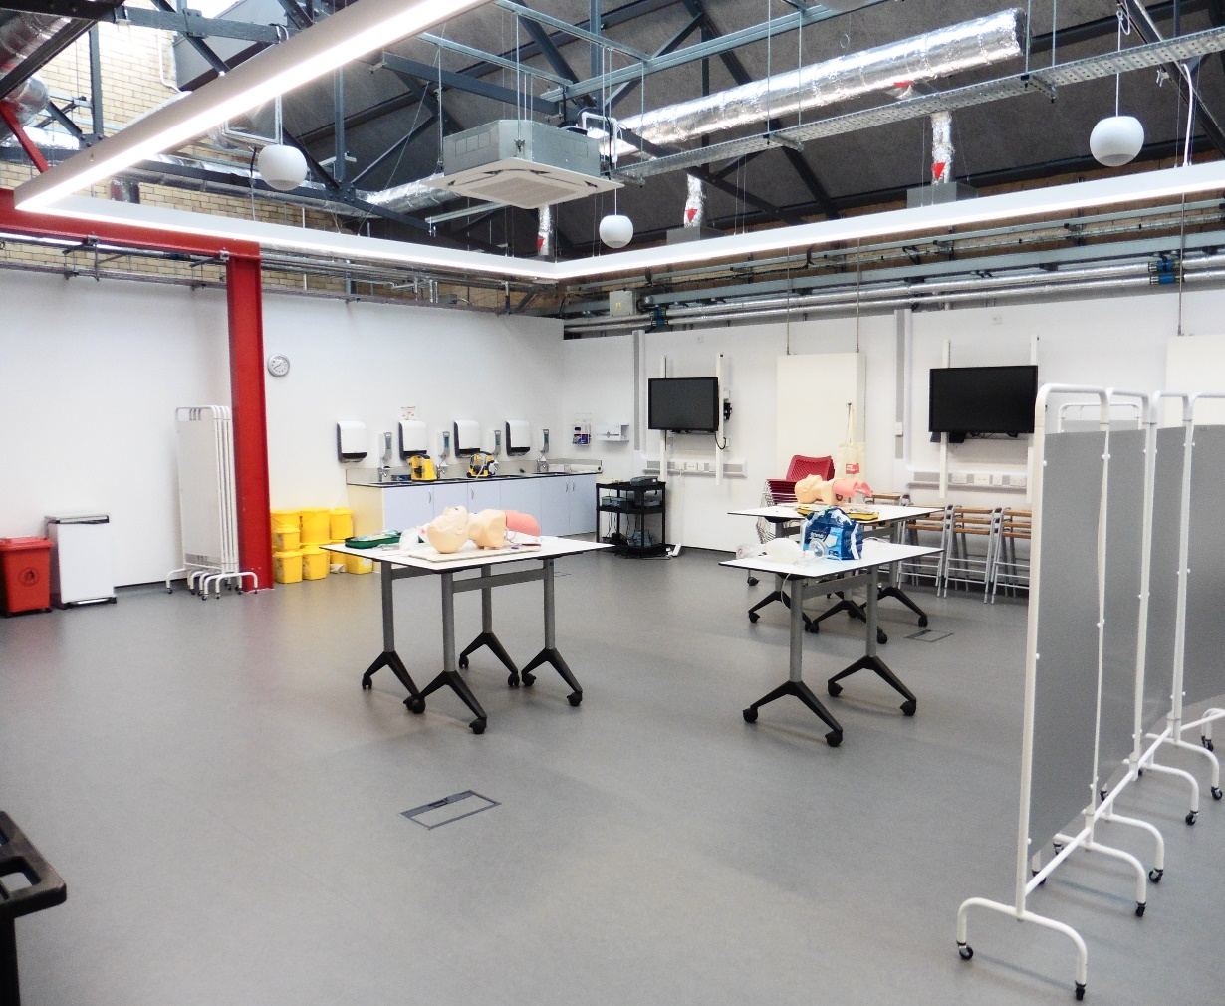
UWE BRISTOL
HEALTH AND SOCIAL CARE
Building on our success and ecosystem
Simulated learning is vital within health and social care education
Notes:
This slide helps bring this to life and in particular that integrated approach.

Slide 11
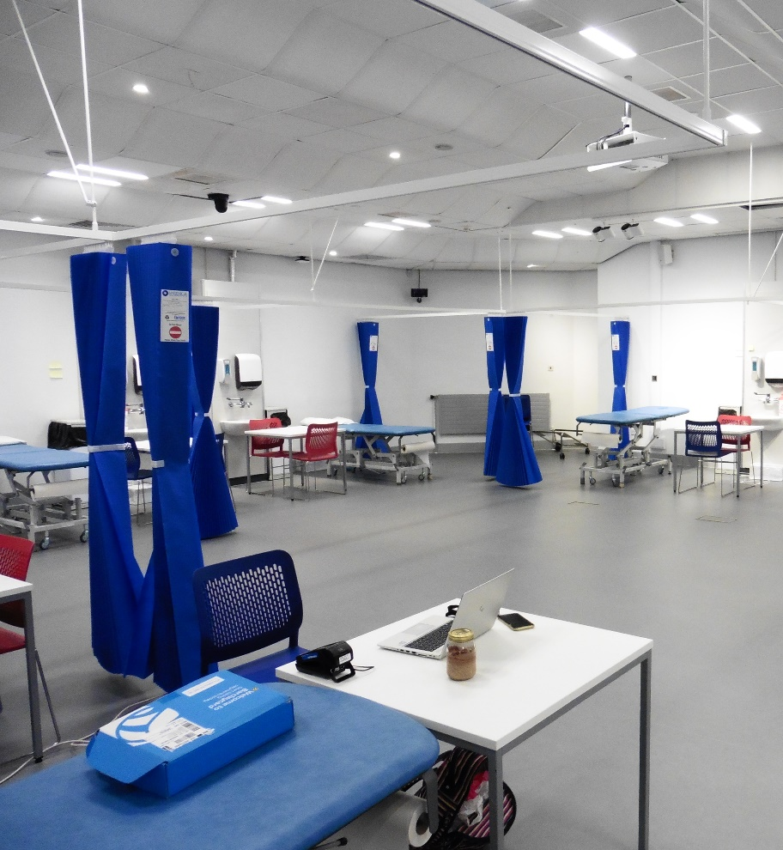
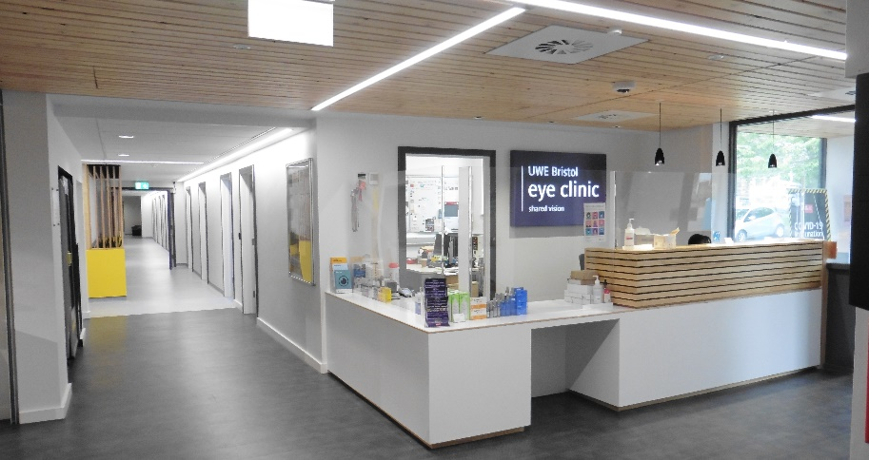
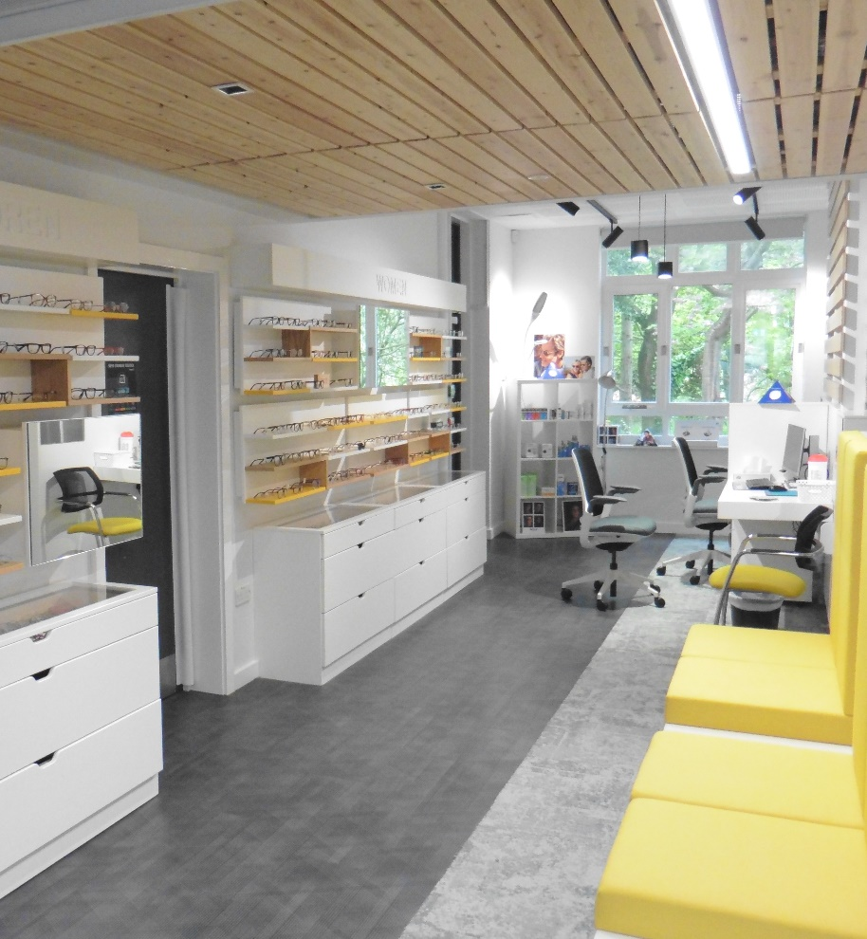
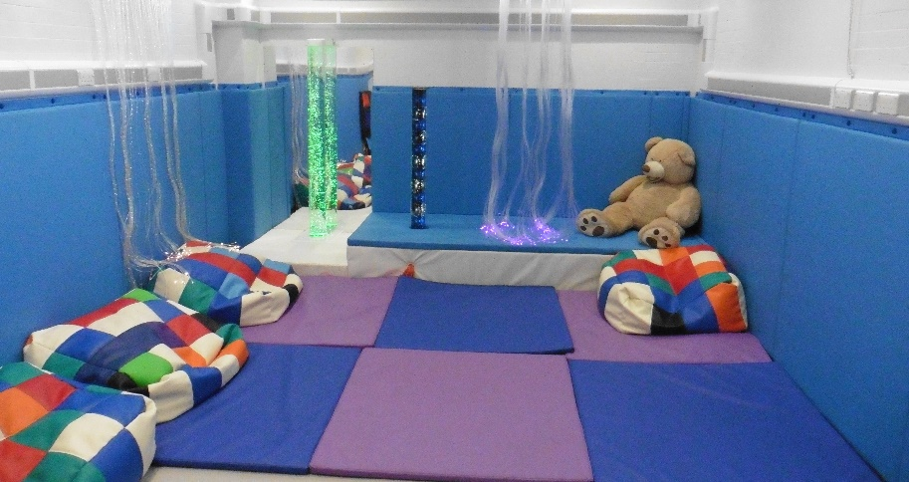
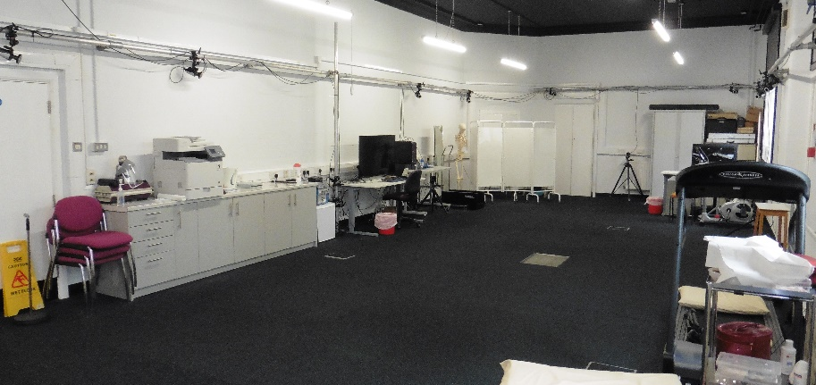
UWE BRISTOL
HEALTH AND SOCIAL CARE
Building on our success and ecosystem
Public Facing Clinics – an integral aspect of any practice facing subject within an academic setting
Notes:
This slide helps bring this to life and in particular that integrated approach.

Slide 12
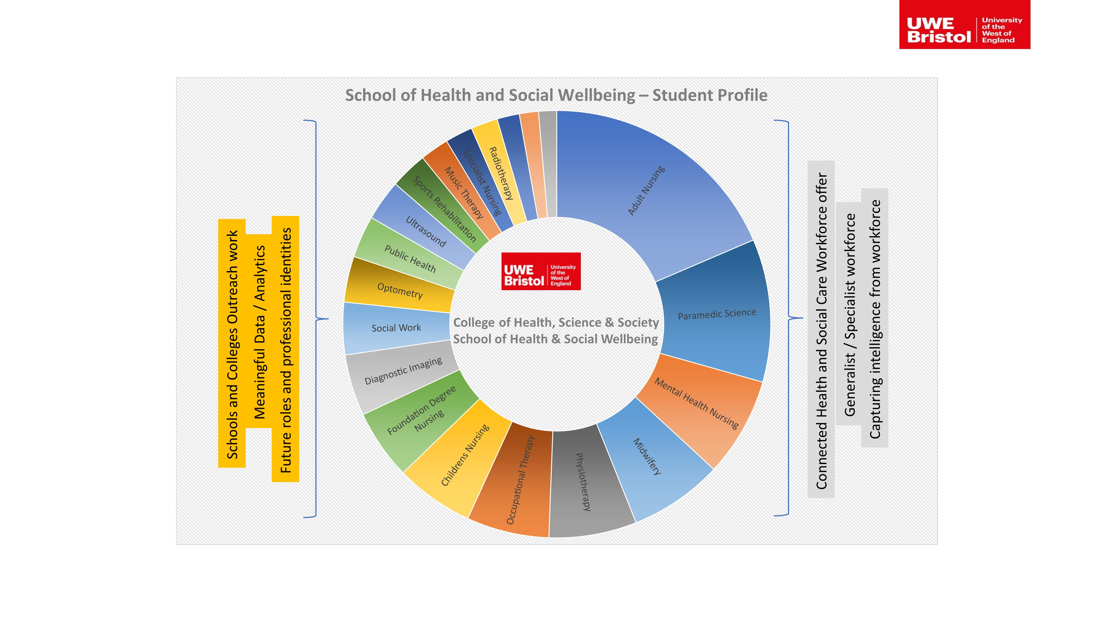
SCHOOL OF HEALTH
AND SOCIAL WELLBEING

Slide 13
LOOKING AHEAD
Changing needs and opportunities
Exploring our collective challenge – getting the workforce mix right
Mentimeter questions (#3-4) – www.menti.com
Code: 2413 5898
Notes:
2 questions posed via MentiMeter and after each question has been completed (i.e. via participant interaction), then a 5 min discussion is undertaken per question on tables with a member of VCE / marketing present to capture key information / points
Questions:
#3 - Where can we work better via a whole system approach to develop the right mix of support and qualified staff?
#4 - How can the health and social care sector retain employees and fill the growing number of hard-to-fill vacancies?
Purpose of this discussion – understanding our challenge to inform what we need to do as a whole system to achieve our best for our stakeholders.

Slide 14
LOOKING AHEAD
Changing needs and opportunities
Mentimeter question (#5) – www.menti.com
Code: 2413 5898
Notes:
Some of the things we have been thinking about are set out on this slide. Would be really interested in your views on these statements. Please could you go to the mentimeter to input your views, strongly agree to strongly disagree.
Question:
#5 - How would you rate these statements-
Geonomics will increasingly become an important part of all health professions skills set
Life long learning will need to evolve to include dynamic 'just in time' digital update / micro-credentials
Bioinformaticians will be common place in the next 5 years across health and social care environments
Artificial Intelligence and other technologically enabled services should be embedded as part of all professional / regulatory bodies
10 mins to discuss the 5th question (rate these statements) on mentimeter.

Slide 15
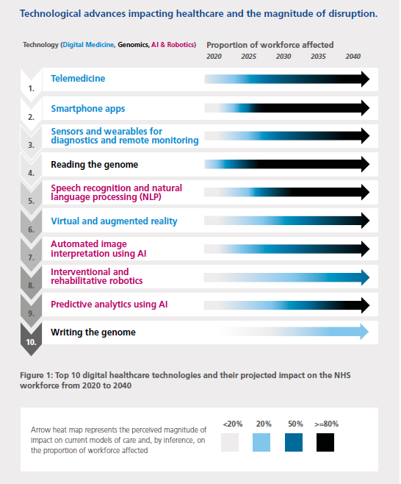
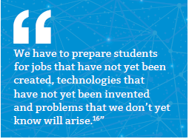
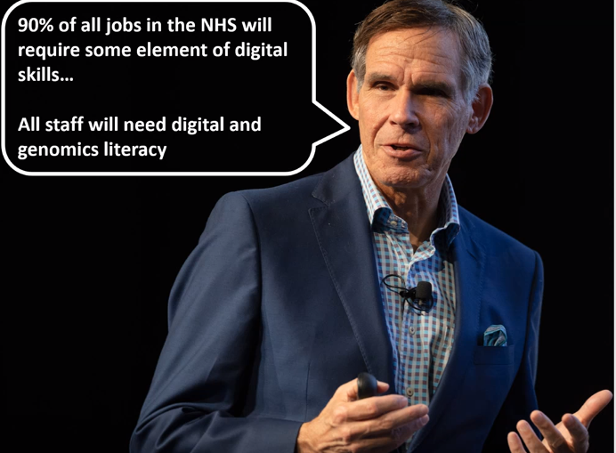
TOPOL REVIEW
Skills and Knowledge
Notes:
2 questions posed via MentiMeter and after each question has been completed (i.e. via participant interaction), then a 5 min discussion is undertaken per question on tables with a member of VCE / marketing present to capture key information / points
Questions:
#3 - Where can we work better via a whole system approach to develop the right mix of support and qualified staff?
#4 - How can the health and social care sector retain employees and fill the growing number of hard-to-fill vacancies?
Purpose of this discussion – understanding our challenge to inform what we need to do as a whole system to achieve our best for our stakeholders.

Slide 16
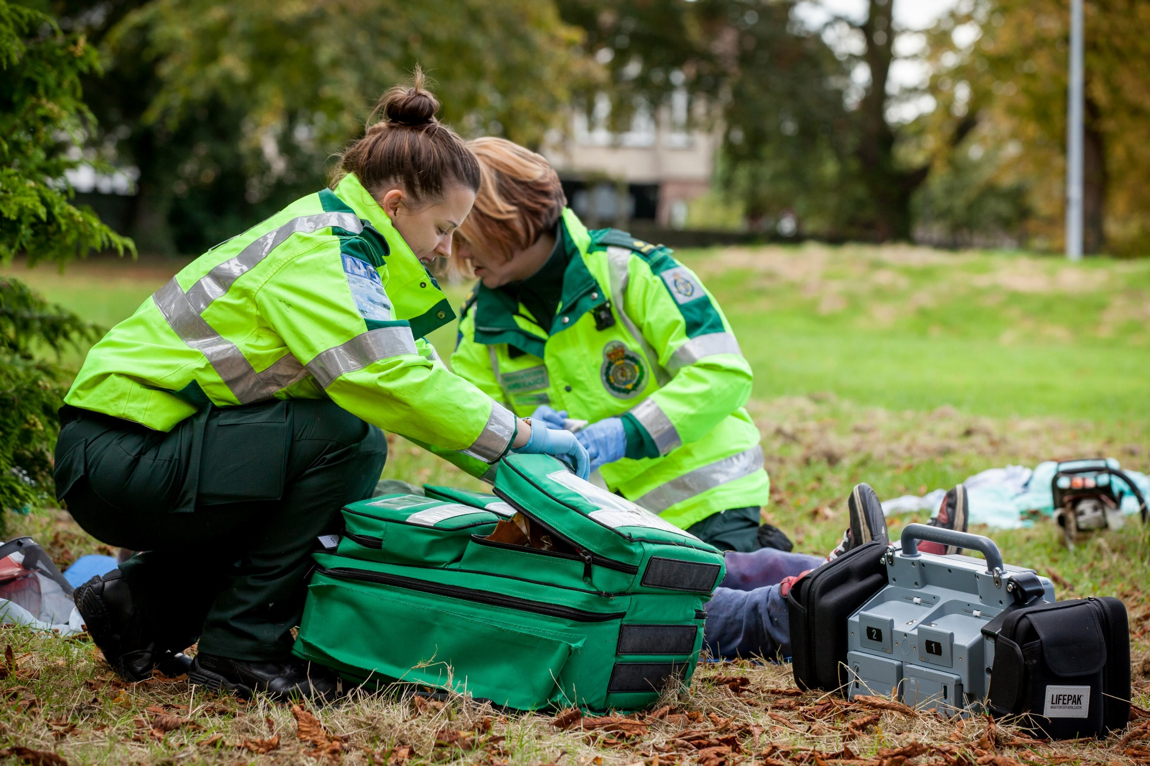
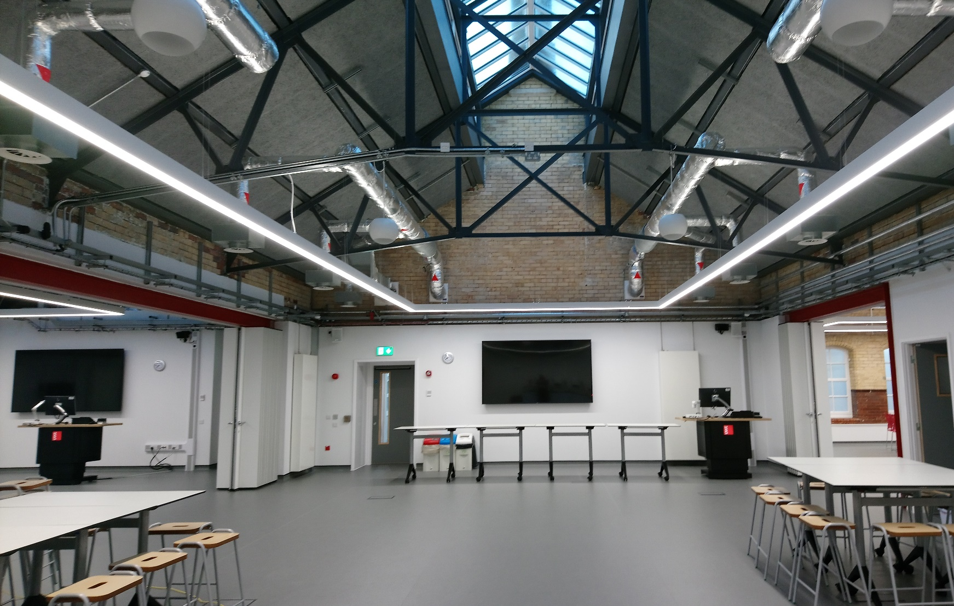
SCHOOL OF HEALTH
AND SOCIAL WELLBEING
Notes:
2 questions posed via MentiMeter and after each question has been completed (i.e. via participant interaction), then a 5 min discussion is undertaken per question on tables with a member of VCE / marketing present to capture key information / points
Questions:
#3 - Where can we work better via a whole system approach to develop the right mix of support and qualified staff?
#4 - How can the health and social care sector retain employees and fill the growing number of hard-to-fill vacancies?
Purpose of this discussion – understanding our challenge to inform what we need to do as a whole system to achieve our best for our stakeholders.

Slide 17
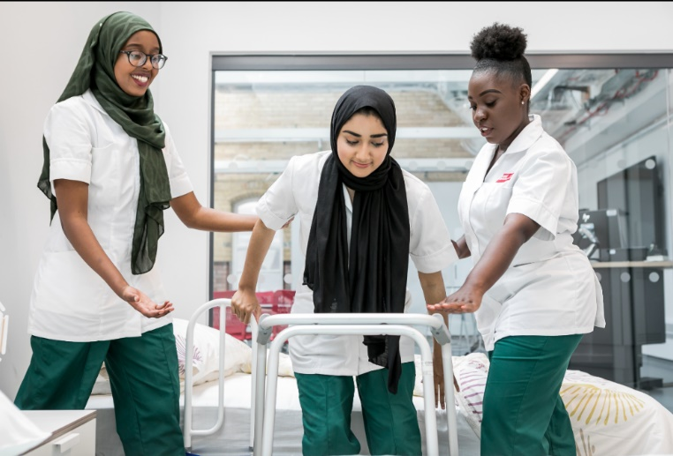
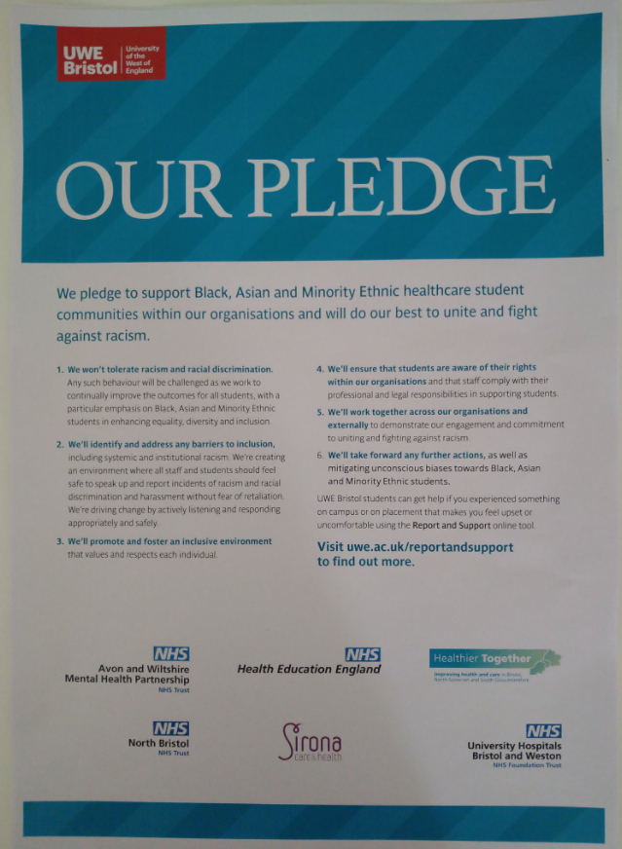
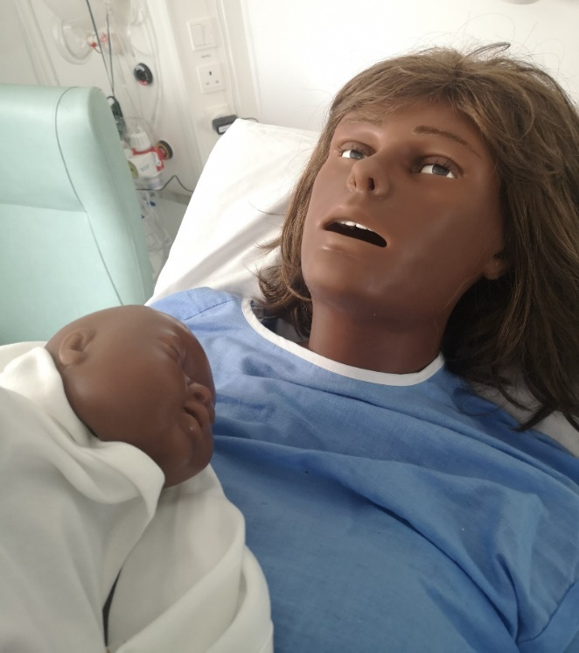
WELLBEING, EQUALITY, DIVERSITY AND INCLUSIVITY
Mental health support for students and staff is becoming increasingly important.
Embracing diversity in student applications / recruitment to health and social care programmes.
Supporting students on placements is equally as important as the academic environment.
Supporting wellbeing and promoting Speak Up / whistle blowing.
Ensuring the curricula and standards of practice map the growing needs of a diverse health and social care population.
Notes:
2 questions posed via MentiMeter and after each question has been completed (i.e. via participant interaction), then a 5 min discussion is undertaken per question on tables with a member of VCE / marketing present to capture key information / points
Questions:
#3 - Where can we work better via a whole system approach to develop the right mix of support and qualified staff?
#4 - How can the health and social care sector retain employees and fill the growing number of hard-to-fill vacancies?
Purpose of this discussion – understanding our challenge to inform what we need to do as a whole system to achieve our best for our stakeholders.

Slide 18
SUPPORTING A DIVERSE WORKFORCE TECHNICIANS
Emerging roles with the university environment to support learning through simulation.
Disrupting the traditional delivery methods of learning and assessment.
Co-creating new approaches to pedagogy and assessment.
Greater skills mix and career development.
Shaping the ‘hybrid workforce’.
Digital learning and design Technologists.
Notes:
2 questions posed via MentiMeter and after each question has been completed (i.e. via participant interaction), then a 5 min discussion is undertaken per question on tables with a member of VCE / marketing present to capture key information / points
Questions:
#3 - Where can we work better via a whole system approach to develop the right mix of support and qualified staff?
#4 - How can the health and social care sector retain employees and fill the growing number of hard-to-fill vacancies?
Purpose of this discussion – understanding our challenge to inform what we need to do as a whole system to achieve our best for our stakeholders.

Slide 19
LOOKING AHEAD
Changing needs and opportunities
Exploring our collective challenge & opportunity | What does a connected model look like?
Mentimeter question (#6) – www.menti.com
Code: 2413 5898
Notes:
Some of the things we have been thinking about are set out on this slide. Would be really interested in your views on these statements. Please could you go to the mentimeter to input your views, strongly agree to strongly disagree.
5 mins to discuss the 6th question (rate these statements) on mentimeter.

Slide 20
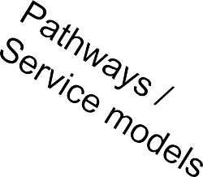
UWE BRISTOL
HEALTH AND SOCIAL CARE
Building on our success and ecosystem
An integrated model for Health and Social Care education
Workforce
Regulators
UWE
UoB BU
UoG
Data Observatory
Learning Academies
ICS x 7
AHSN
Diagnostics Rehabilitation
International connection / Beacons
Notes:
We see our role very much as part of a wider ecosystem. Drawing across our expertise as a University, not just in our School of Health and Social Care, but also critically with our partners – and we are looking to strengthen further going forwards.
We have huge expertise for example in outreach and widening access, key areas that are critical for the future health and social care workforce.

Slide 21
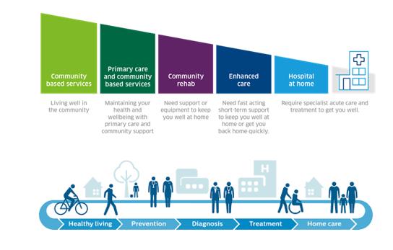
FUTURE THINKING
Building on our success and ecosystem
Mentimeter question (#6) – www.menti.com
Notes:
Interested in your views. Does our view of a connected system resonate with you? Where are the gaps and weaknesses we need to work together to address?
Assuming this still builds on and doesn’t duplicate previous discussion.

Slide 22
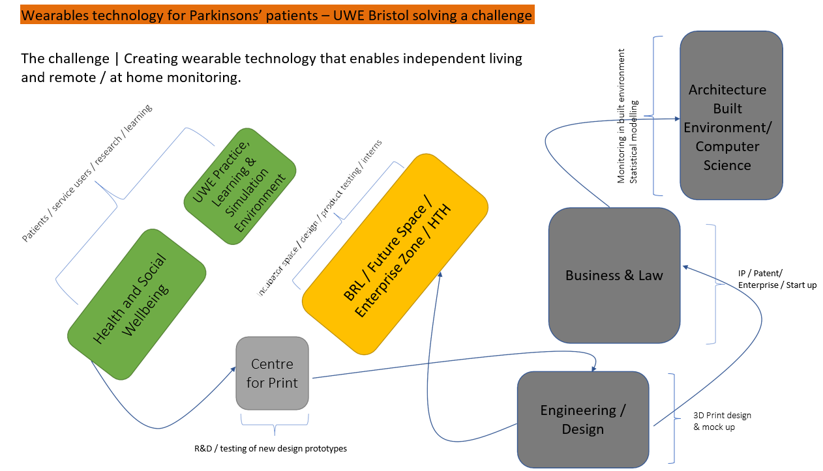
UTILISING THE COMBINED VALUE OF THE WHOLE HEALTH AND SOCIAL CARE ECO-SYSTEM
Notes:
This is an example where UWE Bristol could be working collaboratively with partners and within our environment to develop wearable technology for patients with Parkinsonism disease.

Slide 23
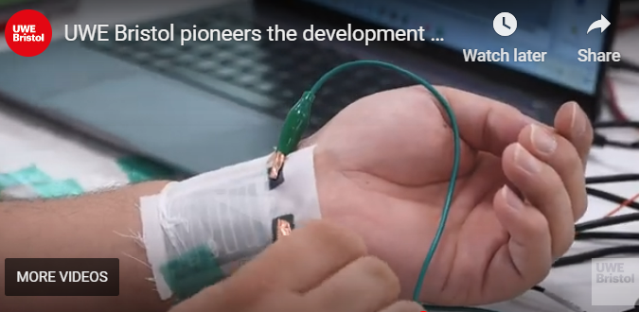
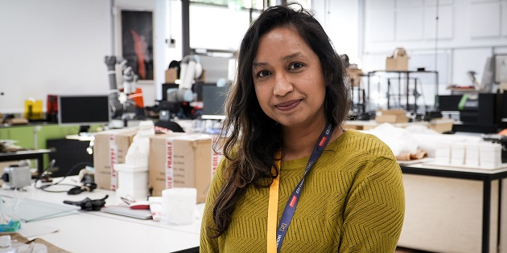
DEVELOPMENT OF WEARABLE HEALTH MONITORING E-TEXTILES
Use of graphene to detect atrial fibrillation in patients with remote monitoring
Dr Shaila Afroj – Senior Research Fellow
Centre for Print Research (CFPR)

Slide 24
HEALTH TECHNOLOGY HUB
Creating opportunities for businesses, universities and the healthcare sector to work together to solve the demanding problems faced by the healthcare sector in the UK and globally.
Notes:
Identifying and solving the challenges which the healthcare facing through collaborative cross-disciplinary approach and partnership working
Opportunities for students’ placement, summer vacation bursaries (paid), experience of working in the “real world environment”, building own network which enhances students’ CV and develops a unique set of transferable skills.
Examples of the research conducted in the Health Tech Hub: technologies for assisted living, rapid diagnostics, point-of-care tests.

Slide 25
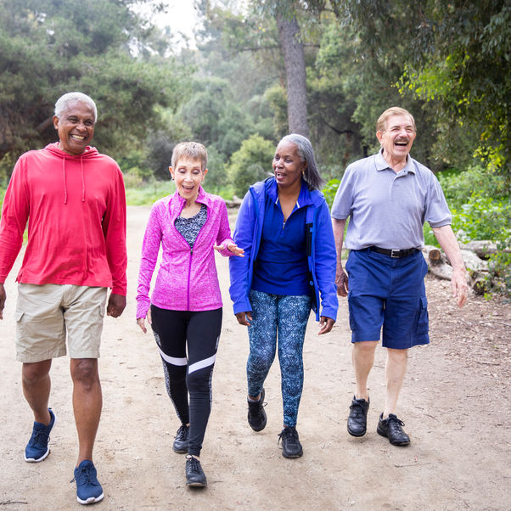
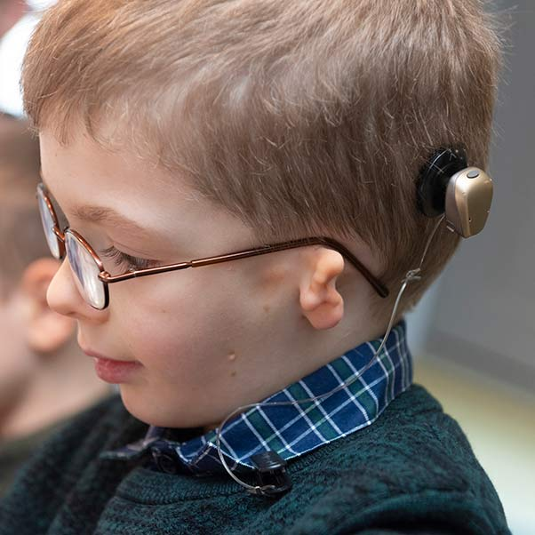
OUR RESEARCH AND INNOVATION
Osteoarthritis Research – Development a rehabilitation program for patients with osteoarthritis
Caring for Craniofacial Conditions – Understanding the concerns and needs of the patients with craniofacial conditions
Alzheimer’s disease – Collaboration with Bristol’s Southmead Hospital and the regional charity BRACE with the patients and public involvement
Biofilm Model Systems in Healthcare – Development of novel technologies for measuring the microbial growth & wound healing technologies
Safer Drugs – Pioneering work on creating drugs for conditions resistant to regular antibiotics

Slide 26
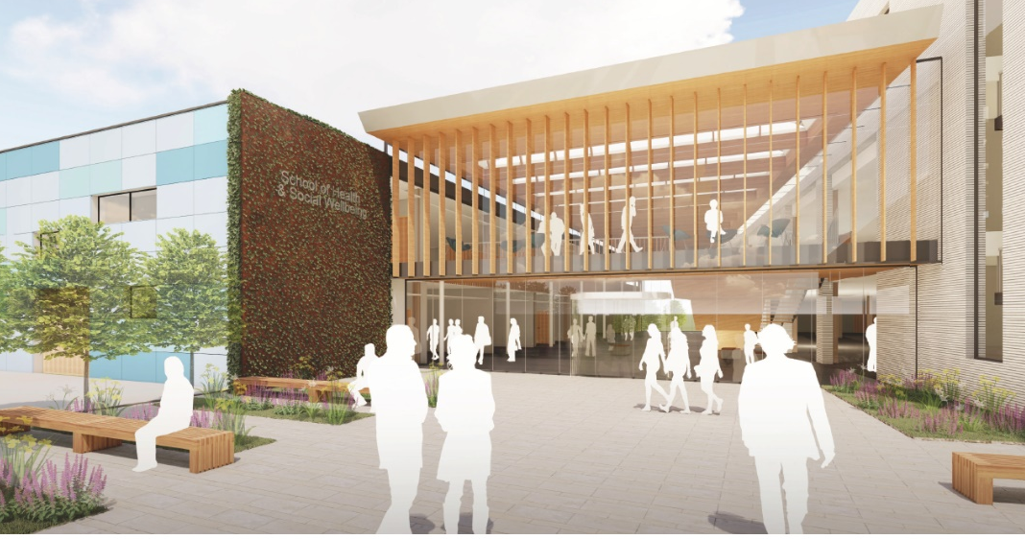
UWE BRISTOL HEALTH
AND SOCIAL CARE
Future Thinking
Our vision
The future health and social care workforce will be required to work in new ways across organisations and sectors, aided by technology, to meet the changing needs of future patients.
To support this evolving workforce, the University has developed a vision to build a centre of excellence in healthcare education and innovation for the South West.
Notes:
As we look ahead, we want to explore with you a bit more about our current vision for the future, which we will continue to shape with your insights from this evening.
Marc – I've changed the visual on this so it is more focused on health and social care as opposed to wider campus.

Slide 27
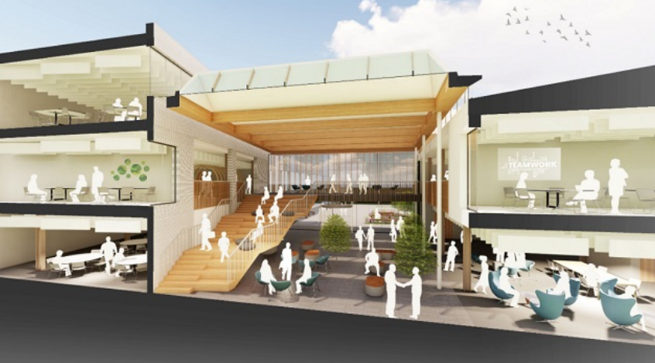
UWE BRISTOL HEALTH
AND SOCIAL CARE
Future Thinking
Our vision
Relocating to new fit-for-purpose facilities on the Frenchay Campus, with state-of-the-art technology and larger spaces with greater flexibility for inter-professional learning, bringing together students and staff from different disciplines, and fostering a more collaborative and immersive approach to learning.
The development would see two existing buildings converted into purpose-built facilities, along with the construction of an adjacent new building. One of the existing buildings would become an Immersive Future Skills Lab supporting flexible, practice-led, skills-based learning. The University has received £5.8 million from the OfS for investment in the lab.
Architecture design of the future of Health and Social Wellbeing at Frenchay Campus
Notes:
You’ll see floor plans around this space – please do engage with us or the architects to understand these further and the potential of these spaces.

Slide 28
UWE BRISTOL HEALTH
AND SOCIAL CARE
Future Thinking
Shaping our vision for a Connected Campus – 2.0
Community and business engagement will be the heart of the new site, with additional public-facing spaces created to allow the University to strengthen links with partner organisations in the region.
Creating physical and digital spaces that provide access to simulation and clinical skills is integral within health and social care.
Constraints on the availability of physical placements within practice, coupled with the experiences of Covid-19.
Having a ‘connected campus’ that creates the required conditions for professional growth, development and key graduate outcomes is vital.
Connections with remote / regional sites will be vital as long arm supervision
becomes more embedded.
Notes:
The ethos of a connected campus is critical to our vision.

Slide 29
UWE BRISTOL HEALTH
AND SOCIAL CARE
Future Thinking
Over the coming months and years, UWE Bristol will be working closely with external partners across the health and care sector to help shape the development.
Notes:
Discussion to help shape this vision further.

Slide 30
UWE BRISTOL HEALTH
AND SOCIAL CARE
Future Thinking
Our vision is built on:
Our partnership with our NHS partners across our local and regional health and social care systems.
Our role in creating a health and social care system where we will deliver new models of patient-centric, sustainable health, social care and wellbeing that become best practice in the UK and beyond.
Our role as a centre of excellence bringing together individuals, organisations, industry, networks and partnerships to form a living lab, dedicated to developing new ways of undertaking research, teaching, enterprise and technology transfer.
Notes:
We will build on your insights as we think more about our next steps and vision, which is founded on… (as per slide)

Slide 31
UWE BRISTOL HEALTH
AND SOCIAL CARE
Future Thinking
Our vision is built on:
Our role in bringing together clinicians, academics, researchers and system leaders to create new delivery pathways. Linking higher and further education to create new innovative pathways for learners across the Severn network using the established partnership created through Institutes of Technology.
Developing new educational and workforce pathways, leading to new professional disciplines that address modern challenges head on. Enabling us to equip health and social care professionals to work collaboratively at every level placing patients and carers at the centre of design and delivery of new care pathways.
Developing, improving, and testing the service delivery models of the future, to equip workforces with skills to keep challenging, reinventing, and refining.
As the South West’s first Integrated Care Academy

