Slide 1

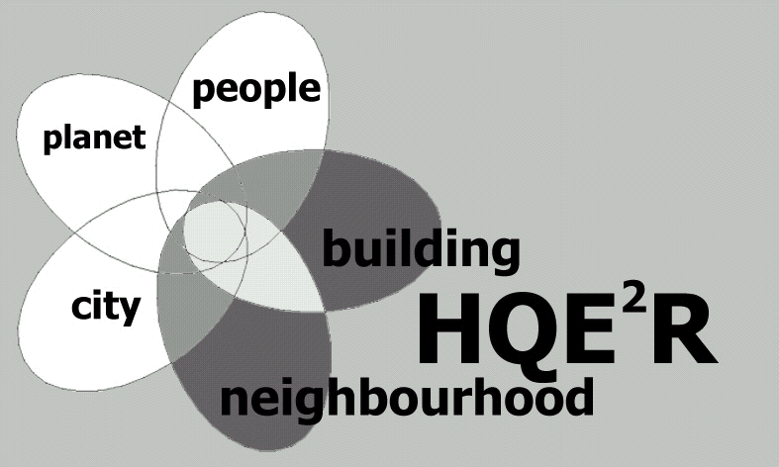
The UK Case Study - Bristol
Involving the community in selecting indicators
HQE²R
Mantova
8 September 2003

Slide 2
What is Community at Heart?
The New Deal for Communities - UK government regeneration programme.
Comprehensive regeneration - social and physical.
Community at Heart - delivering the New Deal for Communities in Bristol.
Community leadership - in partnership with Bristol City Council and other agencies.
£50M over a 10-year period from 2000.

Slide 3
The Community at Heart neighbourhood
Maps removed due to publisher’s copyright rules.
Bristol: 400,000
CAH: 5,900
Close to, but isolated from the city centre.

Slide 4
A neighbourhood working to overcome multiple deprivation
Strong sense of community - and participation in the regeneration process, although many are sceptical
Long-term economic problems - unemployment and low income
High rates of crime and fear of crime
Lack of investment - little benefit to the area from regeneration in recent decades

Slide 5
Community at Heart objectives
‘Our vision is to create a strong responsible community that has
the ability to understand, engage and overcome its problems
enabling Barton Hill to build a safe environment that fulfils local
needs, inspires and provides opportunities for all.’
Project areas:
Employment and business Sustainable health and well-being
Tackling crime Education
Housing Community services
Arts, sports and leisure Tackling racism

Slide 6
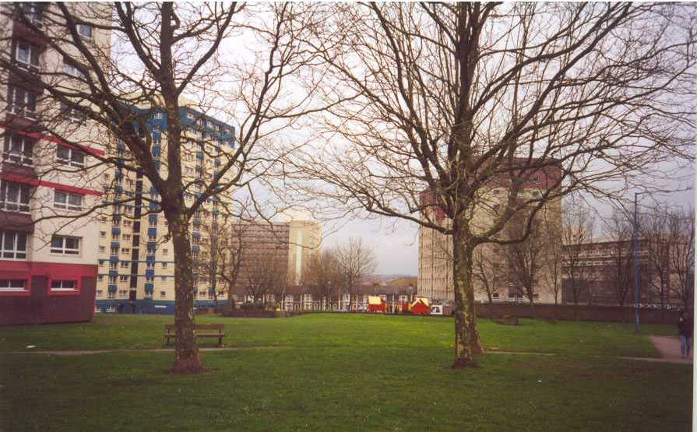
HQE²R
Bristol

Slide 7
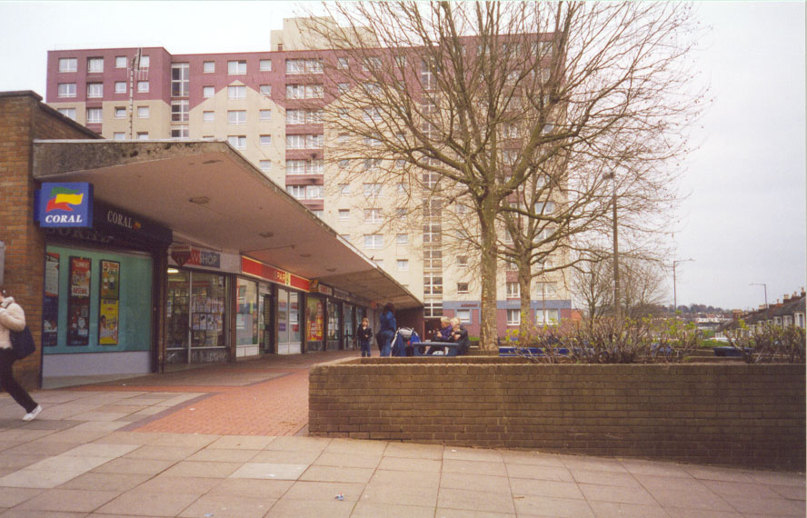
HQE²R
Bristol

Slide 8
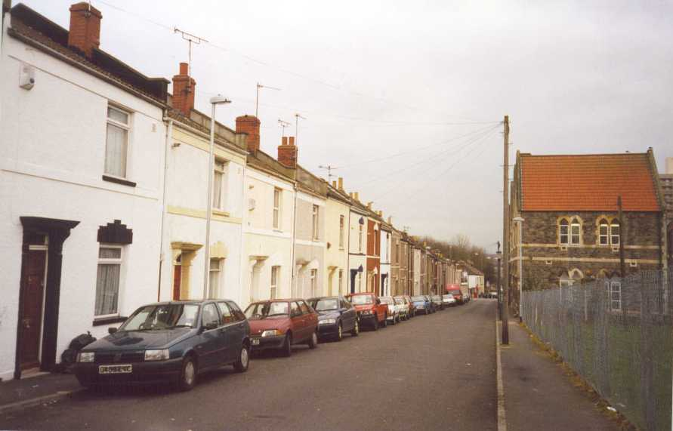
HQE²R
Bristol

Slide 9
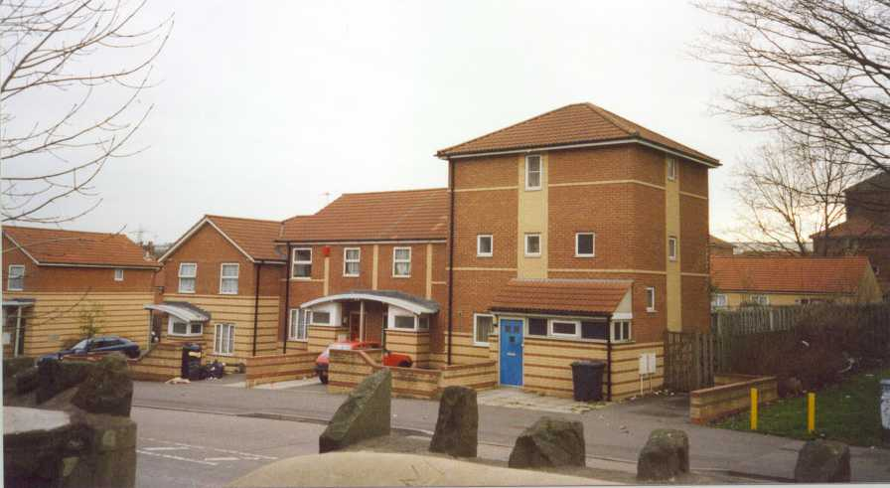
HQE²R
Bristol

Slide 10
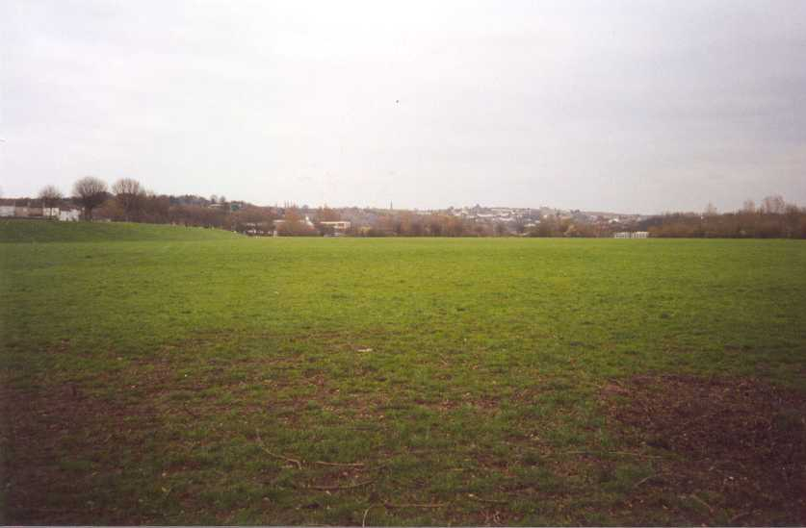
HQE²R
Bristol

Slide 11
HQE2R case study -
involving the community
February- April 2002 - participatory consultation for HQE2R inventory
Aug - September - follow up consultation; indicators to feed into Community at Heart evaluation

Slide 12
Participatory consultation on neighbourhood issues
Tenants Associations
Churches
Youth Groups
Schools
Businesses
Mosque
Elderly peoples group
Shops
Doctor’s surgery
Cafe
UWE + Local Consultant
Recruitment
+Training
5 Researchers
December 01 – January 02
February – April 02

Slide 13
HQE2R case study -
involving the community

Slide 14
Community indicators
How can YOU tell if the neighbourhood has changed for the better?

Slide 15
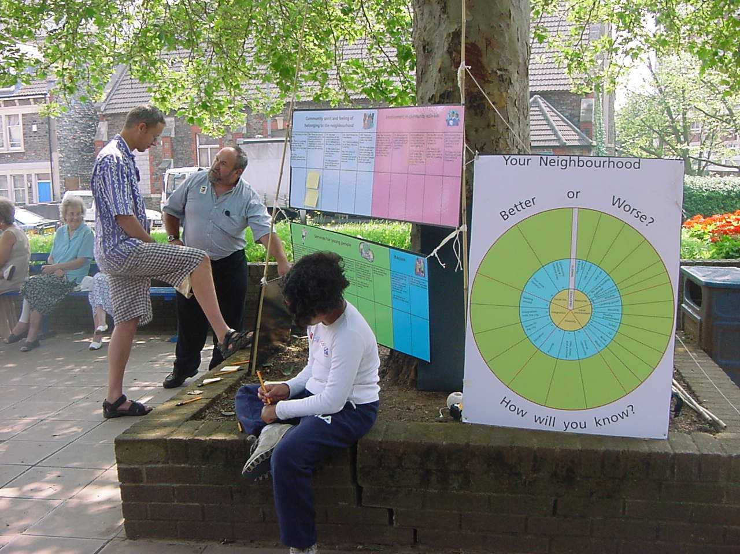
HQE²R
Bristol

