Slide 1
The Nature of the Request Requirement for Collective Self-Defence
Professor James A. Green
British Academy Mid-Career Fellowship funding supported this research
14 March 2023

Slide 2
Introducing collective self-defence
Article 51 of the UN Charter 1945 sanctifies ‘the inherent right of individual or collective self-defence if an armed attack occurs…’.
Collective self-defence can be broadly defined as the use of military force by one or more states to aid another state that is the innocent victim of an armed attack.
e.g., First Gulf War (1991)
Collective self-defence treaty arrangements
e.g., NATO
The defence of another

Slide 3
Introducing collective self-defence
Tension:
Genuine acts of defensive support for states unable to defend themselves / collective stance against aggression
vs
Abuse, pretext and the risk of significantly escalating uses of force / armed conflicts.
Unprecedented increase in the number of claims in recent years, e.g.:
Syria (since 2014) – a whopping 10 coalition states
Turkey in relation to Azerbaijan/Nagorno-Karabakh (2020)
Collective Security Treaty Organisation (CSTO) / Kazakhstan (2022)
Armenia (2022)
Russia in relation to Ukraine (2022) / NATO in relation to Ukraine (?)

Slide 4
Criteria shared with individual self-defence
Armed attack (a grave use of force)
NB: controversies also shared, e.g.:
Is an imminent armed attack sufficient?
Can the armed attack be perpetrated by a non-state actor?
Necessity
Proportionality
Reporting requirement
Requirement to desist once UN Security Council steps in (‘Until Clause’)

Slide 5
Two additional requirements for collective self-defence?
Nicaragua case (merits) (1986), paras. 165-166, 195, 199, 231 (and the majority scholarly view since) is that under customary international law the victim state must:
declare that it has been the victim of an armed attack.
request that another state or states comes to its aid in response to that attack.
Underpinning policy goal…

Slide 6
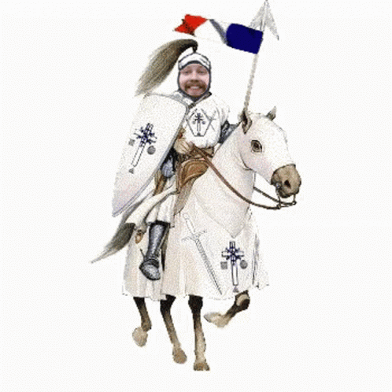

Slide 7
Debunking ‘declaration’
Unclear why the declaration criterion is needed as a matter of policy.
Indeed, unhelpfully formalistic and perhaps even unnecessarily antagonistic.
Dropped from latter case law of the ICJ:
Oil Platforms (2003)
Armed Activities (2005)
Most importantly, states don’t declare and other states don’t take issue with the fact that they don’t declare.

Slide 8
‘Request’ is a legal requirement
Victim states have almost invariably made requests for aid throughout the UN era.
States claiming to come to the victim’s aid have relied upon and invoked those requests.
States that have questioned the lawfulness of those collective self-defence claims have commonly done so based on the view that the request was invalid.

Slide 9
Nature and importance of the request requirement
Note that ‘request’ ≠ ‘consent’.
The request requirement is fundamental:
Without it ‘the way would be open to unlimited aggression’ (Wright, 1959).
The uncertain picture of what underpins ‘validity’.

Slide 10
Who can issue a request?
Statehood
US in relation to Syrian Democratic Forces (SDF) (2017)
Hims and Kim (2021)
US in relation to SDF (2018)…
Russia/South Ossetia (2008)
Russia/Donetsk and Luhansk (2022)
UN membership?

Slide 11
Who can issue a request?
De jure government
Effective control?
Other factors key, e.g.:
Democratic legitimacy (although sometimes no basis in fact, e.g., Chad in 1980s)
External recognition
Internal constitutional (or other) due process
Legal weight?

Slide 12
The manner and form of requests
‘Open’ vs ‘targeted’ requests
Nicaragua case (merits) (1986), para. 196:
The lawfulness of collective self-defence ‘depends on a request addressed by [the victim] State to the third State.’
e.g., Mozambique request (1977)
No formalities/format
Requests have been made in all kinds of ways…

Slide 13
Implied/covert requests
Public vs publicised
US /Cambodia (1970)
Difficult to establish a legal requirement…
But evidentiarily, would make complying with the requirement extremely difficult.
Clear, explicit, public requests are preferable both on policy grounds and as a procedural matter. They also are overwhelmingly the norm in practice.

Slide 14
Timing of the request
Requests must be made before the use of force begins…
e.g., USSR/Afghanistan (1979)
That said, this need for timeliness is complicated if the request can be covert…
Ex ante ‘consent’ in a pre-existing collective self-defence treaty is insufficient: the request must be ad hoc and specific to the relevant armed attack.
Contra Sari and Nasu (2018)

Slide 15
Conclusion
No question that the request requirement exists in customary international law and it is important for protecting against abuse.
But there remain many uncertainties regarding how it operates.
I have started to try to map out the requirement more than had previously been the case, but more work needs to be done.

