Slide 1
EXPLORING TECHNOLOGY RESISTANCE IN ONLINE ASSESSMENT AND FEEDBACK
PRACTICES
Dr Anabela Soares
(anabela.soares@uwe.ac.uk)
Dr Moya Lerigo-Sampson
(moya.lerigo-sampson@uwe.ac.uk)
Dr Jacqueline Barker
(jacqueline.barker@uwe.ac.uk)
Bristol Business School,
University of the West of England

Slide 2
Overview
Research Objectives
To explore the attitudes of staff regarding online feedback and marking tools
To establish the current state of usage
To investigate future adoption intentions
Outputs
Journal article publications
Report for UWE Digital Strategy 2030
Training and development materials

Slide 3
“Students frequently referred to them as serving the purposes of learning and achievement, while instructors focussed almost exclusively on the role of a rubric in quickly, objectively and accurately assigning grades” (Reddy and Andrade, 2009)
Pedagogic Debate around Marking Rubrics
Advantages
Rubrics can provide consistent, reliable, and efficient marking
Rubrics can be used to teach as well as evaluate
Rubrics can improve learning, academic performance, and self-regulation
Rubrics can provide a sense of transparency and fairness
Disadvantages
Rubrics tend to standardise and narrow the curriculum
Rubrics can lead to instrumental learning and “criteria compliance” among students
Concerns around validity and reliability (links to appropriateness of language)

Slide 4
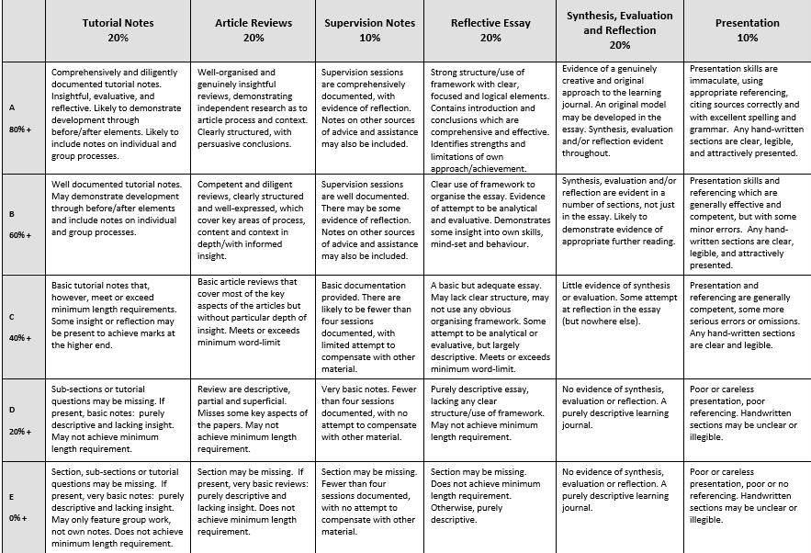
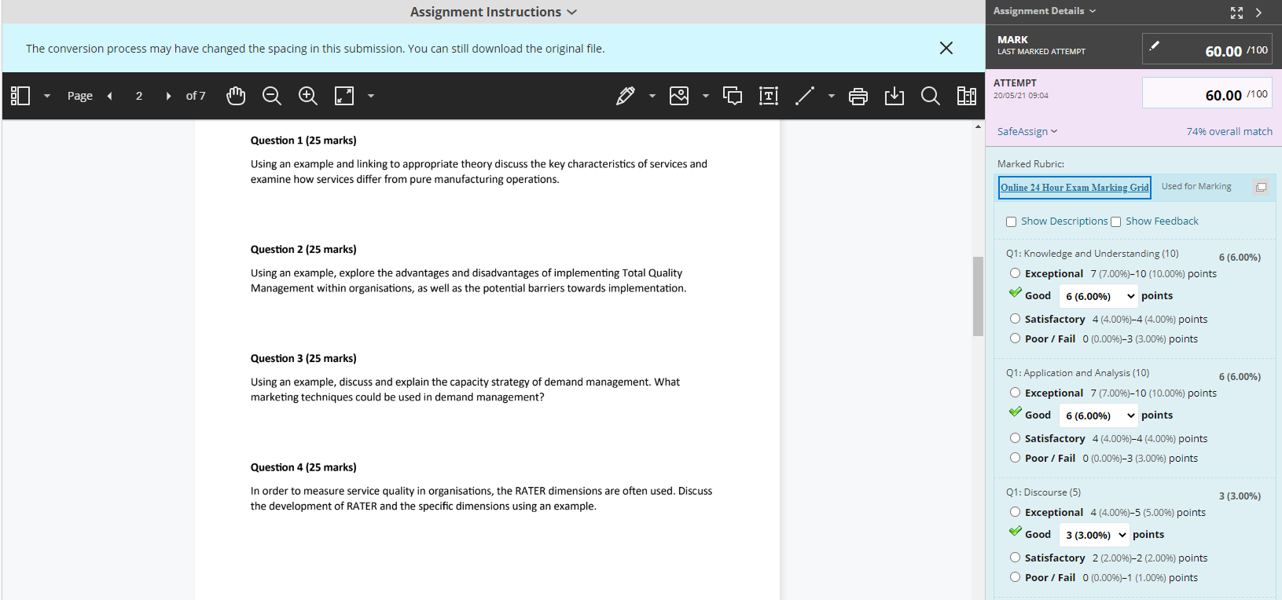
Context
Online Embedded Rubrics vs Offline Rubrics
Online embedded rubrics have only recently been introduced to the Blackboard platform at UWE
Determining the significance of a particular tool and predicting the success of its use prior to adoption is crucial for future identification of training and investment needs.
Offline Rubric
Online Embedded Rubric

Slide 5
Theoretical Framework:
The unified theory of acceptance and use of technology (UTAUT)
Venkatesh et al. (2003)
Digital confidence (DC)
Use of rubrics in general (RG)
Prior knowledge of embedded rubrics (PK)
Performance expectancy (PE)
Effort expectancy (EE)
Behavioural intention to use “Acceptance” (BI)
Social influence (SI)
Actual use of embedded rubrics
Facilitating conditions (FC)
We will only be able to measure ‘Actual Use’ at the end of the project.
Focus group results
Moderators:
Age
Gender
Experience
Voluntariness of use

Slide 6
Methodology
Case study approach
Two phases:
Phase 1 (Quantitative)
Phase 2 (Qualitative)
The project is currently still in Phase 2 with ongoing data collection.
For the purpose of this conference, we will be discussing the preliminary findings from Phase 1
Self-administered questionnaires distributed online via Qualtrics
Sample:
84 Academics (Only 61 valid responses)
38 Professional support services
Data analysis:
Descriptive statistics
Internal consistency
Regression analysis

Slide 7
Methodology
 | 2019 | 2020 | 2021 | 2022
Pilot project with the use of online embedded rubrics (N = 8 participants) | Researchers pilot | Training 2 volunteers | 6 volunteers | Staff focus group (May 2022) N = 6
Meetings with various stakeholders to understand context and UWE marking tool | Context meetings 2 senior technologists 1 IT manager 4 L&T managers
Phase 1: Quantitative data collection | online questionnaire development | online questionnaire development | online questionnaire (N=61)
Phase 2: Qualitative data collection |  |  |  | Staff interviews (May, June 2022) Student Focus group (June 2022)

Slide 8
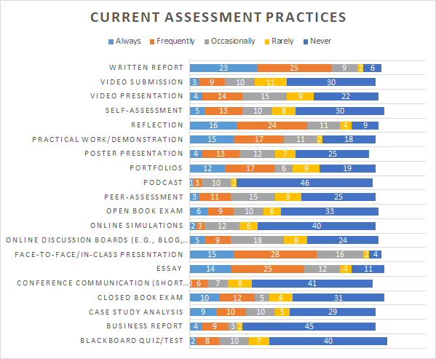
Phase 1: Results

Slide 9
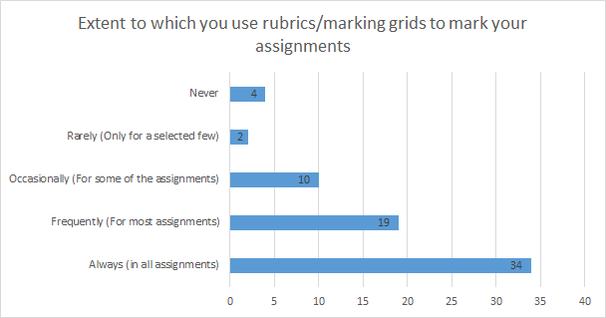
Phase 1: Results

Slide 10
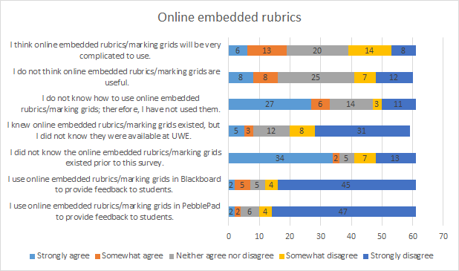
Phase 1: Results

Slide 11
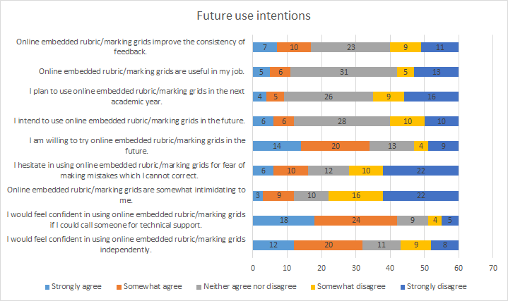
Phase 1: Results

Slide 12
Phase 1: Results
UTAUT factors: | Number of items | Cronbach's Alpha
Performance expectancy (PE) | 4 | 0.82
Effort expectancy (EfE) | 4 | 0.85
Social influence (SI) | 2 | 0.65
Facilitating conditions (FC) | 5 | 0.71
Behavioural intention (BI) | 3 | 0.879
Additional factors | Number of items | Cronbach's Alpha
Rubrics use in general (RG) | 6 | 0.557
Prior knowledge of embedded rubrics (PK) | 4 | 0.576
Digital confidence (DC) | 4 | 0.708

Slide 13
Phase 1: Results
Valid responses (N = 61 academics)
Only one significant relationship: Performance expectancy and behavioural intention to use online embedded rubrics.
F (3,55) = 19.678, p = 0.000; b = 0.780, p = 0.000
Digital confidence (DC)
Use of rubrics in general (RG)
Prior knowledge of embedded rubrics (PK)
Performance expectancy (PE)
Effort expectancy (EE)
Behavioural intention to use “Acceptance” (BI)
Social influence (SI)
Actual use of embedded rubrics
Facilitating conditions (FC)
We will only be able to measure ‘Actual Use’ at the end of the project.
Focus group results

Slide 14
Implications and Conclusions
Competitive pressures to adopt online marking tools, for consistent, reliable, and efficient marking and to align with student expectations and satisfaction (Ozkan and Koseler, 2009; Reed and Watmough, 2015).
Preliminary results show high resistance in adoption of online embedded marking tools at an institutional level.
Strong cultural resistance to change despite Covid-19.
Originality
Studies on the use of rubrics tend to be student centric.
Little research specifically looking at online embedded rubrics.
Exploration and categorisation of external factors: Individual
Cultural
Innovation (barriers and drivers)
Technological
Pedagogical
Integration of these wider external factors to the UTAUT model.

Slide 15
Next Steps
Data Collection
Phase 2:
Currently conducting interviews to explore the results further and address the "why“
Focus group with staff from the pilot project (data analysis stage)
Focus group with students from the pilot project (to be conducted)
Explore opinions and views of students
Triangulation of data
Assessment and evaluation of ‘Actual Use’ of online embedded rubrics
Pilot Implementation
Review of the assessment and feedback policy
Process mapping and interviews with administration teams
Ongoing development of guidance for staff
Training materials and workshops
ANY SUGGESTIONS?

Slide 16
References
Davis, F. D. (1989), Perceived Usefulness, Perceived Ease of Use, and User Acceptance of Information Technology, MIS Quarterly, 13(3), pp. 319-339.
Davis, F. D., Bagozzi, R. P., and Warshaw, P. R. (1992), Extrinsic and Intrinsic Motivation to Use Computers in the Workplace, Journal of Applied Social Psychology, 22(14), pp. 1111- 1132.
Ozkan, S. and Koseler, R. (2009), Multi-dimensional students' evaluation of e-learning systems in the higher education context: An empirical investigation, Computers and Education, 53(4), pp. 1285-1296.
Panadero, E., and Jonsson, A. (2020). A critical review of the arguments against the use of rubrics. Educational Research Review, 30, 100329.
Reed, P., and Watmough, S. (2015), Hygiene factors: Using VLE minimum standards to avoid student dissatisfaction, E-Learning and Digital Media, 12(1), pp. 68–89.
Sadler, D. R. (2009). Indeterminacy in the use of pre-set criteria for assessment and grading. Assessment and Evaluation in Higher Education, 34(2), pp. 159–179
Schneckenberg, D. (2009), Understanding the real barriers to technology-enhanced innovation in higher education, Educational Research, 51(4), pp. 411-424.
Torrance, H. (2007). Assessment as learning? How the use of explicit learning objectives, assessment criteria and feedback in post‐secondary education and training can come to dominate learning. Assessment in Education, 14(3), pp. 281-294.
Venkatesh, V., Morris, M. G., Davis, G. B., and Davis, F. D. (2003), User Acceptance of Information Technology: Toward a Unified View. MIS Quarterly, 27(1), pp.425–478.

