Slide 1
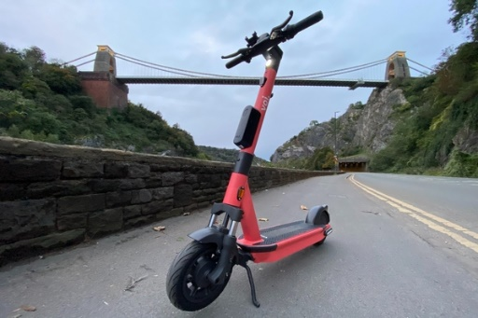
E-scooter experiences: Conflicts and opportunities in urban space
Presentation by
Monique Taratula-Lyons
Billy Clayton
Research team
Monique Taratula-Lyons
Anna Speak
Billy Clayton
Ian Shergold
Paper presented at the RGS-IBG Annual International Conference 2022, 30th August – 2nd September 2022, Newcastle, UK.

Slide 2
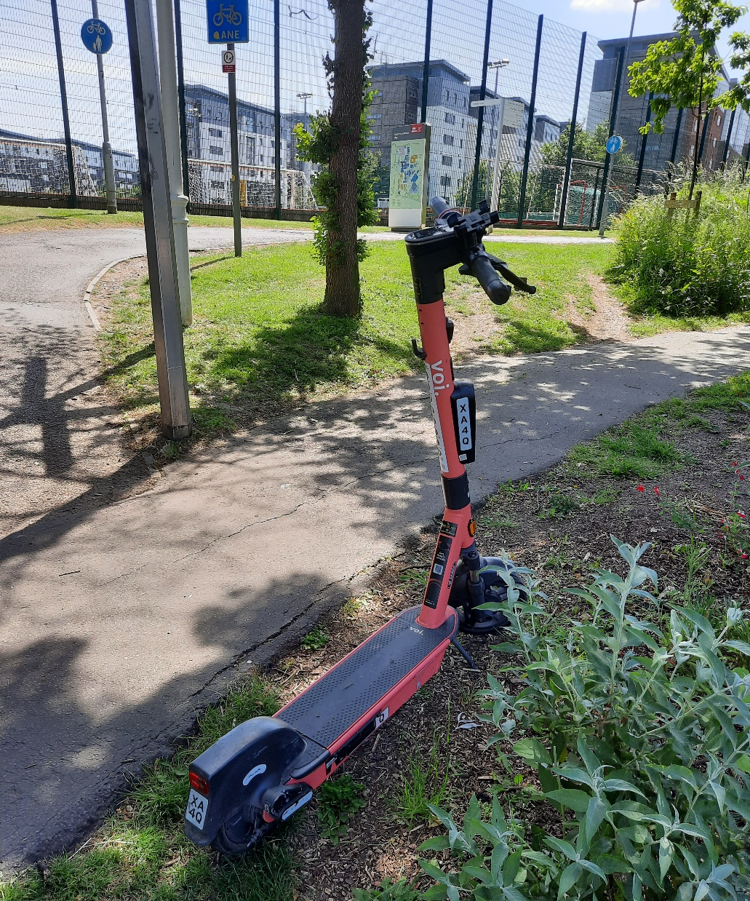
Contents
E-scooters in the literature
Study context
Methods
Results
Conclusions

Slide 3
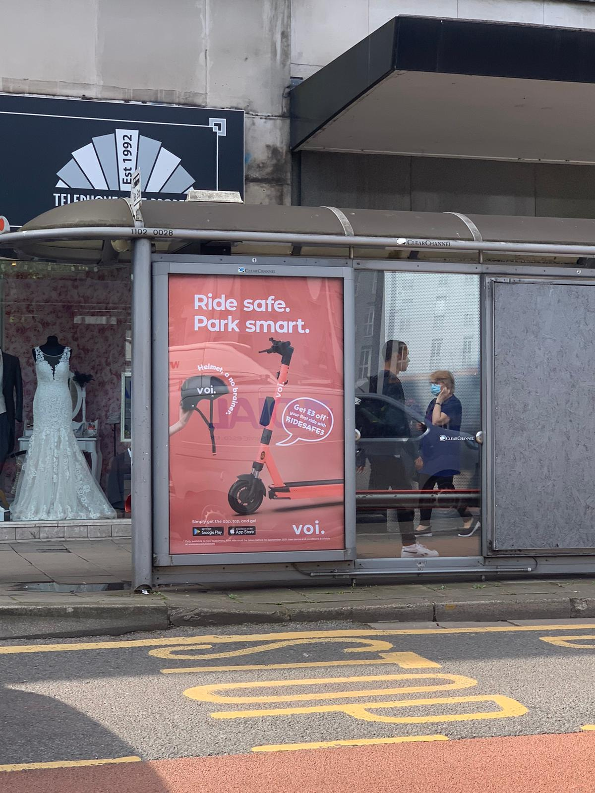
E-scooters in the literature
E-scooters: Use and users
Wave of international popularity since about 2015 (see: Hardt and Bogenberger, 2019; Christoforou et al., 2021)
Used mainly for leisure and enjoyment, and short daily trips (commuting, education access) (Sanders et al., 2020; Hardt and Bogenberger, 2019)
Most popular with younger people (Christoforou et al., 2021)
Gender disparity – used more by men; mirrors the situation with cycling (in the UK) (Wray, 2021)
What modes are e-scooters replacing?
Mixed results – suggestion scooters not as sustainable as portrayed (Hosseinzadeh et al., 2021):
Scooters most often replacing walking and public transport use (Sanders et al., 2020)
However, e-scooters have replaced over 370,000 car journeys in the West of England region during its public trial (WECA, 2021)
Suggested to be a positive form of micro-mobility that provides an alternative option contributing to sustainable mobility objectives (Gössling, 2020) and increasing transport equity through expanding travel choices (Basky, 2020)
New(?) conflicts in urban space
E-scooters are creating new conflicts between users and non-users, adding an additional mode to the already overcrowded shared spaces (Tuncer and Brown, 2020)
Collisions and injuries are becoming commonly reported with e-scooters (Sanders et al., 2020)
Frequent users of e-scooters are seen to develop more risk-taking behaviours (Basky, 2021; Christoforou et al., 2021; BBC News, 2021a)
Helmet use contentious - most customers renting an e-scooter did not wear a helmet (Tuncer and Brown, 2020)
Voi poster on a bus stop located in Bristol City Centre (Taratula-Lyons, 2021)

Slide 4
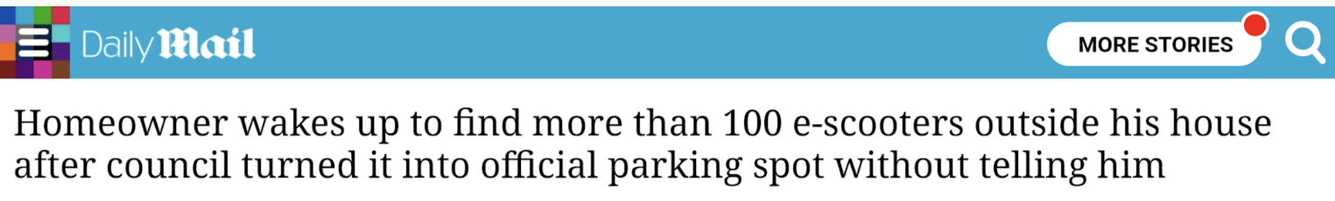
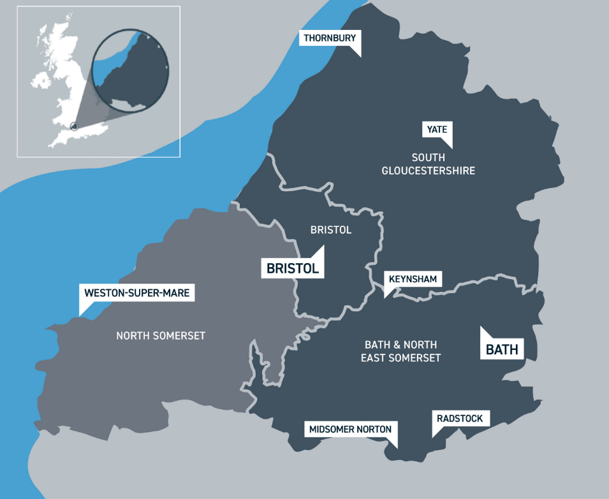
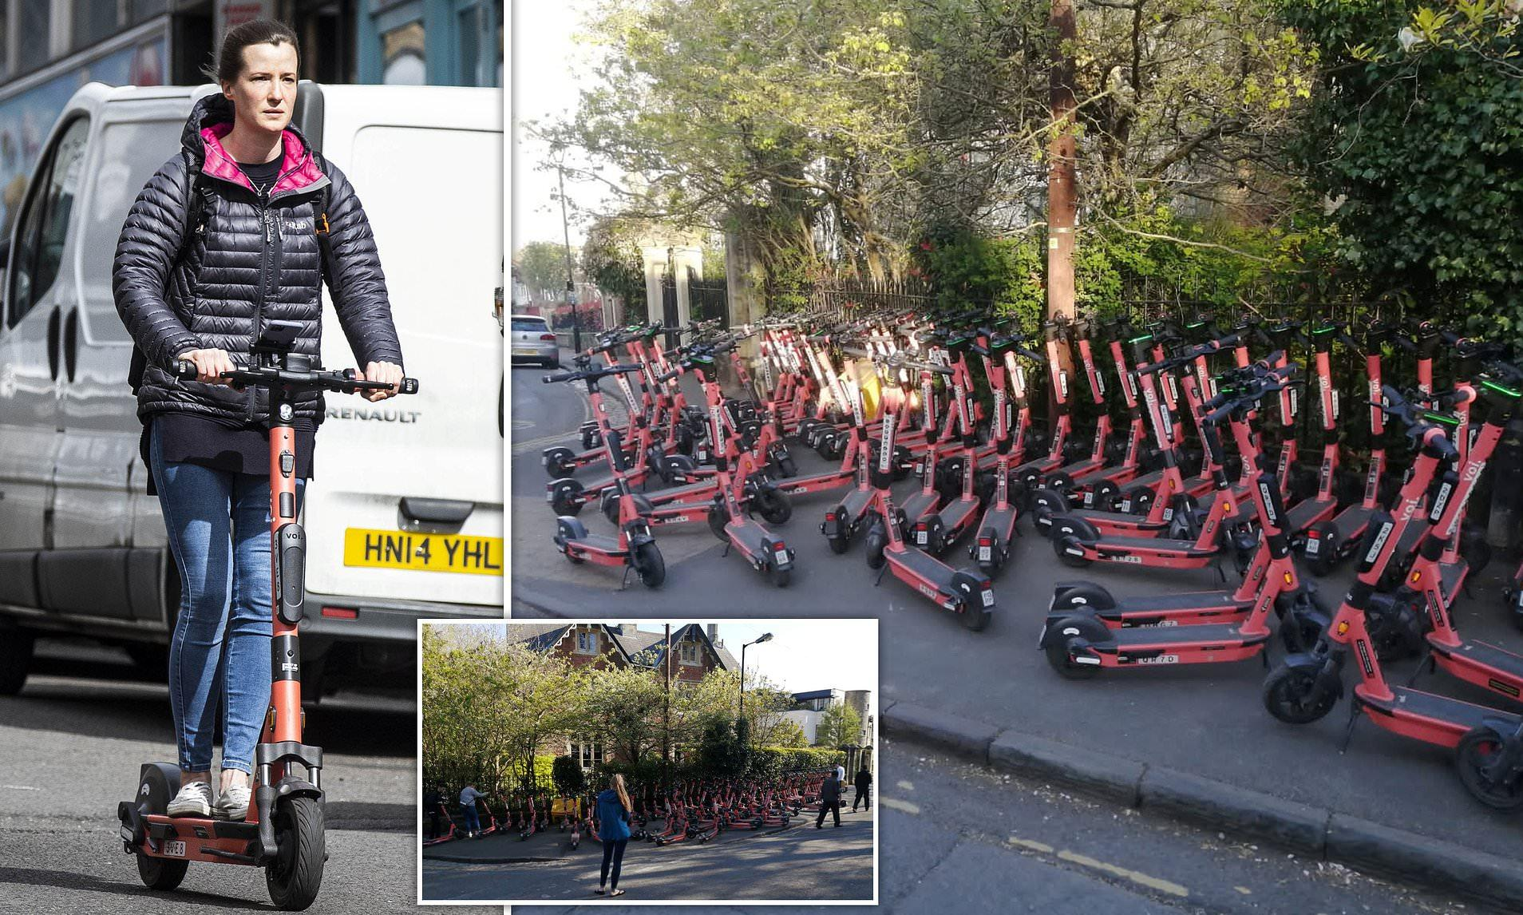
Geographic Context
  UK is unusual as the only country in Europe where private e-scooters are illegal on public roads (Jacobs, 2021)
  West of England Combined Authority (WECA) e-scooter trial
  Scheme operated by Swedish scooter start-up company, Voi
    Voi predicted it could expect a 12-16% private car trip replacement rate
  An alternative to public transport which can accommodate social distancing (Travel West, 2020)
  WECA has objectives to reduce private vehicle trips and encourage the use of active modes and public transport (WECA, 2020)
Map of West of England Combined Authority (Main map: WECA, 2022; Inset: BEIS, 2019)
Source: Daily Mail, 2021

Slide 5
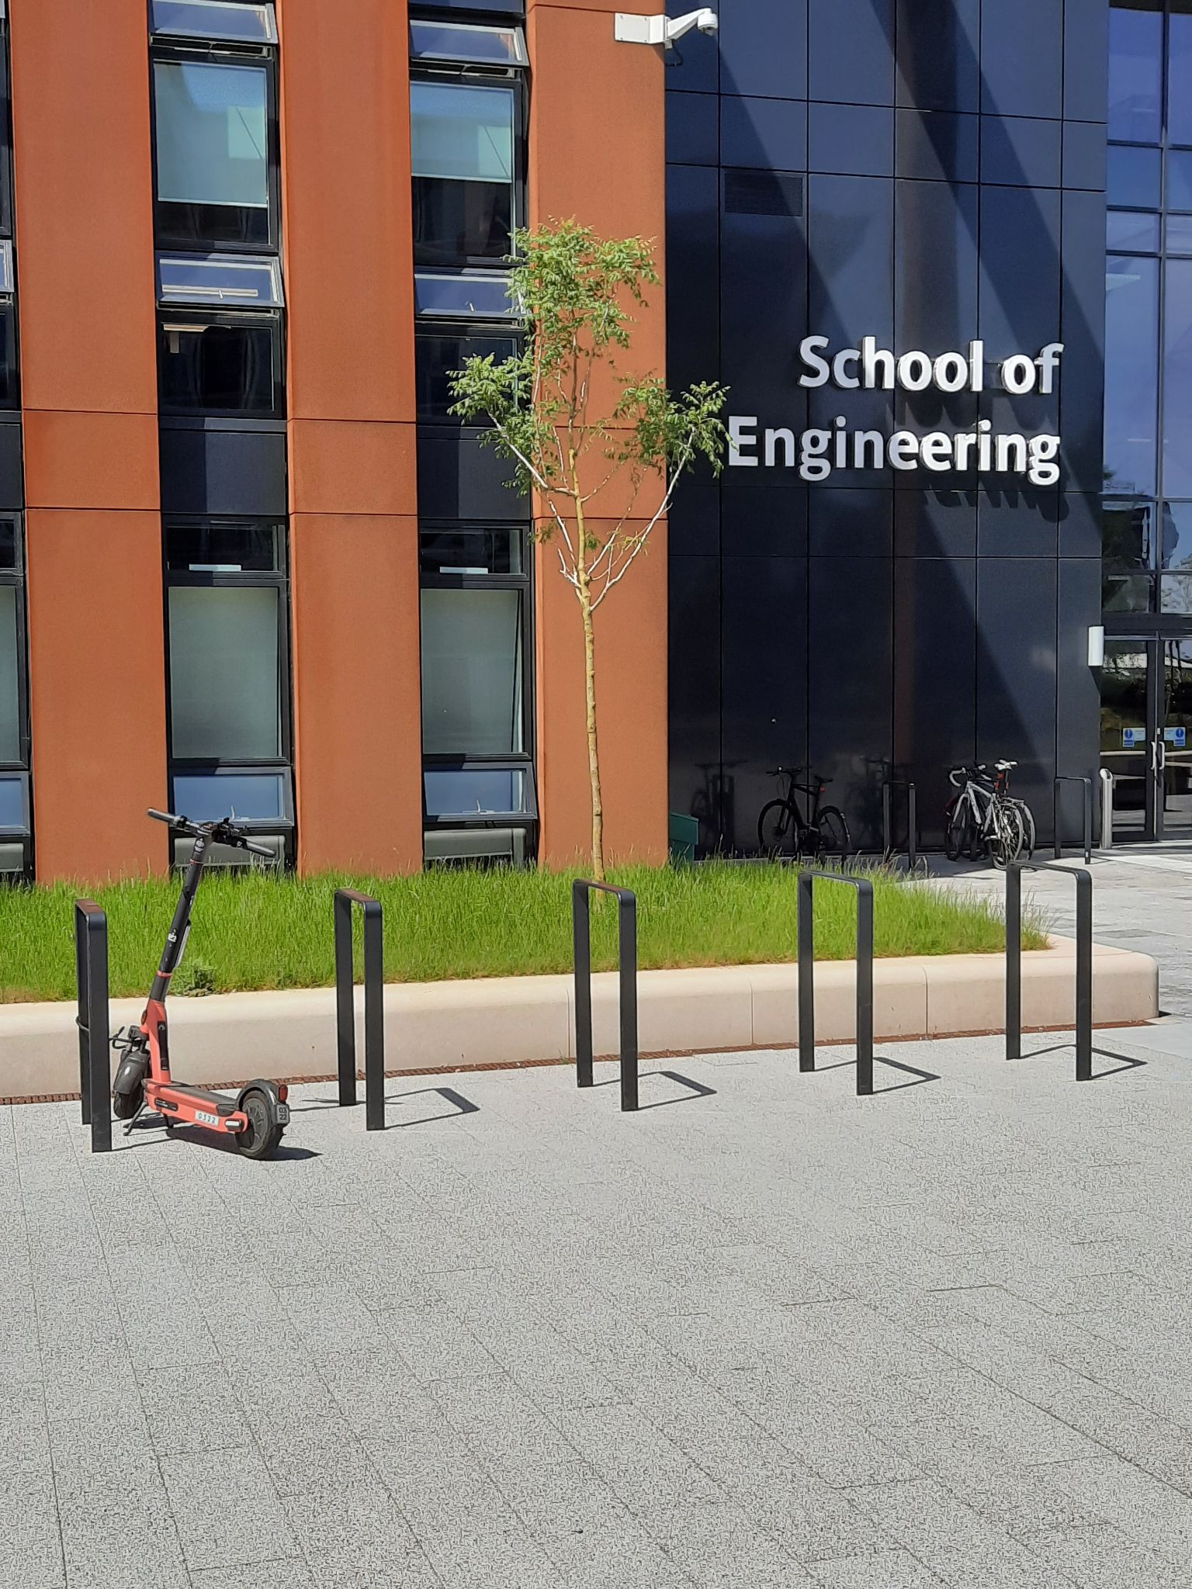
Study site context
E-scooter experiences of staff and students at the University of the West of England (UWE), Bristol.
  University campuses are an important case-study site for scooter use, due to their high use by younger age groups and for the purposes of accessing educational sites (Maiti et al., 2019).
UWE is a large university (~30,000 students), Frenchay is its largest campus (UWE, 2022).
  All UWE campuses within Voi operating zone.
UWE has a stated commitment to prioritising sustainable travel access to its campuses.
  Including for e-scooters.
  20% decrease in car parking spaces by 2030.

Slide 6
Methodology
Sample
Study included both users and non-users of e-scooters.
Qualitative e-scooter stories (124 collected)
  People’s perceptions and experiences of being a user or non-user of the Voi public scooter scheme.
  Asked to recount their “scooter stories.”
E-scooter survey (222 valid responses)
  Perceived barriers and facilitators to e-scooter use, purpose of e-scooter journeys, mode e-scooter trips are replacing, opinions on e-scooters, and demographic questions.
Qualtrics survey and social media group.
  Quantitative responses and scooter stories collected via Qualtrics survey.
  Additional scooter stories collected via e-scooter social media group.
Convenience sampling via student society pages, internal communications channels, and LinkedIn pages.

Slide 7
Results: Sample and scooter use
Gender and age
 |  | Male | Female | Non-binary | Total
18 - 24 | N | 37 | 38 | 1 | 76
 | % | 31.1 | 37.6 | 50.0 | 34.2
25 - 34 | N | 23 | 12 | 1 | 36
 | % | 19.3 | 11.9 | 50.0 | 16.2
35 - 44 | N | 25 | 19 | 0 | 44
 | % | 21.0 | 18.8 | 0.0 | 19.8
45 - 54 | N | 19 | 9 | 0 | 28
 | % | 16.0 | 8.9 | 0.0 | 12.6
55 - 64 | N | 11 | 19 | 0 | 30
 | % | 9.2 | 18.8 | 0.0 | 13.5
65+ | N | 4 | 4 | 0 | 8
 | % | 3.4 | 4.0 | 0.0 | 3.6
Total | N | 119 | 101 | 2 | 222
 | % | 100.0 | 100.0 | 100.0 | 100.0
Staff/Student | N | %
Staff | 125 | 57.3
Student | 93 | 42.7
Total | 218 | 100
Scooter use | N | %
Yes | 92 | 41.6
No | 129 | 58.4
Total | 221 | 100
Scooter use frequency | N | %
Hardly ever- one or two trips | 42 | 47.2
Once or twice a month | 19 | 21.3
Three or four times a month | 13 | 14.6
Once or twice a week | 10 | 11.2
Three or four times a week | 5 | 5.6
Total | 89 | 100

Slide 8
Who is using e-scooters?
*Note: For this analysis the ‘non-binary’ gender category was removed due to a low count (n=2)

Slide 9
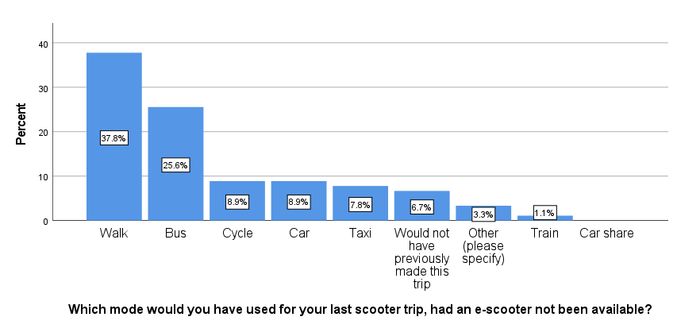
Mode replacement
“How many people using e-scooters would have been using the bus, cycling, or walking if e-scooters weren't available? I highly doubt there is any noticeable modal shift away from cars to e-scooters, and if there isn't a shift, then what's the point of them?”
(Male student, 18-24)
“I cycle and walk. Why would I replace these modes of exercise with a passive experience that contributes to climate change?”
(Male staff, 45-54)

Slide 10
Scooter user perspectives
Reason(s) for using an e-scooter | %
Convenience | 30.2
Fun or relaxation | 29.3
Low environmental impact | 17.1
Inexpensive | 11.7
Reduced PT capacity (COVID) | 4.5
Exercise (active travel) | 1.4
Safety | 0.9
Other | 8.9
Purpose: Last scooter trip | N | %
Socialising/leisure | 49 | 58.3
Commuting to/from work | 13 | 15.5
Transportation to/from education | 5 | 6.0
Shopping/running errands | 7 | 8.3
Exploring the city | 7 | 8.3
Other | 3 | 3.6
Total | 84 | 100
“I rented a scooter to travel back from a friend's house instead of getting the bus as a bit of fun. My house was conveniently close to a drop-off point so when finished, I didn't have far to walk back. I will most likely rent again as I enjoyed using it.”
(Female student, 18-24)
“I like the idea of having shared transport, easy to use and personal, so mobility around the city is increased and car pollution is reduced.”
(Female staff, 35-44)

Slide 11
Non-user perspectives: Summary
The majority (58.4%) of survey participants had not ridden an e-scooter before; 64% of women and 52.9% of men had never ridden a scooter
Many non-users appear to see e-scooter users as operating outside the law, with a general feeling of users being subject to fewer or less-enforced rules
Safety was a key theme for non-users, with many stories mentioning the possibility of injuries, the risks from dangerous riding, and being scared of e-scooters
“Witness drunks riding on the road, crashing at night and finding it 'hilarious', not caring about the criminal damage being caused. (…) They are death traps waiting to happen, being a menace to pedestrians and other road users, who will get the blame for their stupidity.”
(Male staff, 45-54)
“As a car driver, I do not feel that they are safe whatsoever. (…) They often swerve around because the roads are not good enough for their small wheels. (…) They also often do not stop at red lights and will cut in front, meaning a sudden stop is required risking someone going into the back of my car.”
(Female student, 18-24)
“As a community carer, I work with elderly and disabled patients. Conversations with them have highlighted how scared they are to go out into their area due to the scooters. They are scared of being knocked over, because of slow walking.”
(Female student, 25-34)
“Inexperienced non drivers, riding on the road, leaving their signal lights on, indicating to turn left and carrying straight on. Excessive speed on the pavements in crowded areas, not a great combination when young children are about. Riding at night without lights.“
(Male staff, 45-54)

Slide 12
Conflicts and safety: Summary
Conflicts relate to broader issues of legality such as fairness of road use
Some other road users feel scooters don’t have the same rules, despite having the same freedom
Non-use of helmets contested
  Scooter users generally don’t want to wear them
  Non-users are concerned about riders not wearing them
A main theme of the scooter stories calls for the implementation of better cycle lanes and road infrastructure, suitable for e-scooters
  Genuine concern from drivers that they might injure someone
“See illegally used by young riders and two riders at a time (which is a very efficient use of space). Drivers can react angrily to them even when they are used sensibly as they are slow.”
(Male student, 55-64)
“People do not wear helmets, and I have had to stop and provide first aid to people who have fallen off. They are often driven by drunk people and have multiple people riding them. I also think that the police aren't doing enough to stop the use of privately owned scooters.”
(Female student, 18-24)
“E-scooters compete for space on the roads and in cycling infrastructure. In Bristol, more needs to be done to make segregated space for these vulnerable road users. There is a significant differential in speeds between pedestrians and scooter riders and scooter riders and motorised traffic. If they are to be promoted for use these groups need to be kept separate for their own safety/perception of safety.”
(Male staff, 35-44)
“I chose to ride in the later evening as the roads were quieter which made me feel a bit safer away from large quantities of traffic.”
(Female student, 18-24)

Slide 13
Conclusions
37.3% of e-scooter usage is displacing walking, 22% is replacing bus travel, only 8.9% replacing a journey previously made by car.
  Disincentivising short walking trips, making people less active and taking people off of public transport.
However, taken together, 15.6% of scooter trips were either replacing the car, or entirely new trips.
  Clear conflicts between non-users and users, mostly associated with safety and sharing urban space. Interestingly, safety is a particularly strong theme for non-users.
  From the users’ perspective, conflicts arise when they are faced with the necessity of sharing infrastructure.

Slide 14
Implications
An important point from our study, supported by previous research, is that scooters (in the UK context) continue to exist in a “grey area”, between legality and practicality.
  Scooter riders are arguably amongst the most vulnerable of road users, but currently are only legally allowed to ride in the most dangerous of contexts: on the road itself amongst cars and other motorised vehicles.
Urgent attention is needed in terms of considering and defining scooters’ place in infrastructure that make up the shared spaces of towns and cities.
Legislation/regulation needs to be reviewed at both the national and local levels.

Slide 15
Limitations
This study was conducted on a student and staff population at an urban university campus. There are many other urban contexts in which scooters are being used.
Our study focussed on an e-scooter public hire scheme. It is important to expand our understanding to get views and experiences from private owners of e-scooters.
The scooter stories method was very effective at eliciting stories of conflict and tension. Naturally however, when people were asked to tell us their “stories”, they have likely provided us with their most dramatic/extreme examples.
  It also leads to some moralising, particularly on the part of non-users.
  The majority of day-to-day scooter use is occurring without incident.

Slide 16
Thank you!
Any questions?
Do you have your own #scooterstory?
What do you think?

Slide 17
References (i)
Basky, G., (2020). Spike in e-scooter injuries linked to ride-share boom. Canadian Medical Association Journal. [online]. Available at: https://www.cmaj.ca/content/192/8/E195 [Accessed 12 December].
BBC News, (2022). Voi e-scooters damaged after fire at Bristol warehouse. [online] BBC News. Available at: https://www.bbc.co.uk/news/uk-england-bristol-59853100 [Accessed 27 January 2022].
BBC News (2021). E-scooters: Petition to PM calls for end of rental trials. Available from: https://www.bbc.co.uk/news/uk-england-northamptonshire-57893642 [Accessed 29 July 2021].
BBC News (2021)a. Newcastle e-scooter students banned for drink-riding. Available from: https://www.bbc.co.uk/news/uk-england-tyne-56529128 [Accessed 12 August 2021].
BBC News (2021)b. When and where can I ride an e-scooter legally?. Available from: https://www.bbc.co.uk/news/uk-48106617 [Accessed 12 August 2021].
BEIS (2019) West of England Local Industrial Strategy. Industrial Strategy document - Department for Business, Energy, and Industrial Strategy. [Online] Available from: https://assets.publishing.service.gov.uk/government/uploads/system/uploads/attachment_data/file/818989/1907_VERSION_West_of_England_Interactive_SINGLE_PAGES.pdf
BEIS (2020) 2018 UK Greenhouse Gas Emissions, Final figures. National Statistics. Department for Business, Energy, and Industrial Strategy. [Online] Available from: https://assets.publishing.service.gov.uk/government/uploads/system/uploads/attachment_data/file/862887/2018_Final_greenhouse_gas_emissions_statistical_release.pdf
Christoforou, Z., Gioldasis, C., de Bortoli, A. and Seidowsky, R., (2021). Who is using e-scooters and how? Evidence from Paris. Transportation research part D: transport and environment, 92, p.102708.
Dias, G., Arsenio, E. and Ribeiro, P., (2021). The Role of Shared E-Scooter Systems in Urban Sustainability and Resilience during the Covid-19 Mobility Restrictions. Sustainability, [online]s 13(13), p.7084. Available at: https://www.mdpi.com/2071-1050/13/13/7084 [Accessed 31 January 2022].
Dusek, G., Yurova, Y. and Ruppel, C., (2015). Using Social Media and Targeted Snowball Sampling to Survey a Hard-to-reach Population: A Case Study. [online] Ijds.org. Available at: http://ijds.org/Volume10/IJDSv10p279-299Dusek0717.pdf [Accessed 9 August 2021].
Etikan, I. (2016). Comparison of Convenience Sampling and Purposive Sampling. American Journal of Theoretical and Applied Statistics, [online] 5(1), p.1. Available at: https://www.researchgate.net/publication/304339244_Comparison_of_Convenience_Sampling_and_Purposive_Sampling [Accessed 27 February 2021].
Gibson, H., Curl, A. and Thompson, L., (2021). Blurred boundaries: E-scooter riders’ and pedestrians’ experiences of sharing space. Mobilities, [online] pp.1-16. Available at: https://www.tandfonline.com/doi/full/10.1080/17450101.2021.1967097 [Accessed 16 December 2021].
Gössling, S., (2020). Integrating e-scooters in urban transportation: Problems, policies, and the prospect of system change. Transportation Research Part D: Transport and Environment, [online] 79, p.102230. Available at: https://www.sciencedirect.com/science/article/pii/S1361920919312829?casa_token=5JJhsswN8hcAAAAA:Pl7HwzD-8F9zkKyTq8zdOfPtdxOCDHKpwQDtYFayLfJM1rDzj32xRbydTmPvkmc9NCM1LoY [Accessed 31 January 2022].
GOV UK (2021a). Reported road casualties Great Britain: e-Scooter factsheet year ending June 2021. [online] GOV.UK. Available at: https://www.gov.uk/government/statistics/reported-road-casualties-great-britain-e-scooter-factsheet-year-ending-june-2021 [Accessed 17 December 2021].
GOV UK (2021b). Reported road casualties Great Britain: pedal cycle factsheet, 2020. [online] GOV.UK. Available at: https://www.gov.uk/government/statistics/reported-road-casualties-great-britain-pedal-cyclist-factsheet-2020/reported-road-casualties-in-great-britain-pedal-cycle-factsheet-2020 Accessed 17 December 2021].
Green, D.L. and Parkhurst, G., 2017. Decarbonizing transport for a sustainable future: mitigating impacts of the changing climate. In: Transportation Research Board Conference Proceedings (No. 54). Appendix A: White Paper. [Online] Available from: https://trid.trb.org/view/1516315
Hardt, C. and Bogenberger, K., (2019). Usage of e-scooters in urban environments. Transportation research procedia, 37, pp.155-162. Available from: https://www.sciencedirect.com/science/article/pii/S2352146518305933 [Accessed 18 July 2021].
Hosseinzadeh, A., Algomaiah, M., Kluger, R. and Li, Z., (2021). E-scooters and sustainability: Investigating the relationship between the density of E-scooter trips and characteristics of sustainable urban development. Sustainable cities and society, 66, p.102624. Available from: https://www.sciencedirect.com/science/article/abs/pii/S2210670720308416 [Accessed 19 July 2021].
Hoye, A., 2018. Recommend or mandate? A systematic review and meta-analysis of the effects of mandatory bicycle helmet legislation. Accident Analysis & Prevention, 120, pp.239-249.
Hyde, J., 2022. Lawyer demands e-scooter reform as illegal rider makes injury claim. [online] Law Gazette. Available at: https://www.lawgazette.co.uk/news/lawyer-demands-e-scooter-reform-as-illegal-rider-makes-injury-claim/5111092.article?utm_source=gazette_newsletter&utm_medium=email&utm_campaign=S%2bG+posts+huge+loss+%7c+E-scooter+reform+plea+%7c+More+honours+for+lawyers%3f_01%2f10%2f2022 [Accessed 24 January 2022].
Haq, M. (2015). A Comparative Analysis of Qualitative and Quantitative Research Methods and a Justification for Adopting Mixed Methods in Social Research. Annual PhD Conference, University of Bradford Business School of Management., [online] Available at: https://www.researchgate.net/publication/288829287_A_Comparative_Analysis_of_Qualitative_and_Quantitative_Research_Methods_and_a_Justification_for_Adopting_Mixed_Methods_in_Social_Research [Accessed 27 February 2021].

Slide 18
References (ii)
Hollingsworth, J., Copeland, B. and Johnson, J.X., (2019). Are e-scooters polluters? The environmental impacts of shared dockless electric scooters. Environmental Research Letters, 14(8), p.084031.
Jacobs, F., (2022). E-scooter rules still varied – and changing – across Europe. [online] Fleet Europe. Available at: https://www.fleeteurope.com/en/last-mile/europe/features/e-scooter-rules-still-varied-and-changing-across-europe?a=FJA05&t%5B0%5D=e-scooter&t%5B1%5D=legislation&curl=1 [Accessed 31 January 2022].
Khoo, A. (2020). Coronavirus lockdown sees air pollution plummet across UK. Available from: https://www.bbc.co.uk/news/uk-england-52202974 [Accessed 29 July 2021].
Kiger, M. and Varpio, L., (2020). Thematic analysis of qualitative data: AMEE Guide No. 131. Medical Teacher, [online] 42(8), pp.846-854. Available at: https://www.researchgate.net/publication/341087749_Thematic_analysis_of_qualitative_data_AMEE_Guide_No_131 [Accessed 31 January 2022].
Laville, S. (2021). Air pollution kills five people in Bristol each week, study shows. Available from: https://www.theguardian.com/environment/2019/nov/18/air-pollution-kills-bristol-health [Accessed 9 April 2021].
Leiner, D. (2016). Our research’s breadth lives on convenience samples. A case study of the online respondent pool “SoSci Panel”. Studies in Communication / Media, [online] 5(4), pp.397-396. Available at: https://www.researchgate.net/publication/259669050_Convenience_Samples_from_Online_Respondent_Pools_A_case_study_of_the_SoSci_Panel [Accessed 27 July 2021].
Maiti, A., Vinayaga-Sureshkanth, N., Jadliwala, M., Wijewickrama, R. and Griffin, G.P., (2019). Impact of E-Scooters on Pedestrian Safety: A Field Study Using Pedestrian Crowd-Sensing. arXiv preprint arXiv:1908.05846. Available from: https://arxiv.org/abs/1908.05846 [Accessed 18 July 2021].
Mercer, D. (2021). Number of e-scooters on UK roads set to soar - why not everyone's pleased about it. [online] Sky News. Available at: https://news.sky.com/story/death-traps-or-the-future-of-transport-why-not-everyones-pleased-with-the-uks-e-scooter-boom-12255287 [Accessed 9 August 2021].
Mögele, M. and Rau, H., (2020). Cultivating the “car state”: a culturally sensitive analysis of car-centric discourses and mobility cultures in Southern Germany. Sustainability: Science, Practice and Policy, [online] 16(1), pp.15-28. Available at: https://www.tandfonline.com/doi/full/10.1080/15487733.2020.1756188 [Accessed 9 August 2021].
Morris, M. (2020). Active travel: good for body, mind and the environment. [online] Climate & Environment at Imperial. Available at: https://granthaminstitute.com/2020/05/22/active-travel-good-for-body-mind-and-the-environment/ [Accessed 27 February 2021].
Nigro, M., Ferrara, M., De Vincentis, R., Liberto, C. and Valenti, G., (2021). Data Driven Approaches for Sustainable Development of E-Mobility in Urban Areas. Energies, [online] 14(13), p.3949. Available at: https://www.mdpi.com/1996-1073/14/13/3949 [Accessed 31 January 2022].
Transport for London, (2021). TfL announces ban of e-scooters on transport network. [online]. Available at: https://tfl.gov.uk/info-for/media/press-releases/2021/december/tfl-announces-safety-ban-of-e-scooters-on-transport-network [Accessed 31 January 2022].
Travel West, (2021). E-scooter trial - Travelwest. [online] Travel west. Available at: https://travelwest.info/projects/e-scooter-trial [Accessed 26 July 2021].
Tuncer, S. and Brown, B., (2020). E-scooters on the ground: lessons for redesigning urban micro-mobility. In Proceedings of the 2020 CHI conference on human factors in computing systems (pp. 1-14).
Sanders, R.L., Branion-Calles, M. and Nelson, T.A., (2020). To scoot or not to scoot: Findings from a recent survey about the benefits and barriers of using E-scooters for riders and non-riders. Transportation Research Part A: Policy and Practice, 139, pp.217-227. Available from: https://www.sciencedirect.com/science/article/pii/S0965856420306522 [Accessed 18 July 2021].
Shorten, A. and Smith, J., (2017). Mixed methods research: expanding the evidence base. Evidence Based Nursing, [online] 20(3), pp.74-75. Available at: https://pubmed.ncbi.nlm.nih.gov/28615184/ [Accessed 31 January 2022].
Sustrans. 2022. Our position on e-scooters. [online] Available at: https://www.sustrans.org.uk/our-blog/policy-positions/all/all/our-position-on-e-scooters># [Accessed 31 January 2022].
Wallius, E., Thibault, M., Apperley, T. and Hamari, J., (2021). Gamifying the city: E-scooters and the critical tensions of playful urban mobility. Mobilities, [online] pp.1-17. Available at: https://www.tandfonline.com/doi/full/10.1080/17450101.2021. [Accessed 16 December 2021].
West of England Combined Authority, (2021). E-scooter trial - West of England Combined Authority. [online] West of England Combined Authority. Available at: https://www.westofengland-ca.gov.uk/e-scooter-trial/ [Accessed 26 July 2021].
UK Parliament (2020). E-scooters: pavement nuisance or transport innovation? - Transport Committee- House of Commons. Available from: https://publications.parliament.uk/pa/cm5801/cmselect/cmtrans/255/25508.htm [Accessed 2 August 2021].
UWE (2021). Student and staff numbers - Demographic data. [online] Available at: https://www.uwe.ac.uk/about/demographic-data/student-and-staff-numbers#a96fa7113-3b62-4ce7-af88-874fcd28c105 [Accessed 26 July 2021].
UWE (2022). Sustainable transport and travel. [online] Available at: https://www.uwe.ac.uk/about/values-vision-strategy/sustainability/transport-and-travel#:~:text=We%20are%20reducing%20the%20number,a%2020%25%20reduction%20by%202030. [Accessed 15 January 2022].
Voi (2022). Voi Technology - Shaping cities for people. Available from: https://www.voiscooters.com/voi-technology/ [Accessed 27 January 2022].
Wray, S., (2021). Closing the micromobility gender gap in cities - ITU Hub. [online] ITU Hub. Available at: https://www.itu.int/hub/2021/03/closing-the-micromobility-gender-gap-in-cities/ [Accessed 31 January 2022].
WECA (2020) Joint Local Transport Plan 4. West of England Combined Authority. [Online]. Available from: https://www.westofengland-ca.gov.uk/wp-content/uploads/2021/10/JLTP4-Adopted-Joint-Local-Transport-Plan-4.pdf
WECA (2022). Who we are. [Online.] Available from: https://www.westofengland-ca.gov.uk/about-us/who-we-are/

