Slide 1
Blackshirt earls and red duchesses: The british aristocracy and the Spanish civil war 1936-1939
Alison.mcclean@uwe.ac.uk

Slide 2

Key themes
Nature and extent of support of members of the British aristocracy on both sides of the Spanish Civil War
Importance of aristocratic status to the scope / impact of their activities
Significance of activities in relation to perceptions of the position of the British aristocracy in response to the rise of fascism in Europe

Slide 3
For the Spanish republic
Parliament: Duchess of Atholl, Wilfrid Roberts, Lord Faringdon, Earl of Listowel
The International Brigades: Esmond and Giles Romilly, David Guest, Clive Branson
Medical Aid/Humanitarian Relief: Viscountess Hastings, Viscount Churchill, Earl of Antrim
Basque Children: Lady Cecilia Roberts, Lord Davies, Marchioness of Donegal
Writers/Journalists: Nancy Cunard, Carmel Haden-Guest

Slide 4
For Franco
Anglo-Spanish aristocrats: Queen Ena, Princess Beatrice Orleans y Borbon, Duke of Alba, Marquis Merry del Val, Marquis del Moral
Parliament: Earl of Glasgow, Lord Newton, Lord Phillimore, Sir Henry Page-Croft, Alan Lennox-Boyd, Victor Cazalet
Falange/Requetes/Spanish Foreign Legion: Rupert Belville, Peter Kemp, Noel Fitzpatrick, James Walford
Medical/Humanitarian Aid: Lady Ivy Chamberlain, Gabriel Herbert, Lord Howard of Penrith, Priscilla Scott-Ellis
Basque Children: Duke of Wellington, Viscount Fitzalan, Sir Nairne Stewart-Sandeman
Writers/Journalists: Francis Yeats-Brown, Arnold Lunn

Slide 5

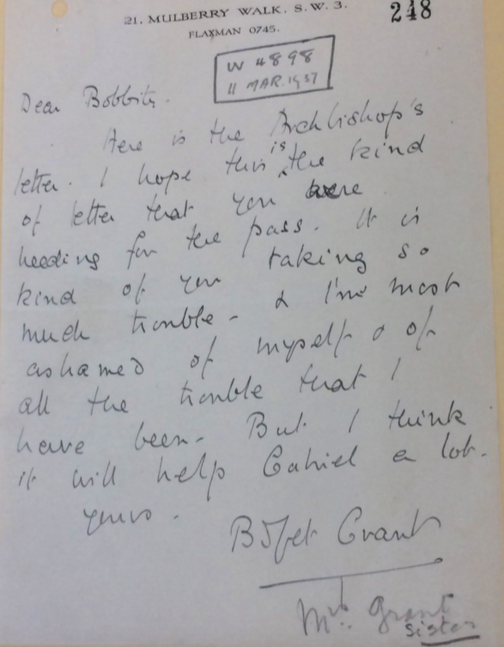
Importance of aristocratic status
Ability to exploit pre-existing social/familial networks
Access to / deference from Foreign Office and Consular officials
Ability to finance activities
Sufficient wealth and leisure to dedicate time to activities

Slide 6
Position of british aristocracy in relation to the rise of fascism in europe
Most existing scholarship / popular history focuses on pro-Nazi sympathies of aristocracy
Research has revealed some overlap between support for Franco and support for Hitler/Mussolini
Accounts of British responses to Spanish Civil War concentrates on position of middle class intellectuals and working-class combatants in support of the Republic
Research has revealed active caucus of anti-fascist aristocrats
Social networks significant to the activities of both sides
Members of the same families could be active on opposite sides

