Slide 1
Challenges and Opportunities for Local Action to Improve Air Quality
Next Steps for Improving Air Quality at a Local Level
Westminster Energy, Environment & Transport Forum
13th November 2022
Presentation by
Professor Jim
Longhurst
University of the West of England, Bristol

Slide 2
Structure of Presentation
This brief presentation considers the role of Local Authorities (LA) in providing local air quality management (LAQM) and public health protection.
It will focus on the role of LAs in reviewing and assessing air quality, declaring Air Quality Management Areas (AQMA) and developing Air Quality Action Plans (AQAP).
LAQM has enabled a new spatial and temporal geography of air pollution to be developed.
Action Plans have been ineffective in improving air quality due to a lack of powers, resources and institutional willingness to undertake actions that enhance public health in the longer term but are unpopular in the shorter term.
Contemporary challenges and potential future LA actions are considered within the framework of a resource constrained future.

Slide 3
A Policy Intent – not yet delivered
“Clean air is an essential ingredient of a good quality of life. People have the right to expect that the air that they breath will not harm them”.
Air Quality Strategy, 2000

Slide 4
Is Change Possible?
‘We can and should go further to reduce air pollution – and it is technically possible to do so’
England’s Chief Medical Officer (CMO) annual report 2022
https://www.gov.uk/government/publications/chief-medical-officers-annual-report-2022-air-pollution
Are we willing to make the social and economic changes that will be necessary to reduce air pollution?

Slide 5
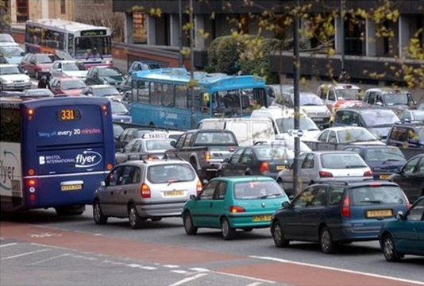
Local Air Quality Management (LAQM)
Requirements for local air quality management (LAQM) are set out in Part IV of the Environment Act 1995 as amended by the Environment Act 2021.
Local Authorities are
’’required to carry out regular ‘Review and Assessments’ of air quality in their area and take action to improve air quality in those areas where objectives set out in regulation have been shown not to have been achieved, or areas where it is thought there is a risk that they will not be achieved.’’

Slide 6
LAQM
When the Review and Assessment process identifies an exceedance of an Air Quality objective, the Local Authority must declare an Air Quality Management Area (AQMA) and develop an Action Plan to tackle problems in the affected areas.
Action Plans set out the measures the LA proposes to take to work towards meeting the air quality objectives (not to meet!).
They may include a variety of measures but authorities have few of the powers needed to make these effective and to deliver air quality improvements.

Slide 7
Action Plans – a Critical Role
In 2003* I wrote
Action Plans require inter-professional and interdisciplinary working.
The Action Plan could be a means to integrate policy packages.
The Action Plan is the key to delivering public health protection. We know where the problems are, that is the simple part.
The Action Plan must provide the solution to poor local air quality.
* Longhurst, J.W.S et al Improving air quality through local air quality management. A critical review of British experience and practice. Air Quality Assessment and Policy at Local, Regional and Global Scales, 14th IUAPPA International Conference, Dubrovnik, Croatia, September, 2003.

Slide 8
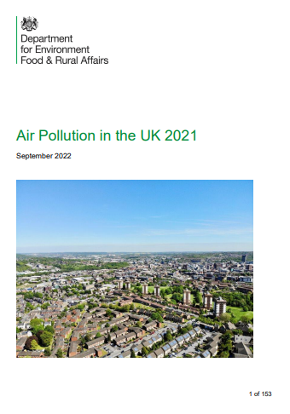
Problem Diagnosis Good
LAQM has helped to reveal a new spatial and temporal geography of air pollution in the UK.
The number of AQMAs in the UK have continued to rise over the last 20 years with 256 local authorities (68%)* having one or more spatially defined areas where air quality objectives have not been met. Many AQMAs have been in existence for a long time!
Most AQMAs in the UK are in urban areas and have been established to address the contribution to air pollution from traffic emissions of NO₂ or PM10, or in some cases both. A small number are for SO₂.
* Out of 374. Data from 2021,
Defra (2022) Air Pollution in the UK 2021 https://uk-air.defra.gov.uk/library/annualreport/viewonline?year=2021_issue_1#report_pdf

Slide 9
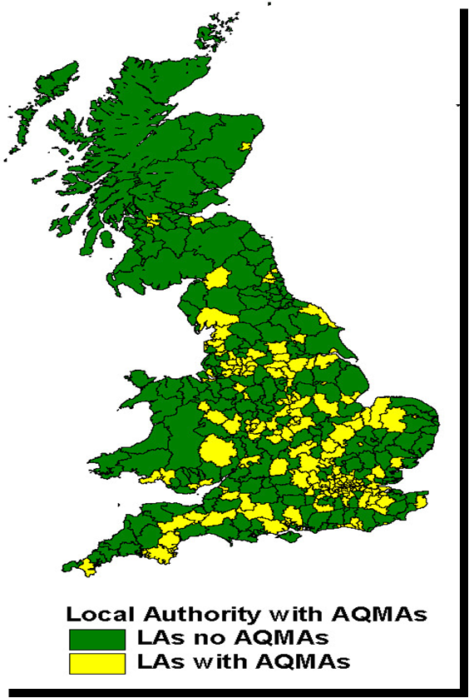
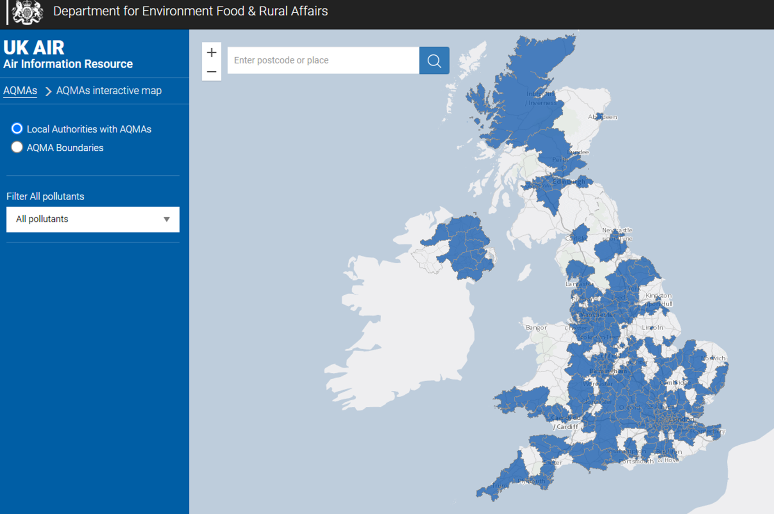
Changing Spatial Pattern of AQMAs
2006
2021
https://uk-air.defra.gov.uk/aqma/maps/

Slide 10
Growth in Number of AQMAs
2004 more than one hundred local authorities have AQMAs for NO₂
2008 225 LAs (52%) had AQMAs (≈500 AQMAs in total)
2016 259 /389 LAs with AQMAs (613 AQMAs in total)
2018 264/391 Local Authorities – 68% of those in the UK – have one or more AQMAs.
2021 256/374 local authorities - 68% of those in the UK – have one or more AQMAs.
These are not ‘localised hotspots’ they are local manifestations of a systemic national problem
A problem that has proved strongly resistant to the current policy prescriptions for management

Slide 11
LAQM Weaknesses
Local authorities were never given the powers to enforce Air Quality Objectives. They are only required to work towards meeting the air quality objectives.
Hence Action Plans were and are weak and ineffective rarely bringing forward targeted and achievable measures likely to be effective in addressing problems mostly but not exclusively caused by transport systems.
Air Quality Objectives are no more than “policy intentions” and not legally binding
Focus on the process rather than the decision outcome
No de facto ability to prevent new local developments on Air Quality grounds
Lack of responsibilities for those in charge of sources (land-use and transport planning)
Constraints of local action in national policy context

Slide 12
AQMAs and Revocation
Local Authorities have been very good at uncovering locations with public exposure which exceed air quality objectives.
They have been less successful at implementing air quality remediation actions.
Once declared an AQMA remains for a long time as a Local Authority rarely has the powers or capabilities to address the root causes of the problem.
Will this change in the near future as local authorities budgets decline?

Slide 13
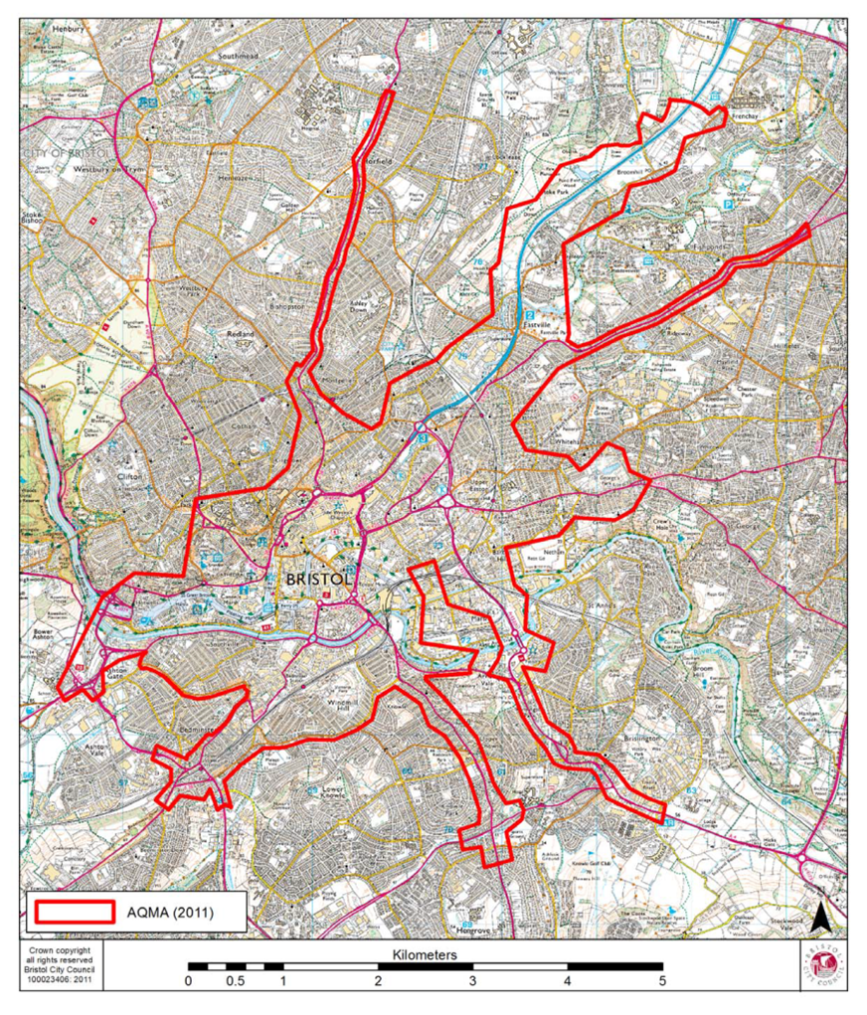
Bristol AQMA
AQMA first declared for Nitrogen Dioxide and Particulate Matter in May 2001.
Amended in 2003
Amended again in 2008
Amended again in 2011.
https://uk-air.defra.gov.uk/aqma/details?aqma_ref=10
Bristol, after many delays, now has an operational CAZ. Yet another attempt at spatial management of air quality without the tool kit necessary to manage sources.

Slide 14
Environment Act 2021
The Environment Act 2021
enables English local authorities to take more effective, co-ordinated actions to achieve their air quality objectives and deliver improvements to public health, and tackle emission from domestic burning, a source of PM10.
https://www.legislation.gov.uk/ukpga/2021/30/contents/enacted

Slide 15
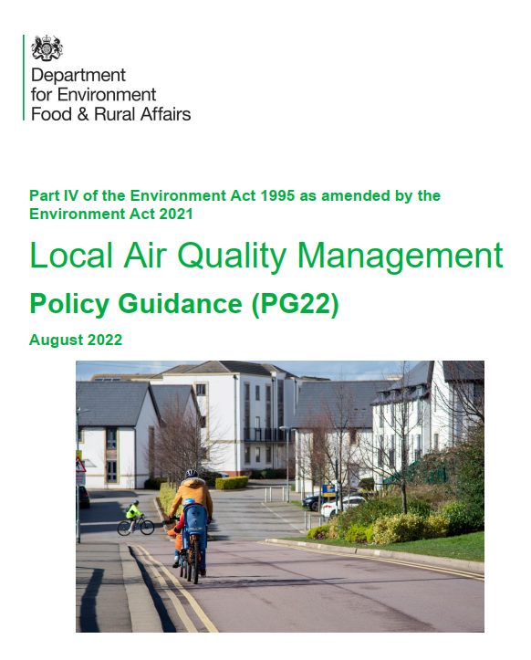
LAQM Policy Guidance
Published in August PG22 sets out the expectations for and requirements of Local Authorities in respect of their LAQM duties.
It covers English LAs but excludes London Boroughs where LAQM guidance is provided by the Mayor of London.
’’All layers of local government have legal duties to act to address elevated concentrations of local air pollution.’’
‘‘All levels of local government are expected to commit to taking the actions necessary to ensure that local air quality objectives are secured.’’
https://laqm.defra.gov.uk/air-quality/featured/england-exc-london-policy-guidance/

Slide 16
High in Aspiration but is it Deliverable?
Does the capacity and capability exist to deliver air quality improvements at the scale and pace needed to address the problem of air pollution?
The resource challenges facing LAs – in staffing and budgets – are stark.
Can national and local actors provide the financial, technical and human capital at pace and scale to meet the challenge of reducing, if not removing, the greatest environmental risk to public health in the UK?
The evidence is not encouraging.

Slide 17
The Continuing Age of Austerity
Recent research from Grant Thornton shows English councils face a £7.3bn financial black hole by 2025/26. This is an increase of £4.6bn since the beginning of the year, according to the data.
It warns that without additional income, councils will be forced to make savings of over £125 per head of population by 2025/26. (6/10/22)
’’Local authorities are also now facing the risk of interest rate rises increasing debt financing costs and the real risk of reduced funding from central government, in response to the current economic turmoil facing the country.’’
https://www.localgov.co.uk/One-in-six-councils-at-risk-of-running-out-of-money-next-year/54951

Slide 18
Regulation and Enforcement
To conceive and execute Local Air Quality Management responsibilities Local Authorities require an effective regulatory framework and a well trained and efficient enforcement capability.
Both must be present to deliver effective environmental protection.

Slide 19
Environmental Health Challenges
The CIEH 2020/21 workforce survey revealed that budgets remained unchanged in around half of all local authorities (51%).
More EH departments reported decreases (24%) in their budgets than increases (17%), which CIEH suggests is indicative of budgets continuing to shrink.
https://www.cieh.org/policy/campaigns/workforce-survey-england/
Budgets and staffing challenges affect the capacity and capability of local authorities to discharge their environmental protection duties and functions.

Slide 20
Bleak Outlook
Local authorities will seek to minimise the impact of the budget reductions on the statutory duty to provide services.
Cuts will fall disproportionately on discretionary services including environmental protection.

Slide 21
Enforcement Action
Unsurprisingly enforcement action has dropped dramatically in local authorities as budget cuts lead to staff cuts and capacity and capability to act is reduced.
Enforcement is the necessary adjunct to the regulatory powers at a local authority’s disposal.
Enforcement is a visible sign of intent and a means of changing cultures.

Slide 22
Enforcement in name only?
On 18/11/22 ENDS reported that:
No local authority with a smoke control area has issued a fine for smoke pollution in the past five years, despite more than 8,000 complaints being lodged over the same period across the UK
ENDS https://www.endsreport.com/article/1805706/pathetic-no-smoke-pollution-fines-issued-despite-thousands-complaints-data-shows

Slide 23
The Future
What might the future hold for LAQM and environmental protection services in local authorities?
Continuing budget cuts, reduction in staff, reduction in competency and capability.
Reduced capacity to innovate and respond to emerging problems.
Yet new responsibilities for environmental protection are emerging.
Not least the duties and implications of the Environment Act 2021, implementing the net zero ambition, identifying the local impacts of a changing atmospheric chemistry in a warmer world, and the continuing need to manage air pollution to reduce the public health impacts arising from exposure to multiple and quite possibly new pollutants.

Slide 24
The Long Term Solution
Meaningful integration of environmental and public health protection into policies and practices for
Spatial Planning
Economic Development Planning
Transport Infrastructure Planning
The problem is that the beneficial impacts arising from these planning processes are long term whilst the problems of air pollution are immediate and near term.
There is a disconnect between the resource inputs and the benefits.

Slide 25
A Continuing Role
Local Authorities have been instrumental in developing and delivering proactive and reactionary services to protect the environment and public health.
The impact of austerity on capacity, capability and willingness to act can not be over estimated.
Public services to protect the environment and public health are stretched and enforcement and public awareness / education activities are diminishing.
Yet, the need for local authority action remains as strong as ever.

Slide 26
Professor James Longhurst
University of the West of England,
Frenchay Campus,
Bristol,
BS16 1QY
UK
Email James.Longhurst@uwe.ac.uk
Public profile
https://people.uwe.ac.uk/Person/JamesLonghurst

