Slide 1
Synthetic Landscape
Ian Chamberlain
IMPACT 12 - September 2022 : The Printmakers' Voice
Instagram – ianchamberlainartist Twitter - iancchamberlain

Slide 2
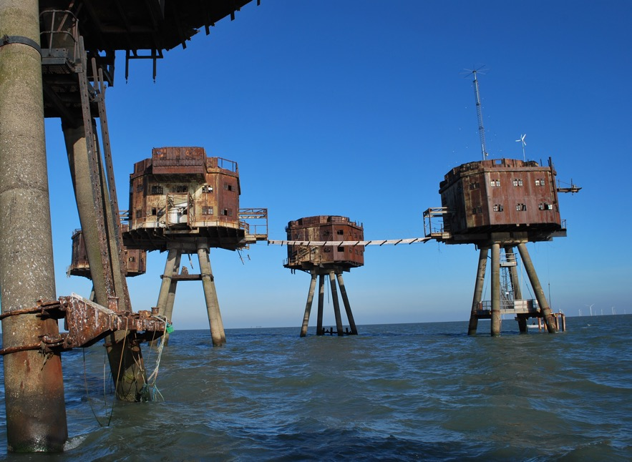
The Maunsell Sea Forts, Thames Estuary, UK

Slide 3
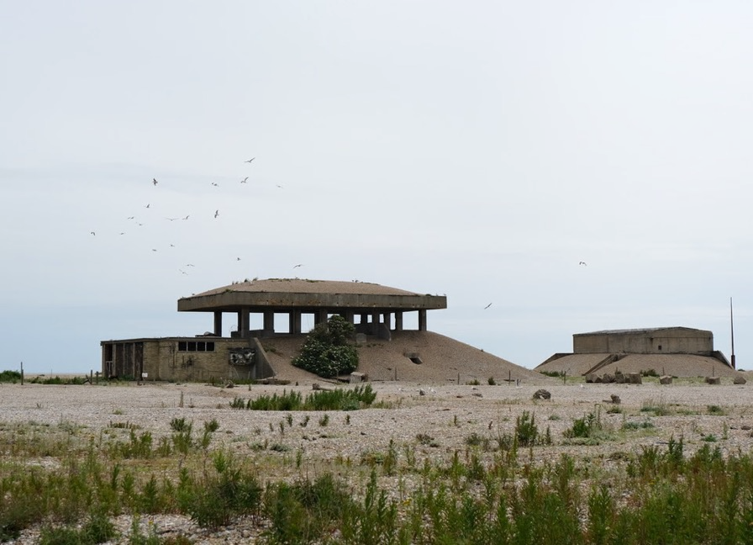
Orford Ness

Slide 4
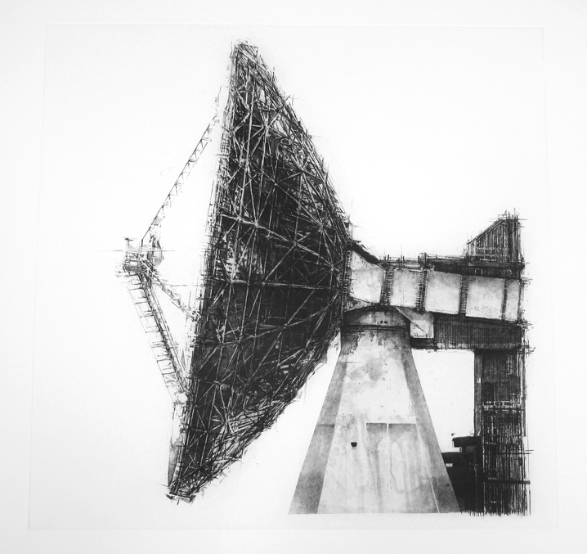
Sat.I , Etching , 2017

Slide 5
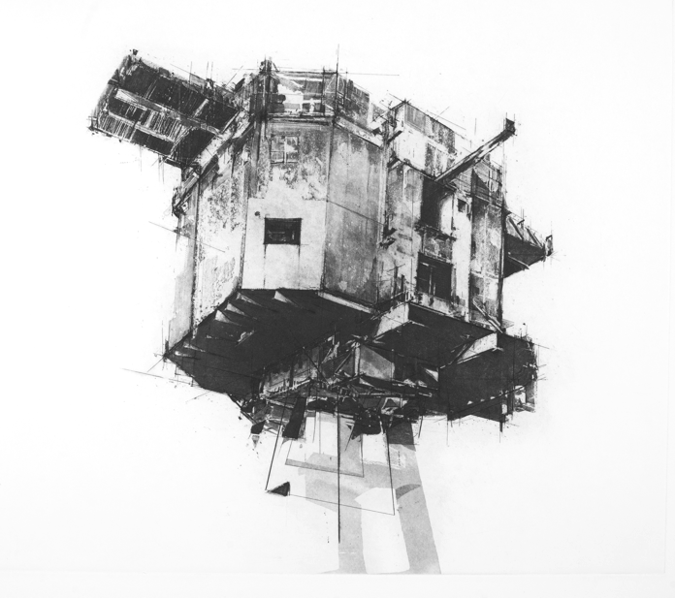
Fort I , Etching, 2013

Slide 6
“Architecture is treated as the material support to history”
(Celeste Olaquiaga, Remains of the fray, Art Forum, 2019)

Slide 7
Mirror Series – The Acoustic Sound Mirrors

Slide 8
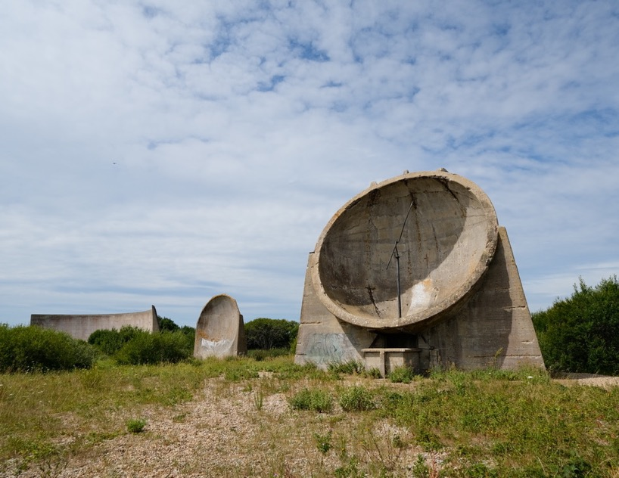
The Acoustic sound Mirrors, Denge , Kent

Slide 9
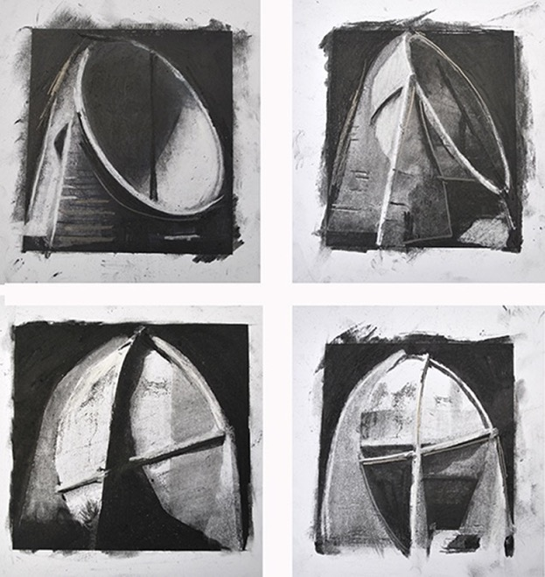
Mirror Studies, Charcoal

Slide 10
Mirror III, Etching, 2015 ( Detail)

Slide 11
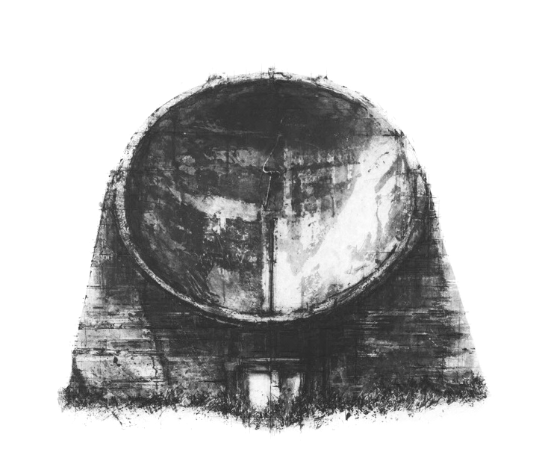
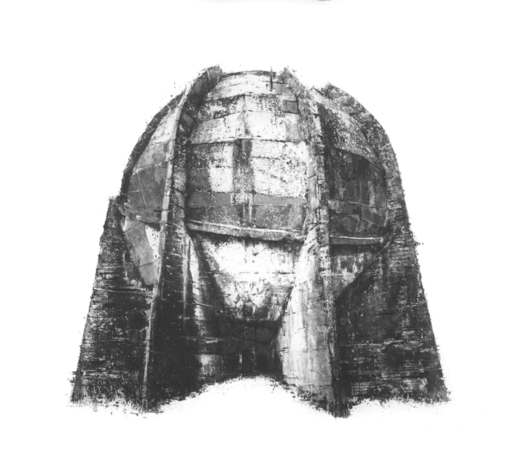
Mirror I and Mirror II, Etching, 2015

Slide 12
Mirror III and Mirror IV, Etching , 2016

Slide 13
Shifting Sands – The North Atlantic Wall

Slide 14
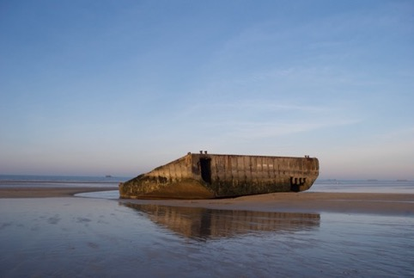
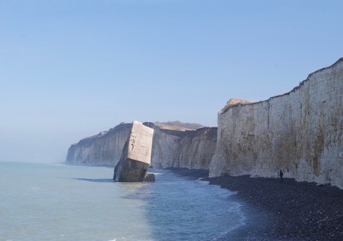
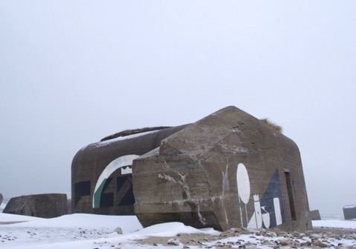
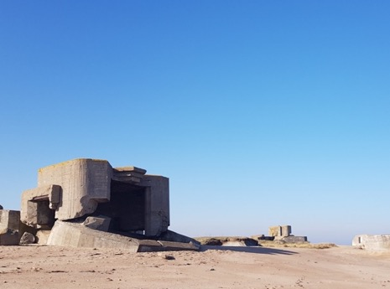
Sections of the Atlantic Wall

Slide 15
Ozymandias – Percy Shelley
I met a traveller from an antique land
Who said: Two vast and trunkless legs of stone
Stand in the desert. Near them, on the sand,
Half sunk, a shattered visage lies, whose frown,
And wrinkled lip, and sneer of cold command,
Tell that its sculptor well those passions read
Which yet survive, stamped on these lifeless things,
The hand that mocked them and the heart that fed:
And on the pedestal these words appear:
'My name is Ozymandias, king of kings:
Look on my works, ye Mighty, and despair!'
Nothing beside remains. Round the decay
Of that colossal wreck, boundless and bare
The lone and level sands stretch far away.

Slide 16
Shifting Sands, Etching 2018

Slide 17
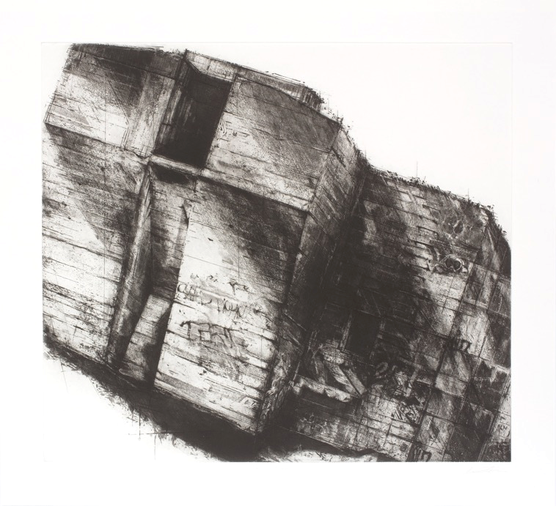
The Last Stand, Etching, 2018,

Slide 18
Isolation, Etching 2019,

Slide 19
Standing Idle series, 2020 , Etching Each plate size 32.5cm x 30cm

Slide 20
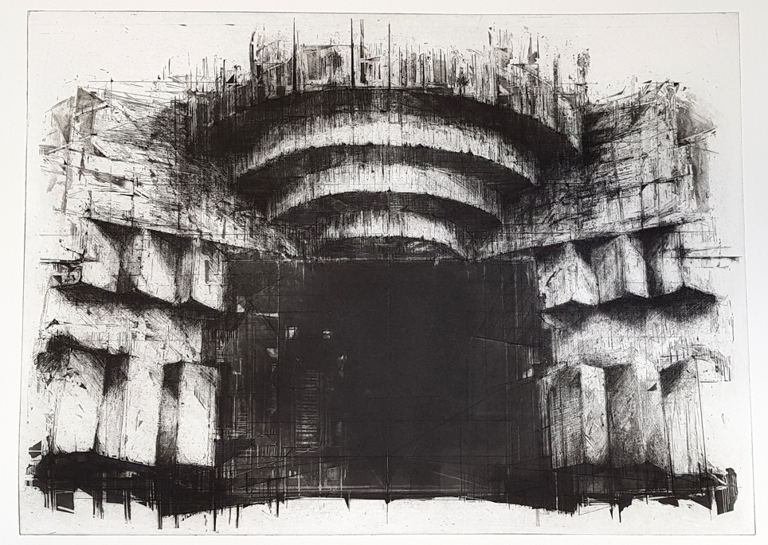
Emergence, A/P 2019, 73cm x 53.5cm

Slide 21
Shelter

Slide 22
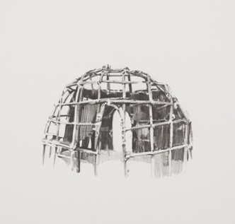
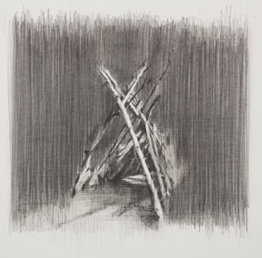
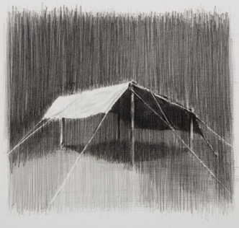
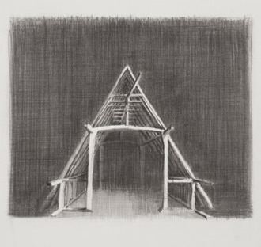
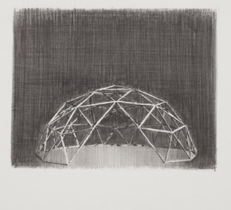
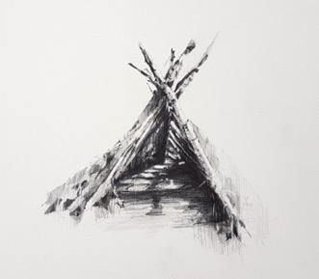
Shelter Drawings, 2019-2021 , Pencil and Graphite, 28cm x 26cm

Slide 23
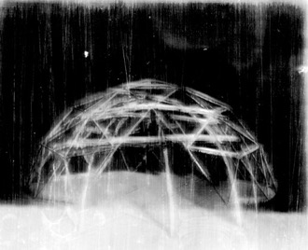
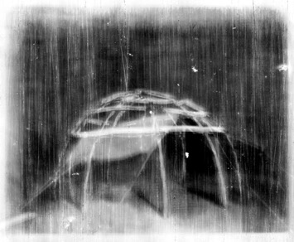
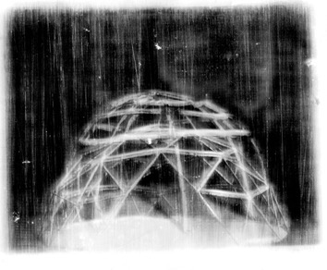
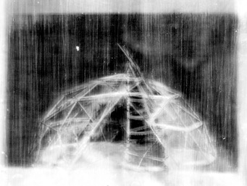
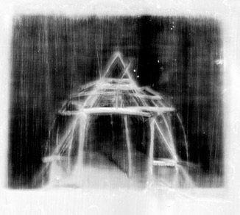
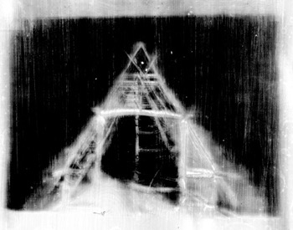
Shelter series, layered Collodion Glass negatives, 2021

Slide 24
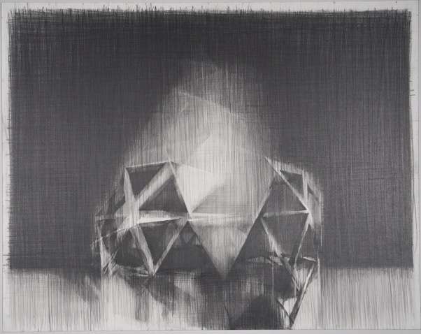
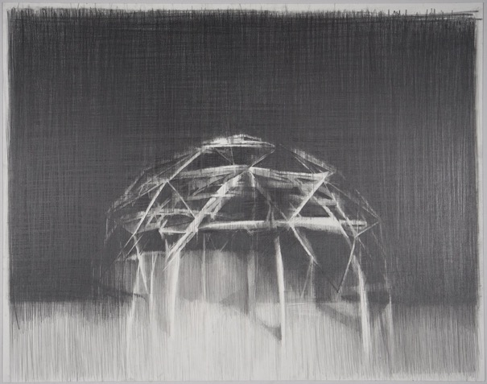
Nothing besides Remains IV, 2022, Pencil and Graphite
Nothing besides Remains VI, 2022, Pencil and Graphite

Slide 25
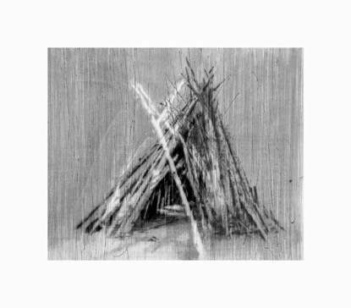
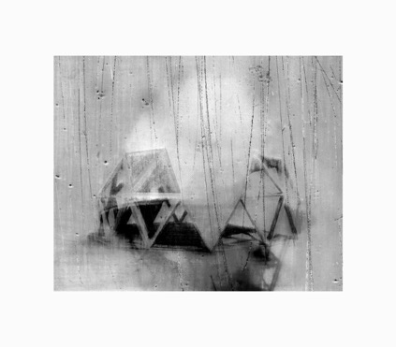
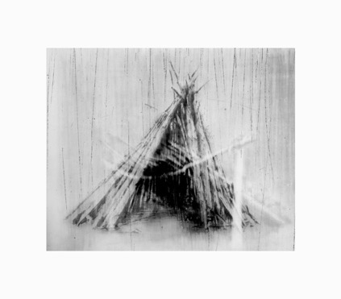
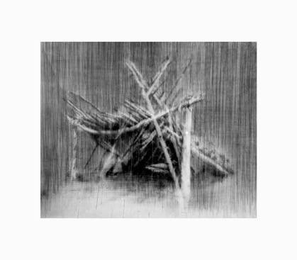
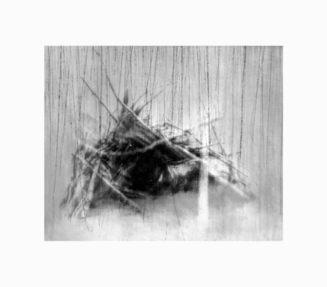
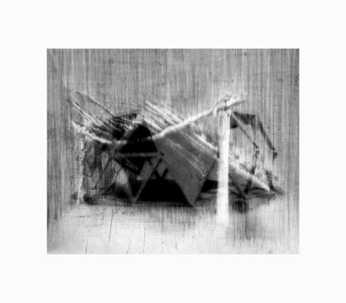
Synthetic Landscape series

Slide 26
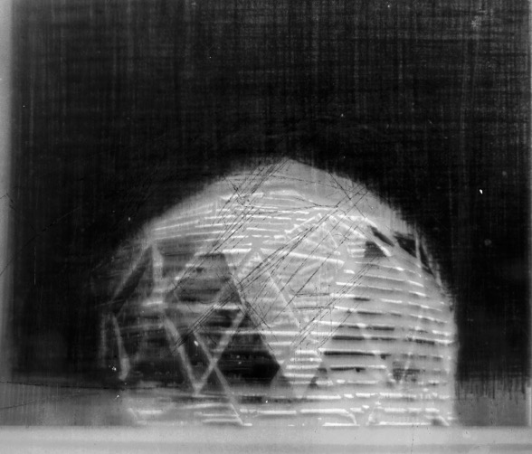
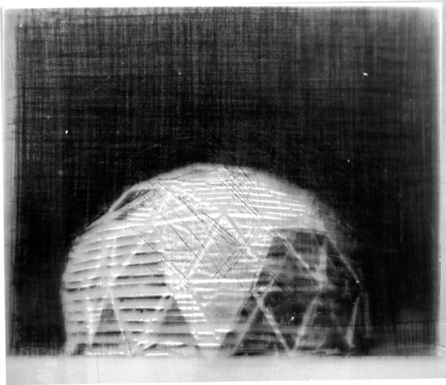

Slide 27
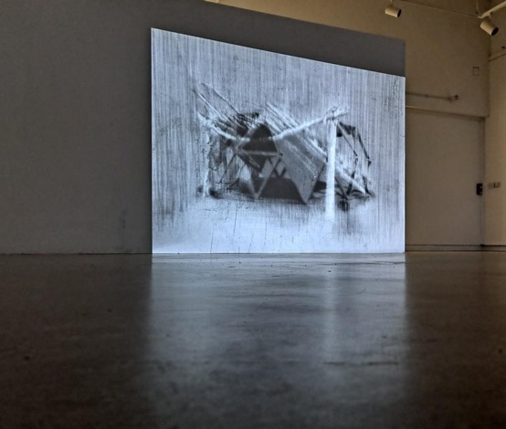
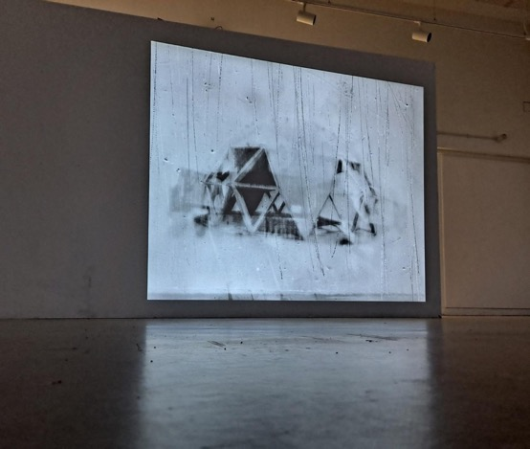

Slide 28


Slide 29
Instagram - ianchamberlainartist
Twitter - iancchamberlain
www.ichamberlain.co.uk

Slide 30
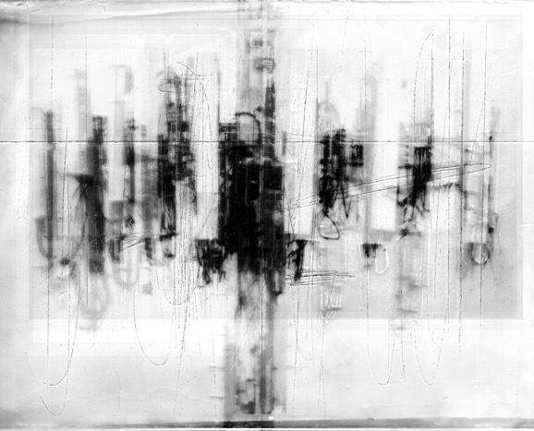
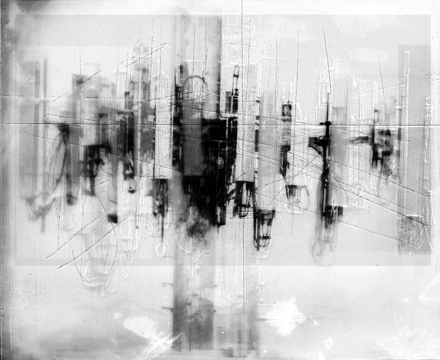

Slide 31
