Slide 1
Correct for the wrong reason: Why we should know more about Mathematical Common Student Errors in e-Assessment questions Project team: Indunil Sikurajapathi, Karen Henderson, Rhys Gwynllyw
Indunil
Sikurajapathi
CSCT, FET,
University of the West of England
Bristol
02-09-2022
Presented at the Continuing Excellence in Teaching and Learning in Mathematics, Statistics and Operational Research conference (CETL-MSOR-2022) at Abertay University, Dundee.

Slide 2
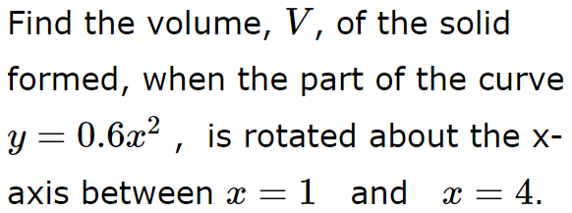
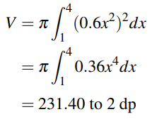
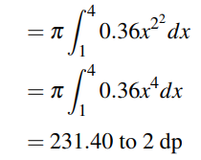
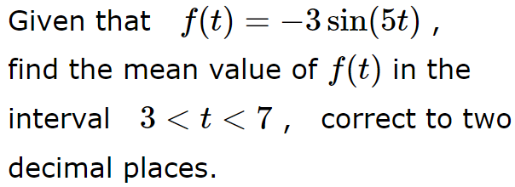
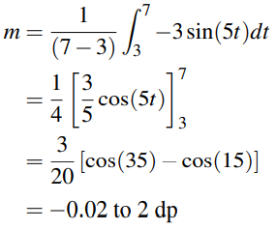
Mathematical Common Student Errors (CSEs):
Dewis E-Assessment System: A fully algorithmic open-source e-Assessment system; developed at UWE Bristol; conducts formative and summative assessments.
CSE project at UWE Bristol: detect Mathematical CSEs and provide tailored feedback in Dewis e-Assessment questions
Correct for the Wrong Reason:
e-Assessment Question | Correct Answer | CSE Answer | How did we resolve this
 |  |  | The original random parameters for the power of $x = \{0.25, 0.5, 1, 1.25, 1.5, 2\}.$ $∴$ 2 was removed.
 |  |  | Using a ‘while loop’, parameters are selected such that the CSE answer is different to the correct answer.
CSE: Taking ${\left(x^{p}\right)}^{q}={x^{p}}^{q}$
CSE: Substituting for $t$ in degrees

Slide 3
For more information about the CSE Project at UWE Bristol
Sikurajapathi, I., Henderson, K., and Gwynllyw, R., (2020) Using E-Assessment to Address Mathematical Misconceptions in Engineering Students. International Journal of Information and Education Technology. 10(5), pp.356–361.
Sikurajapathi, I., Henderson, K., and Gwynllyw, R. (2021) Students' Perceptions of Enhanced E-assessment Feedback Addressing Common Student Errors in Mathematics. MSOR Connections. 19 (2), pp. 10-27.
Sikurajapathi, I., Henderson, K., and Gwynllyw, R. (2022) Collection of Taxonomically Classified Mathematical Common Student Errors in E Assessments – (CSE Book). [online]. University of the West of England Bristol, United Kingdom. Available from: https://uwe-repository.worktribe.com/output/9303961
Sikurajapathi, I., Henderson, K., & Gwynllyw, R. (2022). Gathering and Compiling Mathematical Common Student Errors in e-Assessment Questions with Taxonomical Classification . MSOR Connections, 20 (3), pp. 55-71.
Thank you!

