Slide 1
University of the West of England, Bristol Enabling diagrammatic de-abstraction and modelling of engineering problems Peter Hale – PhD supervision team, Tony Solomonides and Ian Beeson
Abstract
Problem -
Enable de-abstraction of engineering problems from engineers' representation to computer models and code.
To what extent can diagrammatic representations of problems can be used in order to provide modelling solutions.
Solutions -
A source tree is created, then translated to computer code, then represented as a result tree.

Slide 2
Introduction
Purpose -
To test this problem -
C.S. Peirce (1906) -
'Prolegomena to an Apology for Pragmaticism'
"Come on, my Reader, and let us construct a diagram to illustrate the general course of thought; I mean a system of diagrammatization by means of which any course of thought can be represented with exactitude"
To limit the Scope –
Research restricted mainly to engineers (who often use diagrams)
To domain of modelling (which often requires diagrams)

Slide 3
Introduction Continued
Benefits -
Enables engineers to visualise problems such as representation of a product data structure in a familiar way
Gives a visual and colour coded representation of equations
Visualisation is easier to navigate and understand than that in spreadsheets, and more maintainable
Wider Implications -
This research could also be used for business modelling, process modelling, and workflow

Slide 4
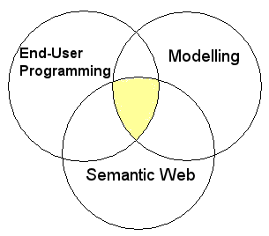
Research Area

Slide 5
Aim
Apply the research first where it can have the most use
Encourage others to expand it for other domains and other users
Simplify modelling/computing for computer literate non programmers, this includes many engineers
Enabling users such as engineers to model the manufacturing and design
Wider aim - to prototype research for enabling a larger range of software users to model their problem
Enabling more end user participation

Slide 6
Methodology
Create collaborative tools - enable users to develop software in a way they will be familiar with from their use of spreadsheets
Brings together approaches of object orientation, the Semantic Web, relational databases, and model driven and event driven programming
Frankel et al. (2004) explain the opportunities for, and importance of this kind of research
Translation steps from user to computer and Vice Versa
Iterative Design of an Iterative System

Slide 7
Methodology - Iterative Design
When things don't work out right can go back a stage instead of having to start again

Slide 8
User Driven Modelling/Programming
Advantages –
Uses a modelling approach for creating modelling solutions
Involves creating systems to create systems
Makes it possible to solve problem by breaking it down into stages - allowing software developers to concentrate on the most complex software problems and domain experts to be able to concentrate on their domain problem
Standardisation to allow software developers to create modelling systems for generic purposes
These can be customised and developed by domain experts to model their domain

Slide 9
Tools and Technologies
This methodology can be facilitated by :-
Modelling Tools - Building an end user interface and extending the translation capabilities of UML and/or other modelling tools (Johnson, 2004)
Spreadsheets - Improving the structuring and collaboration capabilities of spreadsheets, and enabling customisation of spreadsheet templates for particular domains and users
Ontology Tools - Extending the modelling capabilities and equation calculations in ontology tools and providing an end user interface
Semantic Web/Web 2.0 - Extending the capabilities of Semantic Web and Web 2.0 style web based development tools to allow collaborative modelling

Slide 10
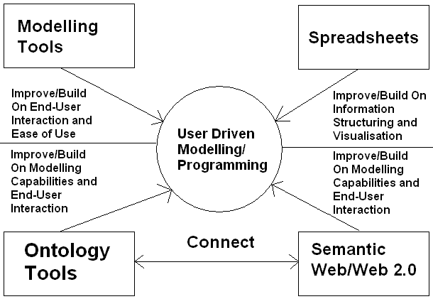
Tools and Technologies 2

Slide 11
Implementation
Demonstrates construction of diagrammatic representations of cost using the example of an aircraft wing parts
Diagrammatic representations achieved by visual representation of items and equations to represent cost
These items and equations are represented in standardised categories used in engineering - ‘materials’, ‘processes’, ‘cost rates’ etc
Other items and equations could be represented in the same way, so other engineering products could be represented
Costing method is also recursive because components and sub components can be costed separately or together and top down or from bottom up
This methodology has the potential to be applied to any calculation based modelling problem

Slide 12
Translation
A taxonomy representation is translated into a computer model
Relationships can be conveyed to a software model that evaluates them
Information is translated from the taxonomy and is visualised in tree form in a decision support tool
The visualisation of the information in a tree can be further translated into visualisation as an interactive diagram
The representation can be translated into different software languages, to allow for language independence

Slide 13
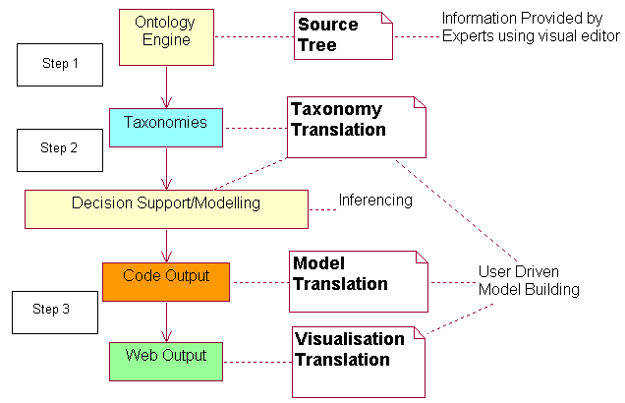
Translation Process

Slide 14
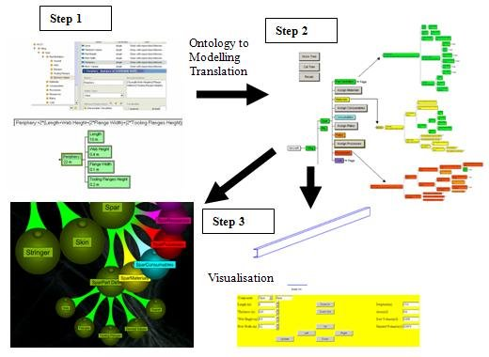
Translation Stages

Slide 15
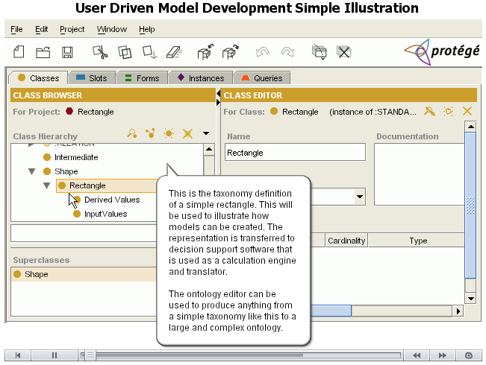
Example Illustration

Slide 16
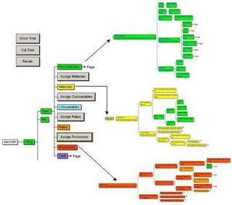
Decision Support Tool Representation
This enables people to see and interact with information in a collaborative ontology/database, and use it for modelling

Slide 17
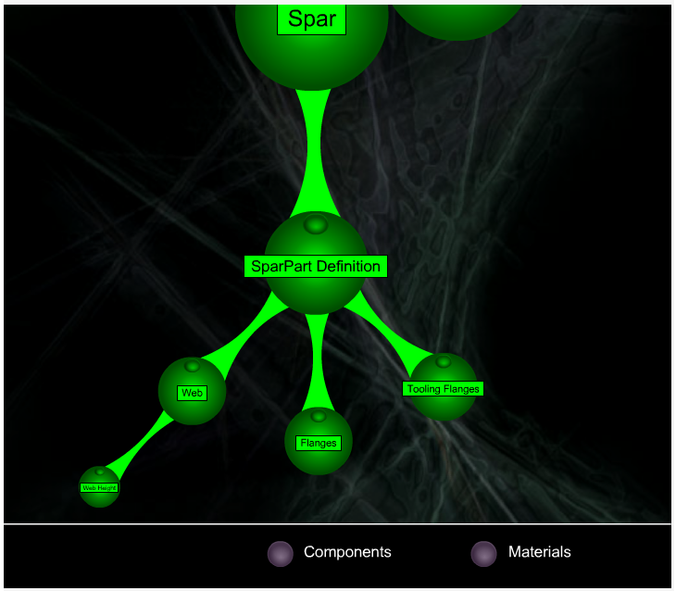
Web Tree Representation

Slide 18
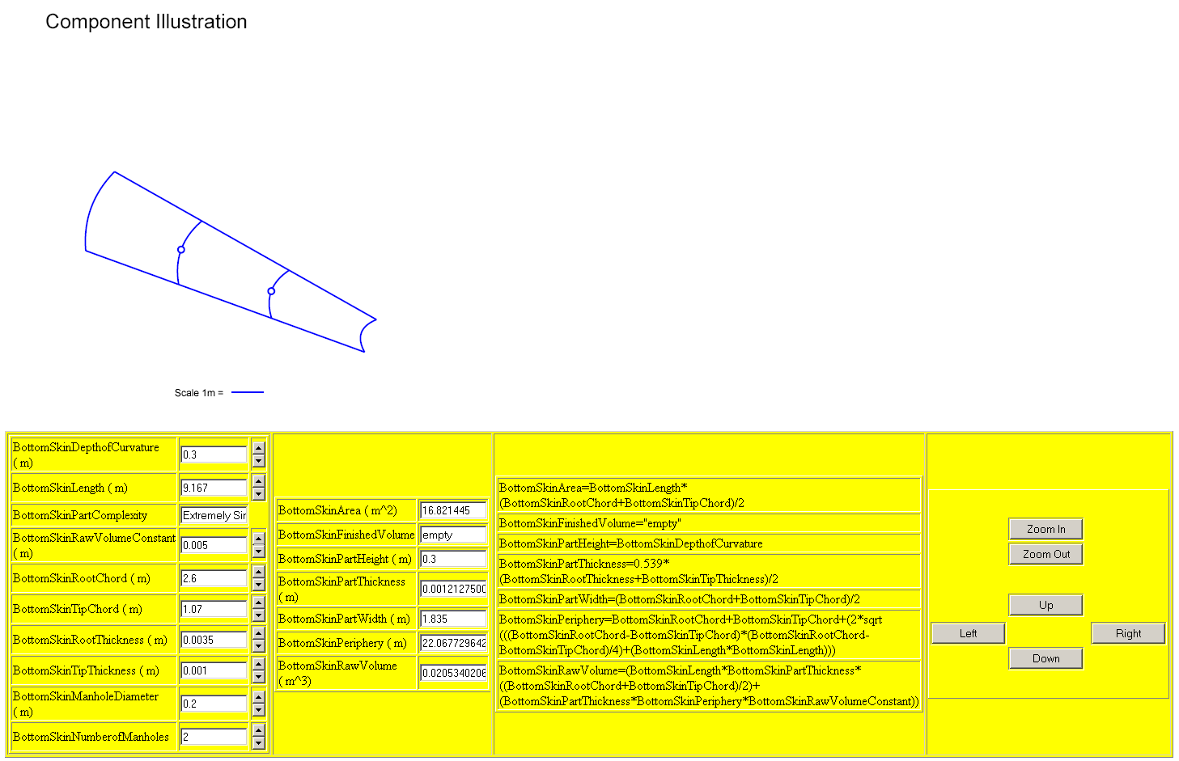
Web Diagrammatic Representation
Interaction with a different view of the Design Problem

Slide 19
Summary and Conclusion
Even if programming is made easier, only a proportion of people would actually be interested or capable of doing this
But there is still an advantage to colleagues such as people in the same team or department as an end user programmer
This closes the gap between those producing software systems, and those who require the software
This also makes it easier to iterate through solutions and solve problems more quickly and collaboratively
Experienced programmers can build a modelling environment that can then be used by non programmers to create models or solve other software problems
Achieved for the DATUM (Design Analysis Tool for Unit-cost Modelling) project with Rolls-Royce, Scanlan et al. (2006)
Enables collaboration, simulation and modelling by translation from a model based representation of software to the actual software
Gives users greater involvement
Partially automates the process of software creation via a collaborative structure that maps the problem, and user interface creation by diagrammatic and/or tree based representation

Slide 20
Related Research
To make the above practical, sustained research is needed in the areas of visualisation, modelling, end user programming, and transformation as well as the links between these areas –
Crapo et al. (2002) - Creation of systems to enable more collaborative modelling by domain expert end users, with visualisation, would allow engineers to model problems
Huhns (2001) and Paternò, (2005) explain that alternatives to the current approach to software development are required
Kraus et al. UWE - UML-based Web Engineering
Modelling languages such as Alloy explained by Wallace (2003) can be used as an interface to an end user programming environment
Transformation from a model building environment to program code has been investigated by Gray et al. (2004)

Slide 21
References
Crapo, A. W., Waisel, L. B., Wallace, W. A., Willemain, T. R., 2002. Visualization and Modelling for Intelligent Systems. In: C. T. Leondes, ed. Intelligent Systems: Technology and Applications, Volume I Implementation Techniques, 2002 pp 53-85.
Frankel, D., Hayes, P., Kendall, E., McGuinness, D., 2004. The Model Driven Semantic Web. In: 1st International Workshop on the Model-Driven Semantic Web (MDSW2004) Enabling Knowledge Representation and MDA® Technologies to Work Together.
Gray, J., Zhang, J., Lin, Y., Roychoudhury, S., Wu, H., Sudarsan, R., Gokhale, A., Neema, S., Shi, F., Bapty, T., 2004. Model-Driven Program Transformation of a Large Avionics Framework. In: Third International Conference on Generative Programming and Component Engineering GPCE, pp 361-378.
Huhns, M., 2001. Interaction-Oriented Software Development. International Journal of Software Engineering and Knowledge Engineering, 11, pp 259-279.
Johnson, P., 2004. Interactions, collaborations and breakdowns. In: ACM International Conference Proceeding Series; Proceedings of the 3rd annual conference on Task models and diagrams Vol 86 Prague, Czech Republic.
Kraus, A., Knapp A., Koch, N., 2007. Model-Driven Generation of Web Applications in UWE. http://ftp.informatik.rwth-aachen.de/Publications/CEUR-WS/Vol-261/paper03.pdf In Proc. MDWE 2007 - 3rd International Workshop on Model-Driven Web Engineering, CEUR-WS/, Vol 261, July 2007.
Paternò, F., 2005. Model-based tools for pervasive usability. Interacting with Computers, 17(3), pp 291-315.
Peirce, C.S. - 1906. Prolegomena to an Apology for Pragmaticism - http://www.existentialgraphs.com/peirceoneg/prolegomena.htm.
Scanlan, J., Rao, A., Bru, C., Hale, P., Marsh, R., 2006. DATUM Project: Cost Estimating Environment for Support of Aerospace Design Decision Making. Journal of Aircraft, 43(4).
Wallace, C., 2003. Using Alloy in process modelling. Information and Software Technology, 45(15), pp 1031-1043.

