Slide 1
Positioning relational feed-forward as a caring pedagogy to enhance students’ affective responses to assessment
Jennifer Hill & Harry West
RGS-IBG Annual International Conference
30 August - 2 September 2022
Notes:
Thursday 1 September - Session 2.40-4.20 (20 mins + 5 for questions)

Slide 2
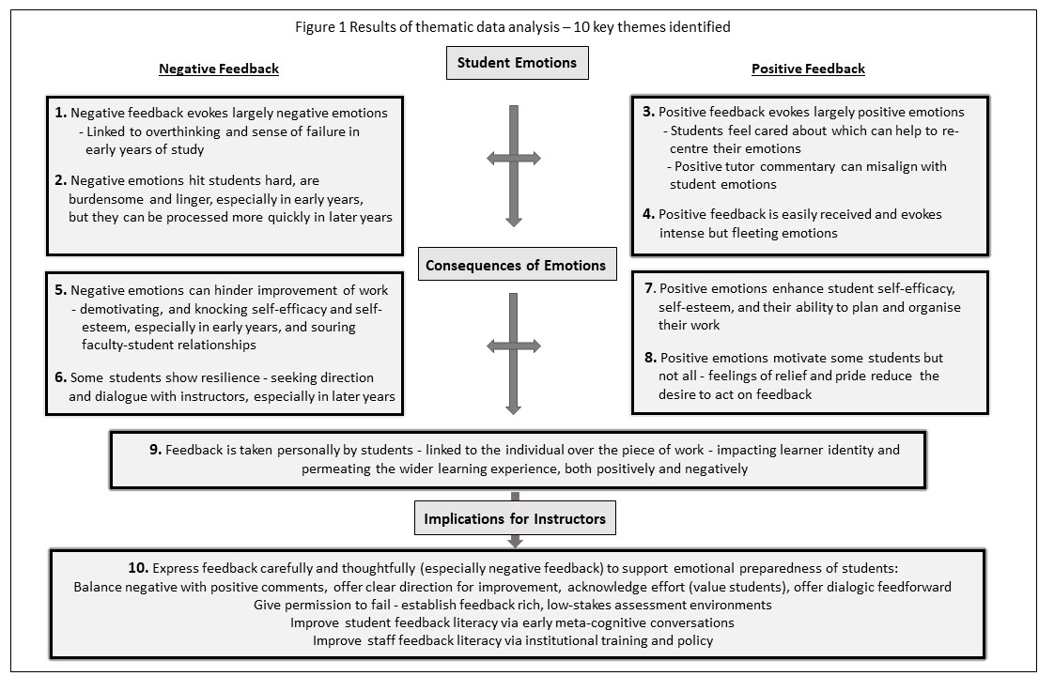
Introduction
receiving feedback is inherently emotional for students, exposing their capabilities as learners & determining how they act upon feedback (Hill et al. 2021a)
Hill et al (2021) TLI 9(1)
Notes:
Assessment feedback should be an integral part of learning in HE, but students can find this process cognitively and emotionally challenging.
Results for largely written feedback in the figure.
Negative emotions –frustration, disappointment, disheartened, stress, sadness, anger, embarrassment, shock
Positive emotions – happiness, relief, excitement, pride

Slide 3
instructors would do well to consider how to manage students’ responses to feedback so they feel capable of learning from instructor commentary
based in social constructivist approaches (Boud & Molloy 2013), our premise was that:
instructor - student relational feed-forward can promote not only cognitive sense-making, but the positive foregrounding of affective responses, supporting wellbeing
Notes:
In this presentation, we examine the role that instructor-student relational feed-forward can play in foregrounding student emotion, dissipating anxiety, and enabling productive learning attitudes and behaviours.
We define relational feed-forward as a dialogic form of assessment communication through which meanings are negotiated, and confusions and expectations are clarified. It is future-oriented, referring to instructor commentary that either impacts upon an upcoming assignment, or is given post-assignment with specific direction on how it can be applied to future work.
Relational feed-forward involves an awareness of the socio-affective context of feedback and a consideration of its impact on the learner. Relational feed-forward draws on elements of the therapeutic relationship found in health care settings, notably respecting the individual, being receptive to their emotions, and establishing warmth, empathy, genuine interest, and non-judgmental behaviour.
We view wellbeing as an umbrella term that emanates from the achievement of positive emotions, motivation, and self-regulative and self-efficacious learning behaviours.

Slide 4
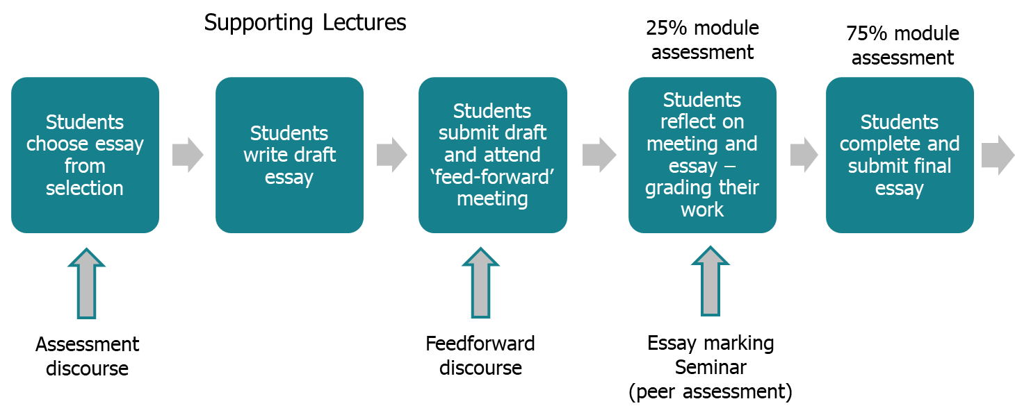
Module teaching and assessment structure
Hill and West (2020)
Notes:
Individual 30 minute face-to-face meeting with the instructor. Only two of 30 students did not attend. Students received no grade or feedback prior to the meeting.
The instructors set the scene for honest feedback interactions, outlining meeting purpose and setting expectations for dialogue focused on learning. The teacher began with the question ‘Are you ready for feedback’?
Meetings were purposely friendly, open and dialogic, with the instructors demonstrating a receptive and respectful attitude to work of all standards
Students selected when to meet with the instructor, and after this they revised their work before submission for summative grading. Each session ended with the co-creation of an action plan for improvement.
Interviews were audio-recorded and exemplar paragraphs were used. Students engage with learning ‘head on’

Slide 5
Methods
two qualitative projects run over academic years 2015-2017 and 2019-2020
2019 - 2020
2 focus groups of 6 students as module started
20% response rate
2 focus groups of 5 students at end of module
17% response rate
2015 - 2017
44 individual semi-structured interviews at end of module
Average 30 mins
61% response rate
digitally recorded interviews were transcribed and analysed thematically, initially via grounded approach, with further deductive coding based on literature
(See Hill & West 2020 and Hill et al. 2021 a and b)
Notes:
Interviews
Full-time students, most aged 18-21 years, male = 45% female = 55%
Interview average = 29.58 minutes. Range = 13.02 mins - 56.33 mins
Focus groups
Full time students – aged 18-21, predominantly female
Average 50 mins
Conducted by RA who had not taught on the course
The projects passed through the ethical review process of the authors’ faculty.

Slide 6
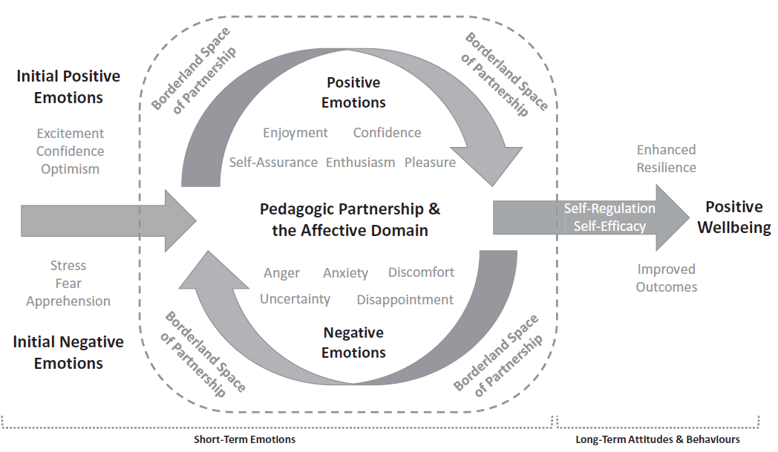
Findings
anticipating instructor feedback made the students feel ‘anxious’ and ‘nervous’ above all other emotions:
‘I felt a bit nervous, kind of vulnerable … my tutor was going to judge me and tell me face-to-face what she thought about my work. This opens you to criticism and that’s quite scary’
on receiving instructor commentary:
Hill et al (2021c)
students who progressed worse than they expected
negative feelings of disappointment and embarrassment
students who had made good progress
positive feelings of relief,
happiness, satisfaction
Notes:
Receiving commentary was a moment of reckoning for students, offering a judgement about their performance, and the uncertainty associated with this exposed their vulnerability.
‘You go through a grieving process … trying to accept it’

Slide 7
Findings
talking with the instructor about draft work helped the students to process and deal with their emotions, both short- and long-term:
‘As the meeting progresses you have that sort of relief that there was a lot of positives about the piece of work … it was quite reassuring and we need reassurance if we are going to keep going and get better’
derived from six central aspects of the relational feed-forward encounter:
The open and supportive environment prompted student questions
Talking clarified the tone of instructor comments
The instructor offered constructive critique, giving students a sense of direction
The dialogue pertained to the work in progress rather than personal ability
The dialogue directed student attention to assessment as a process
The instructor focused student attention on the assessment rubric
Notes:
Cathartic, offering an emotional release for students to admit their progress (or lack of) and to move forward from a mutually recognised benchmark.

Slide 8
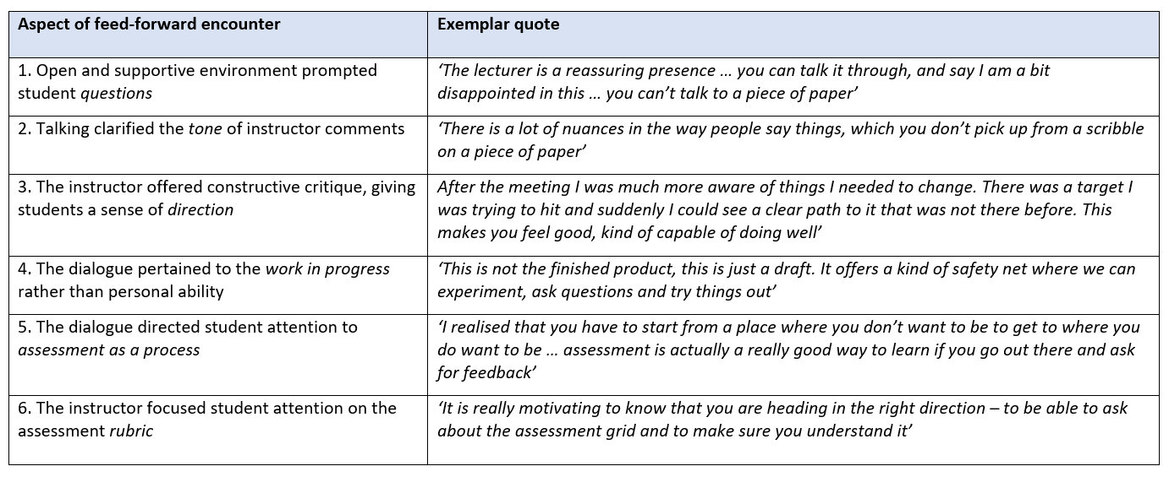
Notes:
‘The lecturer is a reassuring presence … you can talk it through, and say I am a bit disappointed in this … you can’t talk to a piece of paper’ ‘It does help when you have that face-to-face conversation. You know that you can ask those questions and not feel silly about it’
‘There is a lot of nuances in the way people say things, which you don’t pick up from a scribble on a piece of paper’ ‘You really understand what the tutor is saying and this can help with your emotions … talking helps you to deal with feedback,
both emotionally and then taking action’
‘I did feel a lot better afterwards. I was confident that I knew what to do to improve. I had a clear sense of direction’ ‘It re-motivates you to do the piece of work because you know where you are going with it’ ‘After the meeting I was much more aware of things I needed to change. There was a target I was trying to hit and suddenly I could see a clear path to it that was not there before. This makes you feel good, kind of capable of doing well’
‘Having the tutor comments before final grading, I recognize more that it is about the work and not about me. Because it’s in sort of a dynamic process that can still be changed’ . ‘This is not the finished product, this is just a draft. It offers a kind of safety net where we can experiment, ask questions and try things out’
With assessments it can make some students feel ‘ah ok I just have to write it and hand it in’. This assessment and feedforward supports you to develop the draft element of work’’ ‘I see it as allowing us to fulfil what we actually can do , rather than working with what you think you can do and then handing it in to be criticsed’ ‘I realised that you have to start from a place where you don’t want to be to get to where you do want to be’ ‘ Assessment is actually a really good way to learn if you go out there and ask for feedback’.
It is ally motivating to know that you are heading in the right direction – to be able to ask about the assessment grid and to make sure I understand it’

Slide 9
Findings
the meeting motivates students
I went through and was like “well this is good but I can still do even better”. I was a lot more excited to keep going at it and doing better’
‘It definitely re-motivated me to complete the piece of work to the best of
my ability’
helps to build their confidence:
‘My anxiety fell away and I began to feel more confident’
‘I did feel a lot better afterwards. I was confident that I knew what to do
to improve’

Slide 10
Findings
demonstrated that the instructor cared about them:
‘I saw her as much more human. She treated me like I was not just a number on a piece of paper. I was an individual and she made me feel like that, as though she appreciated my efforts’
students believed the assessment dialogue forged a closer bond between themselves and their instructor:
‘Often tutors just stand at the front and you don’t feel you can talk to them in depth … Now I feel I can approach her and say “I really don’t understand, can
you help me?”’
‘I feel a greater connection after our conversations. I was not just a face in the class doing work behind the scenes’
Notes:
‘Sometimes they seem unapproachable but really they are there to help us. You just have to sort of be brave enough to go and do it’
‘I see her as more of a friendly person, that I can talk to about things other than the assessment specifically’

Slide 11
Findings
the students were keen for instructors to help them manage their emotions related to assessment:
‘Assessment is about judgement and tutors have to be kind as well as fair in how they judge you. If they show you they care then you want to do well for them as well as yourself’
students made clear that talking about feedback helped them to deal with their emotions, promoting their wellbeing:
‘I didn’t feel so alone with my work, with a tutor waiting to criticize it. I felt more like we were a team, trying to make me the best that I could be. This made me feel capable and strong, and not isolated and doubting myself … Being confident in yourself and being able to talk with your tutor definitely helps with wellbeing’
Notes:
The students offered ideas about what instructors could do to help them with the emotions they experience related to feedback:
- instructors giving balanced critique and offering more personal feedback encounters
- more relational feed-forward on work in progress
- informal chats before or after lectures
For larger groups, students discussed screen-casting of personalized feedback for students who might record and send a response back to their instructor.
Talking with the instructor appeared to remove the isolation and confusion often experienced by students with respect to assessment feedback. It reduced or resolved problems before they festered and impacted upon their mental health.

Slide 12
Discussion
instructor-student relational meetings supported students to process and manage the affective aspects of their assessment tasks
negative emotions arising from feedback did not dwell with the students as they had done previously with respect to written commentary
dialogue helped the students feel positive about their work in real time, boosting their confidence to act on instructor commentary
the relationship with the instructor [pedagogies of mattering and care] is important in encouraging students to seek wider learning support
Notes:
Post-human mattering ‘pays better attention to the situated particularities of students’ learning journeys and takes better care of their developing subjectivities as learners.’ position assessment as a material-discursive doing (Gravett et al. 2021 - Teaching in HE).
Enables assessment to become an intra-active mattering – to move beyond assessment as something which is considered as primarily cognitive, rational and technical toward a more complex understanding of affective, embodied, and relational processes.
But note Tronto explains powerfully that ‘care depends upon adequate resources: on material goods, on time and on skills’ (1993).

Slide 13
Discussion
we can map relational feedback practice onto the moral elements of the political ethics of care (Tronto 1993, 2013, 2015):
Bozalek et al. (2016)
Notes:
Noddings’s (1984) ethics of care is conceptualized as a moral obligation, a caring attitude, a long-term inclusive commitment and a volitional act devoted to entering into caring relations, and acting compassionately, responsively and morally for the cared-for’s growth
Attentiveness – caring about – acknowledging that care is necessary; students and staff being attentive to one another
Responsibility – caring for – a willingness to take responsibility in the relationship (staff not becoming over-responsible); reciprocity
Competence – aspects concerning the ability to care; challenging who has expertise, resources
Responsiveness – response of the care-receiver to the care received; vulnerability/inequality of students
Trust – qualities needed to work together; taking risks to open up practice and their learning to the scrutiny of others

Slide 14
Implications for practice
incumbent upon instructors to explore pedagogies that might mitigate negative emotions
we recommend students are prepared early in their university experience with information about feedback theory and practice - from pre-arrival information, through induction, to development over the first year and onward
to scale up relational feed-forward, develop first-year curricula specifically around assessment, in which students are taught feedback literacy as an intended learning outcome
position relational feed-forward as an act of care, but consider the challenges to this in the neoliberal university
Notes:
Might scale up by dividing larger numbers of students amongst a greater number of instructors (e.g. a ratio of 20:1) to undertake assessment, with a clear aim of building assessment skills and feedback recipience. For a core module, a single staged assignment with a feed-forward meeting might replace multiple smaller summative assignments, essentially requiring comparable instructor resource. Personal tutoring might be absorbed into this module to offer a larger resource envelope and this also ensures that conversations between academic staff and students are meaningful as they are directly relevant to ongoing assessment.
The value of assessment dialogue can come from many activities over the duration of a course, both within class time and extending beyond it:
extended induction period in first year might focus on reflective and discursive approaches to feedback.
Seminars can be used to direct students to reflect on written feedback they have received and to discuss it with their instructor and/or peers.
Oral presentations and collaborative projects are good vehicles for engaging students in carefully supported peer-to-peer dialogue around the strengths and weaknesses of work in progress.
The personalized nature of feed-forward can be replicated by screen-casting instructor commentary on an exemplar piece of work and enabling students to view this in their own time.,
Interactive coversheets can be used, on which students self-evaluate their assignment submissions against the rubric, summarising how previous feedback has informed their work, and requesting specific feedback.

Slide 15
Any questions?
Email:
jhill18@glos.ac.uk and Harry.West@uwe.ac.uk

Slide 16
References
Boud, D. & Molloy, E. (2013) Rethinking Models of Feedback for Learning: the Challenge of Design.” Assessment and Evaluation in Higher Education 38: 698-712.
Bozalek, V., Mitchell, V., Dison, A. & Alperstein, M. (2016) A diffractive reading of dialogical feedback through the political ethics of care. Teaching in Higher Education, 21, 825-838.
Hill, J. & West, H. (2020) Improving the student learning experience through dialogic feed-forward assessment. Assessment and Evaluation in Higher Education, 45, 82-97.
Hill, J., Berlin, K., Choate, J., Cravens-Brown, L., McKendrick Calder, L. & Smith, S. (2021a) Can relational feed-forward enhance students’ cognitive and affective responses to assessment? Teaching and Learning Inquiry, 9(2).
Hill, J., Berlin, K., Choate, J., Cravens-Brown, L., McKendrick Calder, L. & Smith, S. (2021b) Exploring the emotional responses of undergraduate students to assessment feedback: implications for instructors. Teaching and Learning Inquiry, 9, 294-316.
Hill, J., Healey, R.L., West, H. & Déry, C. (2021c) Pedagogic partnership in higher education: encountering emotion in learning and enhancing student wellbeing. Journal of Geography in Higher Education, 45, 167-185.
Tronto, J.C. (1993) Moral Boundaries: A Political Argument for an Ethic of Care. New York: Routledge.
Tronto, J.C. (2013) Caring Democracy Markets, Equality, and Justice. New York: New York University Press.
Tronto, J.C. (2015) Who Cares? How to Reshape a Democratic Politics. Ithaca, NY: Cornell University Press.

