Slide 1
The University of the West of England, Bristol

Slide 2
A case Study of Sustainability at UWE Bristol: a 28 year journey
Presented by
Prof Jim Longhurst
AVC Environment and Sustainability
UWE Bristol
The Eighth International SEEDS Conference 2022
Date
31st August 2022

Slide 3
Presentation Outline
In this presentation I will
briefly discuss the role of higher education as both a cause and a solution to our multiple sustainability crises
explore the changing expectations of current and future students as they confront the reality of the climate and ecological emergencies.
describe UWE’s sustainability journey from the mid-1990s until the present day exploring the progressive inclusion of sustainability considerations in the curriculum, research, campus operations, partnerships and student and staff engagement
conclude with a description of UWE approach to managing its carbon emissions
throughout please note that sustainability is a culture change process and is a team game.
We don’t have all the answers but through conferences like this we learn from others’ experiences and in return we are happy to share our story.

Slide 4
Abstract
This presentation will describe UWE’s sustainability journey from the mid-1990s until the present day.
Key drivers for action include student expectation and demand, staff engagement, senior staff leadership and external certification to ISO 14001.
Strategy 2030 sets the strategic direction for the decade of action and frames our ambition.
UWE’s location in Bristol has been an important driver for change and UWE has helped shape the city-region’s sustainability engagement.
These initiatives inspire and encourage the university to redouble our efforts as well as providing new opportunities for research, live briefs in teaching and volunteering, placement and dissertation opportunities for students.
Students increasingly expect their university to take sustainability seriously and to prepare them for living their life through the changing climate of the 21st Century.
Future students will be even more concerned about the climate and ecological emergencies and universities will need to adapt to this changing expectation.

Slide 5
UWE Bristol
UWE Bristol’s commitment to sustainability is driven by its students, its staff and its senior management team.
"It is about recognising that we are one planet, one world. We all have a collective responsibility to engage individually and collectively… to move to a different place in our mindset and our actions. This is a hugely important agenda that is going to be with us forever"
Professor Steve West,
Vice Chancellor, President and CEO, UWE Bristol.

Slide 6
UWE Bristol
30 000 plus students in the UK from 163 countries
c8000 transnational students
4000 staff
Annual income of approximately c£334 million
3 campus locations Frenchay, City Campus and Glenside
4 Faculties soon to be three Colleges but currently
Arts, Creative Industries and Education
Business and Law
Environment and Technology
Health and Applied Sciences

Slide 7
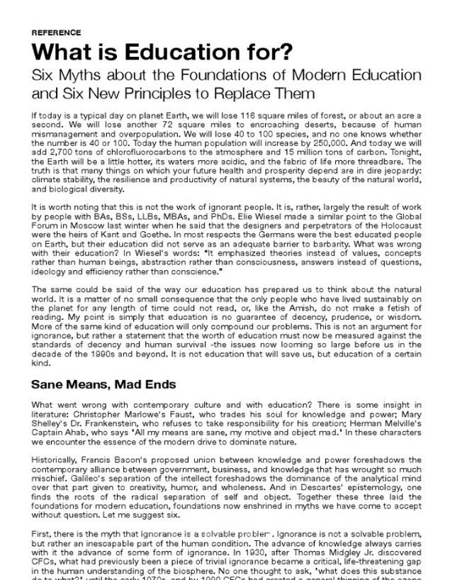
Education – the Problem?
In his 1991 paper What is Education for? David Orr, Emeritus Professor, Oberlin College said
“Many things on which your future health and prosperity depend are in dire jeopardy: climate stability, the resilience and productivity of natural systems, the beauty of the natural world, and biological diversity.”

Slide 8
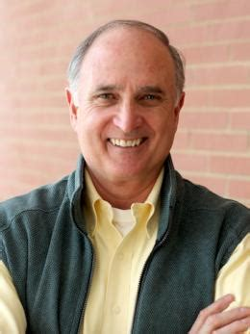
How Did We Get Here?
Well as Orr also said
“It is worth noting that this is not the work of ignorant people. It is, rather, largely the result of work by people with BAs, BScs, LLBs, MBAs, and PhDs”.
https://www.oberlin.edu/david-orr

Slide 9
Education: a (Partial) Solution?
So, if Education is partly the cause of our environmental misfortune might it be a partial solution?
As Albert Einstein allegedly said
“The significant problems we face today cannot be solved at the same level of thinking we were at when we created them.”
Einstein reminded us that doing the same thing over and over again and expecting different results does not result in the desired outcome. We must change.
Voltaire said “No problem can withstand the assault of sustained thinking”.
Universities are good at thinking but we must translate thought into action.
So, how is UWE Bristol addressing this challenge?

Slide 10
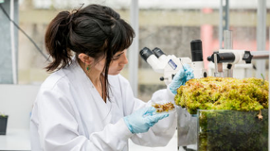
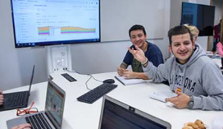
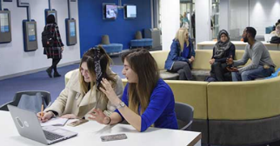
Tomorrow’s Graduates Will Live Through the Climate and Ecological Crises
According to Actuary Tables a student leaving a UK university this year can expect to live at least another 60 years.
Despite the efforts promised by international actors by the 2080s there will be wide ranging, adverse climate and ecological changes.
The graduates will live through these profound changes.
How will their educational experience prepare them for the challenges that they will encounter in their professional and private lives?
Crises manifesting themselves in rising levels of eco anxiety amongst students and young people.

Slide 11
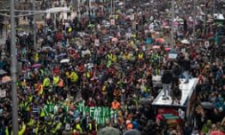
The Next Cohort of Students
Will be much more concerned about the climate and ecological emergency.
They will expect their institution
To take the climate emergency seriously
To manage their estate wisely
To include carbon literacy /climate awareness within the formal and informal curriculum
To prepare them for the challenges they will face across their life course, professional and private, as they live through a changing climate.
Image copyright The Guardian
https://www.theguardian.com/environment/2020/feb/28/greta-thunberg-bristol-schools-shut-students-join-climate-strike#img-1

Slide 12
Future Students
Summer 2020 Survey by Zurich Insurance of young people aged 7 - 17.
Major concern expressed about the impact of and lack of action on the climate emergency
Young people want to see climate included in the formal school curriculum.
(https://www.zurich.co.uk/en/about-us/media-centre/company-news/2020/millions-of-young-people-want-more-climate-change-education)
Institution of Engineering and Technology survey of children aged 5 -13
Over two-thirds of children (68%) hope to follow a career that helps the environment
Lack of understanding about these jobs could stop them from getting there.
(https://www.theiet.org/media/press-releases/press-releases-2020/press-releases-2020-july-september/18-september-2020-generation-green-ambitions-at-risk-of-going-to-waste)

Slide 13
NUS - SOS Surveys
Annual survey by NUS then SOS of students attitudes to sustainability
2021 Survey of 8000 students
91% say their place of study should actively incorporate and promote sustainable development.
84% would like to see sustainable development incorporated in all courses.
66% say sustainable development is something they would like to learn more about.
https://www.sos-uk.org/research/sustainability-skills-survey

Slide 14
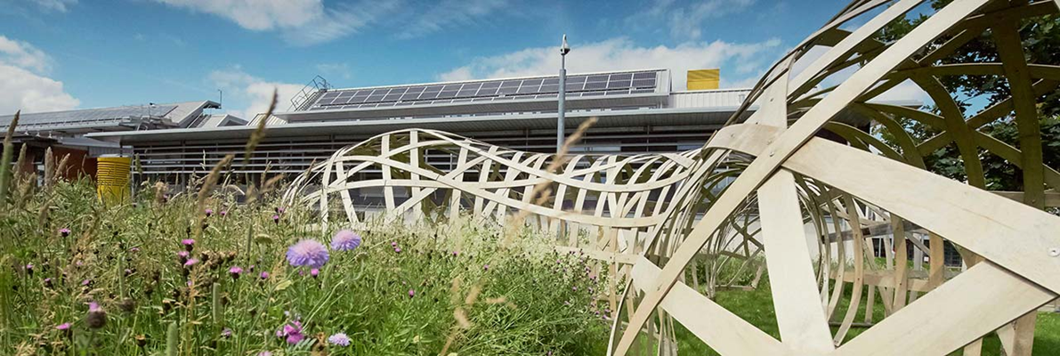
Sustainability at UWE Bristol
Integrating Sustainability into Policy, Practice and Culture so that it is present in the purpose and operation of the university.
Teaching and Learning
Research, Innovation and Knowledge Exchange
Local, National and International Partnerships
Campus Operations and Developments
Student and Staff Engagement
Creating a culture supportive of a sustainable university.
All in partnership with the Students' Union.

Slide 15
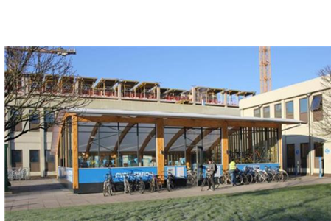
Sustainability at UWE – a 28 year journey
1994 UWE’s first Environmental Policy periodically revised thereafter
1995 Environmental Policy Committees established in Faculties
2004 Sustainability Board established
2004 Sustainability Manager post established
2005 First Sustainability Action Plan
2006 Fairtrade University Status
2007 First Sustainability Strategy
2007 Baseline survey of sustainability in the Modular Scheme
2008 Cross university Knowledge Exchange for Sustainability Education (KESE) group established to promote and enhance ESD across the university
2009 First ESD Action Plan published

Slide 16
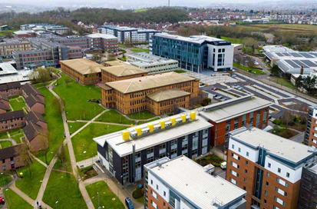
Sustainability at UWE – a 28 year journey
2010 Strategy 2020
2011 Assistant Vice Chancellor Environment and Sustainability established
2011 Waste and Resource Manager post established
2011 Sustainability Engagement Coordinator post established
2011 Annual UWE wide Sustainability and Education Conference established
2012 Sustainability Plan- Positive Footprint
2012 SL in ESD post established
2012 Annual meeting cycle with individual HoDs instigated
2014 ISO 14001 Post established
2014 Certification to ISO 14001:2004 EMS
2015 Internal and external verification that all taught programmes address sustainability in the context appropriate to the individual discipline
2015 Bristol’s Year as European Green Capital
2015 Launch of UWE Green Capital Strategy
2015 Launch of HEFCE Funded Green Capital Student Capital project

Slide 17
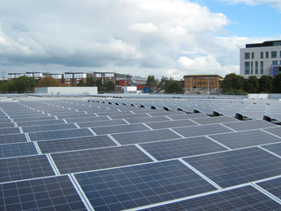
Sustainability at UWE – a 28 year journey
2015 Carbon Action Manager post established
2016 NUS –SOS Responsible Futures accreditation
2016 Annual meeting with Faculty Executive groups instigated
2016 Launch of Sustainable Development Goal (SDG) Mapping Project
2016 Largest single roof mounted PV array in UK HE begins generating
2017 Refreshed Sustainability Plan 2.1
2017 Transition to ISO 14001:2015 EMS
2017 New Environmental Sustainability Policy
2017 Associate Professor in ESD established
2018 KESE Group wins UWE’s first Advance HE Award for Collaborative Approach to Teaching Excellence (CATE)
2019 New Sustainability Communications and Engagement Framework launched

Slide 18
Sustainability at UWE – a 28 year journey
2020 Launch of Transforming Futures Strategy 2030
2020 New Transforming Futures Climate Action and Sustainability Strategy
2021 Completion of Phase 1 of the SDG Mapping Project
2021 New Action Plans for Education for Sustainable Development, Sustainability Engagement, Sustainable Food, Transport, Carbon and Energy Management, Clean Air, Circular Economy including plastics, and Biodiversity
2021 Launch of QAA- Advance HE Education for Sustainable Development Guidance
2021 Reaccreditation to NUS -SOS Responsible Futures and ISO 14001
2021 Work starts on new student accommodation designed to PassivHaus standard
2021 UWE’s Learning, Teaching and Student Experience Committee formally adopts QAA-Advance HE ESD guidance
2022 New carbon literacy training programme for staff and students
2022 UWE Bristol and the SDGs: Programme mapping portfolio published – available soon in the UWE Research Repository

Slide 19
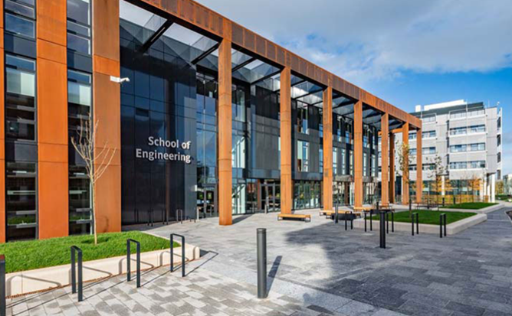
Key Success Factors
Student expectation and demand
Staff engagement
Senior staff leadership
Strategy and clear direction of travel
Willingness to embrace change
Learning from failure
External certification
Partnership with the Students’ Union
Bristol – A European Green Capital

Slide 20
Governance, Policy and Strategy

Slide 21
Sustainability Ambitions in Strategy 2030
Through our 2030 Strategy we will work to address the urgency of the climate and ecological emergency and strive to fulfil our role in the achievement of the United Nations’ Sustainable Development Goals.
UWE Bristol Declaration of a Climate and Ecological Emergency here
Seven ambitious commitments in Strategy 2030.
https://www.uwe.ac.uk/about/values-vision-strategy/strategy-2030

Slide 22
Sustainability Commitments in Strategy 2030
Net-zero emissions of greenhouse gases by 2030.
Clear targets and plans to reduce water and energy use, cut waste generation including food waste, and support biodiversity. Towards a circular economy.
Eliminate all but essential single-use plastic by 2025.
Establish all our campuses as clean air zones.
Secure year-on-year improvement in sustainable travel.
Work with our students to explicitly address climate change and environmental challenges in the curriculum.
Support research that addresses climate change, environmental challenges and biodiversity.
https://www.uwe.ac.uk/about/values-vision-strategy/strategy-2030

Slide 23
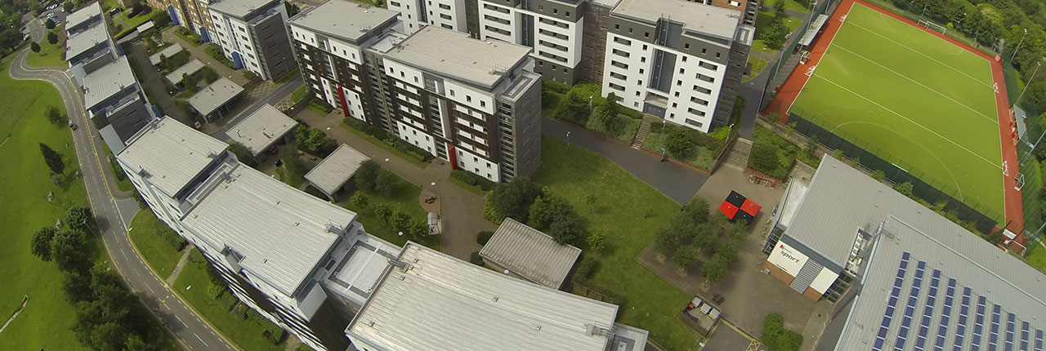
Climate Action and Sustainability Strategy (CASS ) 2030
The Climate Action and Sustainability Strategy develops the key ambitions of Strategy 2030, explicitly linking the sustainability and climate actions with the purpose, the people and the place of the university.
https://www.uwe.ac.uk/about/values-vision-strategy/sustainability/strategy-leadership-and-plans/policy-and-strategy-documents

Slide 24
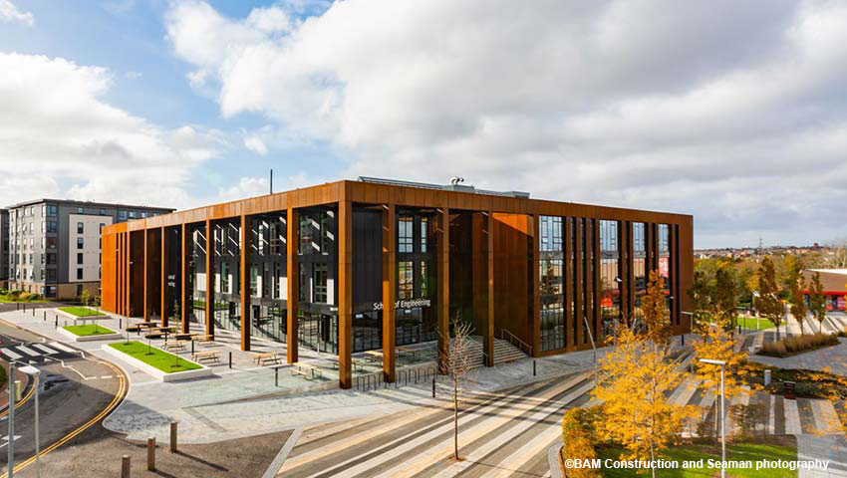
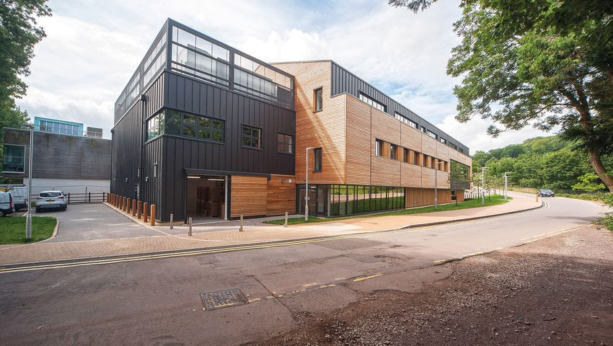
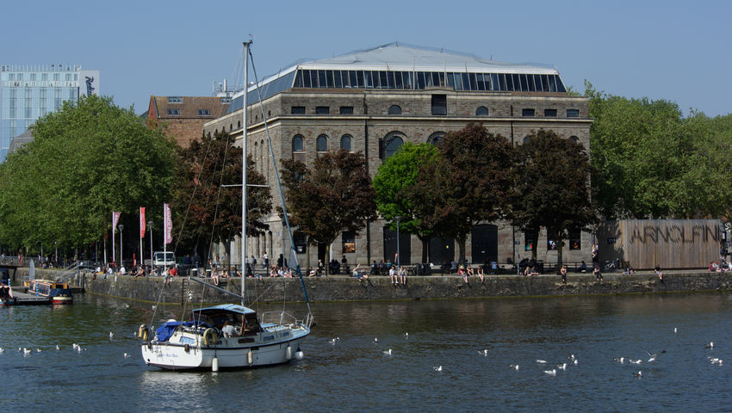
Climate Action and Sustainability Strategy (CASS ) 2030
Our Commitment to Sustainability
How We Will Manage and Report on Our Actions
Practising Sustainability
Understanding Sustainability
Influencing Sustainability and cross cutting each element Adapting to a Changing World

Slide 25
Governing Sustainability
Leadership and Governance
Overall strategic leadership for sustainability is guided by the Vice-Chancellor, Deputy Vice-Chancellor, Pro Vice Chancellor and the Assistant Vice-Chancellor for Environment and Sustainability.
The Assistant Vice-Chancellor for Environment and Sustainability is charged with promoting the integration of sustainability and enhancing the sustainability impact of all our teaching, research, knowledge exchange, operational management and community engagement activities.
Governance is exercised through the Sustainability Board.

Slide 26
The Sustainability Board
Purpose
To enhance the sustainability practices and developments of the university in all its educational and operational endeavours and thereby to enhance the reputation of the university and its attractiveness to current and future students and staff as a place of study or employment.
To consider contemporary and emergent sustainability risks, opportunities and challenges and to advise the University on appropriate actions.
At each meeting, the Board reviews progress with the seven core sustainability commitments of Strategy 2030, undertakes regular reviews of policies including the Environmental Sustainability Policy and the Ethical Investment Policy, approves action plans arising from the Climate Action and Sustainability Strategy, reviews progress with the commitment to adopt the principles of Responsible Management Education (PRME) across the institution, and provides the governance of the whole institution ISO 14001 certification process and the Responsible Futures accreditation.

Slide 27
Terms of Reference
To support implementation of Strategy 2030’s aims and objectives.
To guide, support and develop the University’s integrated approach to embedding sustainability in all of its endeavours.
To oversee implementation and achievement of the Transforming Futures Climate Action and Sustainability Strategy (CASS).
To advise the Vice Chancellor, Academic Board and the Board of Governors on progress with the strategy and matters pertaining to risk and reputation.
To share good practice and promote continuous improvement.
To assure the university that the requirements of ISO 14001 -2015 certification are met.
To assure the university that the requirements of Responsible Futures accreditation are met.
To support the implementation of the Principles of Responsible Management Education (PRME) across the university.
To advise on the sustainability implications of current and future policies and practices.
To advise on the continuing appropriateness of the Ethical Investment Policy.
To establish appropriate procedures to ensure effective communications within the university on issues discussed and decisions taken by the Board.
To undertake such other actions as may be required from time to time to discharge the Terms of Reference.

Slide 28
Membership
Assistant Vice Chancellor, Environment and Sustainability, Chair.
Director of Estates and Facilities.
Pro Vice Chancellor Research and Business Engagement, Directorate Sponsor.
An additional member of the Directorate nominated by the Vice Chancellor.
The President of the Students’ Union.
A Vice President nominated by the Students’ Union.
A PVC / Dean of Faculty nominated by the Deans.
An Associate Dean nominated by the Associate Deans responsible for Learning and Teaching.
An Associate Dean nominated by the Associate Deans responsible for Partnerships.
Chair of the Climate Action and Sustainability Group.
Chair of the Knowledge Exchange for Sustainability Education Group.

Slide 29
In Attendance and Reporting to the Board
Action Plan Leaders.
Sustainability Officer, Students’ Union.
Support staff from The Students' Union at UWE including the Community Manager and the Student Sustainability Engagement Coordinator.
A representative of each of the recognised Trades Unions.
The Careers Service
Research Business and Innovation
Equality, Diversity and Inclusivity
Such others as may be required from time to time to discharge the Terms of Reference.

Slide 30
Ethical Investment Policy
Read the Ethical Investment policy at https://www.uwe.ac.uk/about/values-vision-strategy/sustainability/strategy-leadership-and-plans/policy-and-strategy-documents
We can not divest from fossil fuels because we have no direct investments in stocks or shares. We have deposits in banks.
We have committed to never investing in fossil fuels. https://info.uwe.ac.uk/news/UWENews/news.aspx?id=4208
UWE makes pension payments to the Avon Pension Fund and contributes to the investment direction and decisions agreed by the fund trustees and investment managers. The fund is recognised as a leader in Responsible Investment, has recently reviewed its investment strategy to support the transformation of the portfolio for a lower carbon world.
https://www.avonpensionfund.org.uk/climate-emergency
Read UWE’s 2020/21 Annual Report and Accounts at
https://www.uwe.ac.uk/about/structure-and-governance/financial-information

Slide 31
This Environmental Sustainability Policy Commits UWE Bristol to:
Compliance with legal and other environmental requirements relevant to our activities; UWE Bristol will always strive to exceed minimum regulatory requirements.
Measuring, monitoring, reporting and continuous improvement in environmental sustainability performance.
Progress will be reported annually to our Board of Governors and via our sustainability report, which will be available publicly. Environmental metrics will be made digitally available to relevant stakeholders.
Pursuit of partnerships to share and learn from best environmental sustainability practice.
We will embed principles of sustainable development into our teaching curriculum and find learning opportunities across a range of environmental sustainability measures.
We will act to protect the environment and prevent pollution to air, land and water.
Through resource efficiency measures we will reduce our consumption of natural resources.
We will follow the waste hierarchy to manage waste as a resource, and support the development of a circular economy.
We will promote biodiversity onsite and through partnerships, and provide appropriate wildlife habitats on the UWE Bristol estate.
We will work with our suppliers, contractors and utility providers to continually improve environmental sustainability performance through our supply chain.
We will provide an accessible, comfortable and healthy environment conducive to learning and working.
We will adapt our operations and services appropriately in response to the risks and opportunities presented by external environmental factors such as climate change.
We will embed environmental sustainability alongside a range of ethical and social responsibility considerations into our investment decisions.

Slide 32
ISO 14001 Certification
UWE Bristol was awarded its first certification for the international standard BS:EN ISO14001:2004 in July 2014.
The certification covered the whole institution, our Estates, Services and Educational provision.
In 2017 we were one of the first universities to transition to the ISO14001:2015 standard, which requires organisations to adopt a more strategic, integrated and holistic approach when implementing and managing an Environmental Management System (EMS).
The ISO 14001:2015 standard is designed to manage significant aspects, risks and opportunities that result from the operations taking place across the entire university including The Students’ Union at UWE. The scope includes all activities undertaken at all campuses and sites including those of employees and contractors.
Teaching and academic research carried out by staff and students within UWE Bristol's faculties and professional services is included.
To ensure successful implementation we undertake regular internal audits and are audited once a year by an external ISO-approved consultant.

Slide 33
SOS Responsible Futures Accreditation
The University and the SU at UWE, working in partnership, became the first, post pilot phase, institution in the country to be accredited by the NUS to the Responsible Futures mark. This accreditation has been successfully renewed since then.
This accreditation recognises the partnership working to embed education for sustainable development (ESD) in the curricula, to help students to understand the sustainability challenge facing society and preparing them to contribute to the green and low-carbon economy.
This accreditation represents external recognition of the difficulty and impact of the work being undertaken to help every UWE Bristol student become a globally responsible and future-facing graduate.
As part of the Responsible Futures accreditation process we are able to have external verification of the claim that all UG and PGT programmes of study provide opportunities for ESD in the curriculum.

Slide 34
NUS-SOS Green Impact Students’ Union
The Students’ Union at UWE are the winners of a GISU Special Award for “The Highest Scoring Students’ Union”, for the sixth year in a row!
https://www.sos-uk.org/post/awards-announced-for-green-impact-students-unions
https://www.thestudentsunion.co.uk/news/article/thesuatuwe/The-Students-Union-at-UWE-wins-The-Highest-Scoring-Students-Union-Award-for-Green-Impact/

Slide 35
The Green Team in the SU
‘’The Green Team is a group of students who are striving to create sustainable change at an individual and collective level. This year, we will be creating activities, events and campaigns in-person and with some sessions run virtually. Whether you are on or off campus, you can be part of The Green Team activities and campaigns and make a difference!’’
The Green team’s approach to sustainability is intersectional, as the climate emergency is tightly intertwined with inequalities of gender, race and socio-economics. Climate justice = social justice.
The Green Team has a membership of some 1300 students!
https://www.thestudentsunion.co.uk/community/green-team/news/
https://www.thestudentsunion.co.uk/community/green-team/about/

Slide 36
Curriculum

Slide 37
Education for Sustainable Development
The University recognises we have a responsibility to society to ensure graduates are equipped with the skills, knowledge, capabilities and capacities to contribute to a sustainable future.
Education for Sustainable Development (ESD) sits at the heart of UWE Bristol’s institutional strategy and teaching and learning framework.
Strategy 2030 sets out our commitment to produce graduates who are responsible global citizens and provides a framework for our education for sustainable development work.
UWE Bristol is working to ensure that all programmes of study continue to provide opportunities for students to explore the place of their discipline and related professions in contributing to sustainable development.
https://www.uwe.ac.uk/about/values-vision-strategy/sustainability/education-for-sustainable-development

Slide 38
Education for Sustainable Development
We have been using the SDGs since 2015 to review modules, programmes, teaching, learning and assessment across all of our programmes of study.
We produce an annual ESD Action Plan which specifies the ways our ambitions will be pursued over the coming year, while the annual ESD Report provides details and evaluation of our achievements.
Reporting and evaluation are overseen by the Sustainability Board and the Learning, Teaching and Students Experience Committee.
https://www.uwe.ac.uk/about/values-vision-strategy/sustainability/education-for-sustainable-development
https://www.uwe.ac.uk/about/values-vision-strategy/sustainability/education-for-sustainable-development/sustainability-in-our-curriculum-and-pedagogy

Slide 39
SDGs and UWE Curricula
Making sustainability explicit.
A unique voluntary mapping exercise undertaken by staff teams.
The mapping project has developed a suite of maps showing the relationship of the programme to each of the 17 SDGS.
Phase 1 covers some 80 UG and PGT programmes from across the academic departments.
Report available in the UWE Research Repository
https://uwe-repository.worktribe.com/

Slide 40
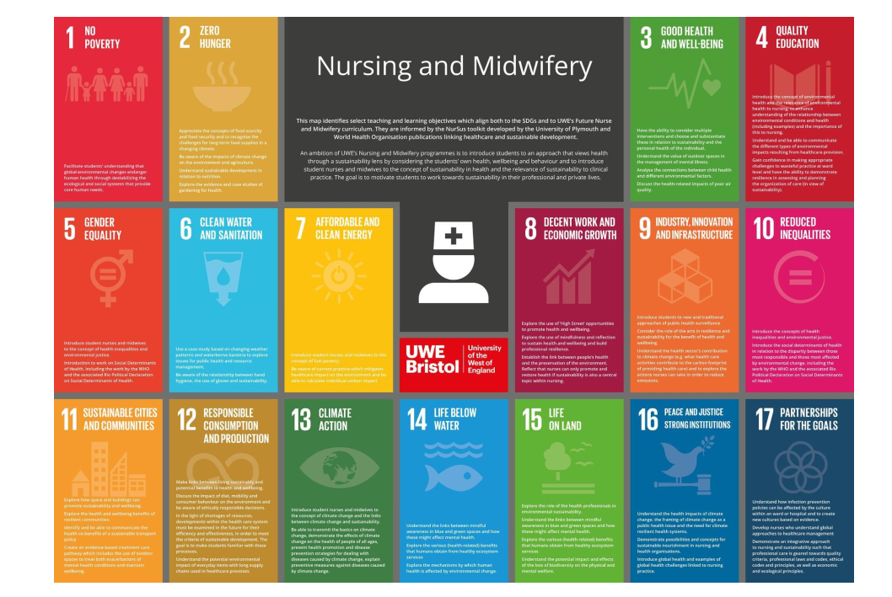

Slide 41
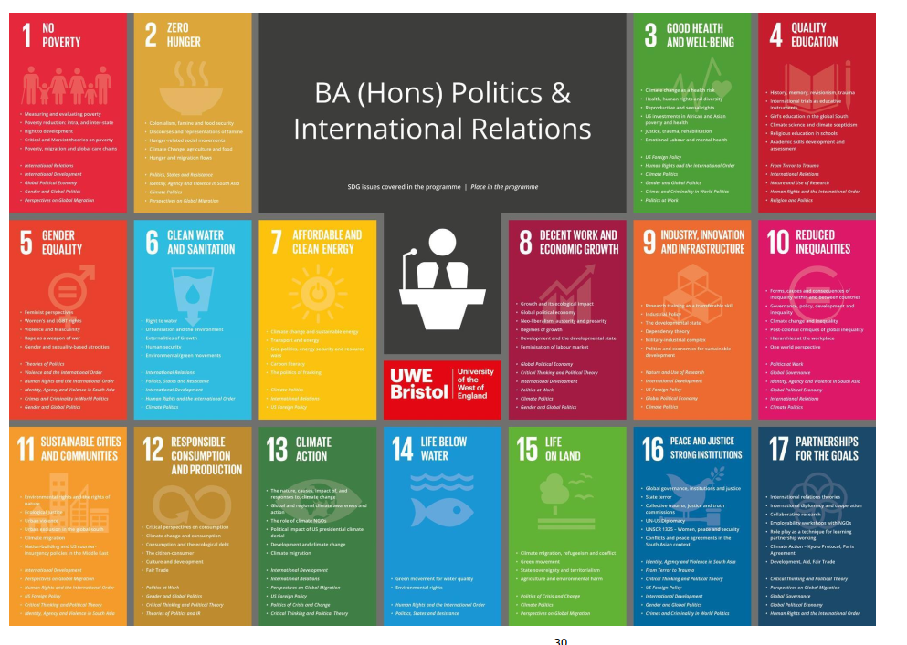

Slide 42
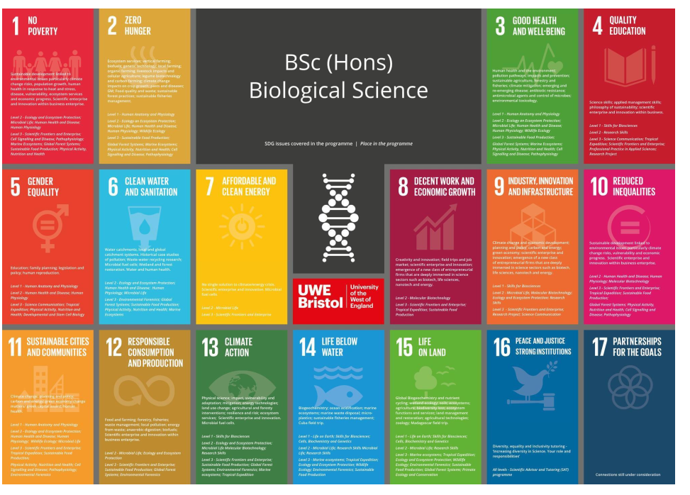

Slide 43
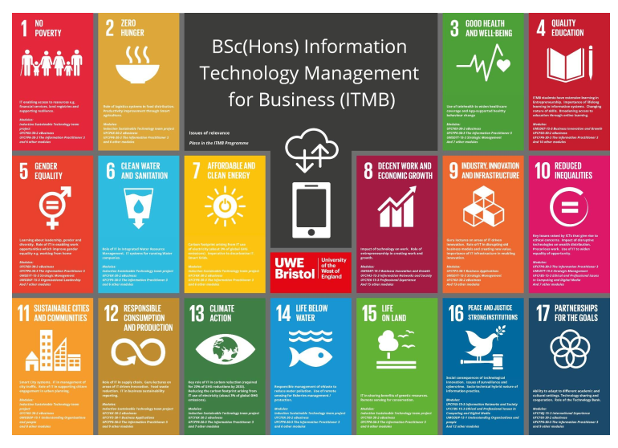

Slide 44
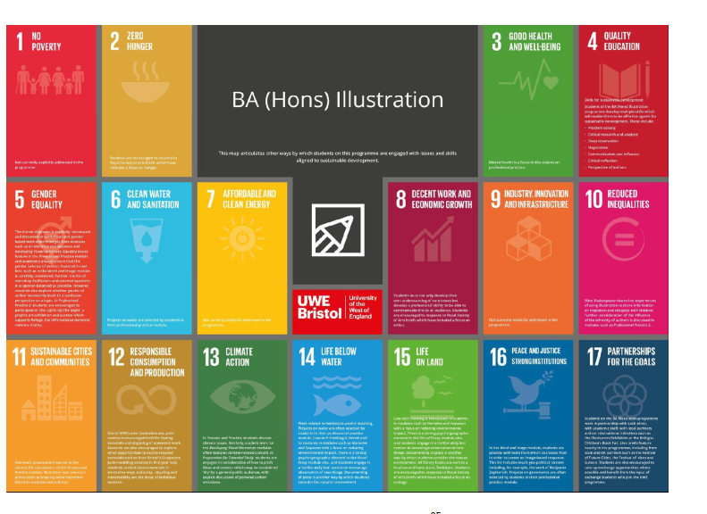

Slide 46
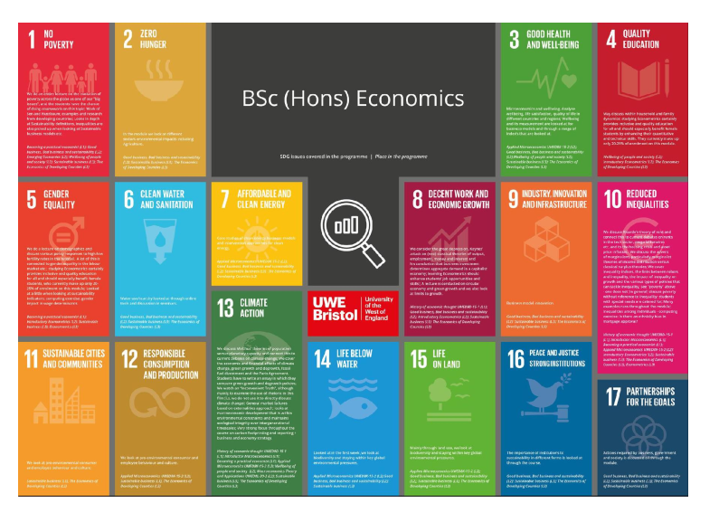

Slide 47
Sustainability and UWE’s Research

Slide 48
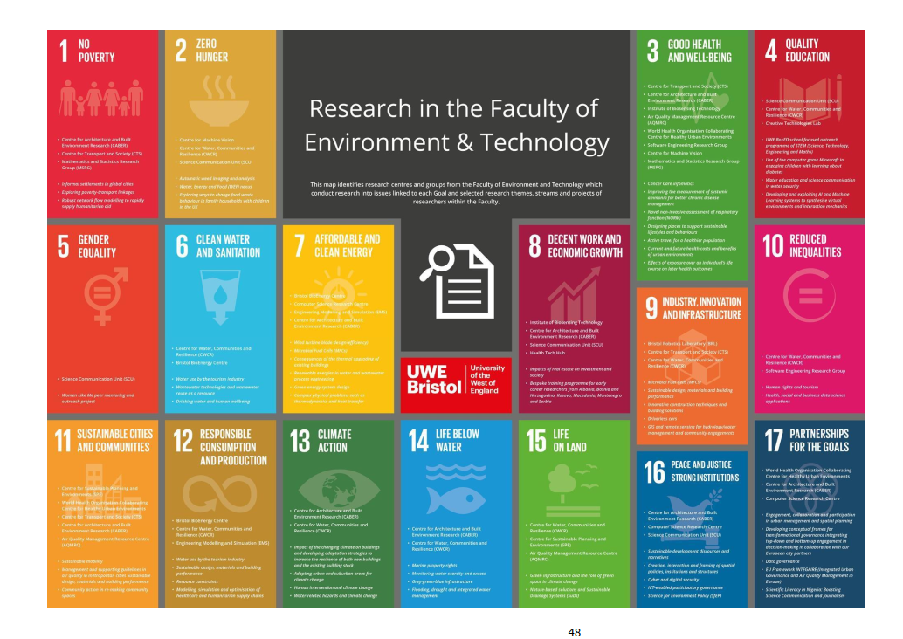

Slide 49
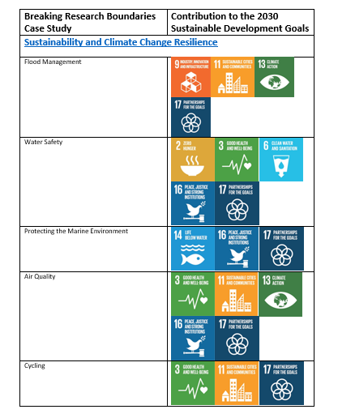
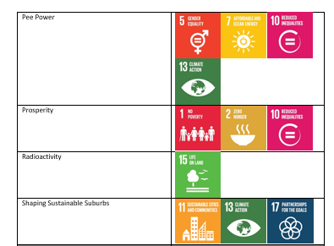

Slide 50
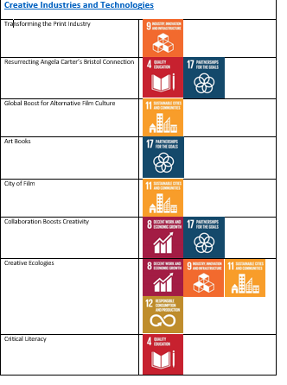
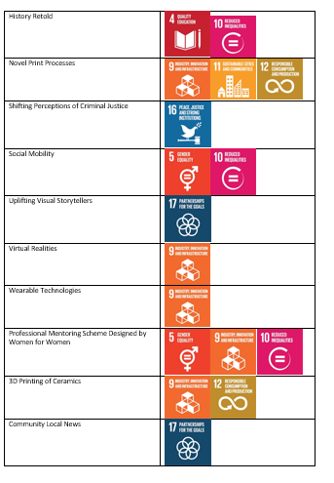

Slide 51
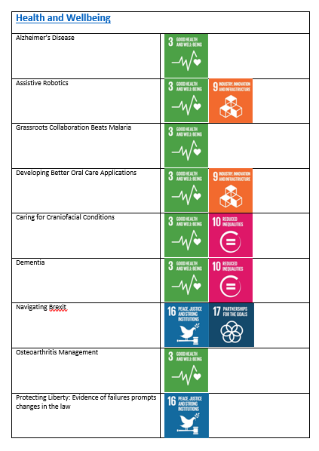
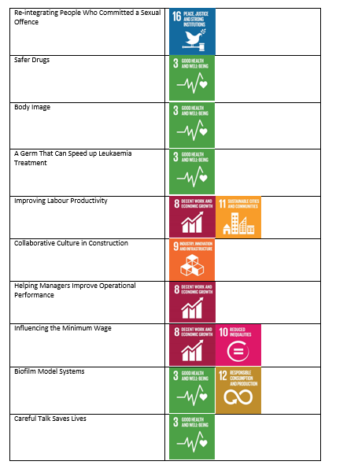

Slide 52
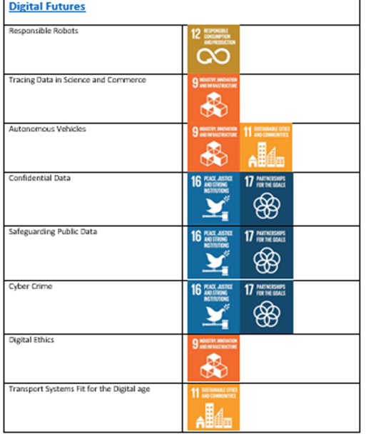

Slide 53
Campus Operations

Slide 54
Reduce, Reuse and Recycle
The circular economy is a key principle of our approach.
We aim to keep resources in use for as long as possible, extract the maximum value from them while in use, then at the end of an item’s usable life we recover materials and regenerate new products.
This marks a significant change in the way we think about the resources we use and is a shift from the traditional linear economy
The Circular Economy Plan 2020 – 2024
promotes sustainable and circular consumption
reduces carbon emissions
takes a holistic ‘whole-institution’ approach
promotes joint working across communities of interest
exerts control/influence over our supply chain.
https://www.uwe.ac.uk/about/values-vision-strategy/sustainability/reduce-reuse-recycle

Slide 55
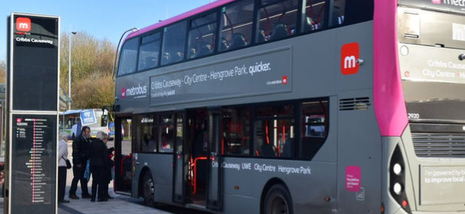
Travel Action Plan 2030
All scheduled buses on campus are to be minimum Euro 6 compliant by 2025 and electric, bio gas, or hydrogen by 2030.
Low/no emission vehicle use should be promoted for users where a private vehicle is the only option and we are improving our electric vehicle infrastructure.
University fleet vehicles will be minimised in number and then chosen and replaced with zero emission options where possible. 66% of our own fleet will be zero emission by 2025, rising to 100% by 2030.
We are reducing the number of cars travelling onto campus each day by promoting and prioritising sustainable travel options, combined with a 10% per head reduction in car parking spaces available for university activities by 2025, and a 20% reduction by 2030.
We are investing resources into projects improving sustainable travel options with financial support obtained by utilising surplus revenue from travel operations and bidding for external capital funding.
https://www.uwe.ac.uk/about/values-vision-strategy/sustainability/transport-and-travel

Slide 56
Travel Action Plan 2030
We are investing resources into projects improving sustainable travel options with financial support obtained by utilising surplus revenue from travel operations and bidding for external capital funding. We are aiming for an 100% increase in covered cycle parking on 2019 levels by 2025.
All users of campus parking facilities to contribute financially, via car parking charges at the published rate, towards the sustainable travel budget for reinvestment into sustainable travel modes and associated carbon reduction activities.
We share our best practice with other higher education institutions (HEIs), public bodies and other organisations.
https://www.uwe.ac.uk/about/values-vision-strategy/sustainability/transport-and-travel

Slide 57
Biodiversity and Ecology
We are developing diverse ecosystems across our estates through:
meadowscaping areas of grass at Frenchay Campus and Glenside Campus - mown only two or three times a year:
increasing artificial habitats for bats, birds, butterflies, and ladybirds by providing appropriate planting, roosting and nesting boxes and feeding stations
improving biodiversity and edible planting at City Campus and at Glenside Campus; including a small orchard, clear water pond, native bulb planting, herb planting, and wildlife habitats
improving the biodiversity of ponds at Frenchay Campus
working with the Students' Union to enhance the community garden
developing an on-site plant nursery to grow key pollinator plants and a native tree sapling nursery
introducing new signage (accessible with a QR code) to tell the story of how we are managing the campus for biodiversity
processing an increasing percentage of our green waste on site into compost for reuse onto the grounds
using 100% peat free compost and growing mediums
using electric vehicles and tools: over 90% of our grounds maintenance tools are electric powered, including lawnmowers and buggies resulting in less noise and air pollution.

Slide 58
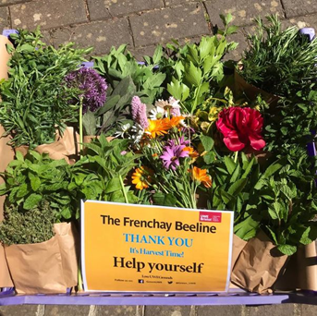
The Frenchay Beeline
The award-winning Frenchay Beeline is a scheme to bring nature into the heart of the Frenchay campus, introducing plants that are specifically “edible pollinators” at over 30 locations.
Our staff, students and visitors have access to free herbs, seasonal fruit and vegetables, while also helping to enhance biodiversity in the local area.
Planting schemes have been designed around ten key edible pollinators, this core planting is then supplemented by seasonal edibles and high-performing pollinator plants on a continuous basis throughout the year.
In 2021/22 work began to extend the Beeline to all campuses.
View the Beeline film at https://youtu.be/zg3-BSyYeoI
More at https://www.uwe.ac.uk/about/values-vision-strategy/sustainability/biodiversity-and-ecology

Slide 59
Fairtrade
UWE Bristol have been an accredited Fairtrade University since 2006.
We have used Fairtrade to raise awareness of issues of social and economic justice, environmental resilience, climate change, gender equality and global citizenship within our university community.
Commitment to Fairtrade from staff and students has grown over the years and is evidenced in our procurement practices, product offer and sales in our shops and cafes, our public engagement work with staff students and visitors, our work within the curriculum and our student volunteering opportunities.
https://www.uwe.ac.uk/about/values-vision-strategy/sustainability/fairtrade-facts-and-benefits/fairtrade-progress
Watch our video about Fairtrade food and drink at UWE Bristol to find out what we have been doing to boost sales of Fairtrade products around campus. https://youtu.be/Hn6GHruPdTo

Slide 60
Hospitality - Sustainable Food
Our students and staff are increasingly concerned about the source of their food, and its impact on the environment and animal welfare as well as on their own health.
We provide environmentally friendly and healthy food to a receptive audience and seek to encourage a longer-term change in buying and eating habits.
We are particularly committed to using local food and ingredients, both to cut food miles and to contribute to thriving local economies and sustainable livelihoods.
We recognise the link between healthier diets and sustainability. UWE’s Sustainable Food Plan has been developed to contribute towards UWE Bristol’s Health and Wellbeing Strategy and action plans.
https://www.uwe.ac.uk/about/values-vision-strategy/sustainability/hospitality

Slide 61
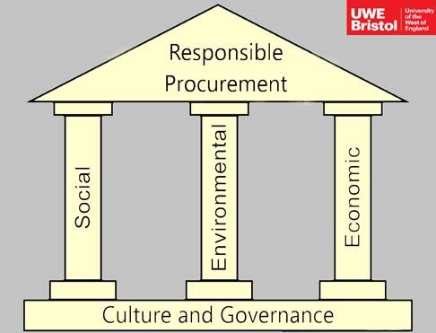
Sustainable Purchasing and Procurement
To reach UWE Bristol’s Sustainability goals responsible procurement plays a key role, not least because more than 80% of our carbon footprint comes from good services and activities off campus to which procurement is a major contributor. Our strategy is guided by our Responsible Procurement ESG policy.
Our approach is to focus on key areas as recommended by the International Organisation for Standardisation:
organisational governance
human rights
labour practices
the environment
fair operating practices
consumer issues
community involvement and development.
https://www.uwe.ac.uk/about/values-vision-strategy/sustainability/purchasing-and-procurement

Slide 62
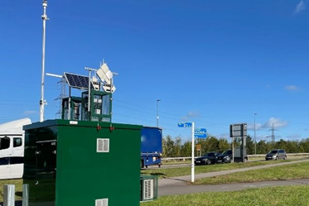
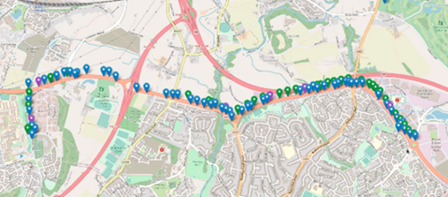
Clean Air – the UMBRELLA AQ Network
Strategy 2030 commits UWE to establishing a clean air zone at each of its three campus locations.
UMBRELLA AQ is a dense, multi pollutant, multi layered, multi location air quality monitoring network integrating high quality, medium quality and low cost sensing devices into one network enabling instrument performance comparison in place and over time.
Interpretation of air quality concentrations is supported by a high quality meteorological station incorporated into the reference station. In turn this supports assessment of the meteorological sensors in the wider network.
It is the means through which we will demonstrate achievement of clean air on the Frenchay campus

Slide 63
UMBRELLA AQ
Dense - 7 km network length, more than 1500 sensors
Multi Location - More than 200 sampling locations, multiple collocation points for inter and intra instrument comparison
Multi Pollutant - Particulate Matter (PM_{2.5} & PM₁₀), Nitrogen Dioxide (NO₂), Nitric Oxide (NO), Ammonia (NH₃) Ozone (O₃) Volatile Organic Compounds (VOC) plus meteorological data
Multi Layered -3 tiers of instrument quality – reference analysers, medium quality and low cost sensors.

Slide 64
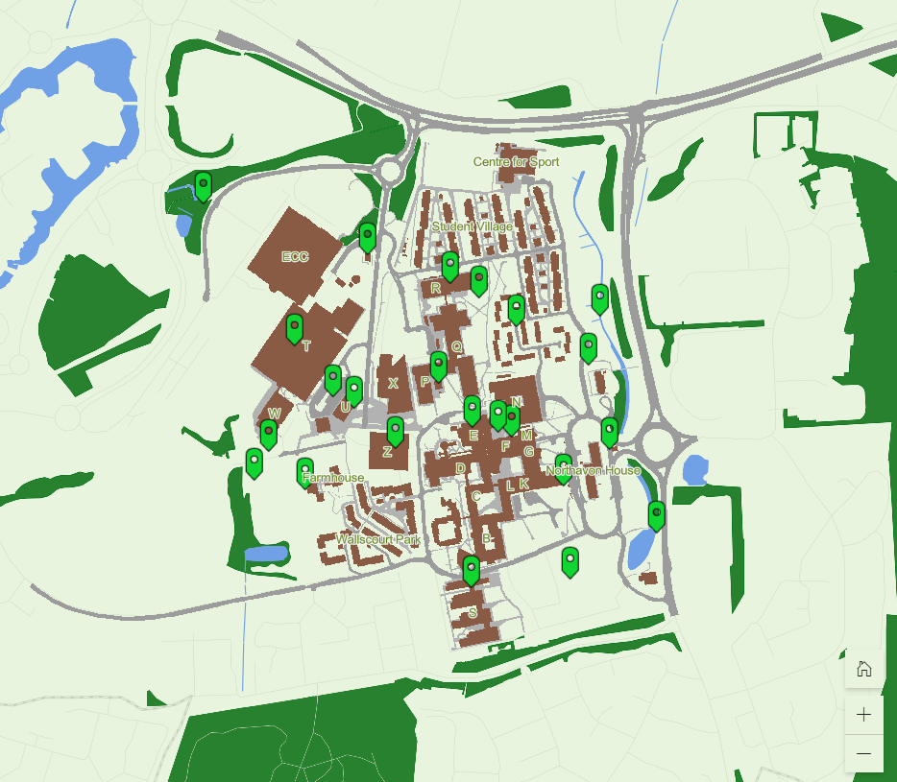
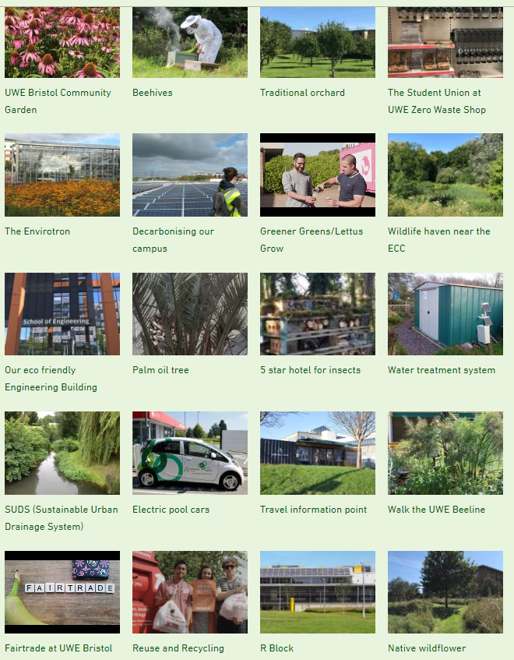
UWE Green Campus map A sustainability tour of Frenchay Campus
https://storymaps.arcgis.com/stories/aa6f24e4adbb4d91a294aa155c09ffd6

Slide 65
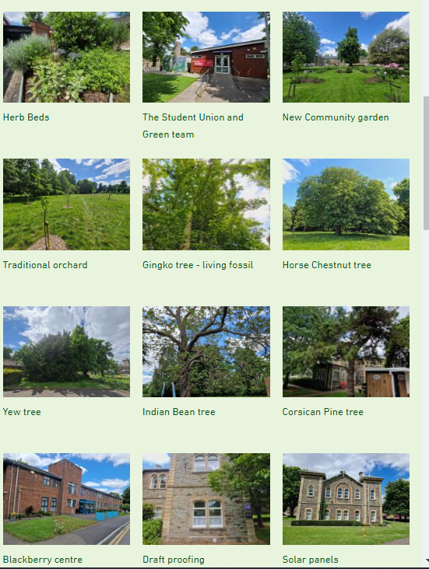
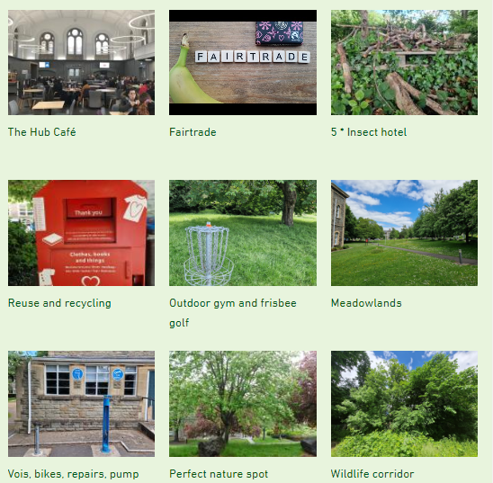
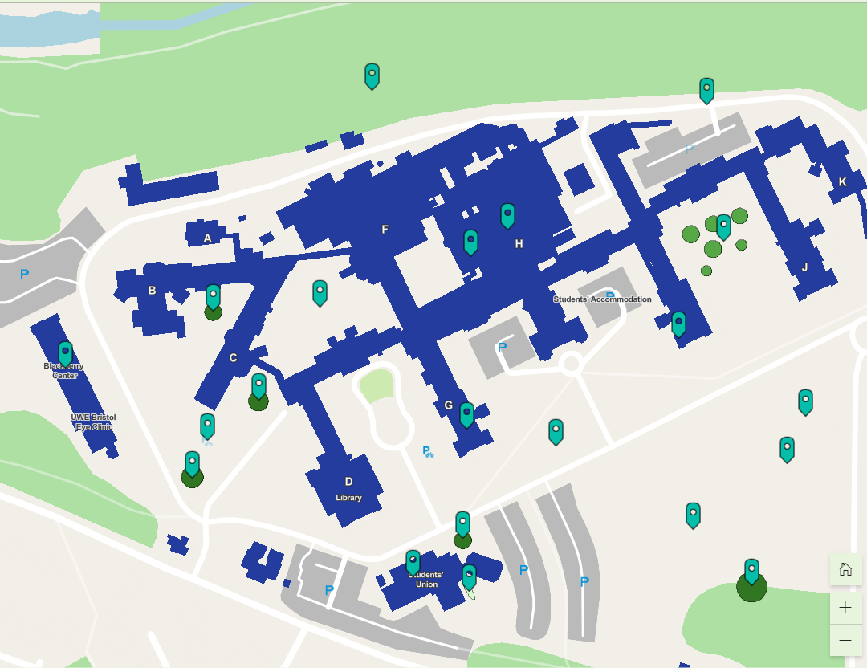
UWE Glenside Green Campus map. A Sustainability and Biodiversity tour of Glenside Campus
https://storymaps.arcgis.com/stories/9924a8f505524ebc89c750baa8aaef0f

Slide 66
Partnerships

Slide 67
Sustainability Partnerships
Working with national partners
Environmental Association of Universities and Colleges
Climate Commission for Higher and Further Education, helped develop the Climate Action Toolkit for HE and the Climate Roadmap for FE
Working with UKRI to develop a ‘Charter’ on Sustainability in Research and Innovation
Supporting QAA and Advance HE in developing and implementing new Guidance on Education for Sustainable Development
Supporting DfE in developing their Climate Change and Sustainability Strategy

Slide 68
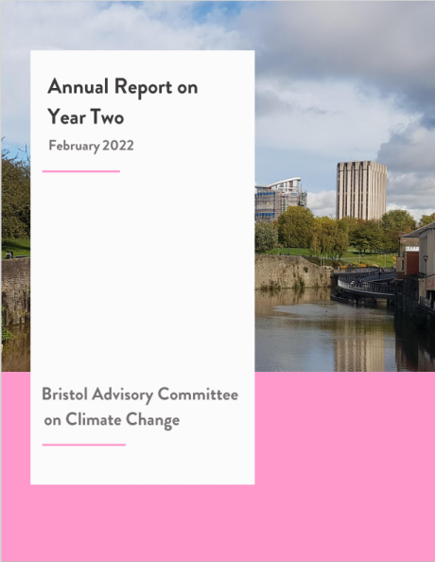
Sustainability Partnerships
Working with local partners
Bristol Green Capital Partnership
Bristol Advisory Committee on Climate Change
South Gloucestershire Climate Emergency University Advisory Group
Business West
Bristol SDG Alliance
Future Leap
Avon Pension Fund engaging with the fund to accelerate decarbonisation of the fund into which Professional Service staff pension contributions are made.

Slide 69
Carbon Management

Slide 70
Managing Carbon at UWE - Policy
Climate and Ecological Emergency Declaration by Board of Governors
Institutional Strategy defined
Net Zero 2030 Target
Carbon and Energy Management Plan 2020-2030 developed using Green House Gas Protocol and Science Based Targets Initiative.
Baseline Scope 1, 2 and 3 established
Scope 3 Action Plan developed
Offsetting Plan drafted
Carbon a KPI on Strategy 2030 Progress Tracker
Climate on UWE Risk Register

Slide 71
The Carbon Management Hierarchy
Avoid
Reduce
Replace
Avoid carbon intensive activities (and rethink business strategy)
Offset
Do whatever you do more efficiently
Replace high-carbon energy sources with low-carbon ones
Offset those emissions which can’t be limited by the above
Actions at the top of the hierarchy are more transformative and lasting in terms of reducing a company’s emissions baseline
Sources: Forum for the Future (2008) Getting to Zero: Defining Corporate Carbon Neutrality

Slide 72
UWE’s Carbon Baseline 2018/19

Slide 73
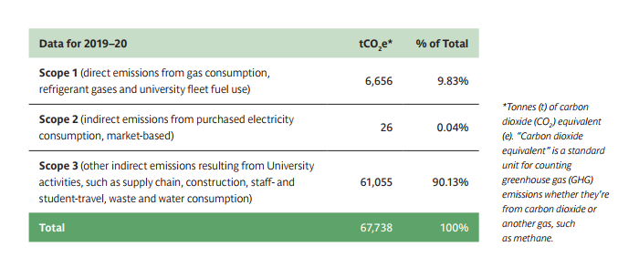

Slide 74
Managing Carbon at UWE - Practice
Direct Power Purchase Agreement for renewable energy
REGO certified electricity for residual electricity demand
PV arrays at each campus
CHP and District Heating Network on Frenchay Campus
Electrifying the university vehicle fleet
Promoting active travel
EV cars available for use by staff and students
Voi Scooters and Big Issue Electric Bikes for staff /students on campus
Pedal cycle scheme for students
Busy bus interchange on Frenchay Campus

Slide 75
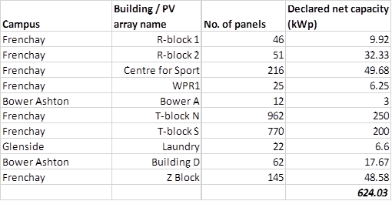
Solar PV Installations and Capacities

Slide 76
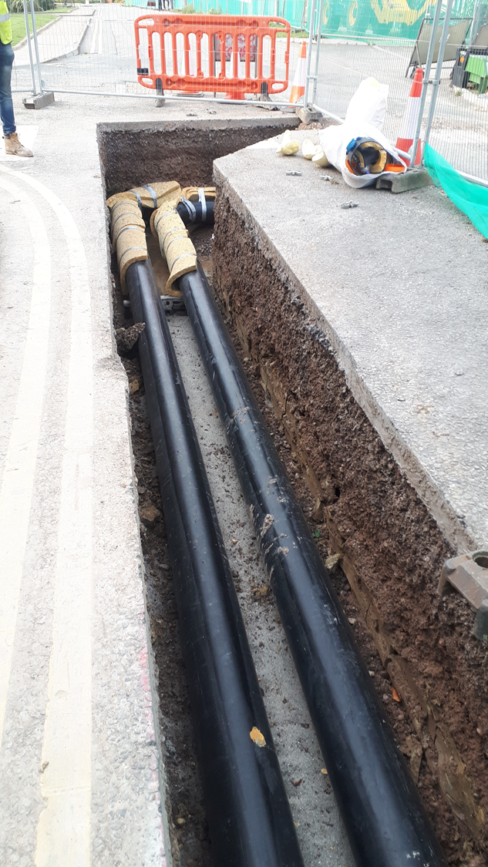
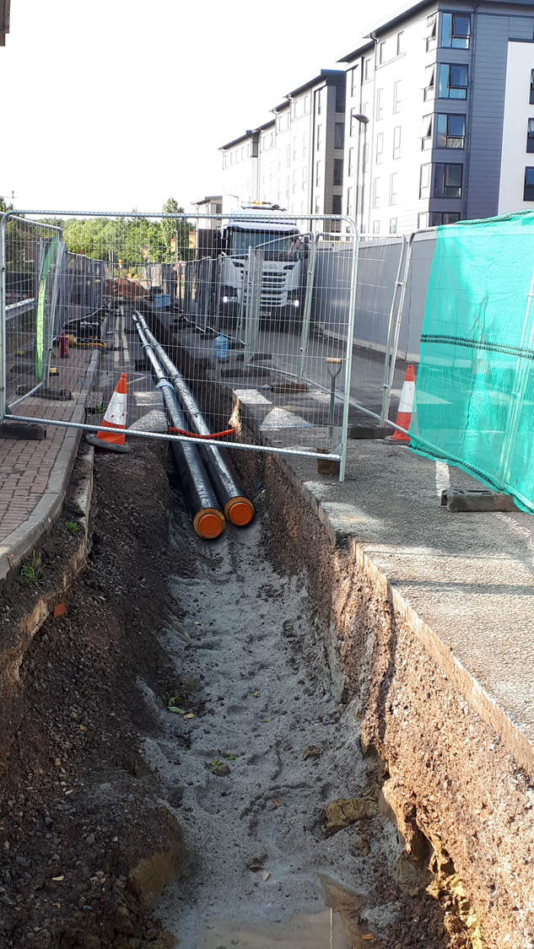
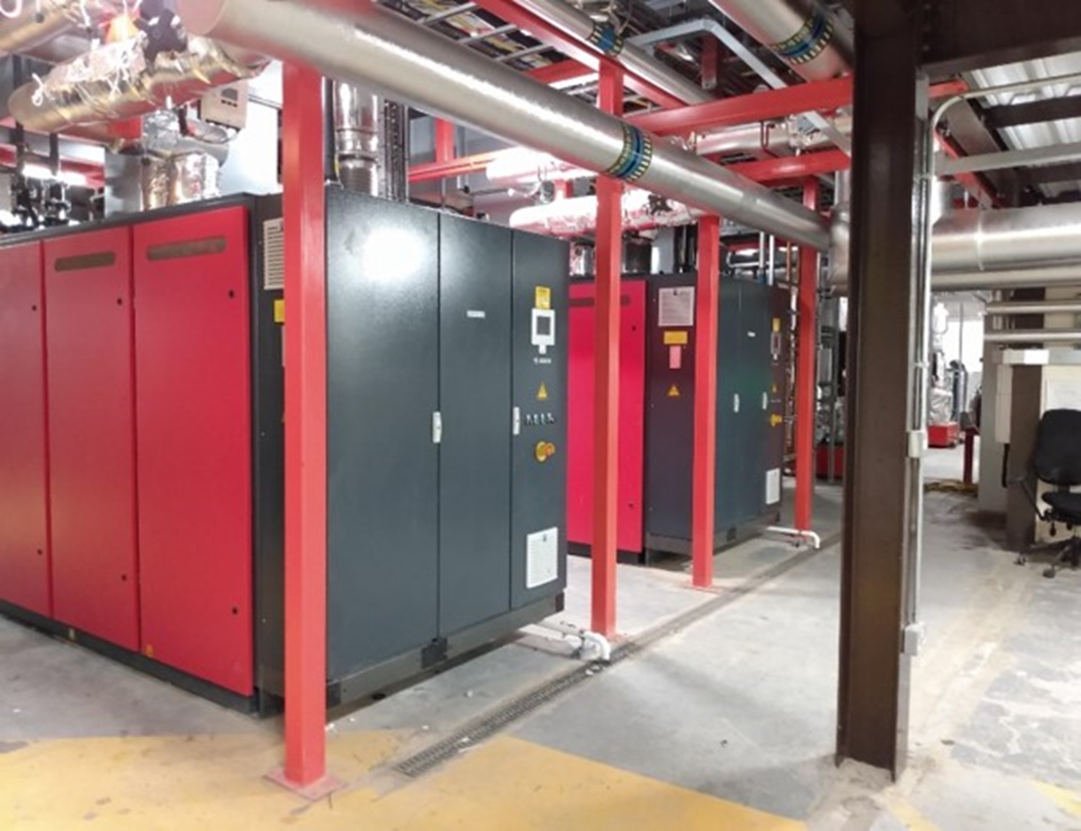
CHP and DHN
CHP engines: 2 x Bosch engines, each with 500kW heat (i.e. total heat capacity 1MW) and 400kWe power (i.e. total power capacity 800kWe).
These are heat-led, so no heat is dumped.
The DHN provides heat to 50% of Frenchay campus.

Slide 77
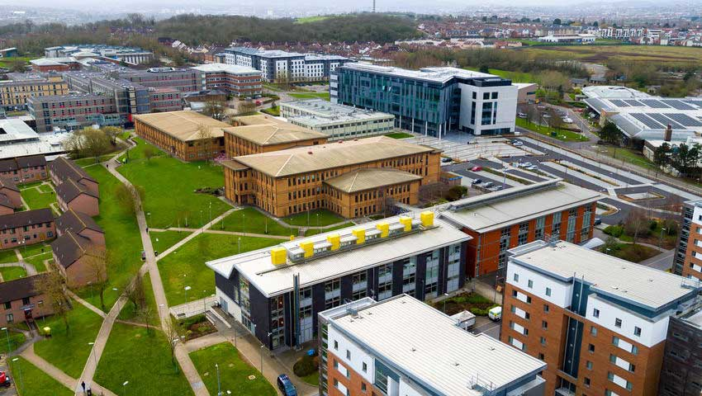
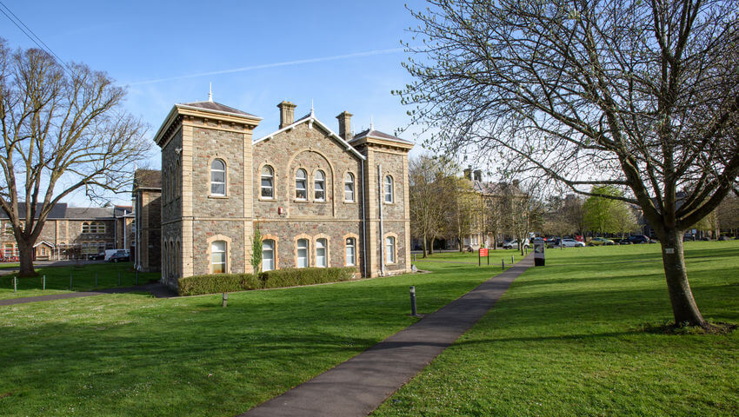
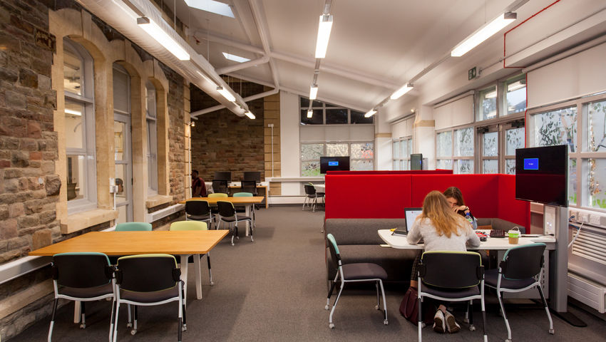
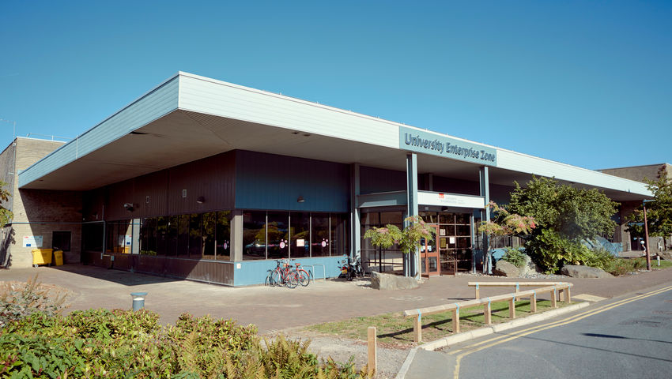
Managing Carbon at UWE
New Student Accommodation designed to PassivHaus Standard
New Engineering Building BREEAM Excellent
BUT
Other developments over the last decade and our historic estate present energy efficiency, emission mitigation and adaptation challenges

Slide 78
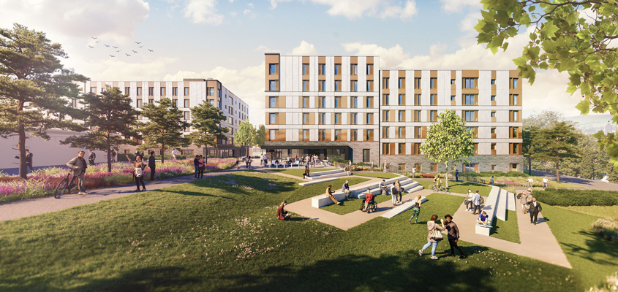
PassivHaus Student Accommodation
Images credit: Stride Treglown

Slide 79
Managing Carbon – Challenges
Mitigation is our focus
Removing gas from the estates is an urgent action but the CHP engines are gas fired!
Understanding the trajectory to 2030 for Scopes 1 and 2
Better understanding the sources and magnitude of Scope 3 emissions and understanding where the control measures may be located
What will be our C compensation or offsetting requirement in 2030?
When to decide on compensation options?
Where to locate compensation actions?
Bringing adaptation into focus as an equal priority

Slide 80
Adaptation and Climate Risk
What is the risk profile for the university site?
Flood, heat, wind?
What are the institutional priorities for adaptation?
Teaching, Research, Sports, Residences?
Critical infrastructure resilience.
Supply chain resilience.
Maintaining access in extreme weather events.
Providing cooling and shade.
Planning for water scarcity.
Risk assessment of climate impacts not fully developed.
When do we need adaptations in place?

Slide 81
Managing Carbon at UWE – Research and Teaching
Changing Climate Research Network established
Sustainability and Climate Change Resilience Research Beacon established
Zero Carbon Building MOOC
Carbon literacy training for staff developed
Carbon literacy and climate awareness being infused into the curriculum as part of SDG mapping – identifying positive and negative impacts of carbon action on other SDGs.
Green Skills for Jobs and Entrepreneurship for young adults from under represented groups
Skills for Clean Growth programme for SMEs in the West of England

Slide 82
The Sustainability Agenda Matters
It can and must be part of a university mission
It needs Senior Management leadership.
It matters to current students.
It matters to future students.
It matters to staff.
It has a place
in the curriculum of EVERY discipline,
in the university’s research activities,
In the management of the campus and
In the civic / community engagement activities of a university
.

Slide 83
Policies and Reports
View all our Sustainability Policies, Strategies, Statements and Annual Reports at https://www.uwe.ac.uk/about/values-vision-strategy/sustainability/strategy-leadership-and-plans/policy-and-strategy-documents

Slide 84
Professor James Longhurst
University of the West of England,
Frenchay Campus,
Bristol,
BS16 1QY
UK
Email James.Longhurst@uwe.ac.uk
Public profile
https://people.uwe.ac.uk/Person/JamesLonghurst
Sustainability at UWE
https://www.uwe.ac.uk/about/values-vision-strategy/sustainability
UWE website
https://www.uwe.ac.uk/

