Slide 1
Model (S2S to climate) representation of subtropical processes Atmospheric temperature and moisture characteristics based on scaling relationships
Kwok Pan Chun¹, Luminita Danaila², Manuel Fossa², Nicolas Massei², Omer Yetemen³, Yasemin Ezber³, Ferat, Çağlar³, Emir Toker³, and Omer Lutfi Sen³
¹University of the West of England; ² University of Rouen; ³ Istanbul Technical University

Slide 2
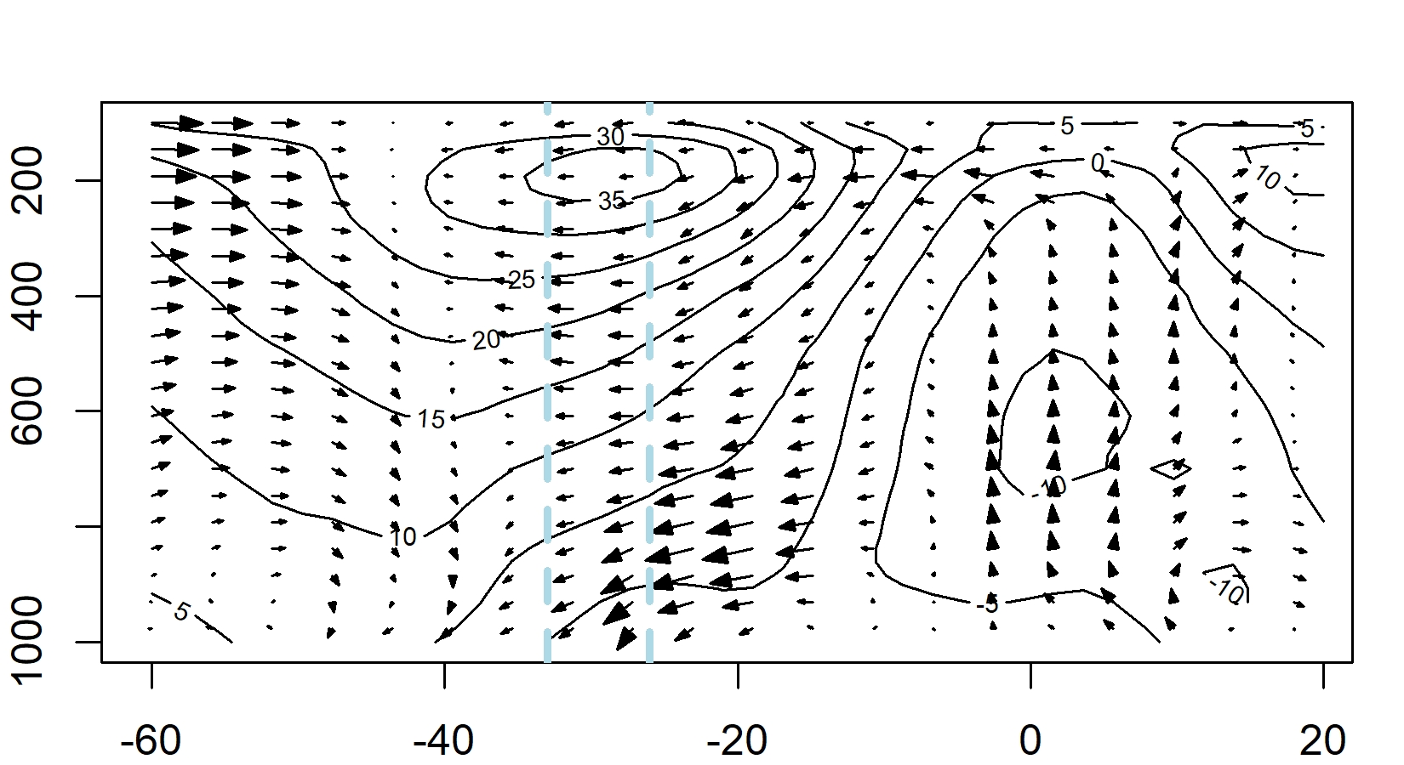
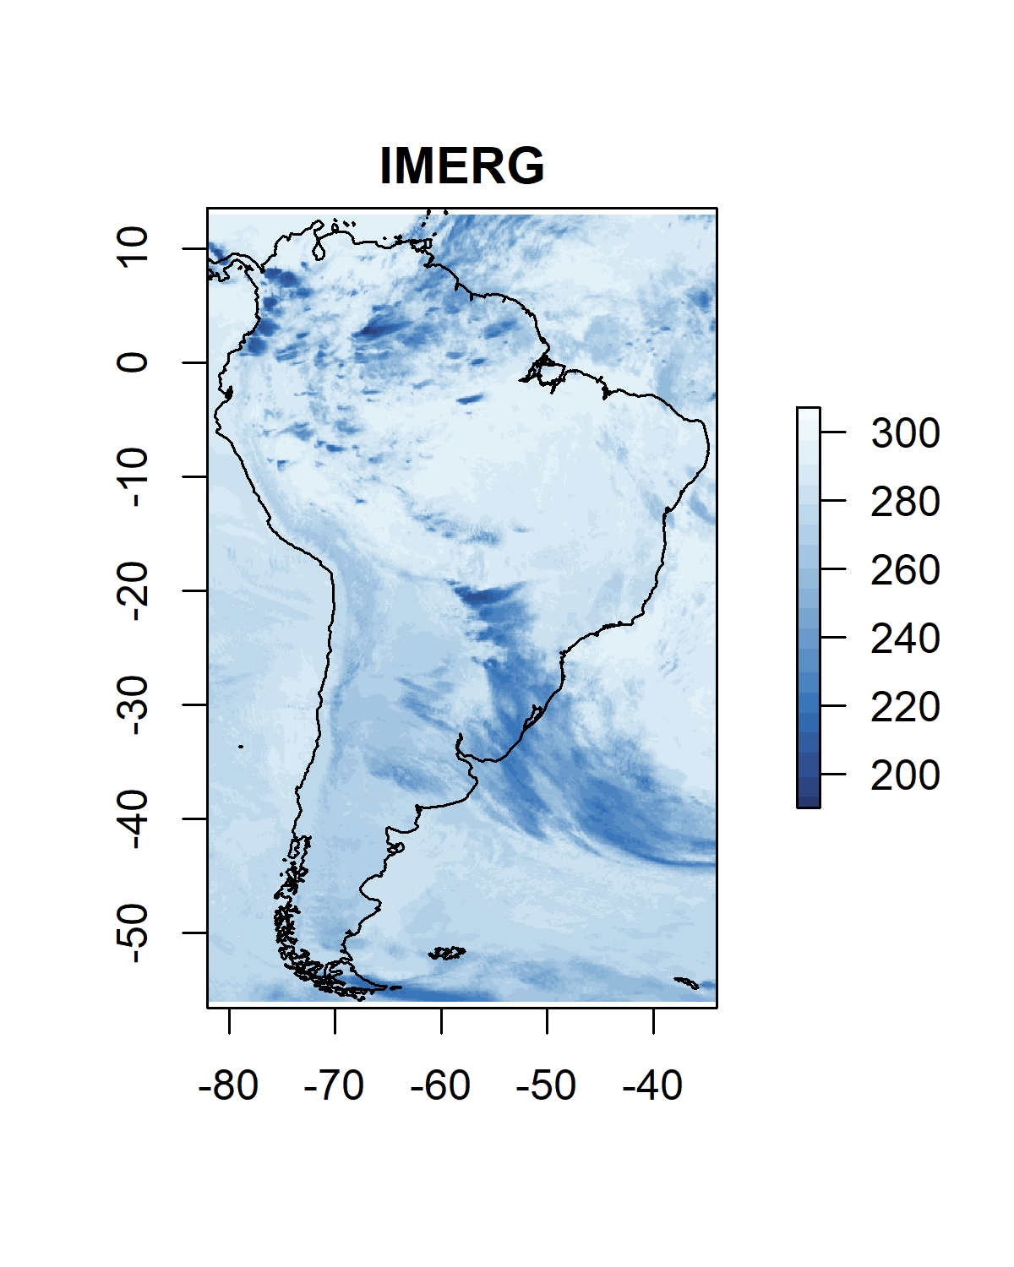
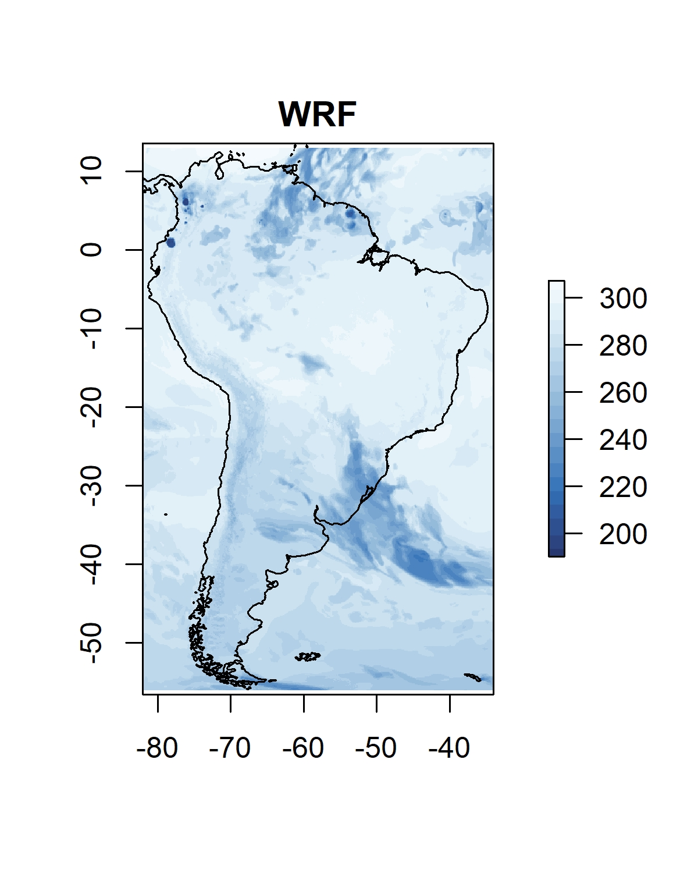
Our plan
U wind and Momentum flux
Basic oscillating mechanisms for S2S to climate
Some ideas of modelling techniques
Emerging topics of subtropical regions for discussion
Luminita will provide new ideas for looking at scaling relationships
CPM simulations (4km)

Slide 3
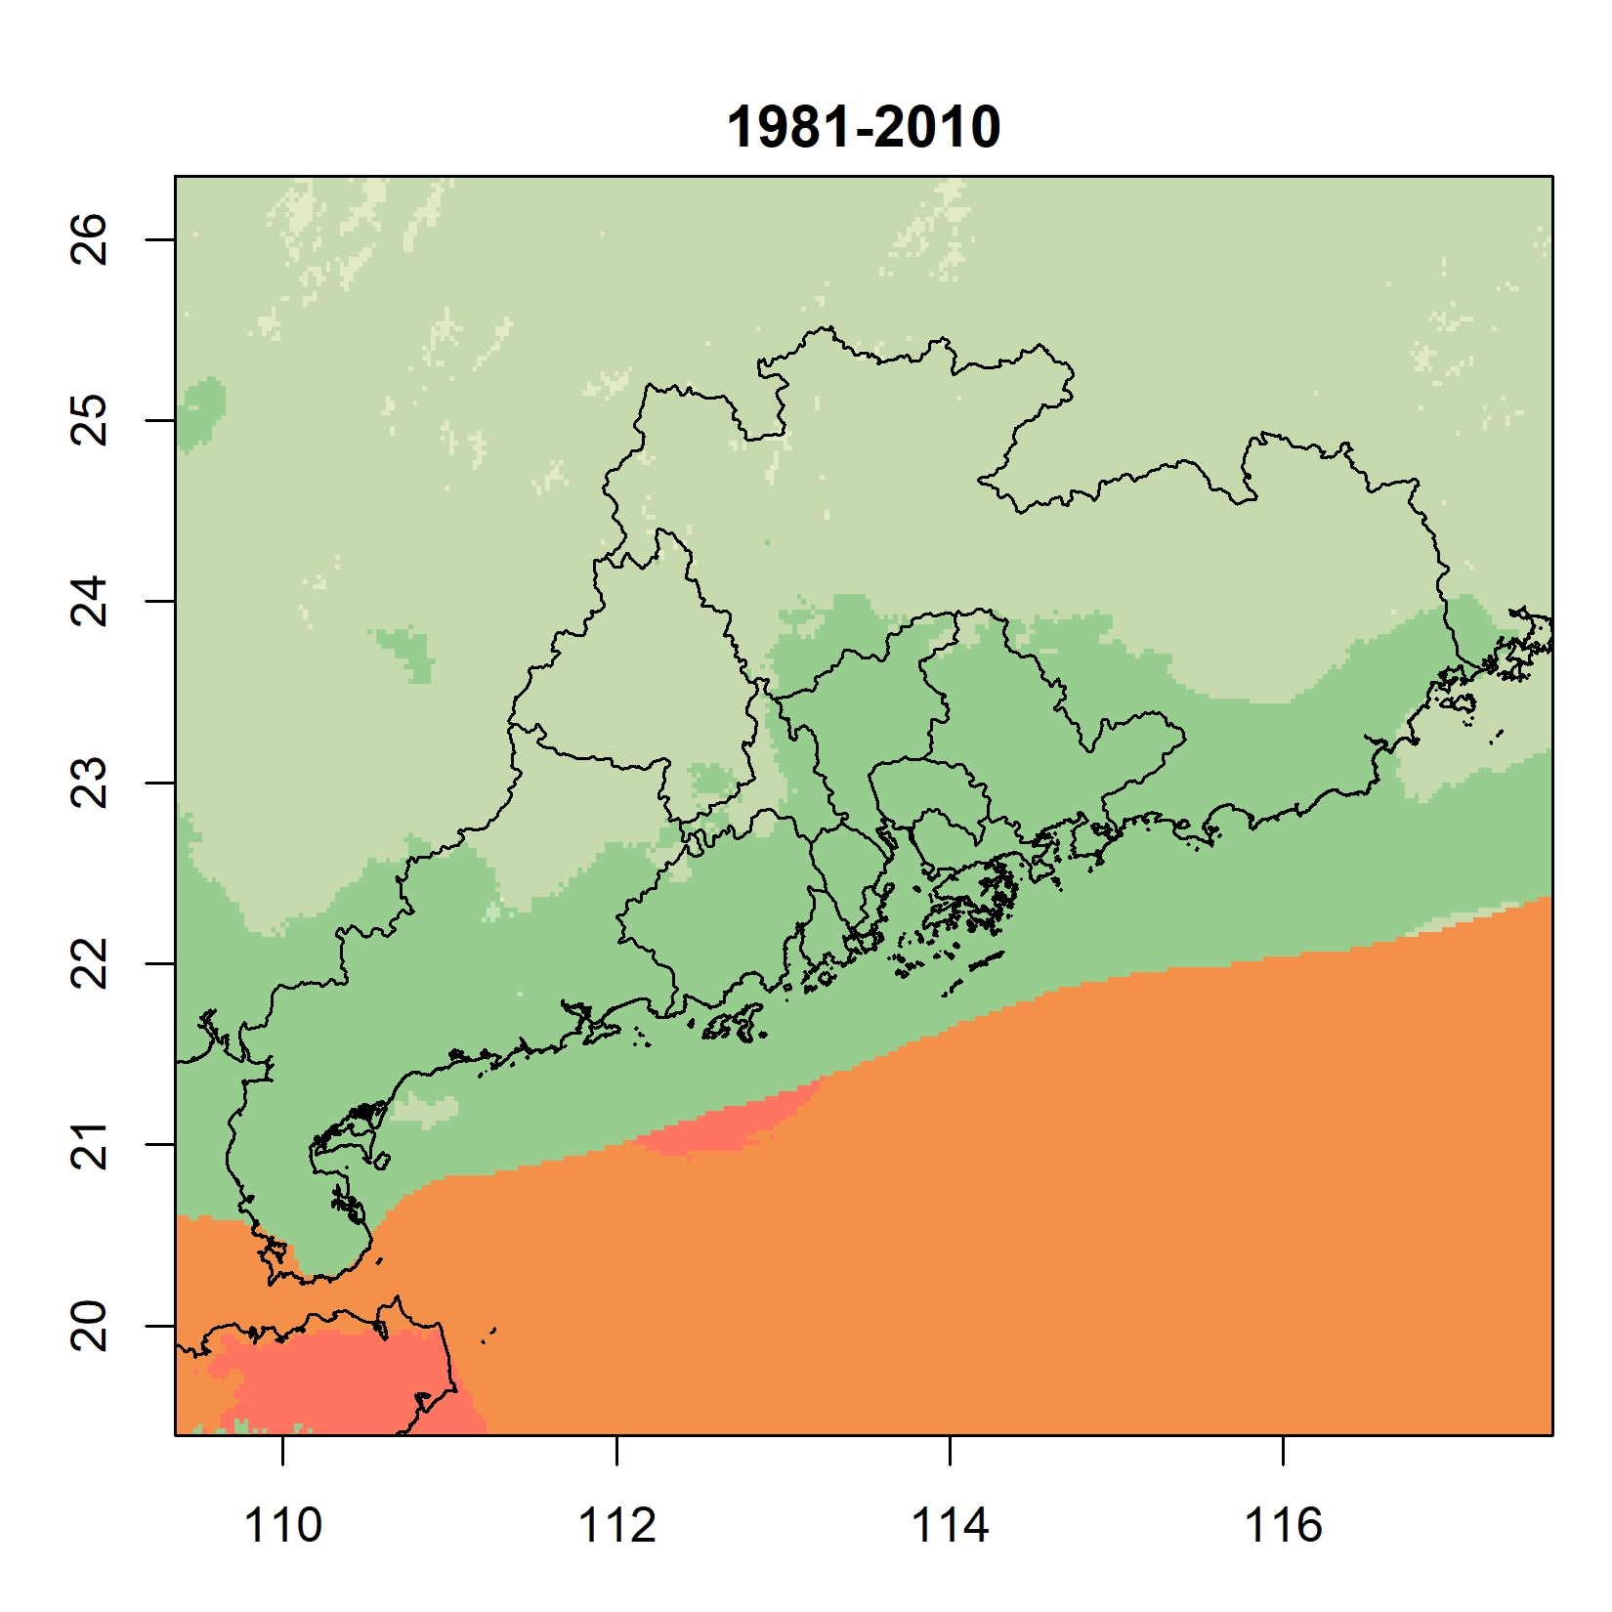
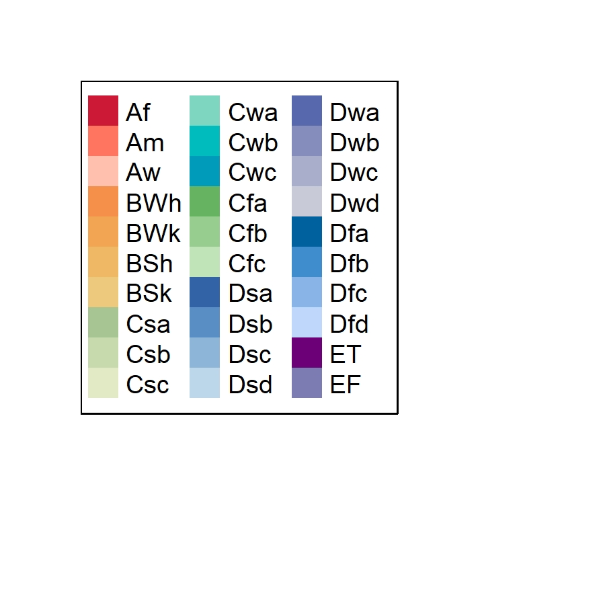
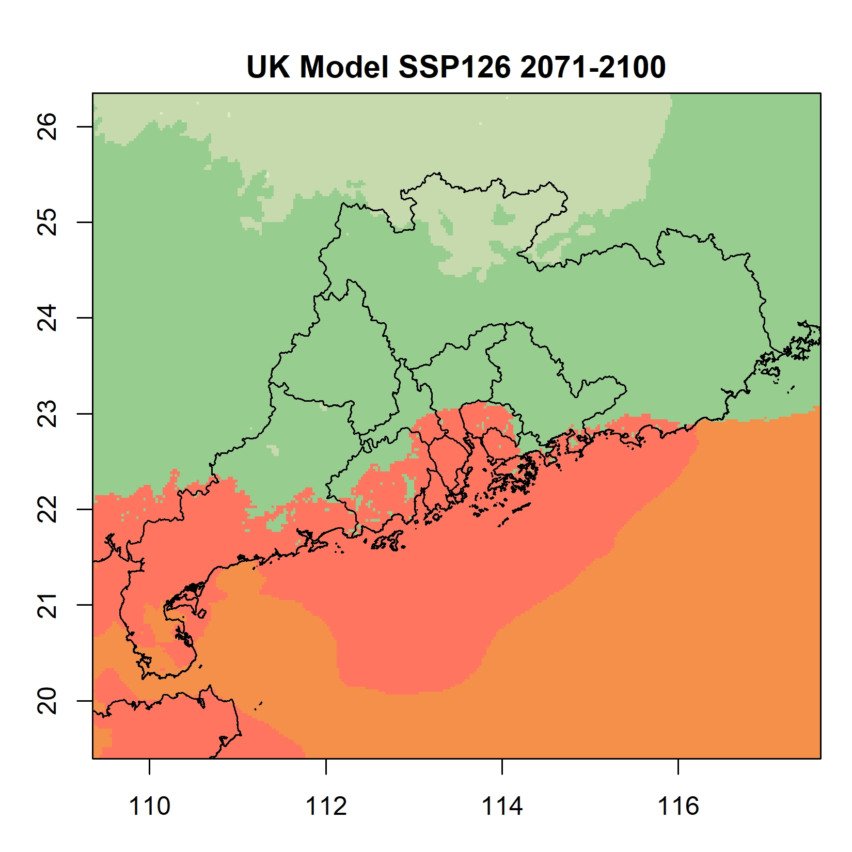
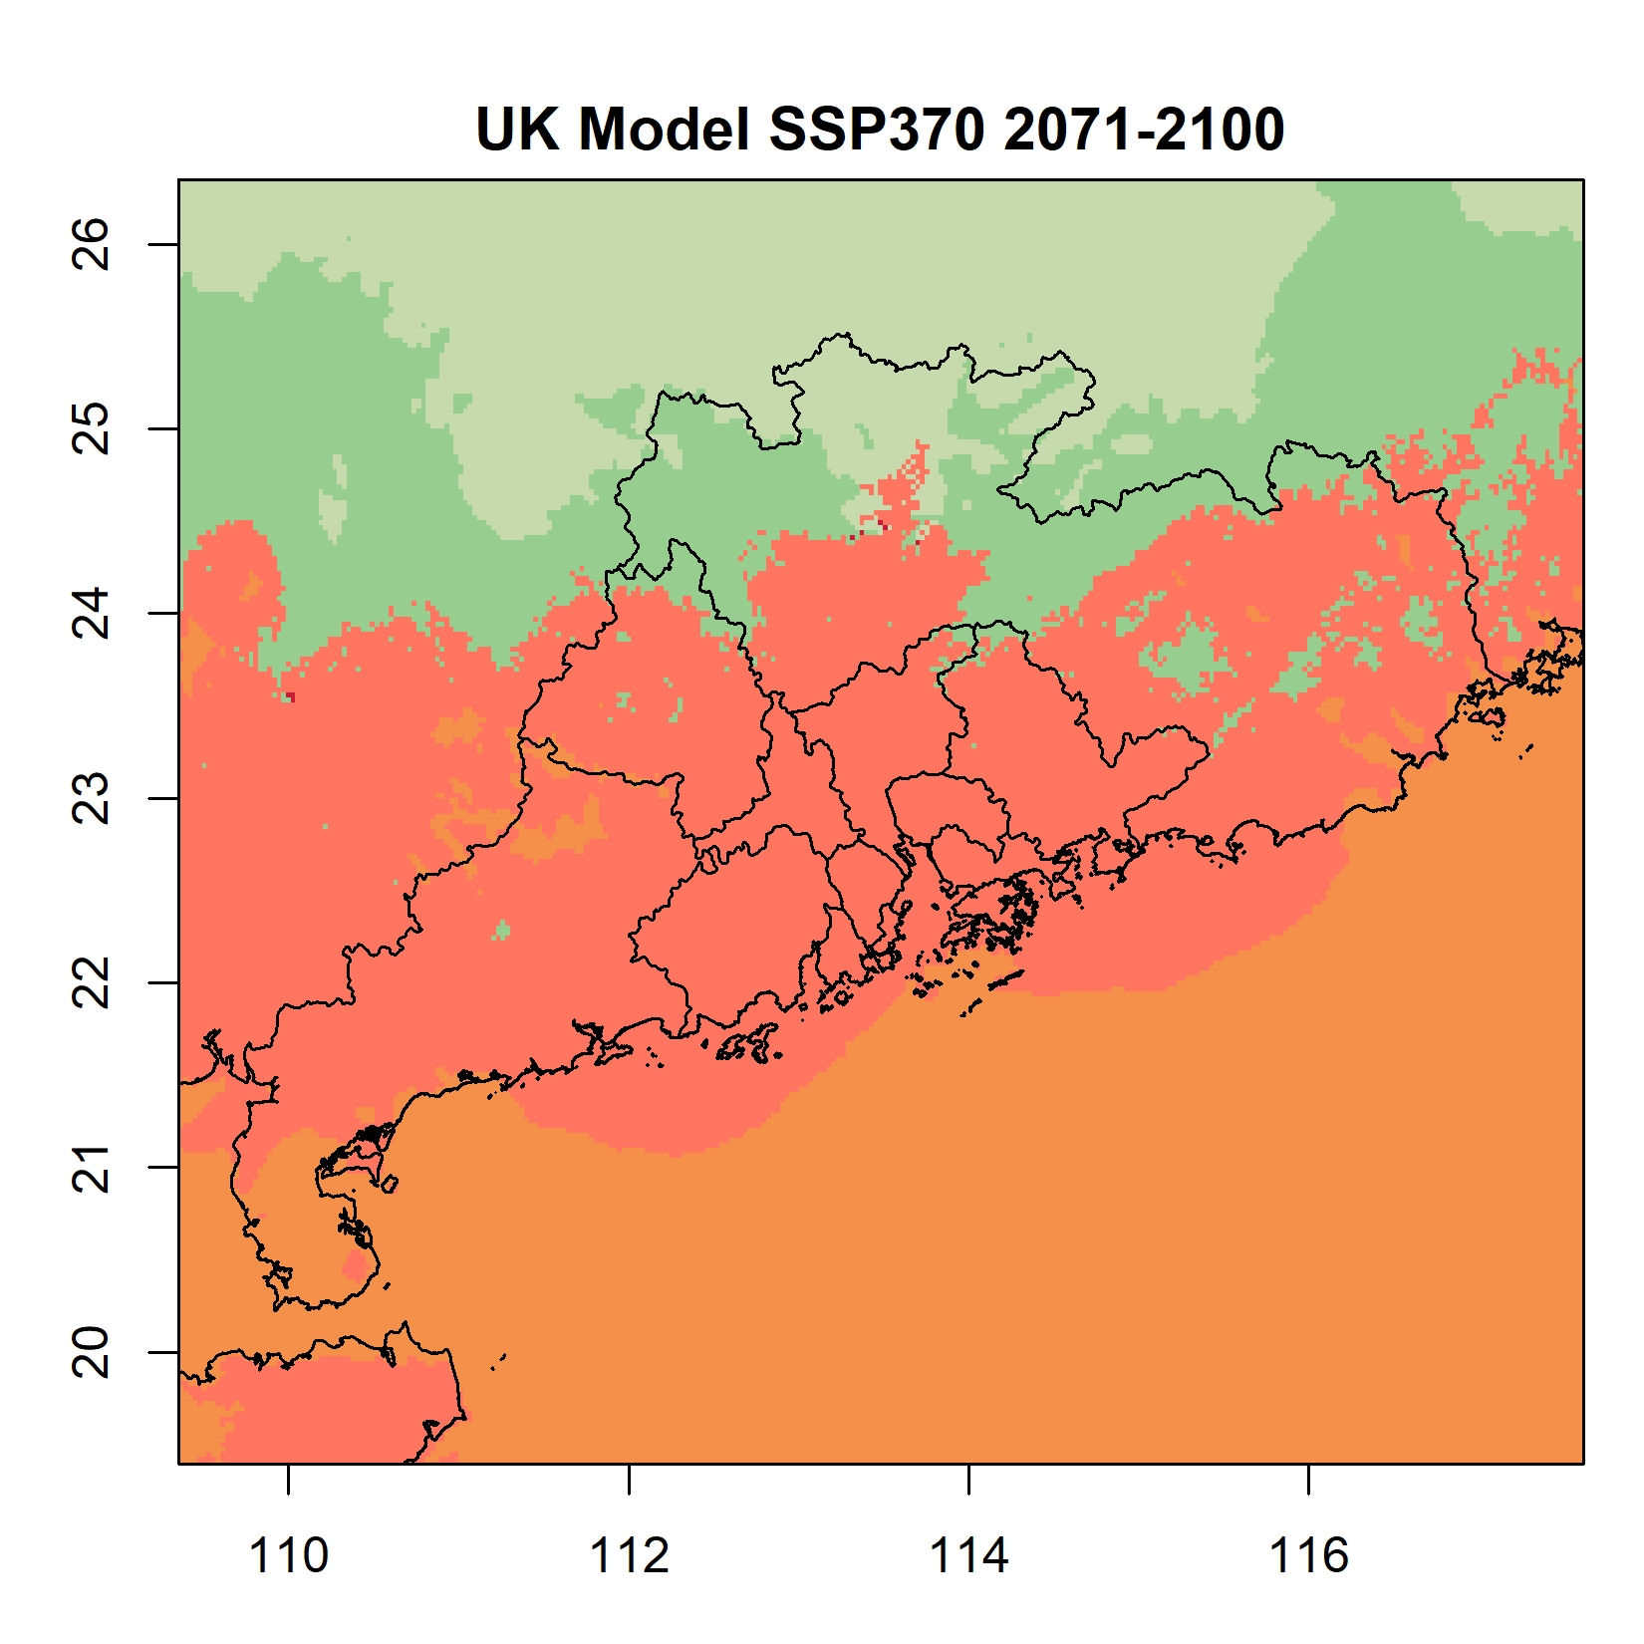
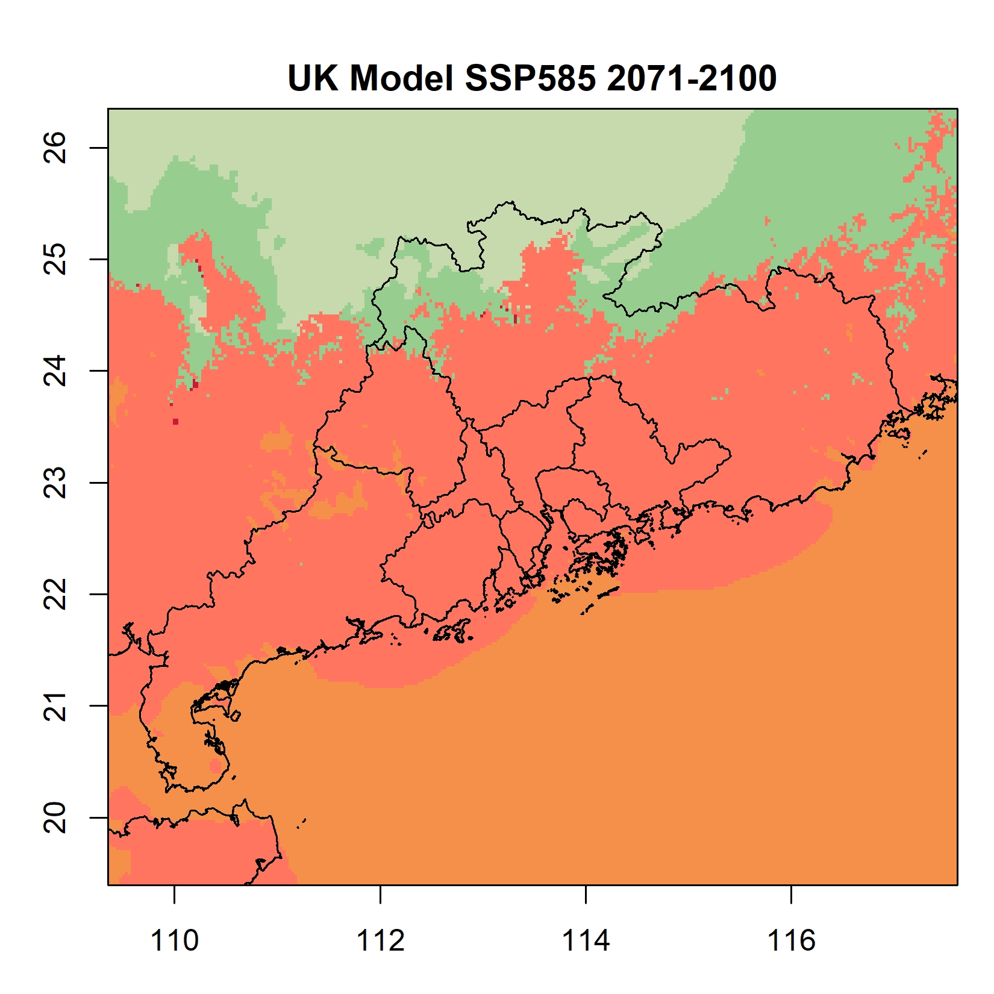
Climate change projections (CMIP6 downscaled to 1km)
Shifting Koeppen regions
Subtropical climate (Green)
Tropical climate (Orange)
Köppen Geiger after Peel, M. C., Finlayson, B. L., McMahon, T. A. (2007): Updated world map of the Koeppen-Geiger climate classification. Hydrology and earth system sciences discussions, 4(2), 439-473.

Slide 4
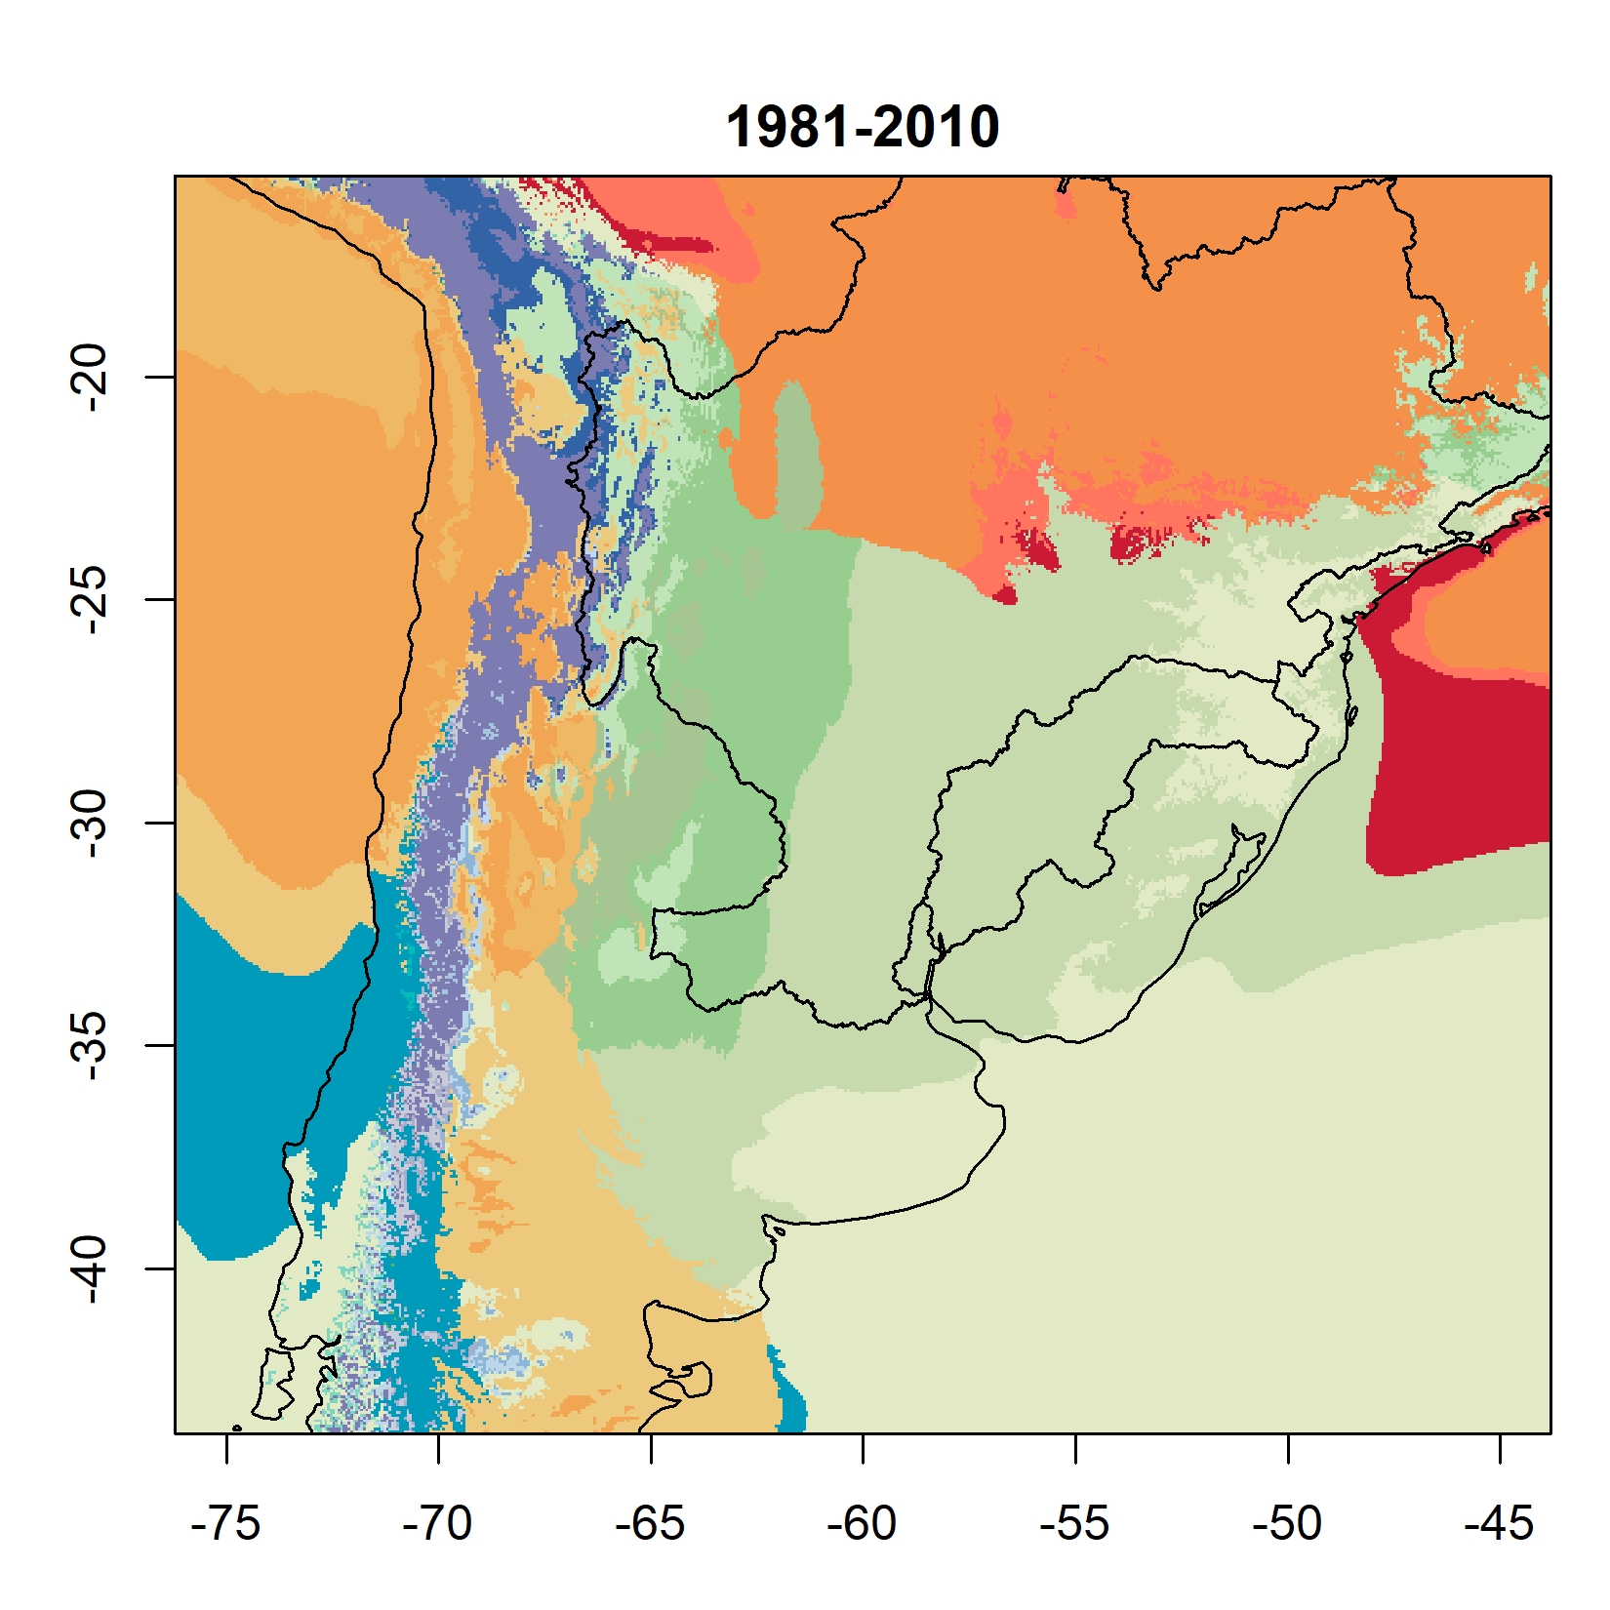
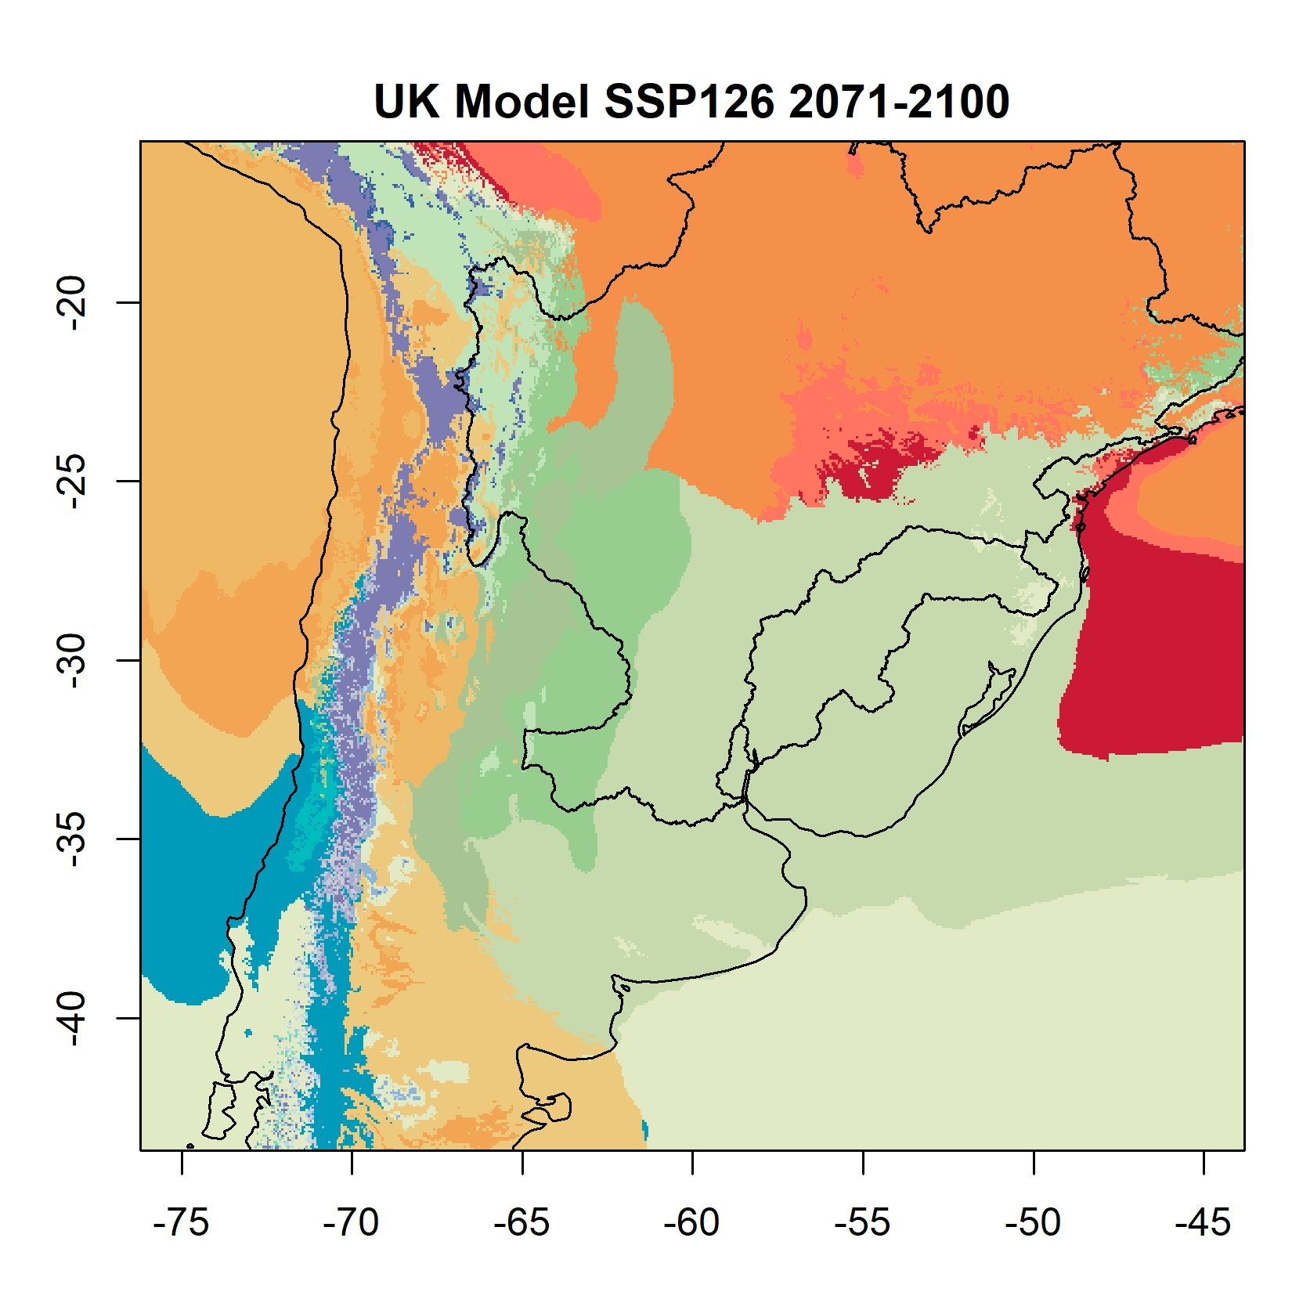
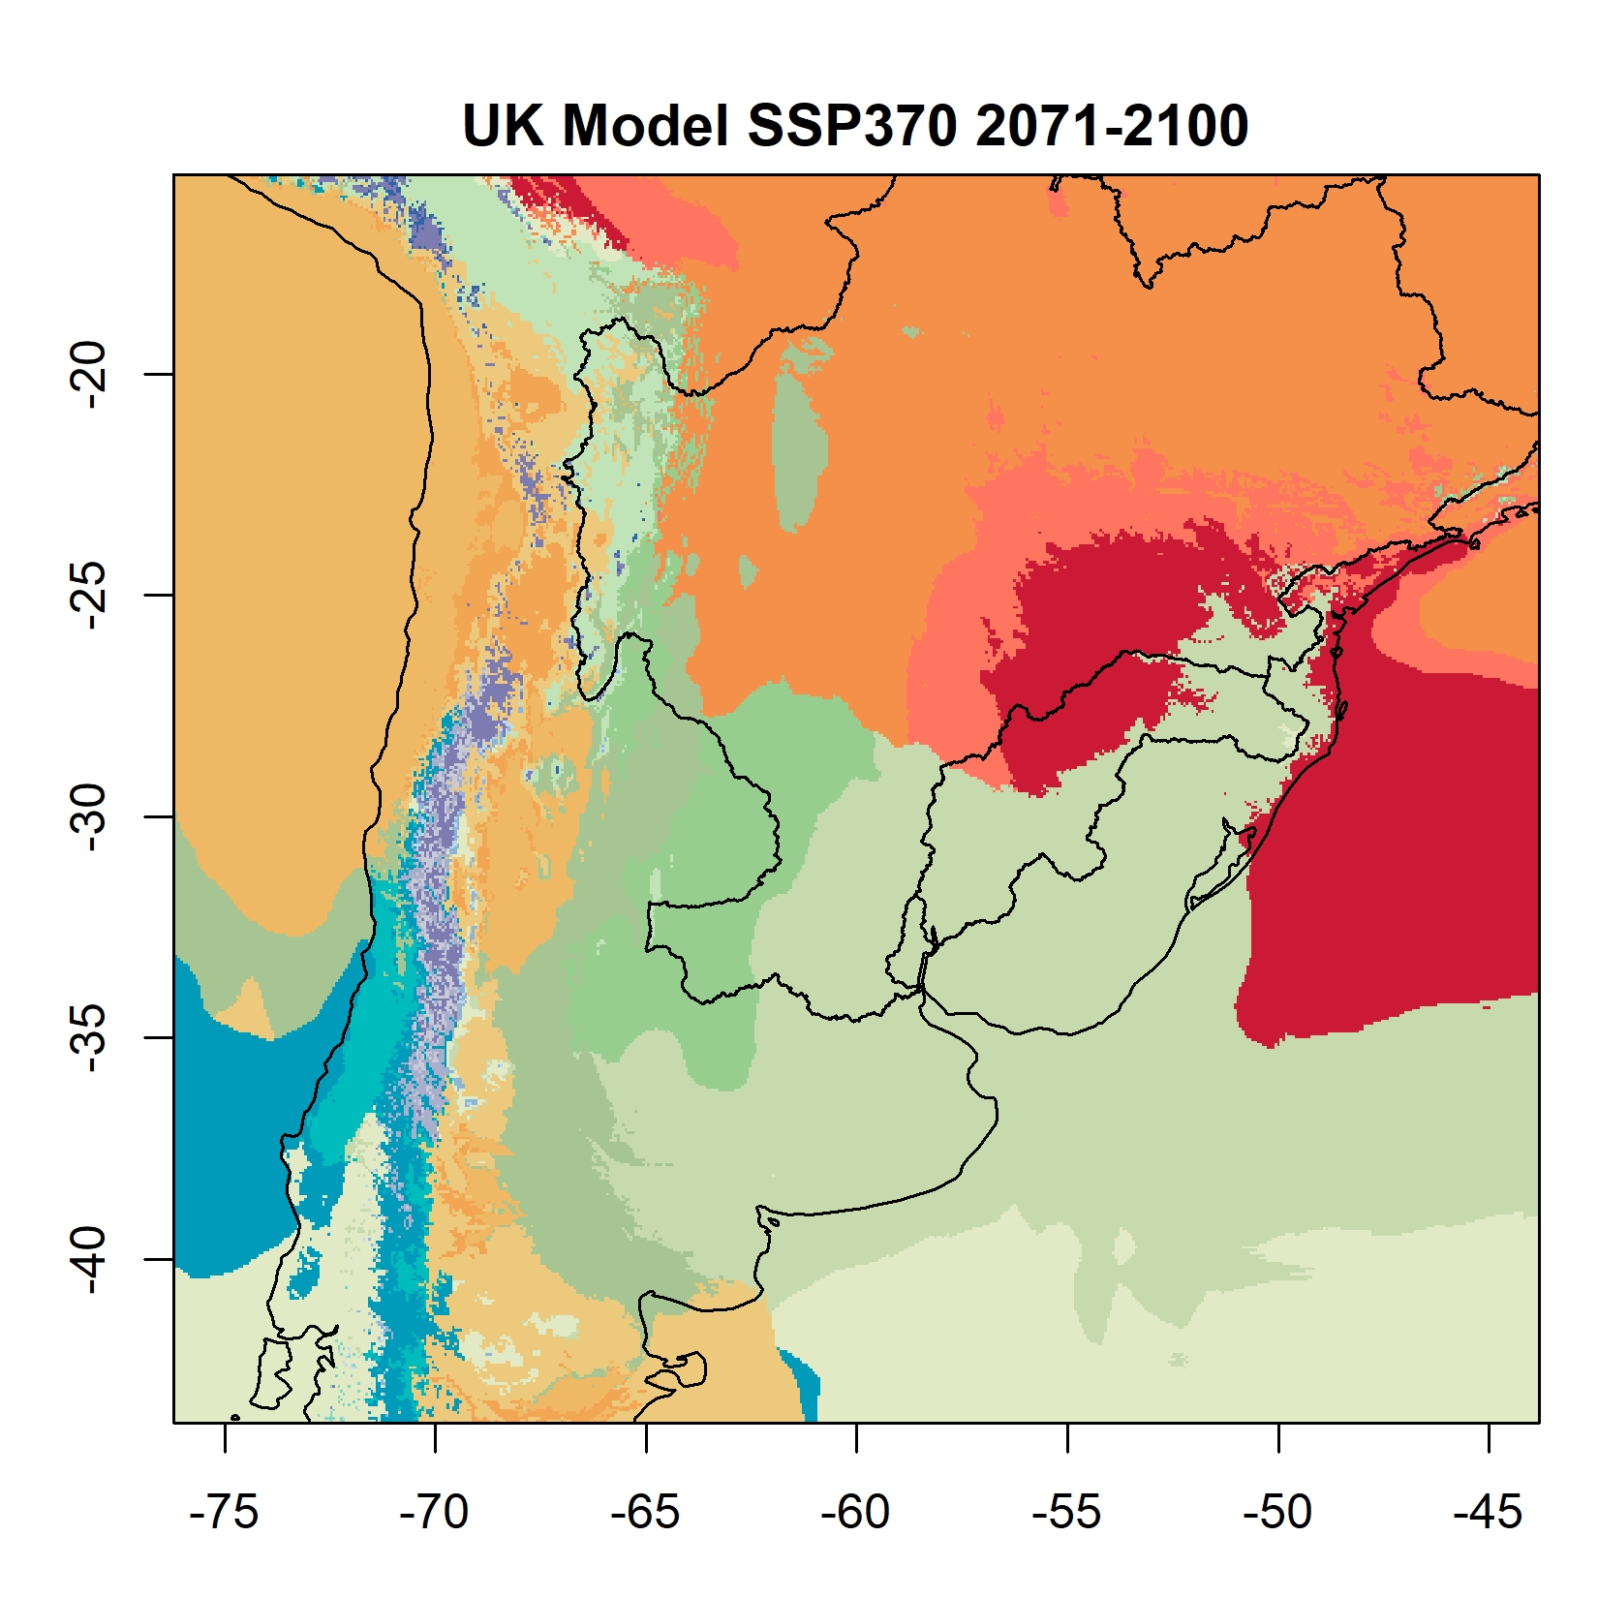
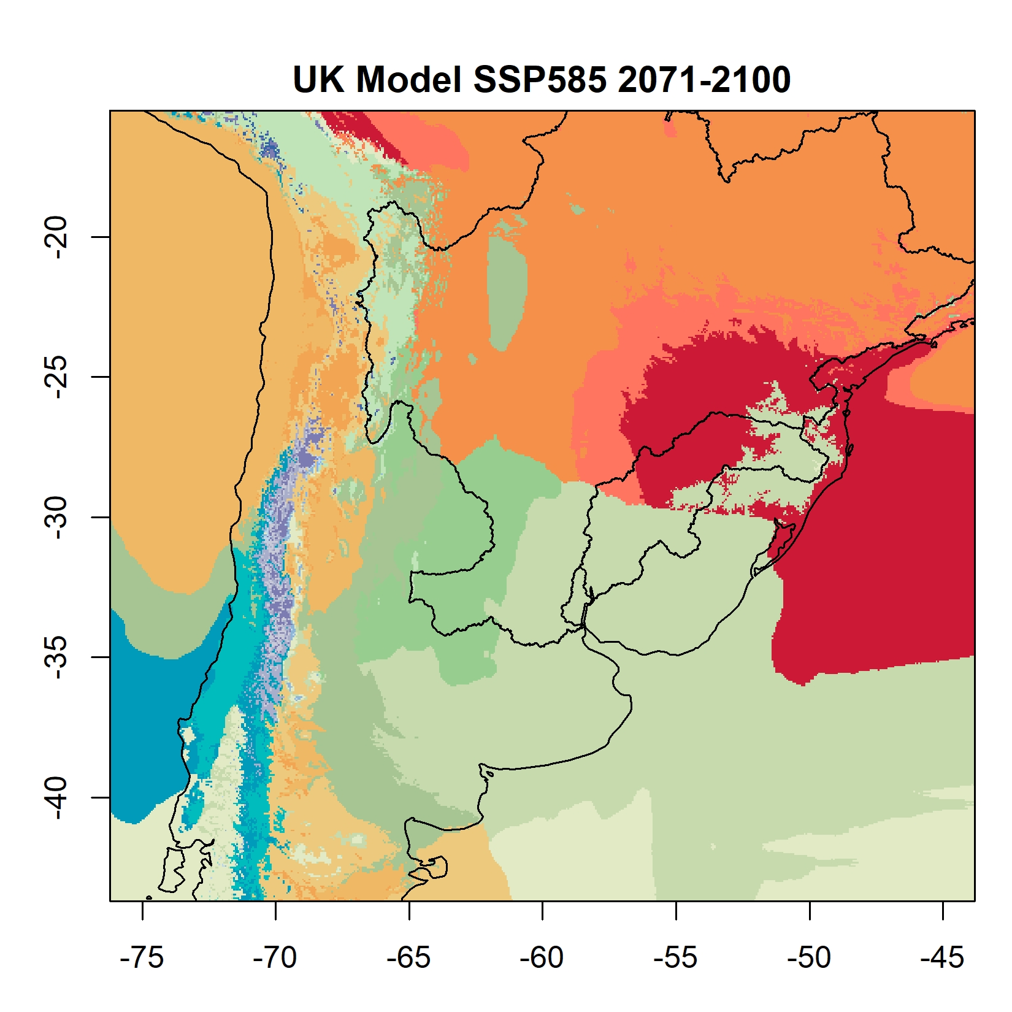
Climate change projections (CMIP6 downscaled to 1km)
Shifting Koeppen regions
Subtropical climate (Green)
Tropical climate (Orange)
Köppen Geiger after Peel, M. C., Finlayson, B. L., McMahon, T. A. (2007): Updated world map of the Koeppen-Geiger climate classification. Hydrology and earth system sciences discussions, 4(2), 439-473.

Slide 5
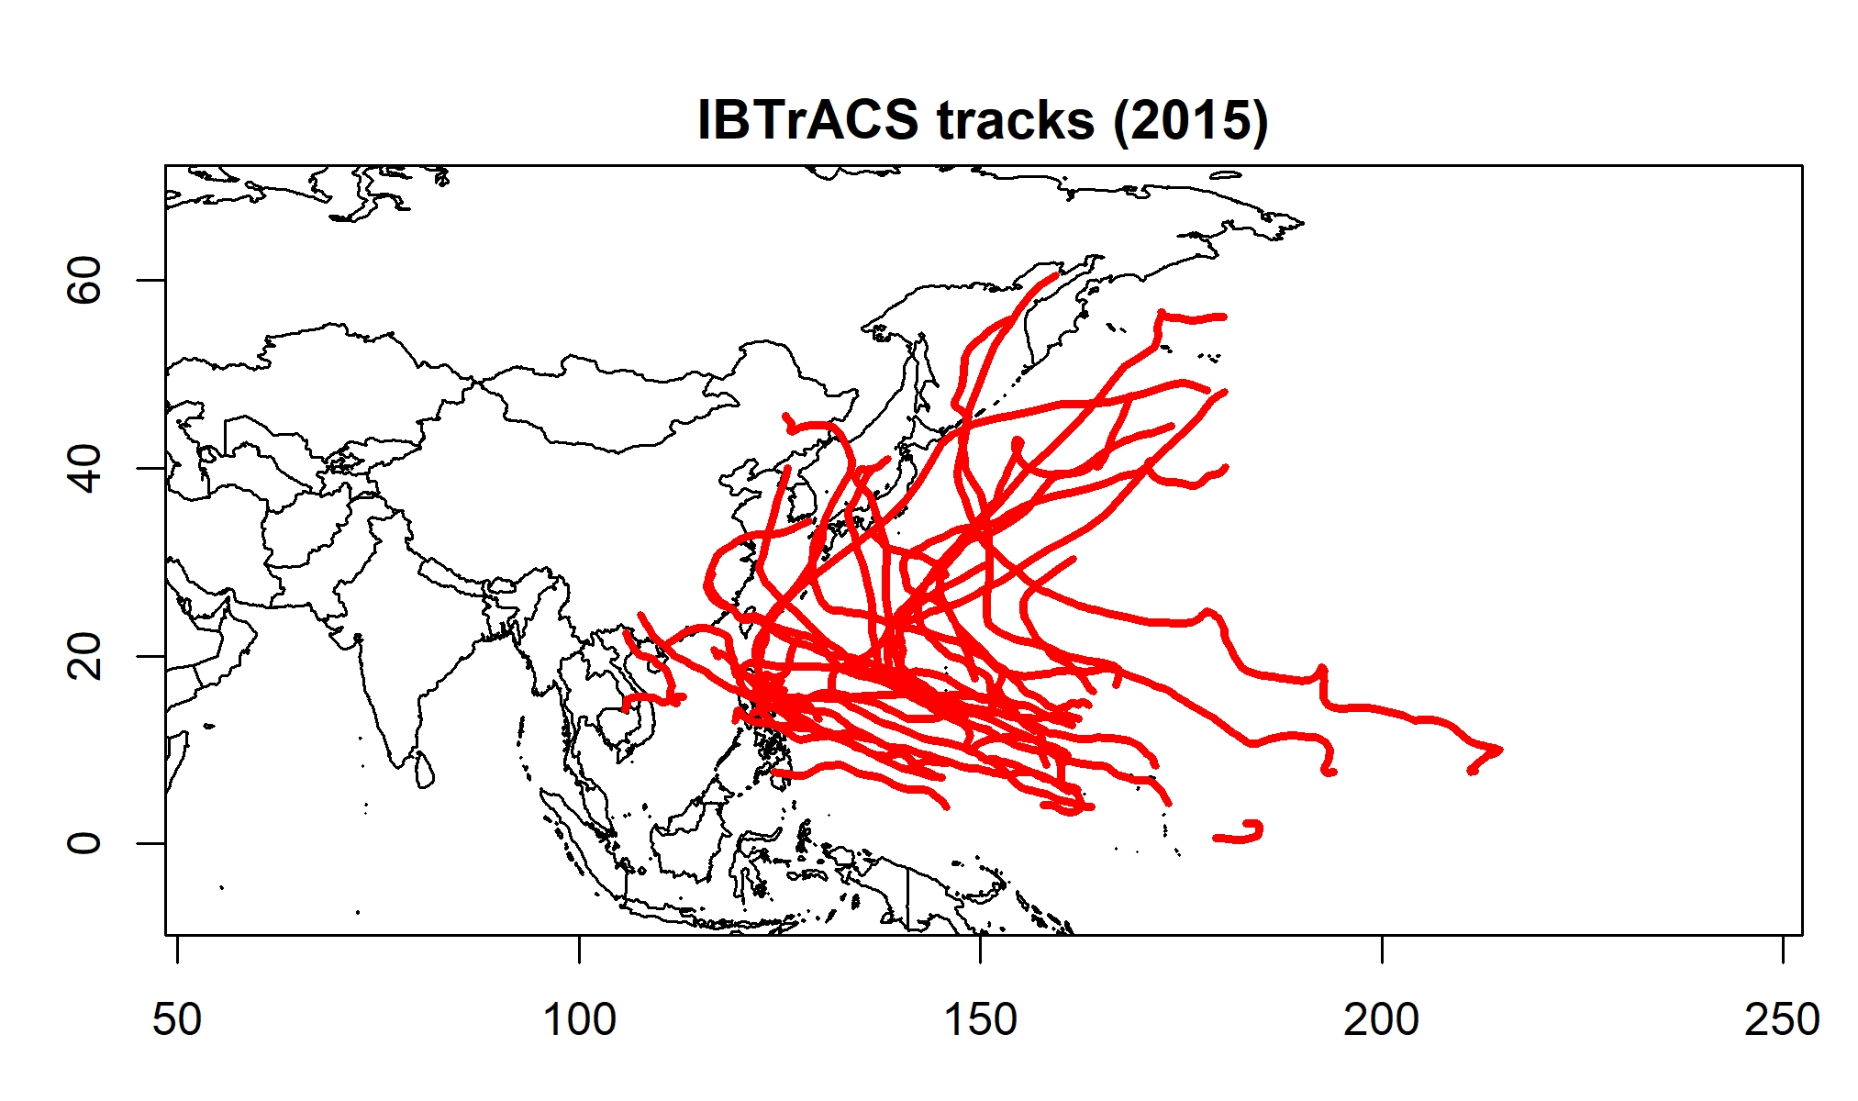
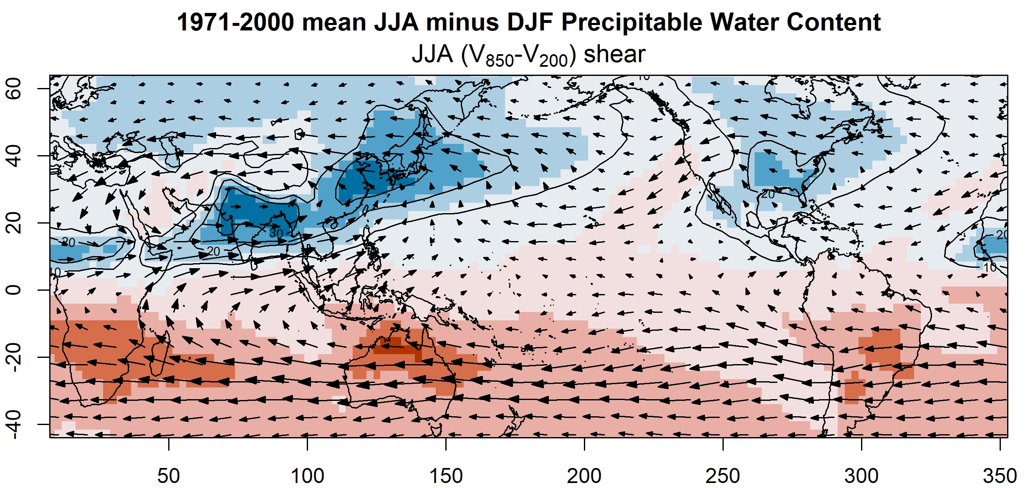
Mechanisms
Tropical
Trade wind
Typhoons
Midlatitude
Westerlies
Extratropical cyclones (frontal systems)
Polar jet stream (Rossby waves)
Subtropical
Monsoon interacting with interannual variability (ENSO)
Subtropical jet
Squalls
Unsteadiness; propagating convective disturbance; Mesoscale Convective System (MCS)

Slide 6
Subtropical stories
Diagonal wind (Transition between Easterlies to Westerlies)
Extratropical-tropical interactions
Interannual scales and Planetary oscillations
Air-sea interactions
Tropospheric and stratospheric teleconnections
Emerging hypotheses for changing climate
Intensify circulation features
Intensifying convection: the Hadley Cell Overturning and the Walker Circulation
Thermodynamic change affecting the transfer rate of surface energy and moisture fluxes
Hot spot location changes
Convergence location changes (e.g. Expansion of the Hadley Cell)
Ocean-land interaction affect local circulation (e.g. Shifting monsoon system)
Pressure gradient changes
Thermodynamic change affecting convection locations
Affecting the impacts of interannual variability (e.g. ENSO)

Slide 7
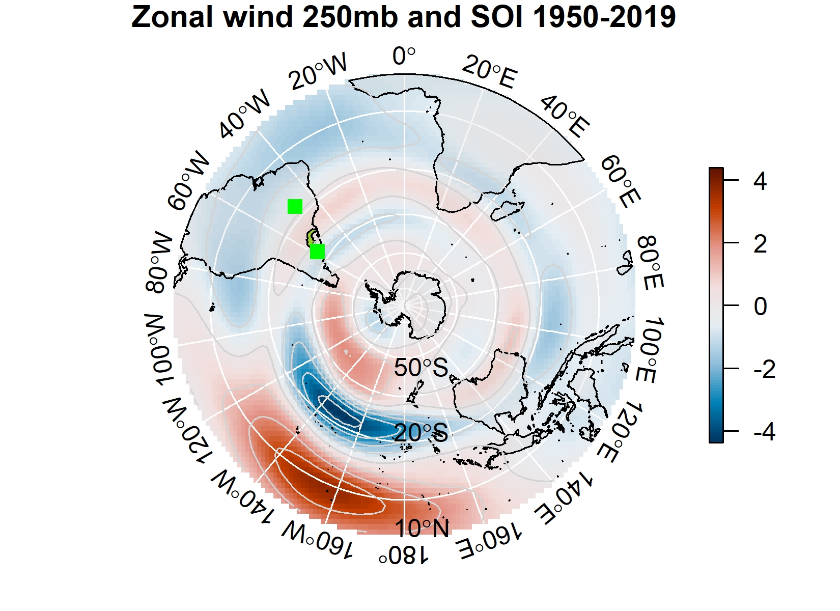
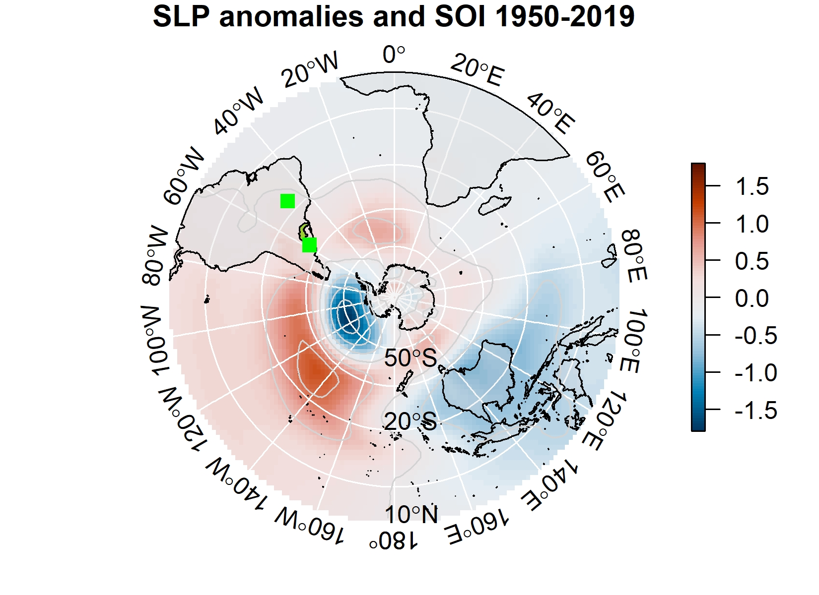
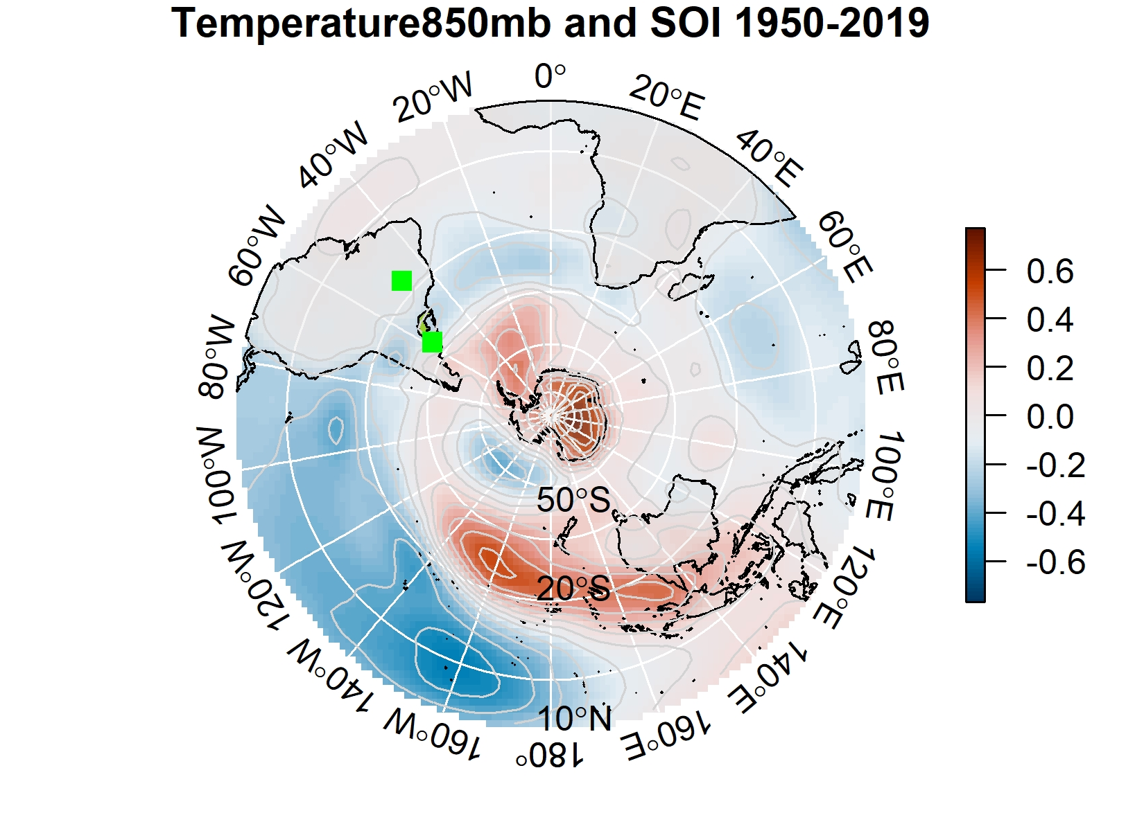
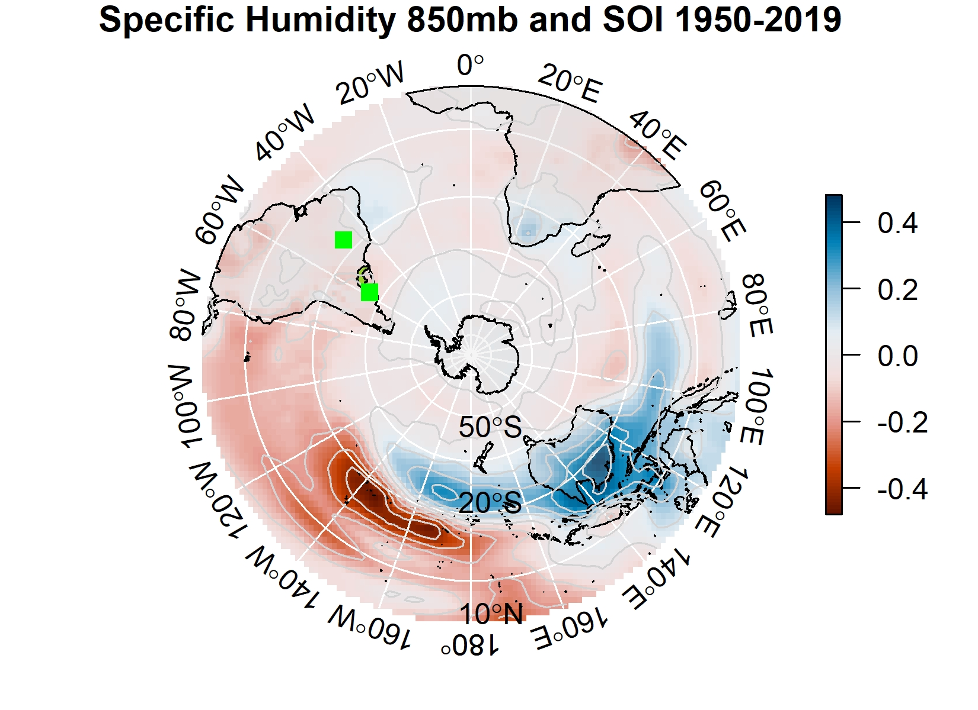
ENSO
3-5 years
Tropical air-sea interactions
SOI
Subtropical effects
Jet and SLP
Temperature and Specific Humidity

Slide 8
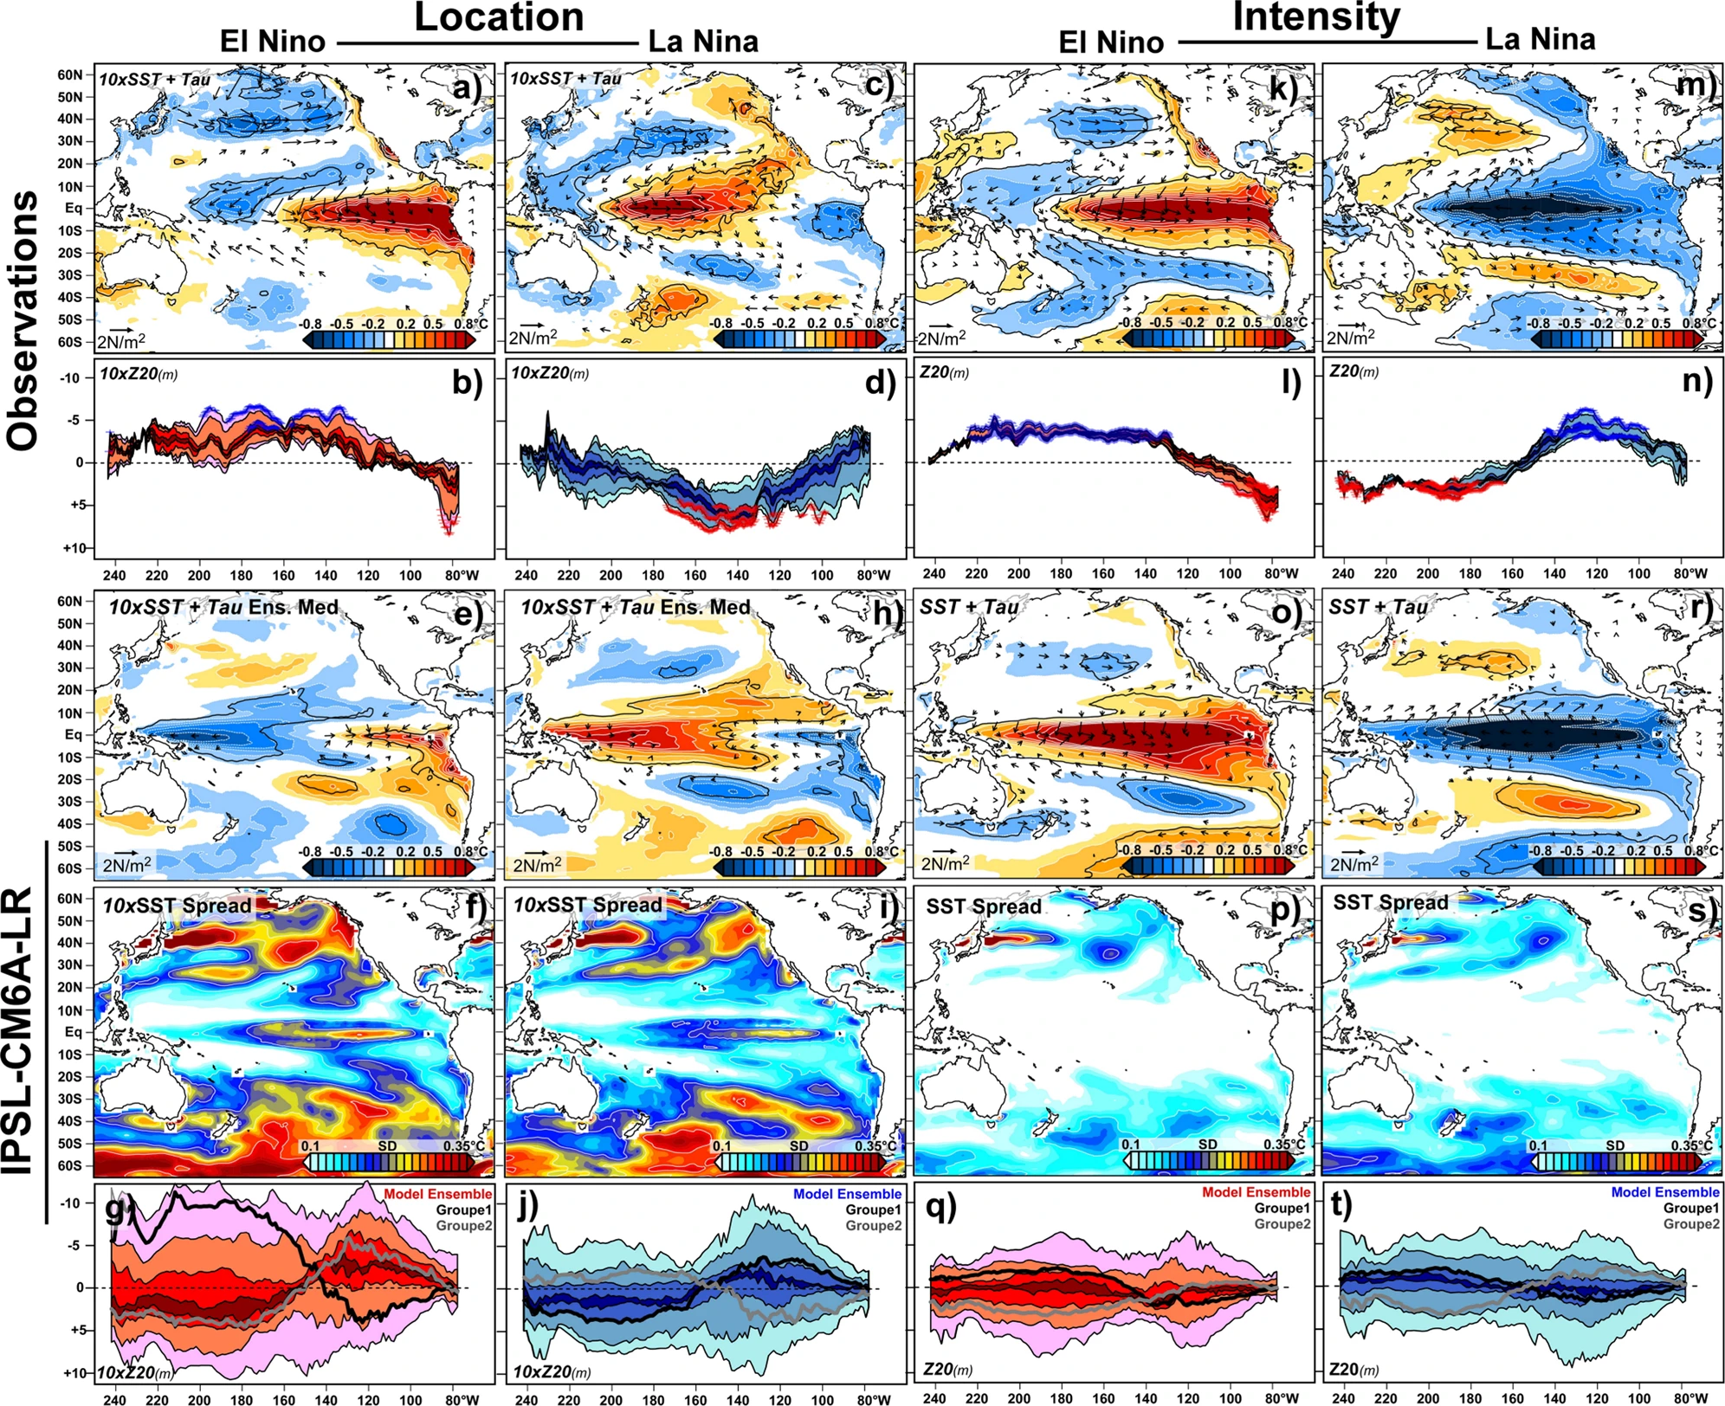
ENSO
Locations
Intensity
Air-Ocean
Thermocline
Dieppois, B., Capotondi, A., Pohl, B., Chun, K.P., Monerie, P.A. and Eden, J., 2021. ENSO diversity shows robust decadal variations that must be captured for accurate future projections. Communications Earth & Environment, 2(1), pp.1-13.

Slide 9
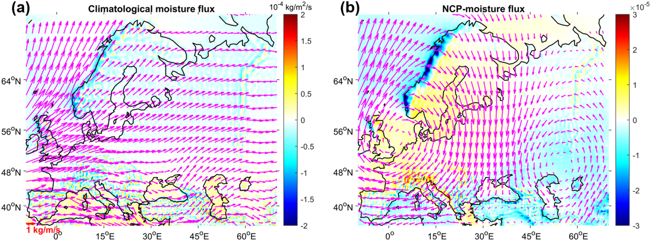
Northern Annular Mode (NAM)? North‐Sea Caspian pattern (NCP)
Defined based on Pressure
Northern Annular Mode (NAM)
AO, NAO, etc.
Locations of dipole centres
Intensity
Moisture transport
Vegetation
He, Q., Xu, B., Dieppois, B., Yetemen, Ö., Sen, O.L., Klaus, J., Schoppach, R., Çağlar, F., Fan, P.Y., Chen, L. and Danaila, L., 2022. Impact of the North‐Sea Caspian pattern on Meteorological drought and Vegetation Response over diverging environmental systems in western Eurasia. Ecohydrology, p.e2446.

Slide 10
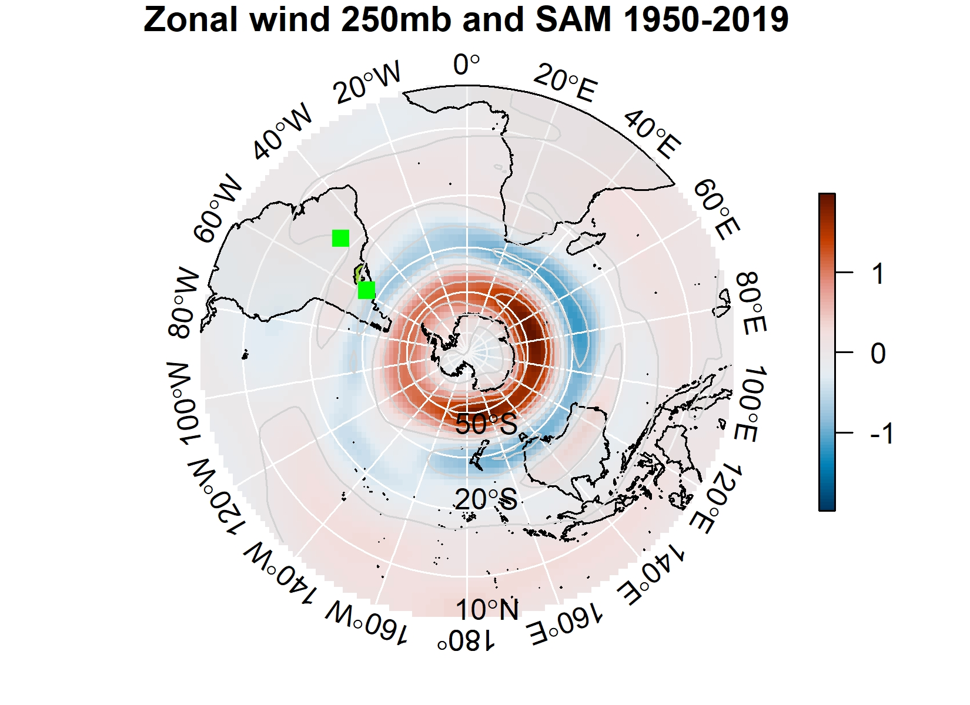
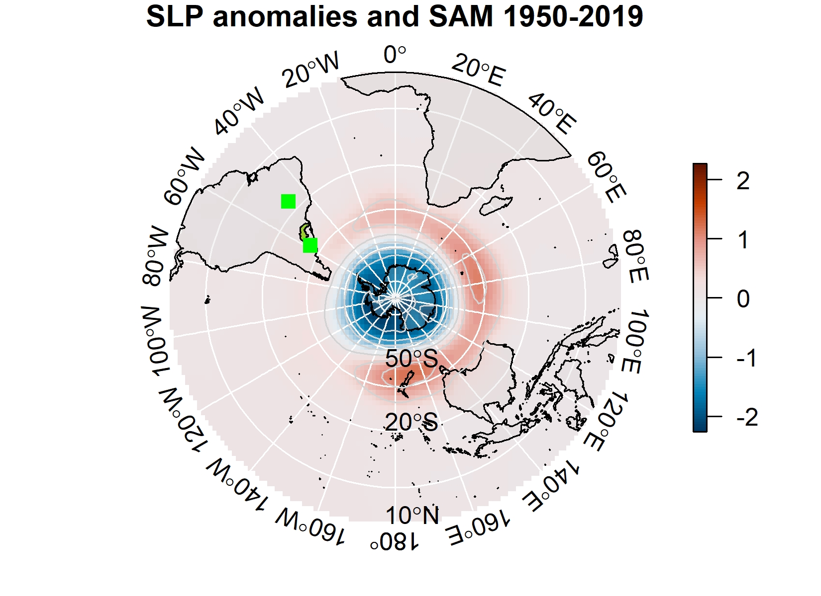
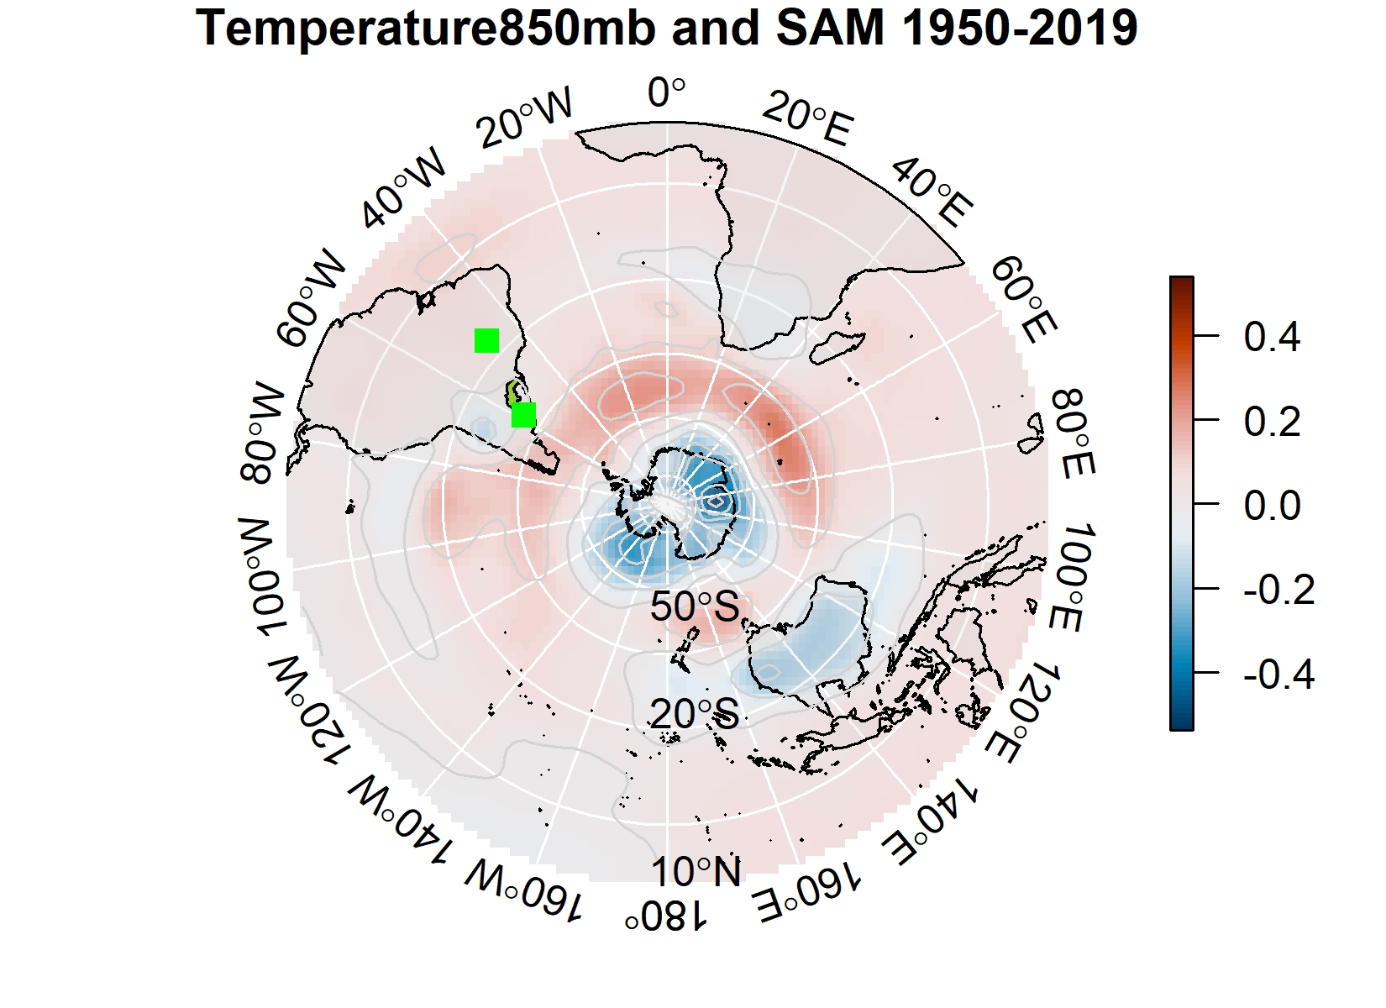
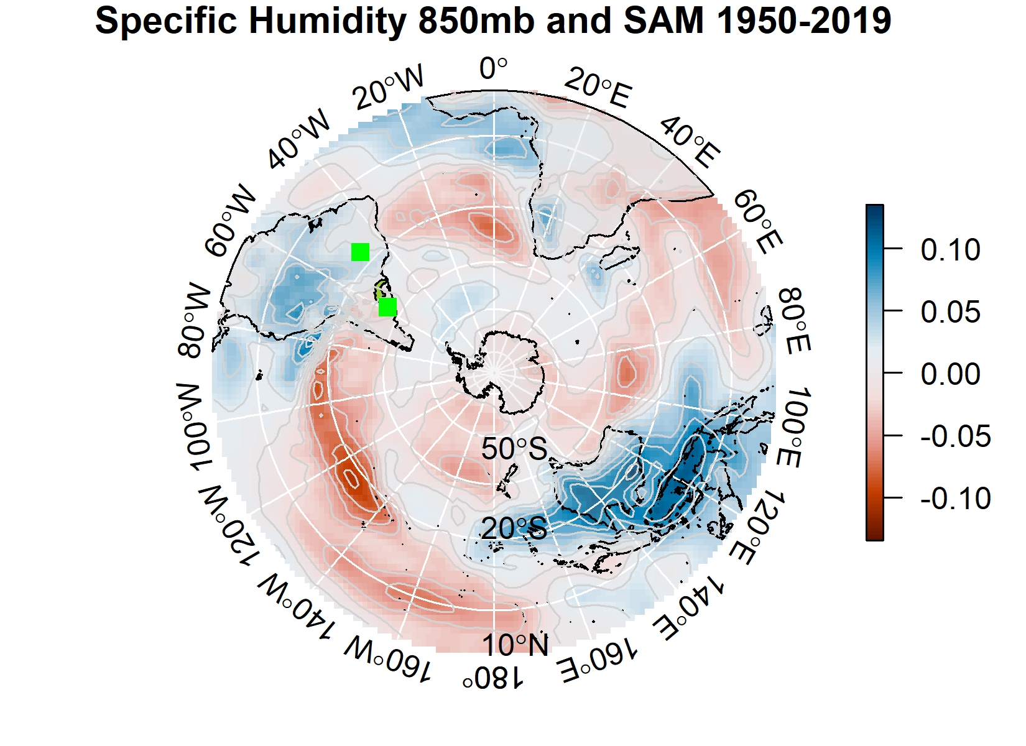
SAM
Southern Annular Mode (SAM)
Antarctic oscillation (AAO)
Midlatitude
Pressure driven
Subtropical effects
Jet and SLP
Temperature and Specific Humidity

Slide 11
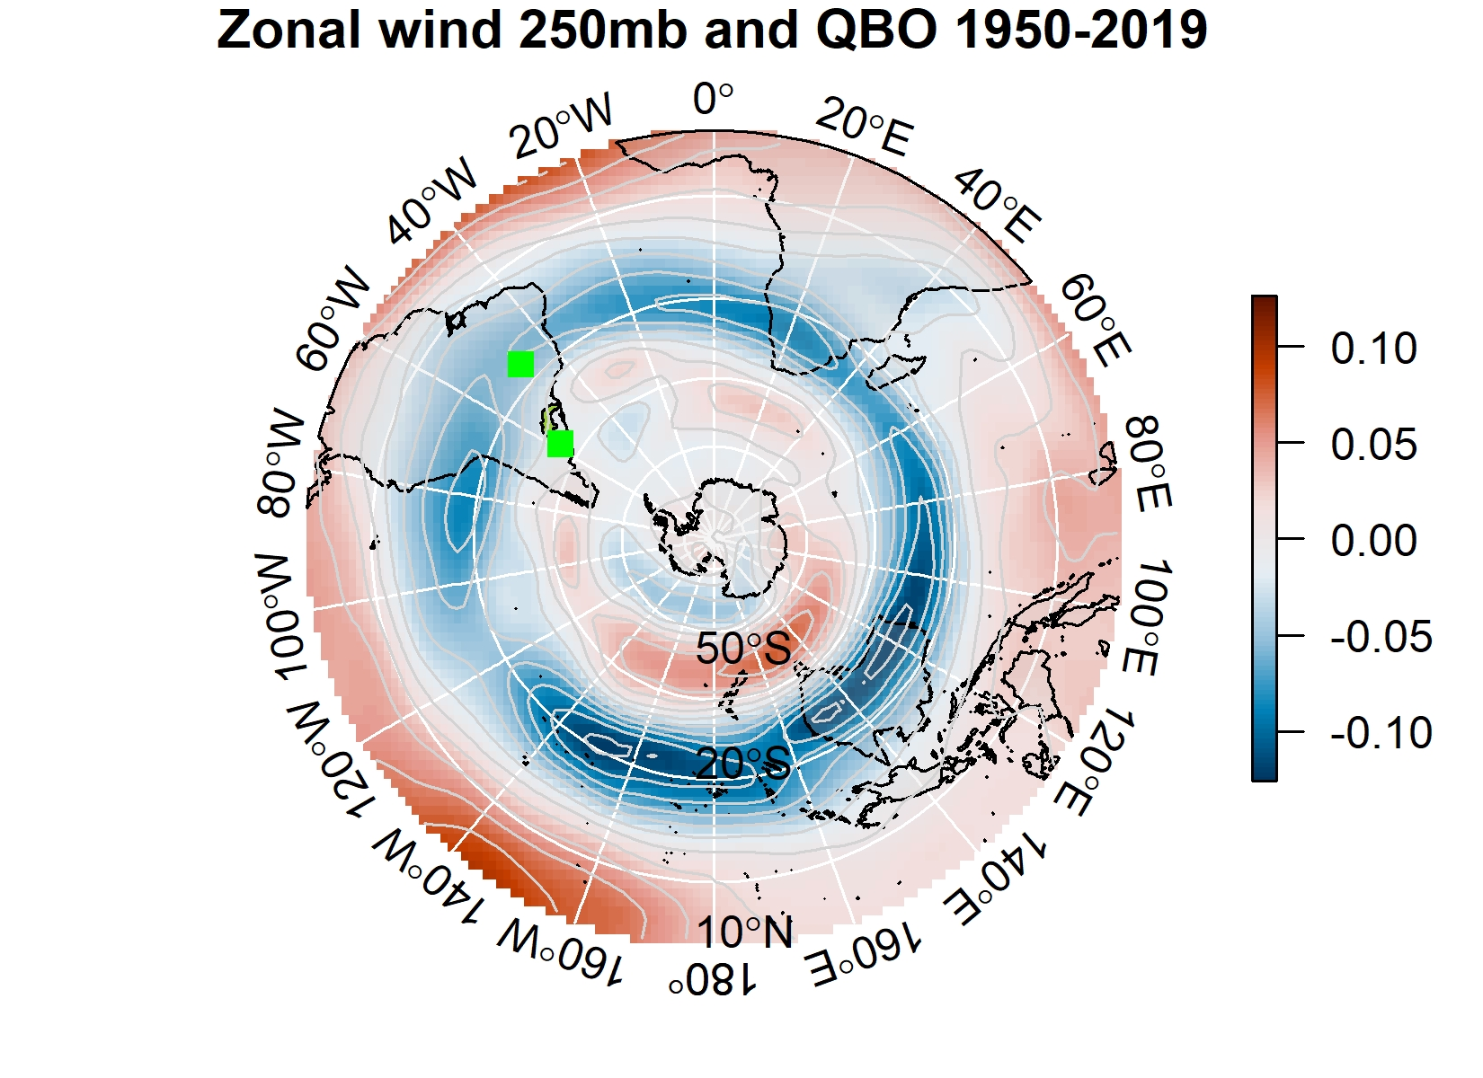
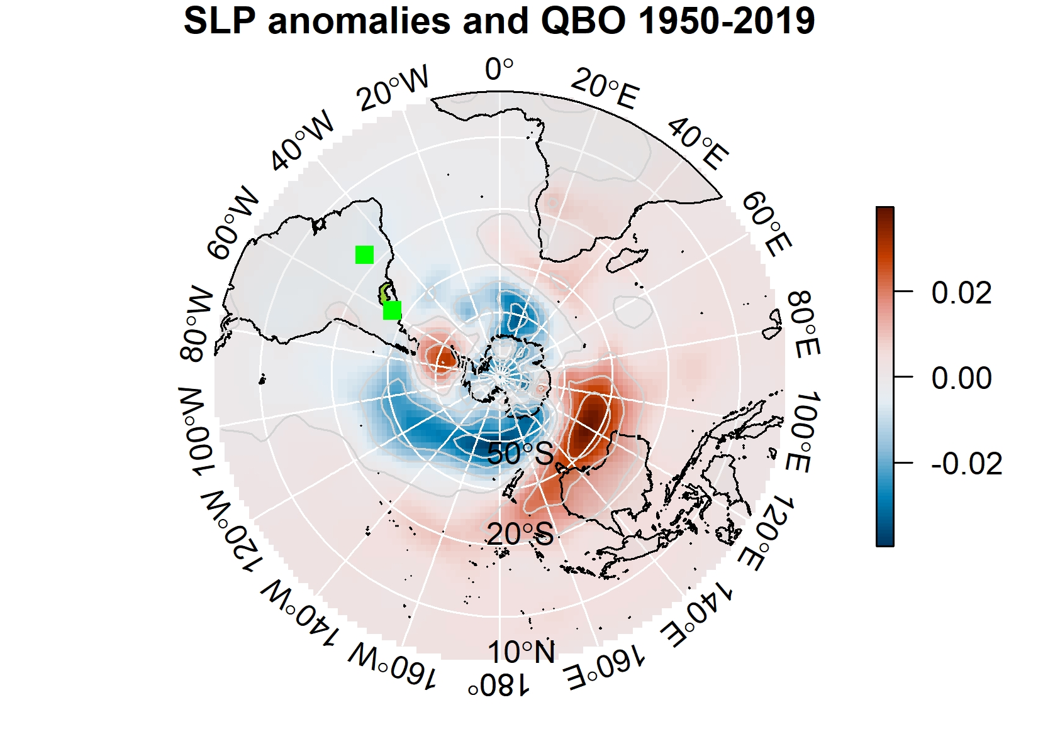
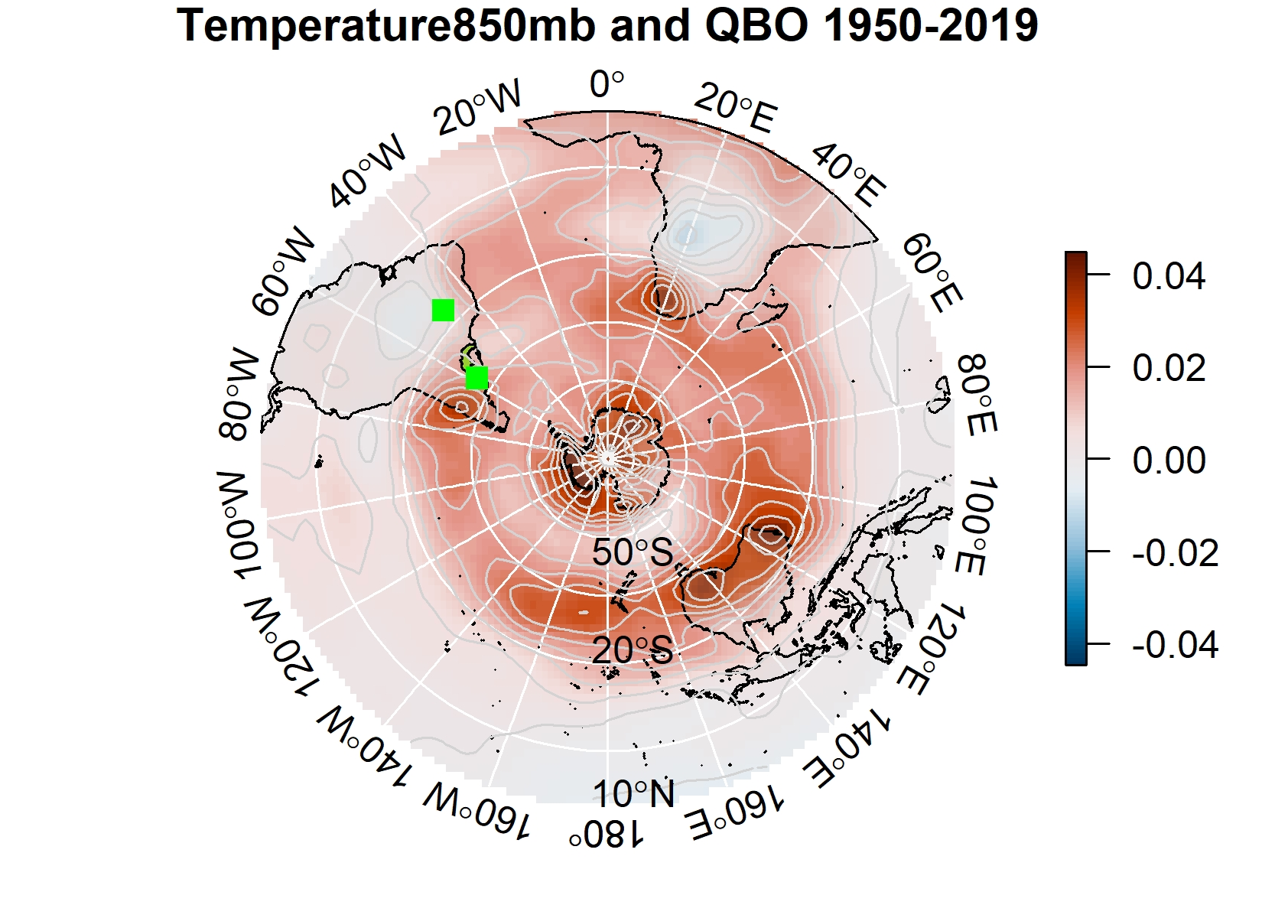
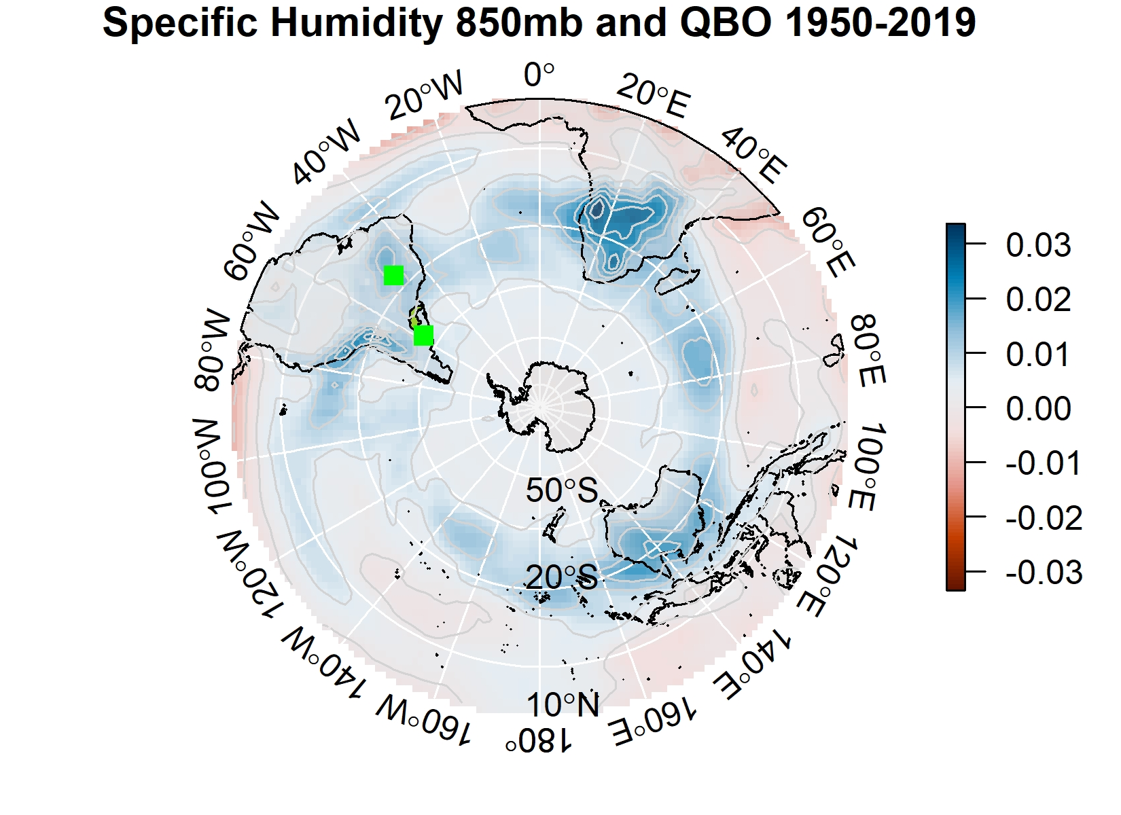
QBO
Quasi-Biennial Oscillation (QBO)
2-3 years
Extratropical-tropical interactions
Tropospheric and stratospheric teleconnections
Subtropical effects
Jet and SLP
Temperature and Specific Humidity

Slide 12
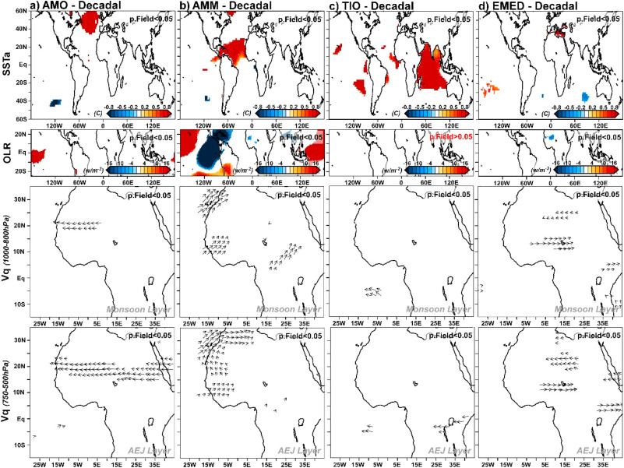
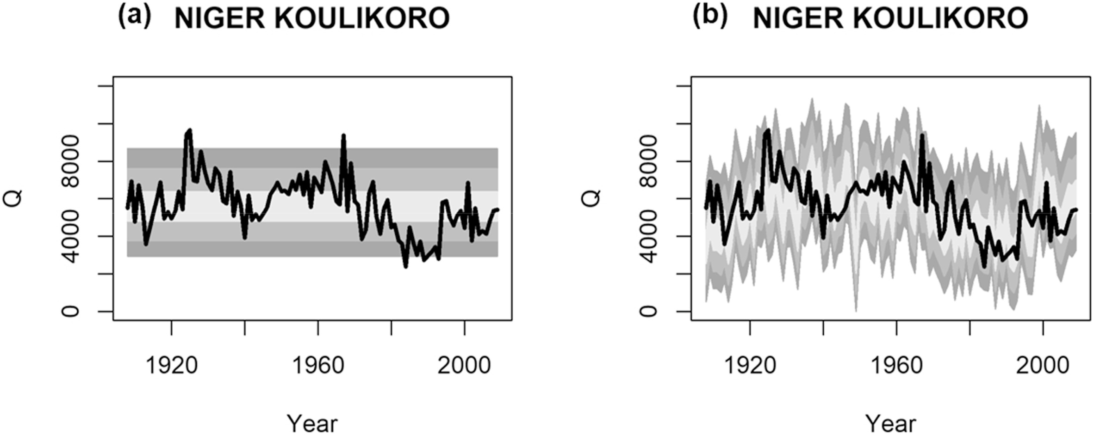
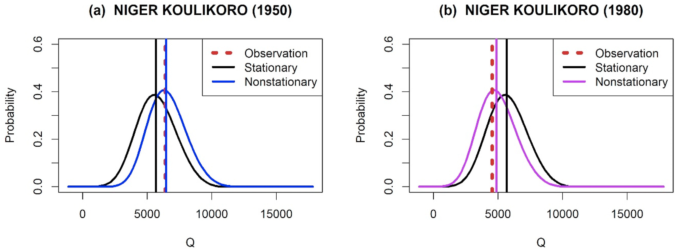
Extremes
Chun, K.P., Dieppois, B., He, Q., Sidibe, M., Eden, J., Paturel, J.E., Mahé, G., Rouché, N., Klaus, J. and Conway, D., 2021. Identifying drivers of streamflow extremes in West Africa to inform a nonstationary prediction model. Weather and Climate Extremes, 33, p.100346.
Variance decomposition of long records to separate drivers’ contributions
Nonstationary statistical models to reveal driving modes
Dry and Wet Regimes: Droughts and Flooding

Slide 13
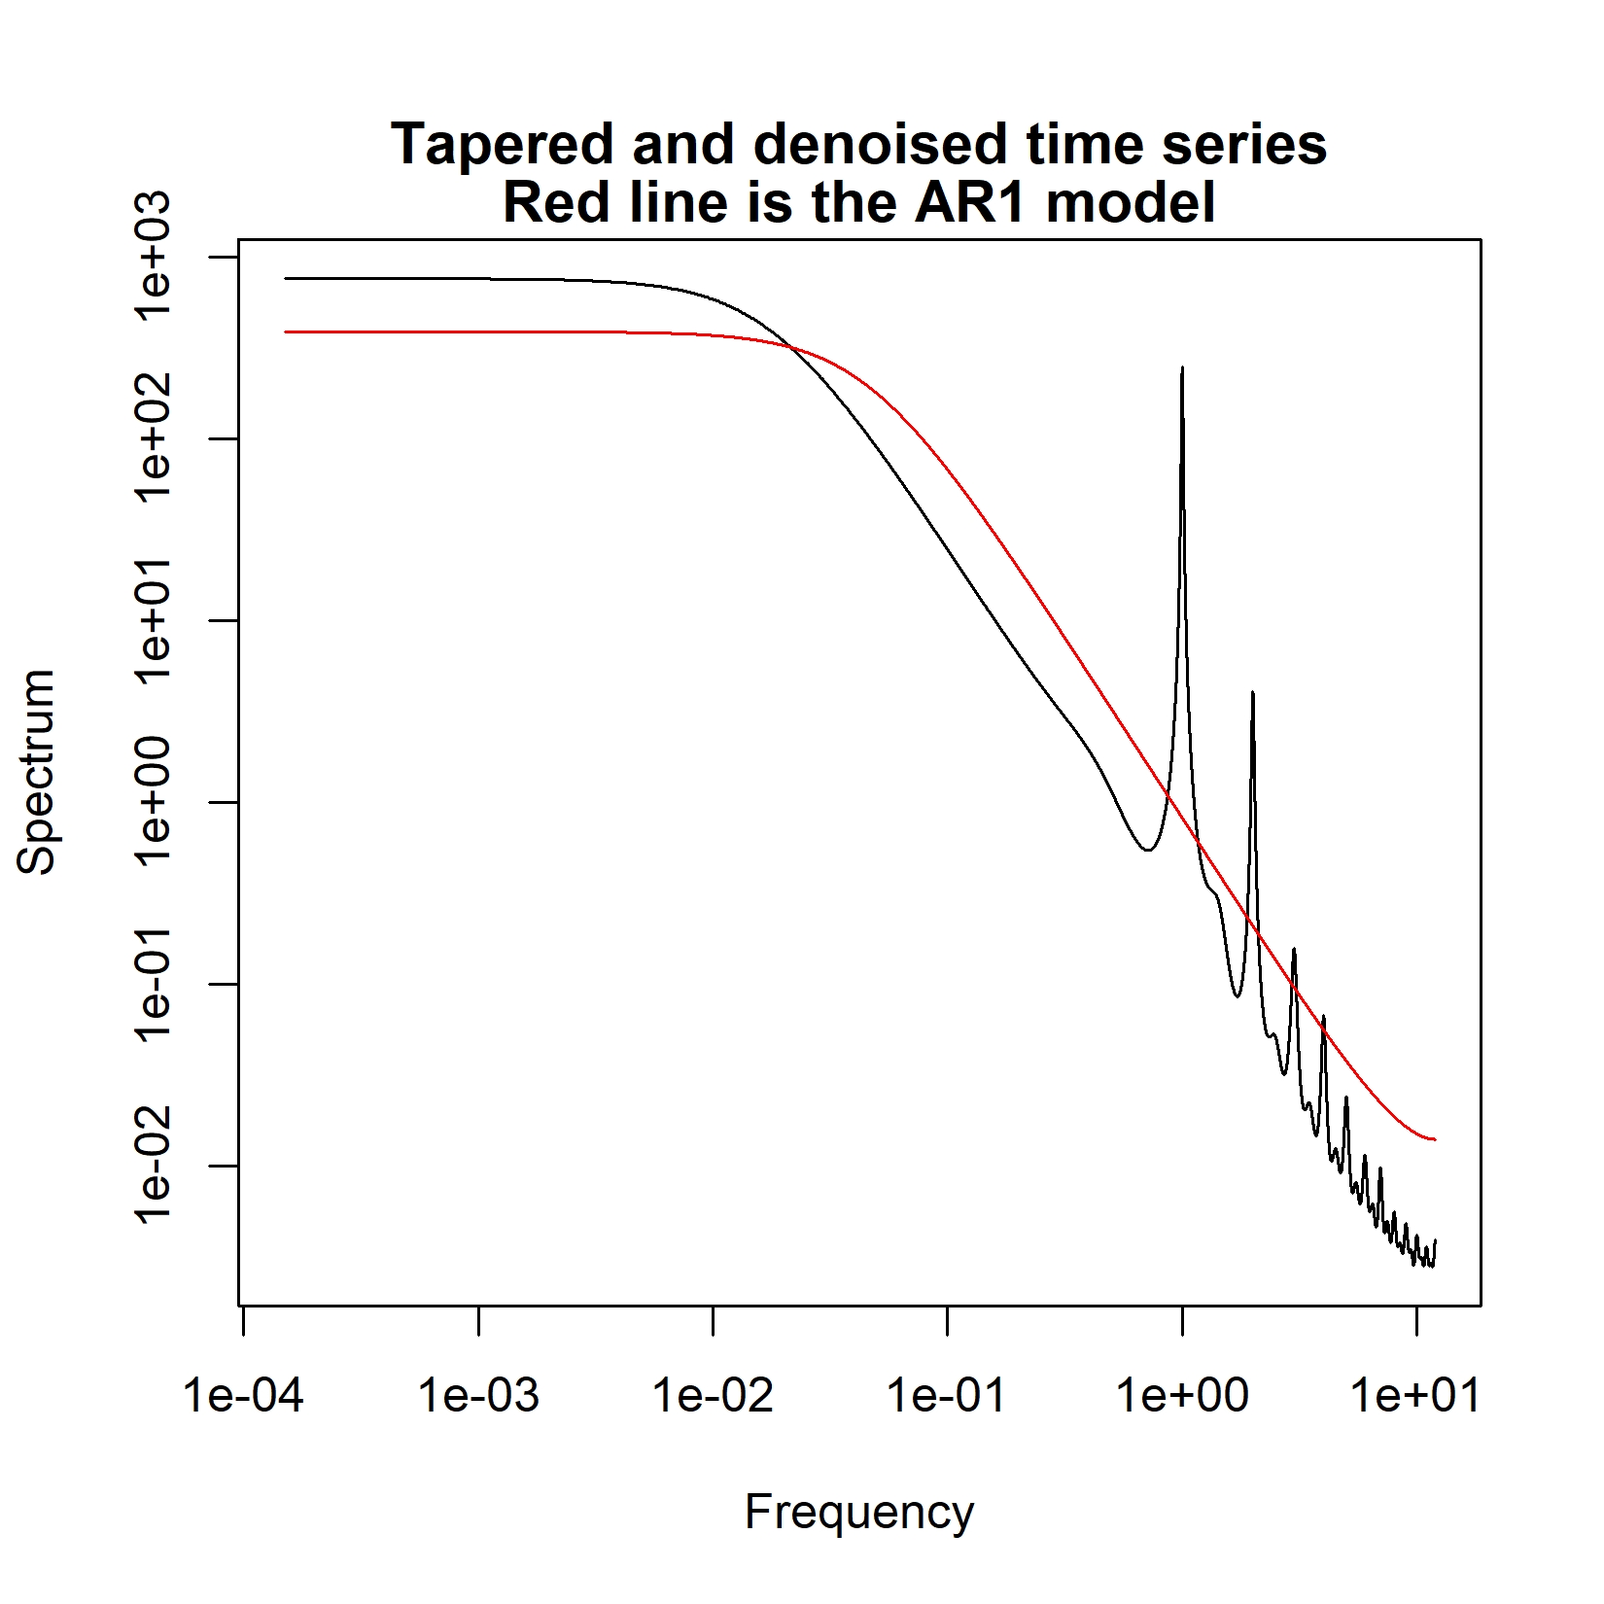
Some ideas of modelling techniques Emerging Topics
Convection-permitting models (CPMs) to provide simulations
Persistent patterns (stability)
Lagging dynamics (heat storage and capacity)
Mode decomposition for feature detections
Variance decomposition (e.g. PCA)
Big data methods for identifying patterns (e.g. Clustering)
Scaling relationships based on observations and CPM outputs
Oscillation over interannual and decadal scales for extremes including flooding and droughts

Slide 14
Some ideas of modelling techniques Emerging Topics (Take home message)
Internal feedback which is balancing the uneven moisture and energy distribution in subtropical regions
Scaling chain
Turbulence Theory (Luminita)
Scale-by-Scale-budget of turbulent fluctuations
Decadal
AMO
Interannual
ENSO QBO
Sub-seasonal and Seasonal
NAO, NCP, SAM
Extremes
Storms; Typhoon; Droughts

