Slide 1
User Driven Modelling and Systematic Interaction for End-User Programming
Modelling for Engineering Processes
Peter Hale UWE

Slide 2
University of the West of England, Bristol
Abstract
Problem -
Enable translation of human problems/representation to computer models and code.
To what extent can diagrammatic representations of problems be used in order to provide modelling solutions.
Application Area -
Engineering Modelling, for manufacturing processes and cost, so far applied to Aerospace Composite Wing Box cost, and Aircraft Engine Design and Cost.

Slide 3
Introduction
Purpose -
To test this problem -
C.S. Peirce (1906) -
'Prolegomena to an Apology for Pragmaticism'
"Come on, my Reader, and let us construct a diagram to illustrate the general course of thought; I mean a system of diagrammatization by means of which any course of thought can be represented with exactitude"
To limit the Scope –
Research restricted mainly to engineers (who often use diagrams)
To domain of modelling (which often requires diagrams)

Slide 4
Introduction Continued
Benefits -
Enables engineers to visualise problems such as representation of a product data structure in a familiar way
Gives a visual and colour coded representation of equations
Visualisation is easier to navigate and understand than that in spreadsheets, and more maintainable
Wider Implications -
This research could also be used for business modelling, all kinds of process modelling, and workflow

Slide 5
Research Approach
This approach involves building a systematic infrastructure and capability, and solving problems which could hamper this
And is based on creation of systems that can be customised to produce other systems and models, and translation from abstract diagrammatic representations to computer representations

Slide 6
Engineering Modelling Design
Methodology
Making the structure of a model be the same as the structure of the engineering component modelled turns 2 problems into one
This speeds up co-operation in prototyping of both the software model and the component

Slide 7
Systems Engineering Involvement
Systems Engineering involved in analysis of the relating of interdisciplinary research requirements, in both engineering and computing
Systems engineering important as application area of modelling, for aerospace (Airbus and Rolls-Royce) involves complex engineering and a systematic approach
Required systematic production of systems that must be usable by wide range of users to produce and share customised engineering models

Slide 8
Engineering Modelling Requirements
Both rapid prototyping and rapid application design/development involve iterative fast development with prototypes communicated
Requirements emerge gradually as part of this process, so early stage design can begin, in co-operation with life-cycle management.

Slide 9
Engineering Requirements Soft Systems
To get full benefit from this all staff who are part of this must be enabled to be involved
Design, manufacturing, management, and life-cycle management people need to be able to access the models

Slide 10
Engineering Modelling User Participation
Longer term aim is to enable direct modelling/prototyping by customers of the modelling tool e.g. engineers/end-user programmers
Such a system documents itself as the structure of the engineering product and software model are displayed/visualised

Slide 11
Engineering Modelling Design Tools
Integration of information representation UML (Unified Modeling Language) is progress towards this user participation
Also a user interface is required that makes it easier for engineers to model using such a combined UML solution

Slide 12
Engineering Modelling Issues
Despite object-oriented programming techniques being heavily influenced by the approach used by engineers for Bill of Materials/Product Data Structure modelling this link has become difficult
Much of object-oriented programming was developed before graphical user interfaces became practical and common
So objects/classes are often represented mainly by text with visualisation/representation being added as an afterthought

Slide 13
Engineering Modelling Issues 2
This is not useful for engineers who are used to objects being physical things, or at least diagrams
A further problem has been an over-emphasis on encapsulation (hiding an objects' details, while creating an interface for its use)
This can lead to errors due to re-use of objects that are not fully understood
So the classes/objects need to be visualised, even if user does not intend to change the contents, so user has sufficient understanding

Slide 14
Engineering Modelling Conclusions
It has been assumed that because engineers often deal with hard systems, a hard systems object-oriented approach would enable them to program
But engineers spend much of the time involved with soft systems and interactions with others
Needs to be more emphasis on allowing engineers to specify the problem at high level and this translated to code, rather than expecting engineers to code all the objects

Slide 15
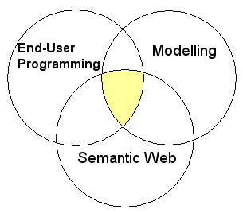
Application of Software

Slide 16
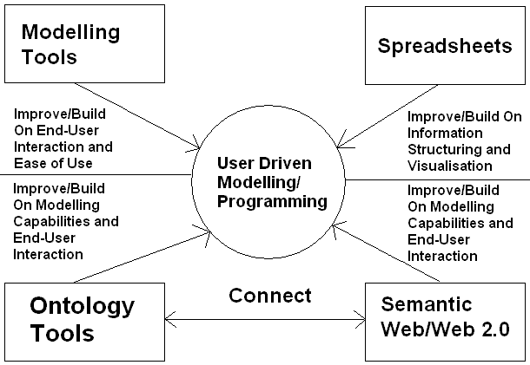
Tools and Technologies 2

Slide 17
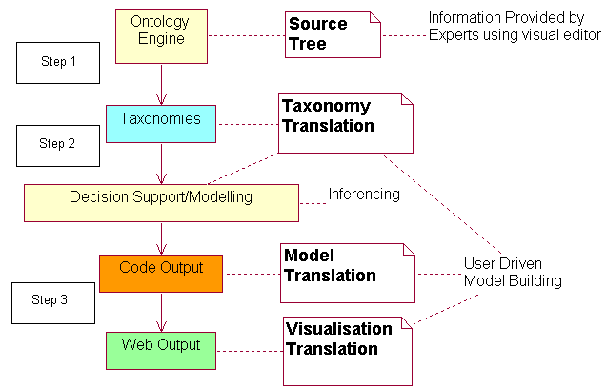
Translation Process

Slide 18
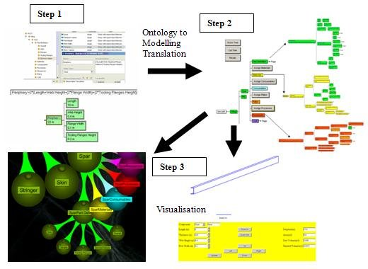
Translation Stages

Slide 19
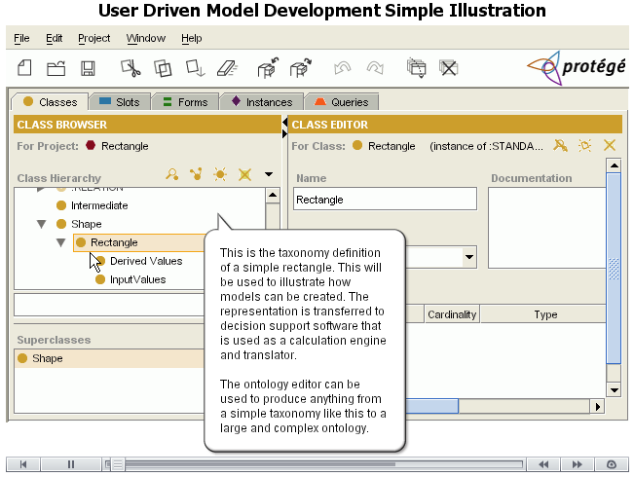
Example Illustration

Slide 20
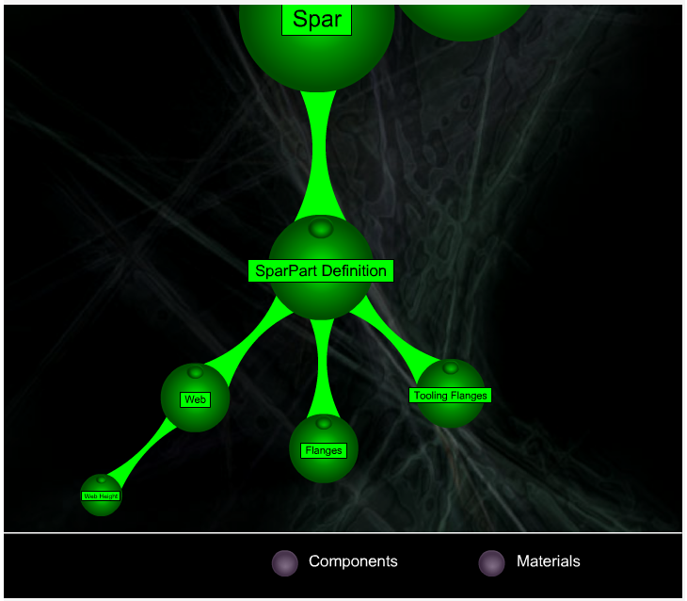
Web Tree Representation
Rhodes et al. 2002

Slide 21
Summary and Findings
Closes the gap between those producing modelling systems, and those who require them
Makes it easier to iterate through solutions and solve problems more quickly and collaboratively
Experienced programmers can build a modelling environment that can then be used by non programmers to create process models
Enables collaboration, simulation and modelling by translation from a model based representation of software to the actual software
Gives users greater involvement
Partially automates the process of software creation via a collaborative structure that maps the problem, and user interface creation by diagrammatic and/or tree based representation

Slide 22
Conclusion
This approach to modelling and end-user programming enables interoperability, and collaboration
This assists with Maintenance, Extensibility, Ease of Use, and Sharing of Information.

Slide 23
References
Peirce, C.S. (1906) Prolegomena to an Apology for Pragmaticism [online]. Available from: http://www.existentialgraphs.com/peirceoneg/prolegomena.htm [Accessed 9 March 2010].
Rhodes, G., Macdonald, J., Jokol, K., Prudence, P., Aylward, P., Shepherd, R., Yard, T., 2002. A Flash Family Tree, In: Flash MX Application and Interface Design Flash MX Application and Interface Design. ISBN:1590591585. [online]. Available from: http://www.friendsofed.com/book.html?isbn=1590591585 [Accessed 9 March 2010].

