Slide 1
British Nuclear Medicine Society 2010 Spring Meeting
Using web-based technology To develop a new approach to learning and assessment
Marc Griffiths, Gary Dawson & Rob Stewart

Slide 2
Background
Post Graduate programme delivered at UWE, Bristol for 14 years
Providing traditional based learning, teaching & assessment approaches
Re-validation of nuclear medicine programme in 2008 prompted an initial evaluation of traditional learning techniques

Slide 3
National Drivers
Department of Health
2004 “Working together, learning together”
2004 “The NHS knowledge and skills framework and the development review process”
2008 “High Quality Care for All: NHS Next Stage Review Final Report”
SCoR
2009 “Scope of Radiographic Practice”
MSC Report
2010 “The UK Way forward”
Service improvement
2006 “Skills for Health” Drive

Slide 4
Consultation phase
Involvement of clinical stakeholders
Student evaluation and suggestive models for future pedagogies
Investment in web based technology and consultation with industry representatives

Slide 5
New Models of Learning
Enquiry based learning using BlackBoard:
Student were involved in the evaluation of working practice relating to the management of radioactive spillages
Contact teaching was supported with discussion forums on Blackboard
Distance based learning approach also adopted:

Slide 7
Clinical scenarios
Use of clinical scenarios reinforced the students learning
Students critically evaluated clinical scenarios developing:
Reflective skills
Analytical skills
Critical thinking skills
Problem solving abilities

Slide 8
Web based processing / manipulation of data
TeleHERMES software installed in May 2009
Initial architecture developed as a teaching tool at UWE
Vision to develop a virtual image manipulation & processing platform remote from the academic environment
Initial findings promising and on-going developments taking place with industry colleagues

Slide 10
Distance based learning
Structured learning utilising BlackBoard
Extra cohort of Nuclear Medicine Technologists in Scotland accessed a science and instrumentation module
Blocks of educational material released to the students
Interwoven with discussion board threads & staged self-directed study
Assessments related to practice & supported using a web-based resource (virtual lab)

Slide 11
Web-based resource
The main experimental component of the module was made available via the BlackBoard interface, but also on a stand-alone web site.
This site was complete with data that could be used if local results were not available. Hyperlinks allowed access to further and complementary information to assist in completing the experiments and also engage in the learning intended

Slide 12
Virtual Lab: Sample Image
Sample images for students who had not met items of equipment in their studies or workplace to date.
Many of the students found this useful.

Slide 13
BlackBoard
All lecture materials were made available to allow students to concentrate on engaging with the lectures, rather than struggling to make notes as the lecturer spoke.
This is also an excellent revision resource.
Developed students analytical and reflective abilities

Slide 14
Discussion Boards
Use was made of the discussion boards to allow students to query their understanding on current issues. This elicited feedback from staff and their own peers. This strongly re-enforced working relationships and made some students very much aware of just how much knowledge they actually had.
The boards were also used to set work out of class and allowed asynchronous study to take place.

Slide 15
e-OSCE assessments
Opportunity to provide assessment environment which reflects clinical practice
Students access a number of virtual cases which include some decision making processes:
Care of the patient
Administration of radiopharmaceutical agents & dose limits
Acquisition parameters
Image quality / artefacts

Slide 16
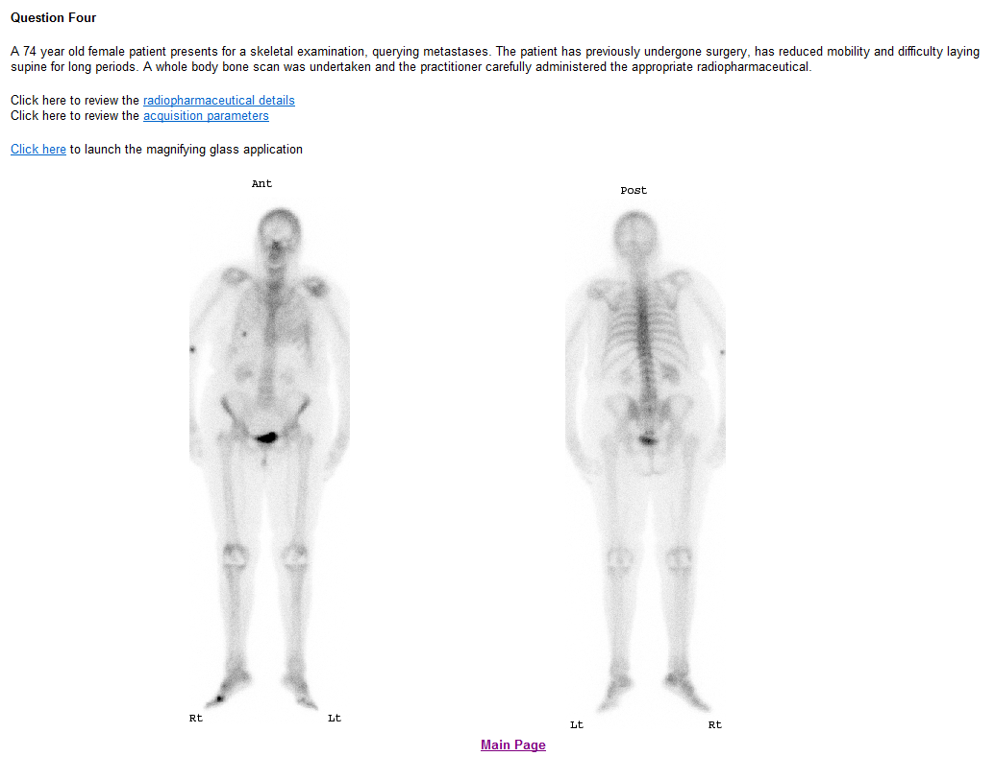

Slide 17
Capturing the students feedback
Essential to evaluate the implementation of web-based education
TurningPoint technology used
Digital recording of students qualitative responses
E-mail communication / Google Documents to obtain extra feedback

Slide 18
How would you rate your overall access to BlackBoard during the course?

Slide 19
Additional comments
“Easy to access from work, no firewall problems”
“Useful to access the lecture notes / clinical scenarios”
“Provides an additional learning in between academic blocks”
“Block release fits in with my learning style and suits my department”

Slide 20
Has the use of the discussion forums within BlackBoard been useful in term of your learning?

Slide 21
Additional comments
“Face to face interaction still essential, however BlackBoard allows you to go back and review knowledge base”
“It’s helped develop my links with other students on the course”
“Allowed me to compare my own practice with others on the course”

Slide 22
From your own personal learning perspective, how important has BlackBoard been within the Nuclear Medicine programme?

Slide 23
Has your ability to learn / reflect using web-based methods improved as a result of this module?

Slide 24
Additional comments
“Great to able to review the lecture notes at a later date, as it allows you to engage during the lectures”
“A great revision tool”
“Sometimes the discussion boards were a bit overwhelming & not easy to navigate”

Slide 25
Is there potential for distance based learning for future Nuclear Medicine courses?

Slide 26
Additional comments / Thoughts
For certain areas on-line learning is great
However the cohort really valued:
Face to face learning
Group interaction / peer support
Sense of community
Dedicated protected time away from the workplace

Slide 27
Conclusions
Feedback from students generally positive
There is a role for web based education within nuclear medicine
Web based learning / assessment in the workplace appears to develop peer support, review and encourage networking
However, this evaluation is on-going, with scope for future development

Slide 28
Future developments
Webinar technology (OCS / Skype)
Inclusion of discussion board threads within the students clinical portfolios of evidence
Critical engagement with clinical stakeholders to develop short courses / focused skilled development
Continue to work in partnership with clinical departments to engage in on-going service improvement

Slide 30
References
Department of Health (2001) Working together – learning together, [online] available from http://www.dh.gov.uk/prod_consum_dh/groups/dh_digitalassets/@dh/@en/documents/digitalasset/dh_4058896.pdf [accessed on 01/02/10]
Department of Health (2004a) The NHS knowledge and skills framework and the development review process. DoH Publications. Available from http://www.dh.gov.uk/en/Publicationsandstatistics/Publications/PublicationsPolicyAndGuidance/DH_4090843 [Accessed on 18 March 2010]
Department of Health (2008) High Quality Care for All: NHS Next Stage Review Final Report, [online] available from http://www.dh.gov.uk/prod_consum_dh/groups/dh_digitalassets/@dh/@en/documents/digitalasset/dh_085828.pdf [accessed on 11/09/09]
Price. R., Edwards, H., Heasman, F., Herbland, A., Le Masurier, S., Miller, L., Todd, A., & Vosper, M. (2008) Scope of Radiographic Practice 2008. Hatfield: University of Hertfordshire. Available from http://doc-lib.sor.org/scope-radiographic-practice-2008 [Accessed on 21 March 2010]
Skills for Health (2006) Delivering a flexible workforce to support better health and health services – The case for change. Bristol: Skills for Health. Available from http://www.skillsforhealth.org.uk/~/media/Resource-Library/PDF/SSA_for_Health_Executive_Summary_Scotland.ashx [Accessed on 27 March 2010]

