Slide 1
Society of Nuclear Medicine 57th Annual Meeting
Evolving new approaches to the development of nuclear medicine education, workforce development & advanced practice
Marc Griffiths¹Gary Dawson²
1-University of the West of England, Bristol
2–Salisbury NHS Foundation Trust, Salisbury

Slide 2
Background
Post Graduate programme delivered at UWE, Bristol for fourteen years
Strong experience with delivering traditional based learning, teaching & assessment approaches
Developing role of nuclear medicine practitioner (NMP) evident in the United Kingdom
Technology + Patient centred care pathways + emerging techniques = Greater demands placed on clinical service

Slide 3
Nuclear Medicine in Context
Technological advancements
Clinical service pressures
Life Long Learning
How can the 21st century workforce be supported?

Slide 4
Evolving core Competencies
Griffiths et al (2010)

Slide 5
National Drivers
Department of Health (DH)
2004 “Working together, learning together”
2004 “The NHS knowledge and skills framework and the development review process”
2008 “High Quality Care for All: NHS Next Stage Review Final Report”
Society & College of Radiographers (SCoR)
2009 “Scope of Radiographic Practice”
Modernising Scientific Careers Report
2010 “The UK Way forward”
Service improvement:
2006 “Skills for Health” Drive
Service enhancement & Quality, Innovation, Productivity & Performance
Notes:
The presence of international educational developments (e.g. SNM core competencies) is also influential.

Slide 6
Research: Consultation phase
Student & practitioner evaluation of traditional educational methods:
On-line questionnaire (Google Documents)
Proposed models for future pedagogies also provided
Mapping of initial findings against DH Workforce development (Skills for Health)
Mapping exercise completed in summer 2009

Slide 7
Sample of feedback (1)
“Traditional methods of learning are fine, however my role is changing & I need to be equipped as a practitioner, researcher & innovator”
“The educational programme has equipped me for current clinical practice, however we seem to be in a constant flux of change”

Slide 8
Sample of feedback (2)
“More practical based learning outside of the clinical department would be useful”
“The use of case studies during the programme was great, we should have more evidence / problem based learning”
“I really value peer learning / support: Could this be increased in the programme?”

Slide 9
Sample of feedback (3)
“BlackBoard is capable of so much more…….”
“Sometimes there is an over-reliance on PowerPoint”

Slide 10
Focus Group findings
Feedback from students discussed at a focus group with key involvement from:
Experienced clinical practitioners
Representative from the strategic health authority
Student representation
Industry partners
Development of new learning and assessment paradigms

Slide 11
Face to Face learning
On-line discussions / multimedia
Blended learning approach

Slide 12
New Learning Paradigms

Slide 13
Problem / Enquiry based learning: Example one
Enquiry based learning using BlackBoard:
Student were involved in the evaluation of working practice relating to the management of “radioactive spillages”*
Peer learning / support & sharing of good practice established
Contact teaching was supported with discussion forums on Blackboard
*Infection control soap mixed with water and spillage area monitored using U/V light

Slide 14
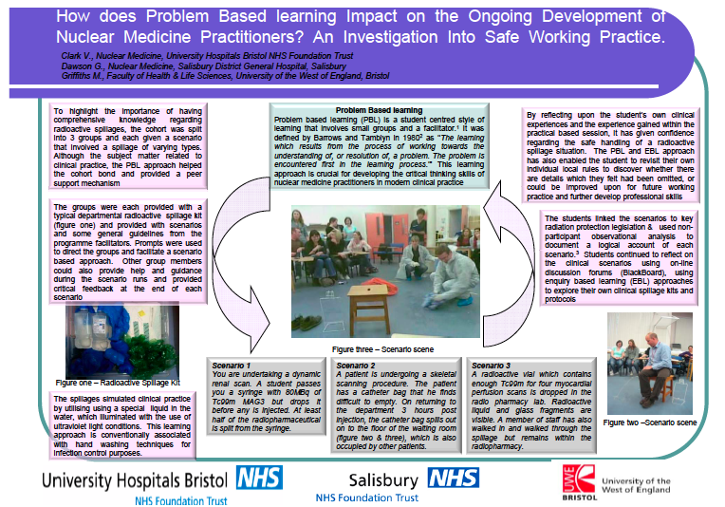

Slide 15
Problem / Enquiry based learning: Example Two
Investigation of students clinical IV injection protocols
Turning Point™ (Interactive voting system) & video scenarios used to evaluate student practice
Peer learning / support & sharing of good practice established
Contact teaching was supported with discussion forums on Blackboard

Slide 17
Clinical scenarios
Use of clinical scenarios to reinforce the students learning
Based upon practitioners experiences
Students critically evaluated clinical scenarios developing:
Reflective skills
Analytical skills
Critical thinking skills
Problem solving abilities

Slide 18
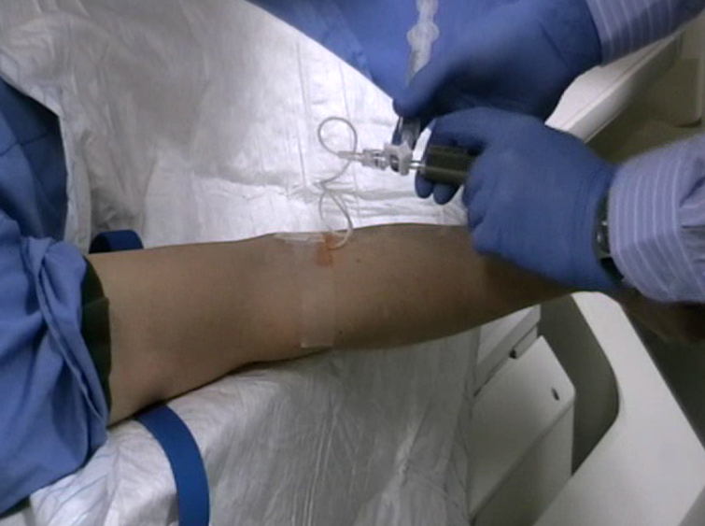
Example of clinical scenarios

Slide 19
Data manipulation / processing skills
TeleHERMES* software installed in May 2009
Initial architecture developed as a teaching tool at UWE
Vision to develop a virtual image manipulation & processing platform remote from the academic environment
Initial findings promising and on-going developments taking place with industry colleagues
*HERMES Medical Systems

Slide 21
Blended learning
Structured learning utilising BlackBoard
Blocks of educational material released to the students
Interwoven with discussion board threads & staged self-directed study
Science assessments related to practice & supported using a web-based resource (virtual lab)

Slide 22
BlackBoard
All lecture materials were made available to allow students to concentrate on engaging with the lectures, rather than struggling to make notes as the lecturer spoke.
This is also an excellent revision resource.
Developed students analytical and reflective abilities

Slide 23
Discussion Boards
Use was made of the discussion boards to allow students to query their understanding on current issues. This elicited feedback from staff and their own peers.
This strongly re-enforced working relationships and made some students very much aware of just how much knowledge they actually had.
The boards were also used to set work out of class and allowed asynchronous study to take place.

Slide 24
Web-based resource
The main experimental component of the module was made available via the BlackBoard interface, but also on a stand-alone web site.
This site was complete with data that could be used if local results were not available. Hyperlinks allowed access to further and complementary information to assist in completing the experiments and also engage in the learning intended

Slide 25
e-OSCE assessments
Opportunity to provide assessment environment which reflects clinical practice
Students access a number of virtual cases which include some decision making processes:
Care of the patient
Administration of radiopharmaceutical agents & dose limits
Acquisition parameters
Image quality / artefacts

Slide 26
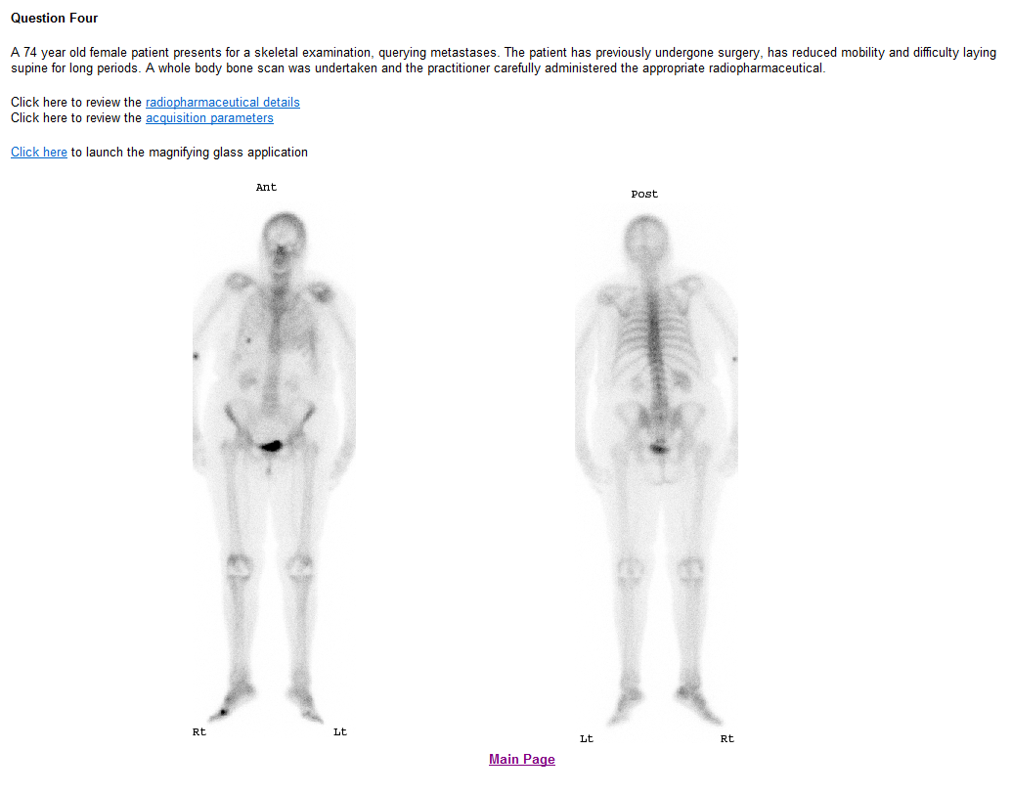

Slide 27
Capturing the students feedback
Essential to evaluate the implementation of new learning paradigms
TurningPoint™ technology used to capture data
Digital recording of students qualitative responses
E-mail communication / Google Documents to obtain extra feedback

Slide 28
How would you rate your overall access to BlackBoard during the course?

Slide 29
Additional comments
“Easy to access from work, no firewall problems”
“Useful to access the lecture notes / clinical scenarios”
“Provides an additional learning in between academic blocks”
“Block release fits in with my learning style and suits my department”

Slide 30
Has the use of the discussion forums within BlackBoard been useful in term of your learning?

Slide 31
Additional comments
“Face to face interaction still essential, however BlackBoard allows you to go back and review knowledge base”
“It’s helped develop my links with other students on the course and share good practice”
“Allowed me to compare my own practice with others on the course”

Slide 32
From your own personal learning perspective, how important has BlackBoard been within the Nuclear Medicine programme?

Slide 33
Has your ability to learn / reflect using web-based methods improved as a result of this module?

Slide 34
Additional comments
“The face to face learning is more practical based & further supported by on-line material ”
“A great revision tool and the interactive discussion boards helped my fundamental understanding”
“Sometimes the discussion boards were a bit overwhelming & not easy to navigate”

Slide 35
Additional considerations
For certain areas on-line learning is great
However the cohort really valued:
Face to face learning
Group interaction / peer support
Sense of a “community” / “belonging”
Dedicated protected time away from the workplace

Slide 36
“I need to be a researcher….”
“I need to be equipped as a practitioner….”
“I need to innovate….”

Slide 37
Conclusions
Feedback from students generally positive
There is a role for blended learning and e-based education within nuclear medicine
Web based learning / assessment in the workplace appears to develop peer support, review and encourage networking
Sharing of good practice is also encouraged

Slide 38
Future developments
Webinar technology (OCS / Skype™)
Inclusion of discussion board threads within the students clinical portfolios of evidence
Critical engagement with clinical stakeholders to develop short courses / focused skilled development
Continue to work in partnership with clinical departments to engage in on-going service improvement
Formulation of a clinical mentorship framework

Slide 39
References
Department of Health (2001) Working together – learning together, [online] available from http://www.dh.gov.uk/prod_consum_dh/groups/dh_digitalassets/@dh/@en/documents/digitalasset/dh_4058896.pdf [accessed on 01/02/10]
Department of Health (2004a) The NHS knowledge and skills framework and the development review process. DoH Publications. Available from http://www.dh.gov.uk/en/Publicationsandstatistics/Publications/PublicationsPolicyAndGuidance/DH_4090843 [Accessed on 18 March 2010]
Department of Health (2008) High Quality Care for All: NHS Next Stage Review Final Report, [online] available from http://www.dh.gov.uk/prod_consum_dh/groups/dh_digitalassets/@dh/@en/documents/digitalasset/dh_085828.pdf [accessed on 11/09/09]
Griffiths M., King S., Stewart R., Dawson G., (2010) Evaluating the Fundamental Qualities of a Nuclear Medicine Radiographer for the Provision of an Optimal Clinical Service, Radiography, doi:10.1016/j.radi.2009.12.005
Price. R., Edwards, H., Heasman, F., Herbland, A., Le Masurier, S., Miller, L., Todd, A., & Vosper, M. (2008) Scope of Radiographic Practice 2008. Hatfield: University of Hertfordshire. Available from http://doc-lib.sor.org/scope-radiographic-practice-2008 [Accessed on 21 March 2010]
Skills for Health (2006) Delivering a flexible workforce to support better health and health services – The case for change. Bristol: Skills for Health. Available from http://www.skillsforhealth.org.uk/~/media/Resource-Library/PDF/SSA_for_Health_Executive_Summary_Scotland.ashx [Accessed on 27 March 2010]

