Slide 1
Communicating complex science
Sophie Laggan
Air Quality Management Resource Centre & Science Communication Unit, UWE Bristol
27 April 2022
Please answer the first two Menti Qs:
Menti.com 3369 2692
Notes:
Filming today
I’ll do a lot more talking before the first break.. There will be more activities afterwards

Slide 2
Outline
1:30 – 1:45
Sci com and the spectrum of public participation
1:40 – 2:00
The evolution of science communication
2:00 – 2:10
Qs & Break
2:10 – 3:00
Engaging diverse audiences– role play and examples
3:00 – 3:10
Qs & Break
3:30 – 3:45
Visuals
3:45 – 3:50
Comms strategy, evaluating impact, signposting
3:50 – 4:00
Takeaways and close

Slide 3
Outline
1:30 – 1:45
Sci comm and the Spectrum of public
participation
1:45 – 2:00
The evolution of science communication
2:00 – 2:10
Qs & Break
2:10 – 3:00
Engaging diverse audiences– role play and examples
3:00 – 3:10
Qs & Break
3:30 – 3:45
Visuals
3:45 – 3:50
Comms strategy, evaluating impact, signposting
3:50 – 4:00
Takeaways and close

Slide 4
Complex science…
A car vs a cake
Full of jargon
Conceptual
Uncertainty
Disconnected from their reality?
… enter science communication
Monitoring
Future scenarios
Management and policies
Low Carbon Future
Health & inequalities
Modelling
Data analysis and interpretation
Notes:
It alienates people. If you can’t explain it without, then you don’t really know it well enough
Run through a readability checker – write for a teenage audience. Simple words make people sound smarter
Academics typically are not rewarded for such outreach, that is, for sharing their findings in non academic outlets; it is time-consuming to do; researchers are not trained to do so effectively, and given the often polarized atmosphere around climate change, many shy away from it.

Slide 5
Science communication
Why do it? To: inform, consult, involve, collaborate, empower
Who for? public, policy makers, businesses, scientists, archetypes, user profiles, messenger
What is it? Science communication concerns the engagement of the public in and with science and decision making
Deficit: Factual information/information campaign; communicating risk; telling people what to do;
Dialogue: asking for input/community consultation;
Empowering ‘political subjects’: a story that appeals to that audience - to their social identity + training/education – to improve efficacy to act. Co-creation of solutions, using arts-based methods
When and where? Opportune moments (e.g., COVID-19, wildfires, festivals) – connecting with the existing wave. Reach out and developing relationships.
How?
Menti.com 3369 2692 x3Qs
Notes:
Inform - (arouse interest, improve understanding, explain societal benefit/solution it is solving, inspire)
Dialogue important for complex issues as it can open minds, deepen understanding, foster empathy, change attitudes, and increase receptivity to policy alternatives
It provides space for reflection and deliberation, and the need for varied methods of facilitation and data synthesis that permit access to participants’ broader values
Involve, collaborate, empower
https://assets.publishing.service.gov.uk/government/uploads/system/uploads/attachment_data/file/969428/net-zero-public-engagement-participation-research-note.pdf
Name a type of science communication (show Menti)

Slide 6
Science communication
How? Stalls, talks or performance at public events; Sculptures; Games; Videos; Infographics; Animations; Interactive websites; Educational materials/lessons; Social media campaigns; Podcasts; Webinars; Posters; Community-led actions; Focus groups; Consultations; Citizen Assemblies; Citizen Science; Movies…
Notes:
It’s not timing in the market, it’s time in the market
Develop relationships
Connect with existing events
Go where the energy is
Name a type of science communication

Slide 7
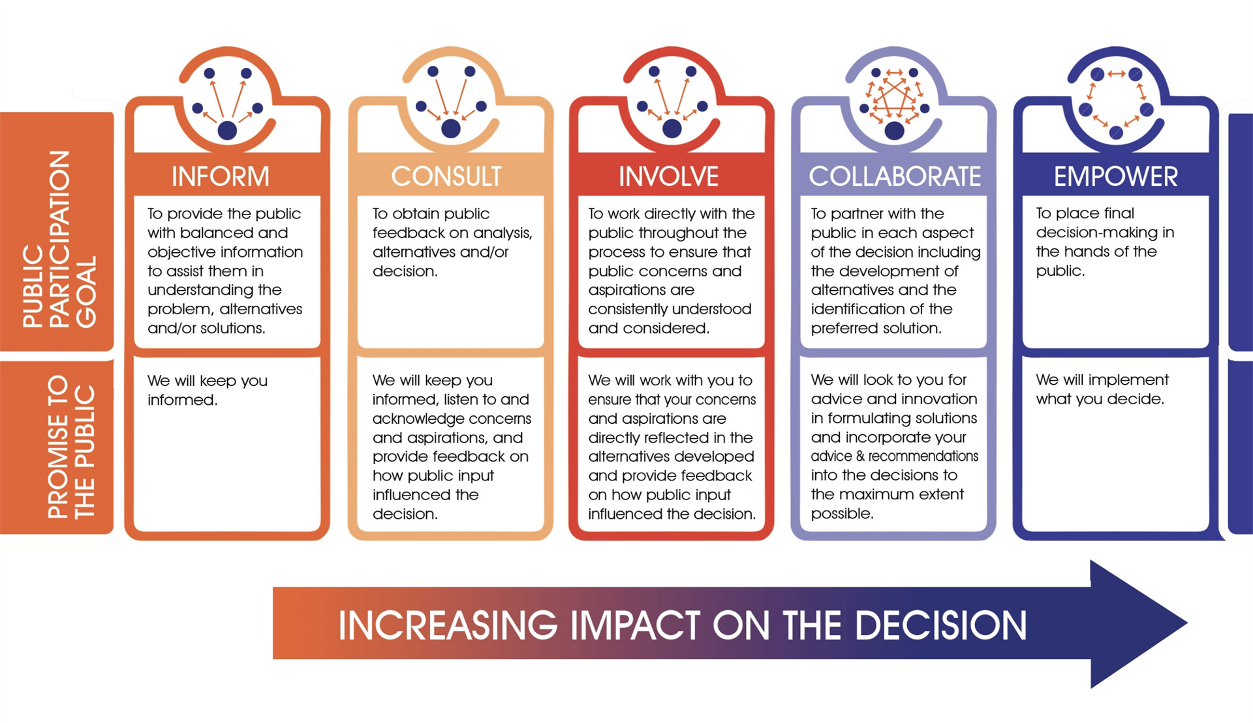
Spectrum of public participation
https://iap2canada.ca/foundations
“Tell me and I will forget, show me and I may remember; involve me and I will understand.”
Notes:
From the association of professionals on public participation
Inviting in (which is not how nature works) to reaching out
From talking with an agenda to meeting people where they are at
Also about language and who holds the power, the knowledge and resources to make a change
Active listening to them, not them to us
One way, to dialogic, to participatory

Slide 8
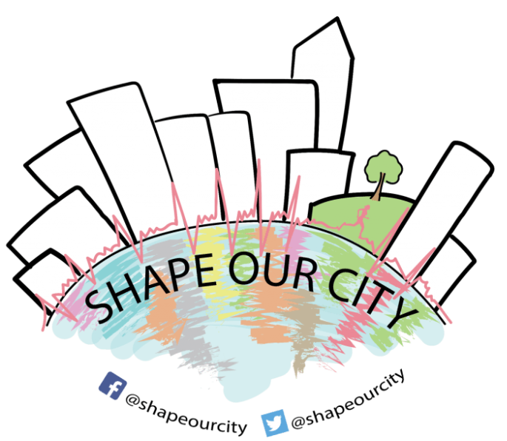
Researchers
Planners and policymakers
Urban developers
Communities?
https://urban-health-upstream.info/impact/our-city-our-health/

Slide 9
Explaining scientific topics to the public

Slide 10
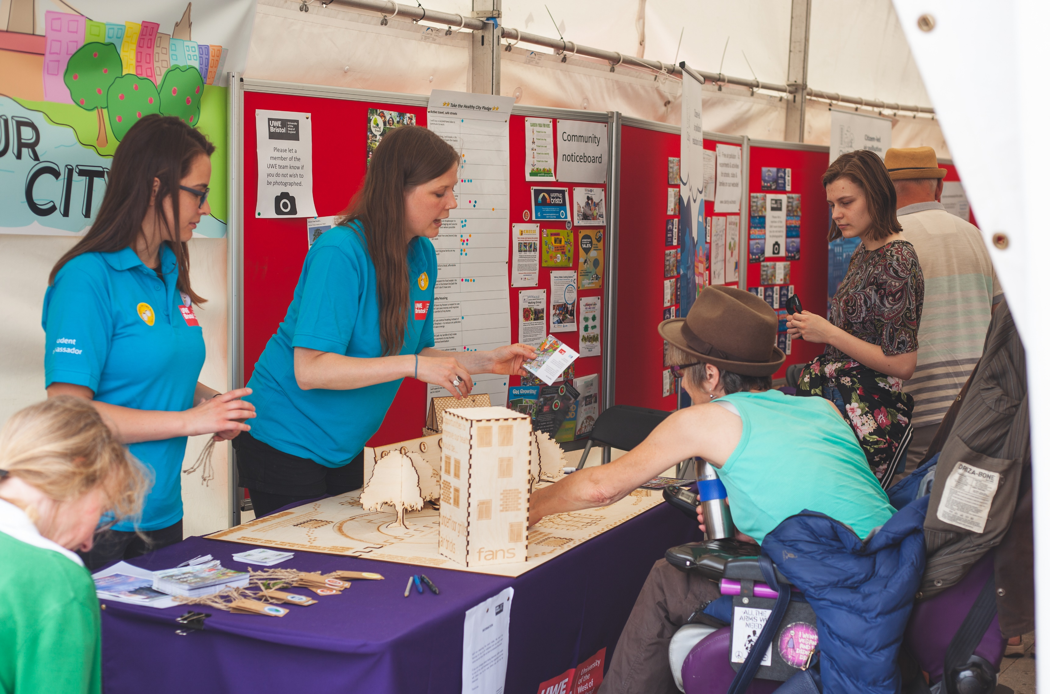
Listening to the public about their opinion on issues

Slide 11
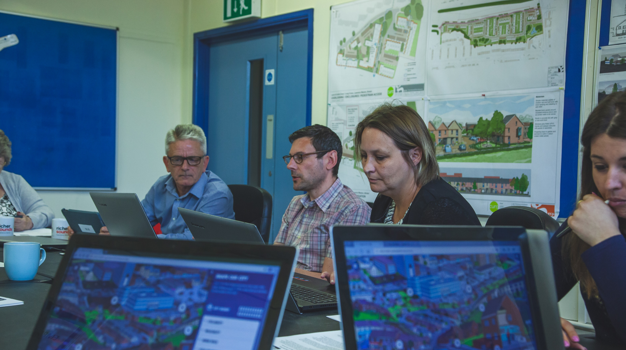
Involving citizens in science (e.g., data collection)

Slide 12
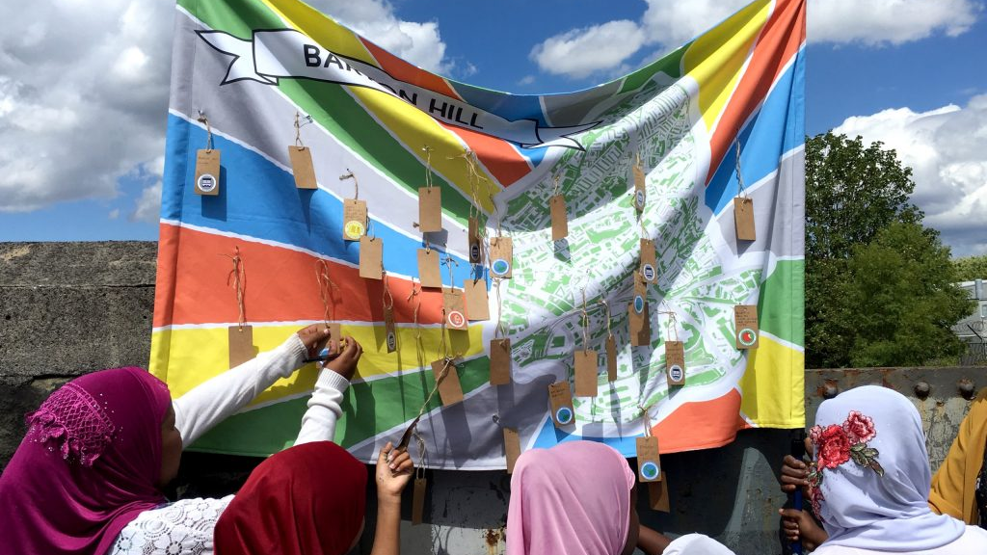
Involving citizens in science (e.g., data collection)
Notes:
Marginalised communities having a voice

Slide 13
Involving citizens in science (e.g., data collection)
Notes:
Marginalised communities having a voice

Slide 14
Supporting the public to lead the change on an issue that matters to them
Notes:
planters

Slide 15
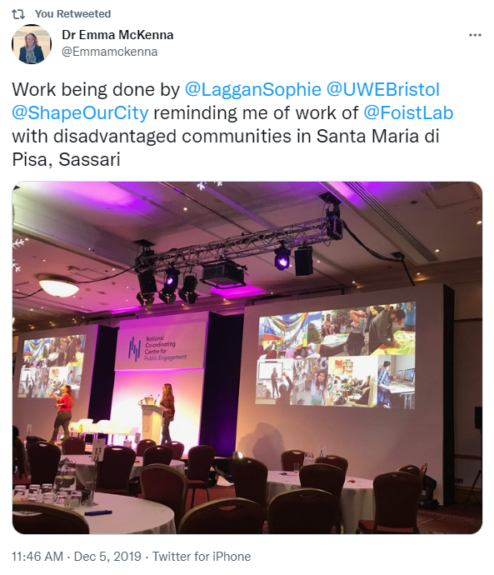
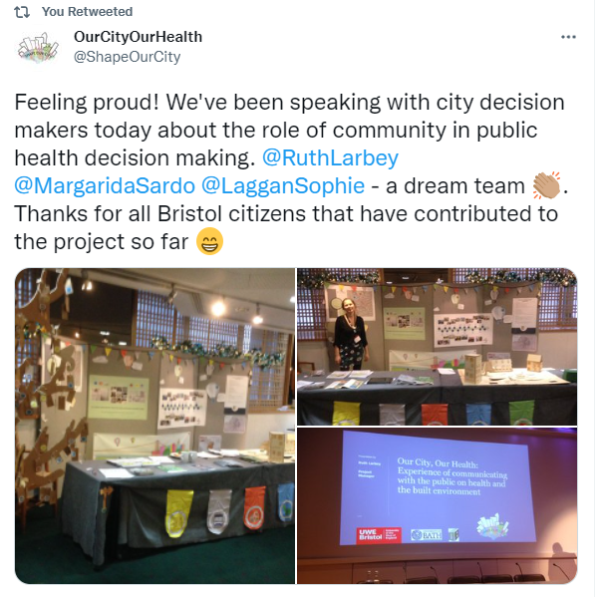
Researchers
Planners and policymakers
Urban developers
Communities?
Notes:
Wellcome Trust Pub Eng project for a national project Upstream
And this is what I continue to do today – communicating messages about the climate and ecological emergency, from the perspective of the people it’s impacting day-to-day, and working with citizens to empower them to act on things that matter to them
My journey may not be the most exciting, or unique, but it is told from the heart, from my perspective… it is my ‘hero’s journey’
We need systems change, but that doesn’t resonate with most people. They need tangible, practical, relatable things that they can do.

Slide 16
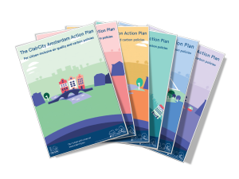
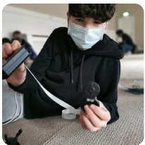
Working with the public to solve a joint issue
+ training, support, advocacy & schools pack

Slide 17
A brief history of climate/air quality communication research
Knowledge alone will move people into action (traditional media, talks)
→ How best to move audiences into action
Knowledge itself is insufficient
Sussanne Moser (2016)
Reflections on climate change communication research and practice in
the second decade of the 21st century: what more is there to say?

Slide 18
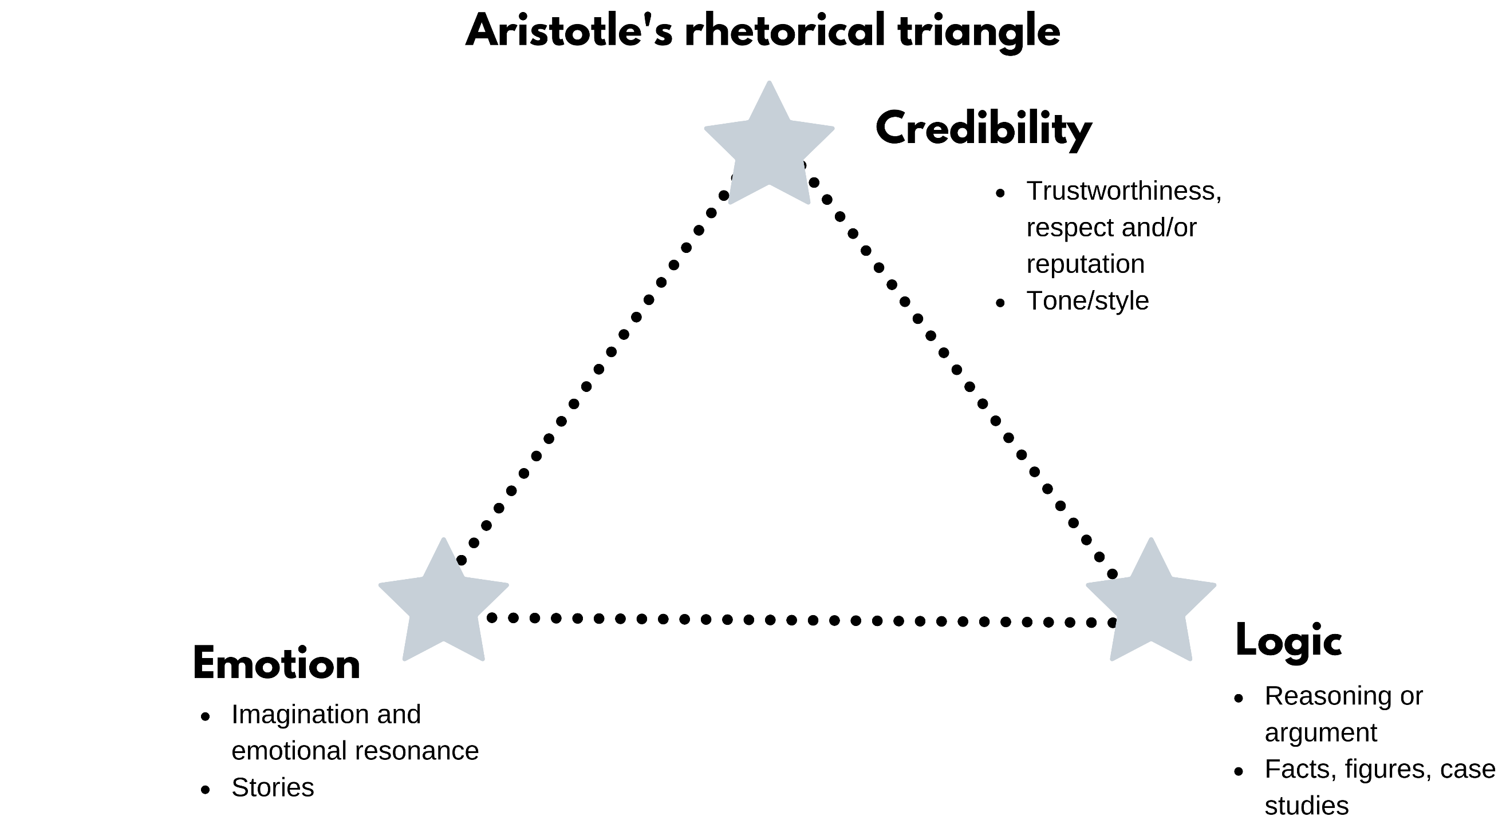
A brief history of climate/air quality communication research
Knowledge alone will move people into action (traditional media, talks)
→ How best to move audiences into action
→ Knowledge itself is insufficient
Values
Attitudes (de Meyer et al. 2020)
Emotions & identity
Emotion, logic & credibility
Social norms (people like me)… collective
leadership and responsibility
Trust
Structural inequality
Notes:
the role of values, beliefs, worldviews, identity, and meaning-making has become one of the most prominent occupations of climate communication researchers.
“We all hear, perceive, make sense of, and judge incoming information (be it spoken, written, visual, or sensory) through the filters of culturally transmit-ted values and no one can escape this influence although we can become conscious of this influence and actively probe it, if we are willing.
…The values we hold affect not only our perceptions and interpretations of the climate and our acceptability of climate science, but—crucially, and often more prominently—the acceptability of anticipated or proposed behavioural changes, technological solutions, or climate policies.
…Climate communication meets acceptance or resistance and thus can be made more resonant for different audiences by approaching it through value frames.
…and as part of framing and messaging, the question of effectiveness of different messengers”.
Moser 2016
Action comes first and justification second if our attitudes about an issue are not strong (de Meyer et al. 2020).
Those of us with strong attitudes, start with the justification (and may not act if they have too much information)
Transforming the stories we tell about climate change: from ‘issue’to ‘action’
If we are emotional about an issue, we are often resistant to change our opinion on it. We have evolved to become resistant against an existential threat so it is natural that we defend our identity, but this stops us thinking, feeling and acting on air pollution. It leads to avoidance and denial of knowledge or loss, cognitive dissonance from guilt, Passing the responsibility, Helplessness, Downplaying the problem, Attack others not our group. All this does is → reinforce existing identity
(Moser 2016)
Can’t afford an electric car
Housing estate built in the suburbs, with no amenities
Etc…
Answering questions that are the concern of everybody
An ancient Greek treatise on the art of persuasion, dating from the 4th century BCE

Slide 19
A brief history of climate/air quality communication research
Knowledge alone will move people into action
People are moved to act if we can connect the dots for them between personal risk and reward (Katherine Hayhoe, 2021)
Overcome social distancing by explaining It’s now, it’s here, it’s concrete, it’s relevant to me
Appeal to their values, show them that some of their actions are pro-environmental, validate negative emotions and enhance positive emotions, provide tools and training for improved efficacy – show how they can fix it (positive framing)
Visuals, imagery, gaming, interactive tools, story-telling…(www)
Social media, dialogue, bottom-up participation…
Notes:
SHOW WEBSITES
Making climate change relevant (the risk) and actionable (the reward – the co-benefits) – link to AIR POLLUTION
e.g., citizen’s assemblies
Overcome psychological distance – in time, space, in abstraction from the concrete, in irrelevant to our main concerns/priorities
Make the issue feel near, human, personal and urgent. Speak of people, places and entities where you are. Tap into local sense of place/patriotism/community/pride. Focus on past loss and restoration of what has been lost. Focus on near-term benefits and opportunities to avoid future losses or costs. ‘A crisis we can’t afford to ignore’. Emphasis on the high degree of scientific consensus
“Given the difficulty of seeing and representing the causes of climate change, as well as the climate itself and changes in it, the role of visualizations and the use of imagery have become prominent topics of exploration. Integrating insights on the difficulties of understanding climate change, on language, imagery, and the imaginal, communication experts now point increasingly to the importance of story-telling and using narrative formats to convey climate change.
Others have investigated gaming and other interactive tools to make climate change and an otherwise abstract and difficult to imagine future more accessible both for lay audiences of all ages as well as in professional planning and decision-making contexts”.

Slide 20
A brief history of climate/air quality communication research
Knowledge alone will move people into action
People are moved to act if we can connect the dots for them between personal risk and reward (Katherine Hayhoe, 2021)
Overcome social distancing by explaining It’s now, it’s here, it’s concrete, it’s relevant to me
Appeal to their values, show them that some of their actions are pro-environmental, validate negative emotions and enhance positive emotions, provide tools and training for improved efficacy – show how they can fix it (positive framing)
Visuals, imagery, gaming, interactive tools, story-telling
Social media, dialogue, bottom-up participation
Social behaviour change → political subjects and policy change….
Notes:
SHOW WEBSITES
Making climate change relevant (the risk) and actionable (the reward – the co-benefits) – link to AIR POLLUTION
e.g., citizen’s assemblies
Overcome psychological distance – in time, space, in abstraction from the concrete, in irrelevant to our main concerns/priorities
Make the issue feel near, human, personal and urgent. Speak of people, places and entities where you are. Tap into local sense of place/patriotism/community/pride. Focus on past loss and restoration of what has been lost. Focus on near-term benefits and opportunities to avoid future losses or costs. ‘A crisis we can’t afford to ignore’. Emphasis on the high degree of scientific consensus
“Given the difficulty of seeing and representing the causes of climate change, as well as the climate itself and changes in it, the role of visualizations and the use of imagery have become prominent topics of exploration. Integrating insights on the difficulties of understanding climate change, on language, imagery, and the imaginal, communication experts now point increasingly to the importance of story-telling and using narrative formats to convey climate change.
Others have investigated gaming and other interactive tools to make climate change and an otherwise abstract and difficult to imagine future more accessible both for lay audiences of all ages as well as in professional planning and decision-making contexts”.

Slide 21
Impact of air quality communication and engagement campaigns on attitudes and behaviour
Avoidance: Gov-led air quality indices or alerts in reducing outdoor activities or avoidance tactics during high air pollution days may reduce outdoor activities (esp. older/health issues)
Controlling: communications on reduced contribution = hard to evidence but some hope to be found in community anti-idling campaigns
Supporting: Civic engagement and supportive behaviours for policy change = Good potential
(Riley et al. 2021 – review of 37 different studies)
Notes:
Governments can enact ‘hard’ policies to affect public behaviour, such as driving and parking restrictions, low emission zones or tax increases on more polluting vehicles; or they can use ‘soft’ policies targeting behaviour change, such as public communication, social marketing, or education campaigns.
Frames - Some research has shown that overall, the public feels individual-level action on air pollution and the environment is futile and that responsibility for improving air pollution primarily lies at the local and national level.
Riley et al. reviewed how effectively we communicate air pollution to change public attitudes and behaviours
Largely ‘top down, keep it simple’ approach whereby experts communicate to the public and the public individualised and presumed to possess a more or less stable “portfolio” of values, attitudes, norms, interests and desires. There have been few attempts to engage the public in the design or development of air pollution communication or to engage in ways that go beyond the provision of facts.
Avoidance - (reducing vigorous activity, avoiding busy streets, avoid peak traffic times, closing windows, etc)
Controlling - reductions in driving, driving speed, refuelling, car sharing, reductions in wood burning
Supporting - lobbying, education in classrooms and community, discussions among friends and family, e-newsletters, and sending e-mails to local officials
Reviewed 37 studies - 28 different behaviours assessed using a variety of designs including natural and research-manipulated experiments, cross-sectional and longitudinal surveys and focus groups. While avoidance behaviour (e.g. reducing outdoor activity) followed by contributing behaviours (e.g. reducing idling) were by far the most commonly studied, supporting behaviour (e.g. civil engagement) shows promising results, with the added benefit that supporting local and national policies may eventually lead to the removal of social and physical barriers that prevent wider behavioural changes. Providing a range of actionable information will reduce disengagement due to feelings of powerlessness. Targeted localized information will appear more immediate and engaging, and positive framing will prevent cognitive dissonance whereby people rationalize their behaviour to avoid living with feelings of unease. Communicating the co-benefits of action may persuade individuals with different drivers but as an effective solution, it remains to be explored. Generally, finding ways to connect with people’s emotions, including activating social norms and identities and creating a sense of collective responsibility, provide promising yet under-explored directions. Smartphones provide unique opportunities that enable flexible and targeted engagement, but care must be taken to avoid transferring responsibility for action from national and local authorities onto individuals. Multidisciplinary teams involving artists, members of the public, community and pressure groups, policy makers, researchers, and businesses, are needed to co-create the stories and tools that can lead to effective action to tackle air pollution through behavioural solutions.
Older people, and people with existing health conditions more likely to heed the advice to reduce outdoor activities
Being told what to do → allowing people to have agency
https://link.springer.com/article/10.1007/s11625-021-01038-2#Sec2

Slide 22
Impact of air quality communication and engagement campaigns on attitudes and behaviour
Providing a range of actionable information will reduce disengagement due to feelings of powerlessness. Targeted localized information will appear more immediate and engaging, and positive framing will prevent cognitive dissonance whereby people rationalize their behaviour to avoid living with feelings of unease. Communicating the co-benefits of action may persuade individuals with different drivers but as an effective solution, it remains to be explored. Generally, finding ways to connect with people’s emotions, including activating social norms and identities and creating a sense of collective responsibility, provide promising yet under-explored directions.
Multidisciplinary teams involving artists, members of the public, community and pressure groups, policy makers, researchers, and businesses, are needed to co-create the stories and tools that can lead to effective action to tackle air pollution through behavioural solutions.
(Riley et al. 2021 – review of 37 different studies)
Notes:
Older people, and people with existing health conditions more likely to heed the advice to reduce outdoor activities
Being told what to do → allowing people to have agency
https://link.springer.com/article/10.1007/s11625-021-01038-2#Sec2

Slide 23
Katherine Hayhoe
Whoever we are is already the perfect person to care about and act on climate change.
If someone doesn’t realise it, our job is to help connect the dots; between, who, what, or where they already love; how [air pollution] affects them; and how [action on air pollution] benefits them
Gone is the need to: convince everyone to care for the same reason we do; recruit people to “our” clan; coerce, guilt or shame others into acting as if they don’t have any reason to other than how others see them
Notes:
https://www.youtube.com/watch?v=ktLt0Hnf_zg&list=LL&ab_channel=SUNYPlattsburghatQueensbury

Slide 24
Katherine Hayhoe
Whoever we are is already the perfect person to care about and act on climate change.
If someone doesn’t realise it, our job is to help connect the dots; between, who, what, or where they already love; how [air pollution] affects them; and how [action on air pollution] benefits them
Gone is the need to: convince everyone to care for the same reason we do; recruit people to “our” clan; coerce, guilt or shame others into acting as if they don’t have any reason to other than how others see them
You should act on air pollution for the environment
We’re the leading organisation on this topic
If you don’t do it you’ll harm your children
Don’t you feel embarrassed about driving?
Notes:
https://www.youtube.com/watch?v=ktLt0Hnf_zg&list=LL&ab_channel=SUNYPlattsburghatQueensbury

Slide 25
Summary
Science communication concerns the engagement of the public in and with science and decision making… participation exists on a spectrum
Knowledge alone will not move people into action because of our differing and changing values, attitudes, emotions, identity, social norms and structural inequalities
It is our job to simplify complexity and help the public understand the risks and rewards… better yet, involve them as co-creators of the narrative and the solutions
We can use art, visuals, metaphors, storytelling, etc to explain complex issues in a way that is understandable
We also need to reach out and involve diverse publics creatively (in “soft” policies) for attitude and behaviour change, and better uptake of policies, with greater ambition and faster implementation
Segmenting can help to target our communications and maximise potential attitude and behaviour change

Slide 26
Questions and break

Slide 27
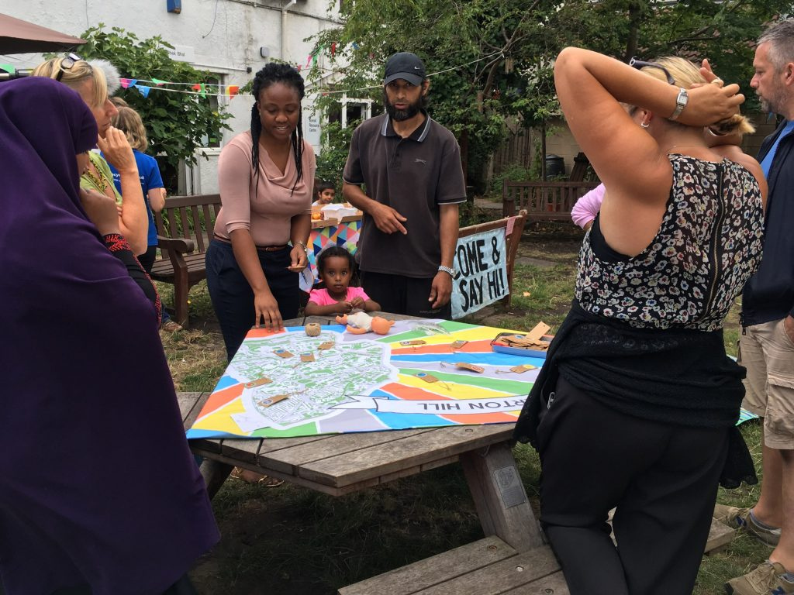
Engaging diverse audiences
Notes:
Visuals image

Slide 28
Katherine Hayhoe
Whoever we are is already the perfect person to care about and act on climate change.
If someone doesn’t realise it, our job is to help connect the dots; between, who, what, or where they already love; how [air pollution] affects them; and how [action on air pollution] benefits them
Gone is the need to: convince everyone to care for the same reason we do; recruit people to “our” clan; coerce, guilt or shame others into acting as if they don’t have any reason to other than how others see them
Notes:
https://www.youtube.com/watch?v=ktLt0Hnf_zg&list=LL&ab_channel=SUNYPlattsburghatQueensbury

Slide 29
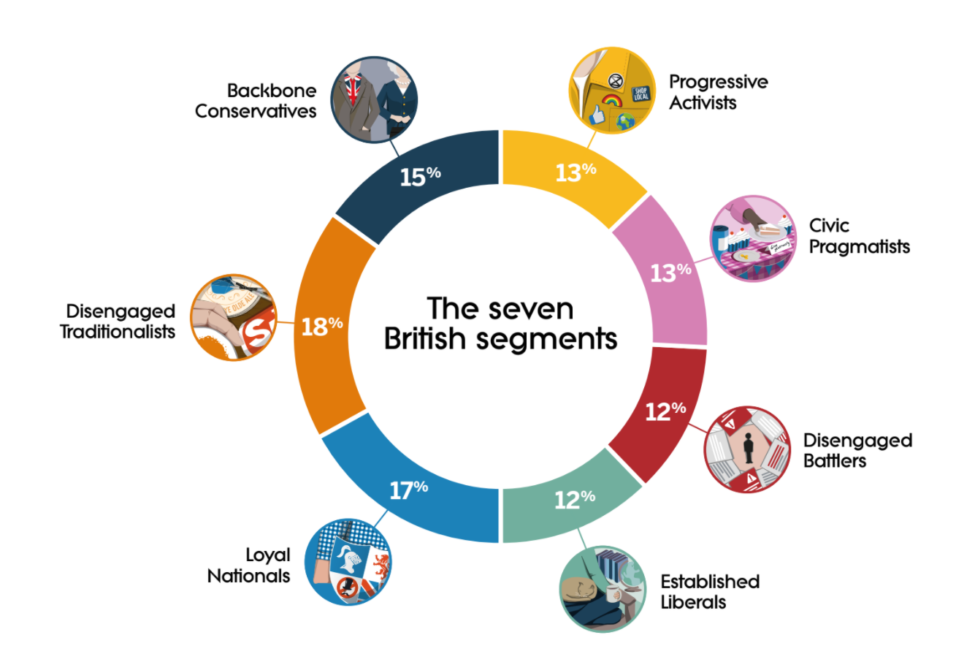

Slide 30
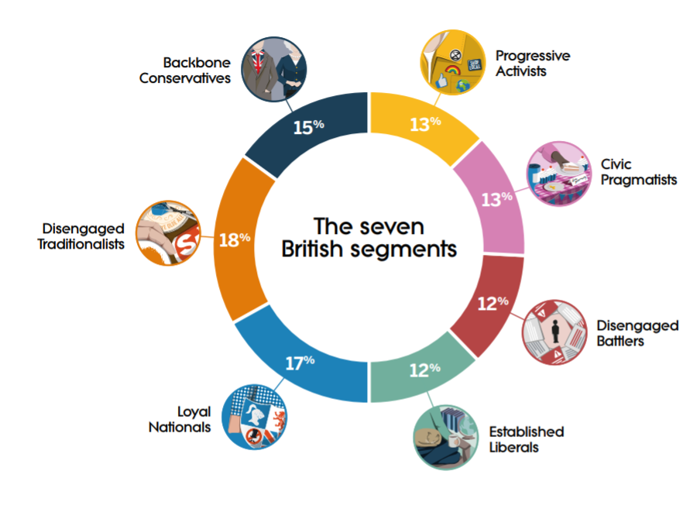
Practical British pride Trusting Conservative Respectful Older Hard-working Traditional Well-off
Young
Voted Remain
Creative
Supports Labour
Compassionate
Global
Affluent
Tolerant
Fair
Educated
Tolerant
Voted Remain
Fair
Compromising
Educated
Compassionate
Global
Environmental
Liberal
Moderate
Notes:
Intrapsychic, interpersonal, social, cultural, and political–economic dynamics that shape people’s responses to climate change.
social norms and psychological defenses perpetuate a remarkable ‘cli-mate silence’ in society

Slide 31
Role play
C
Step inside the shoes of another person
1st person, find out
What do they love about where you live
What don’t they like so much
Empathise/find common ground
Explain how air quality affects what they love; and how action to reduce air pollution benefits them (could address what they don’t like/amplify what they love)
Can you encourage them to do something to fix it?
Individual behaviour, community organising, political action
B
A
Notes:
5 minutes, then swap roles
10 mins to feedback
(20 total)
Behaviour can be civic action (e.g., lobbying, speaking with neighbours, community organising) or reducing car use, etc

Slide 32
Role play
C
How did it go?
What did the person love, and what didn’t they like so much. Did you figure out which archetype they are?
How did you explain how air quality affects them; and how action on air pollution benefits them
Did you encourage them to do something to fix it?
B
A
Notes:
What did the person love, and what didn’t they like so much. Did you figure out which archetype they are?
How did you try to encourage them to see that if they change their attitude or behaviour it will lead to co-benefits for them/the community
Did you need to mention the climate?
Did you connect them to the right people/training for action?

Slide 33
Same action, different motivation
To save money and feel safer in the knowledge that we have our own supply of energy
Because our neighbours did
Because it is the right thing to do – I am concerned about my impact on the planet

Slide 34
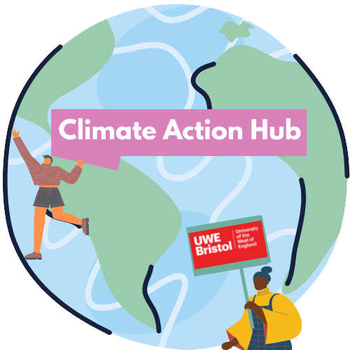
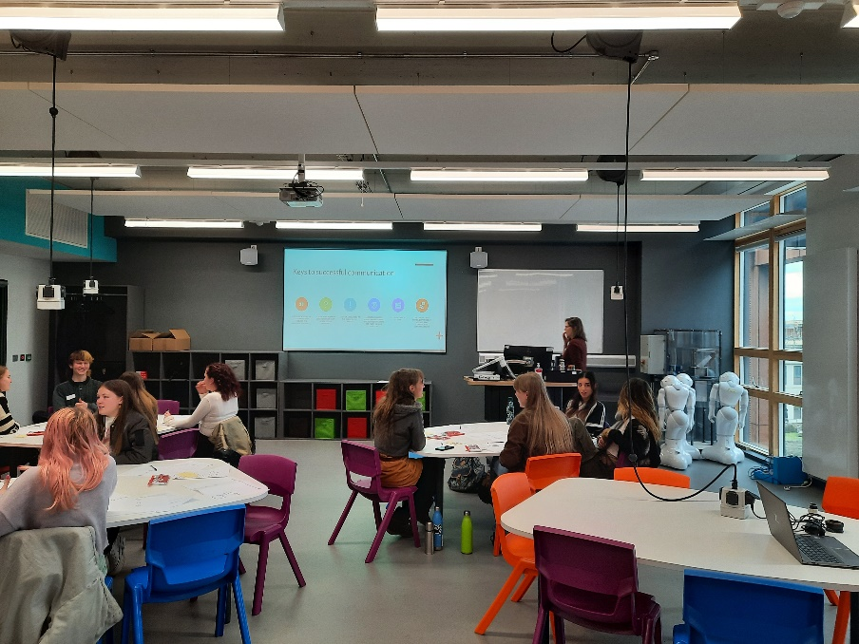
Youth Climate Comms training
Notes:
Dialogue, training and citizen-led interventions
Validate all emotional responses; be witness to suffering; make it safe to publicly display and explore emotional responses (grief, fear etc.)
This is the only group where the link between Covid-19 and climate change lands well.

Slide 35
Youth Climate Comms training
(Emphasise climate justice; validate negative emotions; support with resources and channel energy towards meaningful engagements with local MPs and local community)
Notes:
Dialogue, training and citizen-led interventions
Validate all emotional responses; be witness to suffering; make it safe to publicly display and explore emotional responses (grief, fear etc.)
Emphasise climate justice and help them build bridges with those intimidated by their level of political commitment and activism.
Validate negative emotions (e.g., fear, anxiety, helplessness) while avoiding overly optimistic communications. Consider supporting this group with resources that help to alleviate climate anxiety.
Channel their energy on climate change towards meaningful engagements with their local MPs and local community who could do the dame, as protest is not a substitute for political engagement.
This is the only group where the link between Covid-19 and climate change lands well.

Slide 36
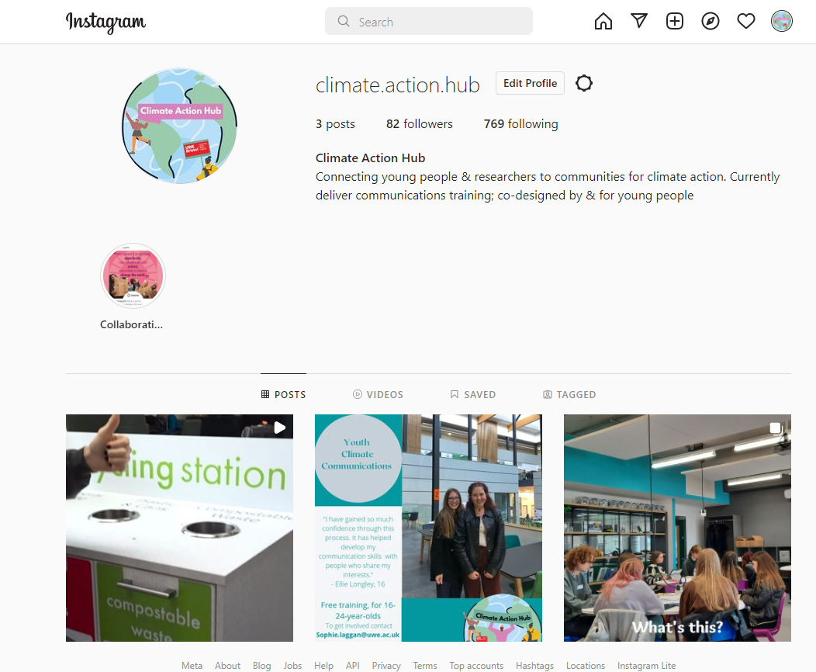

Slide 37
Encouraging mothers to reduce their car journeys for leisure activities
Messenger
Message (elevator pitch)
Awe
Risk
Solutions
Rewards
Creativity (visuals, metaphors, stories)
Where, when (and for how long), what methods (artwork, interactive stall…)?
High level of trust in environmental NGOs and establishment institutions. Emphasise the positive social and economic effects of tackling climate change so they don’t always have to choose where to turn their attention. Key message: “restoring balance” and a “sense of unity”. Build their confidence and conviction by showing them that they are already activists in their own lives. Be sympathetic of difficulties in trying to follow a sustainable lifestyle. Make it easier for them to use their soft power locally to open up space for others.
Notes:
In teams, I’d like you to come up with an elevator pitch to encourage mothers to reduce their car journeys for leisure activities
Where, when and how will you deliver the message? And who will deliver it? Think about the creative elements too.
(15 m + 5m reporting back)
Not as active in climate politics as they could be, as environmentalism not a key part of their identity (not always a priority). High level of trust in environmental NGOs and establishment institutions. Emphasise the positive social and economic effects of tackling climate change – reducing pressure on the NHS, ensuring a more resilient economy, and creating a post-Brexit society in which marginalised communities can play a fuller part – so they don’t always have to choose where to turn their attention. Key message: “restoring balance” and a “sense of unity”. Build their confidence and conviction by showing them that they are already activists in their own lives (e.g., giving to charity, involvement in the community, and ‘personal’ low-carbon lifestyles). Be sympathetic of difficulties in trying to follow a sustainable lifestyle. Make it easier for them to use their soft power locally to open up space for others.

Slide 38
Questions? Break?
Notes:
How could you see this being applied in your own work?

Slide 39
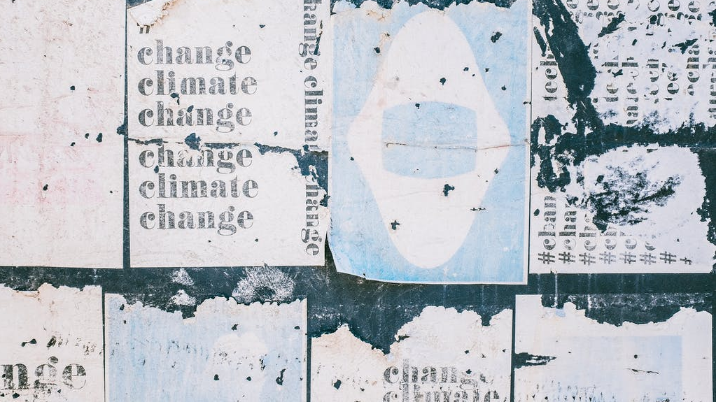
Visuals
Notes:
Visuals image

Slide 40
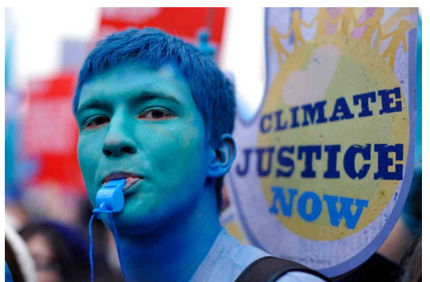
Menti.com 3369 2692 x2Qs
Notes:
Menti

Slide 41
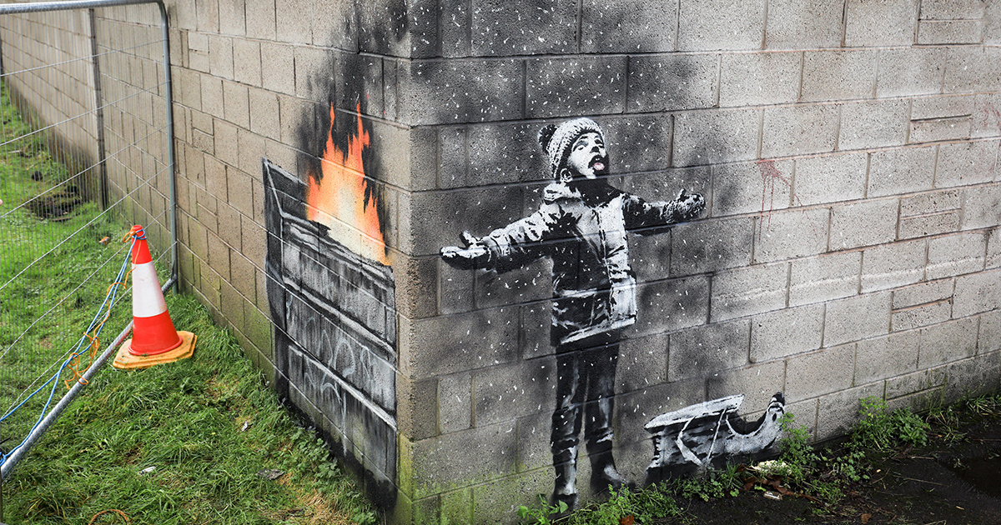
Notes:
Images showing air pollution (compared to images of floods, heat stress, and infectious disease) were found to be more effective for visually communicating the health impacts of climate change: the health consequences of climate impacts other than air pollution are not yet visually salient in the public mind.
While it is crucial to help audiences join the dots between the range of climate impacts and public health – from flooding to heat stress – this survey suggests that information and imagery focusing on air quality could be particularly engaging for UK audiences at present.

Slide 42
Visual communication on the health impacts of climate change should therefore:
Build on the salience of air pollution as an issue with links to climate change to create a visual narrative of climate impacts that is people-focused and relatable and which introduces the link between health and other climate impacts.
Be clear about the ways in which air quality can be linked to climate change, for example when rising summer temperatures create air pollution hotspots in urban centres.
Lead with images that are likely to convey people’s vulnerability and susceptibility to the health risks of air pollution/climate change.
Combine these health-impact images with solutions-focused photos that build a sense of ‘efficacy’, and highlight positive social norms (around people taking relevant climate actions).

Slide 43
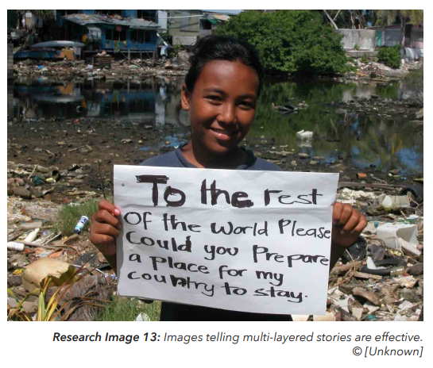
Climate Visuals - 7 principles
Show real people, not staged photo ops
Tell new stories
Show climate causes at scale (one car vs many)
Climate impacts are emotionally powerful
Show local (but serious) climate impact
Be very careful with protest imagery
Understand your audience
https://climateoutreach.org/reports/climate-visuals-seven-principles-for-visual-climate-change-communication/
Notes:
Presence of people, authenticity and credibility
Fed up of the cliched chimney stack or polar bear
Real people doing real work
use humour or subversion.
Don’t assume that your audience sees the same links as you.
While people do not necessarily connect one family and their car to climate change, our survey found that a busy, congested road was more readily understood (as a cause of climate change) (Images 6, 7 and 8). The problematic behaviour is shown at scale (i.e. many different individuals at once) rather than via one singled-out individual. People view congested highways negatively – both in terms of the environmental impact and the personal inconvenience of this mode of travel.
As with spoken communications, climate impacts need to be coupled with text/images for action – for how people can respond
As with spoken communications, climate impacts need to be coupled with text/images for action – for how people can respond

Slide 44
Recap
Air pollution is a salient topic for the UK population, linking health impacts to climate change
Understand your audience
Show real people (e.g., Bristol Climate Hub)
Tell new stories
Tell climate causes at scale (a collective problem)
Don’t leave people hanging
Show local impact and local solutions (the call to action)
Be careful of protest imagery and the shock factor

Slide 45
Comms and media strategy
How long do you have?
Who: Stakeholder mapping – communities, policy makers, other movements, industry, campaign groups, artists; how many people do you want to reach vs. quality of engagements
Where: can you reach your audience – which social media platform, what events
Big events
Clean Air Day
Festival of Nature
Distributed dialogues
More work, greater reward
What types of communications work for you?
Get your message out there – local/regional/national news (story of citizens)

Slide 46
Evaluating your communications
Did you project/programme lead to a change in trust, knowledge, attitude, efficacy and/or behaviour:
Of communities, businesses, scientists, policy makers, etc
Remember: enjoyment → understanding → willingness to change
Approaches
Surveys
Snapshot interviews
One-time focus groups, and/or interviews
Longitudinal studies of cohorts engaged repeatedly over many years, and comparative work with long-term non-air pollution struggles
Numbers
# Involved
Social action projects
Social media reach

Slide 47
Signposting
Informing and consulting
Clean Air Day, 16th June: https://www.actionforcleanair.org.uk/campaigns/clean-air-day
Festival of Nature, 10-18th June: https://www.bnhc.org.uk/festival-of-nature/
Empowering
Community activator toolkit
Active Citizens toolkit
EU-Citizen.Science

Slide 48
Key takeaways
Menti.com 3369 2692 – last 2 QS
Notes:
Fill out the final Menti slides
Key takeaways – what will you take into your future work

Slide 49
Thank you!
Sophie.laggan@uwe.ac.uk

Slide 50
Principles and tips for ‘spoken’ communications for action
Audience
Get to know them – find out what they love, what they don’t
Lead with awe
e.g., a striking image, statement or question to introduce the problem you are trying to solve
Risks
Communicate the personal risks
Solutions
Introduce clear, easy, convenient solutions that will resonate with your audience (in time and space)
Rewards
Show them the co-benefits of action
TIP
Illustrate solutions, possibilities, and ‘new’ social/cultural norms (visual and interactive)
TIP
Use positive emotion (e.g., hope), build tension, be authentic
TIP
Use metaphors and analogies, imagery, and tech if it helps
TIP
Actively listen, empathise (if needed), stay curious, find common ground
TIP
Evaluate – change in trust, knowledge, attitude, efficacy, behaviour
Notes:
Assuming you have figured out who your audience is and what makes them tick, and you have determined how (when and where) you reach your audience
Stories of commitment, conviction (and change in conviction), of people who act out of determination, joy, vision
Heroic stories of overcoming adversity/personal transformation; of well-being and community; of green growth
Continually ask “so what”
Think about body language, enthusiasm and tone of voice
Practice; ask an outsider
Build value – a new perspective, tips, resources
Justify action because of uncertainty - Better safe than sorry.
In 2020, fossil-fuel pollution killed three times as many people as covid-19 did
the fires beneath the hoods of 1.4 billion vehicles and in the homes of billions more people, in giant power plants, and in the boilers of factories and the engines of airplanes ships—are more destructive than the most powerful volcanoes, dwarfing Krakatoa and Tambora
The NewYorker

Slide 51
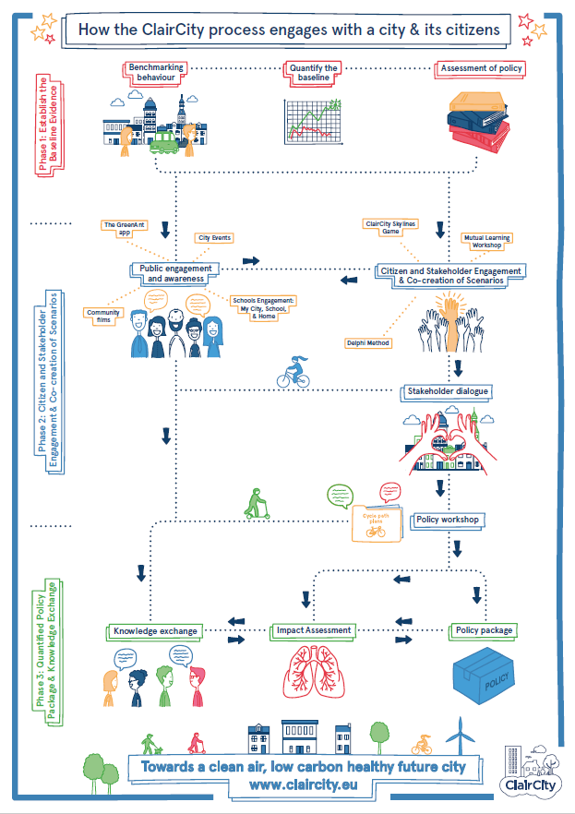
Notes:
Over 6,000 people involved

Slide 52
Notes:
Trained in how to build the sensors
Trained in how to engage decision makers

Slide 54
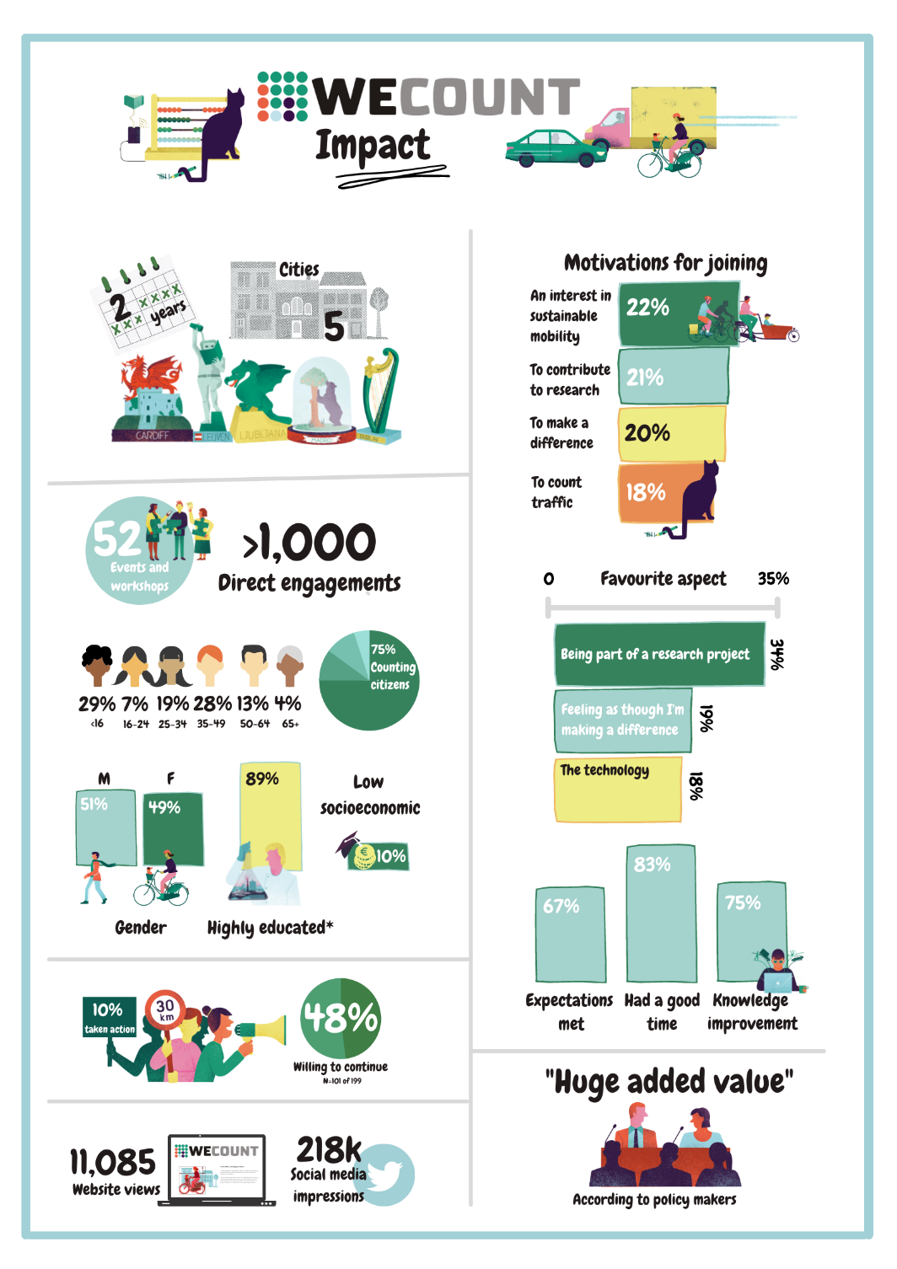
Notes:
Highly educated – motivated by scientific aspects. Already pretty involved in tech or campaigning – and it was those people that were more willing to act. Appealed to their values

Slide 55
Notes:
Our actions → consequences
Empowering statement

Slide 56
Climate Champions Program
Notes:
deliberately participatory, involving scientists, farmers and research managers. Emerged from a survey of farmers carried out by Australia’s national Managing Climate Variability (MCV) R&D programme. The MCV was aiming to provide farmer with better seasonal climate forecasting tools to manage climate risk but they first wanted to assess farmers reaction to these tools. As the forecasting includes a degree of uncertainty and is somewhat complex to understand, they realised the tools would require engagement with farmers in a participatory way. Knowing that farmers learn best from other farms – ‘people like them’ – they set up the programme. They allowed farmers to set their own objectives and design their own activities, including how they wanted to engage with scientists. 45 farms participated in total, across 7 years.
it increased the profile and importance of climate to their peers and the wider community; and helped them establish their own credibility within the climate space
scientists appeared to be actively listening and asking questions
Developed relationships of mutual trust. Reciprocal knowledge was values – scientists now had a much greater understanding of farmers needs. Shaped the tools and products. Improved climate risk knowledge.
Such long-term participatory programs are expensive, but they can create transformational change when relationships of trust make linear communication more effective. Some tips for making them work:
Seek and secure long-term realistic funding, which covers regular face-to-face meetings and social interactions.
Co-design program objectives and activities with participants.
Provide ongoing support for all involved to build their capacity and ability to interact with each other (Sarah in our team provided almost daily support to farmers and scientists).
Ensure meetings/workshops have a strong focus on both structured and informal discussions.
Facilitate (and if necessary, train) participants to actively listen to each other.
https://jcom.sissa.it/archive/21/02/JCOM_2102_2022_A04

Slide 57
Climate Champions Program
(passionate about rural life; values moderation over radical change; avoiding wastefulness is safe and motivating; sceptical of the messenger; likely to look to government for the evidence; point to practical, tangible achievements)
Notes:
deliberately participatory, involving scientists, farmers and research managers. Emerged from a survey of farmers carried out by Australia’s national Managing Climate Variability (MCV) R&D programme. The MCV was aiming to provide farmer with better seasonal climate forecasting tools to manage climate risk but they first wanted to assess farmers reaction to these tools. As the forecasting includes a degree of uncertainty and is somewhat complex to understand, they realised the tools would require engagement with farmers in a participatory way. Knowing that farmers learn best from other farms – ‘people like them’ – they set up the programme. They allowed farmers to set their own objectives and design their own activities, including how they wanted to engage with scientists. 45 farms participated in total, across 7 years.
it increased the profile and importance of climate to their peers and the wider community; and helped them establish their own credibility within the climate space
scientists appeared to be actively listening and asking questions
Developed relationships of mutual trust. Reciprocal knowledge was values – scientists now had a much greater understanding of farmers needs. Shaped the tools and products. Improved climate risk knowledge.
Passionate about rural life (e.g., protecting farmer livelihoods and climate-related weather events).
Find and amplify genuine success stories around British leadership on the environment.
Values moderation over radical change (e.g., taxing meat). Avoiding wastefulness – food, energy or even money– is a safe and motivating starting point.
practical, tangible achievements – improvements in energy efficiency and high standards in farming/welfare – rather than grand claims about global leadership.

Slide 58
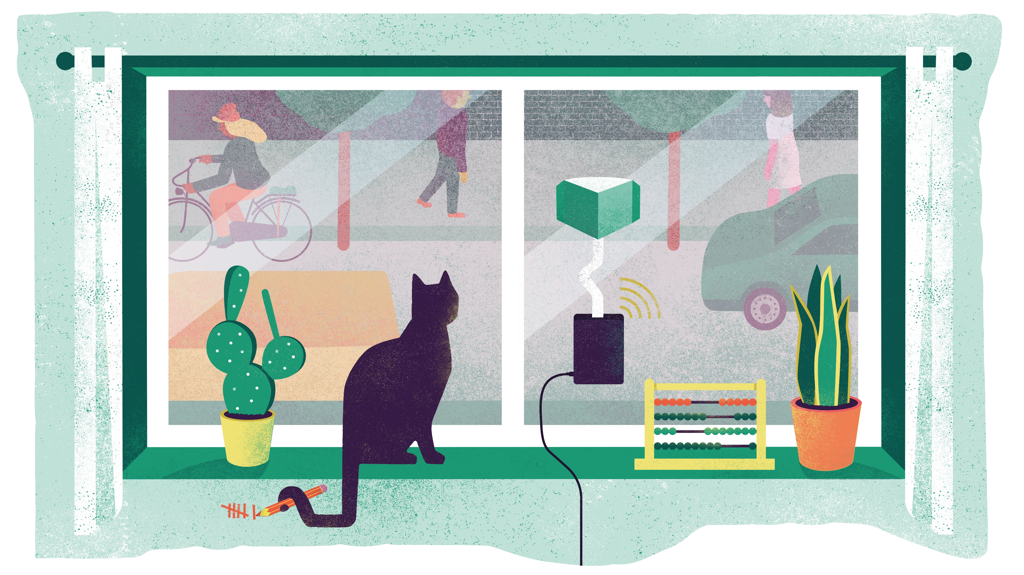
WeCount and ClairCity
Notes:
Dialogue, training and citizen-led interventions
WeCount – they allowed citizens to set their own objectives and design their own activities
CC
5 years, 6 cities
Citizen-led policy making
Open up space to discuss a wide variety of policies/responses.
Dialogue important for complex issues as it can open minds, deepen understanding, foster empathy, change attitudes, and increase receptivity to policy alternatives
It provides space for reflection and deliberation, and the need for varied methods of facilitation and data synthesis that permit access to participants’ broader values

