Slide 1
Science and Culture - Communities, education and knowledge-making: Redistributing power in sustainability transitions through creative and artistic methods for action and the fostering of skills and capacities
Sophie Laggan
Research Fellow
23/06/2022

Slide 2
Who is involved in the sustainability transitions?
Everyone and everything…
The environment
Researchers
Business
Community
Government
Young people & educational settings
Artists…

Slide 3
Why involve everyone?
We all only have partial knowledge
We already have all the solutions… we can learn what works and what doesn’t through our conversations and experiments
We have a shared responsibility…although some more responsible than others
We need to include nature, and indigenous and local knowledge for climate justice
Empowering, creative and artistic approaches a good way to inspire and support action-based approaches
To build connections, build capacities, shift the balance of power

Slide 4
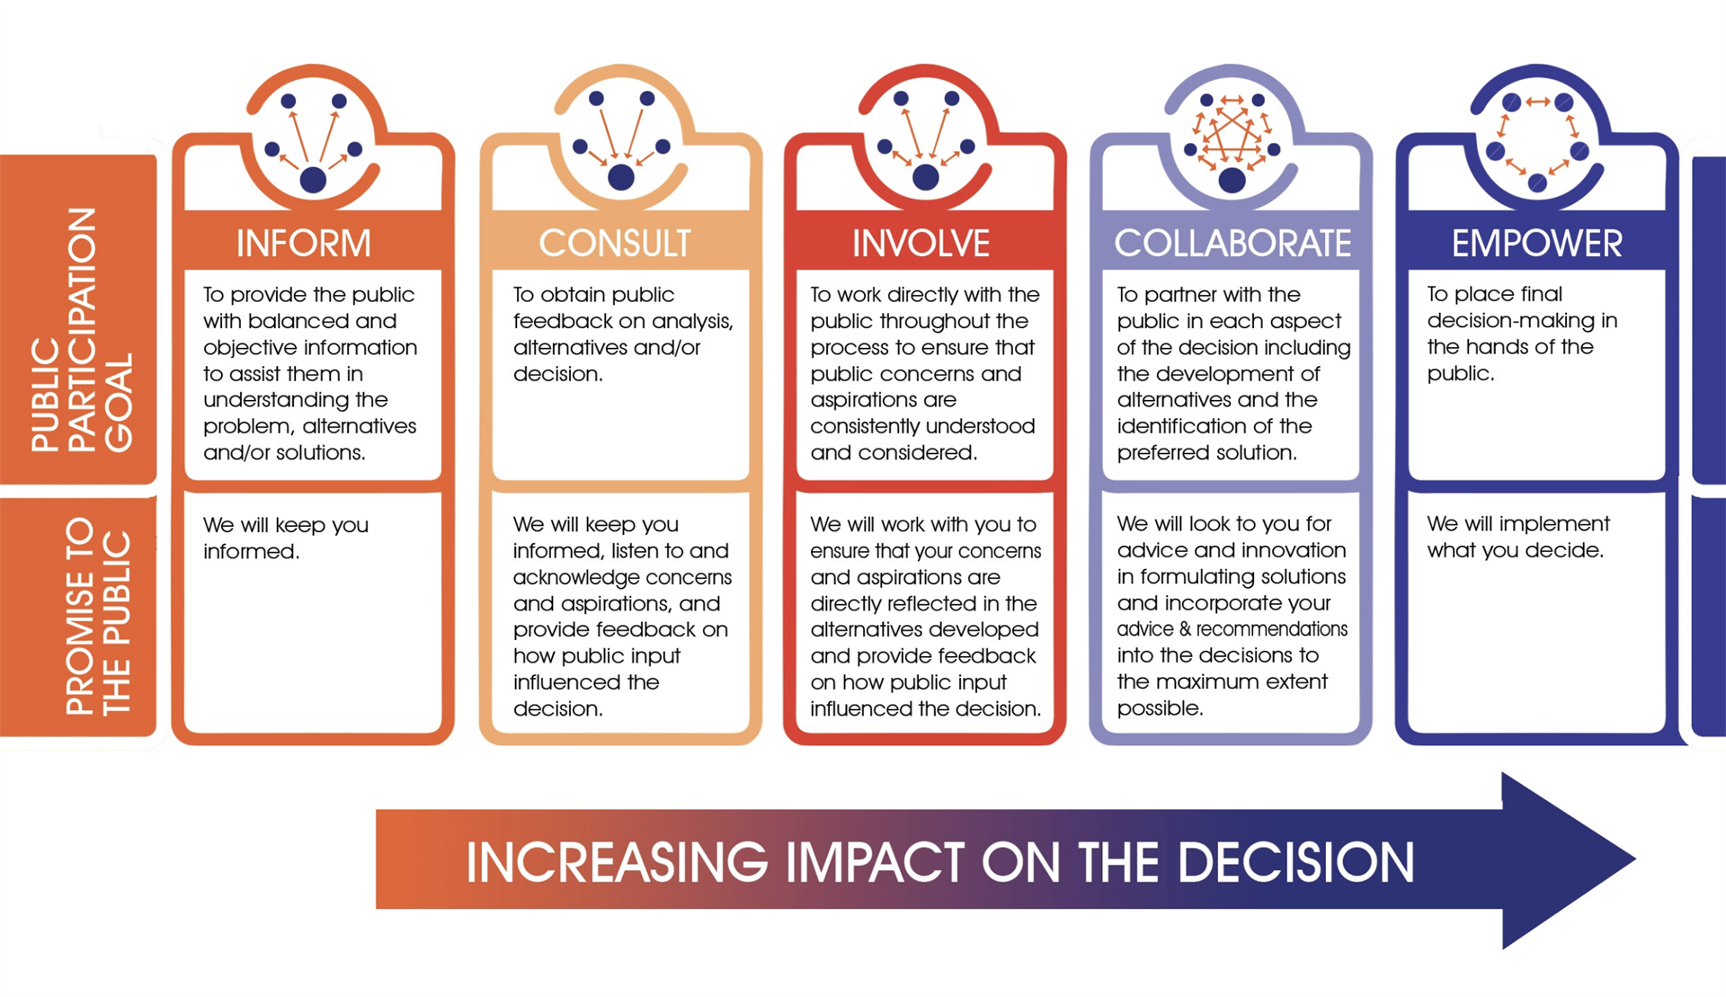
The role of climate communication
Frames engagement according to the spectrum of participation: informing to empowering

Slide 5
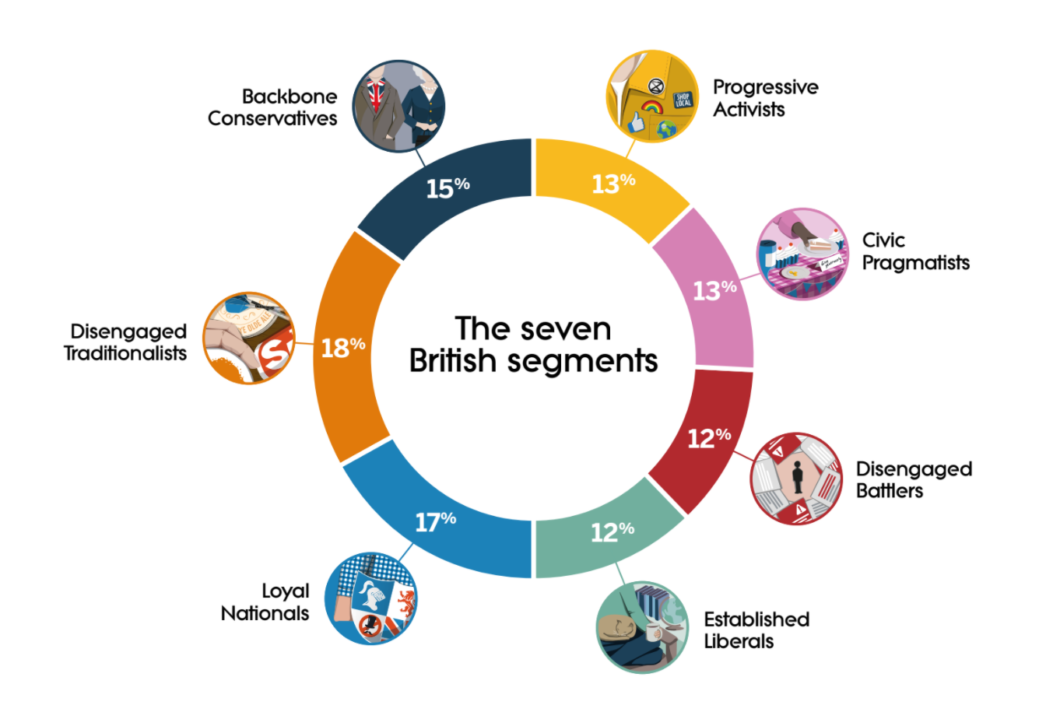
The role of climate communication
Tailors engagements according to audience and sends trusted messengers
climateoutreach.org

Slide 6
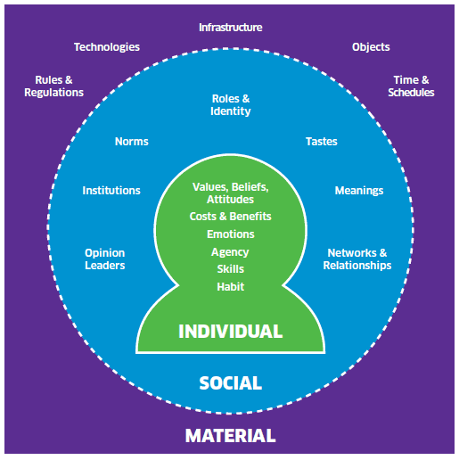
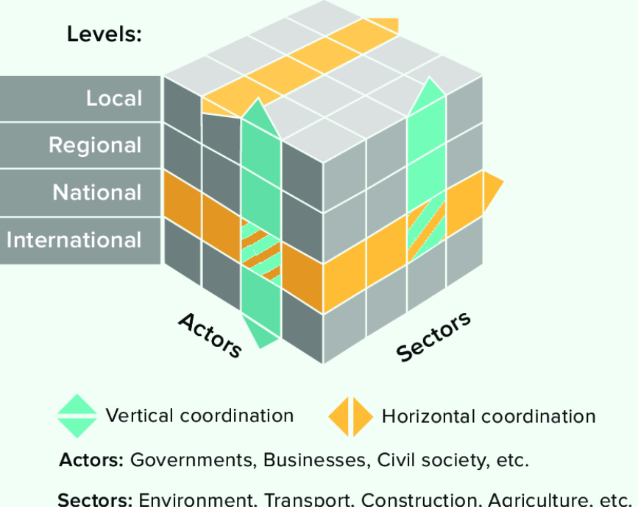
The role of climate communication
Draws from social psychology and sustainability science
looks at lifestyle, values (what they love), social norms & role models, interests and needs among different stakeholders, and how these interconnect with regional, national and international levels of social steering to shape change across scale
Scottish Government
Bellali et al. 2018
Notes:
Bellali, J., Strauch, L., Oremo, F. and Ochieng, B., 2018. Multi-level climate governance in Kenya: activating mechanisms for climate action. Adelphi/ILEG, Berlin.
https://www.gov.scot/publications/influencing-behaviours-moving-beyond-individual-user-guide-ism-tool/pages/1/

Slide 7
The role of climate communication
Recognises that traditional forms of participation are insufficient (Moser 2016)
The deficit model – knowledge alone is enough to move people to action – does not hold
People are moved to act if we can connect the dots for them between personal impact and personal reward (Katherine Hayhoe, 2016) – it’s here, it’s now, it’s relevant
Focus on what people can do – how they can fix it
Train, coach, mentor… build communication knowledge and self-efficacy
Find ways to overcome material inequality… policy change
Notes:
Moser, S.C., 2016. Reflections on climate change communication research and practice in the second decade of the 21st century: what more is there to say?. Wiley Interdisciplinary Reviews: Climate Change, 7(3), pp.345-369.

Slide 8
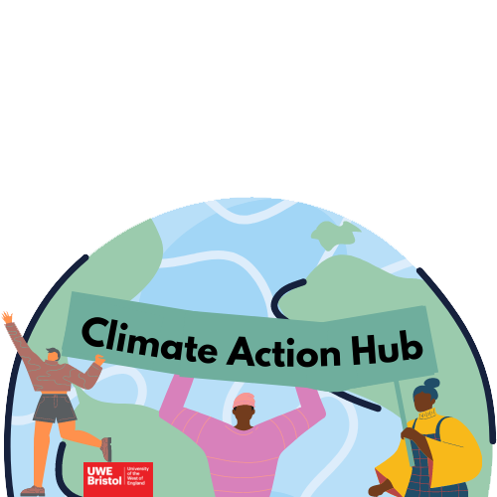
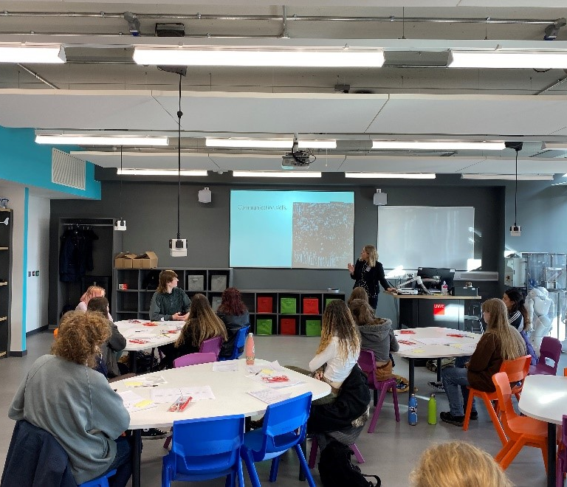
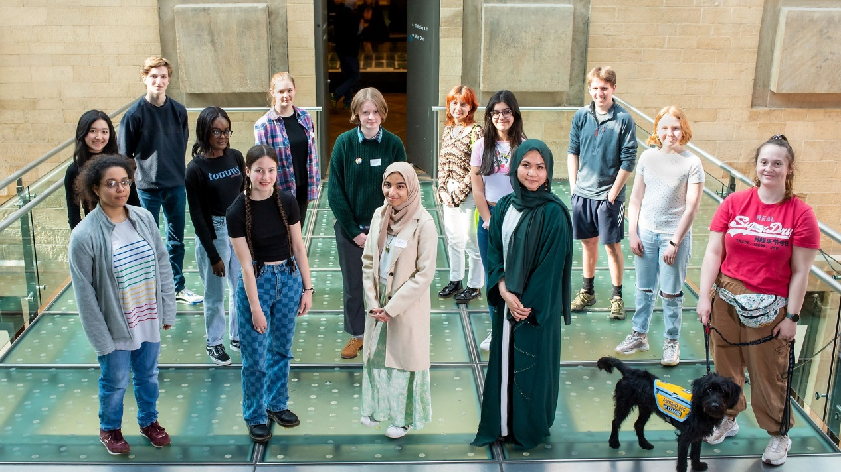
Examples: training and mentoring young people
Notes:
Training young people to engage diverse audiences → to co-produce communication campaigns
https://www.uwe.ac.uk/research/centres-and-groups/scu/projects/climate-action-hub
https://www.bright-green-future.org.uk/
https://catalysechange.com/

Slide 9
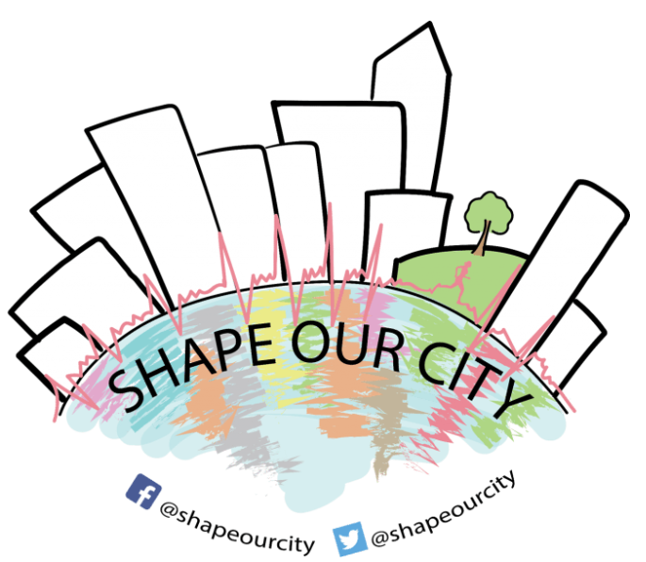
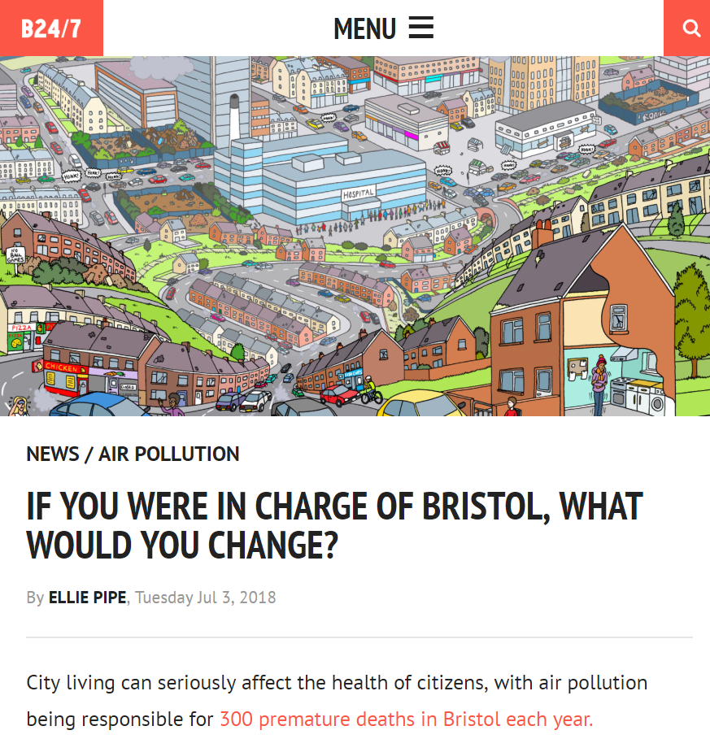
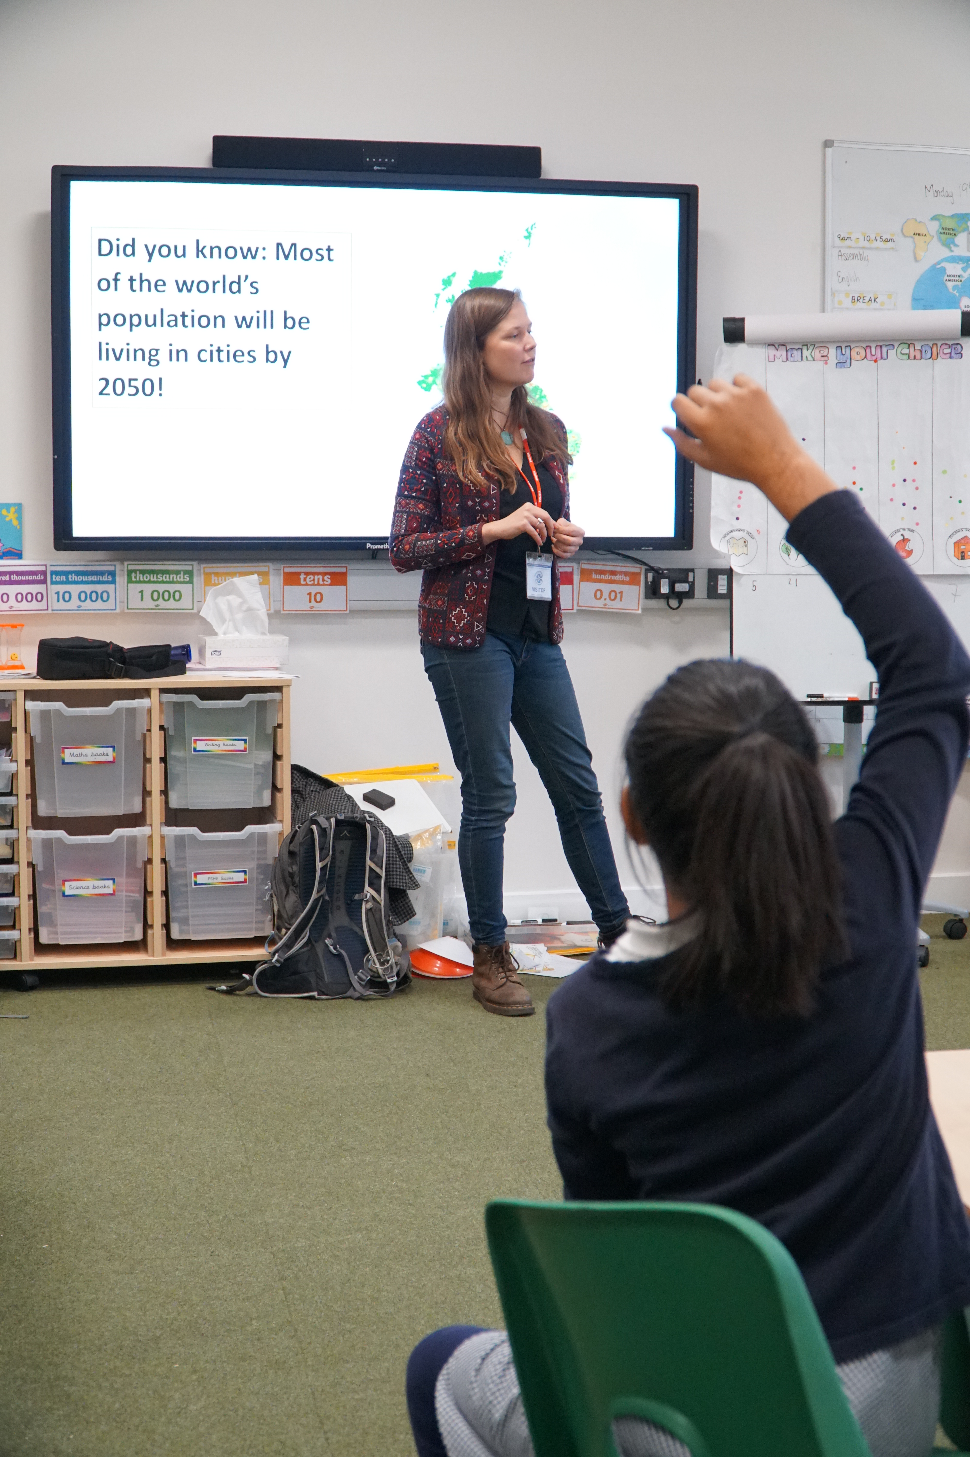
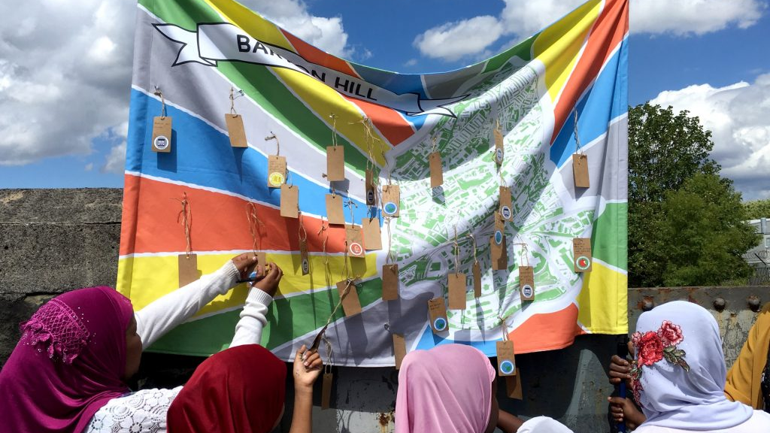
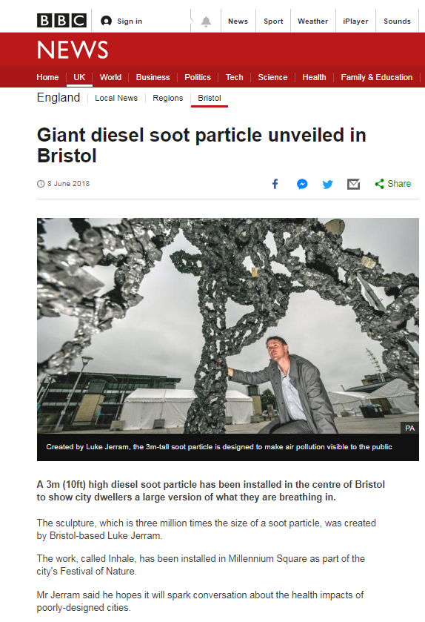
Examples: creative methods for community input and action
Notes:
https://urban-health-upstream.info/impact/our-city-our-health/
Almost 2000

Slide 10
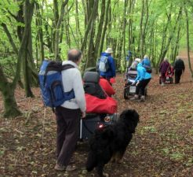
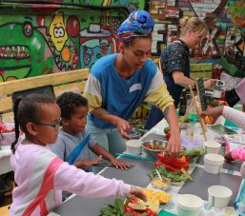
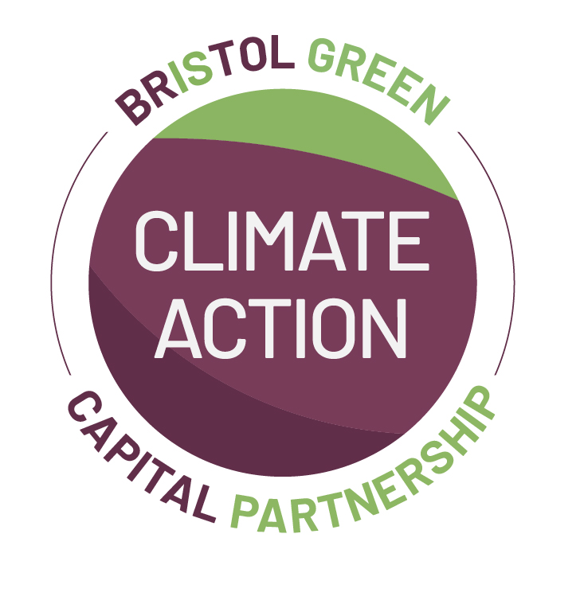
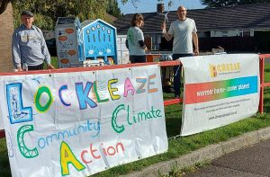
Examples: creative methods for community action
Notes:
https://bristolgreencapital.org/community-climate-action-plans/

Slide 11
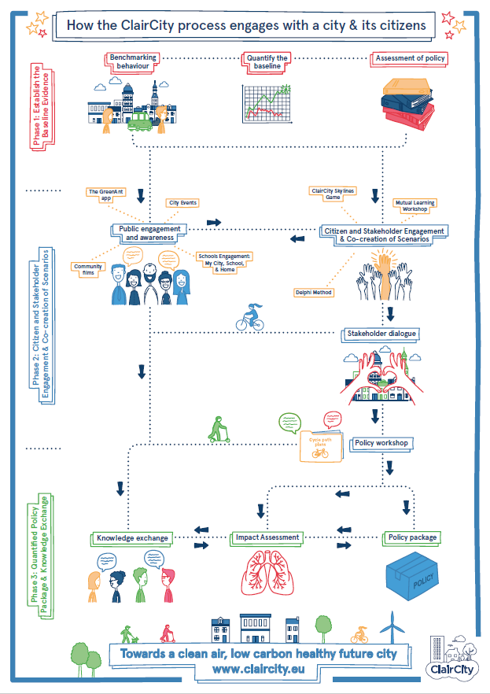
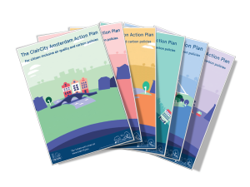
Examples: creative methods for policy action
Notes:
Over 6,000 citizens involved
Supporting civil servants and quantitative scientists to engage the public
https://claircity.eu/

Slide 12
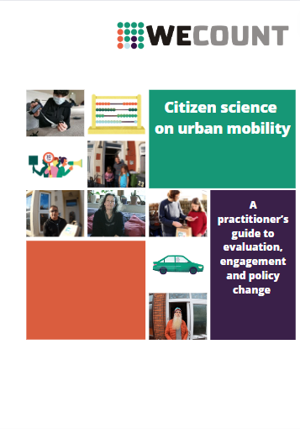
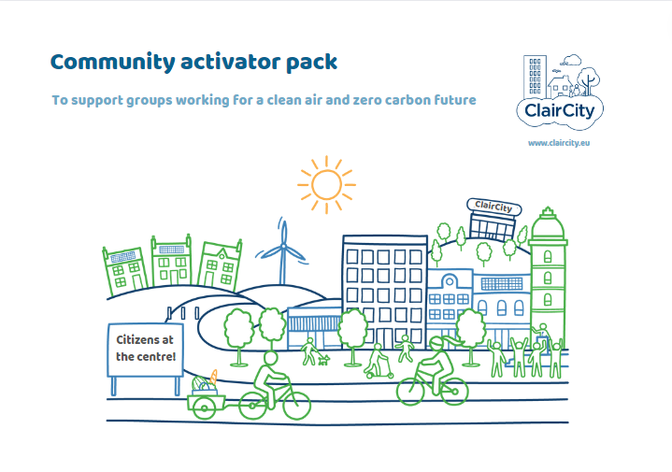
Guides and toolkits to support practitioners, activists…
Notes:
https://zenodo.org/record/5742726#.YrHmhnbMJPY
https://zenodo.org/record/4045909#.YrHmmXbMJPY

Slide 13
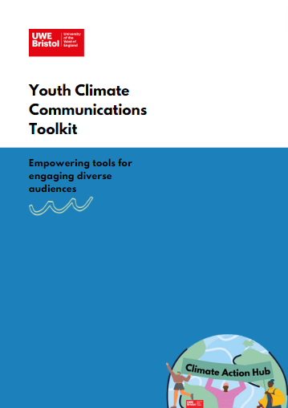
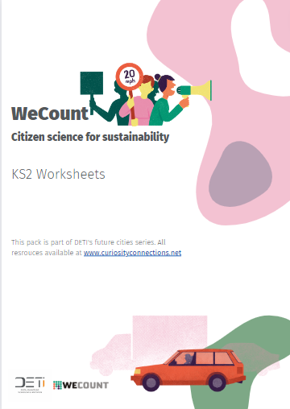
Educational materials to enhance self-efficacy and political action
Partner to amplify, e.g., British Science Association and The Brilliant Club
Promote through various educational resource platforms (e.g., Transform Our World)
Notes:
https://joom.ag/Lgad
https://www.digitaltrailblazers.net/resources

Slide 14
The skills and capabilities scientists and practitioners need to cede power and progress the transition…
Relationship with self: Know thy self → purpose, our assets, self-efficacy
Relationships with others: as knowledge holders sharers, active listeners, evaluators, enablers, facilitators, empathisers (of diverse perspectives), connectors and collaborators… requires communication, artistic, and social science skills. Be in it for the long-term – build trust, create pathways to for citizens’ voice to be heard and to feedback how it was received
Action: Focus on acting in these ways, rather than telling people how to act
Reflection: check your power and privilege; ask for feedback
Seek out support, training, coaching and mentoring → include these on our climate engagement projects

Slide 15
Thank you!
Sophie.laggan@uwe.ac.uk

