Slide 1
Setting the Strategic Direction for Environmental Sustainability in Higher Education Westminster Higher Education Forum Policy Conference Environmental Sustainability in the Higher Education Sector
Presented by
Professor Jim Longhurst
AVC, UWE Bristol and Chair EAUC
14th July 2022

Slide 2
The Challenge for HE
’’If we as educators are serious about preparing our students for the future, we must embrace ESD and ensure that every graduate has not only the knowledge and skills but also the attributes that will enable them at least to cope and ideally thrive in the face of the multiple challenges they will face across their life course in the 21st century’’
https://www.advance-he.ac.uk/teaching-and-learning/education-sustainable-development-higher-education

Slide 3
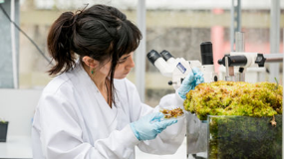
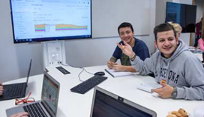
Tomorrow’s Graduates Will Live Through the Climate and Ecological Crisis
According to Actuary Tables a student leaving a UK university this year can expect to live at least another 60 years.
Despite the efforts promised by international actors by the 2080s there will be wide ranging, adverse climate and ecological changes.
The graduates will live through these profound changes.
How will their educational experience prepare them for the challenges that they will encounter in their professional and private lives?

Slide 4
The Next Cohort of Students
Will be much more concerned about the climate and ecological emergency.
They will expect their institution
To take the climate emergency seriously
To manage their estate wisely
To include carbon literacy /climate awareness within the formal and informal curriculum
To prepare them for the challenges they will face across their life course, professional and private, as they live through a changing climate.
Image copyright The Guardian
https://www.theguardian.com/environment/2020/feb/28/greta-thunberg-bristol-schools-shut-students-join-climate-strike#img-1

Slide 5
Future Students
Summer 2020 Survey by Zurich Insurance of young people aged 7 - 17.
Major concern expressed about the impact of and lack of action on the climate emergency
Young people want to see climate included in the formal school curriculum.
(https://www.zurich.co.uk/en/about-us/media-centre/company-news/2020/millions-of-young-people-want-more-climate-change-education)
Institution of Engineering and Technology survey of children aged 5 -13
Over two-thirds of children (68%) hope to follow a career that helps the environment
Lack of understanding about these jobs could stop them from getting there.
(https://www.theiet.org/media/press-releases/press-releases-2020/press-releases-2020-july-september/18-september-2020-generation-green-ambitions-at-risk-of-going-to-waste)

Slide 6
NUS - SOS Surveys
Annual survey by NUS then SOS of students attitudes to sustainability
2021 Survey of 8000 students
91% say their place of study should actively incorporate and promote sustainable development.
84% would like to see sustainable development incorporated in all courses.
66% say sustainable development is something they would like to learn more about.
Https://www.sos-uk.org/research/sustainability-skills-survey

Slide 7
Strategic Direction for Sustainability
Integrating Sustainability into Policy, Practice and Culture
Sustainability in Teaching and Learning
Sustainability in Research, Innovation and Knowledge Exchange
Sustainability in Local, National and International Partnerships
Sustainability in Campus Operations

Slide 8
Sustainability at UWE – a 28 year journey
1994 UWE’s first Environmental Policy periodically revised thereafter
2004 Sustainability Board established
2005 First Sustainability Action Plan
2007 First Sustainability Strategy
2008 Knowledge Exchange for Sustainability Education (KESE) established
2010 Strategy 2020
2012 Sustainability Plan
2014 Certification to ISO 14001:2004 EMS
2015 Confirmed sustainability present in all taught provision
2016 Responsible Futures accreditation
2017 Refreshed Sustainability Plan
2017 Transition to ISO 14001:2015 certification for EMS
2017 New Environmental Sustainability Policy
2020 Launch of Strategy 2030
2020 Climate Action and Sustainability Strategy

Slide 9
Sustainability at UWE – a 28 year journey
2021 Completion of Phase 1 of the SDG Mapping Project
2021 New Action Plans for
Education for Sustainable Development,
Sustainability Engagement,
Sustainable Food,
Transport,
Carbon and Energy Management,
Clean Air,
Circular Economy including plastics, and
Biodiversity
2021 Launch of QAA / Advance HE ESD Guidance and adoption by UWE
2021 Reaccreditation to NUS -SOS Responsible Futures and ISO 14001-2015 recertification
2021 Work starts on new student accommodation designed to PassivHaus standard
2022 New carbon literacy training programme for staff and students
2022? Signing up to the People and Planet Fossil Free Careers Campaign

Slide 10
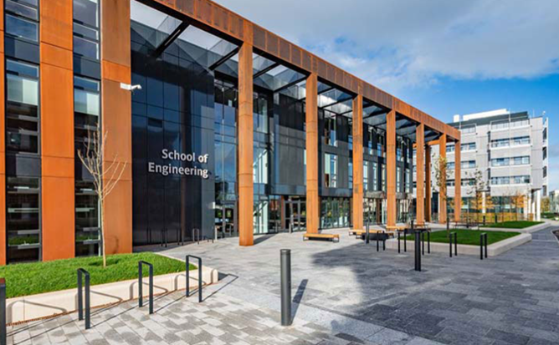
Key Success Factors
Student expectation and demand
Staff engagement
Senior staff leadership
Strategy and clear direction of travel
Willingness to embrace change
Learning from failure
External certification
Partnership with the Students’ Union
Bristol – A European Green Capital

Slide 11
Sustainability Commitments in Strategy 2030
Through our 2030 Strategy we will work to address the urgency of the climate and ecological emergency and strive to fulfil our role in the achievement of the United Nations’ Sustainable Development Goals.
UWE Bristol Declaration of a Climate and Ecological Emergency here
Seven ambitious commitments in Strategy 2030.
https://www.uwe.ac.uk/about/values-vision-strategy/strategy-2030

Slide 12
Sustainability Ambitions in Strategy 2030 (abridged)
Net-zero emissions of Scope 1, 2 and 3 greenhouse gases by 2030.
Clear targets and plans to reduce water and energy use, cut waste generation including food waste, and support biodiversity.
Eliminate all but essential single-use plastic by 2025.
Establish all our campuses as clean air and smoke-free zones.
Secure year-on-year improvement in sustainable travel.
Work with our students to explicitly address climate change and environmental challenges in the curriculum.
Support research that addresses climate change, environmental challenges and biodiversity.
https://www.uwe.ac.uk/about/values-vision-strategy/strategy-2030

Slide 13
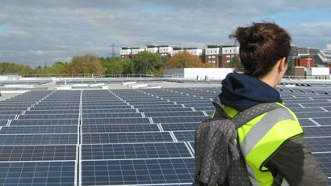
UWE’s Actions
Read about UWE’s work covering campus operations, curriculum, research and community engagement at
https://www.uwe.ac.uk/about/values-vision-strategy/sustainability
Read the policy and strategy documents at
https://www.uwe.ac.uk/about/values-vision-strategy/sustainability/strategy-leadership-and-plans/policy-and-strategy-documents

Slide 14
The Climate and Ecological Emergency
Responding to the urgency of the challenge demands new thinking by universities.
It requires more than a simple declaration of concern.
It requires action.
If a declaration of a climate and ecological emergency is not immediately followed by a root and branch review of institutional culture, policies, processes, and incentives then it is a token gesture.
It requires strategy, plans and policy directed towards solutions not a continuation of business as usual.

Slide 15
The Climate and Ecological Emergency Matters
It can and must be part of a university mission
It needs Senior Management leadership.
It matters to current students.
It matters to future students.
It matters to staff.
It has an important place
in the curriculum of EVERY discipline and in the careers advice to students
in the university’s research and innovation activities,
in the management and development of the campus
in the investment and banking decisions of the university
in the civic / community engagement activities of a university
.

Slide 16
Professor James Longhurst
University of the West of England,
Frenchay Campus,
Bristol,
BS16 1QY
UK
Email James.Longhurst@uwe.ac.uk
Public profile http://people.uwe.ac.uk/Pages/person.aspx?accountname=CAMPUS\j-longhurst
Sustainability at UWE
https://www.uwe.ac.uk/about/values-vision-strategy/sustainability

