Slide 1
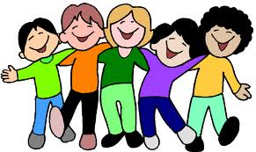
‘Happy being me’ in the UK: A controlled evaluation of a school-based body image intervention with pre-adolescent children
Emma Bird
University of the West of England
South West Public Health Scientific Conference - 1st February 2012

Slide 2
Background

Slide 3
Negative body image in children: A Public Health concern?
40-50% 6-12 year olds report body dissatisfaction (Smolak, 2011)
Risk factors for negative body image?
Internalisation of cultural beauty-ideals
Appearance-related conversations
Appearance-related comparison
Appearance-related teasing

Slide 4
‘Happy Being Me’ (Richardson & Paxton, 2010)
Targeted known risk factors for negative body image, while also incorporating a self-esteem component
Positive effects on:
Overall body satisfaction
Risk factors for negative body image
Eating behaviours
Self-esteem
Intervention topic knowledge

Slide 5
Present study...
School-based body image interventions have shown potential; however, evidence is inconclusive
Focus on risk factor reduction in adolescent girls
Therefore...
Evaluation of an adaptation of ‘Happy Being Me’ with pre-adolescent girls and boys

Slide 6
Methods

Slide 7
Participants
88 year six children (M = 46, F = 42) recruited from two primary schools
Quasi-experimental design
Intervention (n = 43)
Control (n = 45)
Age – 10 and 11

Slide 8
 | Aims | Content
SESSION 1 | Educate on media literacy Reduce internalisation | Media manipulation techniques Appearance does not equal value Ideal-bodies over time
SESSION 2 | Educate on appearance-related conversation / teasing Reduce appearance-related conversation / teasing | What are appearance conversations and ‘fat-talk’? What can be done to avoid engaging with that behaviour?
SESSION 3 | Educate on appearance-related comparison Reduce appearance-related comparison Revisit and recap the issues covered within the program | Introduction to appearance comparison and negative impact What can be done to avoid engaging with that behaviour? Emphasis on positive qualities not related to appearance

Slide 9
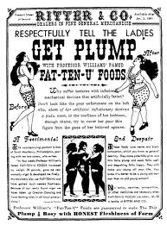
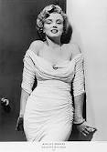
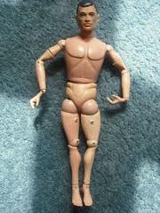
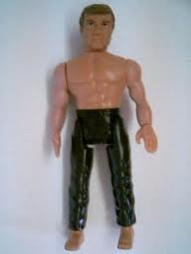
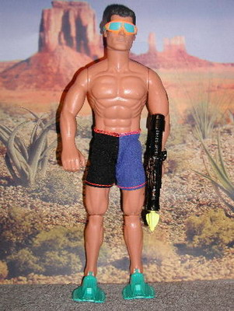
Materials
Original materials adapted for use with pre-adolescent girls and boys:
1891
1960
2000s
1964
1980
2000

Slide 10
Measures
Pre-, post- and three month follow-up questionnaire:
Demographics (BMI, age)
Body satisfaction
Risk factors for negative body image
Eating behaviour
Self-esteem
Intervention topic knowledge
Measures assessed for validity and reliability
Likert-scale response

Slide 11
Results

Slide 12
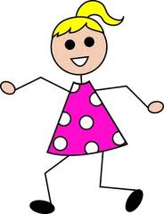
Girls
Mixed between-within MANOVA revealed a significant* positive change from baseline to post-intervention for...
Body satisfaction**
Appearance-related conversation
Appearance-related comparison
Eating behaviours
Intervention topic knowledge
* p < 0.05
** maintained at three month follow-up. 3 (baseline, immediate post-intervention, follow-up) x 2 (intervention, control) ANOVA calculations

Slide 13
Girls
Measure | Baseline M (SD) | Post-intervention M (SD)
Body satisfaction | 11.60 (3.03) | 13.63 (2.93)*
Cultural-beauty internalisation | 17.35 (5.55) | 15.19 (5.21)
Appearance-related conversation | 12.89 (5.90) | 10.19 (4.51)*
Appearance-related comparison | 14.33 (3.91) | 11.56 (3.98)*
Appearance-related teasing | 45.60 (11.96) | 39.11 (10.48)
Restrained eating | 9.25 (4.84) | 8.11 (4.48)*
Emotional eating | 6.65 (3.25) | 4.84 (2.19)*
Self-esteem | 2.90 (0.91) | 3.33 (1.08)
Intervention topic knowledge | 13.75 (4.30) | 16.58 (2.85)*
Higher score = desirable
Lower score = desirable
N.B. All mean scores moved in a positive direction

Slide 14
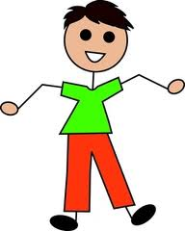
Boys
Mixed between-within MANOVA revealed a significant* positive change from baseline to post-intervention for...
Cultural-beauty internalisation
Appearance-related conversations
* p < 0.05

Slide 15
Boys
Measure | Baseline M (SD) | Post-intervention M (SD)
Body satisfaction | 13.52 (3.26) | 14.00 (3.28)
Cultural-beauty internalisation | 17.04 (5.86) | 14.00 (5.84)*
Appearance-related conversation | 12.35 (6.09) | 9.27 (5.57)*
Appearance-related comparison | 12.30 (3.84) | 9.09 (3.85)
Appearance-related teasing | 35.78 (10.84) | 32.09 (12.17)
Restrained eating | 7.77 (3.46) | 6.52 (3.04)
Emotional eating | 5.70 (2.27) | 5.09 (2.72)
Self-esteem | 3.57 (1.20) | 3.55 (1.34)
Intervention topic knowledge | 14.39 (3.33) | 16.00 (2.51)
Higher score = desirable
Lower score = desirable
N.B. All mean scores moved in a positive direction

Slide 16
Discussion

Slide 17
Discussion
Mixed findings
Different from original application
Encouraging in short-term
More effective with girls
Potential for future application
Limitations
Sample size (particularly at follow-up)
Non-randomised conditions

Slide 18
Conclusions
Novel application
Girls and boys affected by negative body image concerns
Additional sessions – for maintenance and consolidation
Future replication with larger sample
Refinement of intervention materials

Slide 19
Questions?
Contact us...
emma.bird@uwe.ac.uk
Collaborators:
Miss Emma Bird
UWE
Dr. Emma Halliwell
UWE
Dr. Phillippa Diedrichs
UWE

