Slide 1
Redox Mechanisms of Rohypnol and Mogadon and Their Exploitation in an Assay Using Dual Electrode ECD Following HPLC
K.C. Honeychurch, H. Li, S. Pericleous, M. Antoniou, A. Abed and J.P. Hart

Slide 2
Talk Outline
Importance of the 1,4-benzodiazepine class of drugs
Cyclic voltammetric behaviour of Flunitrazepam (Rohypnol), and Nitrazepam (Mogadon)
Possible mechanism for their voltammetric behaviour
Optimisation of Liquid Chromatographic Separation and dual electrode detection conditions

Slide 3
Importance of the 1,4-benzodiazepine class of drugs
Widely used and prescribed drugs for sleeping and anxiety related disorders.
Reviews have highlighted the forensic importance of this class of compounds.
DFSA
robberies
Concern has also focused on the effects of such compounds in the environment.
Levels in drinking water.
pregnant women and children.
Aquatic environment
chronic effects seen at sub-µg/l.
Gas chromatography requires derivatization
Immunoassays show cross reactivity.
Consequently, need for new rapid sensitive methods

Slide 4
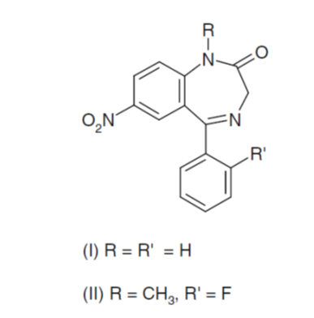
Nitrazepam
Flunitrazepam

Slide 5
Cyclic Voltammetric Behaviour

Slide 6
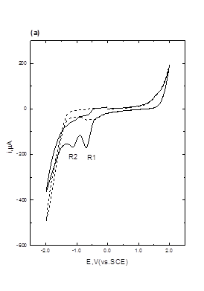
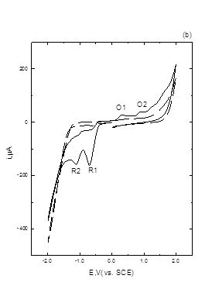
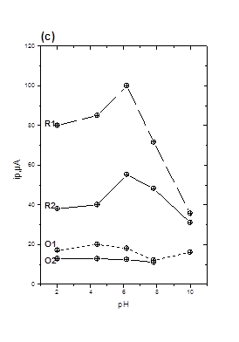
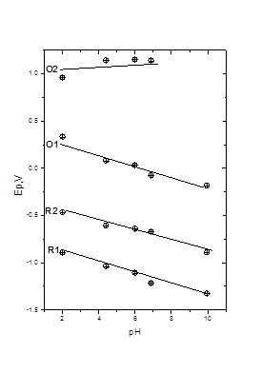
(b)
(a)
Cyclic voltammograms obtained in the presence (solid line) and absence (dotted line) of 1 mM flunitrazepam in 50 % 0.2 M pH 2 phosphate buffer-50 % acetone. Scan rate 50 mV/s, starting and end potential 0.0 V. (a) initial switching potential +2.0 V, second switching potential ‑2.0 V. (b) initial switching potential ‑2.0 V, second switching potential +2.0 V. (c) i_{p} versus pH and (d) Ep versus pH.
i_{p} α v^{½}
(d)
(c)
O2
R1
O1
R2
R2
O1
R1
O2
Honeychurch et al. Anal. Methods, 2012, 4, 132-140.

Slide 7
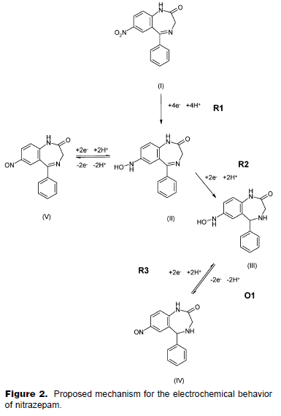
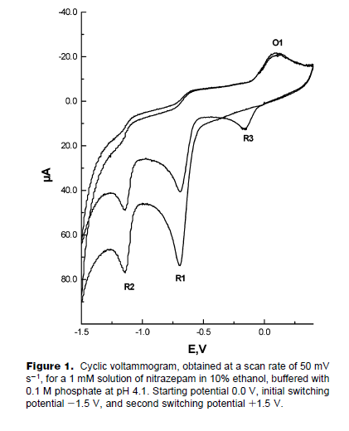
Honeychurch et al, Anal. Chem. 2006, 78, 416-423.

Slide 8
High-Performance Liquid Chromatography Coupled with Dual Electrochemical Detection (LC-DED)
“Generator” and “Detector” Cells
“Generator” cell- analyte is electrochemically converted to a product that can be then more readily electrochemically determined at the “Detector” cell.
Advantages - lower working potentials:
lower background currents
less interferences -
oxygen – no degassing, number of common other interferences not seen.

Slide 9
HPLC
chart recorder
Rheodyne injector
Faraday cage
generator
detector
Thermostatically controlled Column
3 mm diameter GCE
3 mm diameter GCE

Slide 10
Optimisation of Chromatographic Conditions
4X10^{‑5} AUFS
pH 6.6
pH 2.7
N
F
pH 2.3
pKa 1.8 flunitrazepam
pKa 3.2 nitrazepam
0
4
8
12
minutes
Effect of mobile phase pH on peak separation.
50 % acetone, 50 % 100 mM phosphate buffer, 0.8 mL/min, UV detection λ = 380 nm. C₁₈ column

Slide 11
Hydrodynamic Voltammetry
Generator
Detector

Slide 13
Conclusions
We have demonstrated the cyclic voltammetric behaviour of flunitrazepam and nitrazepam.
We have the shown the possibility to determine these drugs by LC-DED.
Future work will focus on accessing the analytical performance of the LC-DED method.

Slide 14
Acknowledgements
We are grateful to the University of the West of England and HEFCE for financial support. Gwen M. Davidson, Emma Brown and Jonathan Toner are thanked for their work with some preliminary studies. Alison Halliday, Paul Bowdler and Mervyn Lewis are thanked for their technical assistance.
References
Kevin C. Honeychurch, Ai Teng Chong, Khalil Elamin and John P. Hart, Novel electrode reactions of diazepam, flunitrazepam and lorazepam and their exploitation in a new redox mode LC-DED assay for serum, Anal. Methods, 2012, 4, 132-140.
Kevin C. Honeychurch, Gemma C. Smith, and John P. Hart, Voltammetric Behavior of Nitrazepam and Its Determination in Serum Using Liquid Chromatography with Redox Mode Dual-Electrode Detection, Anal. Chem. 2006, 78, 416-423.
Thank You

