Slide 1

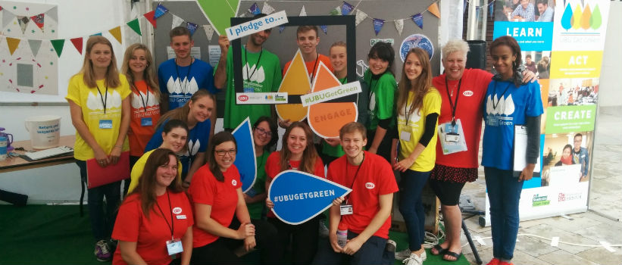
Student Capital: the role of students in city transformation
University of Bristol and University of the West of England Bristol.

Slide 2

Students: lived lives
The biggest single sustainability impact of any University is its graduates
How do we support students to learn to tread more lightly in the lifetime ahead of them?
How do we mobilise student creativity to transform us and our city?
Students as Global Ambassadors:
“I learnt to live sustainability in Bristol- we can live like that too!”

Slide 3
Showing theory is not enough: HE can transform students and their city
Learn
Students learn about economic, social and environmental issues in their curriculum
Act
Students act on this knowledge and develop positive environmental behaviours for waste, energy and water through practical sustainability projects
Engage
Students volunteer on sustainability projects, engage with like-minded studentsand discuss sustainability issues
Create
Students take intiative to create and lead positive sustainable change through their own ideas and campaigns
The Four-Step Approach

Slide 4
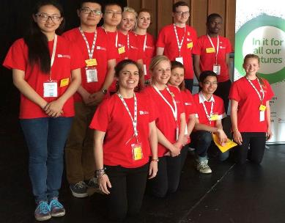
Challenge: mobilise 10% of the population
Bristol city 450,000 population, 1.5m catchment.
  City of radical innovative
  Vision of inclusive, sustainable city
  European Green Capital 2015
Students 10% population
A transformational change in student engagement- our city making the change

Slide 5
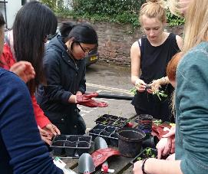
How?
Bristol European Green Capital 2015 as catalyst
Partnership
  Whole institution
  All Universities and Student Unions together
  Bristol Green Partnership > 850 organisations
  City Council & Mayor
Funded by Higher Education Funding Council for England Strategic Catalyst Fund as test bed

Slide 6
100,000 hours student volunteering for sustainability
Students engaged in 100,000 hours of community activity
Volunteering, internships, placements for sustainability
Over 220 Public, private sector, voluntary groups, NGOS, communities
Large and small scale, individual and collective
NOT just this year, but every year

Slide 7

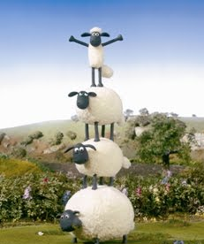

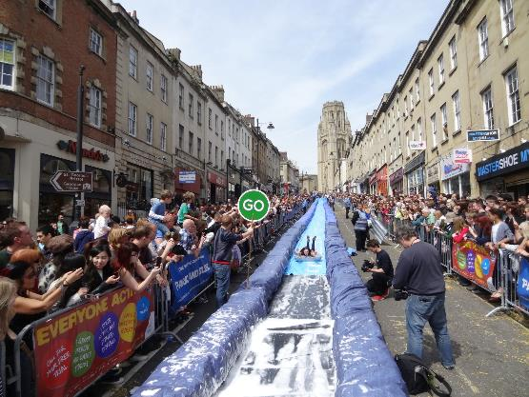




Slide 8

Mapping the hive – bringing all activities into a Network
Holistic Map – curriculum and informal integrated
Surfacing activity
One stop access
Not hard edged- inclusive
Easier for new ideas
Individual and collective
Curricular, extra curricular & institutional
Enables different community & institutional mappings
Seeing the role of the individual within
So business, public, voluntary sectors can better see opportunities
So students, business, public voluntary sectors can better see opportunities
So new ideas can be supported
So initiatives can come and go within the continuing whole
Bee and Hive
Enabling students and community to see Hive as well as Bees
Notes:
Note – backroom different in each uni but front window the same
Map - holistic curricular and extra curricular – reall important as avoids some of ht eprojects of matching curriculum projects to the community – they don’t come to you and say we want to be part of a student curriculum project….. They have an idea and think the uni might be interested in working with them on it.
Surface – you don’t know everything that’s going on –innovation comes form lots of places - need to surface and you will be amazed
- motive to surface
3 So students can better see
- international
chance
4 So community can better see eg Ngo business planning, new groups more ops
Thought too early for conclusions, but yes it works.
The tipping

Slide 9
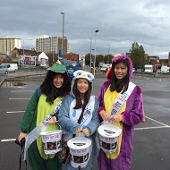
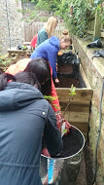
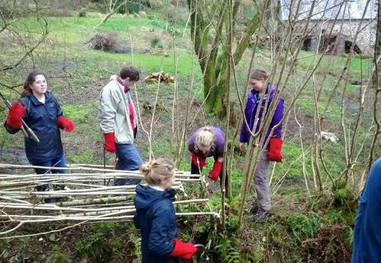
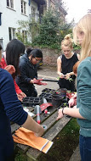
Some are things you might expect
Cash e.g. raising £300k for local charities through recycling
National schemes e.g. Foodcycle
Education e.g. delivering workshops to schools
Conservation e.g. Designing Wildlife Corridors
Designing Household resilience boxes
Energy champions
Health e.g. Obesity prevention
Greening Business e.g. waste & energy audits and green business plans
Notes:
One international student put in 170 hours for 14 organisations in 6 months

Slide 10
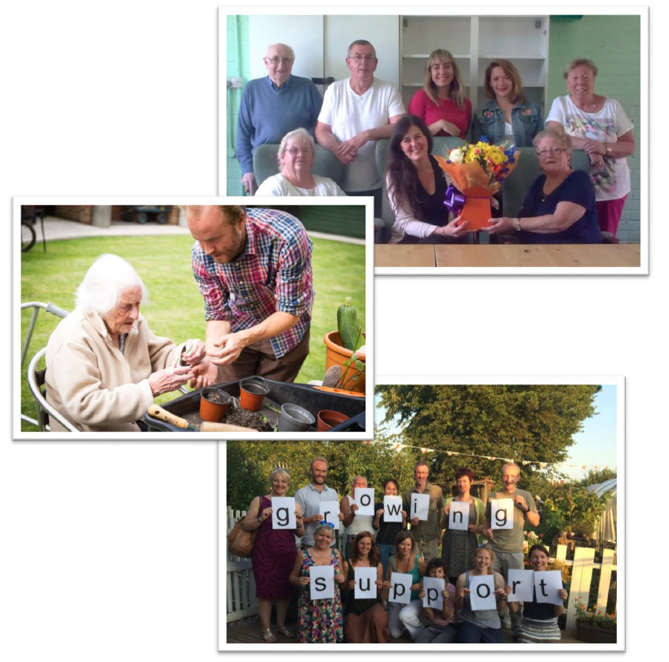



FINDING PARTNERS
44 NGOs wanting business plans…..
Tackling modern slavery
One student with an idea – slavemasters ensure their workers go to the doctor when ill – do doctors know how to spot signs of slavery?
Built a network in the city & developed a toolkit for doctors
57 Bristol doctors signed up and use it
Being looked at nationally
Fostering innovation
Whacky - Knitaversity
New businesses - Students setting up Brisbikes business

Slide 11
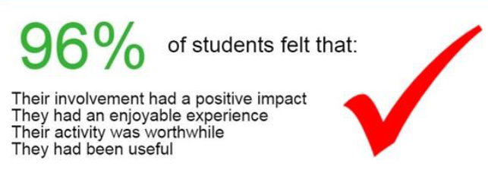
Outcomes ….
What’s the point of being in Bristol if you don’t join in?
We felt they really got to understand our business and produced a brilliant business plan that is really going to help us going forward
  >2500 students
  >100,000 hours
  >£1 million value
  Changing student understanding of what it means to live in a city
  Changing our city
It gave me the belief to move to Bristol: I now sell three times as many bikes
It has been fantastic to work with the University as well; lots of people in this area don’t go on to University or have any connections. It has really changed our perceptions
It made me feel I belonged

Slide 13

For more information please contact
James,Longhusrt@ uwe.ac.uk
Chris.Willmore@bris.ac.uk
Clayton, W., Longhurst, J. and Willmore, C. (2016) Review of the contribution of Green Capital: Student Capital to Bristols year as European Green Capital. Project Report. eprints.uwe.ac.uk/28311
Clayton, W., Longhurst, J. and Willmore, C. (2016) The Bristol Method, Green Capital: Student Capital. The power of student sustainability engagement www.bristol2015.co.uk/method/

Slide 14
What is transferrable from the Bristol Project?
Inner circle means transferable
Outer circle means not transferable
On the line means some thing it is and some not.
Add your own post its
If you disagree with the post its, move them!
Tell us what you think

