Slide 1

The University of the West of England, Bristol

Slide 2
Progress with air quality management in the 60 years since the UK Clean Air Act of 1956. Lessons, failures, challenges and opportunities
Williams, B & Longhurst, J.W.S.
Presentation by
Ben Williams
London Pollution Study Group
November 3rd 2016

Slide 3
Structure of Presentation
2016 marks 60 years since the first UK Clean Air Act.
This presentation considers the factors contributing to successful management of air quality and the factors that act as barriers to progress.
The public health catastrophe of the 1952 London Smog created the political momentum for the 1956 Act to be passed.
The presentation reviews the progress in meeting the air pollution challenge and comments on the weakness of the governmental and societal response to the national and global public health challenge.

Slide 4
Times have changed

Slide 5
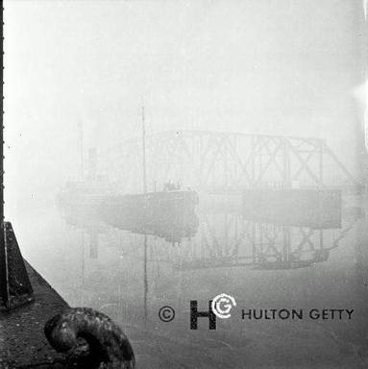
Manchester Ship Canal in Smog.
HELIX Image Service for Higher Education

Slide 6
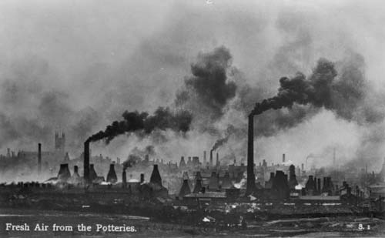
Fresh Air from the Potteries
http://www.staffspasttrack.org.uk/exhibit/coal/historical%20overview/pottery.htm

Slide 7
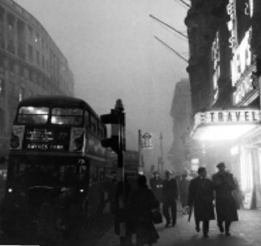

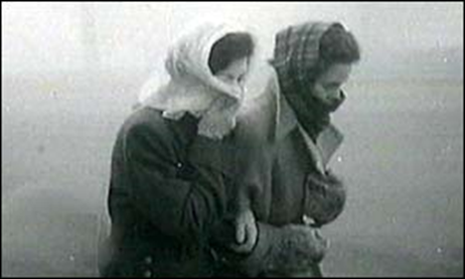
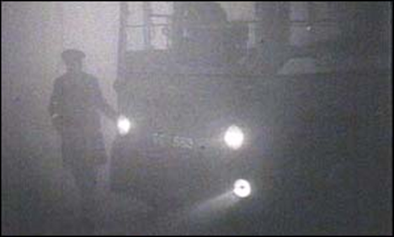
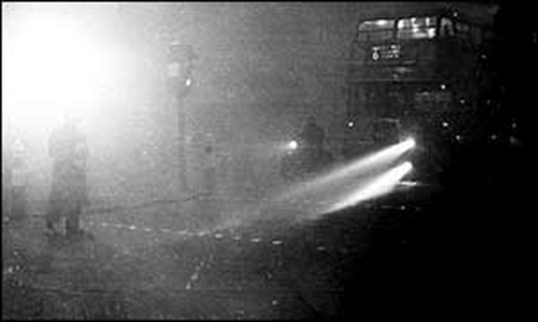
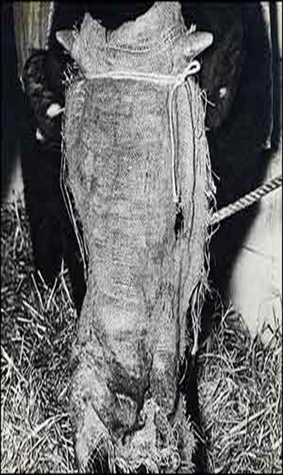
The London Smog, 1952
London 1952, Source: National Archives

Slide 8

The London Smog of 1952
In 1952 London experienced a major smog event which led to large numbers of excess deaths and substantial increases in respiratory illness.
This public health toll was the most significant amongst the many reported smog events in London’s history that stretch back over many centuries.
Its impacts on health were profound and such was the public response to the problem that political action to ensure it could not be repeated was inevitable.
The result was the Beaver Committee whose recommendations ultimately resulted in the Clean Air Act, 1956

Slide 9
Catastrophe drives action.
Creates a willingness to act
Good intentions fall foul of vested interests

Slide 10
The Beaver Committee and the Act
The Act banned dark smoke emissions from chimneys, railway engines and vessels, required new furnaces to be smokeless, required the emissions of grit and dust from furnaces to be minimised, and gave local council’s powers to introduce smokeless zones.
The Clean Air Act helped the UK achieve a world leading position in the battle against air pollution.
Can we say that today?

Slide 11
Reflecting on the 1952 Smog and the 1956 Clean Air Act.
The Clean Air Act demonstrated that substantial air quality improvements could be produced when concerted and sustained governmental action was directed at an environmental and public health problem.
However, the importance of sustained interest became apparent later on as elimination of “pea soupers” created a prevailing ideology that air pollution had been conquered.
Resources were directed towards other problems as governmental priorities changed.
The onset of health based concerns about the impacts of the growth of road traffic in the 1980s and 1990s left the UK woefully ill prepared to tackle a new form of air pollution.

Slide 12
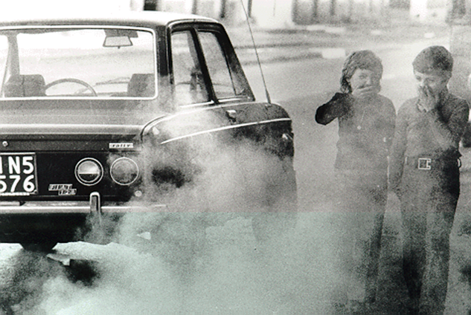
A new Form of Pollution? Was it Avoidable?

Slide 13
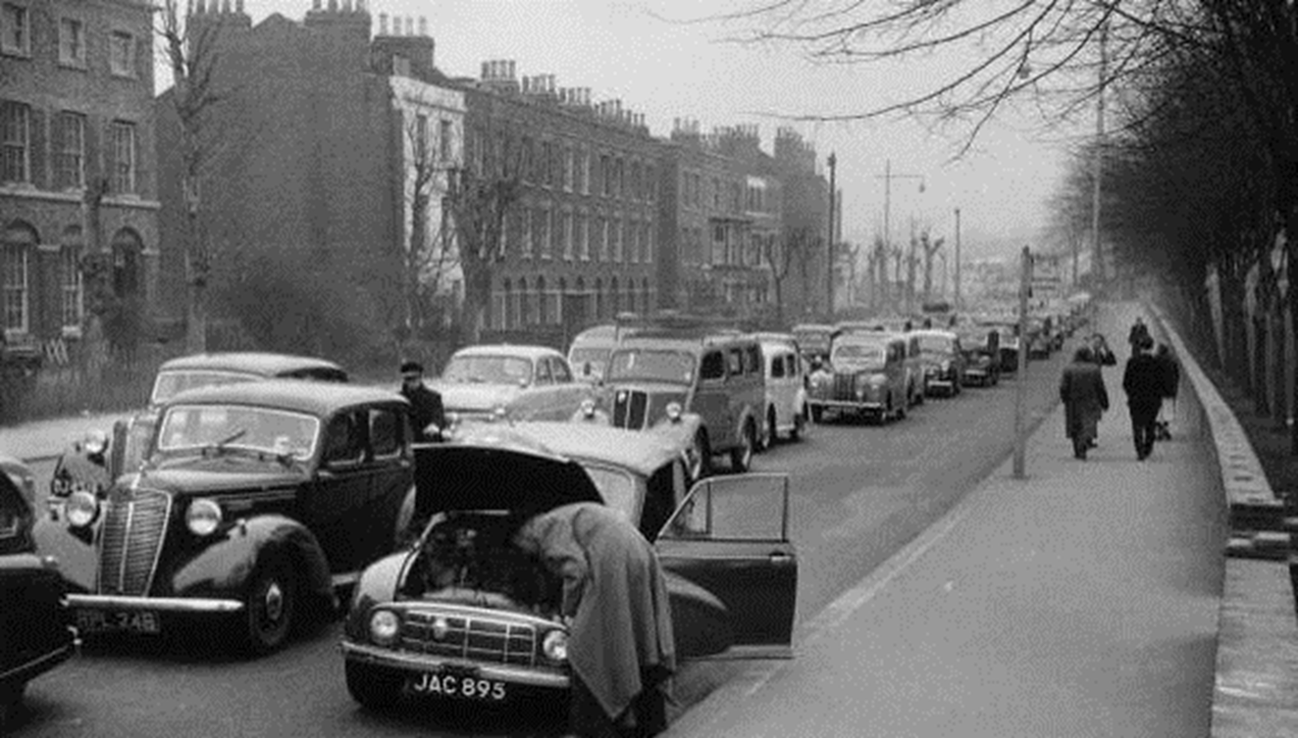
Not a New Problem After All

Slide 14
Environment Act,1995
Late 1980s and early 1990s - a growing public health concern related to childhood asthma and an association with traffic emissions.
The Environment Act of 1995 and the National Air Quality Strategy, 1997 provide the foundations for what promised to be a sustained and concerted attempt to manage air pollution and to reduce it below levels considered to be a risk to public health.

Slide 15
Public Health Challenge of Air Pollution
The political support for the radical actions required to manage the sources of air pollution contributing to today’s NO₂ and PM public health challenges appears absent.
Policy proposals and interventions proposed today are failing to recognise the scale and intensity of the public health challenge created by air pollution.

Slide 16
It’s Not for the Want of Legislation

Slide 17
National Laws
Road Traffic Regulation Act 1984
Environmental Protection Act 1990
Clean Air Act 1993
Environment Act 1995
Transport Act 2000
The Air Quality (England) Regulations 2000
The National Emission Ceilings Regulations 2002
The Large Combustion Plants (National Emission Reduction Plan) Regulations 2007
The Environmental Permitting (England and Wales) Regulations 2010
The Air Quality Standards Regulations 2010
From https://www.ukela.org/

Slide 18
European laws
National Emission Ceilings Directive 2001/81/EC
Directive 2004/107/EC
The Air Quality Framework Directive 2008/50/EC
The Industrial Emissions Directive 2010/75/EU
From https://www.ukela.org/

Slide 19
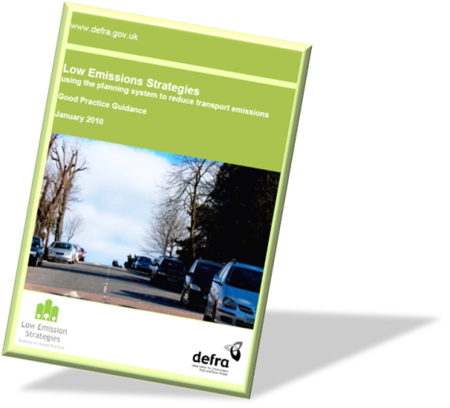
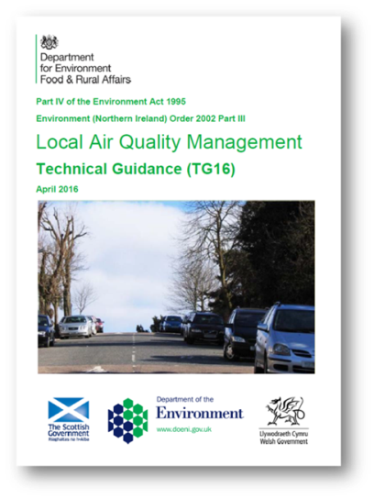
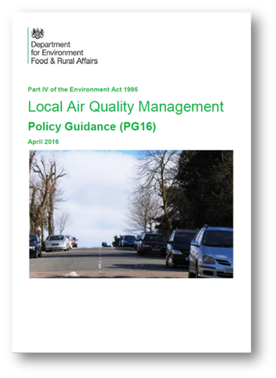
Diagnosis but Not Solutions
We have had plenty of guidance but has it been effective in delivering cleaner air?
Undoubtedly it has helped us to identify where poor air quality exists but has it led to cleaner air?

Slide 20
The Increasing Evidence of Policy Failure
1995 Environment Act and UK Air Quality Strategy set domestic annual mean AQ Objective for NO₂ of 40μg/m³ to be achieved by 2005
It was evident by 2004 that this was unlikely to be achieved on time as over one hundred local authorities had one or more AQMA declarations for NO₂ at the start of the year.
Concentrations are stubbornly refusing to comply with the policy intentions.

Slide 21
The Solutions do not Match the Problem
The Local Air Quality Management (LAQM) process was designed in 1995 it was expected that there would be “a handful of AQMAs in large cities and metropolitan areas”
By 2008: 225 LAs (52%) had AQMAs (≈500 AQMAs in total)
Now: 274 LAs (84%) with AQMAs (704 AQMAs)
These are not ‘localised hotspots’ they are local manifestations of a national problem

Slide 22
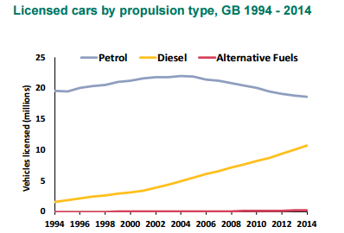
The inexorable rise of diesel
DfT Vehicle Licensing Statistics Q4 2014
Notes:
To add to this problem – there has also been a policy of encouraging more of the worst performing vehicles through incentives for diesels – in terms of both Vehicle Excise Duty and fuel prices

Slide 23
Reliance on improvements from Euro Standards for vehicles
  NOx emission factors of diesel passenger cars (TNO, 2016)
Notes:
The reliance of the 2007 AQS ignored all the early warnings that real world emissions (particularly for diesel vehicles) were not matching those anticipate under the Euro Standard regulations – over time predictions of AQ based on Euro Standards has continually fallen, but real world emissions have not – and in some cases have actually increased

Slide 24
Non-Alignment of Domestic and EU work on AQM
Monitoring and modelling of air quality for reporting under the European Directives is not well connected to domestic Local Air Quality Management
No clear responsibility for LAs in EU process
National PCM model not really able to identify local hotspots
Majority of Air Quality Management Areas not registered as exceedences of the European Directive

Slide 25
Failure of Local Air Quality Action Plans
Very hard to identify clear cases where AQAPs have been effective and improved air quality to the extent that and AQMA has been revoked
Little political weight within LAs
Even if taken seriously by LA, actions are within context of national policies backing increasing traffic flows
Not properly resourced

Slide 26
Typical Measures in an AQAP
Emissions enforcement
Promotion of modal shift
Speed reduction
Low Emission Zone
Retrofitting/scrappage
What powers does a Local Authority Environment Department have to implement these measures?

Slide 27
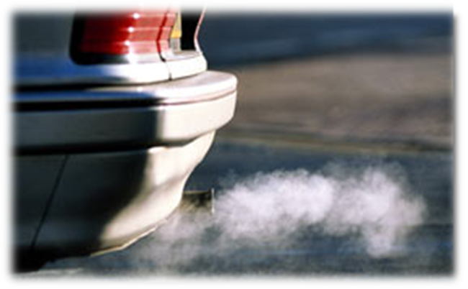
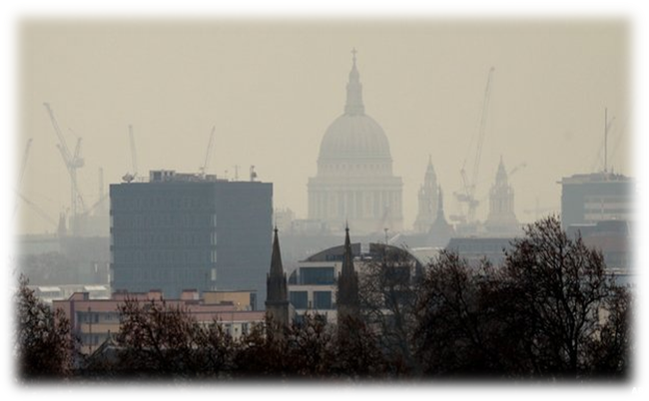
Deaths, Costs and Legal Action

Slide 28
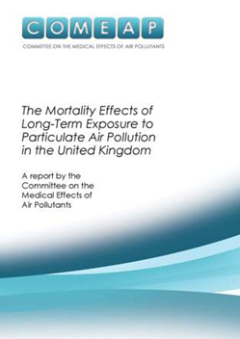
Air Pollution as a Cause of Death
In the UK about 29000 deaths per year are associated with exposure to fine particles, less than 2.5µm in diameter (PM2.5), ca. 5-6% of total deaths.
In cities PM2.5 primarily comes from cars, lorries and buses but they are also produced by the burning of wood, heating oil or coal for domestic or industrial purposes.
In Europe, the WHO estimates about 500,000 people die prematurely as a result of air pollution every year.
These estimates do not include any contribution from NO₂.

Slide 29
Committee on the Medical Effects of Air Pollutants (COMEAP)
It is estimated that the effects of NO₂ on mortality are equivalent to 23,500 deaths annually in the UK (but heavily caveated).
Many of the sources of NOx (NO₂ and NO) are also sources of particulate matter (PM).
The combined impact of these two pollutants maybe as much as 52 000 deaths per year and represents a significant public health challenge.
The response to this burden is inadequate to say the least.
https://www.gov.uk/government/uploads/system/uploads/attachment_data/file/411756/COMEAP_The_evidence_for_the_effects_of_nitrogen_dioxide.pdf

Slide 30
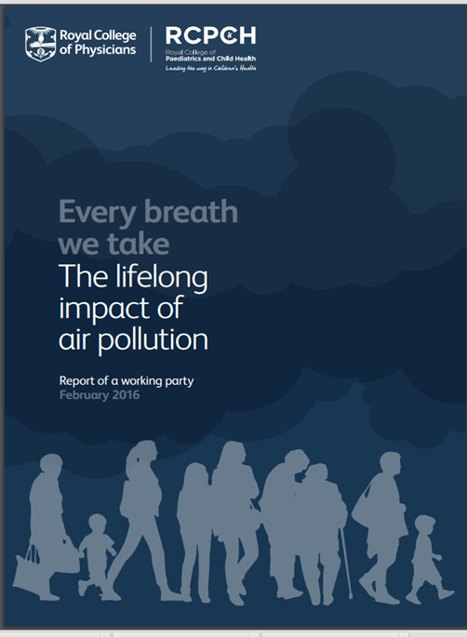
RCP/RCPH Report (Feb 2016)
Focus on health impacts of continuous exposure to chronic air pollution over a lifetime, with specific reference to:
  Pregnancy ,children and adults
  indoor and outdoor exposure
  the influence of local, regional and national policy relating to pollution control measures
  examining the influences of climate change
  socio-economic impacts of air pollution.
Estimate 40000 premature deaths annually from PM and NO₂ in the UK, this is slightly less than other estimates.

Slide 31
WHO
WHO reports that in 2012 3.7 million deaths were attributable to ambient air pollution.
This finding more than doubles previous estimates and confirms that air pollution is now the “world’s largest single environmental health risk”.
http://www.who.int/phe/health_topics/outdoorair/databases/en/

Slide 32
Costs in Context
WHO estimates air pollution costs European economies US$ 1.6 trillion a year in diseases and deaths.
For comparison
  the UK national debt is about US$ 2.33 trillion
  the Greek national debt is US$ 405 billion.
WHO study. Costs corresponds to the amount societies are willing to pay to avoid these deaths and diseases with necessary interventions.
http://www.euro.who.int/en/media-centre/sections/press-releases/2015/air-pollution-costs-european-economies-us$-1.6-trillion-a-year-in-diseases-and-deaths,-new-who-study-says

Slide 33
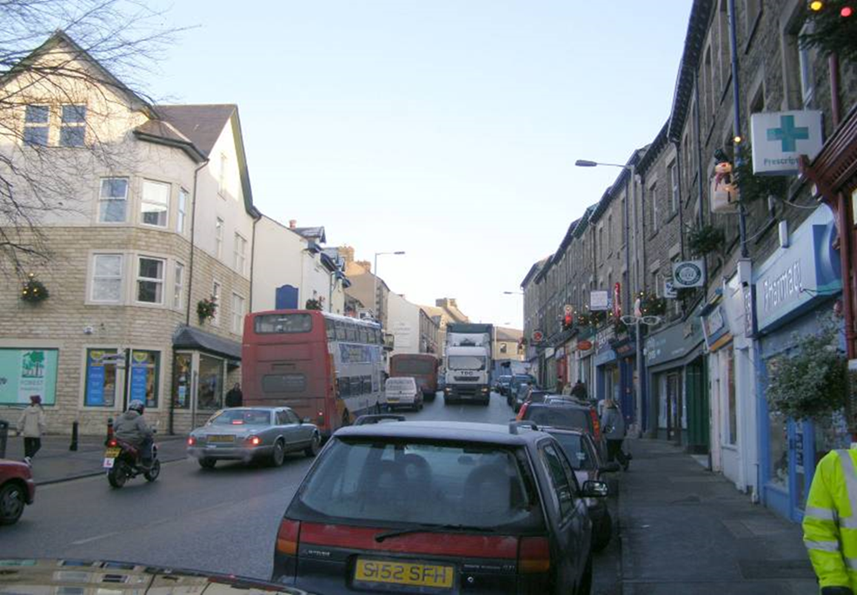
Inequality of air pollution
Who is polluted? Who is polluting?

Slide 34
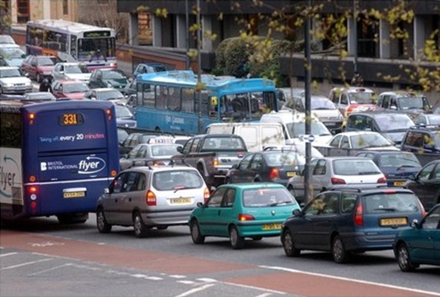
Defra Air Quality Plan
Air quality plan for the achievement of EU air quality limit values for nitrogen dioxide (NO₂) in the UK, 2015
https://uk-air.defra.gov.uk/library/no2ten/

Slide 35
Defra Air Quality Plan
The requirement for action set out in the Plan was much more modest than that previously identified by Defra.
Acknowledged that full compliance will not be achieved until 2025.
Exceedences beyond 2020 are predicted only to occur in 6 locations, Birmingham, Leeds, Southampton, Nottingham Derby and London without additional actions.

Slide 36
The Clean Air Zone
By 2020 the most polluting diesel vehicles (but not private cars) will be discouraged from entering the centres of Birmingham, Leeds, Southampton, Nottingham and Derby.
Birmingham and Leeds will discourage old diesel vans and implement measures such as park and ride schemes, signage, changes in road layouts and infrastructure for alternative fuels.
London’s strategy for improving air quality by 2025, includes the implementation of an ultra-low emission zone by 2020, retro-fitting of buses and licensing new taxis to be zero emission capable from 2018.

Slide 37
Defra Air Quality Plan
The CAZ seem to be a sibling of the smokeless zone or the AQMA. A spatial response to the problem.
The Government’s intentions were quite limited and will not address the contribution of private cars.
The Plan did not appear to offer any new financial resources to implement the CAZ nor did it appear to be backed up by substantially new regulatory powers.
Few of the measures outlined in the Plan could be described as novel and indeed most of the measures are already available to local authorities as part of their tool kit for air quality action planning: https://www.gov.uk/government/uploads/system/uploads/attachment_data/file/486619/aq-plan-2015-list-uk-national-measures.pdf

Slide 38
Defra’s Air Quality Plan
In summary, the Air Quality Plan suggested that progress towards compliance could be more rapid than previously projected, and that all UK zones could be compliant by 2025.
However the basis of the Air Quality Plan’s conclusion that NO₂ concentrations will be brought within EU limits by 2020 (2025 in London) was much more optimistic than the projections made previously.
The basis of the projections appeared to be a combination of model selection, input assumption and changes to vehicle emissions principally associated with the introduction of the new Real Driving Emissions (RDE) standard.

Slide 39
The Defra Air Quality Plan
Within the UK a broad consensus emerged amongst the air quality community.
These plans were not sufficient to address the public health challenge in the shortest time possible.
Was this an example of the UK Government striving to achieve compliance?
The Air Quality Plan simply did not go far enough to address the complexity and depth of air quality problems confronting many localities in the UK.
Much more direct action is required to confront behaviours and vested interests that hinder progress towards cleaner air for all.

Slide 40
Reframing the problem
Recognising the social AND the technocentric causes and solutions to air pollution
Address the social and structural inequalities related to both the cause of air pollution and its impacts
Enable widespread emission reductions - not just hotspot management
CLAiR-City

Slide 41
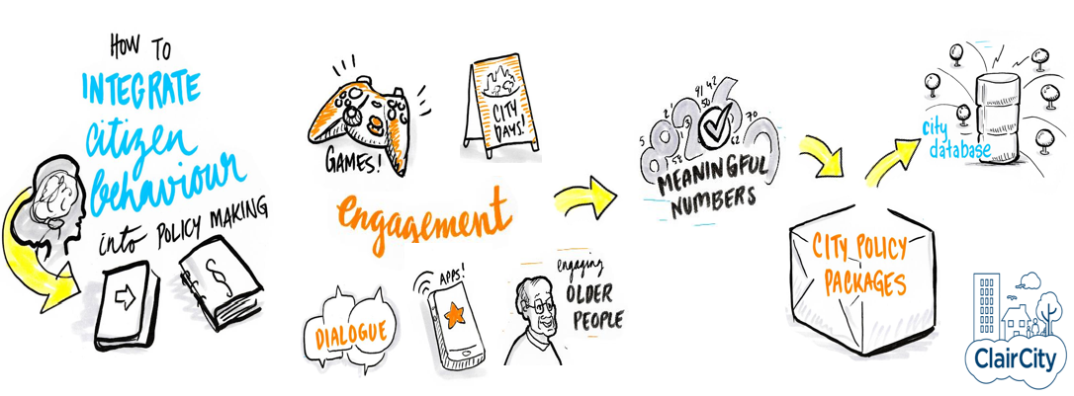
CLAiR-City
CLAiR-City project, the largest citizen-led air-quality project ever in Europe.
Considering the who and the why not just the what and where.
From top down to bottom up decision making.
What do citizens want and what are they prepared to do to get it?
www.claircity.eu
@claircity

Slide 42
Conclusions
Air quality in the UK and across the EU continues to pose a public health risk to much of the population.
Efforts to control emissions and to manage and reduce exposure continue but are often under resourced, lack sufficient political support and public understanding and engagement is often absent.
Ultimately air pollution is a choice society makes through its collective and individual behaviours and social practices.
However the consequences of those behaviours and choices will play out in many different ways with those who are least able to exercise choice having air pollution concentrations imposed upon them.
History shows that concerted, collective and sustained action can lead to dramatic improvements in air quality.
Society can choose to minimise the effects of air pollution.
New ways of thinking and acting are required.
Do we want to change?

Slide 43

Dr Ben Williams
University of the West of England,
Bristol,
BS16 1QY
UK
Email Ben3.williams@uwe.ac.uk

