Slide 1
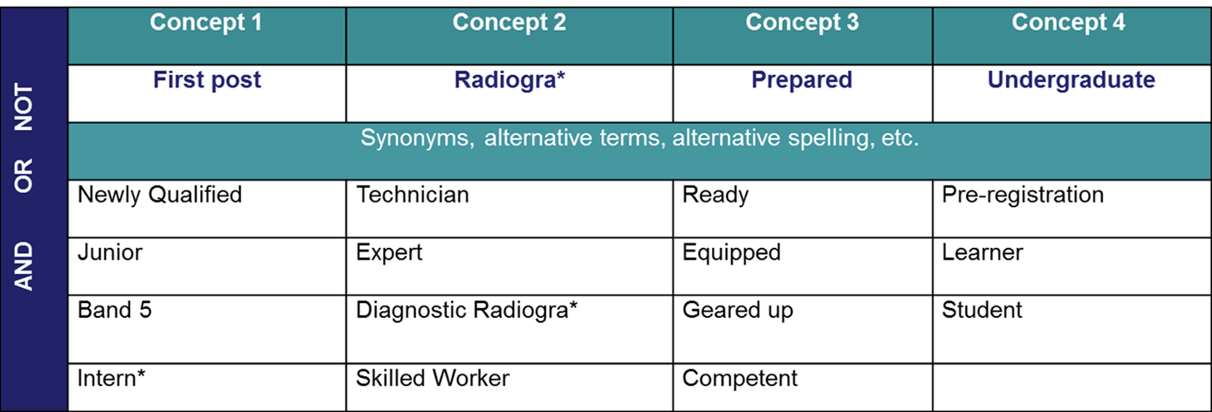
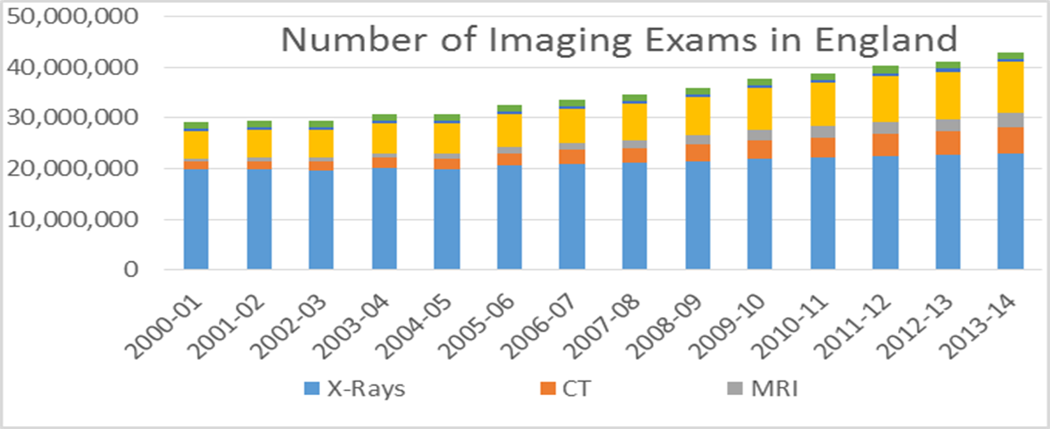

Fit for Practice; Fit for Purpose.
A Critical Appraisal of Diagnostic Radiographer First Post Experiences Literature
Janice St. John-Matthews
Allied Health Professions Associate Head of Department, University of the West of England, Bristol
Introduction The curriculum in diagnostic radiography continually evolves, driven by technological advancements, developing professional roles and a changing healthcare landscape¹.Furthermore areas of practice once seen as a specialism are now considered as first post- competencies². Accordingly there is a responsibility on each institute that offers diagnostic radiography education to ensure appropriately focused clinical and academic training of the future workforce whilst meeting professional body requirement³. Investigating the preparedness of new graduates for their first post is essential in aiding this activity.
Aims and Objectives. The aim is to critically evaluate the literature pertaining to the first post experiences of graduate diagnostic radiographers. The objectives are to identify and appraise the literature using a structured search strategy and an appropriate appraisal framework thus identifying gaps in the research so as to inform a Professional Doctorate thesis proposal pertaining to diagnostic radiography learner preparedness for their first post and radiography curriculum development.
Findings. Three papers were identified ^{8, 9, 10}. All three considered technical competency required by diagnostic radiography graduates. One paper from 2007 ⁹ explored the role of cross-sectional imaging and skull x-raying. Here the researchers aligned their questions to the 2007 HCPC radiography competencies which has been superseded by the 2014 HCPC document ^{11.} A more recent study addressed issues with theatre imaging skills ¹⁰. Although one notes these related to the challenges of inter-professional working rather than technical skills.
Method. The literature search was carried out using on-line electronic databases including Medline; Science Direct and CINAHL. A PICO (Problem/ Indicator/ Comparison/ Outcome) model was adopted for the search. To increase the search sensitivity, Boolean logic was used linking words such as “OR”; “AND” and ”NOT”^{4.}
Figure 1. PICO model adopted for literature search
Only diagnostic radiography literature was used in the appraisal. While it is reasonable to draw parallels from other healthcare profession research, diagnostic radiographers ⁵ tend to spend limited time with patients and are often thought of as “hit and run carers”. This is confounded by the fact that diagnostic radiographers will rarely encounter the same patient again and have to manage the technical components of their role during this time ^{6.} It is acknowledged that radiotherapy (RT) radiographers also have short patient contact time, however it can be argued that their communication differs. This is because they have a number similar encounters over time, thus allowing the development of a rapport with the patient ⁷.
Implications. There is no recent research specifically looking at CT, MRI and US competencies for undergraduate radiographers. This is despite statistics issued by the National Statistics Office ¹² which demonstrate that there is continuing growth in these specialist diagnostic imaging fields in England in the last 10 years compared with minimal increases in general x-raying.
Graph 1. Total number of imaging examinations in England: 1995-2014
Outcome. The literature review highlights a gap in research which explores the technical competencies required by the newly qualified diagnostic radiographer working in the modern imaging department. These findings will be used to inform a thesis proposal which addresses current undergraduate curriculum design in specialist imaging techniques.
Price, R, Radiographer Reporting: origins, demise and revival of plain film reporting. Radiography, 2001; 7, 105-17.
Pratt, S. & Adams, C. How to create a degree course in radiography: a recipe. Radiography, 2003; 91, 317-322.
Society and College of Radiographers. Education Approval and Accreditation. 2014; Retrieved from: http://www.sor.org/learning/education-accrediation
Marshall, G. Critiquing a Research Article. Radiography, 2005; 11, 55-59.
Reeves, P. Models of Care for Diagnostic Radiography and Their Use in the Education of Undergraduate and Postgraduate Students. PhD, University of Wales, Bangor. 1999; Retrieved from: http://e.bangor.ac.uk/4068/1/DX214131.pdf
Strudwick, R. McKay, S. and Hicks, S. Is diagnostic radiography a caring profession? Synergy, 2011; May ed.
Reeves, P. and Decker, S. Diagnostic radiography: A study in distancing. Radiography, 2012; 18, 78-83.
Naylor, S., Ferris, C. & Burton, M. Exploring the transition from student to practitioner in diagnostic radiographer. Radiography. 2016, Retrieved from: http://www.radiographyonline.com/article/S1078-8174(15)00118-2/abstract
Mackay, S., Anderson, A.C. & Hogg, P / Preparedness for clinical practice – Perceptions of graduates and their work supervisors. Radiography, 2007, 14, 226-232.
Decker, S. The lived experience of newly qualified radiographers (1950–1985): An oral history of radiography. Radiography, 2009, 15, e72-e77
Health and Care Professions Council. (2014). Approval and Monitoring Processes. [Online] London: Health Care Professions Council. 2014; Retrieved from: http://hpc-uk.org/education/processes/
National Statistics Office . National imaging and radiodiagnostics activity., 2015. Retrieved from: https://www.england.nhs.uk/statistics/wp-content/uploads/sites/2/2013/04/KH12-release-2013-14.pdf

