Slide 1
A Cultural Intelligent Leadership Architecture and the Built Environment
Presented by
Prof Elena Marco
PVC & Head of College
Andy Bourne, Deputy Head of Department
Kimberly Scott
BI
March / 2022

Slide 2
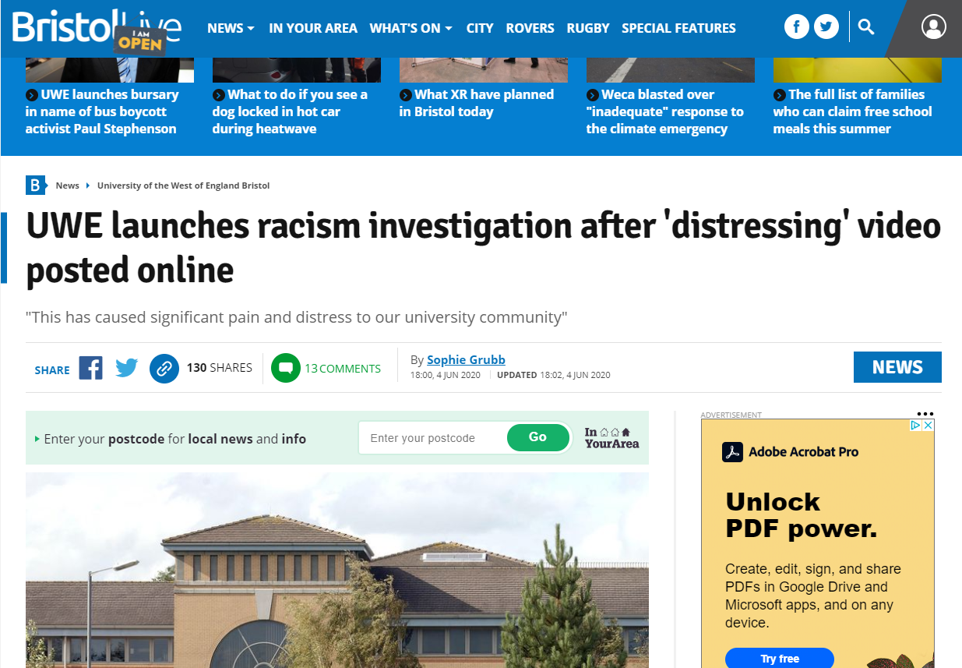
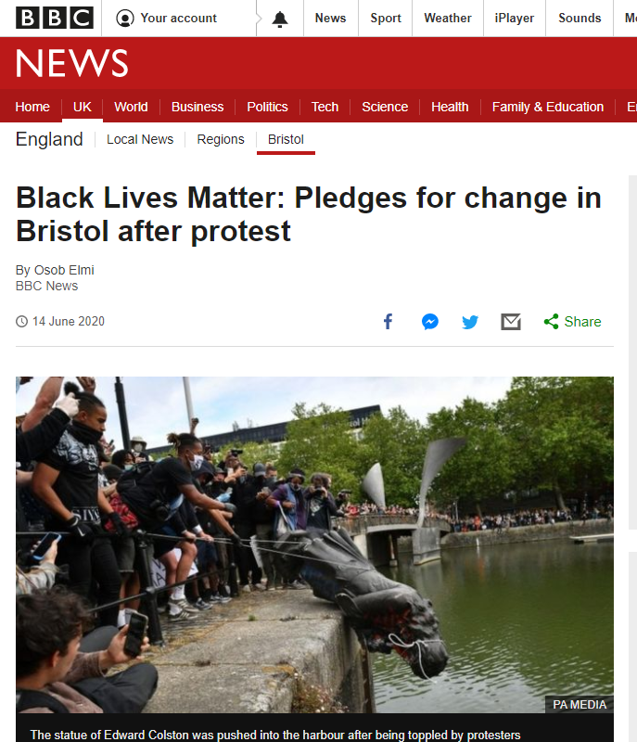

Slide 3
EDI goals and priorities t UWE
Strategy 2030 sets out three EDI goals, which focus on ensuring UWE Bristol;
Is a place where everyone can thrive and flourish
Is ambitious for every student and member of staff
Values diversity
Our priorities for action are:
Closing our award and attainment gaps relating to ethnicity, age, disability and socio-economic status. Our ethnicity award and attainment gaps are our highest priority.
Increasing the diversity of our workforce.
Ensuring all staff feel they are supported to grow and progress in their careers, through a positive and values-based UWE Bristol experience.
Ensuring all students feel they are supported to grow and progress in their careers, through a positive and values-based UWE Bristol experience.
Widening access to higher education, and to UWE Bristol in particular, for students from low socio-economic backgrounds.

Slide 4
Enablers
To achieve our goals and priorities we have:
Live our values: a culture where everyone feels a sense of belonging in which we actively address inequalities by working collaboratively.
Have clear leadership and communication: clear oversight of our strategy through an action focused roadmap with clear governance, leadership, and accountability. Effective communication internally and externally.
Use data and evidence to inform our plans and measure progress: a clear data roadmap focused on embedding EDI data within core datasets, clear objectives and theories of change and evaluation to understand impact of our strategy.

Slide 5
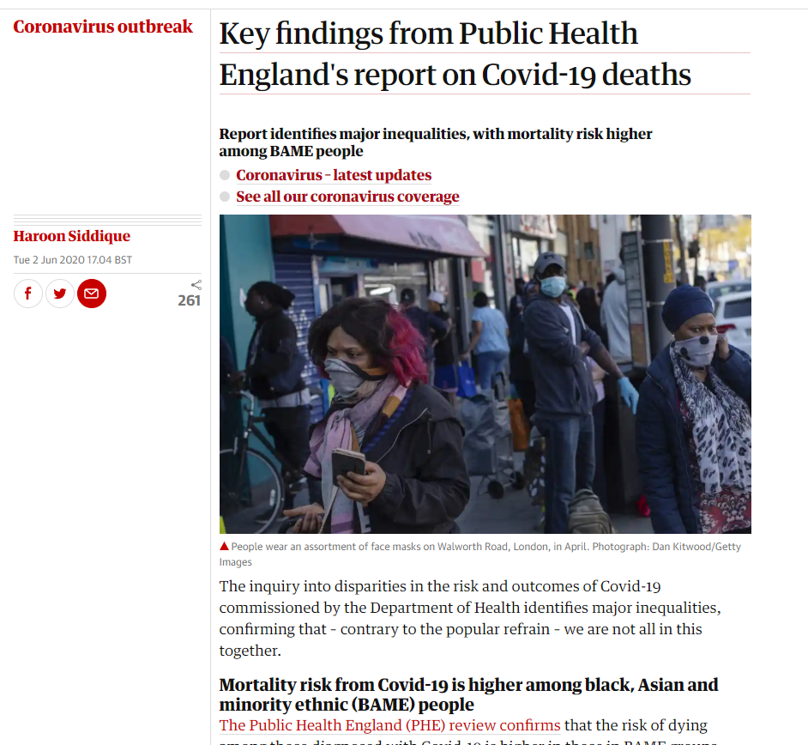
Providing an Accurate Narrative
NOT biological differences between Black Asian Minority Ethnics and non!
NO to the ‘deficit model’
Notes:
Lack of staff awareness of BME issues: this, among other things, includes a tendency to frame the issue of differential attainment by problems associated with the student (the ‘deficit model’) rather than problems relating to the educational experience.
Increased Exposure
Front line roles
Living in deprived areas
Underlying Health conditions
As a product of environment
Poor air quality
Poor access to health
Poor education
Increased Exposure
Front line roles
Living in deprived areas

Slide 6
Architecture & Built Environment’s Approach
What are we trying to shift?
Lack of staff awareness of Black Asian Minority Ethnics issues that leads to staff defensiveness
Hidden curricula
Lack of representation in the curriculum
Concerns about marking bias
Lack of ethnic support
Alternative assessment not considered
Inclusivity of learning – not everywhere
Support
Stubborn Behaviors
Assessment
Culture
Belonging
Student
Placements
Staff Diversity
Awareness

Slide 7
Staff Diversity
34 countries
45% females
20% Black Asian Ethnic Minorities
….but still work to do on our support services & leadership

Slide 8
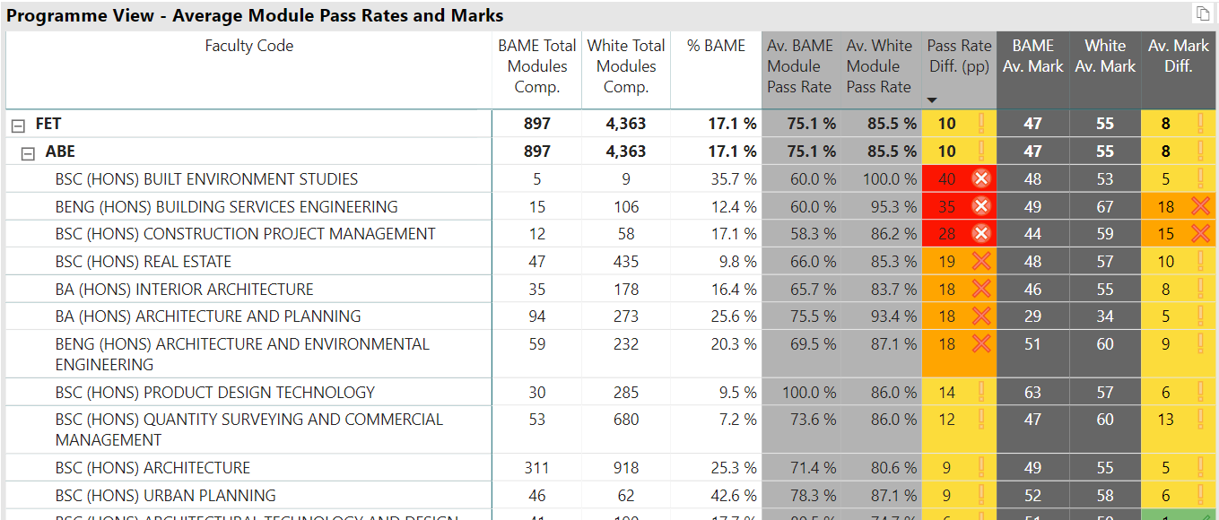
Presenting EDI for Interventions
Programme View 18/19, UG
Notes:
We were able to identify patterns
For example: CT, law, studio modules & modules related to specific staff.

Slide 9
Presenting EDI for Interventions
Programme View 20/21 UG
Notes:
We were able to identify patterns
For example: CT, law, studio modules & modules related to specific staff.

Slide 10
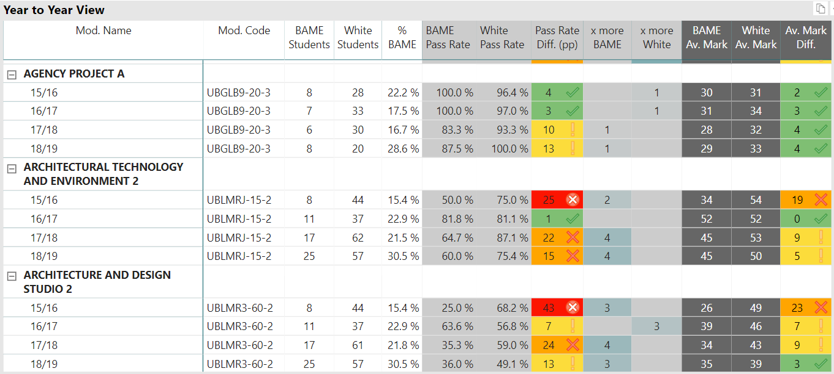
Presenting EDI for Interventions
Trend Data / Year to Year View (only shows years with enough students to produce comparable data, up to 5 years)

Slide 11
Awarding Gaps Data Insights – Progress
Ethnicity gap
Small gaps
Large gaps
Computer Science and Creative Technologies
Law
Business and Management
Art and Design
Geography and Environmental Management
Creative and Cultural Industries
Small gaps
Accounting, Economics and Finance
Engineering, Design and Mathematics
Architecture and the Built Environment
Priority Areas :
- Programmes have large numbers of Black Asian Minority Ethnics students
- Departments have large awarding gaps and/or have made less progress closing gaps
Disability gap
Signs of improvement:
- Programmes have made sustained improvements or have small gaps in a number of areas
- Some programmes have small numbers of Black Asian Minority Ethnics students affecting consistency of data
Education
Social Sciences
Large gaps
Applied Sciences
Health and Social Wellbeing
Notes:
Notes on GEM and Education:
GEM
Large overall gap for BAME but they closed the gap between White and Black students this year. The gap between White and Asian students widened.
Disability gap has closed this year and has reduced significantly – was 17pp three years ago
Education
Significant overall gap for BAME and the gap between Black and White students has been consistently large and not closing for the past three years. The gap between Asian and White students has closed this year after three years of consistent reductions
There have been no significant improvements in the largest programmes (Early Childhood and Education) but there was no gap in pass rate this year in a professional practice module – we know that placement experience is critical so this is a potential sign of improvement.
The gap between disabled students and non-disabled students has decreased over the past 3 years consistently but is still above the average

Slide 12
Cultural Intelligent Leadership
Clear ownership
Cross university evidence-based priorities focusing on key elements highlighted from Closing the Gap
Highlighting the connection between priorities and the importance of building trust
Feeds into programme specific actions with clear monitoring and evaluation
Bridging the Awarding Gap
Targeted interventions to improve teaching, curriculum and assessment.
Creating strong communities where students feel a sense of belonging.
Speak Up
Culture where discrimination and harassment are not tolerated.
Championing inclusive behaviours.
Staff Inclusion and Diversity
Increasing diversity of staff (particularly teaching staff).
Ensuring Black, Asian and minority ethnic staff have positive work experiences.
Building Trust
We will be recognised as being an organisation that lives our inclusivity values and is actively working to become more inclusive and diverse.

Slide 13
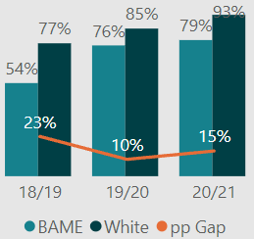
Cultural Intelligent Leadership
Focus on Leadership and creating authentic cultural diversity within a subject area
Improving the quality of the conversations on race and racism
Building intercultural understanding
Co-creating awareness of bias through student-led networks
Transforming staff diversity – building diverse teams
Building intercultural understanding and skills in learning spaces
Understanding and communicating the data consistently: Black Asian Minority Ethnics disadvantage as an accurate narrative
Good Honours rate & Award Gap for Architecture & the Built Environment
Notes:
Key points:
You have been taking ownership of the issues and ensuring your department make the appropriate changes – a key part of this is
Creating spaces for staff to have conversations about race and racism – use the examples of Ann & Flavia, and a supported Speak Up discussion session for PG programme leaders here. You have been using a mix of encouraging staff in the department to contribute and lead this work, but where issues arise you have also shown leadership and mandated involvement from groups of staff.
Building intercultural understanding through talking about difficult issues when they arise – this isn’t always easy but you focus on ensuring staff and students are listened to and respected
Creating spaces for students to co-lead this work through their lecture series (explain the impact on the sector here too!)
Building a diverse leadership team – appointing female deputy with a focus on inclusion is a key part in this.
Relentlessly communicating the key messages from the data and supporting everyone to understand this

Slide 14
What works? – now an institutional approach
Programmatic Approach to Data, so we target programme interventions whose impact is measurable. Data is not enough – culture shift needed!
Non-continuation needs to be linked to Attainment Gap data.
Attainment Gap needs to be split more – intersectional perspective.
Good Honours data needs to be shown at programme level for BAME / White.
Programme data to show the Health of the Programme and Good Honours – Value Added Score.
Targeted Student Support for success.
Focus on changing assessment for success – understanding learners
Decolonialising the curriculum – diversity of staff & role models
EDI data needs to be presented differently to allow interventions at university, faculty, department, programme or module level.
Choose a diverse set of External Examiners to help with the change of culture!
Notes:
We need a Programmatic Approach to Data, so we target programme interventions whose impact is measurable. Data is not enough – change needs to be driven by a culture shift in departments, subjects areas and institutionally.
Non-continuation needs to be linked to Attainment Gap data.
Attainment Gap needs to be split more – intersectional perspective.
Good Honours data needs to be shown at programme level for BAME / White, so again targeted interventions can be done.
Time Series Statistics in Module Field Board Reports could include the Attainment Gap statistics so we raise Module Leaders’ awareness and ensure this is linked to Module Reports. Also, Award Board Reports need to have the BAME data.
Then, CI Tool at programme level should also have the programme data of the Health of the Programme and Good Honours – Value Added Score.
Targeted Student Support for success
EDI data needs to be presented differently to allow interventions at university, faculty, department, programme or module level.

Slide 15
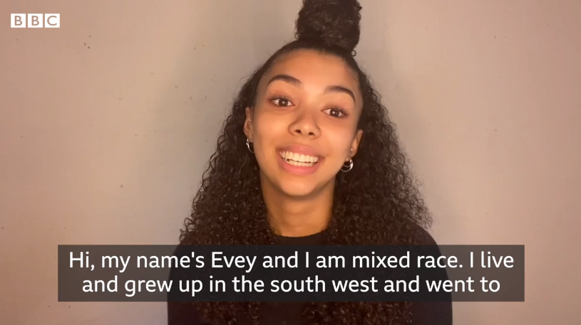
Listening to our students
https://www.bbc.co.uk/news/av/uk-england-devon-52984877/my-experience-growing-up-mixed-race-in-plymouth

Slide 16
The Right Tone from the Top – a non-negotiable

