Slide 1
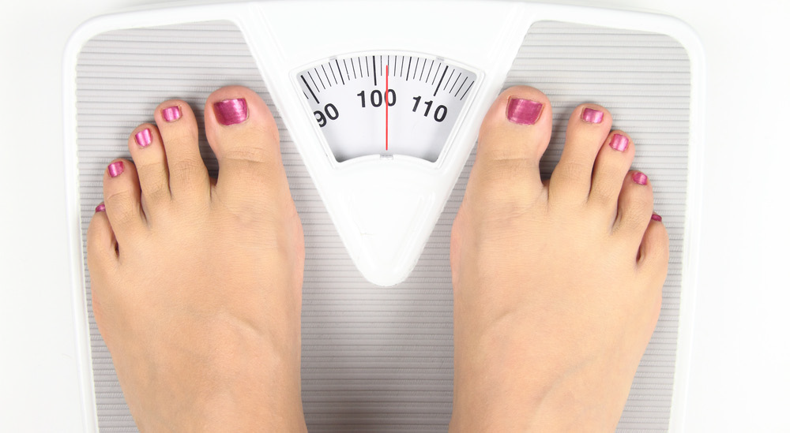
The effect of psychosocial versus surgical weight loss interventions on body image: A systematic review
Hamlet C¹, Williamson H¹, Moss T¹, Meyrick, J²
1.The Centre for Appearance Research, University of the West of England 2. Health and Social Sciences, University of the West of England
Background: Bariatric surgery is the most effective medical treatment for short and long term weight loss¹ but should only be carried out once psychosocial interventions* in combination with diet and exercise changes are attempted ². Body image (BI) dissatisfaction is cited as a key reason people seek weight loss (WL) treatment³. No systematic reviews to date have compared the impact of surgical and psychological interventions on BI, despite bariatric surgery patients losing, on average, a quarter of their initial body weight in 12 months ⁴, more than twice as much as those receiving psychosocial interventions⁵.
PRISMA flow chart of study selection
Results
Despite marked differences in the amount of WL, both bariatric and psychological interventions reported significant improvements on at least one measure of BI.
Improved BI in psychosocial interventions was not always concurrent with WL- some had improved BI with no WL. Confounded by 91% of psychosocial interventions targeting BI during treatment?
A total of 9 different BI measures were utilised across studies. The Body Shape Questionnaire was most widely used (57%) with reports of significant improvements of medium to large effect in all studies.
A distinct lack of long term follow up (>12 months) , RCTS (n=3/21) and females massively outweighed males across studies.
Records identified through
database searching (n= 6218)
Additional records identified through other sources (n= 4)
Records after duplicates removed (n= 4282)
Records excluded on title/abstract (n= 4202)
Full-text articles assessed for eligibility (n=80)
Full text articles excluded (n= 59)
Collapsed data at analysis (n=2)
Co-morbidities (n=4)
Mixed psychosocial intervention (n=5)
No pre to post BI /WL data (n=18)
Non-validated BI measure (n=8)
Prescriptive diet or exercise component (n=22)
Aim: To investigate and compare the impact of psychosocial and surgical weight loss interventions on body image among overweight or obese individuals. How much does body image change following weight loss treatment? Is this related to the amount of weight loss?
Discussion
Surgical and psychosocial WL interventions appear to improve BI. It is unclear whether BI improvements are an outcome, a mediator or play a reciprocal role with WL. BI change only appears to be considered a worthwhile outcome if the WL intervention targets it. However improvements could be indicative of broader psychological benefits which are often not considered when evaluating the success of ‘traditional’ WL programs. Many studies had limitations that compromised their integrity and the reliability of their findings (Figure 1). Furthermore ,there was a lack of data on the long-term effect on WL and BI – a particular issue following bariatric surgery where WL typically occurs rapidly during the first 6 months, then slows down until WL stops^{6,} often resulting in skin/soft tissue excess which can leave patients dissatisfied with their appearance⁷.Future research should include measurement of the long-term impact of WL interventions on BI, even if BI is not directly targeted during the intervention. This could help clarify the nature of relationship between WL and BI, what role BI plays during treatment. In addition, consistent use of BI measures would allow comparison across studies.
Methods
Data Source: PsycINFO, CINAHL, Psycharticles, ERIC, MEDLINE, EMBASE and hand searching (1995-2015)
Design: Systematic review, calculation of Hedges G effect sizes with a narrative synthesis
Study selection: papers that included overweight or obese adults (BMI>25), at least one psychosocial or surgical intervention arm and provided pre and post intervention data on BI and WL.
Study quality: assessed using the Effective Public Health Project (EPHPP) tool developed to evaluate the study design of RCTs, non-randomised trials and pre to post studies
Studies included in the review (n=21)
Psychosocial interventions (n=11)
Surgical interventions
(n=10)
Quality appraisal of studies using the EPHPP tool
Figure 1
Footnote: *The terms to describe weight loss interventions that incorporate psychological principles are used interchangeably in the literature (e.g. behaviour therapy, lifestyle modification, psychological treatment) but for the purposes of the current review they will be referred to as psychosocial interventions.
References: (1) Buchwald, H., Avidor, Y., Braunwald, E., Jensen, M.D., Pories, W., Fahrbach, K. and Schoelles, K., 2004. Bariatric surgery: a systematic review and meta-analysis. Jama, 292(14), pp.1724-1737.(2) National Institute of Health and Clinical Excellence (2014). Managing overweight and obesity in adults-lifestyle weight management services. (3) Sarwer, D.B., Thompson, J.K. and Cash, T.F., 2005. Body image and obesity in adulthood. Psychiatric Clinics, 28(1), pp.69-87 (4) Karlsson, J., Taft, C., Rydén, A., Sjöström, L. and Sullivan, M., 2007. Ten-year trends in health-related quality of life after surgical and conventional treatment for severe obesity: the SOS intervention study. International journal of obesity, 31(8), pp.1248-1261. (5) Wadden, T.A. and Foster, G.D., 2000. Behavioral treatment of obesity. Medical Clinics of North America, 84(2), pp.441-461. (6) Bond, D.S., Phelan, S., Leahey, T.M., Hill, J.O. and Wing, R.R., 2009. Weight-loss maintenance in successful weight losers: surgical vs non-surgical methods. International Journal of Obesity, 33(1), pp.173-180 .(7) Kinzl, J.F., Traweger, C., Trefalt, E. and Biebl, W., 2003. Psychosocial consequences of weight loss following gastric banding for morbid obesity. Obesity surgery, 13(1), pp.105-110.

