Slide 1
‘Social experiences of breastfeeding: building bridges between research and policy’ An ESRC-funded seminar series in the UK. A report on progress to date and emerging outcomes.
Dr Sally Dowling
University of the West of England, Bristol

Slide 2
How we started…
Two academics interested in social science research and breastfeeding (Sally Dowling and Kate Boyer).
How can our research ‘make a difference’?
How is other social science research used by those working with breastfeeding women, planning services etc.?
Could we bring together academics from a range of disciplines to talk about this with policy makers and practitioners?

Slide 3
Context
UK has some of the lowest breastfeeding rates in the world.
Social science research is a critical accompaniment to clinical knowledge in this area.
No opportunities for social science researchers working on breastfeeding to come together with UK policy-makers and practitioners to share knowledge.
Our objective is to fill this gap.

Slide 4
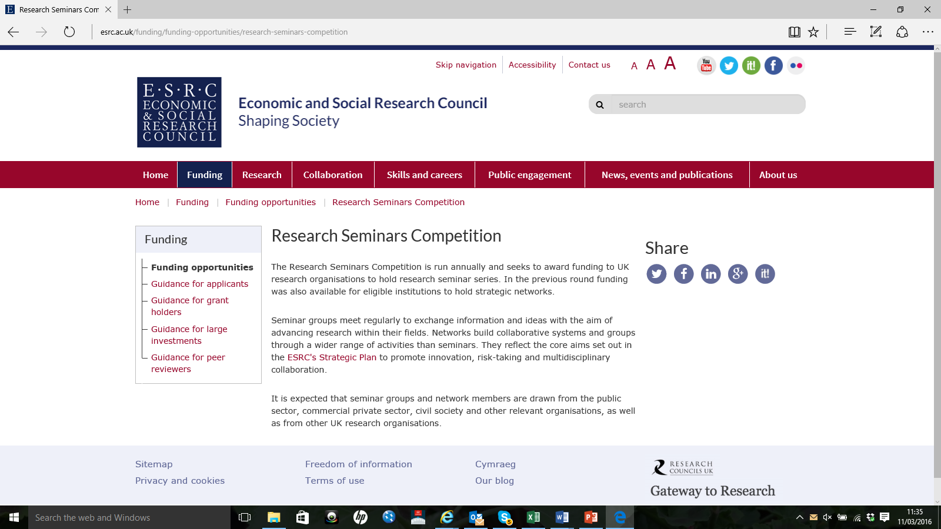
ESRC seminar series funding
The ESRC is one of the UKs 7 Funding Councils.
‘The Research Seminars Competition is run annually and seeks to award funding to UK research organisations to hold research seminar series’.
Funding is a maximum of £30,000 ($43,000) to run 6-9 seminars over 2 years.
‘It is expected that seminar groups and network members are drawn from the public sector, commercial private sector, civil society and other relevant organisations, as well as from other UK research organisations’.

Slide 5
Stated objectives
Share innovative social science research on the social experiences of breastfeeding in the contemporary UK with policy makers and practitioners;
Foster communication between researchers, policy-makers and practitioners about the everyday practice of breastfeeding;
Create effective outputs for both academic and non-academic beneficiaries and enduring networks which will lead to subsequent collaborations;
Provide a venue for postgraduates and early career researchers (ECRs) to liaise with more senior scholars in the field.

Slide 6
Seeking to ask these questions…
'How does attending to the micro-practices and affective and embodied experiences of breastfeeding women advance extant knowledge about the reasons for breastfeeding cessation?‘
'How can we further understanding about inequalities in breastfeeding rates by focusing on the nuances of day-to-day breastfeeding?'
'How might an increased understanding of these perspectives influence policy'?

Slide 7
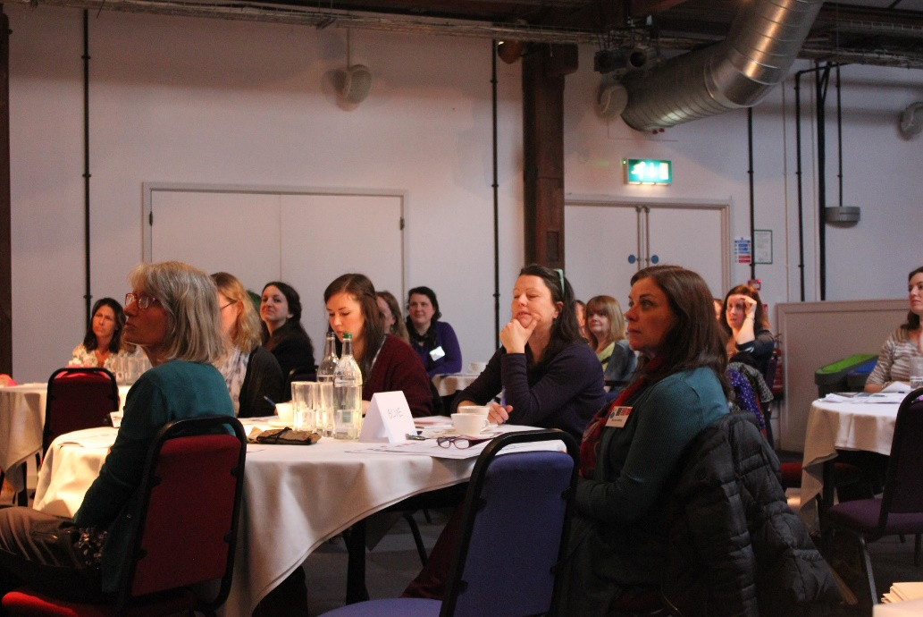
Our overall goal is…
To create an opportunity for participants from academia, practice and policy (both governmental and non-governmental) to come together to engage in collaborative knowledge-creation.

Slide 8
‘This seminar series aims to both increase the visibility of social science research in relation to breastfeeding and to highlight its relevance and applicability to policy and practice. We anticipate that the attendees identified will benefit through the forging of new links, both cross-disciplinary and between academia and policy/practice…This will potentially identify new, valuable and useful avenues for research as well as emphasising the potential for impact of interdisciplinary breastfeeding research. We anticipate that new research partnerships will also be created.’

Slide 9
Applying for funding
Other bid collaborators also – Prof David Pontin and Dr Julie Mytton.
Bid submitted January 2014; heard we were successful August 2014
Bid runs from December 2014 – December 2016.
The money pays for travel and subsistence for core attendees, venue hire and food. No salary costs.
Each seminar has one international speaker, two UK academic speakers and one policy maker/practitioner.

Slide 10
Our plan
Hold 6 seminars over 2 years (three venues)
Invite a core group of people (academics, policy-makers and practitioners) to attend each time.
Make free/low cost places available to others – particularly PhD students/ECRs/people from NGOs/practitioners.
Structure sessions to encourage conversations between people from different settings.
Produce a book/other publications at the end of the series.

Slide 11
The seminars
March 2015: Breastfeeding and changing cultures of parenting
June 2015: Breastfeeding, wage-work and social exclusion
November 2015: Breastfeeding, affect and materiality
March 2016: Breastfeeding and the politics of embodiment
June 2016: Breastfeeding, the media and popular culture
November 2016: Thinking innovatively about breastfeeding policy

Slide 12
Who has given presentations?
International speakers
Dr Cecilia Tomori
Dr Alison Bartlett
Dr Danielle Groleau
Maia Boswell-Penc
Policy maker/practitioners
Sally Tedstone
Nicki Symes
April Whincop
Geraldine Lucas
UK academics
Dr Amy Brown
Dr Lisa Smith
Dr Lucilla Newell
Dr Kate Boyer
Dr Louise Condon
Melanie Fraser
Dr Dawn Leeming
Dr Sally Dowling

Slide 13
Structure of the sessions

Slide 14
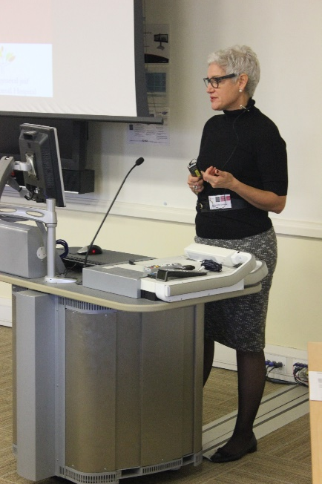
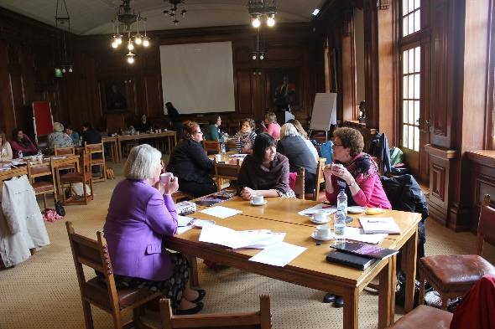
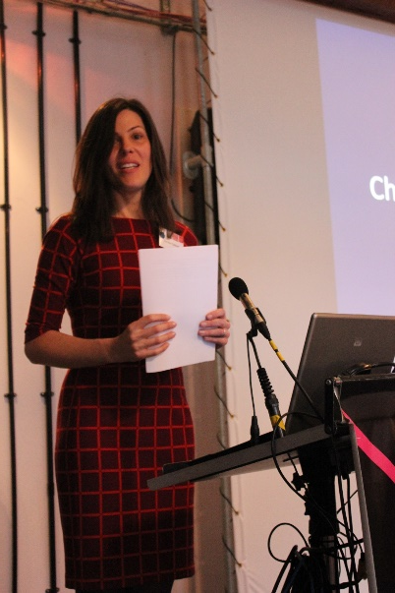
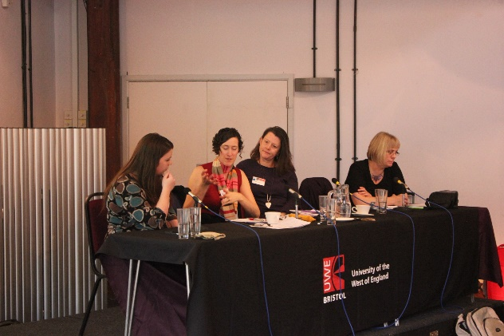
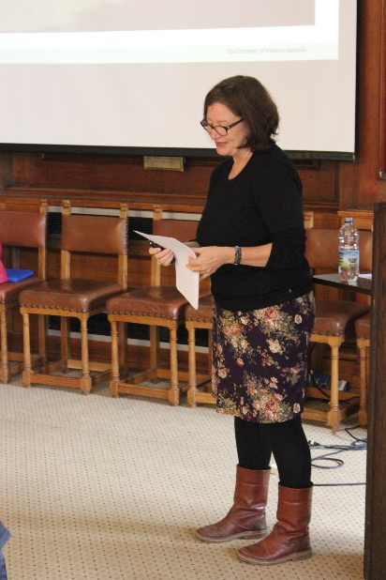
Who has attended?
20 academics
Geography, sociology, psychology, nursing, anthropology,
gender studies, public health…
43 policy makers/practitioners
Breastfeeding counsellors
Breastfeeding peer supporters
Public health managers
Doulas
Independent and NHS midwives
Infant feeding co-ordinators
Milk bank co-ordinator
Children’s centre workers
Student midwives
Public health students
8 PhD students/ECRs

Slide 15
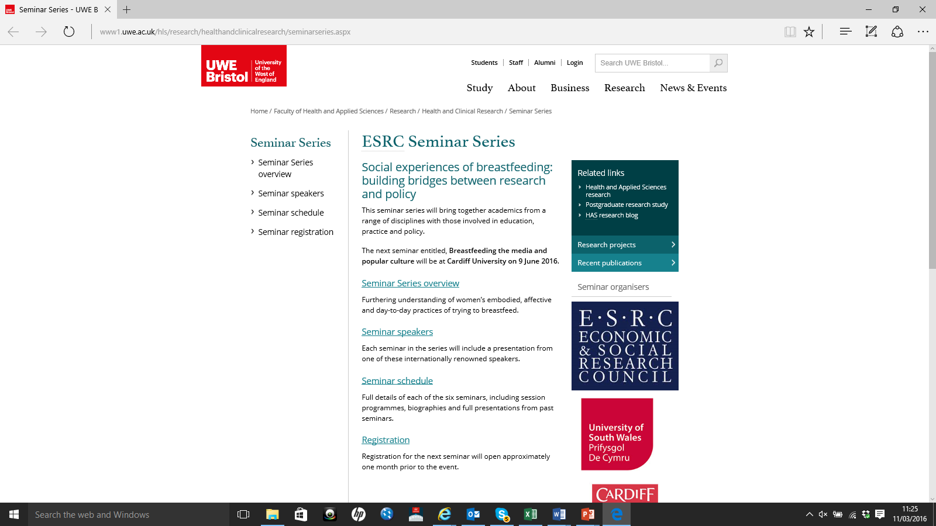

Slide 16
Website
http://www1.uwe.ac.uk/hls/research/healthandclinicalresearch/seminarseries.aspx

Slide 17
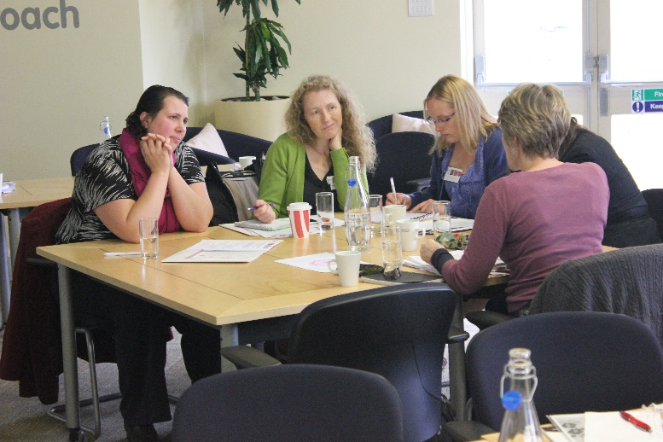
What do people say about the seminars?
‘I felt as though a different language was being spoken however I could add to the real-lived on-the-ground experience of the mother and current breastfeeding support, otherwise it was theoretical - presentations were about research in the past, and recommendations of what *should* happen and I felt that I was in the middle - actually doing it…this felt like a nice balance’
‘I wasn't expecting such a high level of academia/academic language although it seems obvious now!...The March seminar was particularly interesting from a practice point of view with the presentations on shame and longer term breastfeeding. I shall be sending the podcast links to all BFCs with a recommendation to listen.’
(BF counsellor)

Slide 18
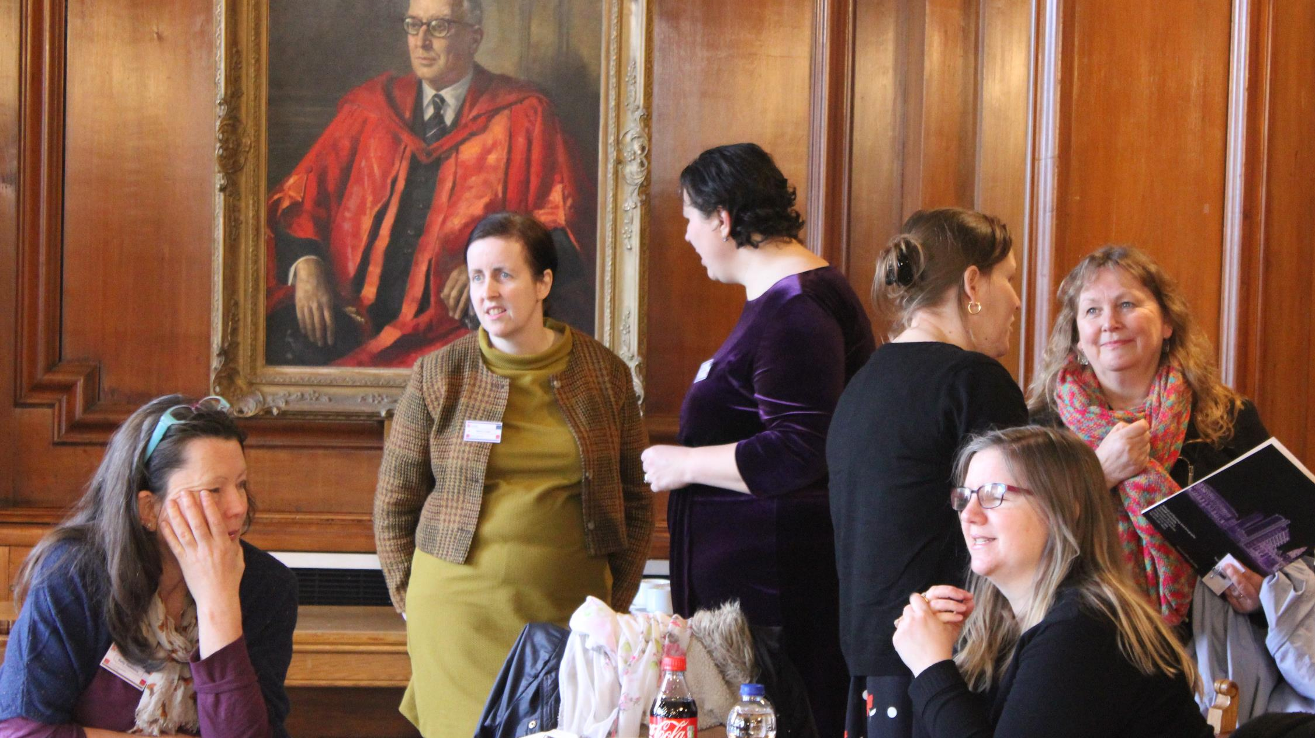
‘I found the approach really, really valuable, having a mix of academics and practitioners working together in groups. It is very easy to get lost through a narrow focus in academia, particularly dangerously perhaps when intellectually exploring manifestations of the maternal…as of course well we know that many mothers' lived experiences, stories and voices do not impact upon policy, cultural attitudes or healthcare provision, leading to isolation, depression and a kind of social invisibility. So being able to talk with practitioners working with breastfeeding mothers was really valuable’. (PhD student)

Slide 19
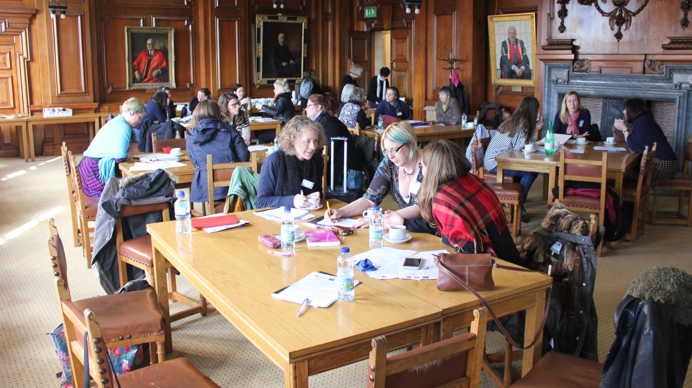
‘I wasn’t sure what to expect and wondered if it would be so academic that I would find it difficult to relate to my practice. I found the information presented in a very accessible way with very real implications for my practice which I hadn’t been expecting…The seminar caused me to challenge some of my current practice and therefore change mine and colleagues current practice with regard to young mothers’. (Breastfeeding Nurse Advisor, NICU)
‘It’s a great seminar series. One thing I particularly like is the idea of getting practitioners and academics together – such a wonderful opportunity!’ (ECR)

Slide 20
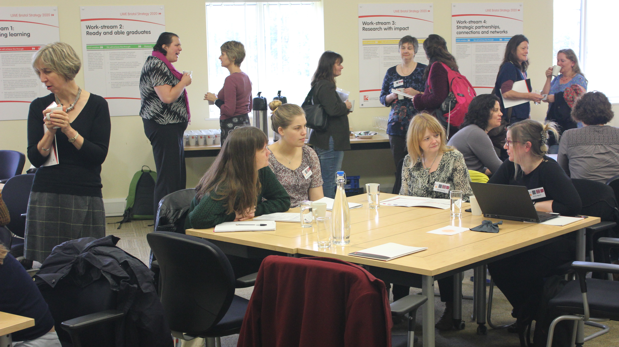
Occasionally discussions can be a little unfocused, though this isn't entirely negative as it does have the advantage of meaning we find out about all sorts of interesting asides e.g. local practices around supporting mothers…
It's also expanded my awareness of relevant literature, particularly in other disciplines.
(UK academic)

Slide 21
Still to come:
International speakers
Dr Fiona Giles
Prof Fiona Dykes
Policy maker/practitioners
Shantini Paranjothy
Francesca Entwistle
UK academics
Dr Abigail Locke
Dr Catherine Angell
Dr Julie Mytton
Plus Hollie McNish, performance poet

Slide 22
Outputs so far
Invitation to attend inaugural meeting of All Party Parliamentary Group (APPG) on Infant Feeding and Inequalities at the Houses of Parliament (November 2015).
Publicity
2 core attendees have been interviewed for radio
Bidding activities/new and emerging research collaborations.
Academic/policy/practice
Academic/academic
Paper writing
To academic journals and practitioner-facing publications
Collaborations between academics from different disciplines and with practitioners
Book
Planned with Policy Press
Broad audience – accessible to all
Cost
Meeting after final seminar to work together

Slide 23
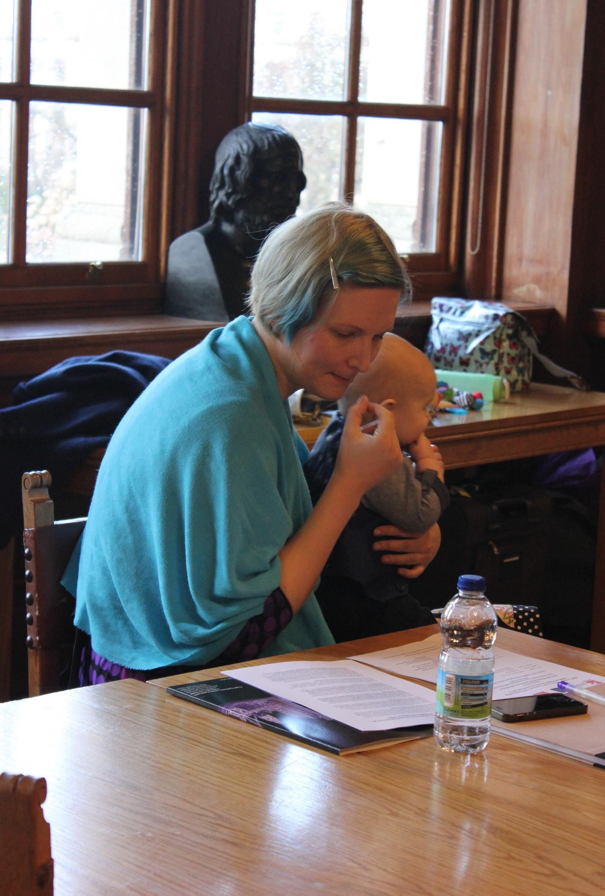
Thanks also to Dr Kate Boyer, Professor David Pontin, Dr Julie Mytton and the ‘core attendees’ at the seminar series.
Please contact me for further information
sally.dowling@uwe.ac.uk

