Slide 1
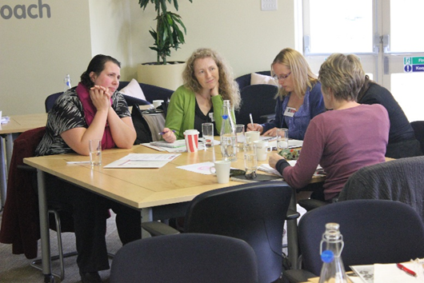
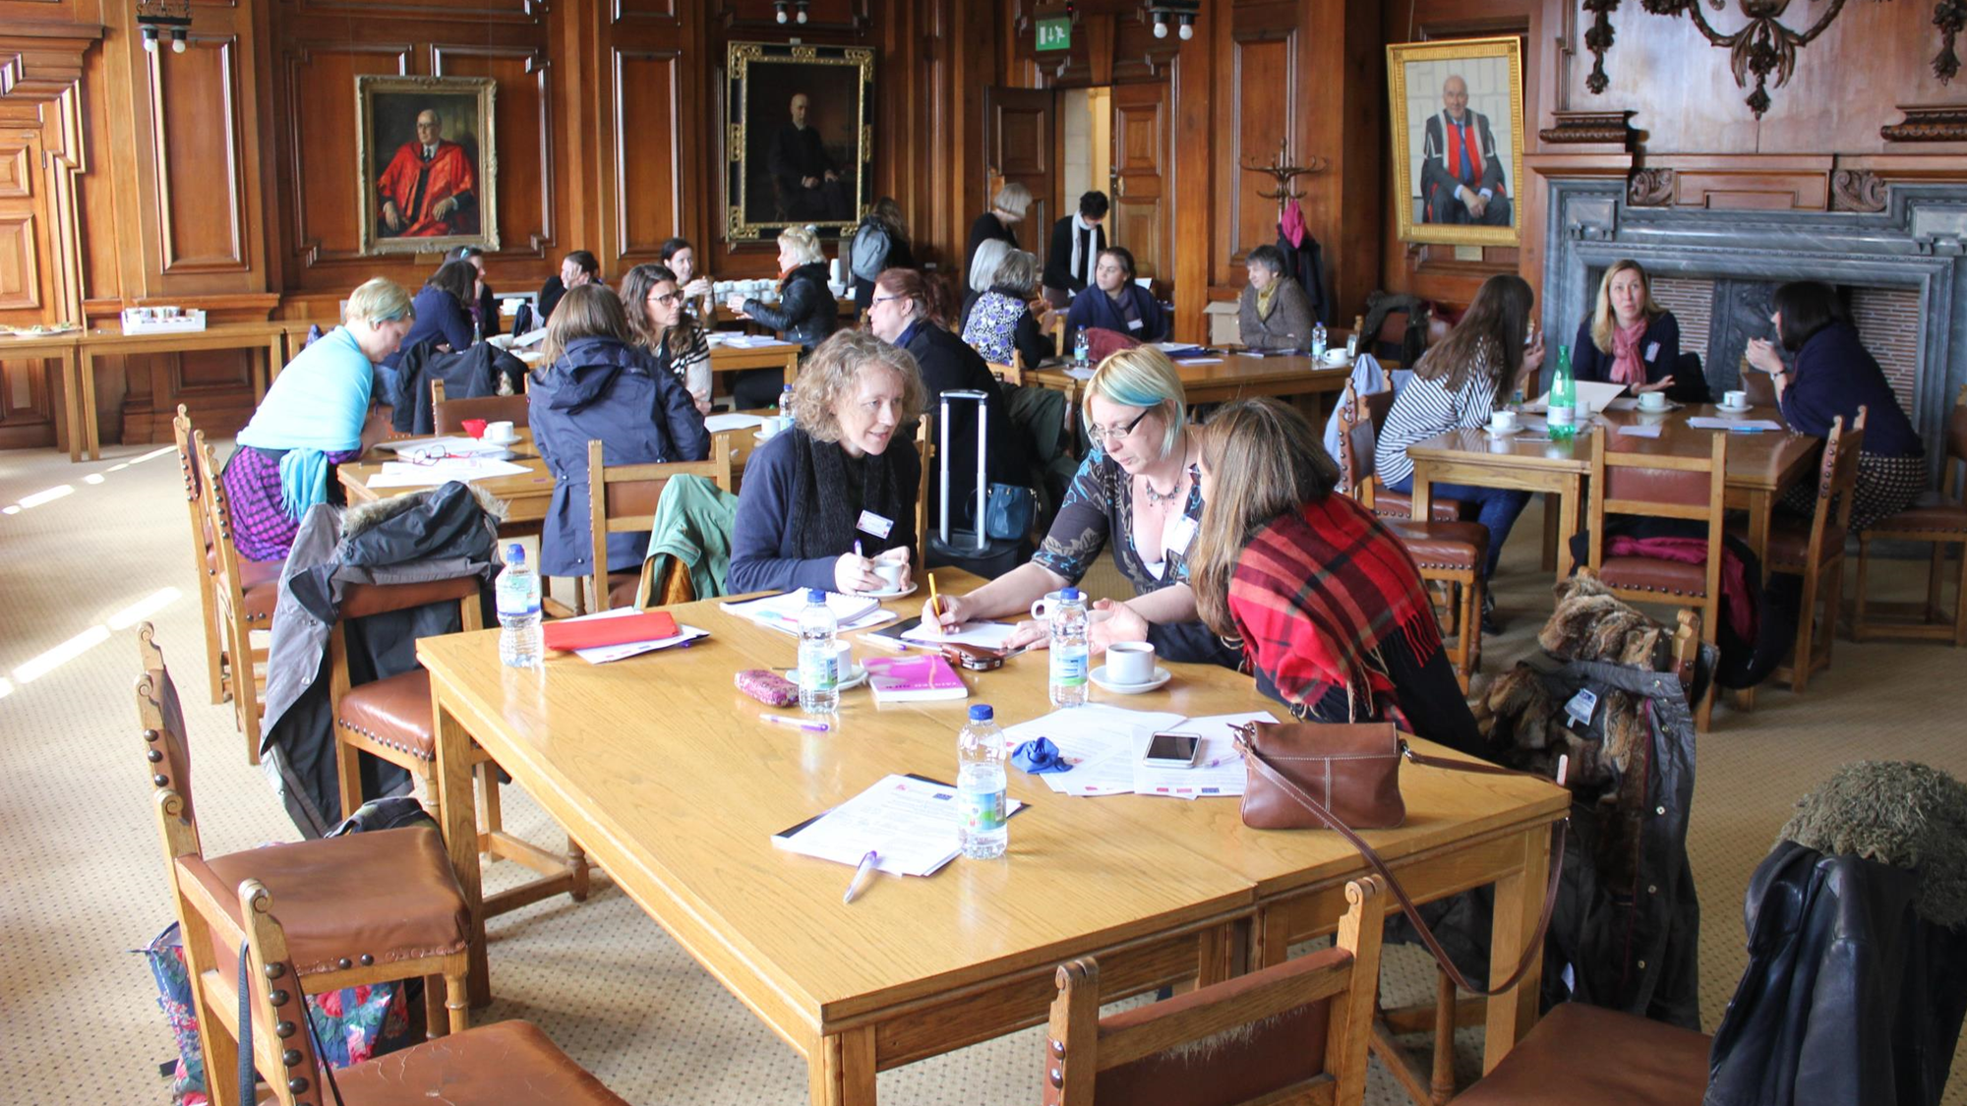
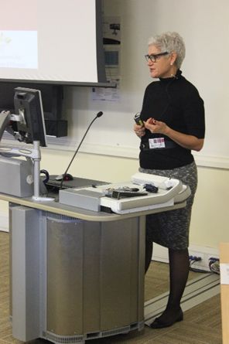
Social experiences of breastfeeding: building bridges between research and policy. Progress and emerging outcomes from an ESRC-funded UK seminar series.
What have we done?
Organised six seminars in Bristol and Cardiff 2015/16.
Funded a core group of selected academics, policy-makers and practitioners to attend each event.
Made available free/low cost places to early PhD students/ECRs/people from NGOs/practitioners.
Designed sessions to encourage dialogue, interaction and draw out diversity of experiences from delegates to inform issues.
Context
The UK has some of the lowest breastfeeding rates worldwide and there are few opportunities for social science researchers in this area to come together with UK policy-makers and practitioners to share knowledge.
Goal
To create an opportunity for academics, practitioners and policy makers to meet and engage in collaborative knowledge-creation.
Seminars
March 2015: Breastfeeding and changing cultures of parenting
June 2015: Breastfeeding, wage-work and social exclusion
Nov 2015: Breastfeeding, affect and materiality
March 2016: Breastfeeding and politics of embodiment
June 2016: Breastfeeding, media and popular culture
Nov 2016: Thinking innovatively about breastfeeding policy
Who has presented?
5 international academics
11 UK academics
5 policy makers/practitioners
Who attended?
24 academics: geography, sociology, psychology, nursing, anthropology, gender studies, media studies, public health.
54 policy makers/practitioners: breastfeeding counsellors and peer supporters, Public Health managers, doulas, independent and NHS midwives, infant feeding co-ordinators, milk bank co-ordinator, children’s centre workers, student midwives, Public Health students.
9 PhD students/ECRs
‘I wasn’t sure what to expect and wondered if it would be so academic that I would find it difficult to relate to my practice. I found the information presented in a very accessible way with very real implications for my practice which I hadn’t been expecting…The seminar caused me to challenge some of my current practice and therefore change mine and colleagues current practice with regard to young mothers’.
(Breastfeeding Nurse Advisor)
Outputs so far…
Some core members invited to inaugural UK All-Party Parliamentary Group (APPG) on Infant Feeding and Inequalities at Houses of Parliament (Nov 2015), and to subsequent meetings (Sally Dowling, Kate Boyer, Amy Brown, Francesca Entwistle)
Publicity: 2 core attendees interviewed for radio (Kate Boyer, Dawn Leeming)
Bidding activities/new & emerging research collaborations (ongoing)
Academic/policy/practice
Academic/academic
Writing papers: academic journals and practitioner-facing publications (ongoing)
Collaborations between academics from different disciplines and with practitioners
Edited book (Sally Dowling/Kate Boyer): under review with Policy Press
Aimed at a broad audience – accessible to all/low cost
Policy makers/practitioners to write commentaries on groups of academic pieces
‘I wasn't expecting such a high level of academia/academic language although it seems obvious now!... I shall be sending the podcast links to all BFCs with a recommendation to listen.’
(BF counsellor)
‘I found the approach really, really valuable, having a mix of academics and practitioners working together in groups. It is very easy to get lost through a narrow focus in academia ….. So being able to talk with practitioners working with breastfeeding mothers was really valuable’.
(PhD student)
’It’s a great seminar series. One thing I particularly like is the idea of getting practitioners & academics together – such a wonderful opportunity!’
(Early Career Researcher)
Seminar website: http://www1.uwe.ac.uk/hls/research/healthandclinicalresearch/seminarseries.aspx
Seminar team: Dr Sally Dowling¹, Dr Kate Boyer², Prof David Pontin³, Dr Julie Mytton¹.
¹University of the West of England, Bristol; ²Cardiff University; ³University of South Wales
For further information contact: Dr Sally Dowling sally.dowling@uwe.ac.uk

