Slide 1
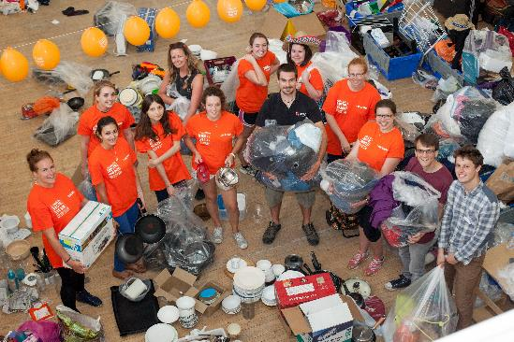
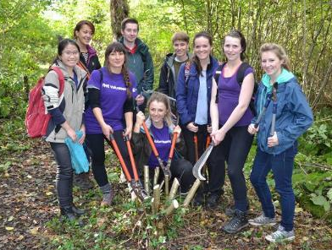
Student Capital: the role of students in city transformation
James Longhurst, Chris Willmore, Billy Clayton, Georgie Gough, Amy Walsh, Hannah Tweddell
University of Bristol and University of the West of England Bristol

Slide 2

Students: lived lives
The biggest single sustainability impact of any University is its graduates
How do we support students to learn to tread more lightly in the lifetime ahead of them?
How do we mobilise student creativity to transform us and our city?
Students as Global Ambassadors:
“I learnt to live sustainability in Bristol – we can live like that too!”

Slide 3
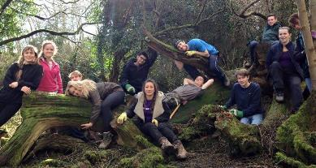
Challenge: mobilise 10% of the population
Bristol city:
  450,000 population and 1.5m catchment
  City of radical, innovative people
  Vision of inclusive, sustainable city
European Green Capital 2015
Students 10% population
A transformational change in student engagement – our city making the change

Slide 4
How?
Bristol European Green Capital 2015 as catalyst
Unique university partnership
  Within: whole institution approach
  Between: all Universities and Student Unions together
Bristol Green Partnership: >850 organisations
City Council and Mayor
Funded by Higher Education Funding Council for England Strategic Catalyst Fund as test bed

Slide 5
100,000 hours of student action for sustainability
Students engaged in 100,000 hours of city community activity
Volunteering, internships, placements, and projects for sustainability
Over 220 Public, private sector, voluntary groups, NGOS, communities
Large and small scale, individual, and collective
NOT just this year, but every year

Slide 6
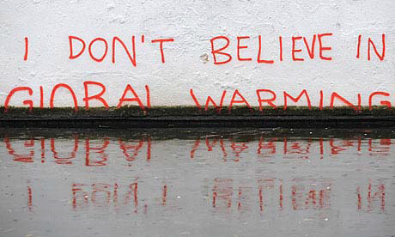
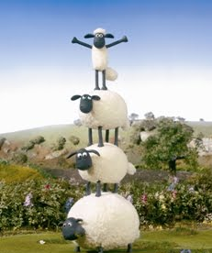
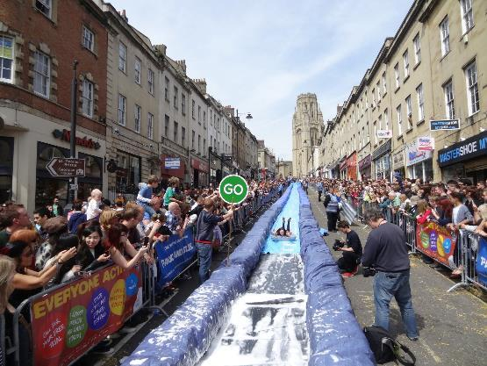
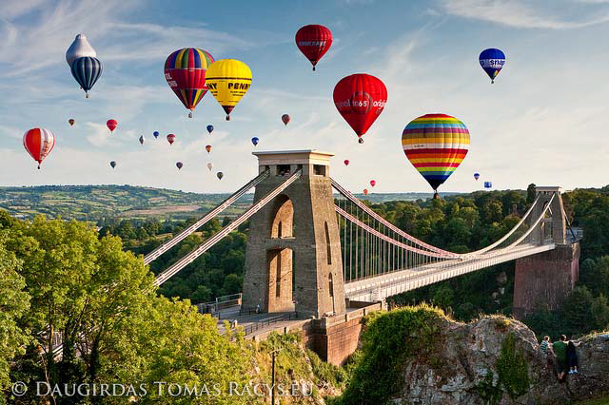
Celebrate
Give ownership
Have fun!

Slide 7
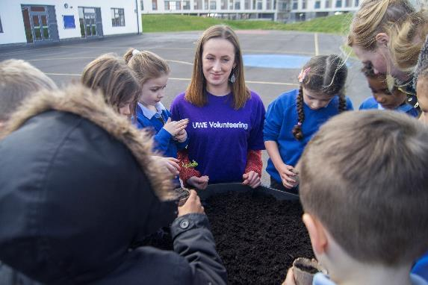
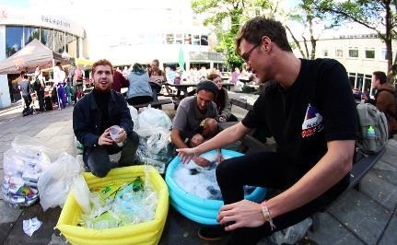
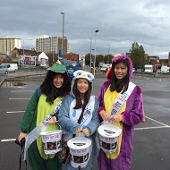
What have students been up to during Green Capital?
Cash: raising £300k for local charities through recycling
National schemes: FoodCycle
Education: delivering workshops to schools
Conservation: Designing Wildlife Corridors
Energy champions
Health: Obesity prevention
Greening Business : waste and energy audits and green business plans
Notes:
One international student put in 170 hours for 14 organisations in 6 months

Slide 8

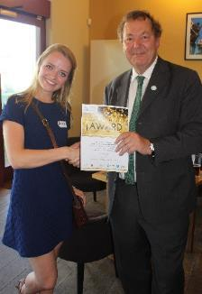
The Change Makers
  New award created to celebrate and reward students efforts
  Two levels: Change Maker and Gold Change Maker
  Three public award ceremonies held to-date
  Over 700 confirmed Change Makers
  The awards will continue into the future

Slide 9
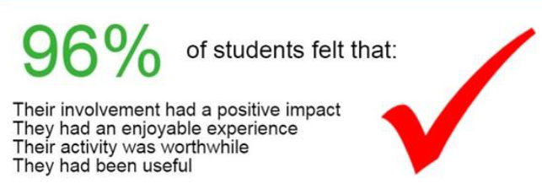
Outcomes…
What’s the point of being in Bristol if you don’t join in?
We felt they really got to understand our business and produced a brilliant business plan that is really going to help us going forward
  >2500 students
  >120,000 hours
  >£1 million value
  Changing student understanding of what it means to live in a city
  Changing our city
It gave me the belief to move to Bristol: I now sell three times as many bikes
It has been fantastic to work with the University as well; lots of people in this area don’t go on to University or have any connections. It has really changed our perceptions
It made me feel I belonged

Slide 10




  Online brokerage platform
  “Front of house” for local organisations to engage with students
  Maintained in partnership between Universities
  Case studies
  Easy and direct contact with right people
  City-wide benefit

Slide 11
Experiences…
Notes:
Student quotes

Slide 12
Who’s taking part?
Notes:
Student quotes

Slide 13

Skills Bridge
Change Makers
Partnerships
  City-wide
  Universities
Student Capital becomes integral part of Universities

Slide 14
For more information please contact
James,Longhusrt@uwe.ac.uk
Chris.Willmore@bris.ac.uk
Clayton, W., Longhurst, J. and Willmore, C. (2016) Review of the contribution of Green Capital: Student Capital to Bristols year as European Green Capital. Project Report. eprints.uwe.ac.uk/28311
Clayton, W., Longhurst, J. and Willmore, C. (2016) The Bristol Method, Green Capital: Student Capital. The power of student sustainability engagement www.bristol2015.co.uk/method/european-green-capital/

