Slide 1
The UK Scallop Fisheries Time for a fundamental review The law
Dr Thomas Appleby
Associate Professor in Property Law
Solicitor of the Supreme Court (non-practising)

Slide 2
Scallop Dredging

Slide 3
Under international law whose fishery is it?
cc licence Maya Ibuki
Notes:
All rights in the resources of the high sea are vested in mankind as a whole
UN Convention on the Law of the Sea, Article 137
In the exclusive economic zone there a coastal state has sovereign rights in living or non-living natural resource
UN Convention on the Law of the Sea, Article 56
Common Heritage of mankind
Public right to fish

Slide 4
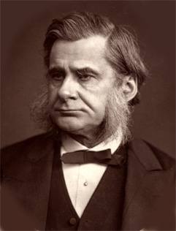
The default position is for the sea to be a fishery
“Oyster fisheries may be exhaustible for those which lie outside the territorial limit [3 miles] no real protection is possible”
Inaugural Address to the Great Fisheries Exhibition, London - 1883
Thomas Huxley
Notes:
Reasoning:
Blasphemy realm of the gods – Oppidian
by nature open access – Pandects of Justinian
The Normans – Institutes of Azo
Sailors for the Royal Navy – Sea Fishing (Scotland) Act 1704
Unpractical to regulate – Thomas Huxley

Slide 5
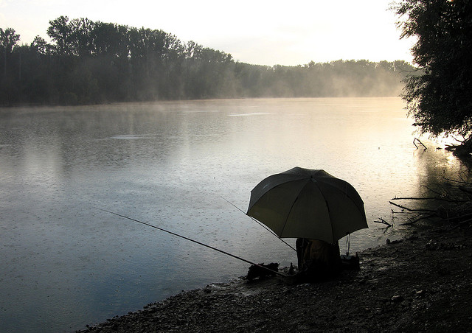
What are fishing rights in law?
Probably a profit a prendre in gross held by the public
It is ‘untrammelled’ but at some level would constitute a trespass to the seabed owner
cc licence tbee
Notes:
In essence it is similar to a right to fish from a riverbank – but owned and operated by the public
Adair v the National Trust

Slide 6
Scallop dredging and other public uses of the seabed
Submarine Cable Systems
Source TeleGeography
Notes:
But could include MPAs, aggregrates dredging, wind farms and gear conflict

Slide 7
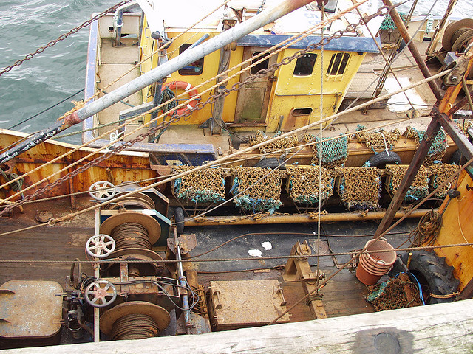
Scallop Dredging Regulation
Vessel licences on over 10m vessels
Limits on dredge numbers per side
Minimum landing size
Days at sea in some areas for over 15ms
Some spatial closures
cc licence Ostaleri

Slide 8
Starting Point
No quota
No initial zonal restrictions
cc licence Silverstack

Slide 9
Conclusion
The fishery is a public resource
The current system permits scalloping anywhere until it gets stopped; scalloping is a default fishery
It has obvious serious negative implications for other marine users
Is this the right way around for such an intrinsically invasive fishery?

