Slide 1
Presentation by
Win! Win! Win! Win!
A case study of student / tutor / researcher / technician collaboration in teaching and research integration.
Michael Horswell, Nevil Quinn, Harry West & Paul Satchell
21 June 2016

Slide 2
Researcher perspective:
The Need
Nevil Quinn
Associate Professor in Applied Hydrology

Slide 3
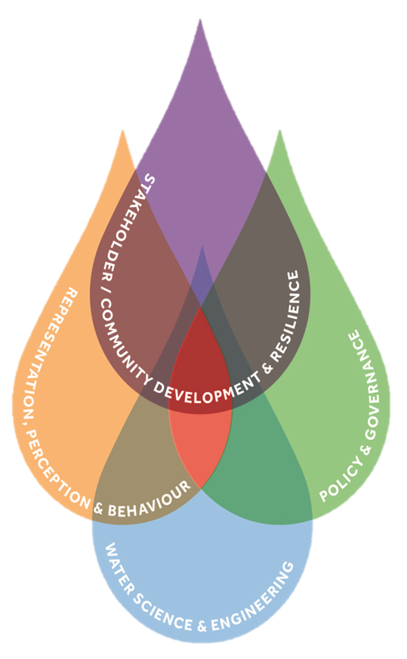
The CFCR and the DRY project
Centre for Floods and Community Resilience
“world class research, knowledge exchange and co-generation, science communication, community engagement and training for decision makers at all levels”
DRY Project
Part of ‘UK Droughts and Water Scarcity Programme’
bringing together information from drought science and with stakeholder engagement and narrative storytelling

Slide 4
Identifying and meeting a need
Value of the spatial view of data recognised – seven case study catchments across England, Scotland and Wales
Using location as an integrator for information from a range of stakeholders
Many opportunities for spatial analysis to reveal interrelationships and to present future scenarios
Maps and spatial visualization recognised as key tools in stakeholder engagement

Slide 5
Challenge for the DRY project
Specialised skills & knowledge needed to implement vision
Value of this teaching/research integration exercise:
Ten third year GIS students working on three projects defined by DRY researchers
Outputs, three ESRI StoryMaps, providing a valuable engagement resource to the DRY project
Process has helped identify further research needs

Slide 6
Tutor perspective:
The Response
Michael Horswell
Senior Lecturer in Applied GIS and Spatial Analysis

Slide 7
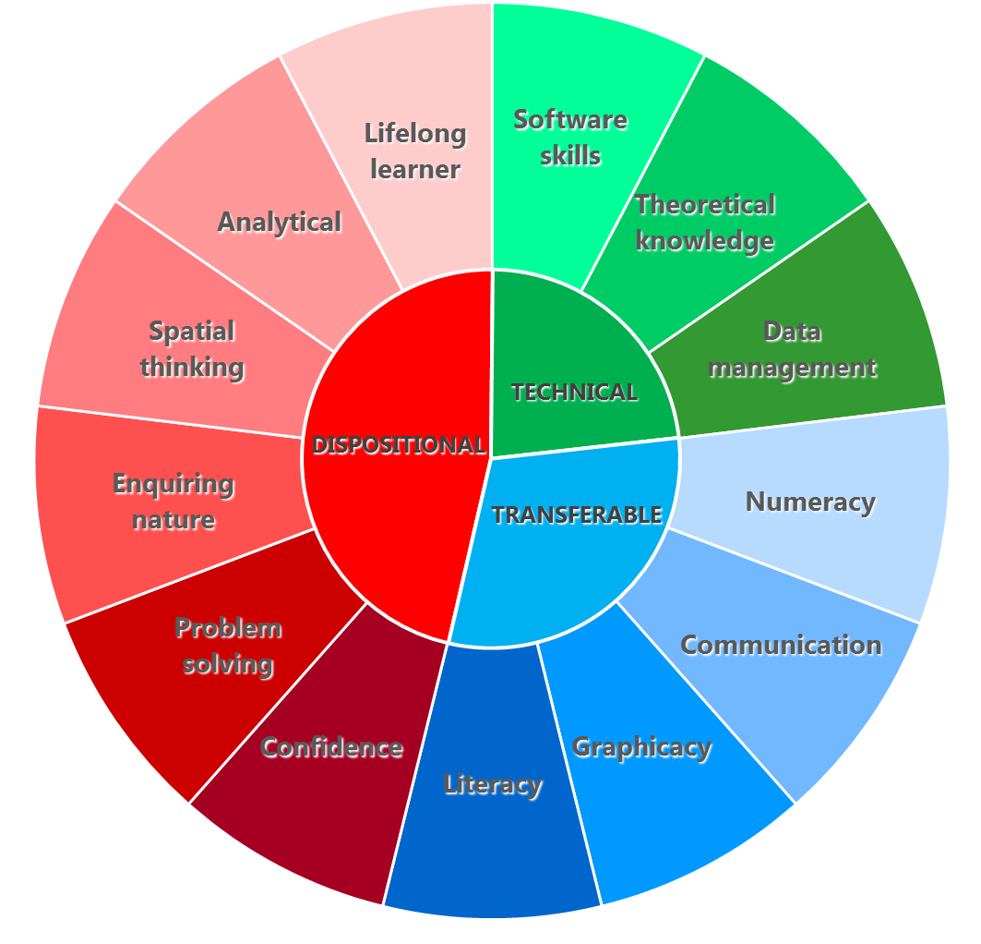
Practice-oriented learning
An applied discipline - prepare students for professional practice
professional skills and dispositions
fully engage in the experiential learning cycle
planning, preparing, engaging in practice
reflecting, interpreting and making connections
Technical University of Sydney (online)

Slide 8
Learning and assessment
Offering final year students the opportunity to participate in research activities in this way, and to provide something of value to the researchers was a natural fit with the approach to GIS learning and teaching
“complex of knowledge, skills and other attributes that are tied to the objectives of instruction or otherwise valued by society”
Life beyond university
Curriculum and practice
Content and instruction
Authenticity
Processes and products
Conditions
Figurative context
Messick (1994) in Palm, T. (2008) Performance assessment and Authentic Assessment: A conceptual Analysis of the Literature. Practical Assessment, Research & Evaluation 13(4): 1-11

Slide 9
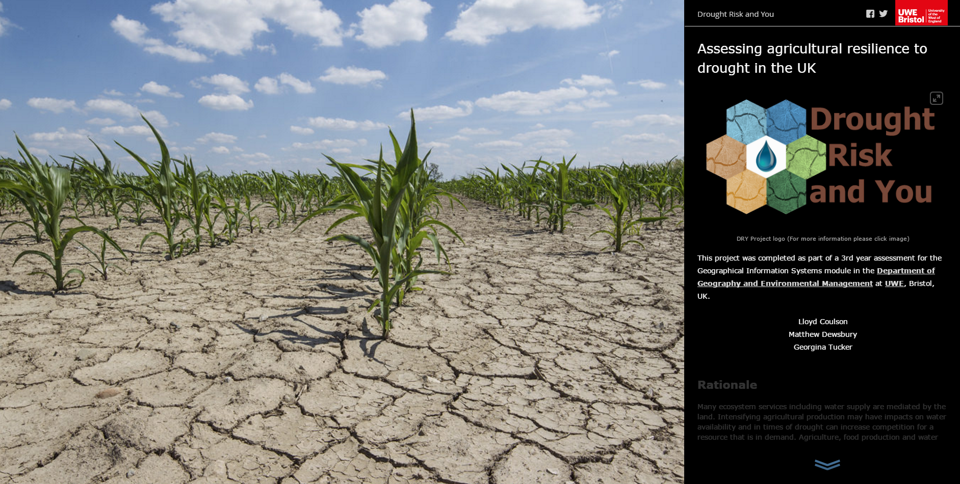
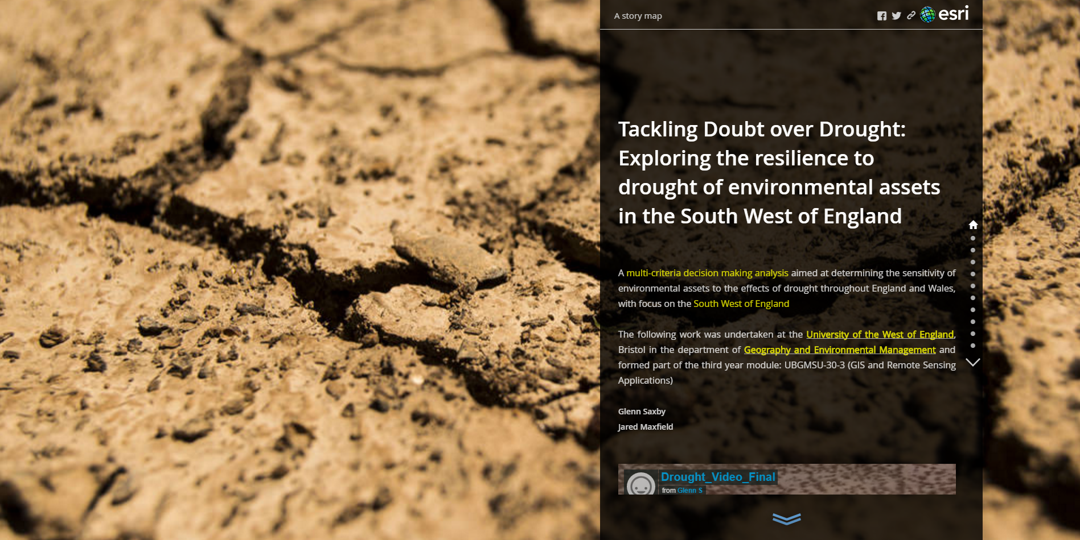
Three student projects

Slide 10
Student support perspective:
The Process
Paul Satchell
GIS and Cartography Support Technician

Slide 11
Supporting students
Student cohort being pushed
Data sources not normally available to students through the researches need supporting and licensing correctly
Had a higher awareness than a typical undergraduate student because of the access to specialists
Managing the student ‘budgets’
More challenging and engaging
interaction with students!

Slide 12
Supporting researchers
Technical awareness & skills development
Online, web-based solutions
Public participation facilitation
Consideration of the needs of a range of
internal & external stakeholders

Slide 13
Support experience
Awareness
Communication
Interaction
Management
Research activity
Stakeholders
Science
Digital cartography
User needs
Online resources
Student “budgets”
Data licencing
Professional development

Slide 14
Student perspective:
The Product
Harry West
Third year GIS student

Slide 15
Challenges
Collaborative process
DRY was already an established project within the department
We needed to quickly understand the projects aims and underpinnings in order to create our own GIS projects within the scope of DRY
Close liaison with researchers within the CFCR
Theoretical learning
New thematic content behind the projects that had not been covered in modules/assessment before
New theory and new methodologies (fuzzy logic, drought assessment, MSI)

Slide 16
Benefits
Students as researchers
New perspective on assessment – a “real life” project
Gives the assessment process a sense of purpose
Communicating research outcomes to a diverse audience – language choices, layout, interactivity
Life after assessment
Our projects become a resources to the DRY Project
Recognising our ability to learn responsively

Slide 17
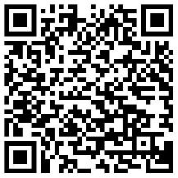
Product: A StoryMap

Slide 18
Conclusions
Opportunities and benefits for all

Slide 19
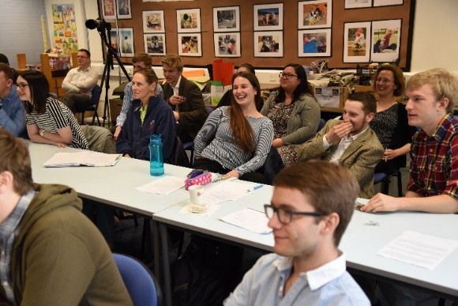
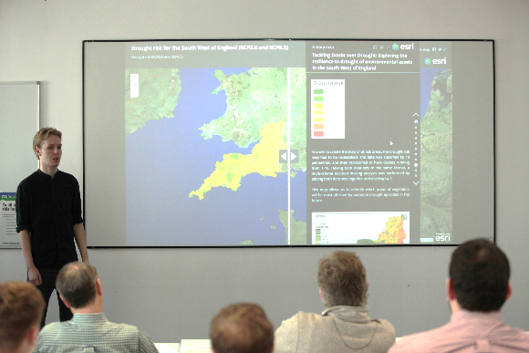
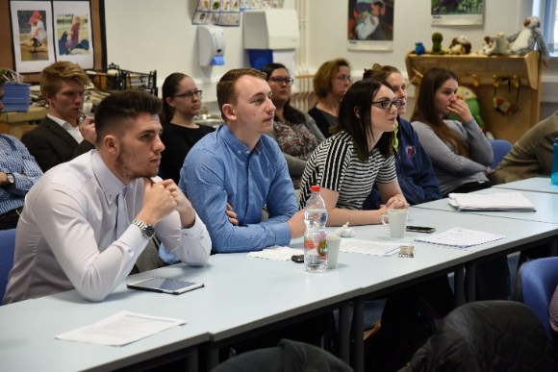
Win! Win! Win! Win!
Access to expertise
Professional development
Disciplinary extension
Useful outputs
Skills development
“Workplace” experience
Employability
Opportunities to excel
Reflective practice

