Slide 1
Welcome to the pedagogic borderlands
Jennifer Hill & Harry West
UWE Learning & Teaching Conference, 21 June 2016

Slide 2
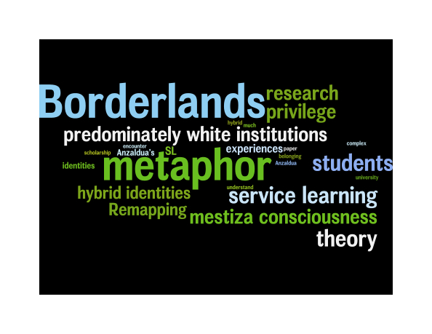
Presentation outline
An invitation
Introductory (re-)conceptualisations
Borderland spaces for learning:
- introduction
- characteristics
- empirical research example
Conclusions
RWendler@email.arizona.edu

Slide 3
An invitation
we invite you to let go of the familiar
to consider how spaces in higher education might be used
creatively for pedagogic practice as borderlands
encourage you to reconceptualise pedagogic spaces,
identities and practices for you and your students

Slide 4
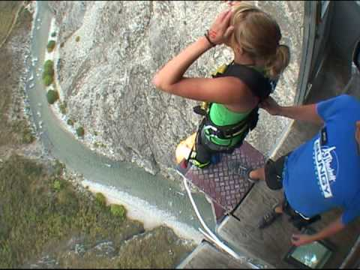
Introductory (re-)conceptualisations

Slide 5
Borderland spaces for learning – intro.
we should encourage our students towards self-authorship:
the ability to know oneself, to know what one knows, to reflect upon it and to base judgements on it
(developed from Baxter-Magolda 2004)
we must challenge our students to become border crossers
offer novel and constructively disruptive spaces and
encounters (Glasser & Powers 2011)

Slide 6
Borderland spaces for learning - intro
challenge our students to become border crossers:
familiar pedagogic spaces unknown / challenging spaces
How? (Hill et al. 2016)
enter a novel learning space e.g. virtual world
adopt unfamiliar pedagogy in a familiar space e.g. student-
led activities

Slide 7
Borderland spaces – characteristic 1
traditional power hierarchies scrutinized and destabilized
(teacher-student contradiction: Freire 1970)
students draw from their experiences working with each
other / faculty
prompts construction of new identities (Giroux 1992)
messy and unpredictable space – but ultimately productive

Slide 8


Borderland spaces – characteristic 1
(Flickr: Robert Donovan)
http://www.red-thread.com/inspire/education/education-trends/

Slide 9
Borderland spaces – characteristic 2
students and faculty must become accustomed to positions
of liminality and ambiguity (Cook-Sather & Alter 2011)
new ways of thinking and practising are permitted, which
are not easily unlearnt (Land et al. 2014)
initial discomfort and uncertainty but persistence in this
space can be transformative

Slide 10
Borderland spaces – characteristic 3
permissive spaces of the borderland allow genuine dialogue
offering opportunities for co-inquiry and reflection amongst
students and between students and faculty (Lodge 2005)
teacher-student relationship becomes one of mediation and
exchange

Slide 11
Borderland spaces – empirical example
Borderland space beyond the curriculum: PAL Leaders
initial movement beyond ‘comfort zone’, antithetical emotions
of insecurity and vulnerability:
‘I was very apprehensive. I probably did not feel that prepared to lead a group of my peers knowing you are slightly superior
to them but you’re not, you’re on the same level ...
but it’s exciting as well’

Slide 12
Borderland spaces – empirical example
students were re-positioned, progressing from recipients of
learning to assume the responsibility of tutors:
‘PAL allows you to become more than a student ... for those sessions you are a member of staff who has the chance to pass on information to an entire class of students ... you view academic work from a more responsible level’
identities were complicated – emerging multi-dimensional
learners, engaging more thoughtfully with their work

Slide 13
Borderland spaces – empirical example
are perils of grappling with new identities and associated
responsibility
issues of student non-attendance mentioned in particular:
‘That was the hardest thing, dealing with the feeling rejected ... I only had two weeks when very few students came but I felt heartbroken .... that was really, really challenging’

Slide 14
Borderland spaces – empirical example
students self-evaluate and exercise judgements they consider
to be appropriate to context and audience:
‘Being a Leader has improved my ability to judge different people’s learner types, allowing me to adapt my teaching to accommodate’
‘I learnt how to change my style depending on the students that came. Something that will work with one student won’t work for another ... I learnt that everyone is different so you have to be flexible as a PAL leader’

Slide 15
Borderland spaces – empirical example
students recognise transferability of knowledge and skills:
‘I now feel confident that ... I could apply presentation and facilitation skills in the right places at the right times’
‘the transferable skills you learn whilst being a PAL leader will help you stand out from the crowd when looking for graduate jobs’

Slide 16
Conclusions
learning space is not automatically borderland - must be used
as such ontologically, epistemologically, practically (Hill et al. 2016)
lecture theatres and classrooms can be transformed by
encouraging students to become partners in SoTL (Cook-Sather
et al. 2014, Johansson & Felten 2014)
students acquire new knowledge, skills and facets to their
identity, engaging with aspects of critical pedagogy and
developing skills relevant to future employment

Slide 17
Conclusions
But ... letting go of familiar ways of learning requires trust in
a process that is inherently unpredictable (Healey et al. 2014)
guidance and training needed to ensure successful navigation
into and out of these challenging environments
we must ensure managers support the movement of students
and faculty into and out of such spaces through strategies and
policies

Slide 18
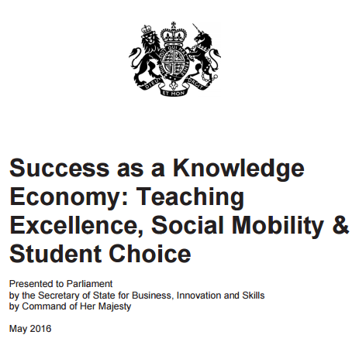

A note of caution ...

Slide 19

Questions and Discussion
What were/are the benefits?
How have you ... or how could you ... take your students into the borderlands?
What were/are the challenges?
Jennifer.Hill@uwe.ac.uk & Harry2.West@live.uwe.ac.uk

Slide 20
References
Baxter Magolda, M.B. (2004) Preface. In M.B. Baxter Magolda & P.M. King. (eds.) Learning Partnerships: Theory and models of practice to educate for self-authorship. Sterling, VA: Stylus Publishing, pp. xvii-xxvi.
Cook-Sather, A. & Alter, Z. (2011) What is and what can be: How a liminal position can change learning and teaching in higher education. Anthropology and Education Quarterly, 42, 37-53.
Cook-Sather, A., Bovill, C. & Felten, P. (2014) Engaging Students as Partners in Learning & Teaching: A Guide for Faculty. San Francisco: Jossey-Bass.
Healey, M., Flint, A. & Harrington, K. (2014) Developing Students as Partners in Learning and Teaching in Higher Education. York: Higher Education Academy.
Hill, J., Thomas, G., Diaz, A. & Simm, D. (2016) Borderland spaces for learning partnership: opportunities, benefits and challenges Journal of Geography in Higher Education. http://dx.doi.org/10.1080/03098265.2016.1144728

Slide 21
References
Freire, P. (1970) Pedagogy of the Oppressed. New York: Continuum.
Giroux, H.A. (1992) Border Crossings: Cultural Workers and the Politics of Education. NY: Routledge.
Glasser, H. & Powers, M. (2011) Disrupting Traditional Student-Faculty Roles, 140 Characters at a Time. Teaching and Learning Together in Higher Education, Winter 2011.
Johansson C. & Felten P. (2014) Transforming Students: Fulfilling the Promise of Higher Education. Baltimore, MD: Johns Hopkins Press.
Land, R., Rattray, J. & Vivian, P. (2014) Learning in the liminal space: a semiotic approach to threshold concepts. Higher Education, 67, 199-217.
Lodge, C. (2005) From hearing voices to engaging in dialogue: Problematising student participation in school improvement. Journal of Educational Change, 6, 125-46.

