Slide 1
Trimming Simulation of Forming Metal Sheets Isogeometric Models by Using NURBS Surfaces
D. Herrero-Adan (1), Rui P.R. Cardoso (2), O.B. Adetoro (1)
¹Department of Engineering Design and Mathematics, University of the West of England, BS16 1QY Bristol, UK
²Department of Mechanical, Aerospace and Civil Engineering, Brunel University London, UB8 3PH Uxbridge, London, UK
daniel.herreroadan@uwe.ac.uk

Slide 2
01.- MOTIVATION
02.- GENERAL VIEW
03.- TRIMMING CURVE DEFINITION
04.- STIFFNESS MATRIX AND FORCES
05.- EXAMPLES
06.- POTENTIAL IMPROVEMENTS

Slide 3
01.- MOTIVATION
At the end of forming it is usual to trim the formed part to achieve final shape or to remove edge micro-cracks
After trimming there is a redistribution of the residual stresses and displacements to achieve a new equilibrium
Due to plastic deformation during forming residual stresses are generated
It is necessary to define accurately the trimming line to be able to assess the new state

Slide 4
01.- MOTIVATION
02.- GENERAL VIEW
03.- TRIMMING CURVE DEFINITION
04.- STIFFNESS MATRIX AND FORCES
05.- EXAMPLES
06.- POTENTIAL IMPROVEMENTS

Slide 5
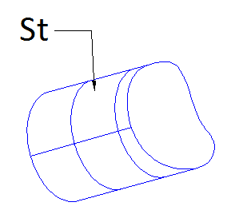
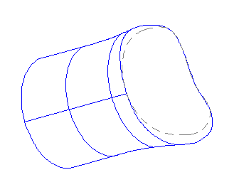


02.- GENERAL VIEW
0) At the end of forming there are defined:
-Part geometry
-Material properties
-Residual stresses {σo}
Stored in surface
model “S”
1) Surfaces S-T intersection is computed, the output is a trimming curve “C”
2) A portion of S is removed and then deactivated for subsequent calculations as [1]. The remaining surface is called “St”
Target of this job
(Definition of trimming surface “T” - NURBS surface)
3) Control points forces due to residual stresses and stiffness matrix are calculated using the remaining area of S (St) in the integrals
$$\left\{f_{ecp}\right\}=−\int_{V}{{\left[B\right]}^{T}\left\{σ_{o}\right\} dV}$$
4) Final configuration
$$\left\{K_{e}\right\}=\int_{V}{{\left[B\right]}^{T} \left[D\right]\left[B\right]dV}$$
[1] Kim HJ, Seo YD, Youn SK. Isogeometric analysis for trimmed CAD surfaces. Comput. Methods Appl. Mech. Engrg. 198 (2009) 2982–2995

Slide 6
01.- MOTIVATION
02.- GENERAL VIEW
03.- TRIMMING CURVE DEFINITION
04.- STIFFNESS MATRIX AND FORCES
05.- EXAMPLES
06.- POTENTIAL IMPROVEMENTS

Slide 7
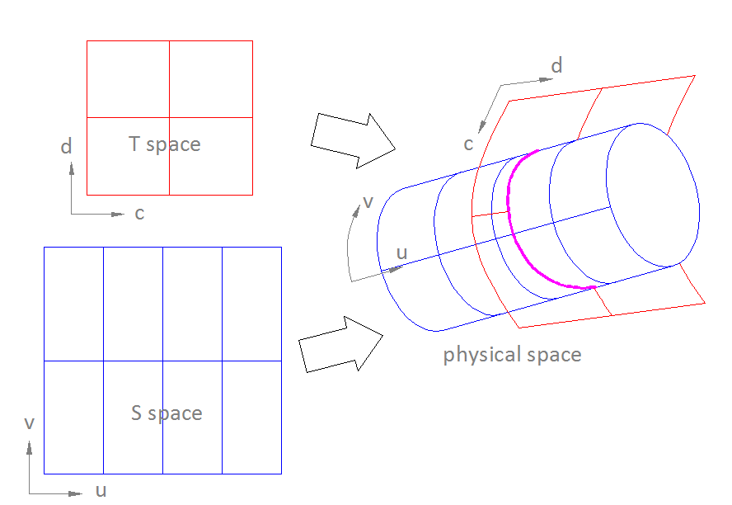
03.- TRIMMING CURVE DEFINITION
03.1.- Strategy
03.2.- Row of intersection points
03.3.- Curve fitting
03.4.- Definition of remaining surface
03.5.- T surface requirements
Surfaces S and T intersect in physical space but are defined in different parameter spaces
Iterations are required
I .- Calculate a row of S-T intersection points
II .- Fit a curve to the row of intersection points but in S parameter space

Slide 8
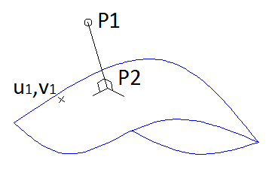
03.- TRIMMING CURVE DEFINITION
03.1.- Strategy
03.2.- Row of intersection points
03.3.- Curve fitting
03.4.- Definition of remaining surface
03.5.- T surface requirements
Points_Row [ Bouncing [ Inversion_Point ] ]
Inversion_Point (technique from [2])
Input: P1 : physical coordinates
u1,v1: initial parameter coordinates
Output: P2: closest surface point to P1
(physical and parameter coordinates)
[2] Piegl L, Tiller W. The NURBS Book. Berlin. Springer-Verlag, (1996).

Slide 9
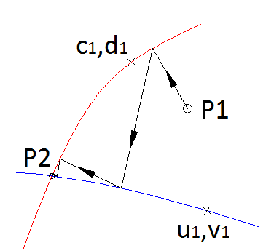
03.- TRIMMING CURVE DEFINITION
03.1.- Strategy
03.2.- Row of intersection points
03.3.- Curve fitting
03.4.- Definition of remaining surface
03.5.- T surface requirements
Points_Row [ Bouncing [ Inversion_Point ] ]
Bouncing
Input: initial searching coordinates
P1 : physical coordinates
u1,v1 & c1,d1 : parameter coordinates
Output: P2: closest S-T intersection point to P1
(physical and parameter coordinates)
T surface
S surface
[2] Piegl L, Tiller W. The NURBS Book. Berlin. Springer-Verlag, (1996).

Slide 10
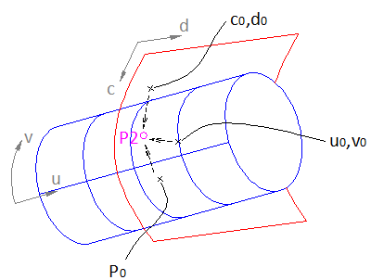
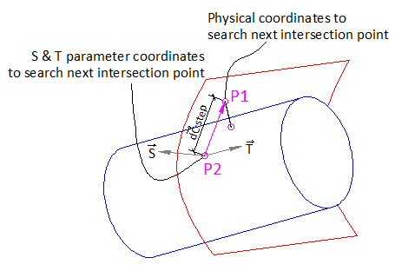
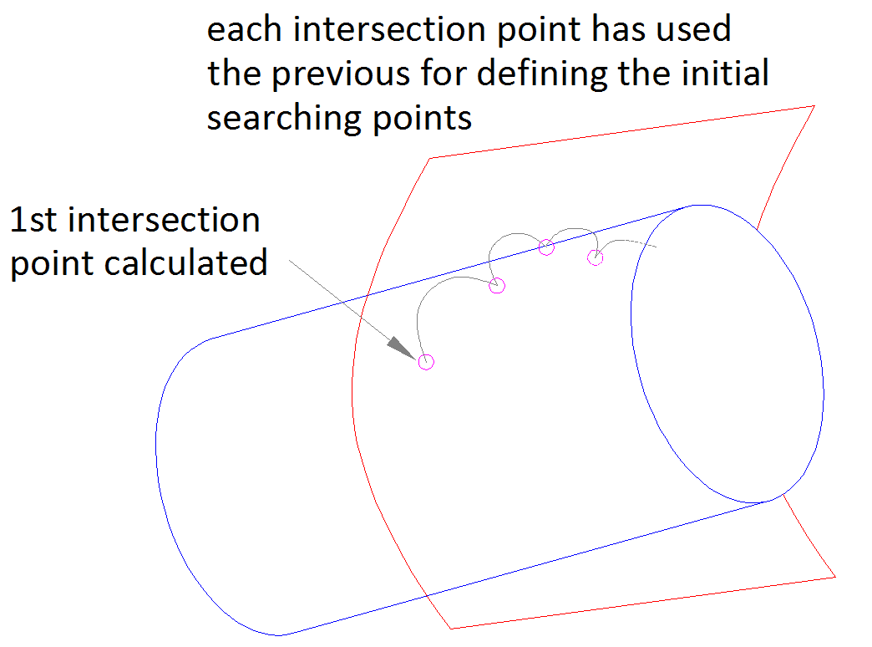
03.- TRIMMING CURVE DEFINITION
03.1.- Strategy
03.2.- Row of intersection points
03.3.- Curve fitting
03.4.- Definition of remaining surface
03.5.- T surface requirements
Points_Row [ Bouncing [ Inversion_Point ] ]
Points_Row
Input: initial searching coordinates
P0 : physical coordinates
u0,v0 & c0,d0 : parameter coordinates
Output: row of intersection points

Slide 11
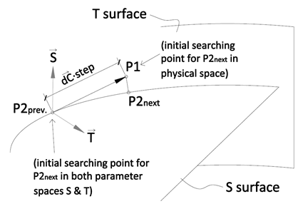
03.- TRIMMING CURVE DEFINITION
03.1.- Strategy
03.2.- Row of intersection points
03.3.- Curve fitting
03.4.- Definition of remaining surface
03.5.- T surface requirements
Points_Row [ Bouncing [ Inversion_Point ] ]

Slide 12
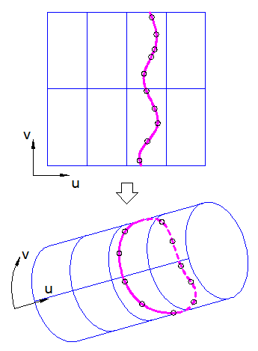
03.- TRIMMING CURVE DEFINITION
03.1.- Strategy
03.2.- Row of intersection points
03.3.- Curve fitting
03.4.- Definition of remaining surface
03.5.- T surface requirements
Row of intersection points in parameter space S
“global curve interpolation to point data” [2]
Parameter
space S
Fit a B-spline in parameter space S
Physical space
[2] Piegl L, Tiller W. The NURBS Book. Berlin. Springer-Verlag, (1996).

Slide 13

03.- TRIMMING CURVE DEFINITION
03.1.- Strategy
03.2.- Row of intersection points
03.3.- Curve fitting
03.4.- Definition of remaining surface
03.5.- T surface requirements
Direction of curve is given by cross product of surfaces S and T normal vectors
$$d\vec{c}= \vec{S} x\vec{ T}$$
Surface on the left hand side of the trimming curve remains
Surface on the right hand side is to be removed

Slide 14
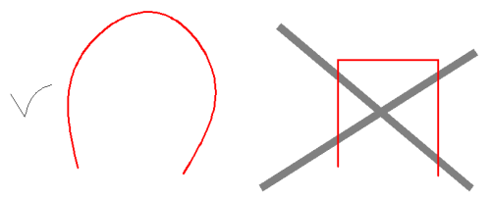
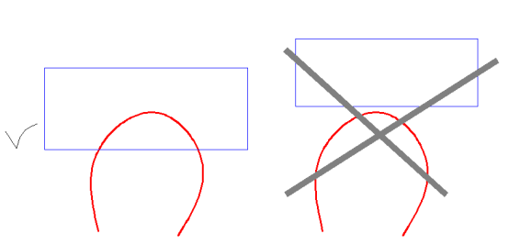
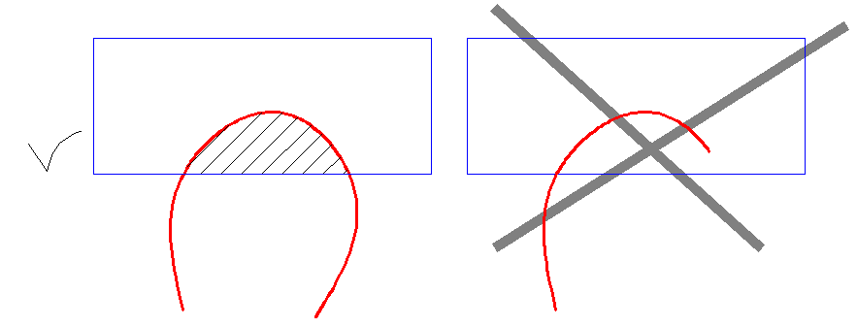
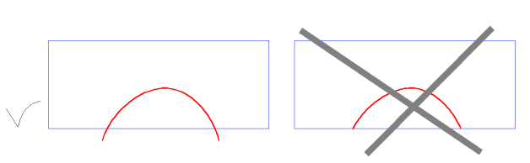
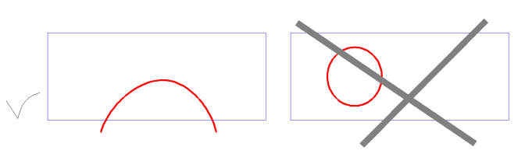
03.- TRIMMING CURVE DEFINITION
03.1.- Strategy
03.2.- Row of intersection points
03.3.- Curve fitting
03.4.- Definition of remaining surface
03.5.- T surface requirements
Trimming T surface has to:
1.- Be smooth (derivable)
2.- Trim the metal sheet in the physical space
3.- The resulting trimming curve has to enclose a portion of S surface
4.- Extend slightly further than the intersection between the two surfaces
5.- Be open surface

Slide 15
01.- MOTIVATION
02.- GENERAL VIEW
03.- TRIMMING CURVE DEFINITION
04.- STIFFNESS MATRIX AND FORCES
05.- EXAMPLES
06.- POTENTIAL IMPROVEMENTS

Slide 16
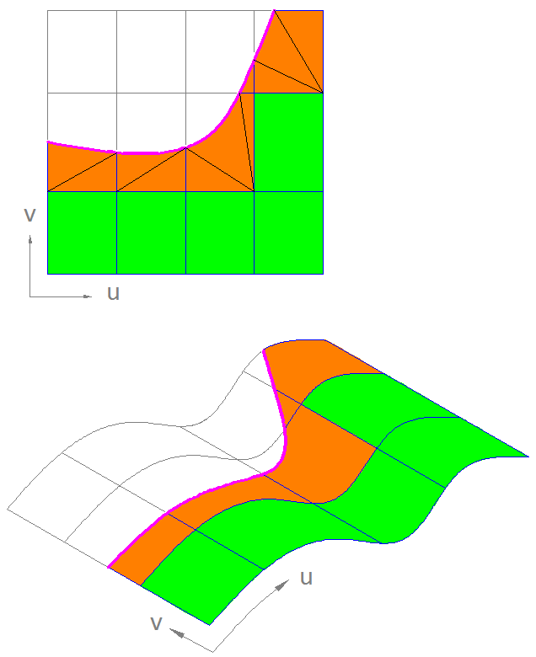
04.- STIFFNESS MATRIX AND FORCES
Already developed for trimmed 2D surfaces by Kim et al. [1]. Here we proceed in a similar manner
When computing [Ke] and {fecp} at each element:
- Ignore totally deactivated elements
- For trimmed elements: divide into triangles remaining area and integrate those triangles
- Integrate in a standard manner totally in elements
Then the control points displacement are calculated and afterwards the stresses
[1] Kim HJ, Seo YD, Youn SK. Isogeometric analysis for trimmed CAD surfaces. Comput. Methods Appl. Mech. Engrg. 198 (2009) 2982–2995

Slide 17
01.- MOTIVATION
02.- GENERAL VIEW
03.- TRIMMING CURVE DEFINITION
04.- STIFFNESS MATRIX AND FORCES
05.- EXAMPLES
06.- POTENTIAL IMPROVEMENTS

Slide 18
04.- EXAMPLES
Trimming examples:
- slotted pipe:
- end-trimmed pipe:

Slide 19
04.- EXAMPLES
Trimming and displacement calculation example:
- Slotted crown quarter :

Slide 20
01.- MOTIVATION
02.- GENERAL VIEW
03.- TRIMMING CURVE DEFINITION
04.- STIFFNESS MATRIX AND FORCES
05.- EXAMPLES
06.- POTENTIAL IMPROVEMENTS

Slide 21
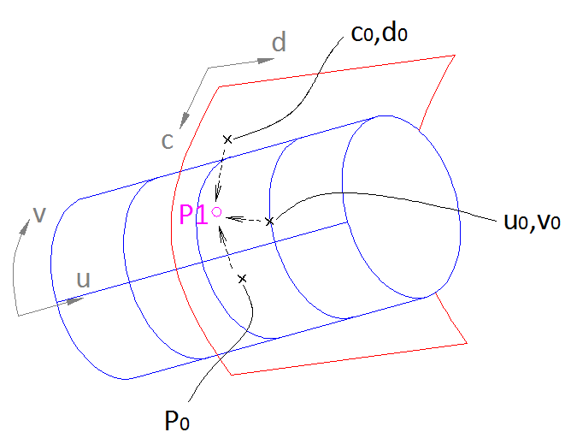
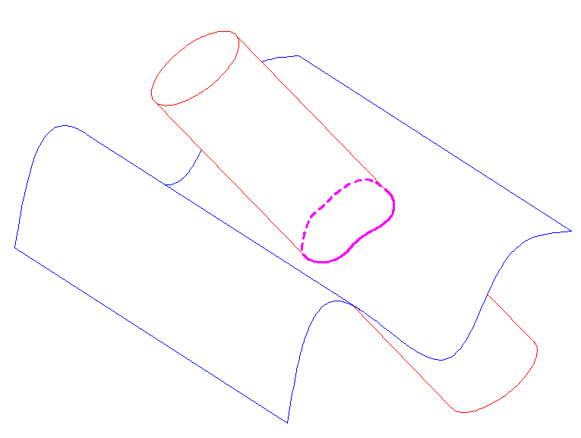
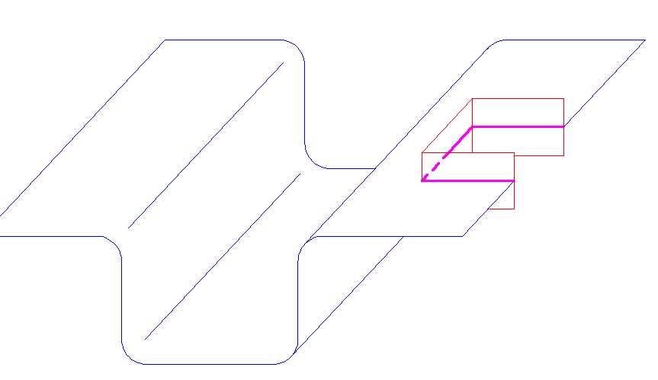
06.- POTENTIAL IMPROVEMENTS
Algorithm to select the initial searching points
Allow trimming surface to be closed
(simulate holes)
Non-derivable trimming surfaces

Slide 22
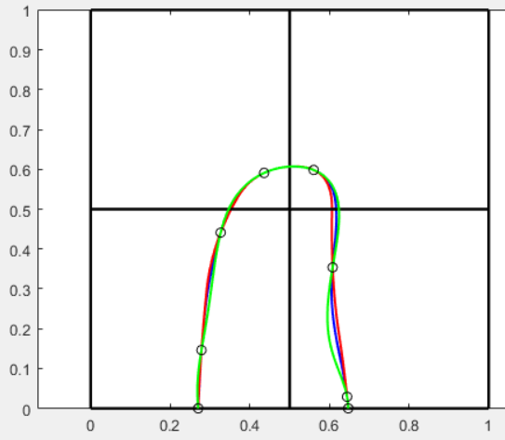
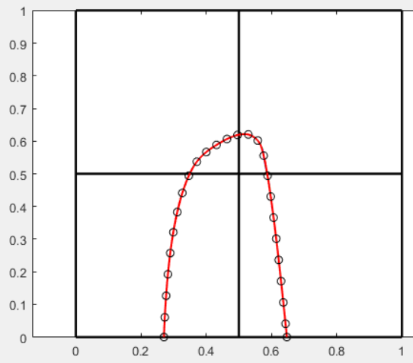
06.- POTENTIAL IMPROVEMENTS
Remove step dependency for trimming curve
(step length selection)
p=2
p=3
p=4
Step = 25
Step = 5
(Overlapping curves)

Slide 23
THANK YOU FOR
YOUR ATTENTION

