Slide 1
Legal Protection of Children as Refugees and Internally Displaced Persons

Slide 2
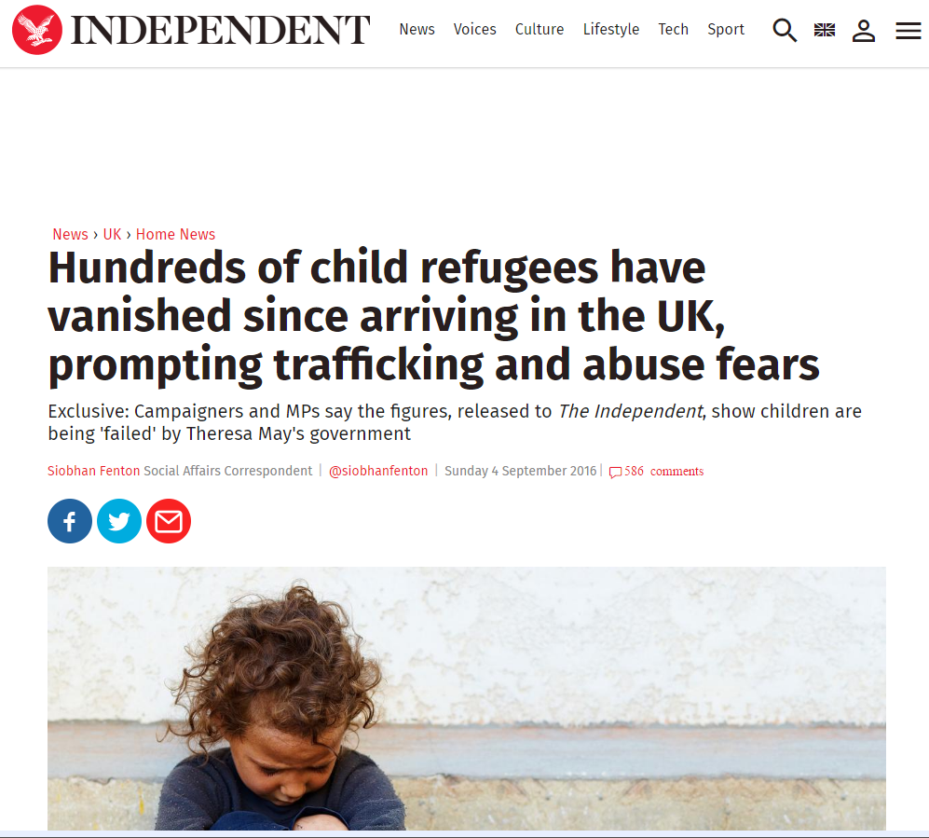

Slide 3
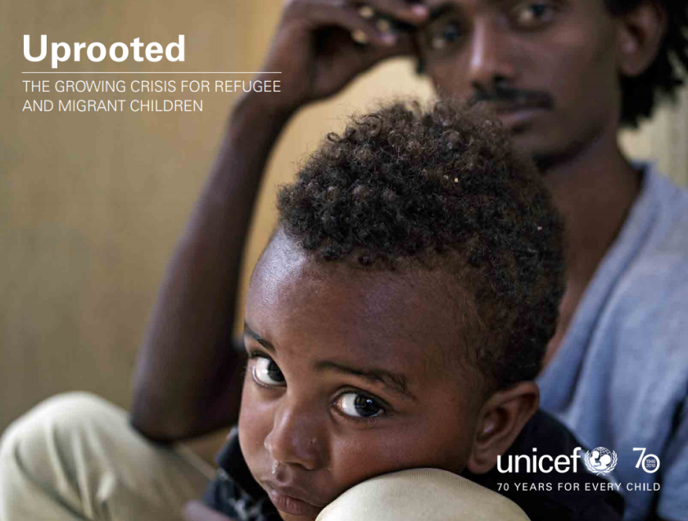
UNICEF report of 6 September 2016:
Half of the refugee population is under 18 years of age

Slide 4
Definitions
Migrant
Refugee
Internally Displaced Person
Person who is moving or has moved across an international border or within a State away from his/her habitual place of residence
Whether voluntarily or not
Legal status of person irrelevant
Cause for movement is irrelevant
Length of stay irrelevant
Someone who is applying for refugee status
Asylum-seeker
Cause for movement is armed conflict, generalised violence, violations of human rights or natural/human disaster
Individual is moving within the territory of his/her nationality

Slide 5
Definition of a Refugee
1951 UN Convention
‘owing to well-founded fear of being persecuted for reasons of race, religion, nationality, membership of a particular social group or political opinion, is outside the country of his nationality and is unable or, owing to such fear, is unwilling to avail himself of the protection of that country; or who, not having a nationality and being outside the country of his former habitual residence as a result of such events, is unable or, owing to such fear, is unwilling to return to it.’

Slide 6
Elements of the definition
Persecution for reasons of race, religion, nationality, membership of a particular social group or political opinion,
Individual is outside country of nationality or does not have nationality but is outside country of former habitual residence
Well-founded fear of persecution
Individual is unable/unwilling to avail himself of protection of country of nationality or return to it

Slide 7
Child Specific Persecution
forcible or underage recruitment into military service
family or domestic violence
infanticide
forced or underage marriages
discrimination against street children
female genital mutilation
forced labour
forced prostitution
child pornography
trafficking
children outside of strict family planning laws and policies

Slide 8
Protection
Protection offered by
UN High Commissioner for Refugees
State

Slide 9
Responsibility of State
But UNHCR not always responsible for granting and protecting asylum-seekers and refugees….. in Europe the State is responsible for:
Protecting individuals when entering State
Dealing with asylum request
Granting refugee status
Dealing with individual if asylum request denied
Protecting refugee

Slide 10
A Complex Web of Legal Rights and Obligations
Protection of Children Refugees
European Law
European Union Law
Council of Europe
International Law
National Law
Asylum Seekers (Reception Conditions) Regulations 2005
Dublin Regulation
Borders, Citizenship and Immigration Act 2009
Immigration Rules
Children Act 1989
Immigration Act 2016
1951 Refugee Convention
1990 UN Convention on the Rights of the Child
Charter of Fundamental Rights
European Convention on Human Rights

Slide 11
National Procedure in the UK
Disperse in UK to a foster carer
Entry at British ports and airports
Initial interview
Asylum process
If refugee status granted
Transfer of child to or oversight by local authority children’s services for UAM or with family

Slide 12
Key Problems
Relating to refugee determination process
Determination of age
Lack of legal representation (Refugee Council Panel of Advisers in UK)
Detention of children
seeking refugee status
being returned/deported

Slide 13
Key Problems
Lack of home/family
Difficulties to keep families together
Lack of homes/foster families (and lack of training of such families*)
Lack of a welcoming community*
Children dispersed across a country*
Lack of education and health services
Lack of access to education and health services
Lack of interpreters*

Slide 14
As a result…. some children leave the foster home…. and some are trafficked for labour and sexual purposes

