Slide 1
At the Edge of the Curatorial Gaze
A critical reflection of a photographic exploration of museum storage spaces.
Nick Bright – Senior Lecturer
University of the West of England, Bristol

Slide 2
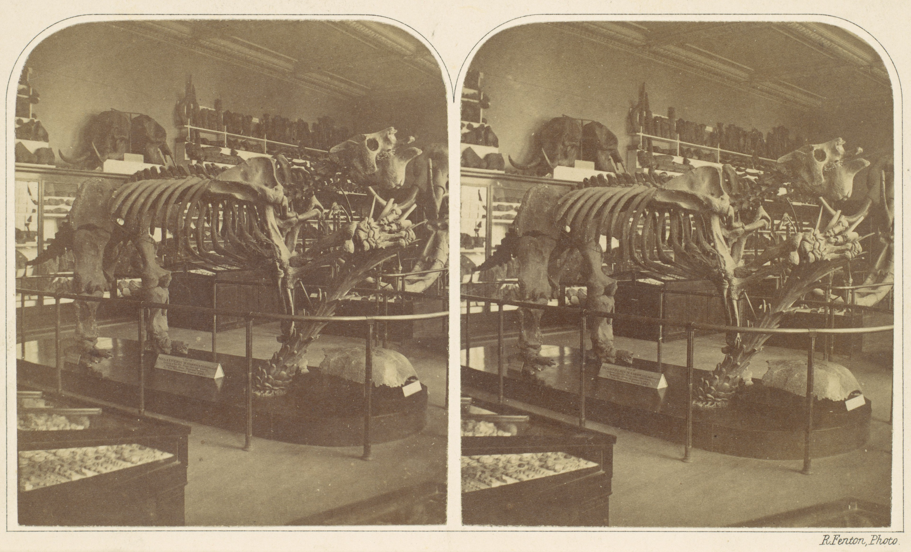
Image © The British Museum; Roger Fenton, The Megatharium, British Museum, c1854

Slide 3
“Every passion borders on the chaotic, but the collector’s passion borders on the chaos of memories” (Walter Benjamin, 1968)

Slide 4
“On one side of a hermetically sealed glass divide, the curator lays out his specimens in accordance with science, giving them a reality of their own by remaining wholly back-stage; on the other side, the public, denied access to this back-stage area in which the curator organizes the mise-en-scene for his specimens and determines what roles of – narrative and representation – to accord them, observes what has been placed before its eyes.” (Bennett, 2007)

Slide 5
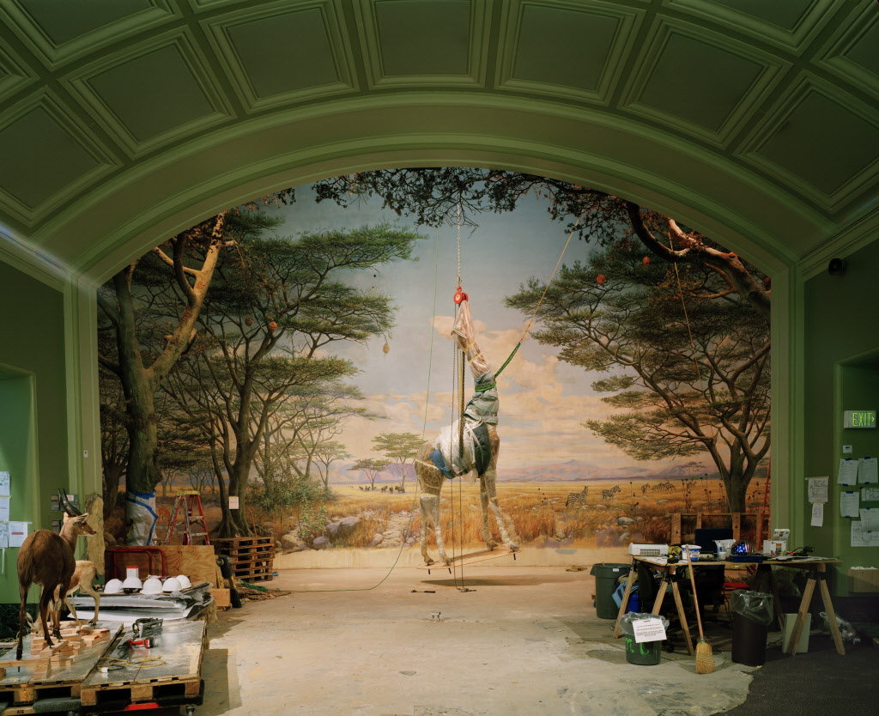
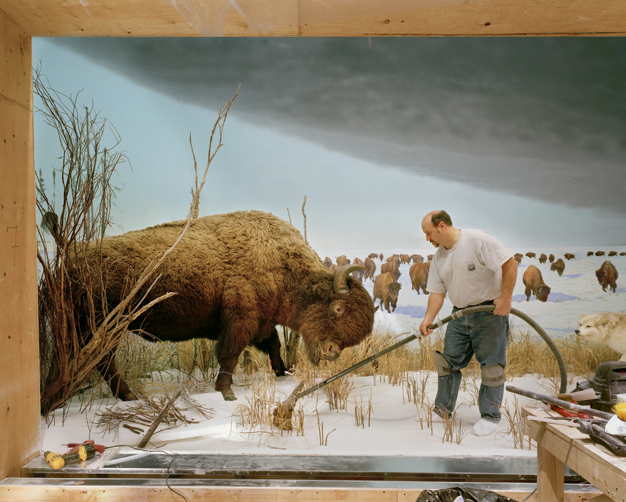
Image © Richard Barnes, Giraffe, 2005
Image © Richard Barnes, Man with Buffalo, 2007

Slide 6
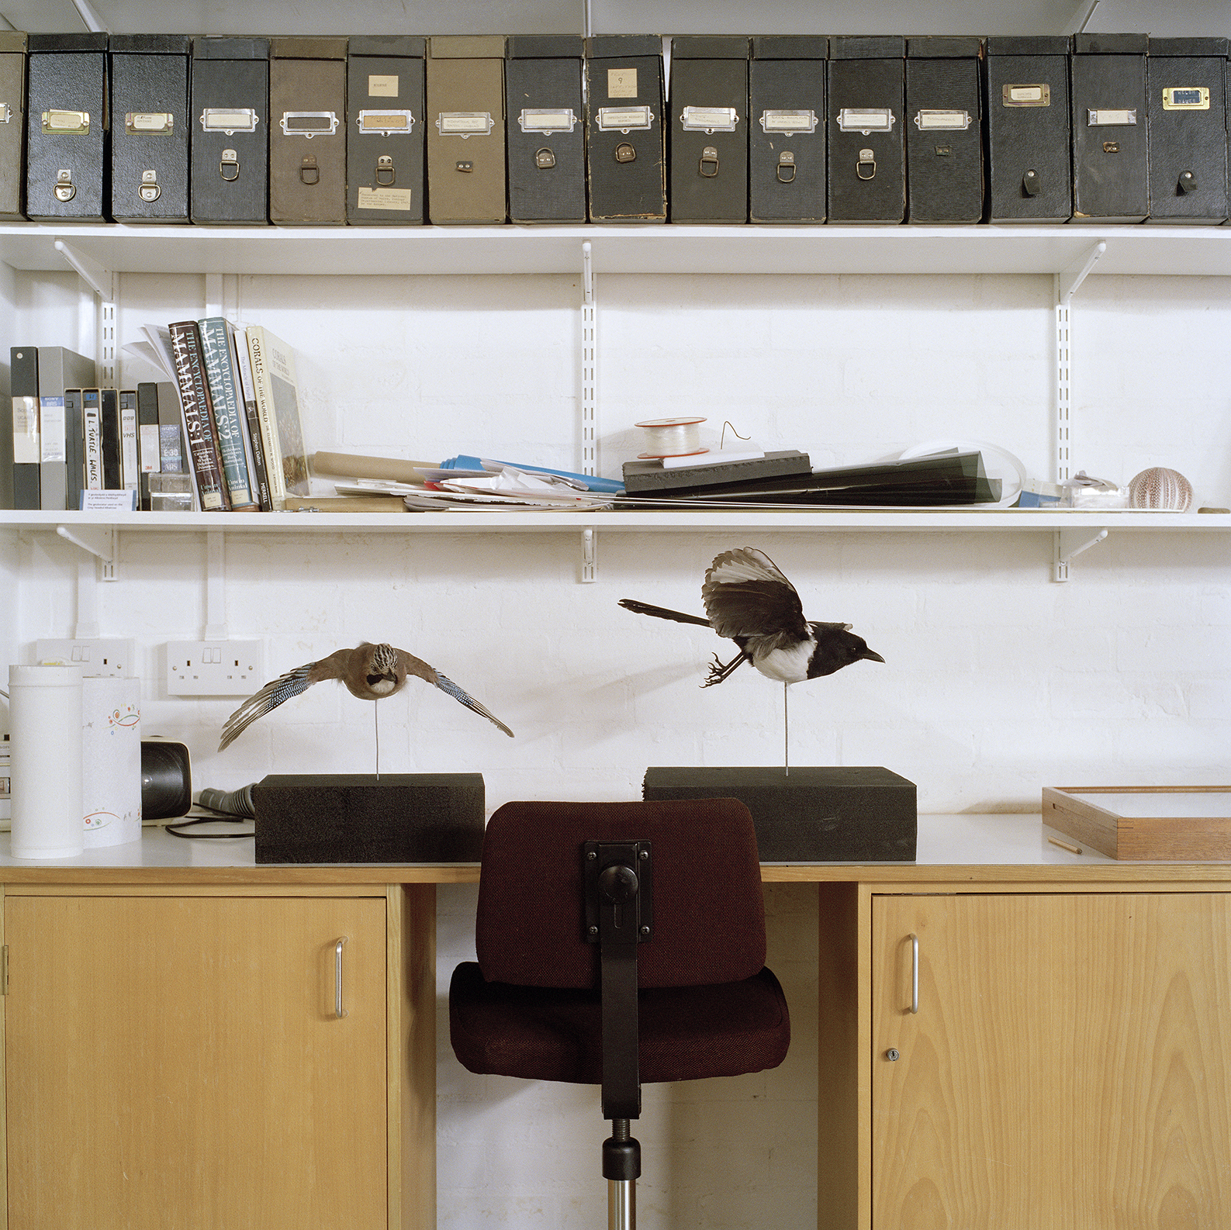
The Chaos of Memory no. 18

Slide 7
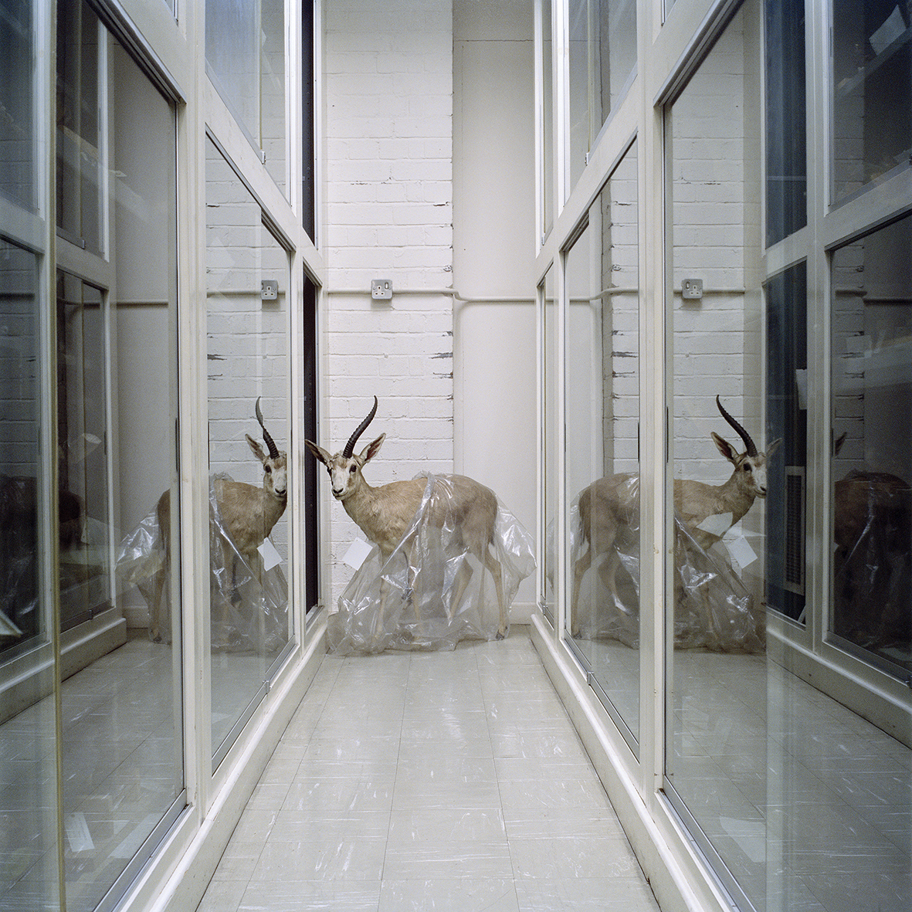
The Chaos of Memory no. 10

Slide 8
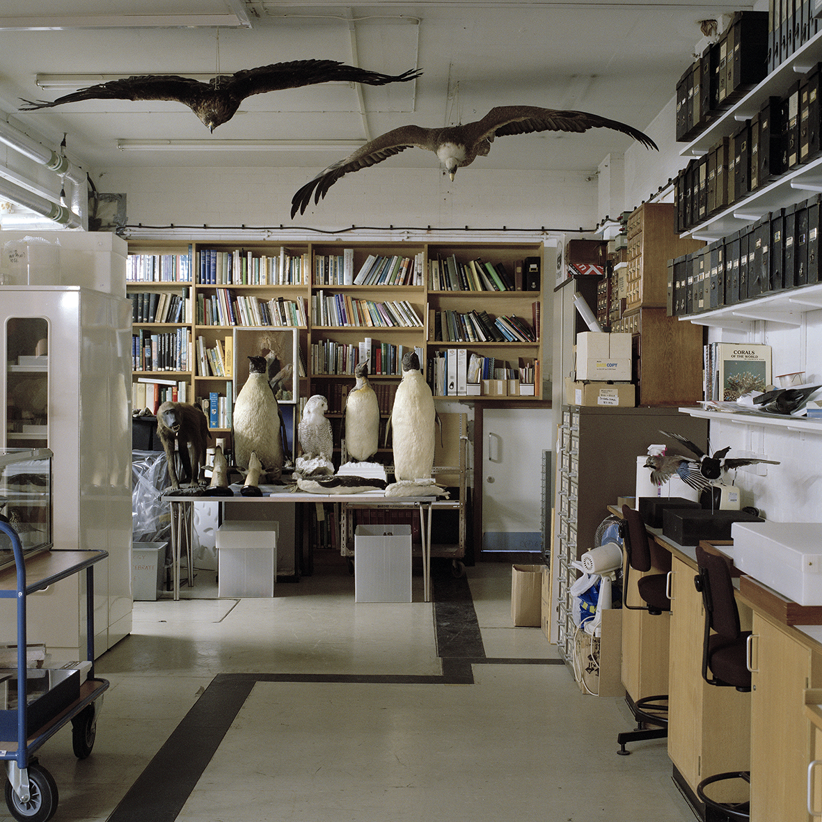
The Chaos of Memory no. 25

Slide 9
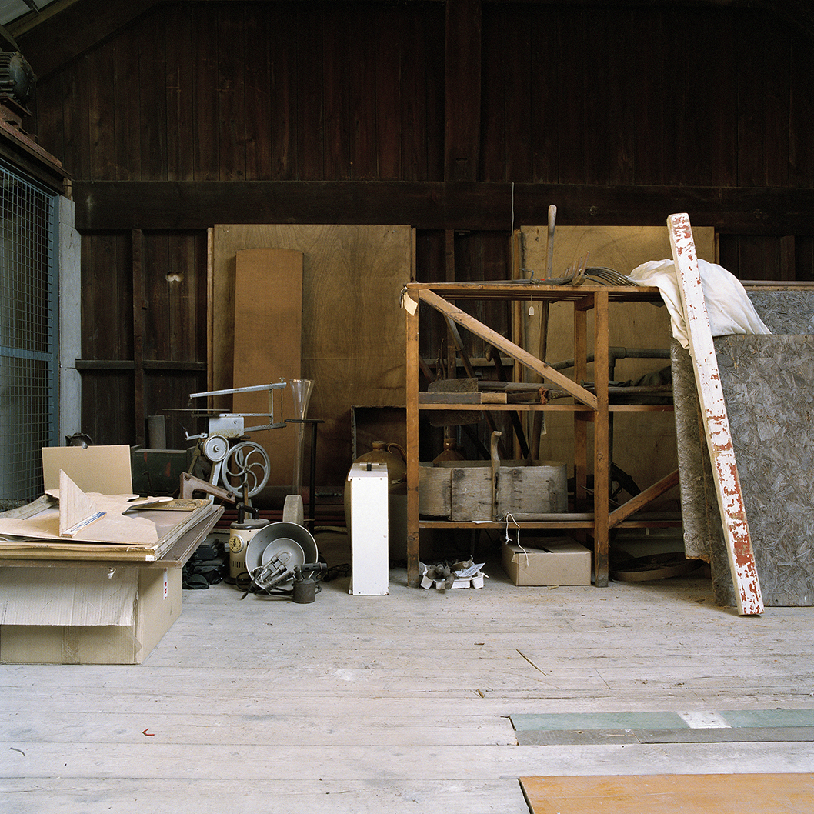
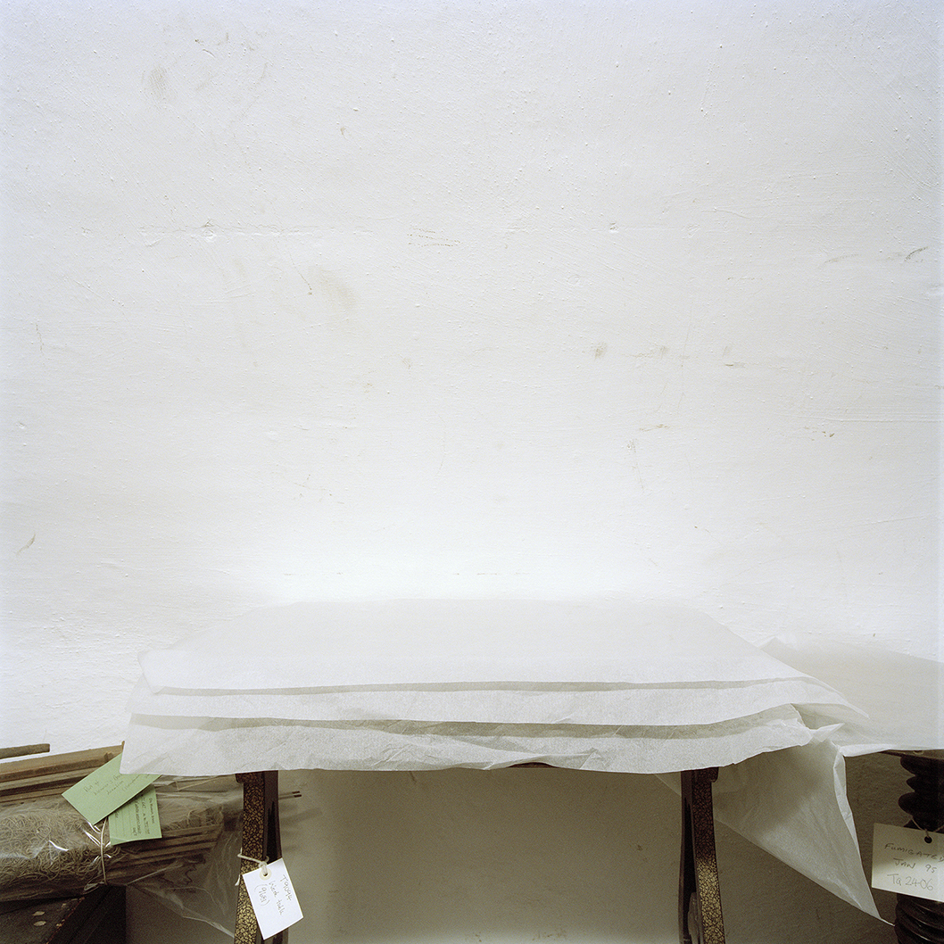
The Chaos of Memory no. 39
The Chaos of Memory no. 58

Slide 10
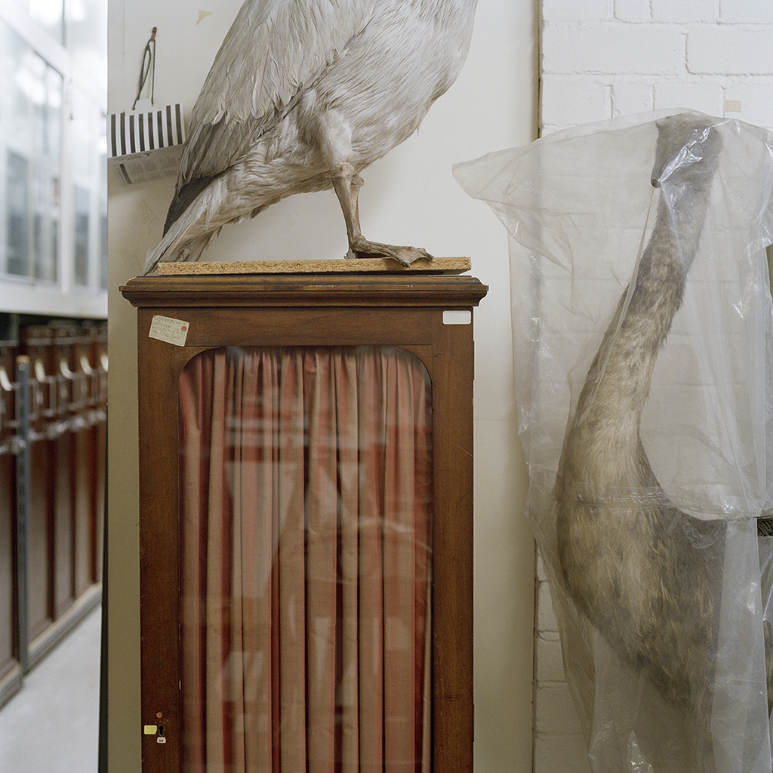
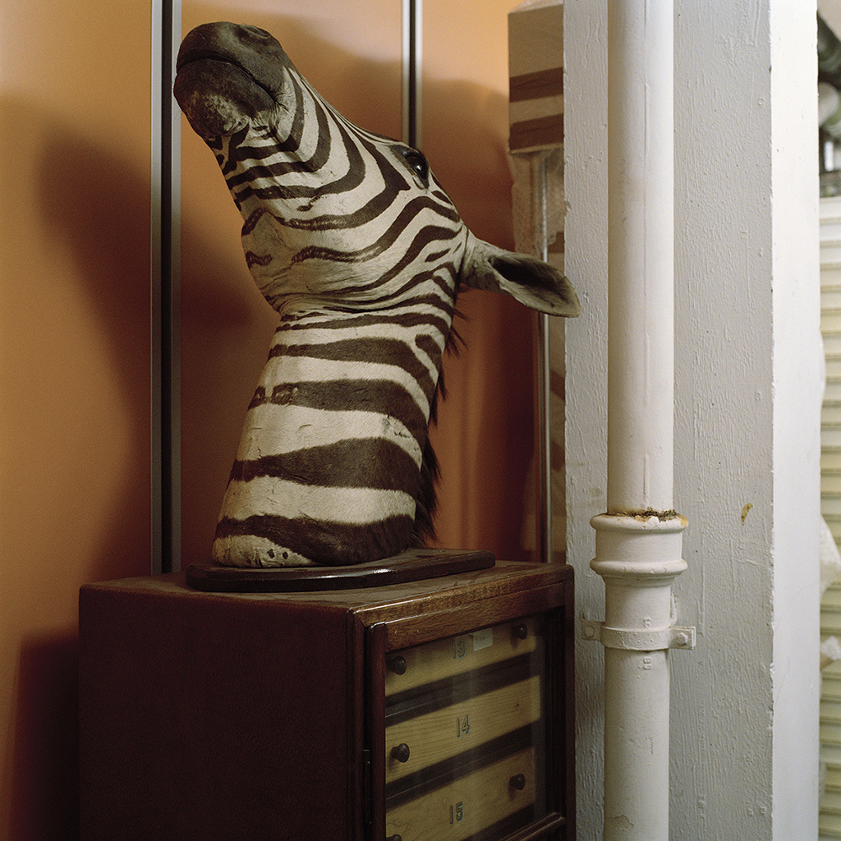
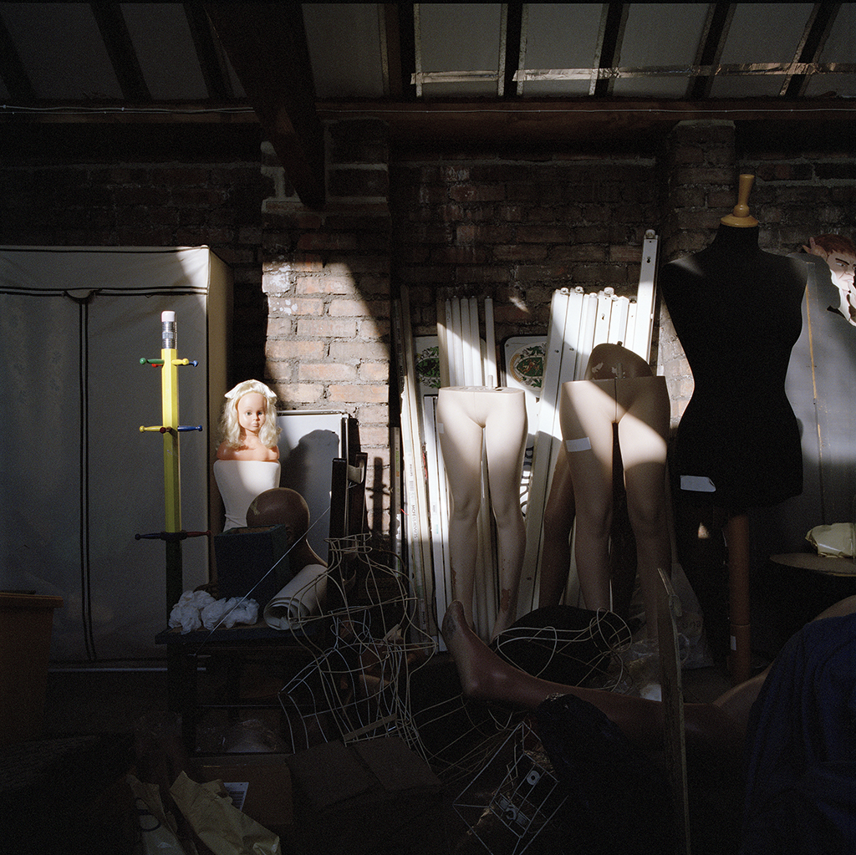
The Chaos of Memory no. 14
The Chaos of Memory no. 2
The Chaos of Memory no. 52

Slide 11
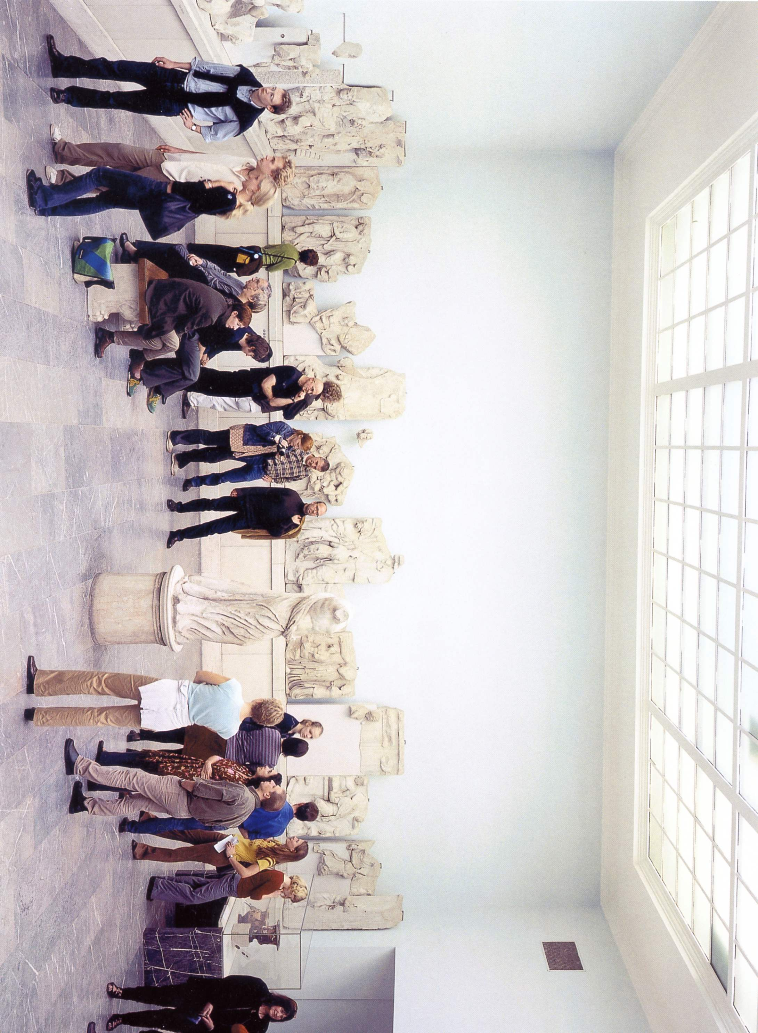
Image © Thomas Struth, Pergammon Museum III, 2001.

Slide 12
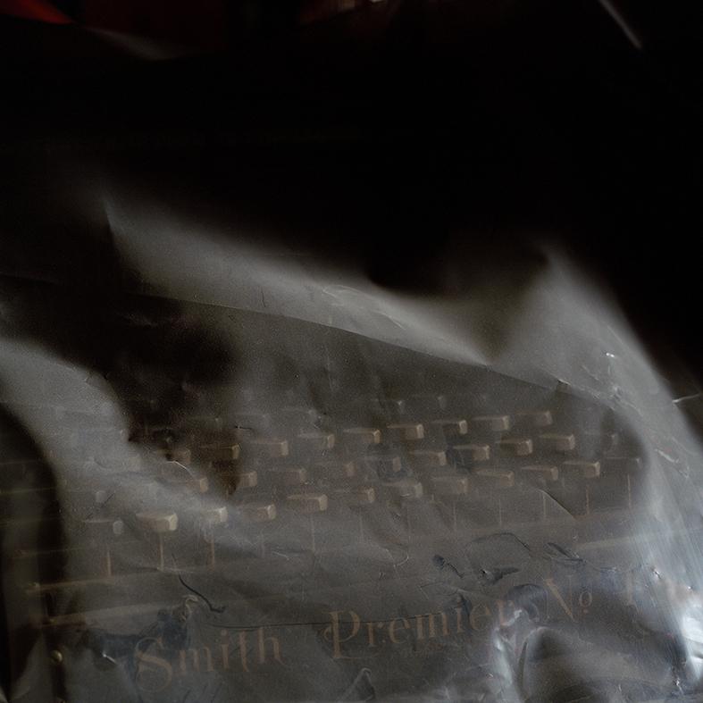
The Chaos of Memory no. 32

Slide 13
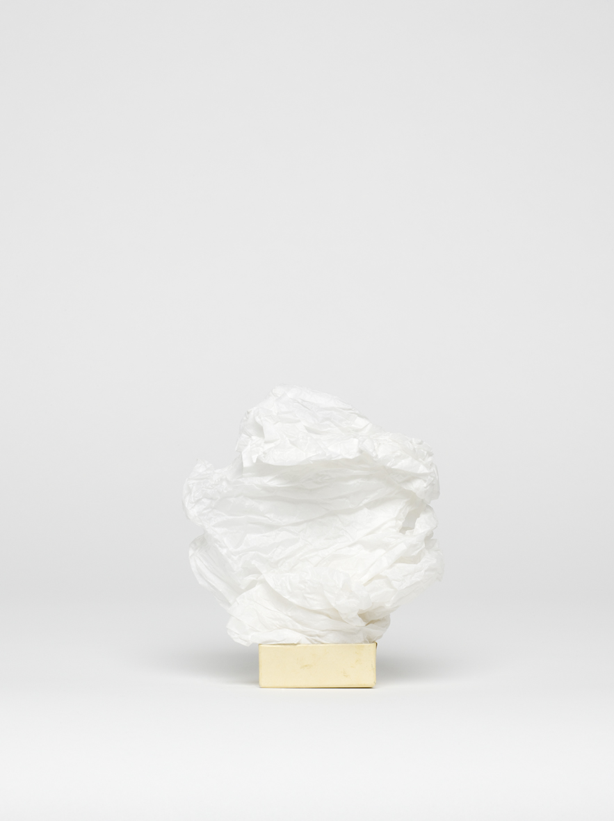
Anonymous Object no. 00016
Anonymous Object no. 00022

Slide 14
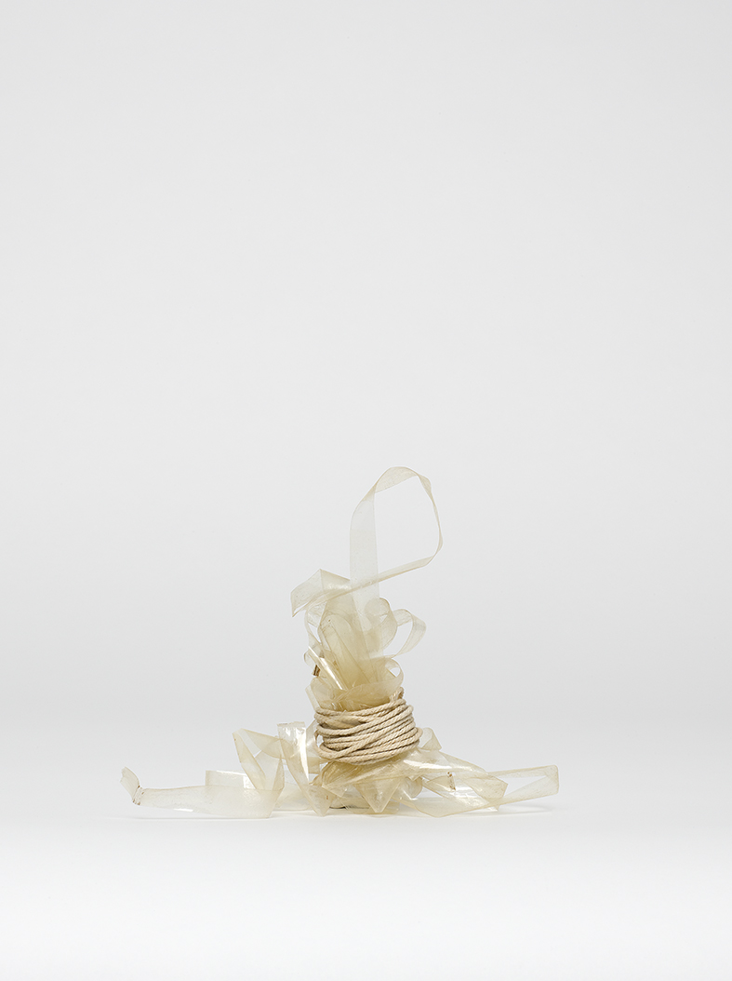
Anonymous Object no. 00025
Anonymous Object no. 00032

Slide 15
www.nick-bright.co.uk
All images © Nick Bright

