Slide 1
Beyond nudge and improving transport infrastructure: the real task of tackling poor air quality
Dr Jo Barnes
With Tim Chatterton, Enda Hayes, James Longhurst, Ben Williams & Emily Prestwood
UWE, Bristol
Presentation by
Dr Jo Barnes
Senior Research Fellow
Air Quality Management Resource Centre
Better Places Symposium, November 24, 2016, Kia Oval, London, UK

Slide 2
Presentation
A new approach to Air Quality Management
Moving from “What and Where” to include “Who and Why”
Why? The role of social activities
Who? Differentials between the polluters and the polluted
Conclusions

Slide 3









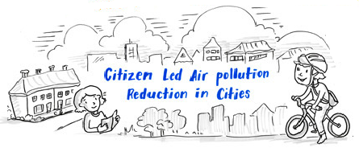




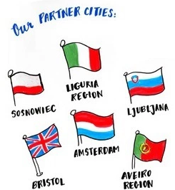



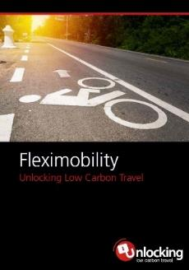
http://MOTproject.net
1
2012-16
http://www.claircity.eu/
www.DisruptionProject.net
www.Fleximobility.Solutions
2016-2020
2012-15

Slide 4
Air Quality Management vs
Air Pollution Control
Pollution Control = Use of predominantly technical measures (end-of-pipe or before) to control emissions from individual sources (stacks or exhaust pipes)
Air Quality Management = The control of diffuse sources to achieve reductions in ambient concentrations of pollutants

Slide 5
Air Quality Management has failed!
Not all of it…and it wasn’t its fault!
Local Air Quality Management (LAQM) process was designed in 1997 when it was expected that there would be “a handful of AQMAs in large cities and metropolitan areas”
2005: Achievement date for UK NO₂ AQ Objective
By 2010: 236 LAs (58%) had AQMAs (≈500 AQMAs in total)
Now: 274 LAs (69%) with AQMAs (704 AQMAs)
These are not ‘localised hotspots’ they are local manifestations of a national problem
Notes:
Change 84% to

Slide 6
A new approach to Air Quality Management
WHO & WHY not just WHERE AND WHAT!
Traditionally AQM has focussed very much on ‘hotspots’ where concentrations are highest
= WHERE
It also focusses on the objects that emit the pollution (e.g. cars, industrial plant, boilers etc.)
= WHAT
We propose:
Looking not at cars but at drivers/owners = WHO
Apportioning emissions not by type of vehicle but by the type of journey being undertaken = WHY

Slide 7
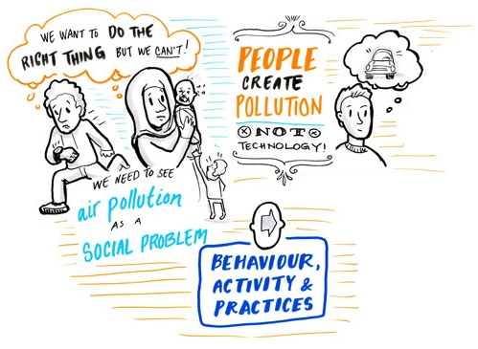

Why is Pollution Created?
http://www.claircity.eu/

Slide 8

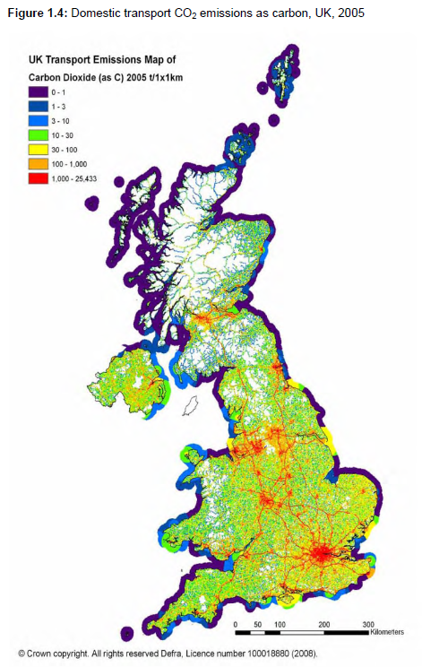
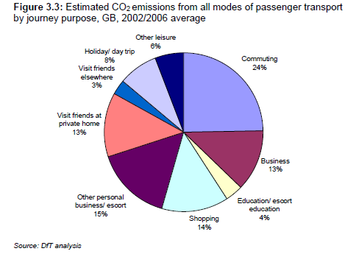
Moving from point of use…..
…to journey purpose
Images from DfT (2008). Carbon pathways analysis: informing development of a carbon reduction strategy for the transport sector. DfT, London.
Notes:
Traditionally, work looking at impacts of air pollution have focussed on looking at emissions at point of use – as the local concentrations are highly dependent on these.
Or journey purpose where the spatial aspect is less relevant for exposure with CO2 for example.
The MOT project is taking a ‘Who’ approach by looking at emissions in terms of where the car is owned, not where it is driven…..

Slide 9
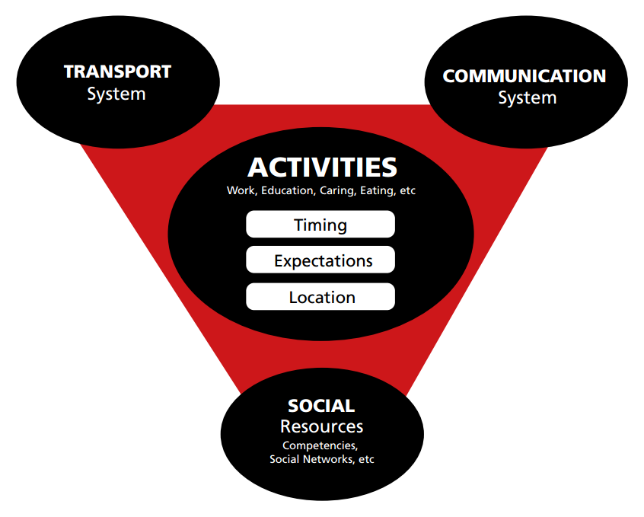
The ‘Mobility System’
TRANSPORT
System
www.fleximobility.solutions

Slide 10
The role of ‘activities’
Transport is generated through the participation of people within sets of socially constructed ‘activities’
How it is considered ‘normal’ to participate in these is established through a range of things from physical infrastructure to cultural conventions
Organisations (employers, service providers etc.) at the heart of these activities often take unrestricted (auto) mobility as a given
Where some attention is paid (green travel plans etc.) this is often seen as helping out individual travellers…
..rather than addressing a fundamental part of their ‘business model’

Slide 11
Who is Creating Pollution?
Looking at the “Polluter” not just the “Polluted”
Who are the people driving the cars that cause the emissions?
Do the people who cause the most pollution suffer from the most pollution?
What types of areas lead to the most emissions?
Are their social or structural reasons for this?

Slide 12
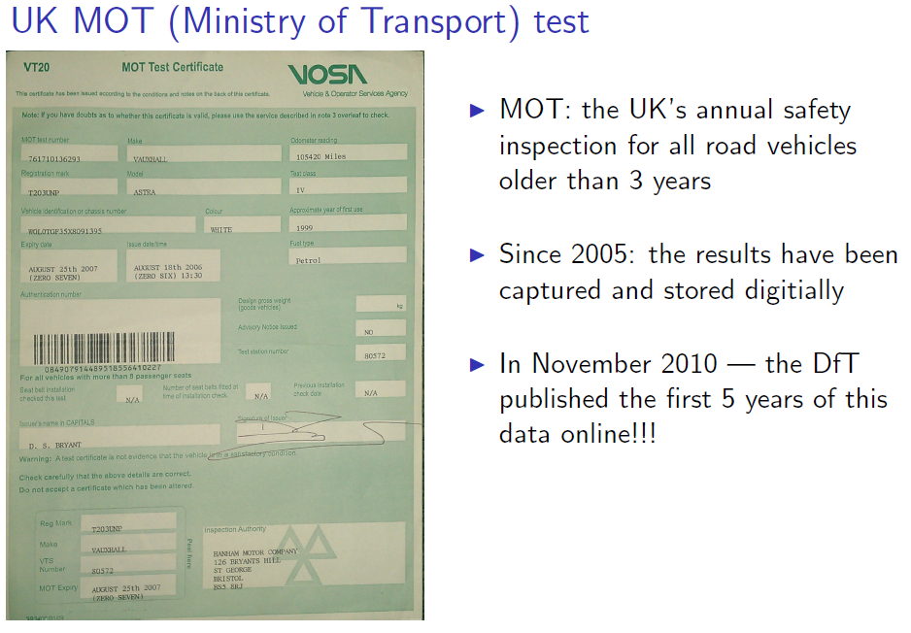
MOT dataset
(test data)
Test date
Odometer reading
MOT dataset
(vehicle data)
Engine size
Stock tables
(vehicle data)
Keeper location (LSOA/ Data Zone)
Private or commercial
Vehicle class
Fuel type
Test type and result
First use date
Make, model and colour
CO₂ value
Location of test (Postcode Area)
≈ 30 million vehicles per year

Slide 13
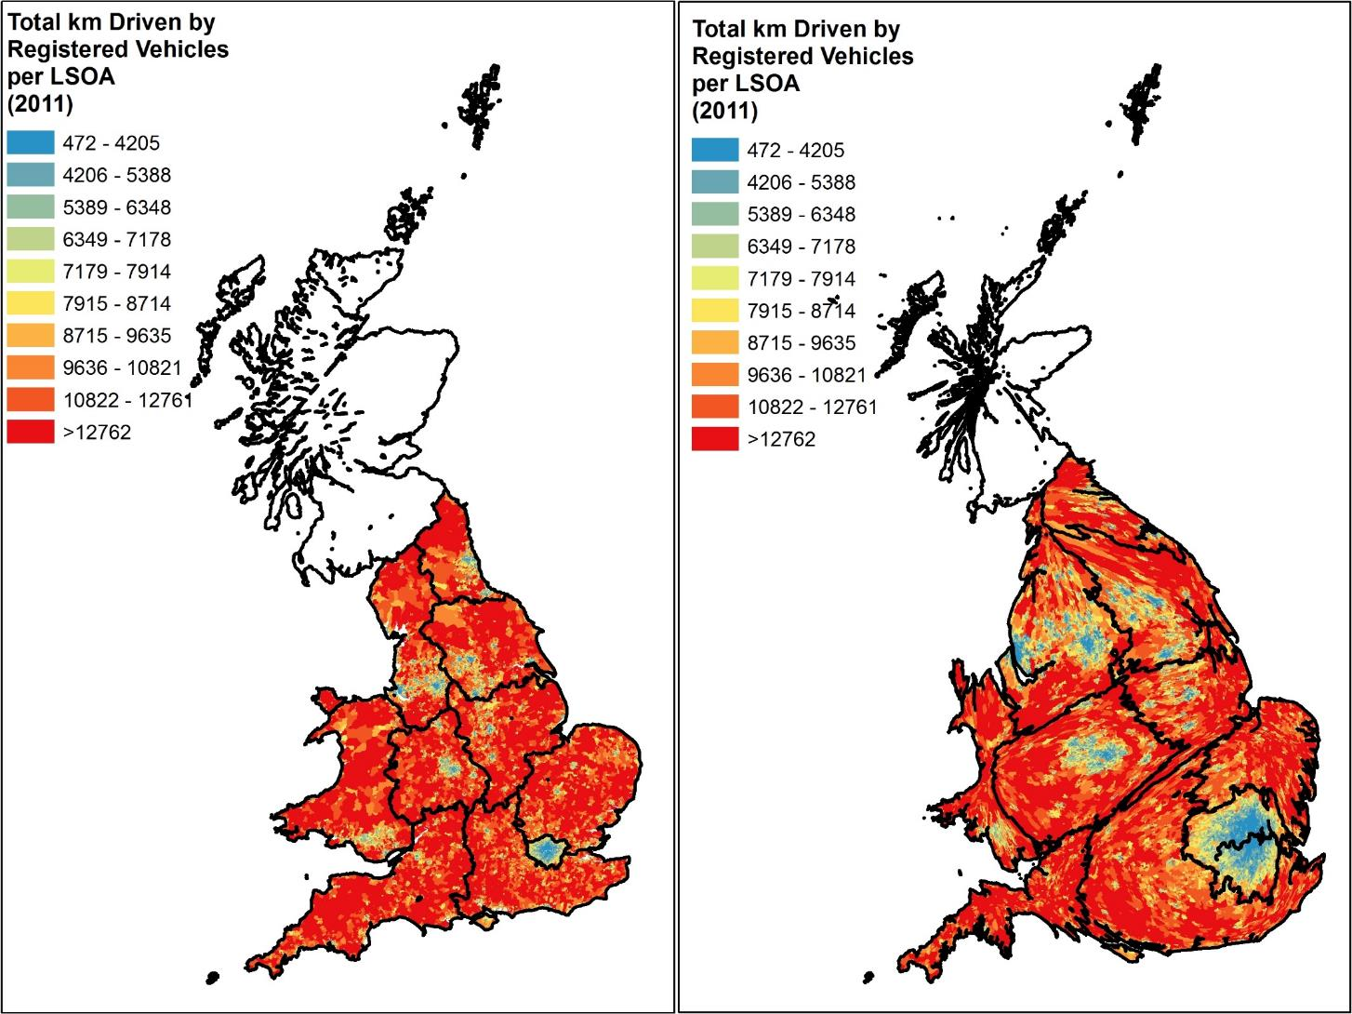
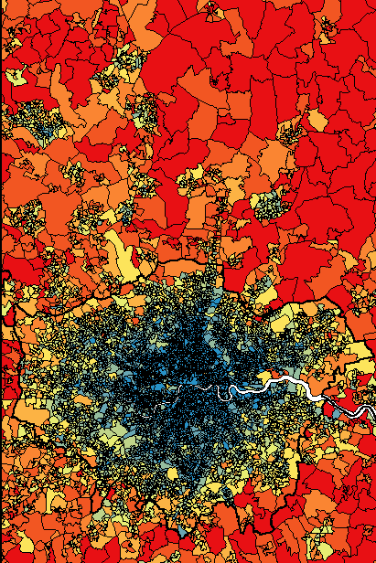
Contains National Statistics data © Crown copyright and database right 2012

Slide 14
Contains National Statistics data © Crown copyright and database right 2012

Slide 15
Exposure to NO₂ Concentrations
NOx Emissions
from Local Vehicles
% of Households in Poverty
% of Households in Poverty

Slide 16
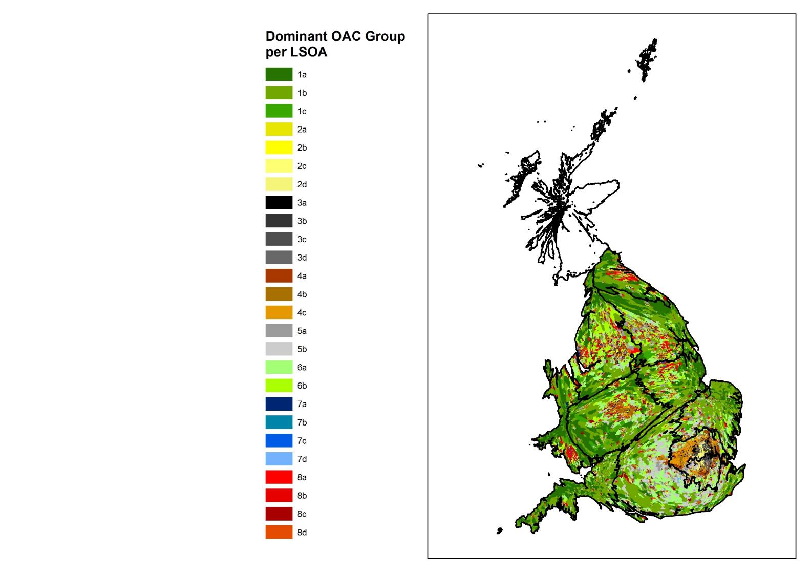
Office for National Statistics Output Area Classifications
OAC Supergroup
Rural Residents
Cosmopolitans
Ethnic Central
Multicultural Metropolitans
Urbanites
Suburbanites
Constrained City Dwellers
Hard Pressed Living
8 Supergroups
27 Groups
76 Subgroups
Farming Communities
Rural Tenants
Ageing Rural Dwellers
Students Around Campus
Inner-City Students
Comfortable Cosmopolitans
Aspiring and Affluent
Ethnic Family Life
Endeavouring Ethnic Mix
Ethnic Dynamics
Aspirational Techies
Rented Family Living
Challenged Asian Terraces
Asian Traits
Urban Professionals and Families
Ageing Urban Living
Suburban Achievers
Semi-Detached Suburbia
Challenged Diversity
Constrained Flat Dwellers
White Communities
Ageing City Dwellers
Industrious Communities
Challenged Terraced Workers
Hard-Pressed Ageing Workers
Migration and Churn
Modal OAC used to classify LSOA (average
of 3 OAs per LSOA)
Contains National Statistics data © Crown copyright and database right 2012

Slide 17

Emissions vs Exposure
OAC Supergroup
Rural Residents
Cosmopolitans
Ethnic Central
Multicultural Metropolitans
Urbanites
Suburbanites
Constrained City Dwellers
Hard Pressed Living

Slide 18
Access to Motor Vehicles

Slide 19
Emission Factors vs Distance Driven

Slide 20
What next?
H2020 ClairCity project
4 year project: 2016-2020
10 Research + 6 City partners across Europe
Extend ‘social activities’ approach to quantitative emissions and concentration modelling for alternative source apportionment
Use new approaches to carry out improved public engagement with city management (through workshops, game and app)

Slide 21
Summary
AQM has failed to achieve both high levels of public engagement or to address activity part of the equation: emissions = emission factors x activity
A social rather than technocentric and point-of-use approaches may help and should be complementary to current practice
This will help to address the social and structural inequalities related to both the causes of air pollution and its impacts….
And enable widespread emission reductions - not just hotspot management – linking more clearly to energy and carbon agendas and achieving co-benefits

Slide 22
Thank You!
http://www.Fleximobility.Solutions
http://MOTproject.net
http://ClairCity.eu
jo.barnes@uwe.ac.uk
The work has been undertaken under EPSRC Grants EP/K000438/1 (MOT) and EP/J00460X/1 (Disruption) and has received funding from the European Union’s Horizon 2020 research and innovation programme under grant agreement 689289 (ClairCity).
Contains National Statistics and Ordnance Survey data © Crown copyright and database right 2012.

