Slide 1
Launch event of the Town & Country Planning special edition on planning for health 1 December 2016, TCPA London Putting the pieces together in Reuniting Planning and Health – Lessons from an ESRC seminar series
Dr Laurence Carmichael
Head, WHO Collaborating Centre for Healthy Urban Environments
University of the West of England, Bristol
www.uwe.ac.uk/research/who
Laurence.carmichael@uwe.ac.uk

Slide 3
ESRC seminar series Re-uniting Planning and Health: tackling the implementation gaps in evidence, governance and knowledge
Researchers:
WHO CC for Healthy Urban Environments, LSHTM, Universities of Bristol, Newcastle, Liverpool, Public Health England
Aims:
considering how public health can contribute to urban planning and the delivery of healthy sustainable communities
identify workable and economically viable solutions that help deliver health outcomes, wellbeing and equity
forum for academics and practitioners to discuss the obstacles to reuniting planning and health in the UK
Themes covered in 6 seminars so far:
Nature of the evidence base, Health Impact Assessment, good practice and initiatives from the UK and from overseas, taking forward the agenda with policy-makers in the UK

Slide 4
Key findings in UK context evidence base, evidence-sharing and integration into planning processes and policies
Demand from planning and public health professionals to improve:
their mutual understanding of the nature and uses of evidence
sharing evidence and good practice that are fit for purpose within an increasingly resource-poor local authority environment
the methods and instruments available to achieve this

Slide 5
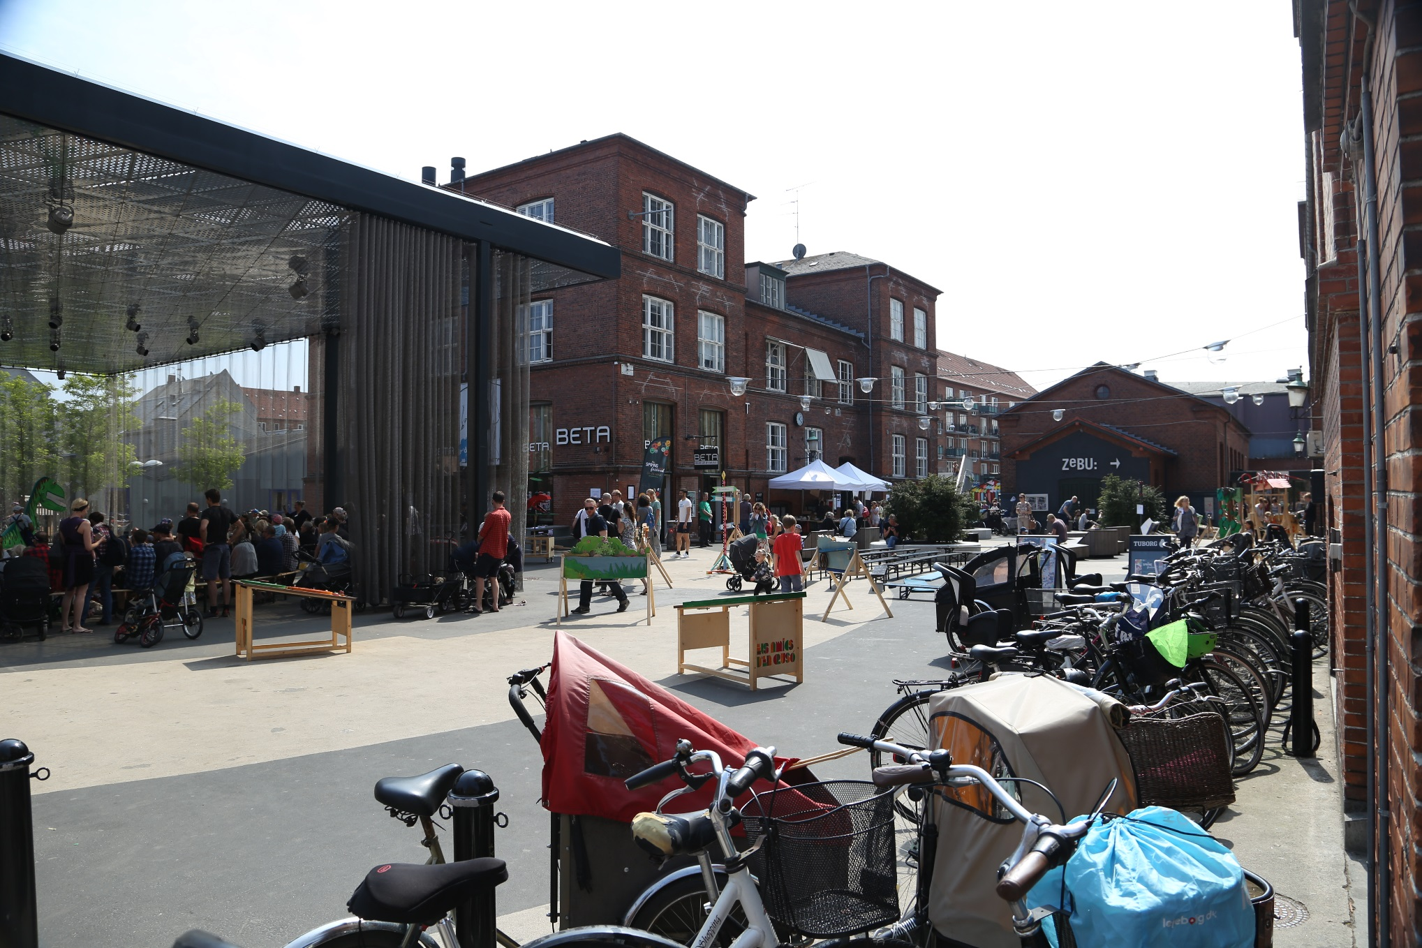
Source: Mark Drane

Slide 6
Mutual understanding of the uses of evidence: discipline tradition, professional backgrounds, processes, governance, legal and policy frameworks influence the conceptualisation and use of evidence
Planning | Public health
Aim: to achieve sustainable development through plan-making and decision-taking | Aim: creating the conditions in which people can live healthy lives for as long as possible
Objectives: Implementing a statutory system of adopted policies and plans | Objectives: Advocating proactive strategies in response to population health needs
Process: understanding and acting with planning practices, vocabularies and stakeholders, and implementing and co-producing outcomes | Process: understanding systems thinking, consider health impacts that may be related to various social, economic or environmental factors
Evidence: case studies, guidance and key laws | Evidence: consideration of current local knowledge, uncertainties, and social and economic issues, research (scientific, multidisciplinary)

Slide 7
Mutual understanding of the uses of evidence
Planning | Public Health
Key factors in planning decisions: case-by-case basis, considering information on local factors relevant to a specific area | Key factors in public health: evidence at a broader population level, which may not have direct links to a particular development, or a geographical location
Planners and PH professionals need to work more closely locally to:
better translate the wider evidence base to a local context
and find appropriate ways to evaluate local policies and innovations, thus increasing the ‘local evidence base’

Slide 8
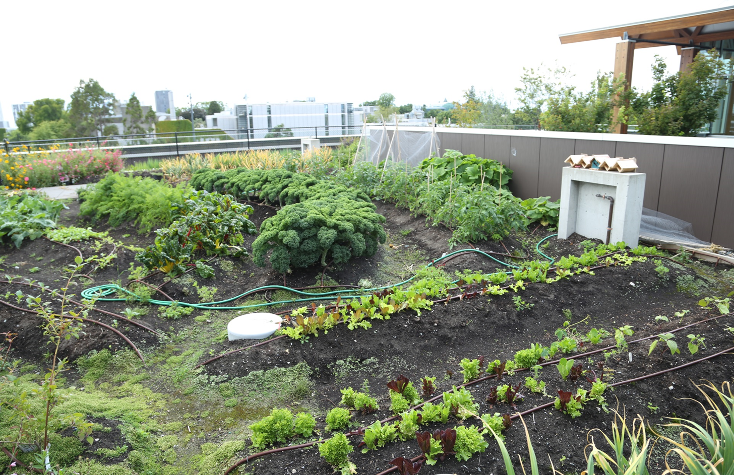
Source: Mark Drane

Slide 9
Promoting the evidence base at national level: role of a Built Environment Champion 1
ESRC Seminar 6: Exploring recommendations of the HL SC Report Building Better Places
Chief Built Environment Adviser and small strategic unit: bringing evidence base into planning and urban design?
Assessment of the evidence base - What is the knowledge base needed for built environment champions at national level?
Critique of the existing scientific evidence base
Research not well enough informed by the types of questions that practitioners were interested
Evidence available, not joined up and not in a useful format for decision-making
Multi-factorial nature of the evidence makes it difficult for clear conclusions and recommendations
Academics: not good enough at presenting their findings in ways that facilitate decision-making

Slide 10
Promoting the evidence base at national level: role of a Built Environment Champion 2
Missing evidence:
call to include people’s experience of living in certain places: you can currently deliver a development that meets all the recommended standards, but still feels like a bad place to live
Quantifying the costs of the health and social impacts of design to financially incentivize good design (Wellcome project)
Skills:
Multidisciplinary knowledge and skills: architect, engineering, planning climate change and health.
Knowledge of designing new developments and retro-fit existing housing stock
Budget to be able to commission research to address gaps in evidence

Slide 11
Source: Mark Drane

Slide 12
Chief built environment adviser and small strategic unit: challenges of policy integration
How would a new structure work? What Horizontal integration would be needed?
Already sub-scientific advisor within each government department: new structure or post would need to work closely with these existing advisors
Not ‘command and control’ role but way of bringing people together from different disciplines
In or out of government?
Departments made it impossible to progress certain issues.
Longevity of such position
Link up with Smart Cities, Future Cities and the National Infrastructure Commission
Challenges and opportunities of implementing national guidance at local levels
Resources exist for vertical integration (BRE, Cambridgeshire Quality Panel eg) but lack of resources at local level, or focus on environmental health because evidence not understood or not convincing enough
Additional layer not necessary, capacity building at local level needed (NHS England HNT)

Slide 13
How to integrate public health evidence into local planning practice 1
Policy hooks:
Bristol’s DM 14 - HIA for developments likely to have a significant impact on health and wellbeing
Healthy’ planning policies – restricting hot-food takeaways in close proximity to schools and youth facilities
Requiring monitoring by planning consent to assess the success of “healthy” measures (Bicester)
Leadership:
Leadership at executive level to promote the use of HIA (Conwy County Borough Council) to support local public health advocacy in the field
Partnership - community engagement:
Strong consortium approach to place-based and proactive planning and design (Bicester)
Policy integration at plan level:
PHE advocates JSNA and HWS as part of evidence base for local plan

Slide 14
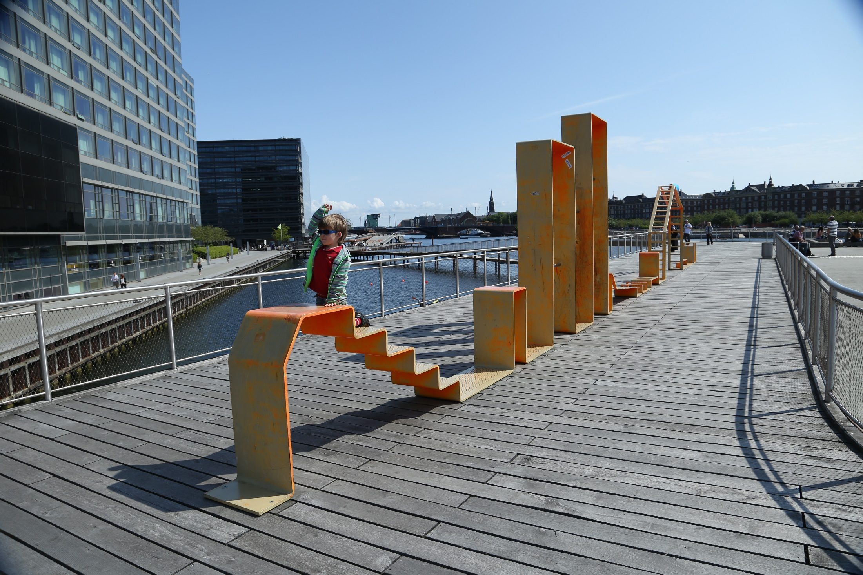
Source: Mark Drane

Slide 15
How to integrate public health evidence into planning practice 2
Health indicators:
What is the importance of health indicators in planning processes/policy? At what stage of policy making should they be used?
Health indicators important to operationalize the buy-in and help to assess how planners and developers are doing in implementing healthy environments
Large house builder had recently reported they ‘don’t do health’ because no-one is asking them to
It was also suggested that targets should be set at the local level
Many types of indictors and different roles in decision-making process: target, transparency monitoring

Slide 16
How to integrate public health evidence into planning practice 3
Should indicators be set at national or local level and should they be statutory or used as guidance only?
Planners need to have confidence that decisions in accordance with health recommendations will not be overturned by local politics, (hot food takeaways)
NPPF give weight to indicators but vertical integration must be effective to deliver healthy design
Added value of indicators into the NPPG when existing tools to drive local practice such as local JSNAs and local HWSs do not reference the importance of the built environment at all or the Local Plan and Local Plan does not use them as evidence; yet they are important to align the agendas for place, poverty and inequality
Public Health England to explore better use of the built environment components of existing Public Health Outcomes Framework indicators

Slide 17
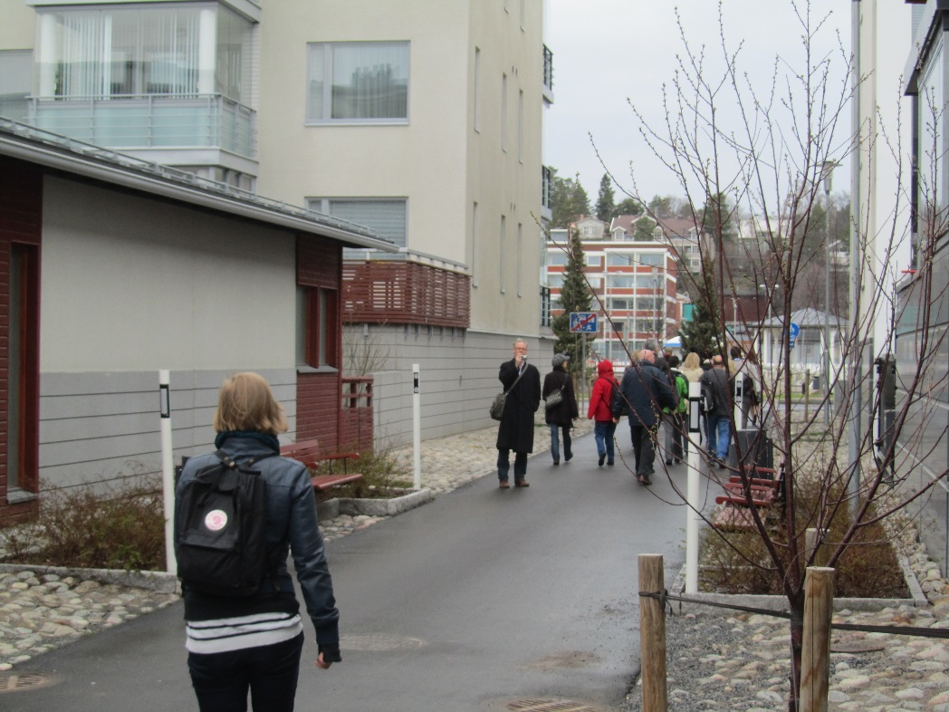
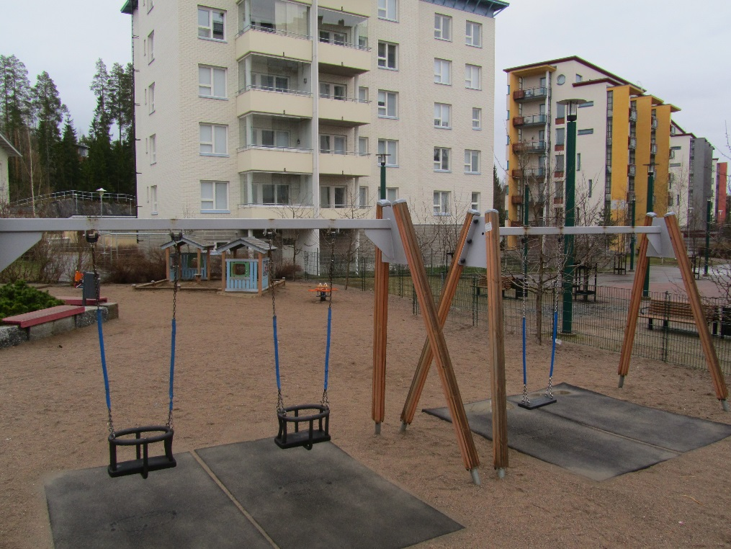
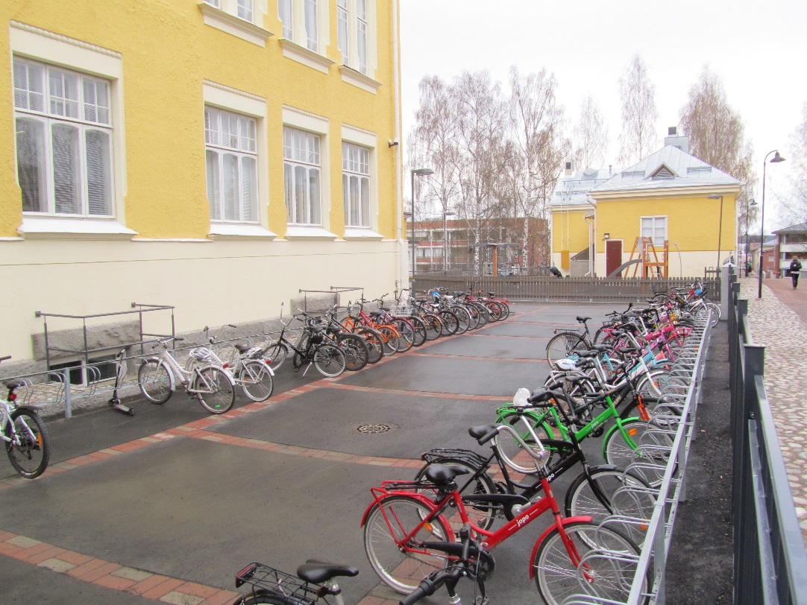
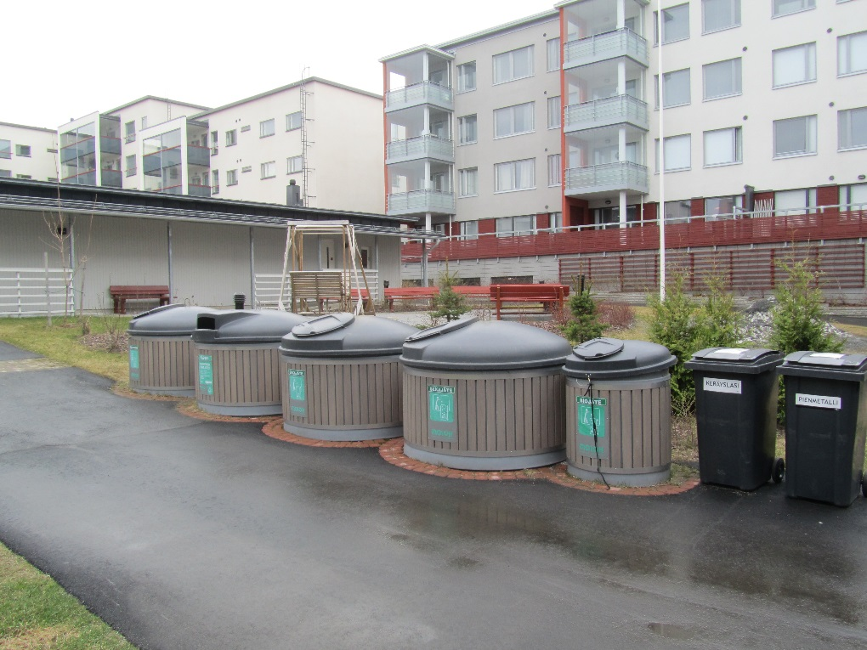
Source: Sarah Burgess

Slide 18
Integration of health into planning 4: appraisal instruments
Health Impact Assessment (HIA): applied in a wide range of policy, plan and project situations, non statutory instrument
Strategic Environmental Assessment (SEA): for plans and programmes: local, transport, waste, energy, minerals and other plans - European Directive (Directive 2001/42/EC) explicitly asks for human health to be considered
Environmental Impact Assessment (EIA): for certain infrastructure/large development projects, statutory - The new EIA Directive (Directive 2014/52/EU) for the first time explicitly requires human health consideration

Slide 19
Challenges and opportunities for inter-sectoral integration
Challenges:
Unlikely that the England planning system will change
Viability clause in the NPPF: allows sound planning decisions to be circumvented.
Understanding the long-term impacts of new development on health could help rebalance the meaning and testing of viability, redressing the balance of power
Opportunities:
need for new approaches to professional training and organisational capacity building in every local authority
JSNA and sharing health data to inform Local Plans could support the mainstreaming of systems thinking, inform more complex built environment interventions.
Engaging with communities to generate the health evidence base for Local Plans
HIA
Think of the other actors of the development process

Slide 20
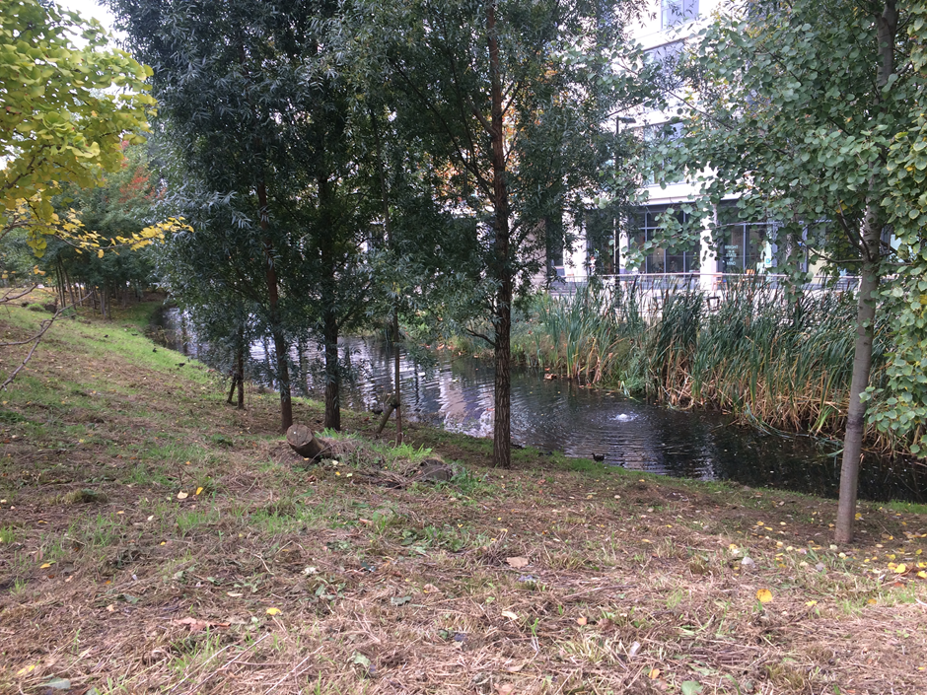
Source: Laurence Carmichael

Slide 21
How will your organisation promote the building better places agenda? Responses of stakeholders in ESRC roundtable
The Cambridgeshire Quality Panel will now put health on the agenda
Aim to share more knowledge across sectors
Aim to ensure health is on the urbanisation agenda in low and middle income countries as well as in the UK
Make the most of the Habitat 3 New Urban Agenda
There is an opportunity to raise health as an agenda with the National Construction Board
Work with designers and developers to improve the evidence base
Test models within the NHS Healthy New Towns, but also share learning more widely
Explore new guidance on planning and dementia
Consider learning from the USA
Engage in the Planning for People campaign
Develop a business case for investing in the built environment for health

Slide 22
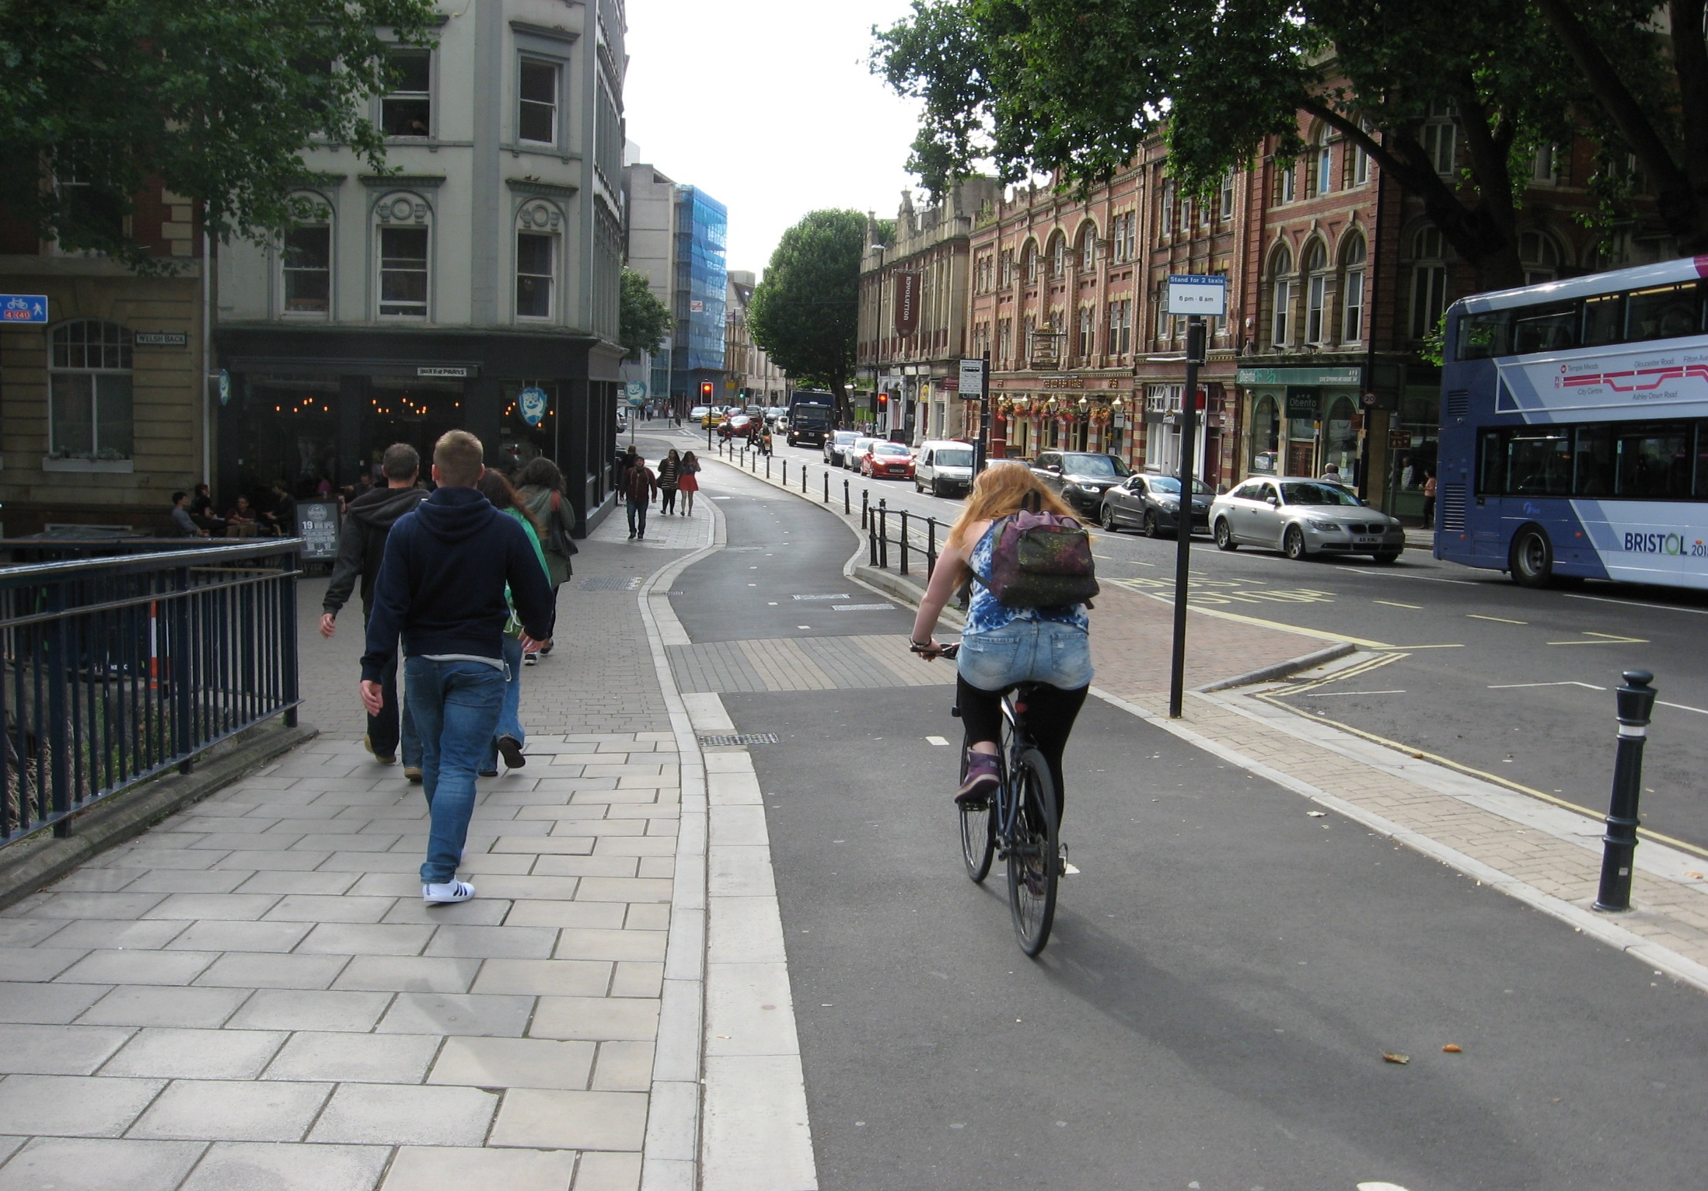
Source: John Parkin

Slide 23
Thank you Laurence Carmichael WHO Collaborating Centre for Healthy Urban Environments University of the West of England, Bristol www.uwe.ac.uk/research/who Laurence.carmichael@uwe.ac.uk

