Slide 1
Improving the Student Learning Experience through Dialogic Feed-Forward Assessment JGHE Celebration of Learning & Teaching in HE Geography
Jennifer Hill
Associate Professor in Teaching & Learning | UWE, Bristol
Harry West
Associate Lecturer & Researcher | UWE, Bristol

Slide 2
Research context
Assessment – central to the student experience:
‘frames learning, creates learning activity and orients all aspects of learning behaviour’
(Gibbs, 2006: 23)
Feedback – central to learning from assessment:
‘feedback quantity and quality are the probably the most important factors in enhancing students’
learning’ (Race, 1999: 27)
However:
‘the literature on student experiences of feedback tells a sorry tale’ (Handley et al., 2007: 1)
‘many students commented on ‘cryptic’ feedback which often posed questions, but gave no
indication of where they went wrong’ (GfK, 2008: 8)
Notes:
Consistently low satisfaction scores for assessment and feedback in the National Student Satisfaction surveys

Slide 3
Research context
feedback should help students to:
- understand current performance
- understand how to close the ‘performance gap’ in future assignments
- have the confidence and belief they have control over their success
- maintain motivation throughout their degree
our research based on premise that feedback should occupy a central position within a dialogic approach to learning and teaching (Alexander, 2004; Sutton, 2009) and be future-oriented (Sadler, 2010; Beaumont et al., 2011)
Notes:
Feedback: indicates to students why they gained the grade they did and indicates to external examiners why students gained the grade they did.
Feed-forward specifically refers to feedback given by tutors that should either a) be given post-assignment with more specific direction on how this can be applied to future assignments or b) impact upon an upcoming assignment.
dialogic feedback is the way in which meaning is created and understood in spoken and written discourse (Wegerif 2006:59). It occupies a very important place within a critical and reflective pedagogy.

Slide 4
Research aims
Test theory that if academic staff and students discuss feedback together students might learn to actively reflect upon feedback, developing their capacity to ‘feed forward’ this learning
Examine whether this process asserts a positive influence on the student learning experience, supports student performance/achievement, and potentially raise NSS scores related to feedback

Slide 5
Module assessment structure
Supporting Lectures
Students choose essay from selection
Students write draft essay
Students submit draft and attend ‘feed-forward’ meeting
Students reflect on meeting and essay – grading their work
Students complete and submit final essay
25% module assessment
75% module assessment
Assessment discourse
Feedback
discourse
Notes:
Feedback discussion identifies areas for improvement (diagnosis) and scaffolds students to achieve higher grades: Interpretations are shared, meanings negotiated, and confusions and expectations clarified.
Dialogue thus involves relationships in which the participants think and reason together (Gravett & Petersen, 2002). We discussed how to discern key aspects of the question, apply appropriate knowledge and
skills to analyse it and to develop an effective answer (Bowden & Marton, 1998). Students come to understand meaning, and internalise and act on the information they gain via conversation.
Interviews were audio-recorded and exemplar paragraphs were used during them.
Arrow on right leads on to ipsative feedback – ‘based on a comparison with the learner’s previous performance and linked to long-term progress’ (Hughes 2011, p. 353). Supports development of long-term generic skills over short-term achievement of assessment criteria.
An assignment divided into two or more phases permits iterative feedback cycles which facilitate engagement with feedback and the prospects of improvement from one task to the other (e.g. Prowse et al.
2007).

Slide 6
Data collection
qualitative case study approach
semi-structured interviews …. from two consecutive cohorts
second year ug optional physical geography module in a British university
24 interviews conducted so far from one cohort
response rate of 67% : Male = 10 Female = 14
full-time students, most aged 18-21 years

Slide 7
Results
Enhanced learning process
Time management is improved and more time is put into assessment:
‘you don’t just have the hand-in at the end of the semester. You have something a bit earlier on to make you get more work done, which I find really good because it’s more of a motivation and driver to get work done early’ R6
‘the meeting made me plan ahead and work towards a good draft early on’ R7
‘it pushes you to get more work done before the deadline and then you can have lots of feedback and then have more time to improve. I don’t think I would have done as well without the meeting’ R21

Slide 8
Results
Enhanced learning process
conversation important in engaging students critically with their work:
‘when I have had drafts handed back to me and it’s just written over, either I don’t understand what they are trying to say, or it’s not clear enough. I can ask you questions if we’re talking to each other about it, it’s easier to see things … It’s definitely better to talk about it’ R7
‘the meeting is good, because I’ve had it before where you get electronic feedback and you might not be sure what some of the comments mean … being able to discuss it is quite important I think. You get that progress and can discuss how you can change it as opposed to just saying this is wrong’ R9
Notes:
Students can decode feedback

Slide 9
Results
Enhanced learning process
Motivational due to pertinent application:
‘the bit inbetween my draft and writing the final piece was the best bit because I knew what I was doing and could tweak it and I enjoyed that process of making it better. It gave me more confidence in my writing skills’ R7
‘my first draft was quite vague and I didn’t really know what direction I was going with it. Then, after speaking and having the feedback, I spent more time on it because I knew where I needed to go with it’ R8
Notes:
Students can ‘make good’ – immediate relevance of feedback

Slide 10
Results
Enhanced learning process
changes working practice and improves self-efficacy:
‘in ‘Climate Change’ you have the option to hand in a draft. And this has made me want to submit a very full draft to get feedback’ R3
‘it helped me to realise how to critique my own essays because I was able to sit down with you and go through the essay and know exactly why you were commenting on something … It allows me now to see in other essays the same things I’m doing’ R10
‘I never understood how good submitting a draft and getting feedback is and now that I’ve done it I’m definitely going to take advantage of it this year’ R24
Notes:
Nicol’s self-regulation
Baxter-Magolda self-authorship??

Slide 11
Results
Enhanced learning process
delivers skills for employability:
‘there are skills that can be used elsewhere, like splitting a task into planning and then evaluating for yourself’ R4
‘just having a meeting with a professional academic, that’s going to help you. That’s going to help you to act more formally’ R14
‘it’s always useful to be reflective and think about what you are doing. Whenever decisions are to be made you should think that way. It’s good for careers’ R16
Notes:
Future oriented beyond the Academy and into employment

Slide 12
Results
Enhanced student performance
Band (%) | 2011-2012 (%) | 2012-2013 (%) | 2015-2016 (%) | 2016-2017 (%)
0-39 (inc. NS) | 18 | 16 | 0 | ??
40-49 | 9 | 7 | 3 | ??
50-59 | 33 | 40 | 28 | ??
60-69 | 40 | 32 | 58 | ??
70-100 | 0 | 5 | 11 | ??
Number (n) | 33 | 43 | 36 | ??
Dialogic assessment

Slide 13
Results
Enhanced NSS and TEF metrics
all students rated the module as giving them high quality feedback: detailed, conversational, personalised, timely (relevant application), multi-faceted
all students said the feedback helped them clarify things
they did not understand: proactive engagement with
learning – they had to prepare for the meeting,
think about their work, ask and answer questions
Notes:
‘I felt like you cared’ R1
‘I definitely felt like you cared about what I was getting’ R7

Slide 14
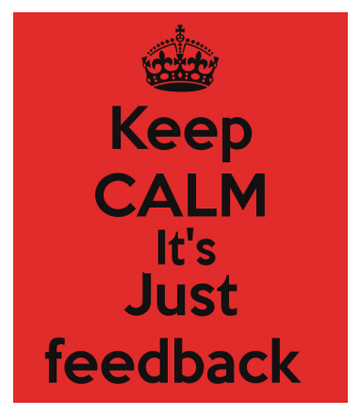
Conclusions
Dialogic feed-forward assessment enhanced the student learning experience by:
- Increasing motivation to engage with the assignment
- Increasing confidence in their ability to complete the assignment
- Solidifying good practice & supporting higher assignment grades
- Increasing satisfaction with the feedback process (potentially boosting NSS
metrics)
Positively changing behaviour in working towards future assignments (fostering self-
efficacy) & boosting employability skills
Notes:
Feedback from students can help tutors to adapt and adjust their teaching strategies in order to accommodate the learning needs of particular students.

Slide 15
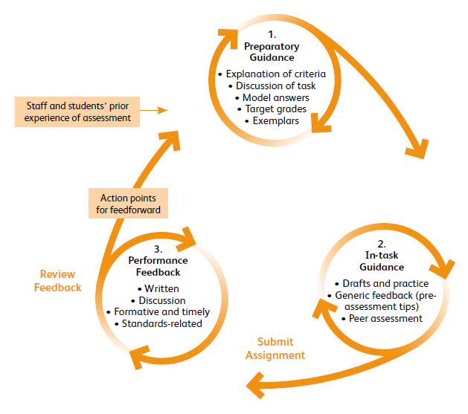
1.
Preparatory guidance
Explanation of criteria
Discussion of task
3.
Performance feedback
Draft and discussion
Audio feedback
Exemplars
Formative and timely
2.
In-task guidance
Model answers
Generic feedback
Peer assessment
Dialogic feed-forward assessment cycle
(Modified from Beaumont et al., 2011)

Slide 16
References
Alexander, R. (2004) Towards Dialogic Teaching: rethinking classroom talk (Third edition) University of Cambridge: Dialogos.
Beaumont, C., O’Doherty, M. & Shannon, L. (2011) Reconceptualising assessment feedback: a key to improving student learning? Studies in Higher Education, 36, 671-687.
GfK (2008) NUS/ HSBC Students Research. GfK Financial London, Study Number 154021.
Gibbs, G. (2006) Why assessment is changing. In C Bryan and K Clegg (eds) Innovative Assessment in Higher Education. London, Routledge.
Handley, K., Price, M. & Millar J. (2011) Beyond ‘doing time’: investigating the concept of student engagement with feedback. Oxford Review of Education, 37, 543-560.
Sadler, D.R. (2010) Beyond Feedback: Developing student capability in complex appraisal. Assessment and Evaluation in Higher Education, 35, 535-550.
Sutton, P. (2009) Towards dialogic feedback. Critical and Reflective Practice in Education, 1, 1-10.

