Slide 1
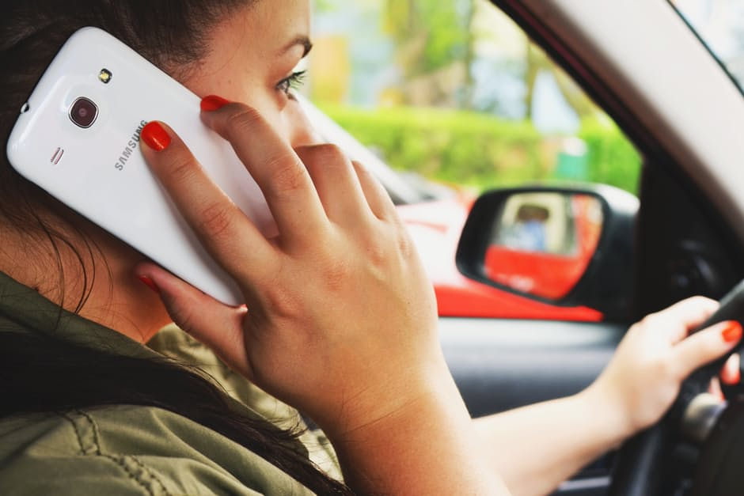
Recording and reporting of mobile phone involvement in road traffic collisions: survey of police officers
Pilkington P¹, Ige J¹, Banstola, A²
¹ Department of Health and Social Sciences, University of the West of England, Bristol
² Department of Research and Training, Public Health Perspective Nepal
INTRODUCTION
RESULTS
DISCUSSION
There is consistent evidence of an association between mobile phone use while driving and increased risk of a road traffic collision. However, the magnitude of this problem cannot be fully addressed until current investigation tactics are improved (McEvoy et al., 2005).
This study aimed to investigate how police forces investigate and record mobile phone involvement in road traffic collisions and to explore ways in which the investigation and recording of mobile phone involvement in road traffic collisions could be improved.
A total of 134 respondents participated in the survey. A vast majority of respondents were aware of the impact of mobile phone use on RTCs and on driving behaviour.
99% of respondents agreed/strongly agreed that using a mobile phone negatively impacts driving behaviour and performance
Three quarters of officers were unsure of the total proportion of road collisions in their force area linked with mobile phone use (Figure 2). A similar proportion indicated that better mechanisms to analyse and investigate phone usage would most likely improve data collection (Figure 3).
Some officers expressed concerns that they did not have the authority to seize mobile phones at the crash scene.
Among the responses from officers were:
“We are not encouraged/supported to seize and analyse mobile phones unless the driver is involved in a collision involving serious injury.”
“The law needs to be amended to give police officers the power to seize and examine a mobile phone at the roadside…also need to make a simple device that can be used at the roadside to download…”
Findings from this survey raise serious concerns about the under-reporting of mobile phone use in road traffic collisions. There is a need for more effective means of detecting and analysing mobile phone usage at the crash scene. In New York, discussions are ongoing about the introduction of a hand-held ‘textalyzer’ device, which allows officers to analyse mobile phone usage data at the roadside. Such technology offers the potential to improve enforcement and monitoring of the role of mobile phones in road traffic collisions. It is equally important to improve the way data on risk factors for RTCs are recorded. It has been previously reported that collision report forms are neither flexible nor detailed enough to record certain crash risk factors and that there are important gaps in collecting detailed contextual information (Ige et al., 2016; Pilkington et al., 2014)
METHODS
Two linked literature reviews examined the magnitude of impact of mobile phone use on road traffic collisions and how the contribution of mobile phone use towards RTCs is recorded globally. We conducted an online survey of road traffic collision investigation officers in the UK. The survey was cascaded via the National Roads Policing Intelligence Forum to regional traffic officer leads and then individual collision investigation officers. Officers were asked a range of questions regarding their knowledge, attitudes and experiences of the role of mobile phones in RTCs, including issues of recording and reporting.
RECOMMENDATIONS
Figure 1: There is an under-reporting of the contribution of mobile phones to fatal road traffic collisions
Support of police officers and road traffic investigators on how to carry out timely analysis of mobile phones.
Explore technological options that can detect mobile phone usage and activity at the scene of RTC.
Improve data collection forms to account for a wider range of risk factors surrounding a RTC.
Four out of five collision investigators surveyed indicated that there is an under-reporting of mobile phone involvement in non-fatal crashes while 50% believed that contribution of mobile phone use to fatal crashes is also under-reported (Figure 1).
ACKNOWLEDGEMENT
We thank the National Roads Policing Intelligence Forum for their support during this study.
REFERENCES
Ige, J., Banstola, A. and Pilkington, P., 2016. Mobile phone use while driving: Underestimation of a global threat. Journal of Transport & Health, 3(1), pp.4-8.
Pilkington, P., Bird, E., Gray, S., Towner, E., Weld, S. and McKibben, M.A., 2014. Understanding the social context of fatal road traffic collisions among young people: a qualitative analysis of narrative text in coroners’ records. BMC Public health, 14(1), p.78.
McEvoy, S.P., Stevenson, M.R., McCartt, A.T., Woodward, M., Haworth, C., Palamara, P. and Cercarelli, R., 2005. Role of mobile phones in motor vehicle crashes resulting in hospital attendance: a case-crossover study. BMJ 331(7514), p.428.
Figure 3. What do you think would help your police force area to improve data collection on the contribution of mobile phone usage to road traffic collisions?
Figure 2: On an average, what percentage of road traffic collisions in your area is linked with mobile phone use each year?

