Slide 1

THE BLACK MEDITERRANEAN
IN ACTION SYMPOSIUM
Birmingham City University.
June 9-10, 2017
© Ade Olaiya, M.A.
University of the West of England.
Email: Ade.Olaiya@uwe.ac.uk

Slide 2
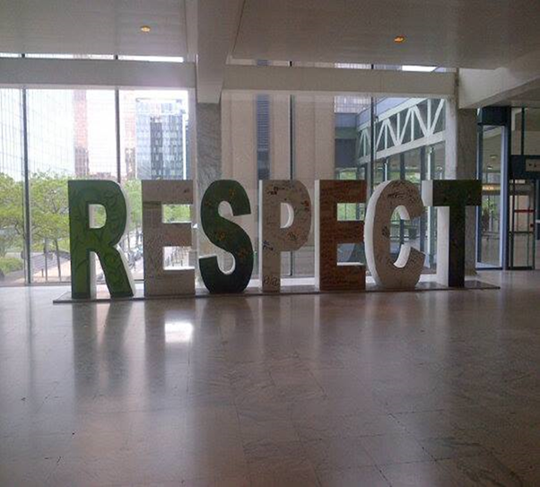
CONTENT
Background
Research Study
Empirical Findings
Conclusions
“RESPECT”. Created by Author.

Slide 3
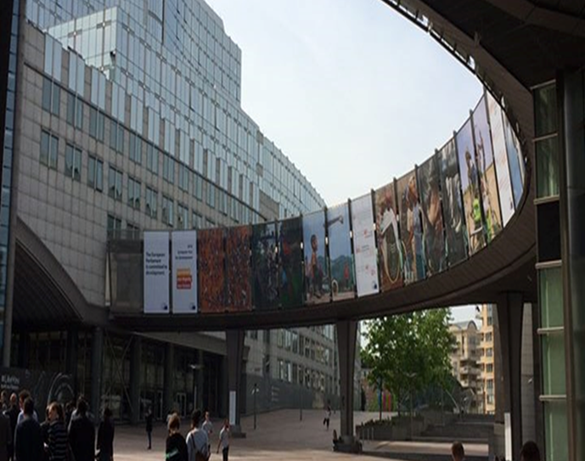
African Migration
Spain - approximately 979, 000 African migrants
Italy - approximately 350,000 residents with citizenship of a Sub-Saharan country in 2014.
Greece- 25 850 permanent residents born in Africa
Cyprus & Malta- < 2, 000
“AU … EU” . Created by Author.
Notes:
The Migrant Crisis, the Refugee Crisis & the Reception Crisis

Slide 4
WHAT IS THE PROBLEM ?
African Migration
Research Question:
Countries of origin
Places of transit
Destination countries
“What bridges can be built to address structural barriers which marginalise the African diaspora from fulfilling universal human rights?”
Notes:
Almost twice mortality rate crossing Med despite substantially less (from 206 000 in the first half of 2016, to 71000 in the corresponding period for 2017);
humans rights violations including trafficking of humans & labour exploitation, modern day slavery, detention in inhumane conditions, deaths

Slide 5

RESEARCH AIMS
Interpret anti-discrimination norms to create new knowledge employing narratives of the African diaspora.
Illustrate strategic policy interventions to address Afri-phobia / Afro-phobia
Critically evaluate norm implementation in Europe from an Afrocentric perspective.
Ade Olaiya, M.A. supports the International Decade for People of African Descent.

Slide 6
Black Emancipatory Action Research (B.E.A.R)
METHODOLOGY
METHODS
Africana Studies
Critical Race Theory
Participatory Research
Action Research
qualitative research interviews
research observation through participatory research and action research
desk research e.g. normative theory, organisational reports
Notes:
Black Emancipatory Action Research: as an appropriate theoretical & methodological approach; & mixed research methods analysis, to conduct my qualitative research study.

Slide 7

Afri-phobia/Afro-phobia
Definition:
… exclusion based on racial, ethnic or national origin which nullifies the principle of equality in people of African descent’s fulfilment of universal human rights …
Ade Olaiya, M.A. supports the International Decade for People of African Descent.
Thematic Objectives:
Recognition
Justice
Development

Slide 8
Recognition
Migration and integration policies impact both migrants & citizens of African heritage:
Recognition of qualifications and experience of African migrants within labour markets, by state parties is imperative.
Invisibility: lack of disaggregated statistics to monitor outcomes for key social indicators e.g. health and housing.
Notes:
E.g. Cyprus, Greece and Malta report that the term ‘migrant’ is used to describe all Black people, even if they are born in those countries and have a European citizenship. (ENAR: 2015)

Slide 9
Justice
Strategic policy intervention as a response to persistent inequalities:
Reinforcement of rules and practices to combat labour exploitation of migrants.
Complaint mechanisms for fair and unbiased access to legal redress are lacking for both irregular and documented migrants of African descent.
Notes:
reporting duties focuses attention and provides NGOs with a chance to write shadow reports that shame governments into action.
universalisation of human rights through customary law contributes to international human rights law becoming the standard by which governments are measured.

Slide 10
Development:
The Joint (AU &EU) Valletta Action Plan (JVAP)
The Five JVAP Domains
Development benefits of migration and addressing root causes of irregular migration and forced displacement
Legal migration and mobility
Protection and asylum
Prevention of and fight against irregular migration, migrant smuggling and trafficking in human beings
Return, readmission and reintegration
EU Emergency Trust Fund for Africa (EUTF): focuses on ‘causes of destabilisation, forced displacement and irregular migration: promotes resilience, economic and equal opportunities, security and development : addresses human rights abuses’.
Jean-Claude Juncker, President of the European Union, announcing the creation of the fund in his State of the Union address on 9 September 2015.
Notes:
Additional funds have also been made available under the European Investment Plan (EIP). The EIP uses EUR 3.35 billion from the EU budget and that of the European Development Fund (EDF) to support innovative guarantees and similar instruments in support of private investment, enabling the EIP to mobilise up to EUR 44 billion of investments. If Member States and other partners match the EU's contribution, the total amount could reach EUR 88 billion

Slide 11
Projects implementing the Joint Valletta Action Plan, Dec. 2016
Domains & priority projects initiated
% of projects % of budget
enhancing employment opportunities and revenue-generating activities, improve remittances, mobilising investments & technical assistance in partner countries, improving economic governance and engaging with the private sector.
mobility of students and researchers.
capacity building with governments, humanitarian assistance and Regional Development and Protection Programme.
new or adapted legislation and capacity-building
strengthening logistical and operational capacity of authorities of countries of origin, and enhancing the dialogue between countries of origin and destination on returns, readmission and reintegration.
58 % 60%
2% 1%
17% 13%
13% 7%
11% 16%
Notes:
“Member States and associated countries will use their relevant (national) financial instruments available for cooperation with African partners in line with their legal and financing frameworks”, its main instrument of operationalisation is the EU Emergency Trust Fund for Africa (EUTF).

Slide 12
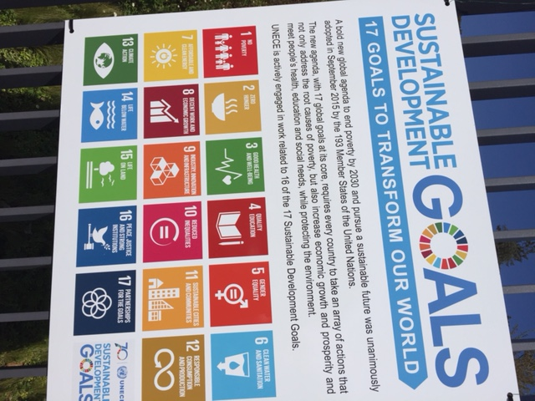
The 2030 Agenda for Sustainable Development
Target 4b on provision of scholarships for study abroad;
Targets 5.2, 8.7 and 16.2 combating human trafficking, especially for women and children
Target 8.8 to protect labour rights and promote safe and secure working environments for all workers, including migrant workers, in particular women migrants, and those in precarious employment
Target 10.7 to facilitate orderly, safe, regular and responsible migration and mobility of people, including through implementation of well-planned migration policies
Target 10c on lowering the costs of transmitting remittances
Target 17.18 on disaggregating data by migratory status.
“SDGs” created by Author.
Notes:
1. facilitate imperative community participation for achievement of successful outcomes;
2. critically evaluate community empowerment of people of African descent by 2030 Agenda Targets and Indicators.

Slide 13
Thematic Monitoring Indicators
Universal Declaration of Human Rights 1948
Sustainable Development Goals
Article 25 – Right to standard of living adequate for health & wellbeing
Article 26 – Right to Education
SDG 3
SDG 4

Slide 14
National Monitoring Indicators
Sustainable Development Goal (SDG) 10
Sustainable Development Goal (SDG) 17
State parties reduce inequality within and between countries.
Target 10.2 “empower and promote the social, economic and political inclusion of all, irrespective of age, sex, disability, race, ethnicity, origin, religion or economic or other status by 2030
GMI 10.c.1 monitors remittance costs as a proportion of the amount remitted.
GMI 10.7.2 monitors number of countries that have implemented well-managed migration policies
Global partnership to enhance North-South and South-South cooperation by supporting national plans to achieve targets.
Target 17.18 requires state parties “enhance capacity-building support to developing countries (…) to increase significantly the availability of high-quality, timely and reliable data disaggregated by (…) race, ethnicity, migratory status, (…) relevant in national contexts, by 2020”
GMI 17.18.3 monitors states with a national statistical plan that is fully funded and under implementation: the number of “Developing Countries” complying fell marginally between 2010 and 2015; “Developed Regions” are not accounted for
(IAEG-SDGs: 2017)
Notes:
GMI 10.2.1 makes no mention of racial or ethnic origin
GMI 10.7 to facilitate orderly, safe, regular and responsible migration and mobility of people, including through the implementation of planned and well-managed migration policies

Slide 15
Regional Monitoring Indicators
Racial Equality Directive (RED) 2000
Extracts from letter dated 9/02/16. addressed to Frans Timmerman, 1st V.P. of the European Council & endorsed by leaders of European civil society
Outlaws discrimination on the grounds of racial, ethnic or national origin.
ECRI General Policy Recommendation No. 7: defines direct and indirect discrimination on the grounds of racial or ethnic origin: integrates ICERD 1965 and RED 2000 in its provisions.
Target 10.7 to facilitate orderly, safe, regular and responsible migration and mobility of people, including through implementation of well-planned migration policies
Target 17.18 on disaggregating data by migratory status.
“ to develop an overarching Sustainable Development Strategy with a timeline of 2030 (…) and associated implementation policies (…)
which differentiate between the parts of the 2030 Agenda for which Member States are primarily responsible, versus those for which an EU lead is necessary and for which the EU must be held to account.”

Slide 16
Global Monitoring Indicators
International Convention for the Elimination of All Forms of Racial Discrimination (ICERD) 1965
2030 Agenda for Sustainable Development
Article 2 asserts state parties: pursue policies to eliminate racial discrimination by appropriate measures including:
c) governmental, national and local policy reviews, to amend, rescind or nullify any laws and regulations which have the effect of creating or perpetuating racial discrimination.
Article 5 asserts state parties: undertake to prohibit and eliminate racial discrimination: guarantee everyone’s right to equality before the law without distinction as to race, colour, or national or ethnic origin …
SDG 16 advocates peace, justice and good governance through non-discriminatory laws and policies.
Target 16.b requires state parties promote and enforce non-discriminatory laws and policies for sustainable development.
GMI 16.b.1 & GMI 10.3.1 are identical in monitoring the proportion of population reporting a ground of discrimination prohibited under international human rights law.
(IAEG-SDGs: 2017)
Notes:
E.g. advocate state parties implement anti radicalisation policies for social cohesion.

Slide 17
GOOD PRACTICE
Advocacy for : recognition of IDPAD: disaggregated equality data collection to plan and monitor implementation of inclusive global, regional and national policies.
Collaborations with the European Parliament’s Anti Racism & Diversity Intergroup (ARDI) to secure parliamentary work; e.g. addressing Afri-phobia/Afro-phobia.
Lobbying regional public bodies e.g. the African Union & Council of Europe to protect universal human rights.
compliance with UN General Assembly Resolution 68/261.
strategic interventions to combat Afri-phobia/Afro-phobia
Mainstreaming progressive policies into regional & national political debates.

Slide 18
CONCLUSIONS
State parties in Developed Regions have failed in reducing Afro-phobia; and in enforcing provisions of anti-discrimination norms such as ICERD 1965 and RED 2000.
State parties in both “Developed Regions” and “Developing Countries” should equally monitor implementation of SDG targets in accordance with UN GA Res. 68/261; i.e. fully disaggregated equality data collection and analysis for strategic policy interventions.
Civil society, academia and other stakeholders have a vital role to play in achieving successful outcomes for the 2030 Agenda and IDPAD.

Slide 19
BIBLIOGRAPHY
ARDI (2015) The European Parliament Anti-Racism and Diversity Intergroup (ARDI). http://www.ardi-ep.eu/work/ : [24/04/17]
Buckner-Inniss, Lolita (2007-2017) The Black Past: Taubira, Christiane. http://www.blackpast.org/gah/taubira-christiane-taubira-delannon-christiane-1952 : [2/05/17]
Council of Europe (2003) ECRI GENERAL POLICY RECOMMENDATION No. 7 ON NATIONAL LEGISLATION TO COMBAT RACISM AND RACIAL DISCRIMINATION. https://www.coe.int/t/dghl/monitoring/ecri/activities/gpr/en/recommendation_n7/ecri03-8%20recommendation%20nr%207.pdf : ECRI [05/06/2017]
European Council (2015) Valletta Summit, 11- 12 November 2015: Action Plan. http://www.consilium.europa.eu/en/meetings/international-summit/2015/11/11-12/ : General Secretariat of the Council [25/04/17]
Farkas, L. (2017) The meaning of racial or ethnic origin in EU law: between stereotypes and identities. Publications Office of the European Union: Luxembourg.
Inter-Agency and Expert Group on SDG Indicators -IAEG-SDGs (2017) Report of the Inter-Agency and Expert Group on Sustainable Development Goal Indicators (E/CN.3/2017/2) : Revised list of global Sustainable Development Goal indicators. United Nations Statistical Commission
McGregor, E. (2017) MOVEMENT : A Global Civil Society Report on Progress and Impact on Migrants’ Rights and Development: through Year 3 of Civil Society’s 5-year 8-point Plan of Action International Catholic. Migration Commission Europe (ICMC Europe)
Nwabuzo, O. (2015) Afro-phobia in Europe: ENAR Shadow Report 2014-2015. ENAR
Sustainable Development Knowledge Platform (2015) Transforming our world: the 2030 Agenda for Sustainable Development. https://sustainabledevelopment.un.org/post2015/transformingourworld : United Nations Department of Economic and Social Affairs [ accessed 21/10/15]
United Nations (2015) 2015 – 2024 International Decade for People of African Descent http://www.un.org/en/events/africandescentdecade/ : UN Web Services [20/08/15]
UNESCO, Declaration on Race and Racial Prejudice. http://portal.unesco.org/en/ev.php-URL_ID=13161&URL_DO=DO_TOPIC&URL_SECTION=201.html : [17/03/16]
United Nations (2015) 2015 Time for Global Action for People and Action. http://www.un.org/sustainabledevelopment/ : UN Web Services [5/09/15]
von Martius, L. (2017) Taking Stock of Valletta. http://www.madenetwork.org/sites/default/files/Taking%20Stock%20of%20Valletta%20-%20Conference%20Report%20-FINAL.pdf : MADE [7/06/17]

