Slide 1

2017 HAS POSTGRADUATE RESEARCH CONFERENCE
A Qualitative Research Study of Strategic Interventions
to address Afro-phobia in the European Union
© Ade Olaiya, M.A.

Slide 2
CONTENT
AIMS
B. E.A.R.
METHODS
RESEARCH DESIGN
EMPIRICAL FINDINGS
CONCLUSIONS
BIBLIOGRAPHY

Slide 3
BACKGROUND
AFRO-PHOBIA
RESEARCH QUESTION
Definition
Structural discrimination: based on racial, ethnic or national origin,
which nullifies the principle of equality, in people of African descent’s fulfilment of universal human rights …
Can strategic intervention reduce Afri-phobia / Afro-phobia in Europe ?

Slide 4
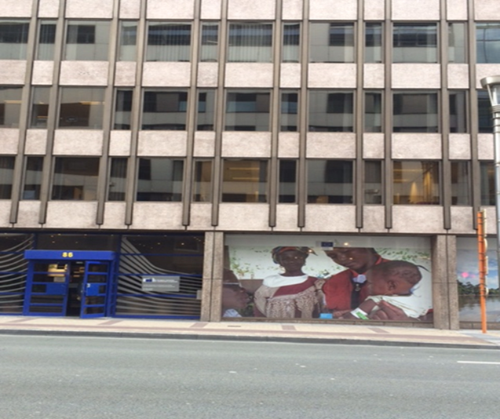
RESEARCH AIMS
Interpret anti-discrimination norms to create new knowledge employing narratives of the African diaspora.
Illustrate strategic policy interventions to address Afri-phobia / Afro-phobia
Critically evaluate norm implementation in Europe from an Afrocentric perspective.
“the Sixth Region”. Created by Author.

Slide 5

IDPAD’s THEMATIC OBJECTIVES
Recognition
Justice
Development
Ade Olaiya, M.A. supports the International Decade for People of African Descent.
Notes:
Concepts, claims, warranted assumptions, arguments, perspectives, narratives, theories, praxis
.

Slide 6
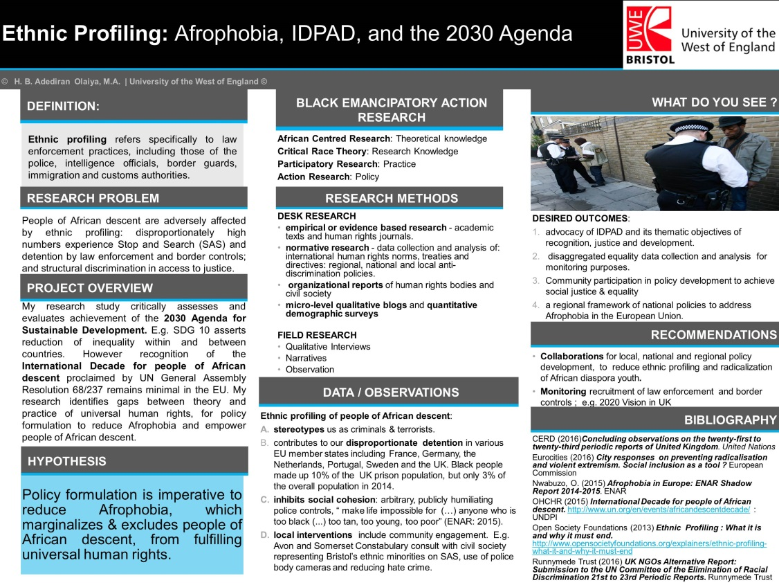
BLACK EMANCIPATORY ACTION RESEARCH
Africana Studies
Critical Race Theory
Participatory Research
Action Research
Notes:
Theoretical and methodological orientation; critically evaluating normative theory and norm implementation from Afrocentric perspective.

Slide 7
RESEARCH DESIGN
ETHICS
SAMPLE
CONFIDENTIAL DATA COLLECTION
CONSENT
ANONYMISED DATA OUTPUTS
SECURE DATA STORAGE
20+ PARTICIPANTS PRIMARILY REPRESENTATIVE OF THE AFRICAN DIASPORA
SUPRANATIONAL, REGIONAL, NATIONAL & LOCAL STAKEHOLDERS
PUBLIC BODIES, ACADEMIA, CIVIL SOCIETY & OTHER STAKEHOLDERS
VARYING ORGANISATIONAL FUNCTIONALITIES
Notes:
Iterative, relativist perspective, pragmatic epistemology

Slide 8
RESEARCH DESIGN
METHODS
TACTICS
Desk Research e.g. normative theory, academic literatures, organisational reports
Qualitative Research interviews
Field Research Observation
A. Research Questions (generated by literature review)
B. Interview Questions
Experiential Research Questions
Critical Research Questions
C. Questions asked of data inputs (to answer research questions)
Notes:
What existing gaps between policy and practice must be addressed to eliminate Afro-phobia facing people of African descent?
ii. Who do we define as people of African descent ? What is their experience, perspective or understanding of Afro-phobia / Afri-phobia ?

Slide 9
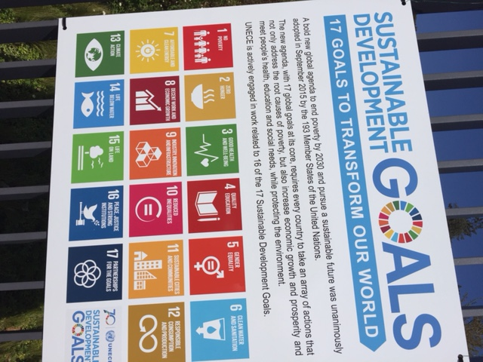
EMPIRICAL FINDINGS
UNIVERSAL DECLARATION OF HUMAN RIGHTS, 1965
2030 AGENDA FOR
SUSTAINABLE DEVELOPMENT
THEMATIC AREAS HIGHLIGHTED:
Articles 1 & 2 – principle of equality
Articles 6-11 – access to justice
Article 25 – Right to standard of living adequate for health & wellbeing inc. medical care
Article 26 – Right to Education
“Sustainable Development Goals” . Created by Author.
Notes:
SDGs 3, 4, 5, 10, 16, & 17 highlighted

Slide 10
EMPRICAL FINDINGS
2030 AGENDA FOR
SUSTAINABLE DEVELOPMENT
ANTI-DISCRIMINATION NORMS
International Convention on the Elimination of all forms of Racial Discrimination 1965
Council Directive 2000/43/EC implementing the principle of equal treatment between persons irrespective of racial or ethnic origin.
National jurisprudence
E.g. UK’s Equality Act 2010;
French Loi Taubira 2001.
SDG 16 features in narratives of stakeholders interviewed. E.g. implementation by state parties of:
Target 16.3 ensure equal access to justice;
Target 16.a strengthen relevant national institutions, prevent violence and combat terrorism and crime;
Target 16.b promote and enforce non-discriminatory laws and policies for sustainable development.
GMI 16.a.1 monitors the existence of independent national human rights institutions in compliance with the Paris Principles
Notes:
GMI 16.a.1 highlighted an increase between 2000 and 2015 in the number of countries in the Developed Region which were in compliance. narratives in this study do not reflect a corresponding trend in the reduction of Afro-phobia, but the need for further interventions to address existing gaps between normative theory and interventions to reduce inequality and discrimination

Slide 11
CONCLUSIONS
Narratives in my research study highlight the importance of adopting a holistic approach to the 2030 Agenda, including community participation in decision making.
Implementation of SDG Targets identified in the study is imperative for inclusive achievement of thematic objectives of IDPAD. E.g. State parties should complete fully disaggregated equality statistical analysis in compliance with UN GA Res. 68/261.
State parties interpret and implement regional & international anti-discrimination norms differently. Collaboration is therefore imperative to achieve thematic objectives of IDPAD; e.g. advocacy by civil society in Sweden and the UK to achieve recognition.

Slide 12
BIBLIOGRAPHY
European Council (2015) Valletta Summit, 11- 12 November 2015: Action Plan. http://www.consilium.europa.eu/en/meetings/international-summit/2015/11/11-12/ : General Secretariat of the Council [25/04/17]
Farkas, L. (2017) The meaning of racial or ethnic origin in EU law: between stereotypes and identities. Publications Office of the European Union: Luxembourg.
Inter-Agency and Expert Group on SDG Indicators -IAEG-SDGs (2017) Report of the Inter-Agency and Expert Group on Sustainable Development Goal Indicators (E/CN.3/2017/2): Revised list of global Sustainable Development Goal indicators. United Nations Statistical Commission
Nwabuzo, O. (2015) Afro-phobia in Europe: ENAR Shadow Report 2014-2015. ENAR
Sustainable Development Knowledge Platform (2015) Transforming our world: the 2030 Agenda for Sustainable Development. https://sustainabledevelopment.un.org/post2015/transformingourworl : United Nations Department of Economic and Social Affairs [ accessed 21/10/15]
United Nations (2015) 2015 – 2024 International Decade for People of African Descent http://www.un.org/en/events/africandescentdecade/ : UN Web Services [20/08/15]
UNESCO, Declaration on Race and Racial Prejudice. http://portal.unesco.org/en/ev.php-URL_ID=13161&URL_DO=DO_TOPIC&URL_SECTION=201.html: [17/03/16]
United Nations (2015) 2015 Time for Global Action for People and Action. http://www.un.org/sustainabledevelopment/ : UN Web Services [5/09/15]

